Slide 1
National Training
On preparing to negotiate a potential CAREC-wide FTA
Session 2:
Preparing for Negotiations |
Process, Organization and Strategic Considerations
Instructor:
Tashkent, Uzbekistan
March 2023

Slide 2
Outline
01
02
03
04
Preparing for Negotiations & Managing workflow
Objectives & Mandate of Negotiations
Process & Techniques of Negotiations
Implementation, M&E

Slide 3
Preparing for Negotiations & Managing Workflow
01

Slide 4
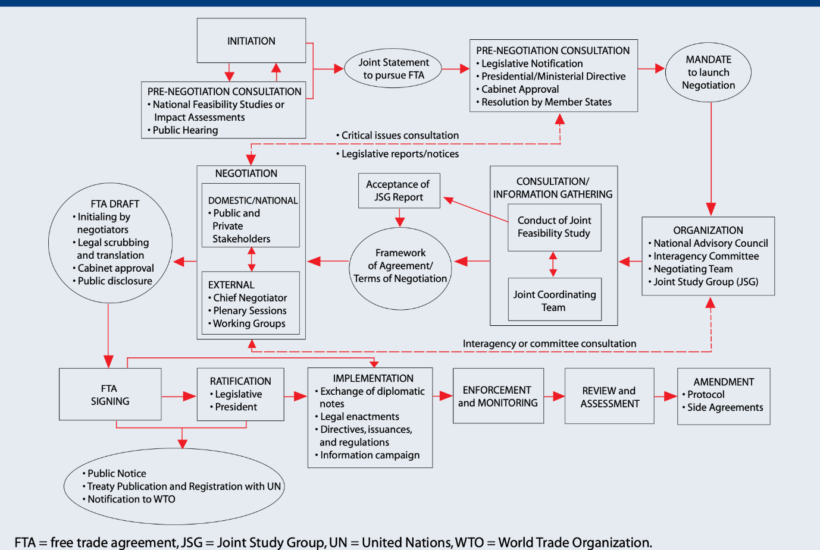
01
Trade Negotiations & Workflow
Source: ADB 2008
Notes:
Trade negotiations is a complex and multistakeholder process which involves different stages, from initiation to review and assessment as described in the table.
This complexity requires relevant institutional set-up and human resources equipped with adequate technical and soft skills across a government to make the process effective and successful for a country.

Slide 5
CAREC Context
01
Trade Negotiations & Workflow
General Technical Skills
01
The basic principles, rules and operation of international trade agreements.
Substantive Areas of Expertise
02
Detailed knowledge on how trade agreements incorporate different obligations in specific sectors.
Soft Skills
03
How to prepare for, organize, execute and implement trade negotiations at the domestic and international levels.
Notes:
The experiences of individual CAREC countries in negotiating FTAs varies considerably
Weak institutions for trade is another constraining factor
3 sets of core blocks, each representing a different kind of skill set, were identified as important for the CAREC countries
general technical skills
the substantive areas of expertise that would likely form the first set of chapters to be negotiated under a future CAREC FTA
“soft skills”

Slide 6
Pre-negotiation Phase
01
Trade Negotiations & Workflow
General Alignment of Interests
01
Either in the political, the economic or both realms.
Political Summitry
02
Usually announced as part of a bilateral or multilateral political summit.
The Need for Economic Data
03
Governments need to be able to credibly argue that there are mutual economic gains to be had from the agreement.
Notes:
General alignment of interests. The announcement that two or more countries have decided to enter into FTA negotiations doesn’t just happen out of the blue, but is usually followed by a period of closer economic ties and political alignments that unfold over a certain period of time.
Political Summitry. The announcement to launch FTA negotiations is almost always made at a bilateral or multilateral political summit, since the leaders can boast that this decision was a concrete result of the summit, thereby justifying the enormous expense and effort that goes into these kinds of events.
The Need for Economic Data. Political leaders need to be able to justify to the public why they are engaging in an FTA, something that is more important today than it ever was, since the general public no-longer accept without reservations that FTAs are beneficial. A case needs to be made that an FTA can bring material benefits to both countries, and for this, a cost benefits analysis, or a economic impact or feasibility study is undertaken, which is the subject of my next slide.

Slide 7
Economic Impact Assessment
01
Trade Negotiations & Workflow
Independent vs Joint studies
01
Countries either embark on these studies separately or jointly.
02
In-house vs Outsourced studies
Some countries prefer to do these studies in-house, while others prefer to outsource this work.
Different Analytical Models
03
There are different modeling techniques that can be used to predict the economic impacts of an FTA.
Notes:
Independent vs Joint studies.
Countries can either do this separately or jointly, depending on how much they’re willing to work together and to what extent they share views on the appropriate methodologies and underlying assumptions.
In-house vs Outsourced studies.
Where countries have the appropriate resources to do this in their own economic ministries or if they have a government think tank they can entrust this work to, they may want to have the study done “in-house”. Other countries, even though they have the capability, prefer to outsource this, feeling it gives more credibility to the final results.
Different Analytical Models
This is always an exercise in quantitative and speculative data analysis, with the preferred models being Partial Equilibrium (PE), General Equilibrium (GE) and Computable General Equilibrium (CGE) models.

Slide 8
Stakeholder Consultations
01
Trade Negotiations & Workflow
Sharing the Results of Economic Impact Studies
01
The results of the initial studies need to be sound-boarded with stakeholders and interest groups.
Consultations and Legitimacy
02
Consultations also serve an important legitimating function for future negotiated outcomes.
Consultations and Negotiating Positions
03
Consultations can also give governments insights they would not have on their own.
Notes:
Sharing the Results of Economic Impact Studies
It is important to share the initial economic impact studies with those most likely to be affected, i.e. stakeholders and interest groups, which will include employers and trade unions, NGOs and academia.
Consultations and Legitimacy
How countries manage the consultation process differs based on the country governance models, traditions and readiness of the stakeholders to engage in substantive discussions. Nevertheless, it is good regulatory practice and boosts the legitimacy of the final negotiated outcome if it aligns broadly with the findings obtained from a sufficiently broad and lengthy consultation process. This can also help with getting parliament to ratify an agreement in those countries where this is constitutionally required.
Consultations and Negotiating Positions
Seeking and obtaining input from the private sector on the actual trade barriers they face is really important if the negotiated outcome is to really have any hope of translating into better market access for your exporters. This is why its important to listen to them. Almost all of the most sophisticated trading countries that have decades of experience in negotiating FTAs have set up mechanisms of varying formality and informality to obtain market intelligence from their respective private sectors.

Slide 9
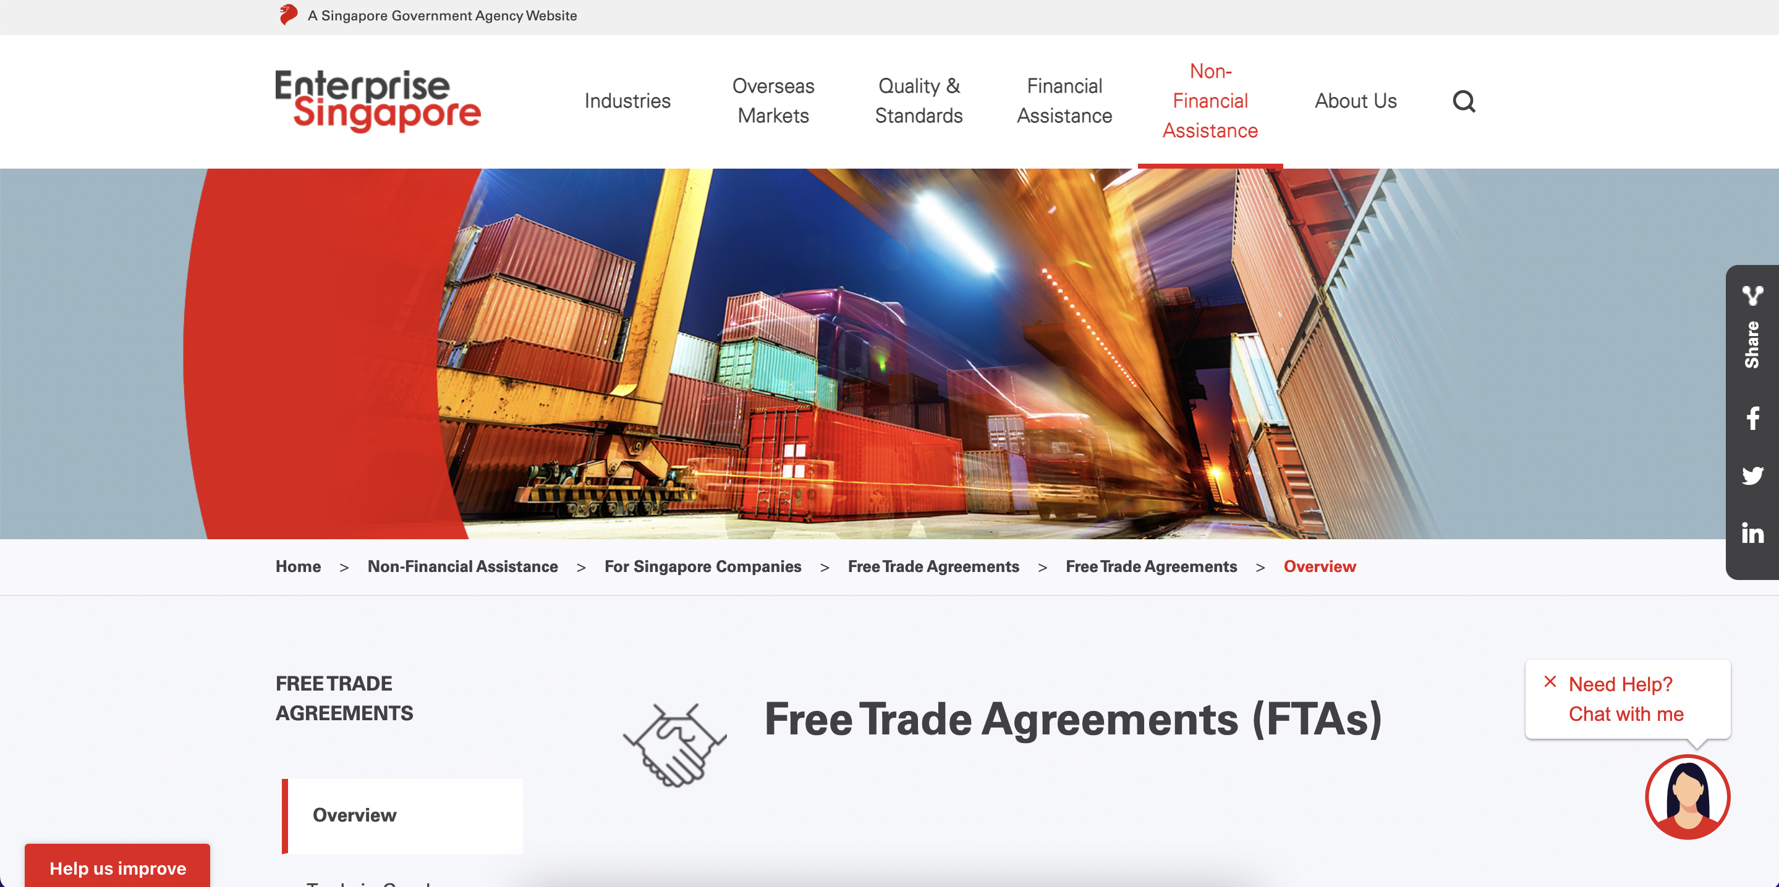
National Trade Portals
01
Trade Negotiations & Workflow
Notes:
Transparency can be achieved through digital information exchange mechanisms and platforms.
Trade related portals help traders find useful information about trade agreements and their implementation. They ensure participatory processes and help government negotiate provisions that cater to the needs and interests of stakeholders.

Slide 10
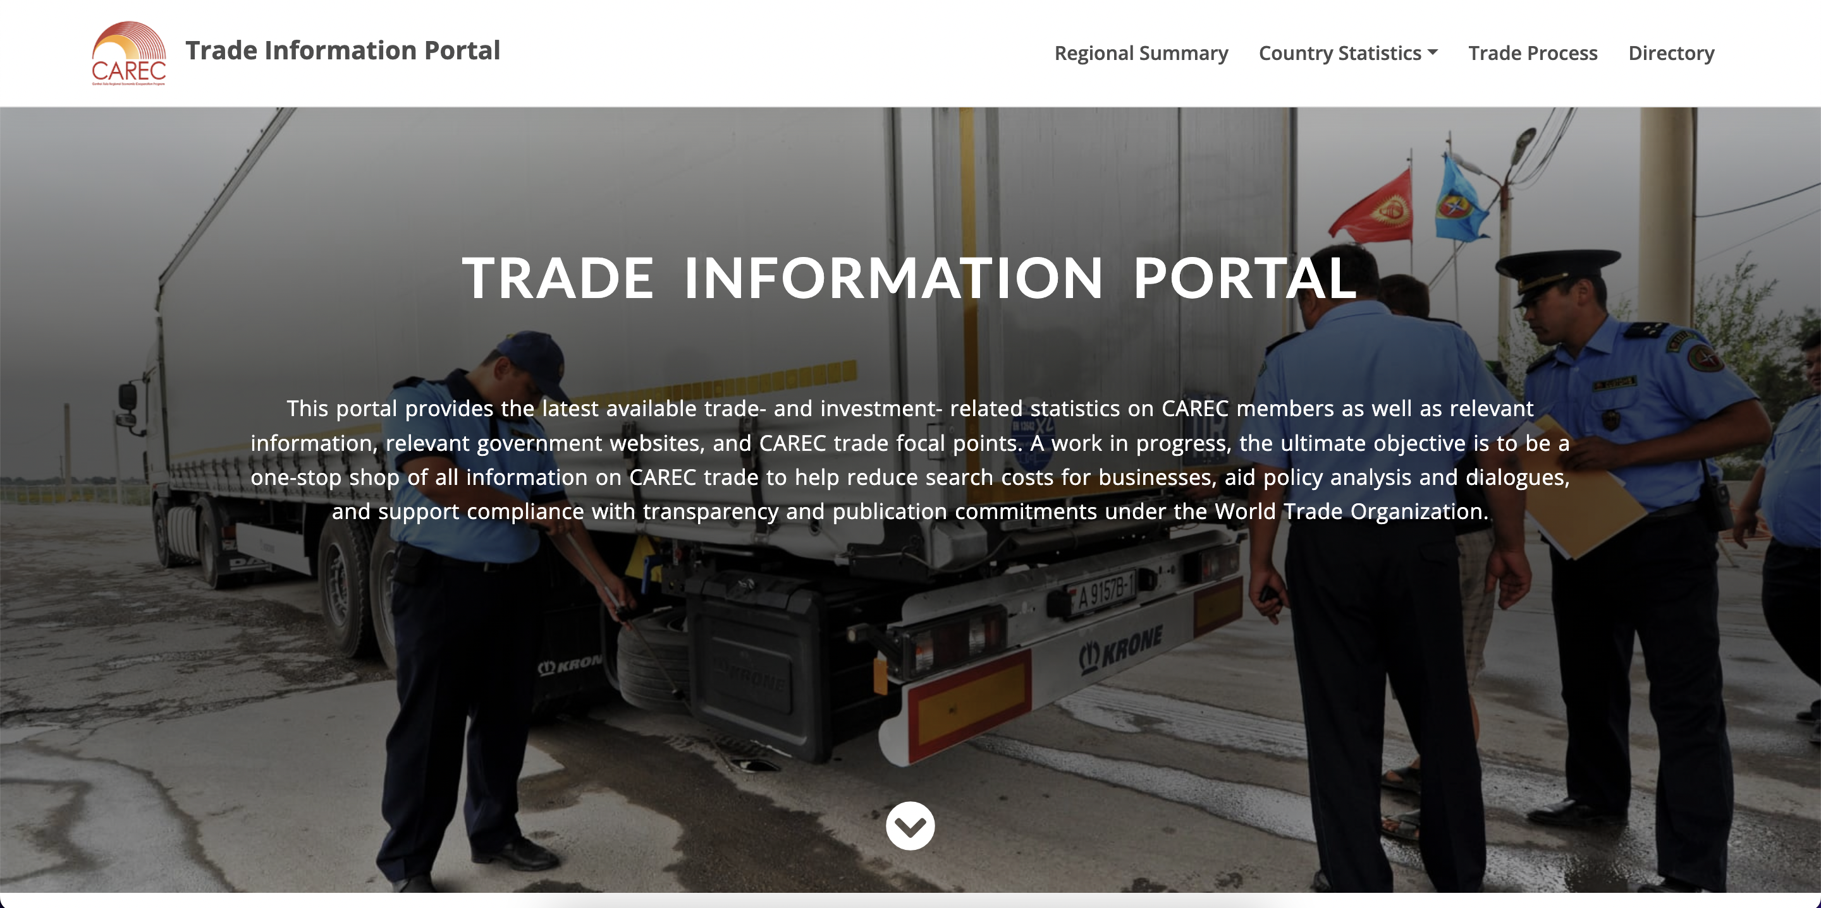
International and Regional Trade Portals
01
Trade Negotiations & Workflow
trade.carecprogram.org
Notes:
There are various regional and global trade information portals, which can serve as good sources for trade negotiators when preparing for and conducting FTA negotiations.
CAREC Trade Information Portal is the most recent regional portal that aims to be a one-stop shop of all information on CAREC trade.

Slide 11
International & Regional Trade Portals
01
Trade Negotiations & Workflow
aric.adb.org
wits.worldbank.org
atr.asean.org
rtais.wto.org
unescap.org/our-work/trade-investment-innovation
tfadatabase.org
trainsonline.unctad.org
epingalert.org
globaltradehelpdesk.org
i-tip.wto.org/services
tina.trade
marketanalysis.intracen.org

Slide 12
Outline
01
02
03
04
Preparing for Negotiations & Managing workflow
Objectives & Mandate of Negotiations
Process & Techniques of Negotiations
Implementation, M&E

Slide 13
Objectives & Mandate of Negotiations
02

Slide 14
Official Launch of Negotiations
03
Negotiating Team
02
Objectives & Mandate of Negotiations
03
National Procedures
01
Announcement

Slide 15
Negotiation Objectives
02
Objectives & Mandate of Negotiations
Economic Growth Objectives
01
These objectives result from an assessment of a country’s offensive and defensive interests.
Reform-Oriented Objectives
02
This involves identifying difficult areas of domestic reform that can be facilitated by international trade agreements.
Other Objectives
03
These can range from other economic objectives but also include political objectives.
Notes:
Economic Growth Objectives
The primary objective of virtually all efforts at trade and investment liberalization are to promote the more efficient use of scarce resources and to promote more trade and investment, thereby stimulating economic activity and creating more jobs. This means that trade and investment liberalization, at least in the minds of most policymakers, is intricately linked with economic growth objectives. This likewise means that governments entering into FTA negotiations need to think hard about their offensive and defensive interests and what strategies and outcomes will help them realize these objectives.
Reform-Oriented Objectives
Governments can also use trade agreements to help them implement reforms that may face opposition from entrenched and well-organized domestic interests, and here trade agreements can help bind the government’s hands when confronting these interests. A good example of this is trade facilitation chapters of FTAs which face resistance not only from customs and other bureaucratic actors but also in some cases express shipping companies. This can also be true for high tariffs that protect a specific sector from import competition to the detriment of a country’s consumers . An anecdotal example of this is the way the Mexican government used the WTO dispute over telecoms (Mexico — Measures Affecting Telecommunications Services) to dilute some of the monopoly power enjoyed at the time by Carlos Salim and his company Telmex).
Other Objectives
As already mentioned, countries generally choose to enter into an FTA with another country as part of a concerted effort to elevate the importance of a bilateral economic and political relationship, with the FTA serving an important signalling function for this intent. Otherwise, countries sometime enter into an FTA to retain parity with their competitors who have already done so, or out of fear of being left behind when their trading partners and competitors are entering into FTAs.

Slide 16
Negotiating Mandate
02
Objectives & Mandate of Negotiations
Development of Negotiating Objectives
01
Based on the assessment of national interests and stakeholder consultations.
Appointment of Negotiating Team
02
Authorizing group of negotiators headed by the chief negotiator.
Red Lines and Negotiating Positions
03
Setting limits for the scope of the agreement and positions in the negotiations.
Notes:
Development of Negotiating Objectives
These objectives typically outline the scope and content of the proposed agreement, including the sectors to be covered, the level of tariff reductions or eliminations, and the provisions on investment, intellectual property, labor, and environment. Different political systems require different degrees of public disclosure about these objectives, whereas in other systems, good intelligence and analysis of the country’s political-economy realities will allow one to infer what the likely negotiating objectives are going to be.
Selection of Negotiating Team
Once the negotiating objectives are finalized, the country will select a team of negotiators with the necessary expertise and experience to represent its interests in the negotiations. This team may include government officials, trade experts, lawyers, and other technical specialists. Because of the broad range of regulatory issues typically covered in modern-day trade agreements, it is not uncommon for a broad range of regulatory actors to be asked to participate in the negotiations.
Red Lines and Negotiating Positions
Red lines are the boundaries beyond which a government is unwilling to compromise during negotiations. Governments must define their red lines carefully to ensure that they protect their key interests and priorities, such as sensitive sectors or issues of national security.
These positions should be carefully crafted to reflect the government's priorities and objectives, and to be responsive to the proposals put forward by the other negotiating parties. Negotiating positions should also be flexible enough to allow for compromises and adjustments during the course of negotiations.

Slide 17
Negotiating Team
02
Objectives & Mandate of Negotiations
Lead Negotiator
01
The backbone of a negotiating team is a lead institution (ministry, agency, etc) responsible for trade policy implementation.
Advisory and Consultative Committees
02
Other committees to guide and give technical support to the negotiators are essential .
Respecting Turf
03
Setting limits for the scope of the agreement and positions in the negotiations.
Notes:
Lead Negotiator
The position of lead negotiator needs to combine a number of skills and capabilities, including a certain political authority, technical expertise, negotiating savvy, organizational and management skills, as well as a work ethic and temperament that is well suited to the often arduous and exhausting rhythm of negotiations.
Advisory and Consultative Committees
Organizing a negotiating team involves not only enlisting those who will be at the negotiating table but also forming an advisory committee, an interagency committee, and other committees to guide and give technical support to the negotiators.
Respecting Turf
Because trade agreements today involve commitments that extend considerably beyond the simple task of negotiating and agreeing tariff concessions, and in fact extend deep into the regulatory competence of many other bodies and agencies, the trade ministry must involve these bodies and agencies in these negotiations, not just for their expertise but also in order to avoid turf battles.

Slide 18
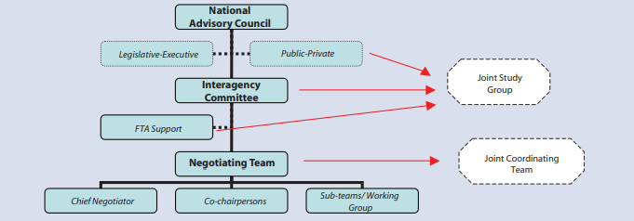
Organizational Chart
02
Objectives & Mandate of Negotiations
Source: ADB 2008

Slide 19
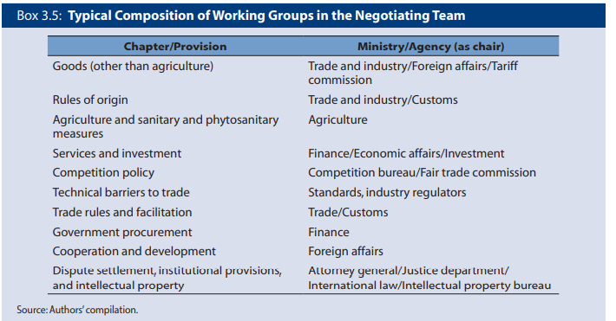
Working Groups
02
Objectives & Mandate of Negotiations
Source: ADB 2008

Slide 20
Outline
01
02
03
04
Preparing for Negotiations & Managing workflow
Objectives & Mandate of Negotiations
Process & Techniques of Negotiations
Implementation, M&E

Slide 21
Process & Techniques of Negotiations
03

Slide 22
Negotiation Process
03
Process & Techniques of Negotiations
Scheduling and Hosting of Successive Rounds
01
An initial timeframe is adopted and rounds within this timeframe scheduled.
Guidelines and Modalities
02
Different approaches and modalities exist, such as sectoral approaches, or focusing on market access before turning to rules.
Overarching Principles
03
These include standstill, confidentiality, consistency with WTO rules, etc.
Notes:
Scheduling and Hosting of Successive Rounds
Governments often set unrealistic or highly ambitious timeframes for the conclusion of FTAs, which can prove difficult to meet if politically sensitive issues lead to negotiating impasses or if there are many countries with disparate interests participating in the negotiations. Usually, countries share the burden of hosting and travelling to negotiating rounds, with the task of negotiating always easier for the team with home-court advantage. It is often necessary to schedule additional rounds, and it is not uncommon for FTAs to go on for many years, if there is no commitment from the highest levels of political leadership to conclude negotiations within a certain timeframe.
Guidelines and Modalities
Sectoral approach
Two-track approach (i.e., the modalities-and-rules approach in the GATS) vs gradualist approach (from simpler to more complex issues)
Template approach.
Overarching Principles
A number of principles generally apply to countries engaged in negotiating trade agreements, including the standstill rule, which means that while they’re negotiating, they can’t enact any measures that make their trade regime more restrictive, such as raising tariffs. Confidentiality is another guiding principle in most FTAs, so that participating governments are not allowed to leak draft texts to the public. Consistency with WTO rules of the resulting FTA is another important principle that is always observed.

Slide 23
Guiding Principles of RCEP
03
Process & Techniques of Negotiations
Parallel Negotiations for “Single Undertaking” Effect
01
Parallel negotiations for trade in goods, services and investment and other areas simultaneously to provide comprehensive and well-rounded overviews on a broad range of issues.
WTO Consistency
02
Consistency with WTO, including GATT Article XXIV and GATS Article V.
Modelled on existing ASEAN Plus One FTAs
03
Facilitating trade and investment, enhancing transparency and increasing engagement in global and regional supply chains.
Explicitly considering the needs of least-developed economies
04
Via special and differential treatment, including technical assistance and capacity building.
Open accession was allowed at the outset
05
With terms and conditions needed to be agreed by all existing members.
Notes:
Parallel Negotiations for “Single Undertaking” Effect
Negotiating different issues in parallel allowed for cross-sectoral trade-offs to be exercised and provided a kind of nothing is agreed until everything is agreed approach which provides a mutually reinforcing dynamic that supports the more politically sensitive areas of any negotiations.
WTO Consistency
This means consistency with GATT Art. XXIV and GATS Art. V so that the agreement can gain the rubber stamp of the WTO Committee on Regional Trade Agreements, but it also means in practice that none of the FTAs provisions can openly violate or contradict any of the remaining WTO rules, otherwise countries have to have one set of rules and procedures for WTO Members and another for FTA partners, which introduces new and unnecessary complexity into their trade regimes.
Modelled on existing ASEAN Plus One FTAs
This means going beyond existing ASEAN Plus One FTAs, albeit taking care not to abrogate previous terms.
Explicitly considering the needs of least-developed economies
This is increasingly becoming de rigeur in most FTAs and even in WTO agreements, where the needs of developing countries, particularly LDCs and specifically with regard to implementation costs, are being recognized and mitigated from the outset and via binding treaty provisions.
Open accession was allowed at the outset
This means that RCEP was concludes with the explicit understanding that new countries could join in future, so as to be an open, rather than a closed system.

Slide 24
Conducting Trade Negotiations
03
Process & Techniques of Negotiations
The Role of Chief Negotiators
01
The chief negotiator is the overseer and the impasse breaker.
Negotiating Teams
02
Teams negotiate the substantive and technical details in the trenches..
Parallel Processes
03
While negotiations are ongoing, its important to keep different constituencies and stakeholders up to date.
Notes:
The Role of Chief Negotiators
Chief negotiators play the role of leading and managing negotiations and coordinating different negotiating teams. They may choose to lead a specific team based on their own substantive expertise. They are also required to lead negotiations on any sensitive issues and help resolve negotiating impasses. The role of chief negotiator is difficult because they have to maintain the overview of where each negotiating group is at any given time. Usually, they meet with each negotiating team at the end of each day and take stock of where each negotiating group is and what concessions have been given and received. It’s up to the Chief Negotiator to know and understand where the balance of rights and obligations stands at any given moment during the negotiations and to make sure that red lines are respected by teams.
Negotiating Teams
Teams are responsible for negotiating specific issues or chapters, and tend to be constituted by subject matter experts or officials from the regulatory agencies specifically responsible for the chapter being negotiated by the team in question. For example, for the chapter on SPS, you would expect to have at least one expert from the ministry of agriculture or the quarantine service on the negotiating team. By the same token, for any negotiations on financial services, you would expect to have at least one person from the central bank, or the financial services regulator on that team.
Parallel Processes
It is critical that in parallel with the external trade negotiations domestic negotiations take place with stakeholders from both the public sector (e.g., policy makers, cabinet members, and regulatory bodies) and the private sector (e.g., business or industry groups, NGOs, workers’ unions, environmental lobbyists, civil society, and consumer groups).

Slide 25
Trade Negotation Timeline
03
Process & Techniques of Negotiations
The Short Game
01
Some negotiations can be concluded quickly under a given set of conditions.
The Long Game
02
Negotiations involving more than two parties, and that involve many chapters tend to drag on for years.
Getting to Yes
03
This is a question of political will, but also carefully managing expectations from the outset and information flow during negotiations.
Notes:
The Short Game
Negotiations started in 2015 and the agreement was signed in 2017 and entered into force in 2018. The Georgia-China FTA timeline is unusual in that although no timetable was set, substantive part of the Agreement was negotiated in a record seven-month period, and it was the fastest FTA negotiation process that China had with a partner by then.
The Long Game
RCEP was first proposed at the 2011 Summit in Bali Indonesia, the negotiation started in 2012 were expected to be concluded in 2015 but dragged on until 2020. There were a total of 31 negotiation rounds, 15 ministerial meetings, and four Leader’s Summits before it was finally signed.
Getting to Yes
Getting to yes can be accelerated by saying “yes” to all of your counterparts demands, which may or may not be the desired negotiating strategy.

Slide 26
Negotiation Techniques
03
Process & Techniques of Negotiations
Who Needs to Know
01
It’s important that not only the chief negotiator but also everyone involved in the teams has an understanding of negotiating techniques.
Know the Rules and Protocols
02
There are established rules and protocols of negotiations that need to be adhered to if the negotiations are to succeed.
Negotiate in Good Faith
03
This is so important and cannot be emphasized enough. .
Notes:
Who Needs to Know
It is important that not only the chief negotiator, but the all the negotiating team members have the basic knowledge of negotiation techniques. The best way is to learn through practice, including through simulation exercises.
Know the Rules and Protocols
Adherence to the certain established rules and protocols of negotiation is key to successful negotiations which should be first of all ensured by the chief negotiators.
Negotiate in Good Faith
Good faith negotiations lead to credibility and mutually accepted outcomes, within the set national mandates for negotiators.

Slide 27
Role of Negotiators
03
Process & Techniques of Negotiations
Sending and Receiving
01
Negotiators should be able to articulate clearly the negotiating positions and understand the positions of the counterpart
Building and Maintaining Trust
02
It is important that the counterparts have good working relationship that establish and maintain mutual trust.
Back-up Plans
03
Chief negotiators need to have a better alternative to a negotiated agreement (BATNA) instead of conceding their red lines
Notes:
Sending and Receiving
Negotiators should be able to articulate clearly the negotiating positions and understand the positions of the counterpart.
Building and Maintaining Trust
It is important that the counterparts have good working relationship ensuring the trust and the trust is also built on the ability of the negotiators to defend the negotiating positions at home.
Back-up Plans
It is crucial for the chief negotiator to be prepared with a best alternative to an agreement. Developing one’s best alternative to a negotiated agreement-BATNA and considering the partner’s BATNA are also very important in strengthening bargaining power during negotiation and strategizing the options available.

Slide 28
Negotiation Skills and Habits
03
Process & Techniques of Negotiations
Listen actively
Practice role reversal
Ask questions
Listen to and record all proposed options
Use Silence
Be sensitive to cross-cultural dynamics, gender, and language
Organize brainstorming sessions
Build a reputation for reliability and integrity
Use objective criteria
Create a win-win mentality

Slide 29
Outline
01
02
03
04
Preparing for Negotiations & Managing workflow
Objectives & Mandate of Negotiations
Process & Techniques of Negotiations
Implementation, M&E

Slide 30
Implementation, Monitoring and Evaluation
04

Slide 31
Implementation
04
Implementation, Monitoring and Evaluation
Legislative Implementation
01
Most modern and comprehensive FTAs require legislative and regulatory changes to existing laws or the enactment of new laws.
Procedural Implementation
02
After an agreement takes effect, administrative procedures may also need to be also amended.
Implementation Stakeholders
03
Chief negotiators need to have a better alternative to a negotiated agreement (BATNA) instead of conceding their red lines
Notes:
Legislative Implementation
Implementation of a trade agreement requires adopting of new legislation or amending existing laws to comply with different agreement commitments.
Procedural Implementation
Many FTA commitments that seek to achieve greater transparency or implement more due process rights for importers, also require changes to the way administrative agencies operate, which means that procedures and protocols have to be changed.
Implementation Stakeholders
All relevant state authorities and bodies have to be involved in implementation process to fulfil agreement obligations and benefit from new market opening. Depending on a country’s internal constitutional structures, this will almost inevitably involve various degrees of involvement from parliament and executive branch agencies.

Slide 32
International Monitoring
04
Implementation, Monitoring and Evaluation
WTO Committee on Regional Trade Agreements
01
Preferential Trade Agreements that contain deviations from MFN and non-discrimination obligations must be notified.
Notification Requirements
02
WTO Members must notify any PTAs they have signed and do so before preferential treatment is extended to its FTA partners.
Review Procedure
03
The CRTA conducts a review of the FTA and makes a factual presentation to other members.
Notes:
WTO Committee on Regional Trade Agreements
The CRTA's work helps to ensure transparency, promote compliance with WTO rules, and maintain the integrity of the multilateral trading system. By examining and monitoring regional trade agreements, the CRTA plays an essential role in maintaining coherence between regional and multilateral trade initiatives.
Notification Requirements
The obligation to notify the CRTA flows primarily from GATT Art. XXIV and an accompanying Understanding on the Interpretation of Article XXIV and another text adopted in 2006 called the Transparency Mechanism for Regional Trade Agreements, as well as under Art. V of the GATS. Since the Transparency Mechanism came into effect, there are set deadlines and data requirements that must accompany notifications by countries regarding PTAs. Changes to existing FTAs and the end of the transition period for tariff elimination also trigger notification obligations.
Review Procedure
The WTO Secretariat makes a factual presentation of the RTA to the CRTA which forms the basis for members to “consider” the agreement’s conformity with WTO rules, but the consensus rule of the CRTA effectively means that no agreement has found to be in breach of WTO rules to date.

Slide 33
National Monitoring
04
Implementation, Monitoring and Evaluation
01
Rationale for National Monitoring
This is a way of determining whether the FTA has met or is meeting its original objectives.
Procedural Modalities
02
Like the various other phases of the negotiations, this also requires inter-agency cooperation.
Feedback Loops and Actionable Information
03
Monitoring can also show gaps in implementation that can be actioned at annual review meetings.
Notes:
Rationale for National Monitoring
Monitoring the economic impact an FTA is having and the extent to which tariff preferences and other market access opportunities are being utilized is an important indicator for whether the FTA is achieving its original goals.
Procedural Modalities
Coordination among agencies is essential especially between those agencies that will put into operation provisions of agreements and those that will eventually review agreements and provide for necessary amendments.
Feedback Loops and Actionable Information
Monitoring call also reveal where implementation by a trading partner is falling short, so that this can be actioned in the regular meetings that the two governments will inevitably have to discuss implementation issues.

Slide 34
Review of Trade Agreements
04
01
Living Agreements and In-built Agendas
Some FTAs have in-built clauses designed to encourage their regular review or renegotiation.
Evaluation Criteria
02
There are a number of objective and measurable indicators that can inform policymakers as to whether an FTA is working optimally.
Reviews for Deeper Integration
03
Reviews should serve as mechanisms to improve the implementation of existing agreements but also agree new rules.
Notes:
Living Agreements and In-built Agendas
Some agreements contain clauses that set out a specific date on which one or both parties can seek to update the agreement. Otherwise they may contain a clause that provides for the start of new negotiations upon the lapse of a given transition period. These types of instruments aim to stop an FTA from becoming outdated but also to maintain momentum towards broader and deeper economic integration.
Evaluation Criteria
Various criteria can be used to determine how successful a given PTA has been in achieving its original goals and the degree to which it has served as an instrument for trade and investment liberalization, including: macroeconomic indicators, industry utilization indicators, trade volumes, growth in market shares, diminished or increased use of non-tariff measures.
Reviews for Deeper Integration
Typically, deciding to review and update an agreement serves the purpose of adjusting an agreement to new realities and using it to achieve broader and deeper economic integration between FTA partners.

Slide 35
Trade Impact Assessment (TIA)
04
Implementation, Monitoring and Evaluation
In 2022, UNCTAD published a Guidebook on Trade Impact Assessment which is designed to help trade policymakers and practitioners in developing countries to have comprehensive information on:
When and how to conduct an impact assessment;
Where to obtain detailed and technical information on the conduct and use of impact assessments;
How the results of the impact assessments may be interpreted and put into practice.
When to Conduct an Impact Assessment
01
This is best done after the agreement has had time to exude its intended effects, so several years after entry into force.
Indicators and Methodologies
02
A number of data points and trade indicators exist to help policymakers assess the socio-economic impact of a given FTA.
Applying the Results of Impact Assessments
03
The results of the impact assessment will show the way forward for the trade and investment relationship in question.
Notes:
In 2022, UNCTAD published a Guidebook on Trade Impact Assessment which is designed to help trade policymakers and practitioners in developing countries better understand the broader socio-economic impact of trade policies, such as a negotiated trade agreements.
When and How to Conduct an Impact Assessment
This can happen at various stages, whereby at each stage different policy purposes are inevitably being pursued. Doing an impact assessment after a certain period of time following the conclusion and entry into force of an FTA allows the government to see what the real-world socio-economic impacts have been. Recall that FTAs are inherently distributional, meaning that they create winners and losers. Impact assessments can help governments better understand these dynamics and mitigate any negative externalities that have resulted from implementation of the FTA that are not self-correcting or which the market has failed to adequately address.
Indicators and Methodologies
Important indicators include trade data, tariff data, trade indicators like revealed comparative advantage, trade intensity index, trade complementarity index, export diversification (or concentration) index, index of export market penetration, and others. The Guidebook also discusses several quantitative and qualitative methodologies for conducting an impact assessment.
Applying the Results of Impact Assessments
Conclusions of an impact assessment may present opportunities and challenges resulting from the prospective trade and investment agreement between potential FTA member states. An impact assessment may recommend the areas and the degree of concessions in the future trade and investment agreement, as well as flanking measures to accompany the implementation of the future agreement.

Slide 36
Summing Up
01
01
Embarking upon FTA negotiations is a resource-intensive and multi-year undertaking that governments need to adequately prepare themselves for.
Political leaders need to articulate and communicate their objectives, meaning they need to know why they want to negotiate a given FTA and make sure they communicate this vision and purpose to everyone involved.
02
Stakeholder consultation is essential but something many governments struggle with, because this can be organizationally challenging and because the private sector and other interests may not be sufficiently organized.
03
FTAs, trade and investment liberalization, and closer economic integration are not ends in themselves but need to serve the interests of the people and improve the economic welfare of the country as a whole.
04

Slide 37
Thank you!

