Slide 1
Modern Technology
in the AEO Program of China Customs
SEP. 27th, 2023

Slide 2
Enterprise Credit Management Systems
Operating System
 AEO Appication
 AEO Review
 AEO Facilitation Suspension & Restoration
 AEO Certificate Issue
...

Slide 3
Enterprise Credit Management Systems
Enterprise Management System
 Query
 Supervision
 Statistics

Slide 4
Enterprise Credit Management Systems
Collection of Credit Information
 Registration & Filing Information
 Import & Export Information
 External Information

Slide 5
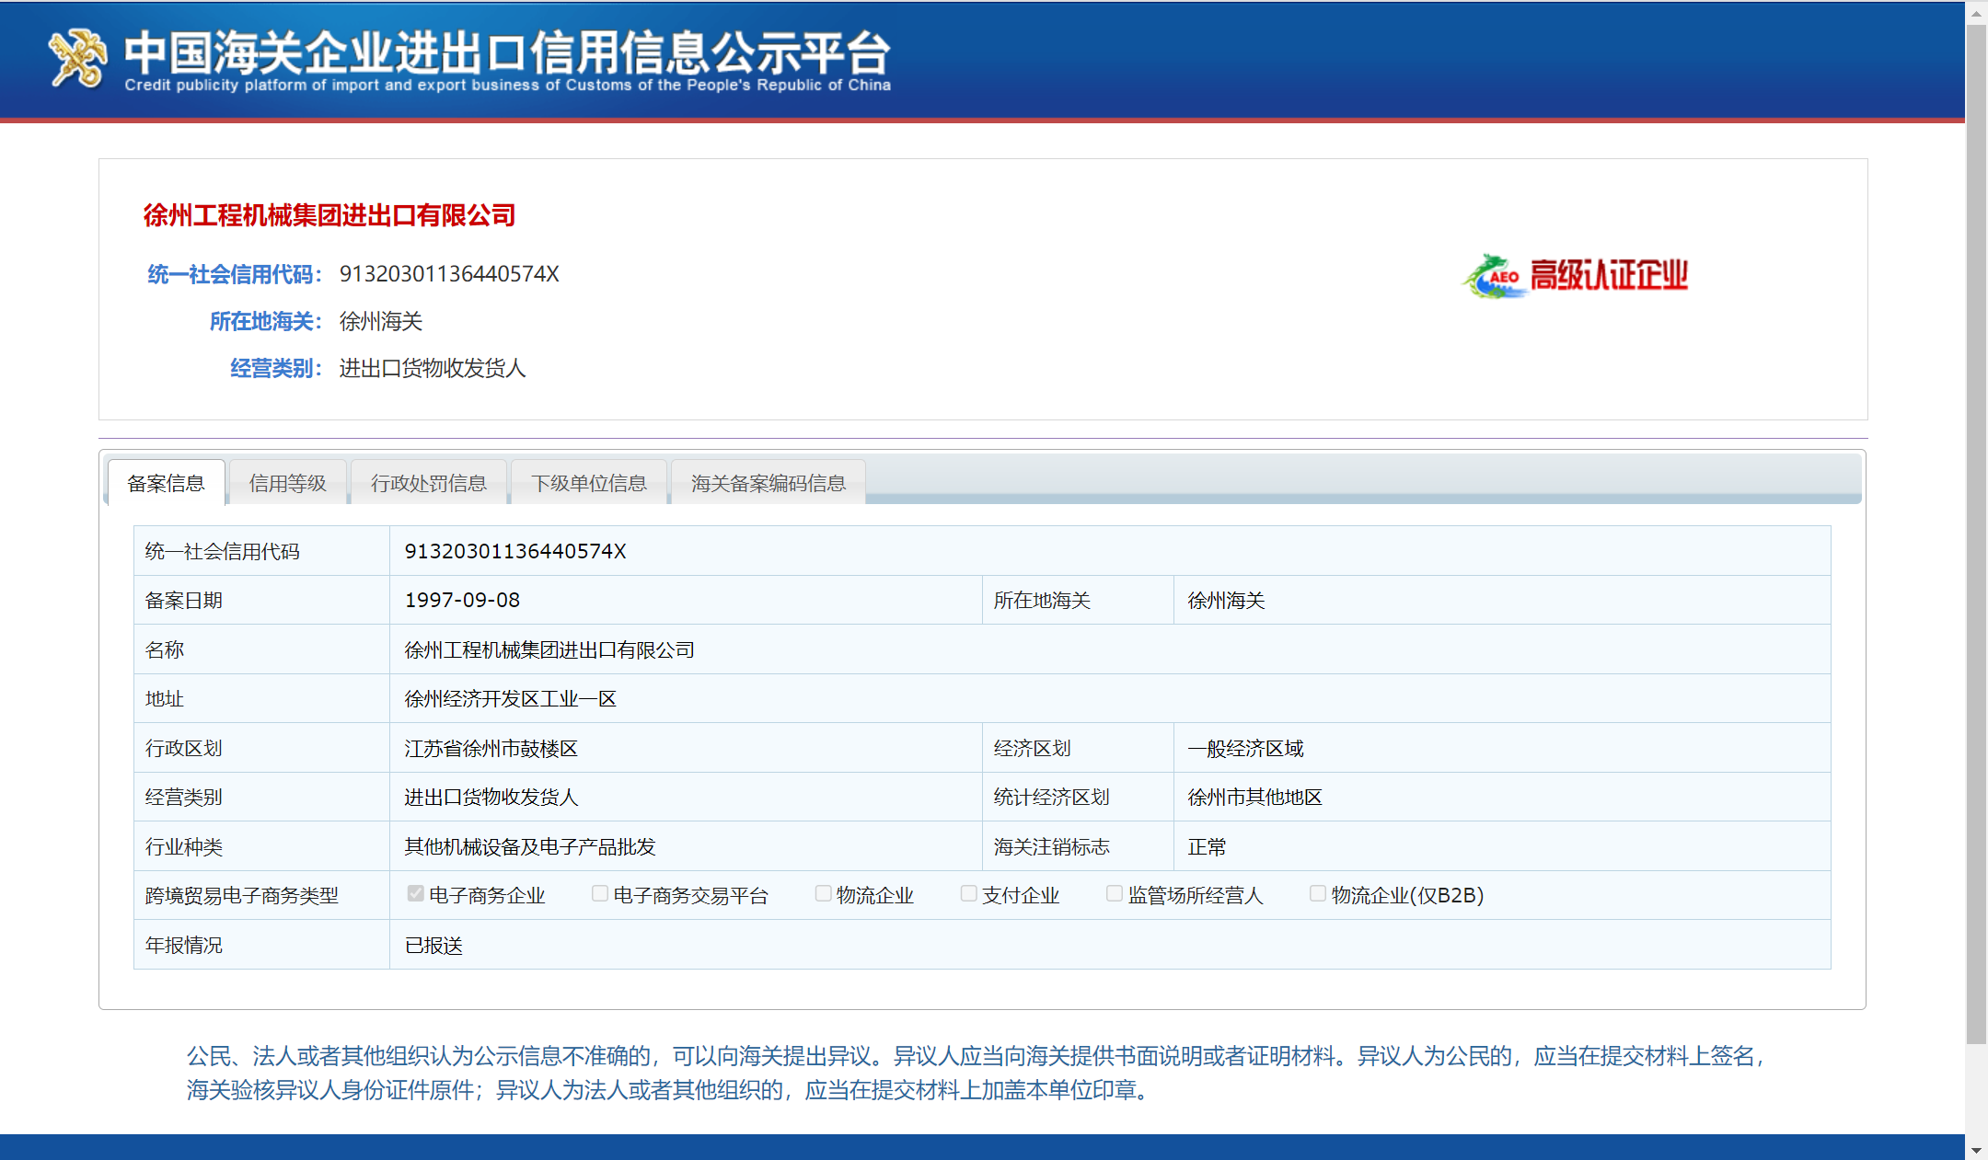
Enterprise Credit Management Systems
Public Disclosure of Credit Information

Slide 6
Enterprise Credit Management Systems
Use of Credit Information
Domestic
National Enterprise Credit Information Publicity System
Credit Information
Overseas
AEO Mutual Recognition Data
Automatic Exchange System
Clearance
System
Risk
Management
System
Inspection
Management
System

Slide 7
Monitoring Procedure
AEO shall be reviewed every 5 years.
If an enterprise no longer meets the AEO Criteria upon review, the Customs shall
Issue a Decision Letter of Disapproval for Review
Withdraw the AEO Certificate
AEO could be reviewed by random if there's any suspected abnormal issue with the credit situation.
Prompted by Info System

Slide 8
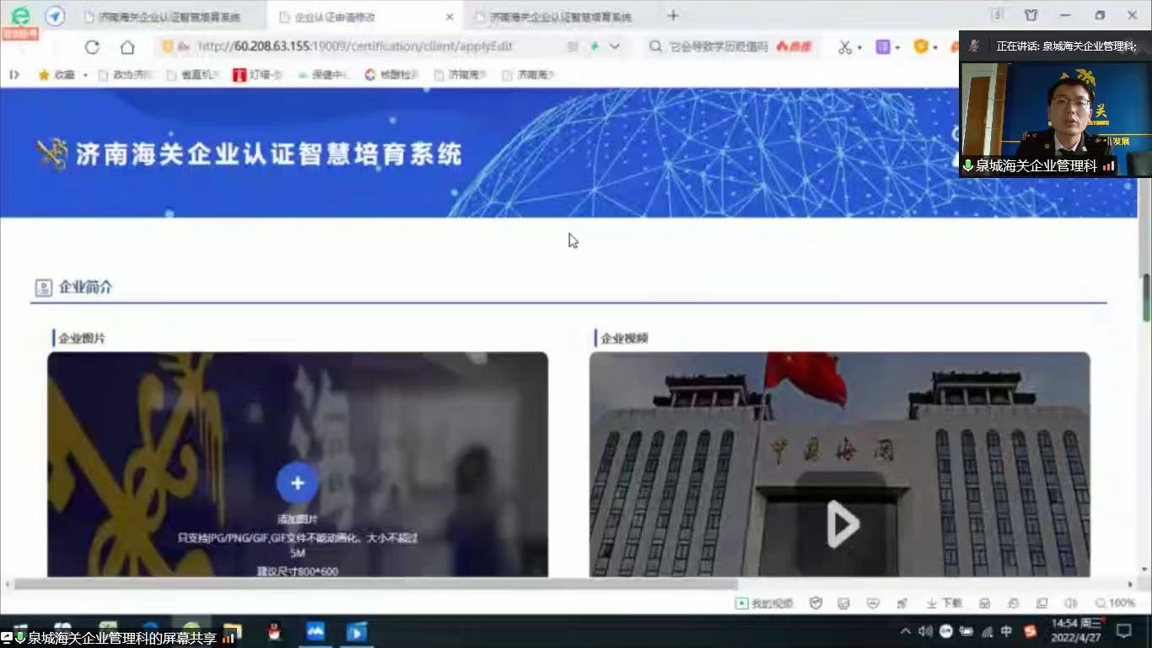
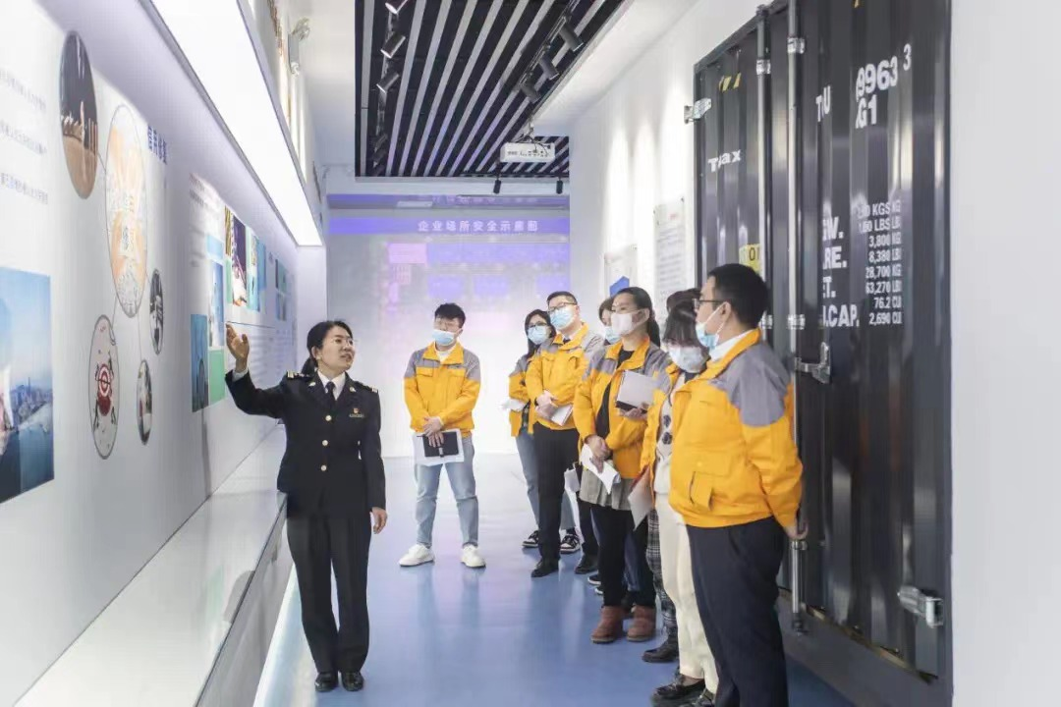
Cultivation to Enterprises
*

Slide 9
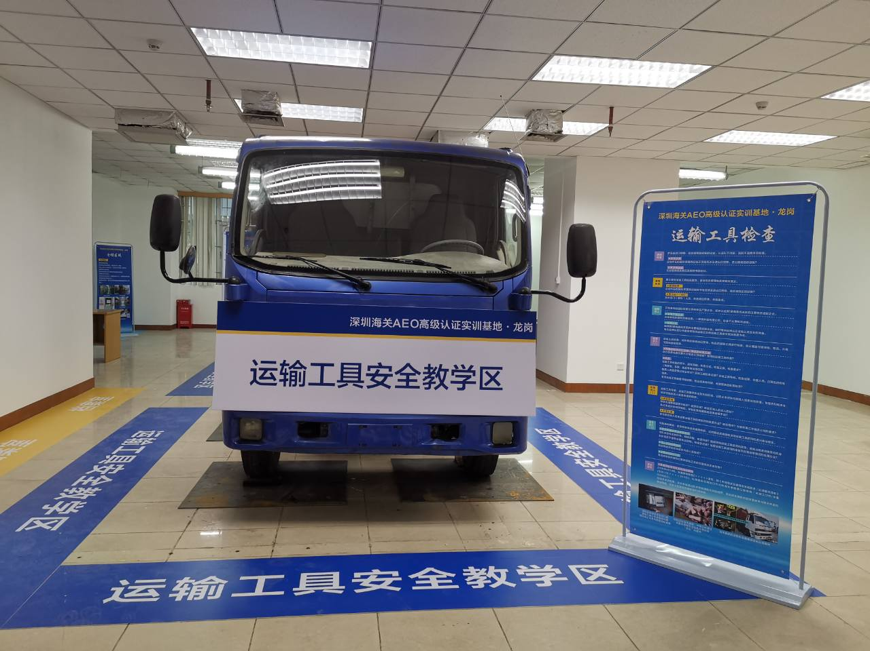
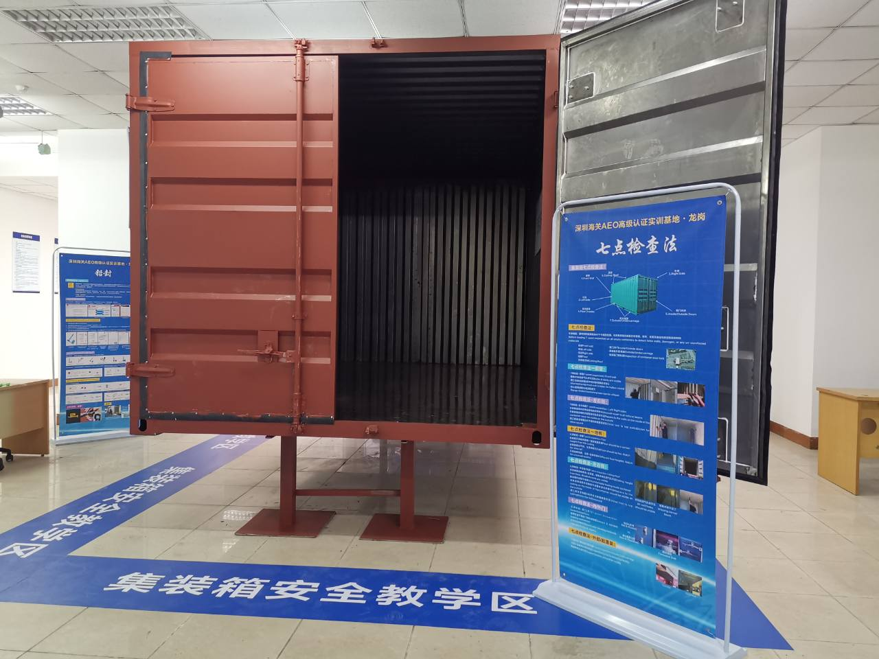
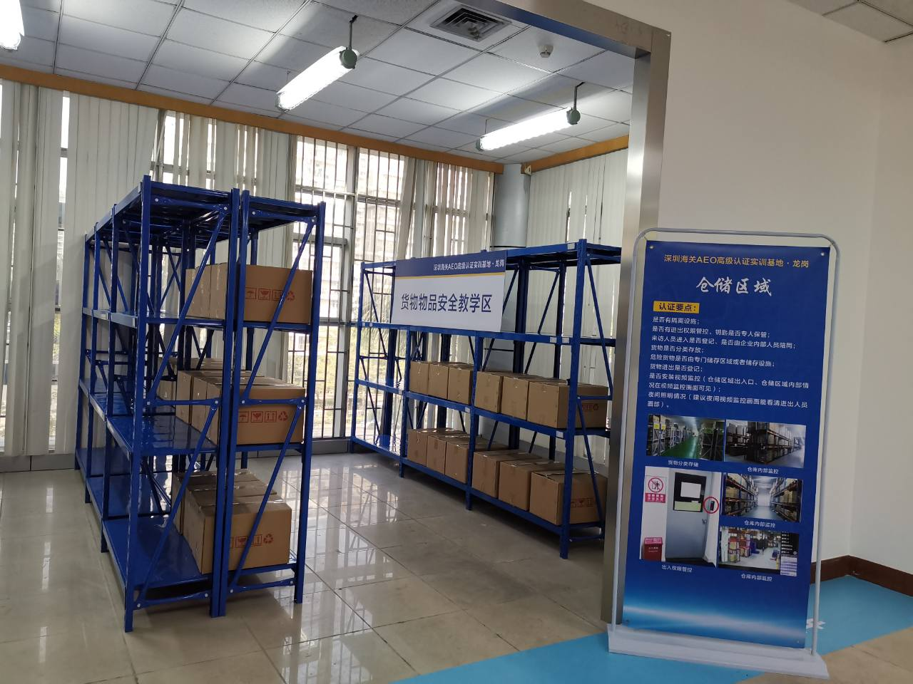
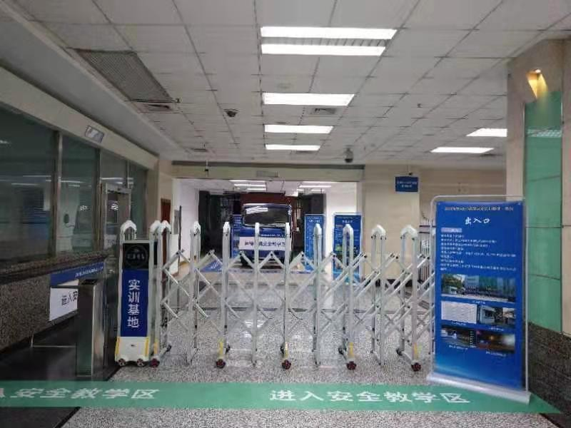
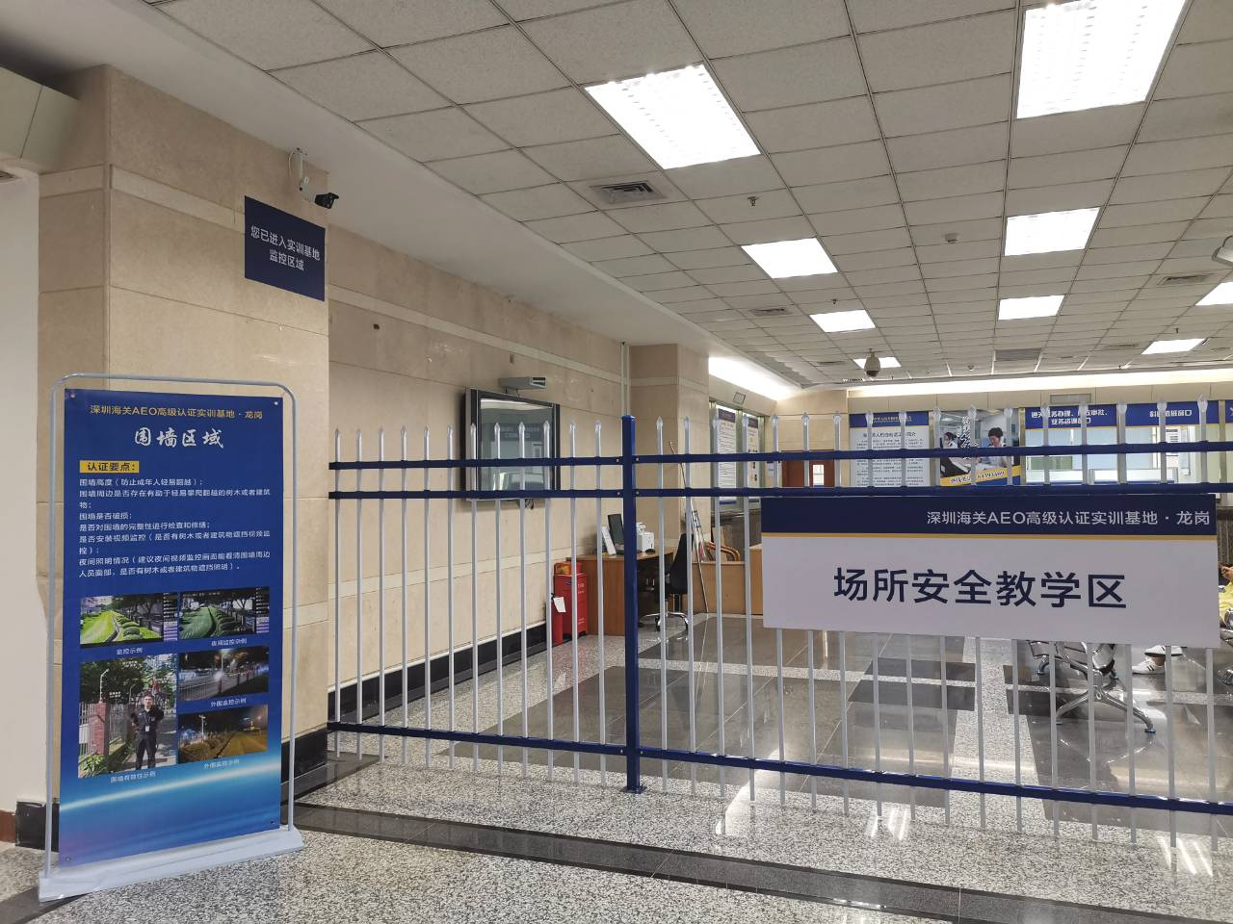
AEO Training Base

Slide 10
Cargo Security
WCO SAFE Framework of Standards
 Establish procedures to positively control all cargo being removed from the storage facility.
 Establish procedures to manage, secure and control all cargo in its custody during transport and while loading into or unloading from a transport conveyance.
...
AEO Criteria of China Customs
 A management system of ensuring the integrity and reliability of import/export goods, inbound and outbound articles in the process of transportation, loading/unloading and storage is established and implemented.
 For Both the enterprise and its business partners that have the responsibility of affixing seals of the container, written policies and procedures on affixing and checking the seals are established and implemented. Seals are managed and registered by special personnel. Seals of loaded containers meet or exceed the current PAS ISO 17712 high security seal standards.
 ...

Slide 11
Conveyance Security
WCO SAFE Framework of Standards
 Ensure, to the extent and scope of its authority and responsibility, that all transport conveyances used for the transportation of cargo within its supply chain are capable of being effectively secured.
 Secure transport conveyances within its supply chain, to the extent and scope of its ability and responsibility, when left unattended, and check for security breaches upon return.
 ...
AEO Criteria of China Customs
 A management system of ensuring the integrity and security of all the means of transport for the shipment of import/export goods and inbound/outbound articles in the supply chain is established and implemented.
 ...

Slide 12
Best Practices of Chinese AEOs
Security Measures in the movement of goods
 Seals
 GPS
 Info Systems-WMS/TMS
 Monitoring System & Large Screen
 ...

Slide 13
Thanks For Your Attention！
SEP. 27th, 2023

