Slide 1
Strengthening Regional Cooperation on Skills Development under the CAREC Program: Key Progress, Challenges, and Opportunities for Collaboration
Inception Meeting and International Expert Roundtable
30–31 May 2022, Tbilisi, Georgia
Session VI: Prospects for Creating a CAREC-Wide Labor Force and Labor Market Database and Information System
Hein de Haas
Professor, University of Amsterdam
Director, International Migration Institute (IMI)

Slide 2
Presentation Outline
1
2
4
The importance of incorporating migration data on LMIS
Prior research projects and migration/policy databases – DEMIG example
3
prospects of expanding similar projects within the CAREC region
The road ahead: insights on possible regional solutions to better link data and analysis on skills, labor market and migration

Slide 3
1. The importance incorporating migration data on LMIS
Migration is one of the principal mechanisms that can lead to more optimal skills-jobs matching
Ill-conceived migration and skills policies lead to suboptimal or counterproductive outcomes in terms of labor force deployment
More effective migration policies lead to higher benefits for origin and destination countries as well as workers
Absence of adequate detailed migration data in CAREC hinders development of more effective labor market policies

Slide 4
Prior research projects and migration/policy databases the DEMIG project

Slide 5
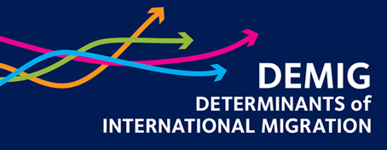
Aims of the DEMIG project
Explore short- and long-term trends of international migration over the 1950-2015 period?
What factors have caused shifts in bilateral and regional migration pattern and trends?
How do policies affect the (i) volume, (ii) timing, (iii) duration, (iv) direction and (v) skills selection of migration flows?
How can policies contribute to more optimal outcomes and how can unintended effects be avoided?
Development of migration scenarios – Global Migration Futures project

Slide 6
DEMIG databases
DEMIG C2C: bilateral flows by country of residence (COR), citizen-ship (COC), birth (COB); 34 countries, 1946-2011, ≈50,000 dyads.
DEMIG TOTAL: Total immigration, emigration and net migration, citizens and foreigners, 163 countries, from 1820.
DEMIG POLICY: 6,500 migration policy changes, 45 countries, 1946-2013, coded by (i) policy area; (ii) policy tool; (iii) migrant category; (iv) geographical origin; also covers emigration policies
DEMIG VISA: Global panel (196*196 countries) of bilateral entry visa and exit permit requirements, 1973-2014.
raining Institutions and Programs

Slide 7
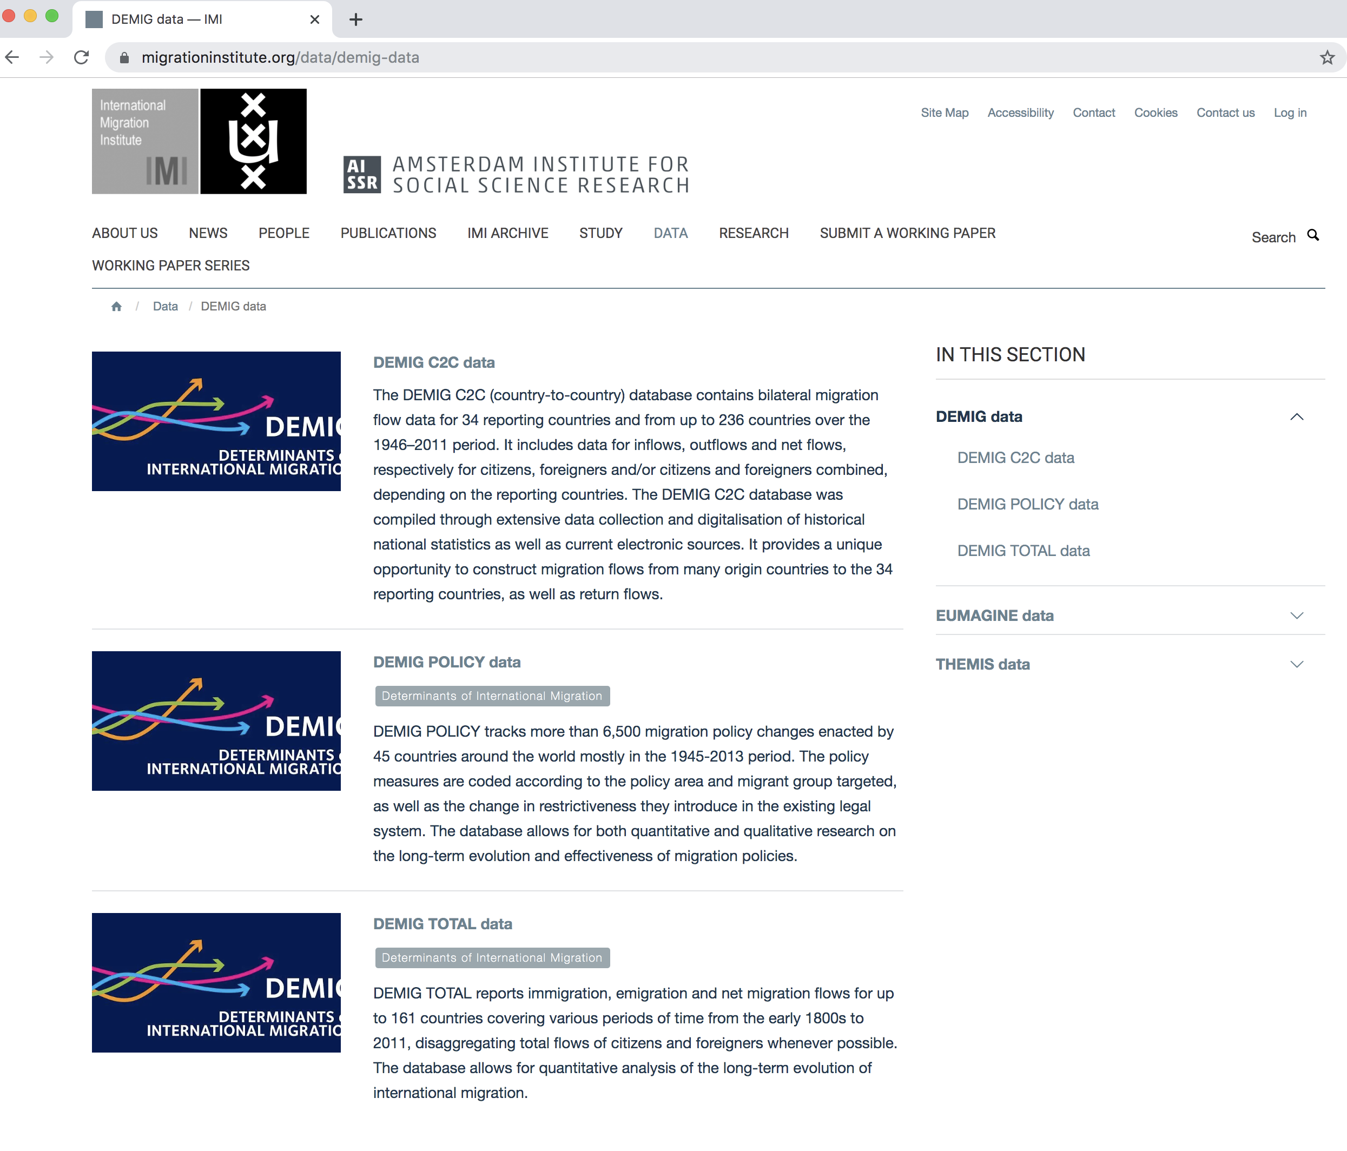
www.migrationinstitute.org

Slide 8
Impact of DEMIG project setting a new standard
Deepened insight into how policies impact on migration-labor market dynamics
DEMIG databases are widely used in OECD countries
Widespread adoption of the DEMIG methodology in scientific and policy research
Recent updates and extensions of DEMIG databases

Slide 9
3. Prospects of expanding similar projects within the CAREC region
Potential of DEMIG methodology to be rolled out in CAREC countries
Methodologies and data requirements
  Expansion DEMIG POLICY and DEMIG C2C databases
  Development of skills mobility scenarios implementing the Global Migration Futures methodology

Slide 10
4. The road ahead
Setting a new global standard in skills mobility analysis
Systematic analysis of unprecedented data will generating vital insights into
    Trends and drivers of Central Asian skill mobilty
    Migration policy trends and labour market access in Central Asia
    The effectiveness of skills and migration policies
    Skill mobility in Central Asia: projections and scenarios
Providing the evidence basis for possible regional solutions to better link data and analysis on skills, labor market and migration dynamics.

Slide 11
Strengthening Regional Cooperation on Skills Development under the CAREC Program: Key Progress, Challenges, and Opportunities for Collaboration
Inception Meeting and International Expert Roundtable
30–31 May 2022, Tbilisi, Georgia
Session VI: Prospects for Creating a CAREC-Wide Labor Force and Labor Market Database and Information System
Hein de Haas
Professor, University of Amsterdam
Director, International Migration Institute (IMI)

