Slide 1
Strengthening Regional Cooperation on Skills Development under the CAREC Program: Key Progress, Challenges, and Opportunities for Collaboration
Inception Meeting and International Expert Roundtable
30–31 May 2022, Tbilisi, Georgia
Session VI: Creating a CAREC-Wide Labor Force and Labor Market Database and Information System and Future Research Collaborations
David Roland-Holst
Professor
UC Berkeley

Slide 2
Central Asia Remains in a
Low-Level Investment Equilibrium
Today’s Central Asia is a resource rich, low-income region.
The primary reason for this is low productivity, due to low investment in labor and capital.
Some primary sectors have drawn investors, but these are very capital intensive, narrowing growth benefits.
To attract and sustain broader investment, raising average labor productivity is essential.
This requires more determined commitments to education and training at all levels.

Slide 3
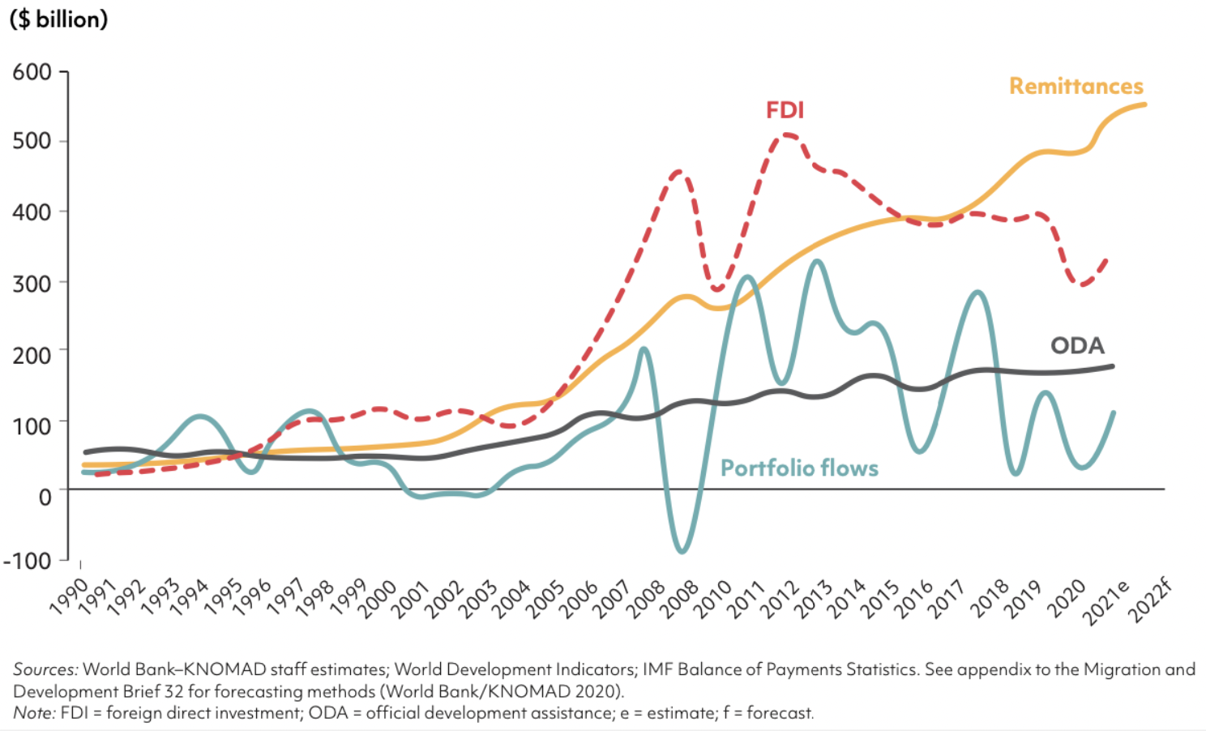
Investment Imbalances and
Global Labor Market Mismatches
Investment in Low-Middle Income economies is trending down.
Remittances now dominate external financial inflows.
Remittances, Foreign Direct Investment, and Official Development Assistance Flows to Low-Middle Income Countries, Excluding PRC, 1990-2022

Slide 4
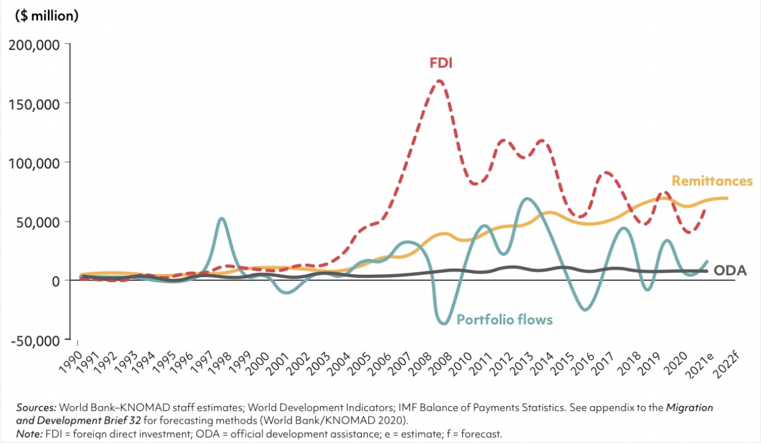
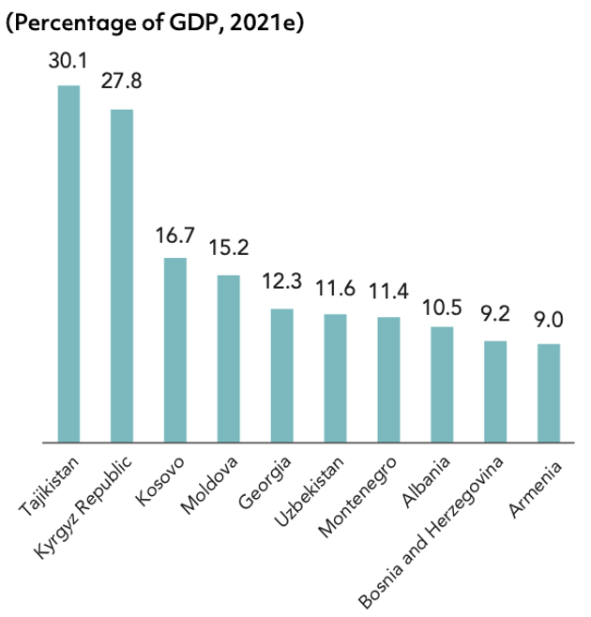
Remittance Dependence is
Particularly High in Central Asia
Resource Flows to Europe and Central Asia, 1990-2022

Slide 5
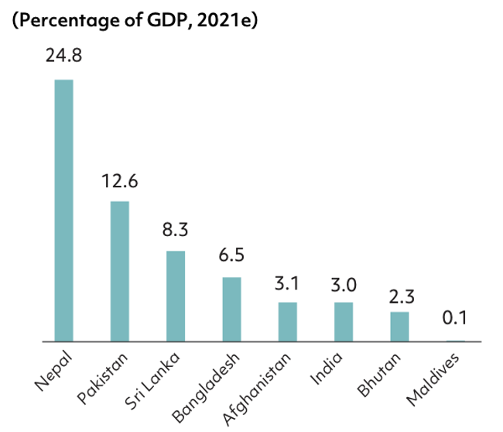
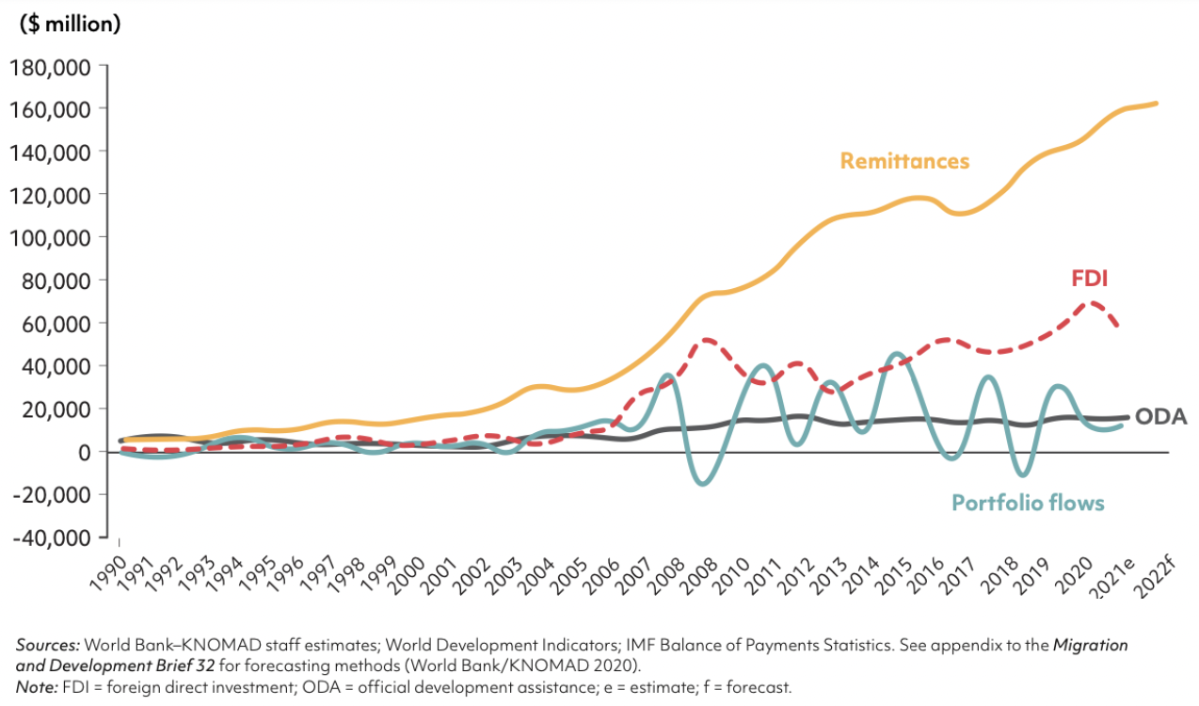
and South Asia
Resource Flows to South Asia, 1990-2022

Slide 6
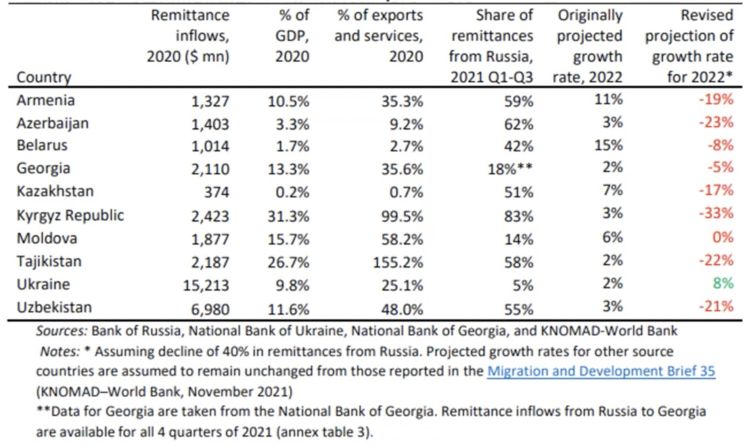
Sending Countries are also
Vulnerable to External Shocks
Impact of the Russia-Ukraine Conflict on Remittances

Slide 7
Shared Income, Unequal Growth:
How to Escape the Low Investment Trap
Remittances offer income to sending countries, but deny them most of the growth benefits of direct investment
Inclusive and sustained prosperity must be built on a solid foundation of domestic investment.
Higher productivity is essential to recruit domestic and international capital for this

Slide 8
Human Resource Development:
The Key to a Better Central Asian Investment Climate
Three initiatives that can promote Regional Standards in Higher Education, Technical, and Vocational Education and Training (HETVET)
CAREC Fellows Scholarly Exchange program
  Objective: To familiarize regional experts with international standards for research on HETVET reform and modernization
International Collaboration to Share and Harmonize HETVET Standards
  Multilateral initiatives to align standards for education, information access, and employment with international best practices
International Research Partnerships to Promote Skill-intensive Development
  Regional workshops on Skills, Trade, and Development (STD), hosted at selected CAREC universities.
  Workshop contributions emphasize international HETVET standards and their regional diffusion.
  Each workshop would produce a proceedings volume for electronic dissemination.

Slide 9
Public Capacity Building:
Standards, Dialog, Information Systems
Three capacity building initiatives that can facilitate individual and coordinated public action:
National Assessments
  To promote evidence-based policy, a new generation of national CGE models will be developed for scenario assessment. National labor market and investment climate research will provide a roadmap for proactive workforce development
Regional and International Workshops to Promote Policy Dialog
  Workshops to assess and compare national assessments: CAREC Institute, ADB/Manila, and ADBI/Tokyo. Presentations emphasizing baseline and gap assessments in each of the Central Asian economies, with evidence-based policy recommendations and a policy brief from each contributor.
Labor market database and information system
  ICT is the most potent infrastructure resource for knowledge development and sharing.
  Following the innovations of e-commerce, labor market search, transactions costs, and information barriers can be dramatically reduced.
  Develop a roadmap for PPP investments in national and regional employment databases.

Slide 10
Internet and Labor Markets
Primary channels of the labor market:
Search behavior
Job advertising
Employment services
ICT and Transport use patterns
Remittances

Slide 11
Mining Google for New Data:
A History Lesson

Slide 12
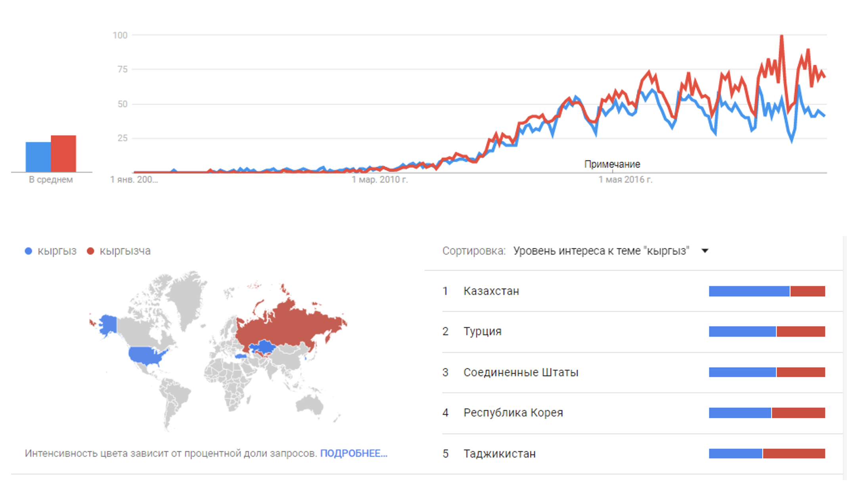
Where are Kyrgyz People?
Searches in Kyrgyz Language Outside of Kyrgyz Republic

Slide 13
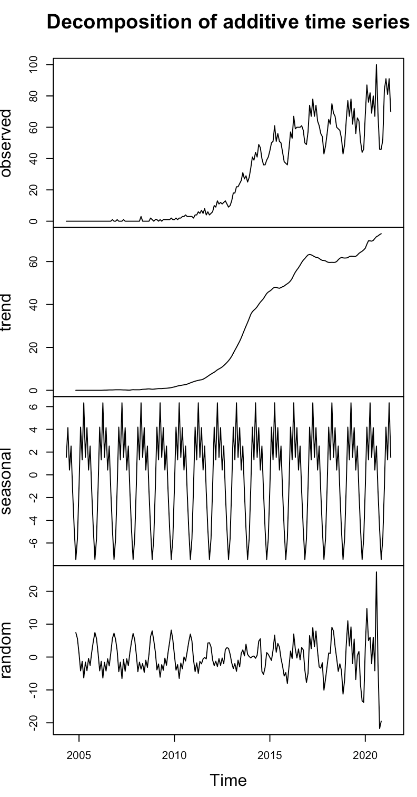
Econometric Estimation
This time series shows very strong trend, cyclical, and seasonal components.
Extracting these can yield useful information about how labor markets operate.

Slide 14
How to change your destiny:
Korea 1970-2010
Realizing the Potential of HETVET Requires
Supporting Social and Labor Market Policies

Slide 15
Thank you!

