Slide 1
Strengthening Regional Cooperation on Skills Development under the CAREC Program: Key Progress, Challenges, and Opportunities for Collaboration Inception Meeting and International Expert Roundtable 30–31 May 2022, Tbilisi, Georgia
Essence and Challenges of LMIS
George Gamkrelidze Head of Labour market Analysis Division Ministry of Economy and Sustainable Developemnt of Georgia

Slide 2
Content
Essene of Information
Challenges of LM
Idea of LMIS
Global drivers of change
Skills anticipation tools

Slide 3
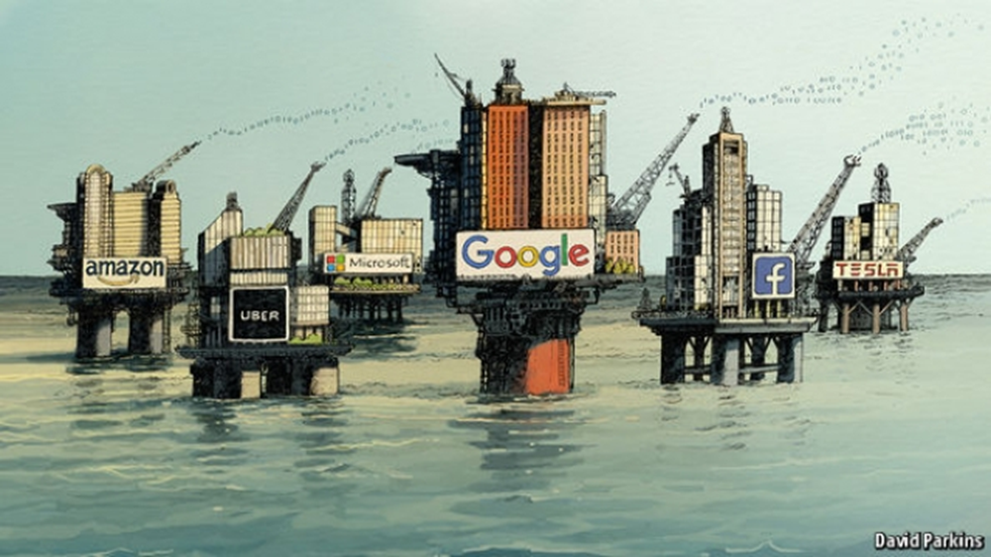
Essene of Information
The world’s most valuable resource is no longer oil, but data
We need to understand business needs for human capital development!
Also to establish different kind of tools such as LMIS in order to address labour market needs!

Slide 4
Challenges of LM
Complexity of the labour market;
Data quality and time series;
Weak cooperation between private sector and educational institutions;
Weak knowledge on skills anticipation methods and different classifications;
Challenges of studying online job vacances.

Slide 5
Idea of LMIS
LMIS is an innovative mechanism to handle collection, procession, analysis and dissemination of the labour market information in timely manner.
LMIS is envisaged as “One Stop Shop” integrated public web portal, which provides updated information on labour market trends.

Slide 6
What are main challenges?
The main challenge is that information is spread throughout institutions, which is not sufficiently analyzed and used in practice.
The main objective of LMIS is to support users overcoming the mentioned above problems.

Slide 7
What do we want to achieve?
To give information structural form, analyze and make it accessible.
To deliver information in the easiest way.

Slide 8
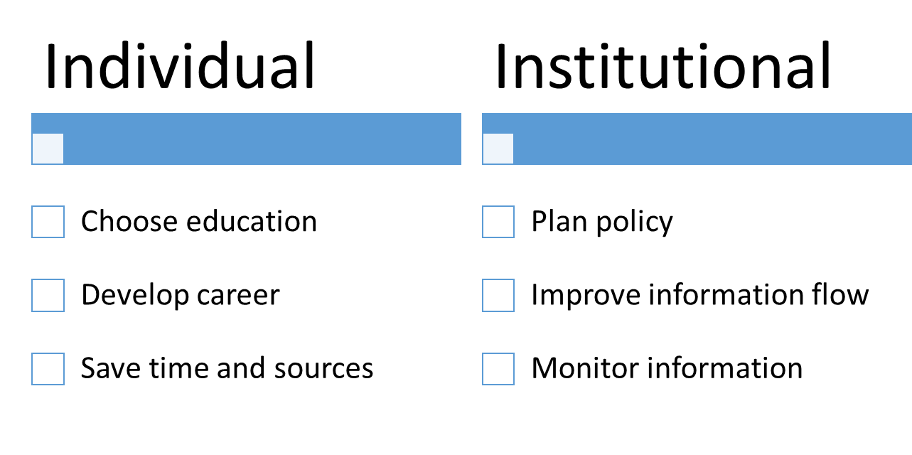
LMIS.GOV.GE

Slide 9
Importance of skills and technology
Skills for Trade and Economic Diversification
Skills and Technology are essential for advancing in international trade
It’s essential to combine sectoral approach to skills with trade and industrial perspectives.

Slide 10
Global drivers of change
Globalization
Work organization
Climate changes
Demographic changes
Technology and innovation
Migration
Which job?
Which tasks?
Which skills and qualification?

Slide 11
Essential Elements of Skills Anticipation
Cooperation
Analytical Capacity
Methods and tools
Data
LM Information
Primery
Secondary

Slide 12
Methods
Quantitative
Establishment skills Survey
Tracer Study
Qualitative
Dephi
Focus Group
Artificial Inteligence
Big Data Machine learning
Pros
Comprehensive
Cons
Expansive
Consistent
Measurable
Everything cannot be measured
False perception
Transparent
Pros
Direct participation
Cons
Unsystematic
Sharing ideas
Subjective
Unjustified
Validation
Pros
Real time
Cons
Unstructured
Instant
Duplicated
Expensive
Big volume

Slide 13
ETF - Big Data LMI - Georgia
Notes:
https://public.tableau.com/app/profile/tabulaex/viz/ETF-BigDataLMI-Georgia/Time

Slide 14
Thank you for attention!

