Slide 1
Strengthening Regional Cooperation on Skills Development under the CAREC Program: Key Progress, Challenges, and Opportunities for Collaboration Inception Meeting and International Expert Roundtable 30–31 May 2022, Tbilisi, Georgia
SESSION V:
Frontiers for Reform: Linking Training Systems
with Migrant Labor Recruitment:
Current Practices within and outside the CAREC region
RAFAEL Y. ABROGAR II Regional Director Technical Education and Skills Development Authority (TESDA)
www.tesda.gov.ph
Notes:
Good afternoon, everyone! It is my great pleasure to be here today to share with you, notable attributes and programs of the TECHNICAL EDUCATION AND SKILLS DEVELOPMENT AUTHORITY (TESDA) in relation to the Current Practices on Training Systems and Migrant Labor Recruitment within and outside the Central Asia Regional Economic Cooperation (CAREC) region. Let me start by giving you some background…

Slide 2
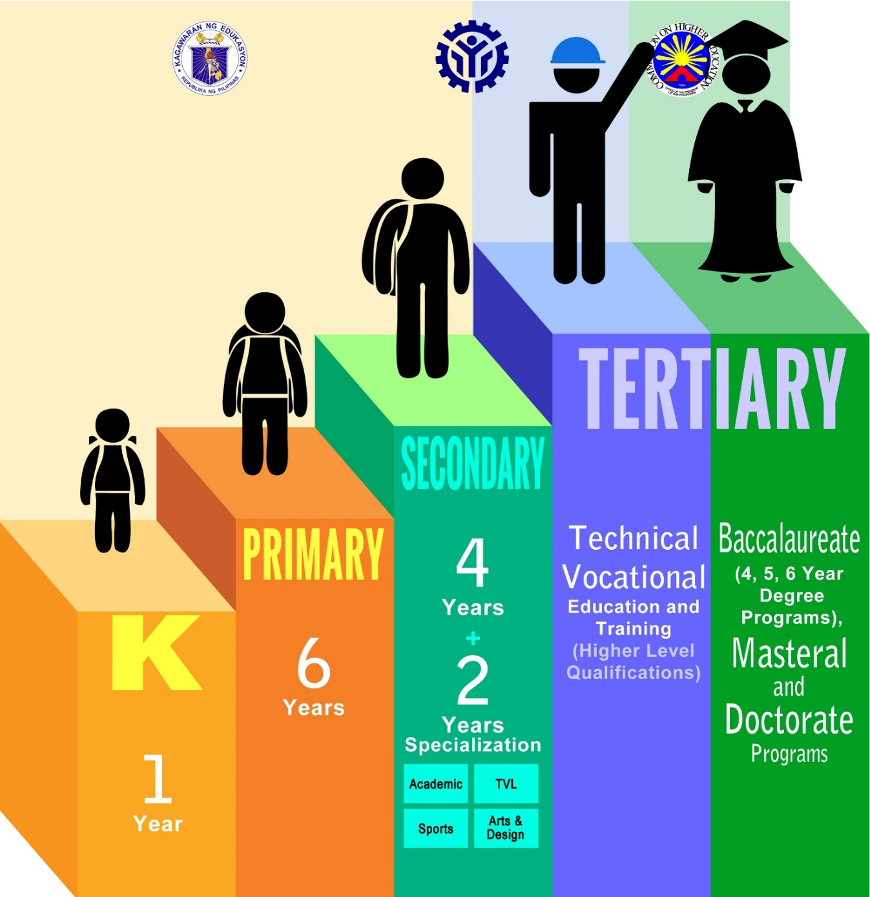
The Philippine Education System
Department of Education
(Basic Education)
Technical Education and Skills Development Authority
(Tertiary – TVET)
Commission on Higher Education
(Tertiary – Higher Education)
Notes:
As a quick overview, allow me to present the Philippine Education System.
The education system in the country is trifocalized in nature – the Department of Education governs basic education, TESDA is responsible for TVET, and the Commission on Higher Education oversees higher education programs.
Note, however, that there are overlaps in the education system, with the basic education’s technical, vocational, and livelihood track being offered in senior high school and both TESDA and CHED offering Diploma programs.

Slide 3
Trust in the Government
Notes:
Speaking for People’s Trust in the Government, TESDA has remained among the most trusted government agencies as posted by PUBLiCUS Asia during its first quarter
survey.
According to the 2022 first quarter PAHAYAG, TESDA gained 49.9% trust rating, higher than its 46.1% trust rating during the PAHAYAG Fourth Quarter Survey released
in December 2021.
Likewise, TESDA ranked second in trust rating behind the Armed Forces of the Philippines with 53.4% trust rating. TESDA was followed by Bangko Sentral ng Pilipinas
(BSP) with 45.9% trust rating.
Meanwhile, TESDA also placed second in approval rating with 65.8%, also next to AFP with 67.4%.
As TESDA has been consistently in the top of the quarterly surveys conducted by PUBLiCUS Asia, it was known that its continuous provision of skills training and
livelihood programs to Filipinos especially to the displaced workers, repatriated Overseas Filipino Workers (OFWs), indigenous people (IPs), former rebels, among
others, attributed to high approval and trust rating for the agency.

Slide 4
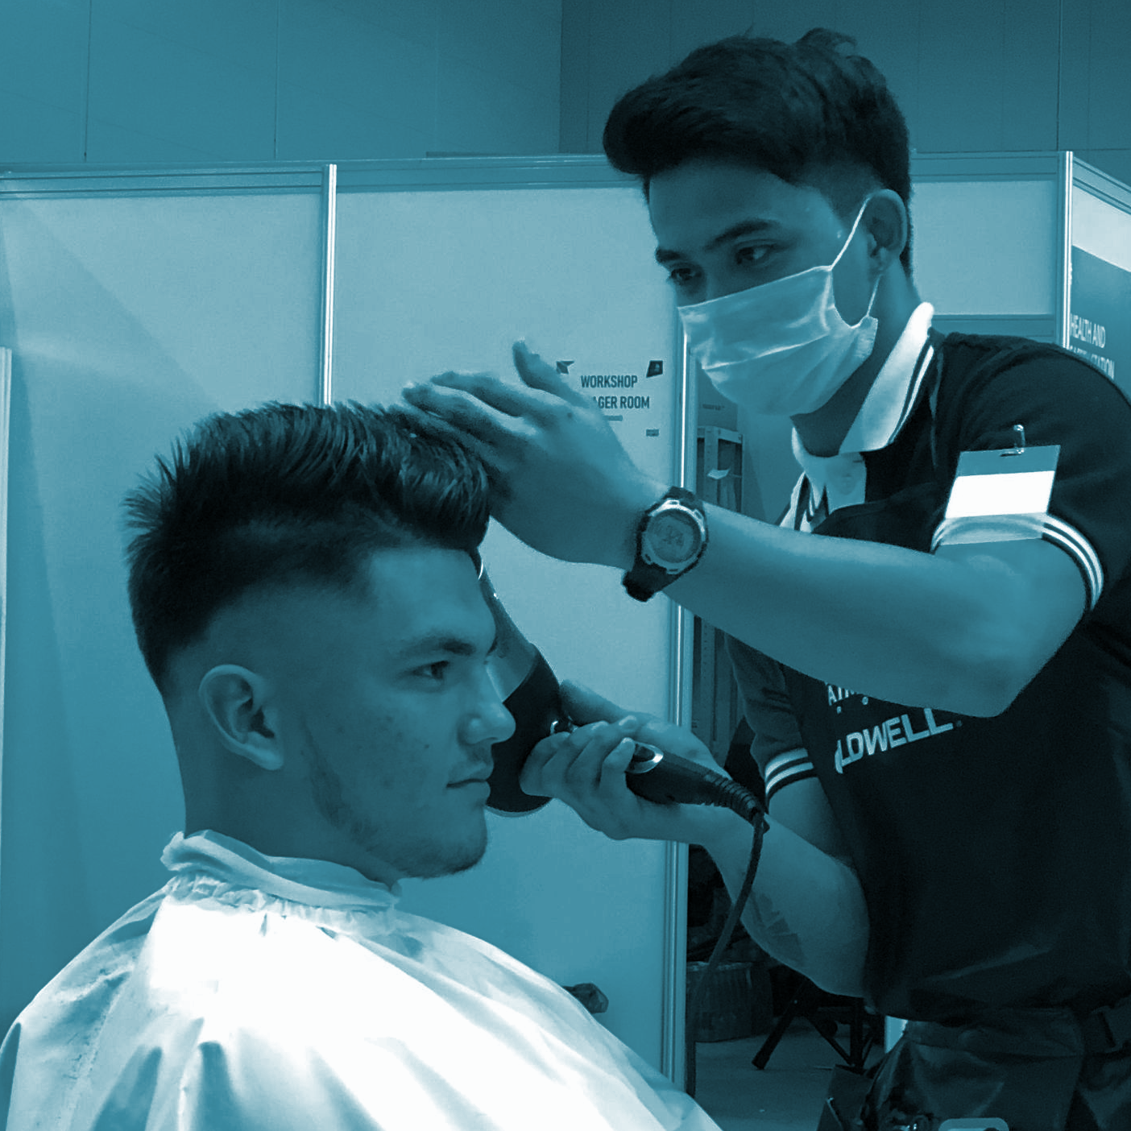
TESDA’s Mandate
(RA 7796, Sec. 2)
to provide relevant, accessible, high quality and efficient technical education and skills development in support of the development of high quality Filipino middle-level manpower responsive to and in accordance with Philippine development goals and priorities.
Direction-Setting
Steering and providing guidance to the sector
Setting out clear directions and establishing priorities
Standards & Systems Development
Ensure quality through the provision of standards and system development services
Competency assessment and certification of workers
Support to TVET Provision
Direct Training Provision
Implementation of Scholarship Programs
Notes:
As one of the most trusted, itself, allow me to present to you the agency’s direction starting with Republic Act 7796 or the TESDA Act of 1994, which mandates TESDA to provide “relevant, efficient, accessible, high-quality technical education and skills development to develop Filipino middle-level manpower responsive to Philippine development goals.”
The TESDA Act of 1994 empowers TESDA to be the sole TVET authority in the country, taking the lead in formulating relevant policies and implementing sound programs for the delivery of TVET programs to the Filipino people.

Slide 5
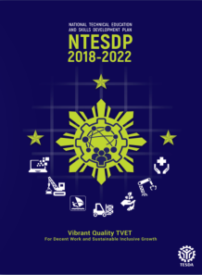
National Technical Education and
Skills Development Plan 2018-2022
Vibrant Quality TVET for Decent Work and Sustainable Inclusive Growth
TVET for
GLOBAL COMPETITIVENESS & WORKFORCE READINESS
TVET for
SOCIAL EQUITY AND POVERTY REDUCTION
Creating a conducive & enabling environment for the development of quality service delivery of the TVET sector
Prepare the Philippine workforce for the challenges posed by the Fourth Industrial Revolution (4IR)
Ensure that industries with high economic and employment growth potentials are provided with the required quantity of quality workforce
Directly and more vigorously address workforce needs of the basic sectors in order to achieve greater social equity and economic inclusion
Instill values and integrity in the conduct and delivery of TVET in the whole sector
Notes:
TESDA as the TVET authority in the Philippines has the mandate to ensure that we are responsive to these economic and labor market changes and needs. The National Technical Education and Skills Development Plan (NTESDP) 2018-2022, is the national roadmap and policy in which all of our programs and initiatives are anchored on.
The NTESDP’s goal is to have a vibrant quality TVET for decent work and sustainable inclusive growth. The Plan’s two-pronged strategies of TVET for global competitiveness and workforce readiness and TVET for social equity and poverty reduction, guide us to be forward looking, to ensure that we meet the skills needs of our constituents now and in the future, and to ensure that we do not leave anyone behind in terms of access to quality TVET programs.

Slide 6
Philippine Qualifications Framework
(RA 10968)
LEVEL
BASIC EDUCATION
TECHNICAL EDUCATION AND SKILLS DEVELOPMENT
HIGHER EDUCATION
L8
DOCTORAL AND
POST DOCTORAL
L7
POST BACCALAUREATE
L6
BACCALAUREATE
BACCALAUREATE
L5
DIPLOMA
L4
NC IV
NC IV
L3
NC III
L2
NC II
L1
NC I
GRADE 12
Notes:
Connected to the Philippine Education System is the Philippine Qualifications Framework, a reference-system of national standards of qualifications earned by individuals educated and trained in the Philippines.
It was established to:
Adopt national standards and levels of learning outcomes of education;
Support the development and maintenance of pathways and equivalencies that enable access to qualifications and to assist individuals to move easily and readily between the different education and training sectors and between these sectors and the labor market; and
Align domestic qualification standards with international qualification frameworks such as the ASEAN Qualification Reference Framework, thereby enhancing recognition of the value and comparability of Philippine qualifications and supporting the mobility of Filipino students and workers.
The PQF was institutionalized in 2018 via Republic Act 10968.

Slide 7
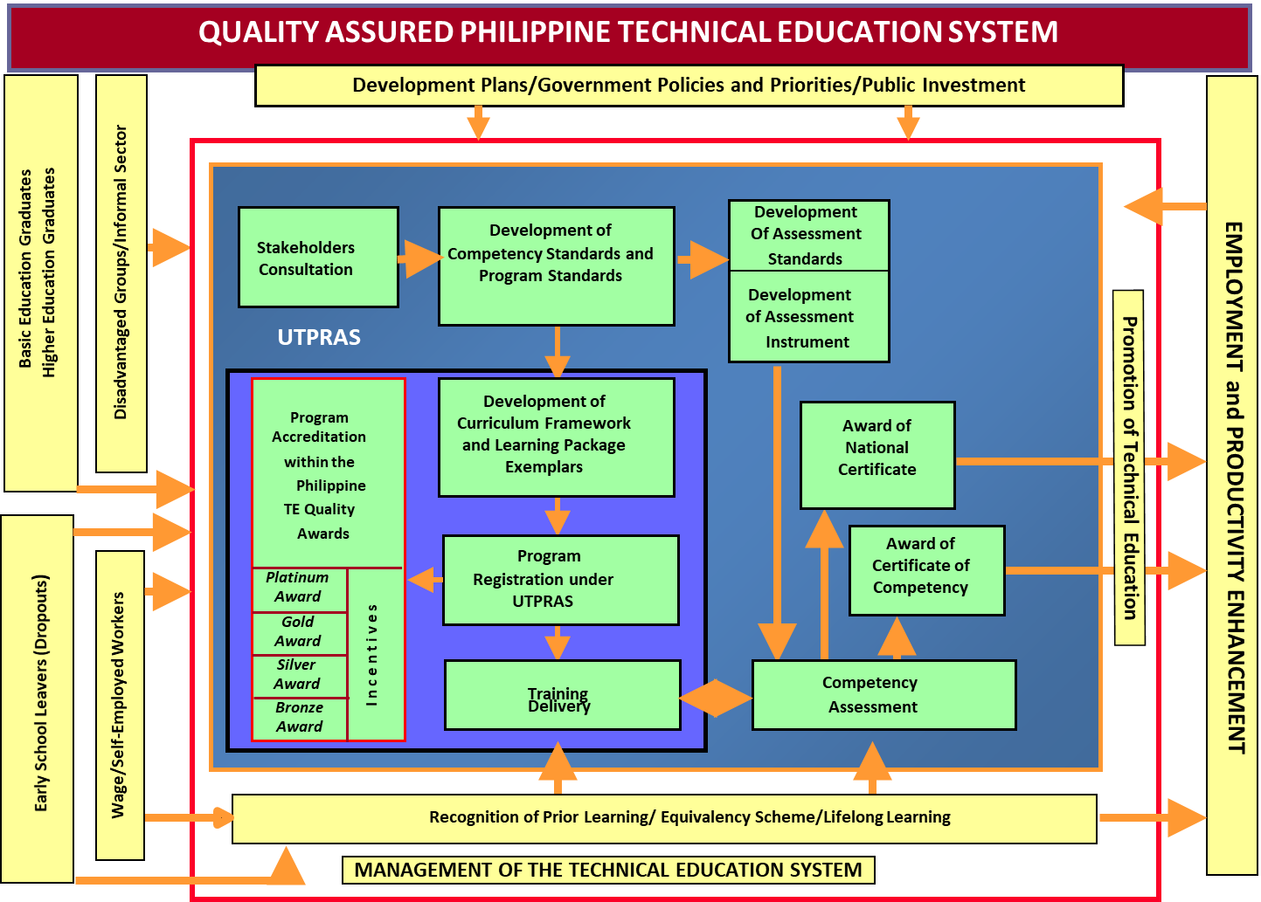
Quality-Assured TESD System
Notes:
This is the Quality Assured Philippine TVET System.
All TVET efforts are designed within the context of the Quality-Assured TVET System anchored on the following principles:
1.TVET supports a competency-based national qualification framework and certification system;
2.TVET draws priorities, standards and performance measures from the users of manpower industry associations, experts and practitioners, among others. The standards are, whenever feasible, benchmarked internationally, especially against the standards of labor receiving countries;
3.TVET is accessible to secondary-education graduates, school leavers, workers, entrepreneurs, and persons in higher-education institutions;
4.TVET allows the person to enter and exit at any stage in the system and allows the recognition of prior learning; and
5. TVET installs quality assurance among TVET providers through a unified system of program registration and accreditation.
Part of the quality assurance in TVET delivery is the Unified TVET Program Registration and Accreditation System (UTPRAS). This serves as a regulatory mechanism by which TVET programs are evaluated against the minimum requirements promulgated in the Training Regulations as specified by industry experts and industry leaders.

Slide 8
Quality-Assured TESD System
Quality Control
Quality Assurance
Quality Enhancement
QC upon Registration
UTPRAS
PQA
APACC
QC during Implementation
STAR
QC before Graduation
Mandatory
Assessment
ISO 9001:2015
Development of Competency and Program Standards
Program Registration
Assessment and Certification
TESDA Vision, Mission and Goals
Institutional Vision, Mission and Goals
Programs
Graduates
Product
Process
Purpose
UTPRAS – Unified TVET Program Registration and Accreditation System
STAR – System of TVET Accreditation and Registration
ISO – International Organizations for Standardization
PQA – Philippine Quality Awards
APACC – Asia Pacific Accreditation and Certification Commission
Notes:
As I have mentioned earlier, Quality Assured TVET ensures that our processes such as: Training Regulations development, Competency-based Curriculum and Assessment Tools development, Assessment and Certification processes are well-managed. Periodic audits are being done to ensure compliance.
Quality Assurance in Philippine TVET can be categorized into three processes: quality control, quality assurance, and quality enhancement
* TALKING POINTS
For Quality Control
Our main product in TVET are graduates. To ensure globally competitive graduates, quality control of program is done through the Unified TVET Program Registration and Accreditation System (UTPRAS) before any program is implemented.
The System for TVET Accreditation and Recognition (STAR) Program provides quality control of programs during implementation. Through the STAR program, TESDA hopes to motivate institutions to quality assure their training programs.
Competency Assessment and Certification system checks on the quality and competencies of graduates, hence, TESDA is making assessment MANDATORY. A Registry of Certified Workers is available on-line at the TESDA website which provides information on the pool of certified workers for certain occupations nationwide.
For Quality Assurance
In line with the implementation of quality management in TESDA, the agency sustained nationwide ISO 9001:2015 certification in the area of Program Registration, Assessment and Certification, Development of Training Regulations (TRs) and Competency Assessment Tools (CATs), which are essential in the exercise of TESDA’s regulatory functions. Internal and external audits are regularly conducted to achieve “Zero Non-Compliance” status.
For Quality Enhancement
Continuing further in its quality journey, TESDA was awarded, in 2016, with the Recognition for Commitment to Quality Management of the Philippine Quality Awards (PQA), and now belongs to the roster of government offices and private organizations in the Philippines recognized for their performance excellence. The PQA promotes standards in organizational performance to be globally competitive. In PQA we commit to continuously improve our system and processes towards the attainment of TESDA’s Vision, Mission and Goals.
APACC accreditation is also an internationally recognized sign of quality. APACC accreditation shows how committed these institutions are to the vision and mission of their respective TVET institutions.
These quality-assurance measures have been set up to produce globally competitive graduates. However, we cannot be complacent, TESDA should continuously evaluate and improve our systems to keep our approaches relevant.

Slide 9
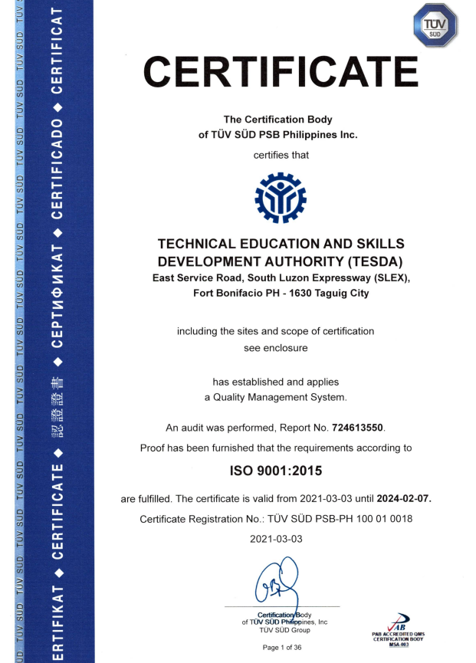
Quality Management
Notes:
Moreover, TESDA holds an ISO 9001:2015 Certification in display of its quality management system, demonstrating its ability to consistently provide products and services that meet customer and applicable statutory and regulatory requirements, and enhancing customer satisfaction through the effective application of the system, including processes for improvement of the system and the assurance of conformity to customer and applicable statutory and regulatory requirements.

Slide 10
PH TVET Internationalization Framework
Notes:
As globalization brings in both opportunities and challenges to TVET, TESDA recognizes that the TVET Sector needs to cope and shape up or else it will bee left out in the benefits that it brings.
The framework presented shows that major components considered in the implementation of various initiatives of the agency towards internationalization.

Slide 11
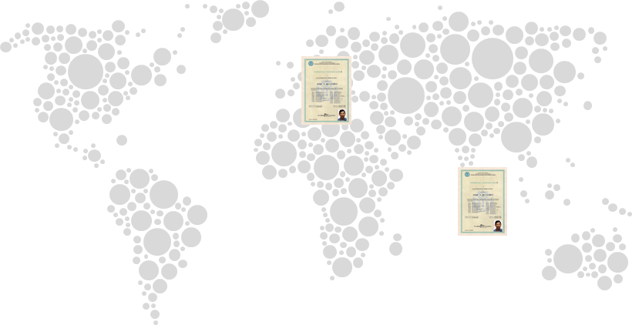
Globalization of TESDA Programs for
Overseas Filipino Workers (OFWs)
Conduct of Onsite Assessment and Overseas Registration of Programs
2014-2019 Total Accomplishment of On-site Assessment Program
Countries | Assessed | Certified | Certification Rate
Hong Kong | 598 | 446 | 74.58%
Singapore | 1,085 | 829 | 76.41%
United Arab Emirates | 1,917 | 1,612 | 84.09%
Kingdom of Saudi Arabia | 1,239 | 1,117 | 90.15%
Qatar | 96 | 88 | 91.67%
Kuwait | 34 | 17 | 50%
TOTAL | 4,969 | 4,109 | 82.69%
Power Technical Training Center in Dubai has registered two TVET programs: EIM NC II and Caregiving NC II
Notes:
To ensure our overseas Filipino workers are granted with the opportunity to skill, reskill, and upskill themselves, TESDA has globalized its programs to provide client-centered service delivery of TESDA programs and services to OFWs where they are employed.
The TESDA Onsite Assessment Program (OAP), for instance, allows our OFWs to get national accreditation on their skills, thereby strengthening their employment opportunities. Candidates are OFWs from the Middle East (i.e. United Arab Emirates, Kingdom of Saudi Arabia, Qatar and Kuwait) Hong Kong and Singapore.
The OAP is institutionalized through the accreditation of onsite competency assessors and assessment centers to ensure that the program will be availed continuously by our OFWs. The program has a monitoring system given the increasing network of the beneficiaries. This system provides efficient documentation and reporting which includes tracking/updating of status to those who already availed the program.
TESDA is also looking towards the registration of TVET programs in foreign countries. In Dubai, Power Technical Training Center has registered two programs with TESDA: EIM NC II and Caregiving NC II. This means that trainees of these programs adhere to TESDA-set training standards.

Slide 12
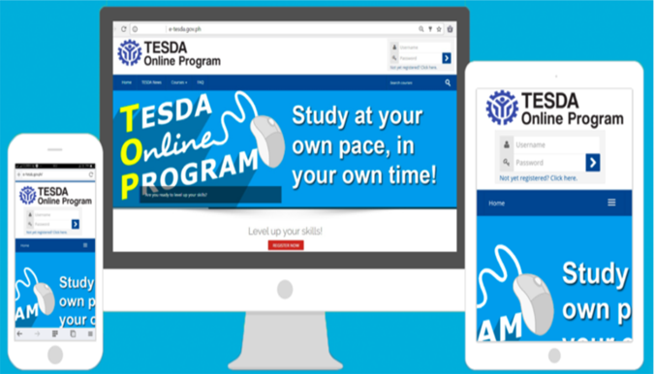
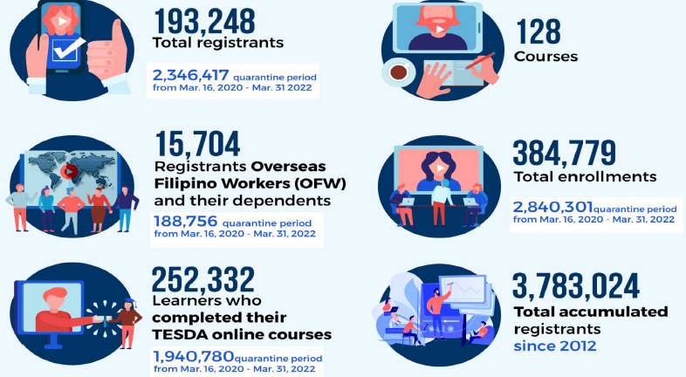
Globalization of TESDA Programs for
Overseas Filipino Workers (OFWs)
TESDA Online Program (TOP)
Notes:
Another globalized TESDA program is the TESDA Online Program (TOP). The TOP is TESDA’s web-enabled learning management system used for the provision of free online TVET Courses. It aims to bring TVET one click away from students, out-of-school youths, unemployed adults and the Overseas Filipino Workers, at no-cost.
Immediately after the imposition of the enhanced community quarantine in the country, the Agency intensified the operation of the TOP to contribute to the government’s efforts in preventing the spread of COVID-19 in the country by encouraging Filipinos to stay at home and enroll in various courses to make good use of their time while mobility is restricted. Based on our data, it was during the enhanced community quarantine that recorded the high registrations and usage of the TOP.
A total of 15,704 Overseas Filipino Workers, returning/repatriated, and their dependents have registered during the first quarter of 2022. Records also showed that from CY 2020 to March 2022, a total of 188,756 OFWs and their dependents have registered to the platform.
The top five (5) courses enrolled by OFWs are as follows:
1. Practicing COVID-19 Preventive Measures in the Workplace
2. Provide Housekeeping Services
3. Introduction to Electrical Installation and Maintenance
4. Foundation of Massage Practice (1 of 4)
5. Digital Tools for Jobseekers
The top five (5) courses of OFW completers are as follows:
1. Practicing COVID-19 Preventive Measures in the Workplace
2. Provide Housekeeping Services
3. Performing Solid Waste Management in the Workplace
4. Introduction to Food and Beverage Services
5. Introduction to CSS
For the first quarter of 2022, the TESDA Online Program (TOP) has recorded 193,248 newly registered users totaling 3,783,024 registered users since 2012.

Slide 13
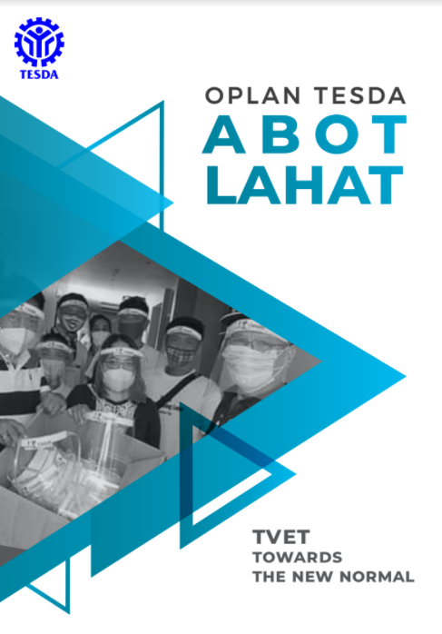
TESDA Programs for OFWs
Scholarship for Returning OFWs
No. of Enrolled, Graduates, Assessed and Certified OFWs CY 2019 - March 2022
Enrolled | 45,574
Graduates | 42,370
Assessed | 10,629
Certified | 10,182
Notes:
In order for TESDA and the TVET sector to respond and adapt to the new normal amid the pandemic, TESDA developed the Operational Plan (OPLAN) TESDA Abot Lahat: Towards the New Normal. Anchored on NEDA’s three phase-approach (respond, recover and rehabilitate), the OPLAN was designed as a quick-response strategic plan to contribute to the nation’s food, health and job security as well as to adapt to a “new normal” state in carrying out its mandate of providing skills to Filipinos and a job and livelihood after.
Under the TESDA Abot Lahat ang OFWs Program, the agency opened the online application for free skills training in June 2020, where OFWS may enlist in various skills training that the agency offers through the TESDA Website and the TESDA Mobile App that is downloadable from Google Play Store and IOS App Store.
From CY 2019 to March 31, 2022, a total of 45,574 OFWs were enrolled in the various skills training programs under the TESDA Scholarship Program. Of this total figure, 42,370 OFWs completed their preferred training programs, 10,629 were assessed, out of which 10,182 were able to get certified.
A stimulus package is provided as part of training benefits:
a. Free training and assessment;
b. 1-year accident insurance;
c. Php160.00/day training support fund;
d. Php500.00 load allowance;
e. Php500.00 health PPE;
f. Post-training fund assistance (may include toolkits and other needed assistance via project-based proposal)

Slide 14
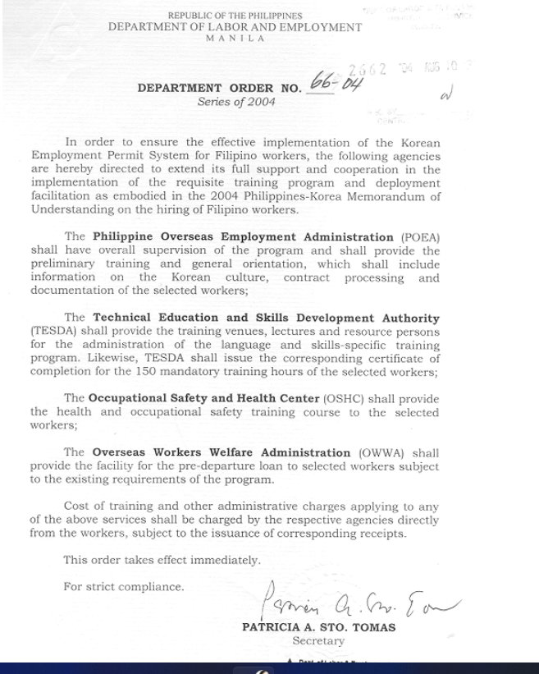
The Korean Employment Permit System (KEPS)
Notes:
The employment permit system (EPS) of Korea is an exemplary case of a government action facilitating temporary labor migration for co-development. It balances the benefits of temporary migration for both the sending countries and the receiving country (Korea) and the political economy surrounding the issue.
In 2004, the Department of Labor and Employment issued the Department Order No. 66-04 in order to ensure effective implementation of the Korean Employment Permit System (KEPS) for Filipino workers.
This was done thru the Philippine Overseas Employment Authority (POEA), the Technical Education and Skills Development Authority (TESDA), the Occupational Safety and Health Center (OSHC) and the Overseas Workers Welfare Administration (OWWA).
The said agencies were responsible for providing support to Filipino workers bound for Korea from training programs up to the deployment facilitation.
As of December 2021, official report from the Philippine News Authority (PNA) posted that more than a hundred overseas Filipino workers (OFWs) have been deployed to South Korea under the employment permit system (EPS). It was also emphasized that 209 workers were able to enter South Korea after the lifting of entry restrictions.
Moreover, it was recorded that the manufacturing industry has the highest number of Filipino workers or EPS workers, numbering 21,546. The companies they are working with are involved in the production of plastic, rubber, metal, furniture, food, and food supplements.
It was also noted that some OFWs are in the performing arts sector and occupations that require special skills, while some are employed as household service workers. Some work in shipping companies while others-who are engineers- work as car seat designers for car companies.

Slide 15
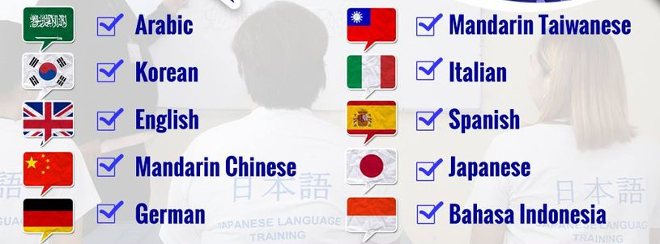
TESDA Language Training Institutes for OFWs
Notes:
To help overseas Filipino workers (OFWs) find better job opportunities, the Technical Education and Skills Development Authority (TESDA) strengthened its Language Skills Institutes (LSIs) across the country through offering more language courses.
Language courses offered include: English Proficiency for Customer Service Workers; Basic Japanese Language and Culture; Basic Mandarin Chinese Language and Culture; Basic Arabic Language and Saudi/Gulf Culture; Basic Spanish Language for Different Vocations; and Basic Korean Language and Culture, and so on, which ranges from 100 to 150 training hours.
As you can see, we have integrated language learning with culture. This is in consideration that when learning a new language, it doesn’t take long to encounter cultural differences. These differences may not only dictate how to speak to a native speaker but also depict the world view of their culture and earn respect. Learning both one's culture and language at the same time can be a meaningful experience.

Slide 17
THANK YOU!

