Slide 1
Strengthening Regional Cooperation on Skills Development under the CAREC Program: Key Progress, Challenges, and Opportunities for Collaboration
Inception Meeting and International Expert Roundtable
30–31 May 2022, Tbilisi, Georgia
Korea’s Employment Permit System
Dr. Prof. Young-bum Park
Former President of HRD Korea
(ybpark@hansung.ac.kr)

Slide 2

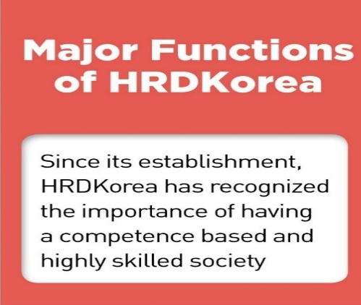
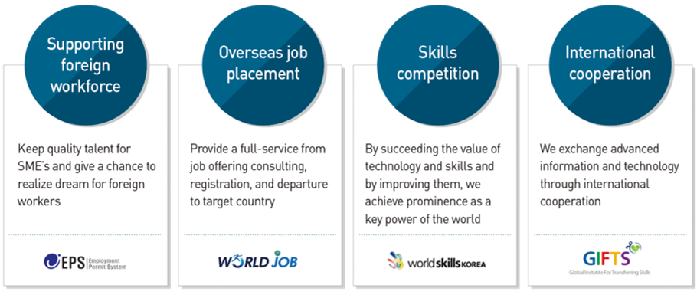
Introduction to HRD Korea
“The best HRD professional organization
to raise the value of people and companies”
Competency Development
Competency Assessment

Slide 3


Slide 4
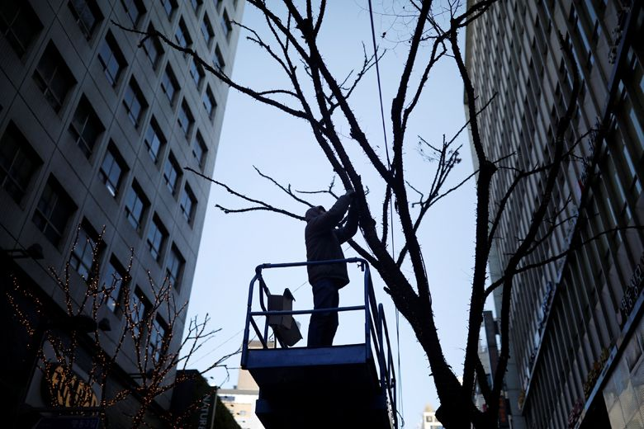
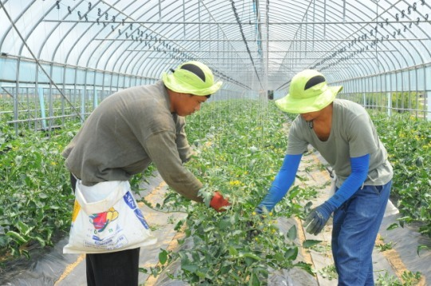
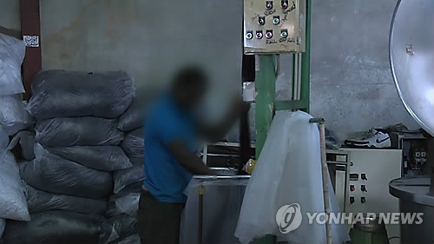
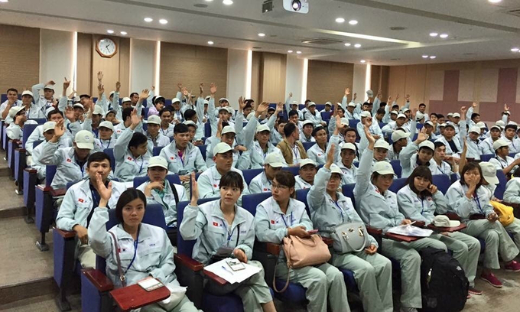

Slide 5
Foreign-born and labor market: Korea vs. G7

Slide 6
Employment of foreign nationals in Korea

Slide 7
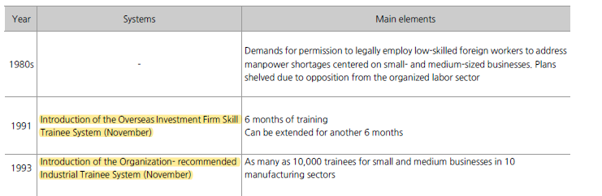

Slide 8


Slide 11
Temporary Seasonal Work Permit for farming/fishing households
Introduced in 2015
Can stay for a short period(90 days, 5 months)
136 local governments applied for allocation and 8,184 foreigners employed from 2015 to 2021
Foreigners residing in Korea became eligible due to Covid-19 pandemic from March 2020; 1516 foreigners employed

Slide 12
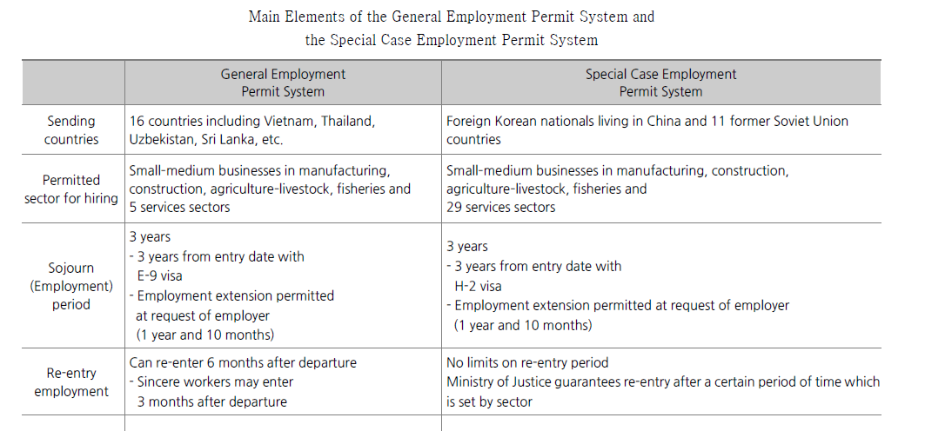
(General) Employment Permit System
(vs. Special Case Employment Permit System)

Slide 13
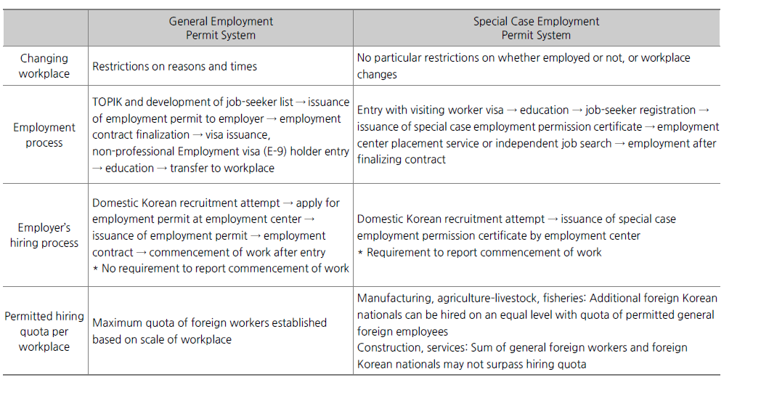

Slide 15
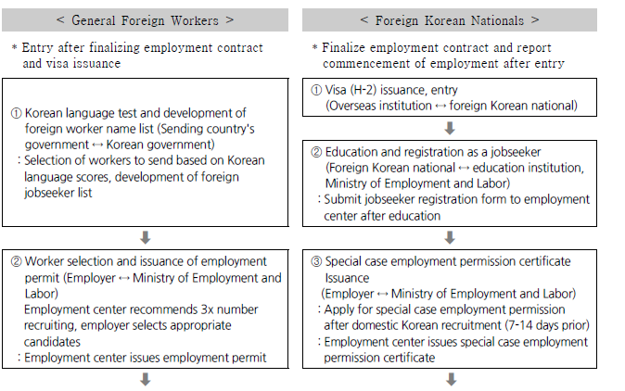

Slide 17
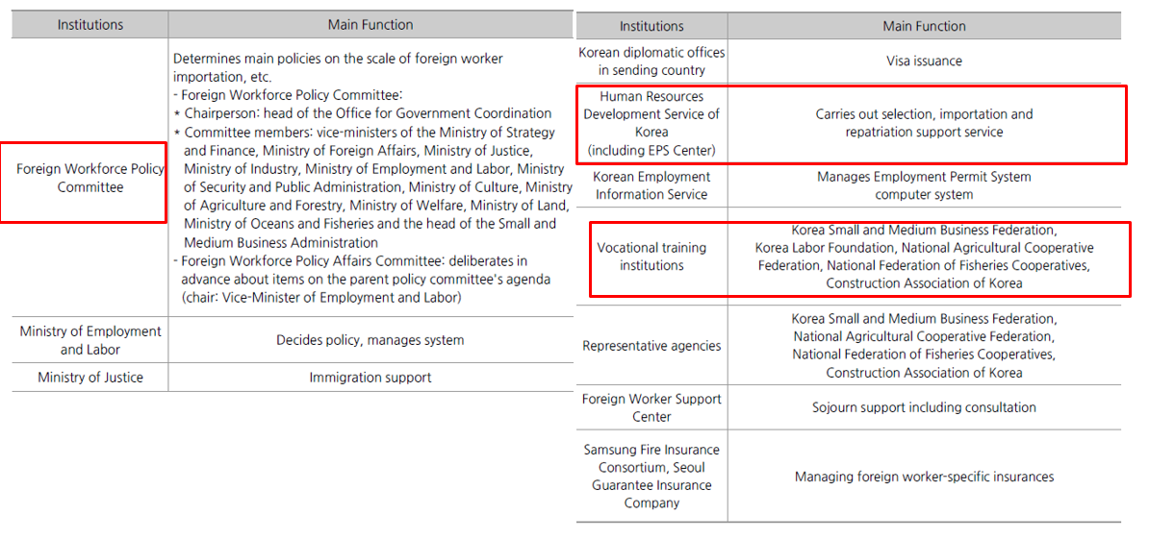
Institutions involved in General EPS

Slide 18
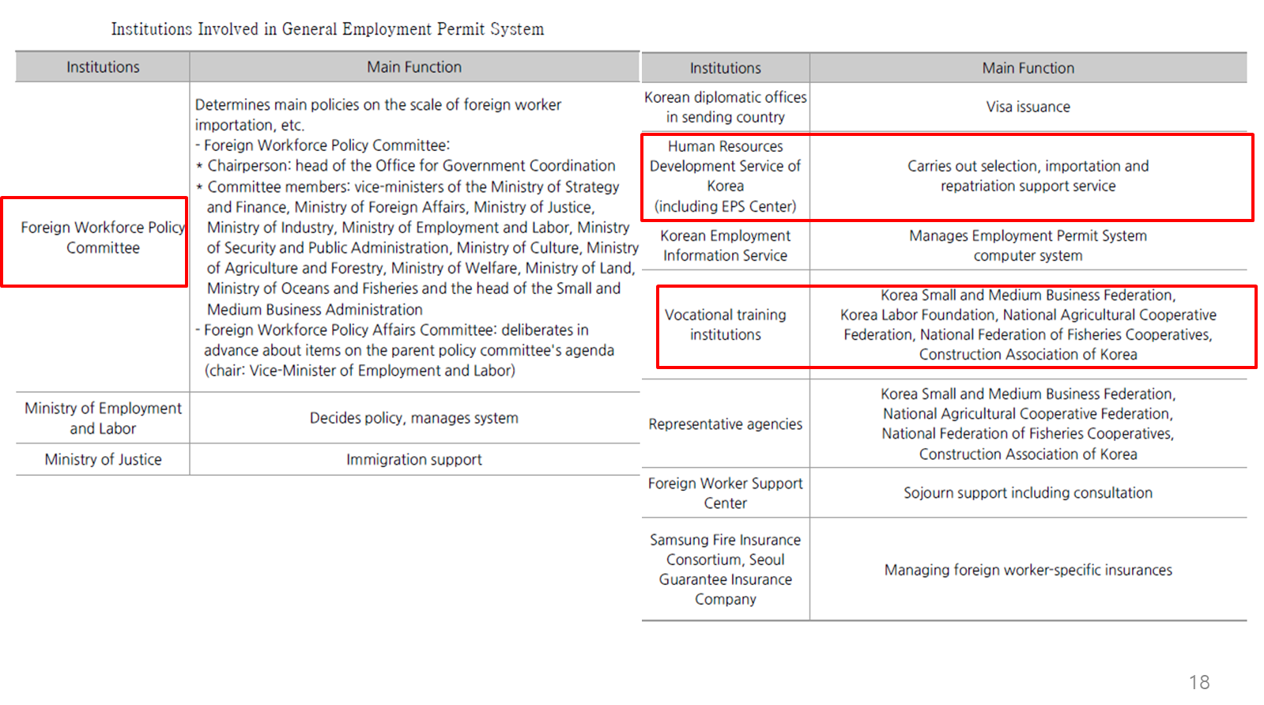

Slide 19
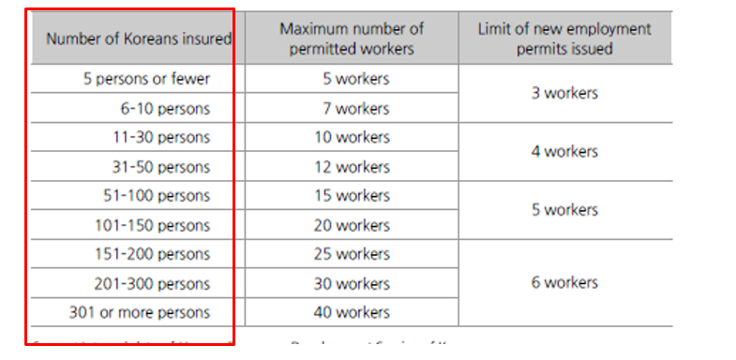
Number of foreign workers in manufacturing in General EPS

Slide 20
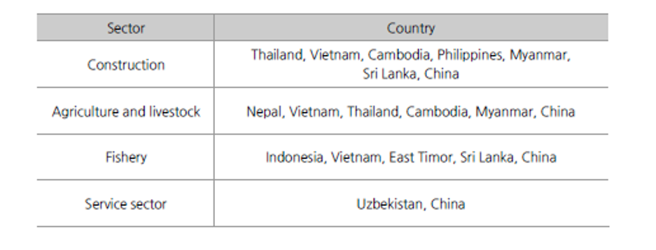
Destination countries selected for small-scale industries in General EPS

Slide 21
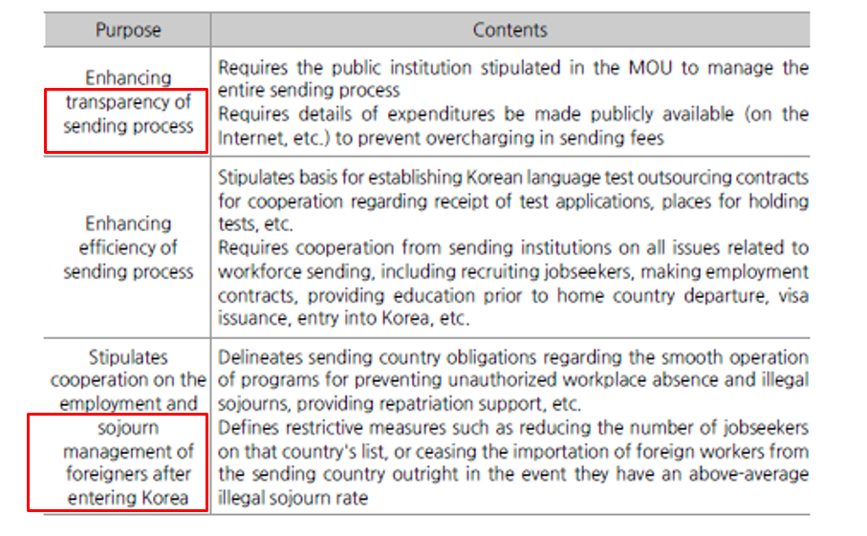
Contents of MOU between Korean government and sending country governments

Slide 22
Employment Permit System’s Main Achievements
Solving labor shortage of small/medium-sized business
Reducing illegal sojourners
Reducing sending costs and increasing fairness of foreign workforce selection
Enhanced support and protection of labor and human rights for foreign workers
Replacing domestic Koreans with foreign workers?!

Slide 23
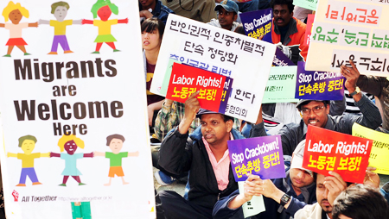
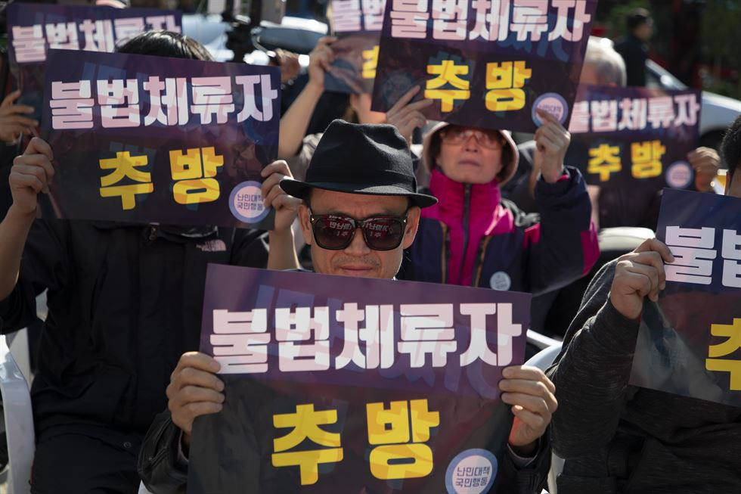
Migrant workers rally in front of Seoul Finance Center in downtown Seoul, Sunday.
Korea Times photo by Choi Won-suk
Korean Protesters call on the government to kick out undocumented immigrants in a rally in downtown Seoul, just down the street from the 2018 Migrant Workers Rally, Sunday. / Korea Times photo by Choi Won-suk

Slide 24
Main pending Issues
Improving the evaluation of job capacity in foreign worker selection
Improving the means for determining the scale of foreign workforce importation
Relaxing limitations on changing workplaces
Long-term employment of skilled workers in industry and prevention of permanent settlement
Introduction of the Employment Levy System
Expanded sojourn support for ethnic foreigners (H-2) Koreans
Combining the systems for other foreign workforce managing system

Slide 25
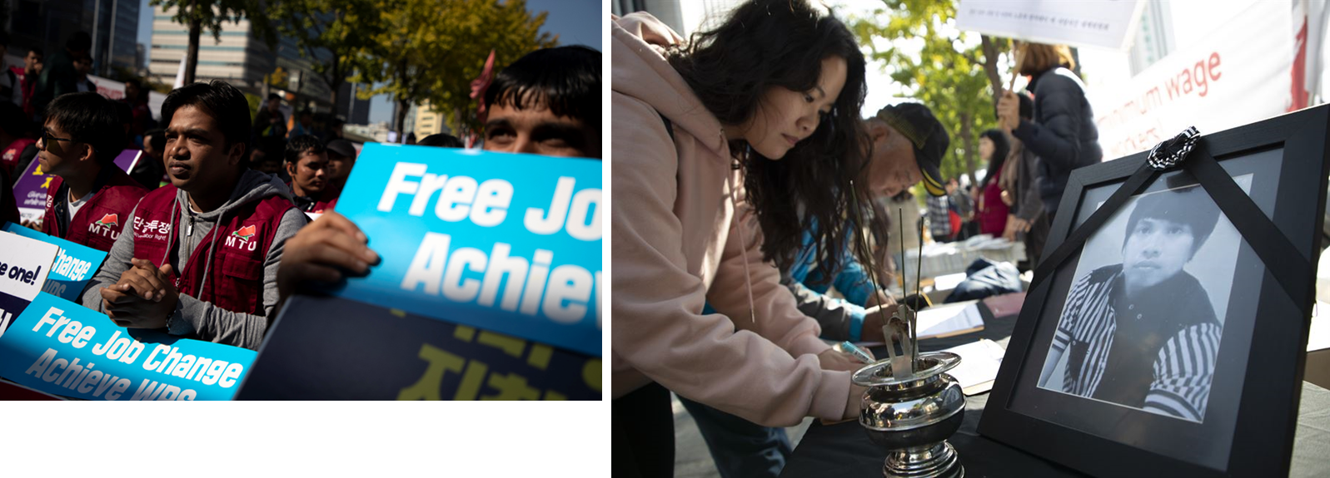
Migrant workers rally in front of Seoul Finance Center in downtown Seoul, Sunday. Korea Times photo by Choi Won-suk
Citizens sign petitions next to a small altar set up for a Burmese migrant worker who fell from a construction site while running away from a police raid and later died, during the 2018 Migrant Workers Rally, Sunday. / Korea Times photo by Choi Won-suk

