Slide 1


Enhance and Accelerate the Implementation of the AEO Program in Central Asia
Virtual Regional Workshop on Authorized Economic Operator Program
14:00 – 16: 00 (Manila time), via Zoom Videoconference
26 – 27 September 2023

Slide 2
Introduction
Crucial role of Customs
Recognize the crucial role of Customs administration in addressing the vulnerable points in applying the supply chain security measures through:
What is an AEO Program?
According to the WCO, an AEO program is about C2B, C2C and C2PGA partnerships of the SAFE Framework in enhancing international supply chain security and facilitate movement of legitimate goods
Incentives
In return, the compliant traders are given incentives to expedite their goods clearance
efficient screening and validation process in relation to movement of goods;
support to the trading community, specifically MSMEs;
proper AEO codification;
public awareness / outreach; and
establishing a holistic approach towards an efficient and dynamic AEO Program
Source: WCO AEO Library

Slide 3
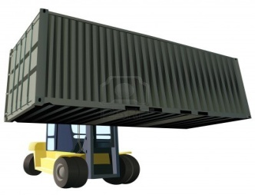
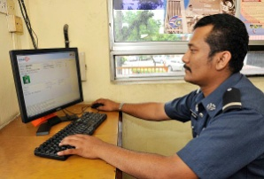
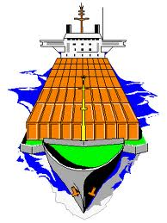




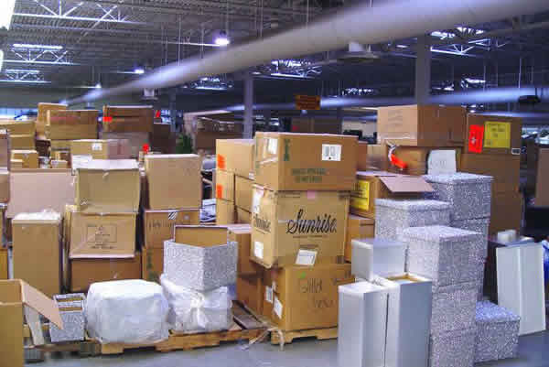
Enhancing International Supply Chain Security and Facilitate Movement of Goods
Port of Loading
Sellers / Exporters
Customs AEO
Port of Arrival
Carriers
Freight Forwarders/
Consolidators
Supply Chain Accountability
PGAs
Domestic Truckers
Buyer / Importer
Suppliers
Customs Brokers
Buyer Storage Warehouse
Control Procedures of International Supply Chain Partners

Slide 4
In return, incentives are given to facilitate movement of legitimate goods
Customs-Business Partnership (Pillar 1)
Customs to Customs Pillar through MRA (Pillar 2)
Managing compliance by setting up control procedures of the international supply chain
Inter-agency sharing of AEO-related data (Pillar 3)
Leverage on the use of modern technology

Slide 5
HOW do you provide an efficient screening and validation process to Customs AEO team in relation to addressing the security measures needed in the movement of goods?

Slide 6
Customs AEO Validator Guide

Slide 7
What is a Customs AEO Validator Guide?
Aim of the Validation Procedure
Verifies that the applicant meets, and the AEO certified member continues to meet, the requirements of its scope of authorization.
Purpose
It provides practical guidance to assist in carrying out AEO validation in a standardized manner
Scope and Tasks
Make judgment about fulfillment of conditions for granting of the AEO authorization.
Sets out the essential elements required
Promotes a minimum set of competencies of Customs officials tasked with conducting validations
Provides a set of core competencies for the long-term application of the AEO process. Promotes a common approach to Customs AEO validation and apply a working methods suited to the national, regional and international context.
Facilitates the efficiency of mutual recognition negotiations and processes.
Identify and evaluate relevant risks and propose further actions to be undertaken.
Identify elements in applicant’s procedures which need closer Customs monitoring.
Advise the applicant to improve or strengthen their relevant procedures and controls.
Source: WCO AEO Library

Slide 8
Application and Validation Procedures
Validation Procedure
Acceptance of the Application Form
The Customs AEO team designates an official in the acceptance of the economic operator’s application in assessing and fulfilling the necessary requirements submitted.
The AEO applicant appoints a company official that is responsible for communication with Customs administration regarding the AEO approval system and maintenance of standards.
Validators are responsible for executing the validation in the most effective way.
The intent is to put in place an organizational structure that enables the team to carry out their tasks efficiently and effectively.
Correctly applying the appropriate validation procedures and techniques and ensuring that established criteria are complied with.
It may be organized using a team of Customs validators led by a manager.
Source: WCO AEO Library

Slide 9
Post AEO Certification
Once the authorization has been granted, monitoring may consist of validation based on risk or cause and, where appropriate, random spot checks by Customs
It is done on a continuous basis and could result reassessment or revalidation, including through monitoring of the day-to-day activities of the AEO trusted partner
If needed, visits to AEO trusted partner premises. It aims at the early detection of any sign of non-compliance, and shall lead to prompt actions in case any difficulty or non-compliance is detected

Slide 10
Ideal AEO Validator Team
A validator team should be composed of 5 members, a manager, a specialist in the addressing security measures in the movement of goods, an information security specialist, a financial accountant and a staff documenting the evaluation process
There should be at least three teams, one team handling accreditation of importer, exporter, and logistics actor/entity
Team managers are responsible for setting the conditions that allow the validators to achieve this goal of building, improving and controlling the validation process

Slide 11
AEO Validator Team’s General Competencies
Knowledge of the Revised Kyoto Convention, the SAFE Framework of Standards and history of AEO
Knowledge of the legal environment of an economic operator
Knowledge of risk management principles and techniques
Knowledge of audit and automated auditing packages and techniques
Knowledge of bookkeeping and IT applications for financial accounting and reporting
Knowledge of information technology, including IT security
Knowledge of safety and security programs from other government or inter- governmental agencies
Knowledge about relevant commercial standards and certifications
Knowledge of the global supply chain
Knowledge of Industry’s best practices
Knowledge of e-Commerce issues and the crucial roles of logistics actors

Slide 12
Professional Values and Ethics
Requires validators to observe the principles of independence, objectivity and standards of professional conduct
Customs validators must exhibit a high level of professional objectivity in gathering and evaluating information during validations
Validators must make a balanced assessment of all the relevant circumstances and not be unduly influenced by their own interests or by others in forming judgments. It is essential that validators are independent and impartial.
Professional competence: validators must apply the knowledge, skills and experience needed to carry out a Customs validation.
Confidentiality: Customs validators are required to protect the privacy of individuals and economic operators in official dealings in accordance with national laws
In every step of the processing of an AEO authorization, validators must be mindful of the image of Customs and the AEO program they are representing

Slide 13
Validation Step-by-step Process
Prepare for validation: collect, analyze information and assess related risks, prepare validation plan, etc.
Coordinate meeting agenda
Understand the business processes of the applicant
Carry out site visits to verify the economic operator ́s compliance with the AEO criteria
Perform specialist evaluation process as required (safety and security, audit services, intelligence and enforcement experts)
Obtaining and verifying any supporting documentation
Establishing, recording, observing, evaluating and testing the applicant’s procedures
Use the respective validation report templates
Completing a report covering the checks carried out and the conclusions drawn
Recommending whether the authorization should be granted or refused
Being available to advise the company throughout the process
Make the EO aware of the importance to instruct and train employees to inform the Customs administration and, where applicable, other relevant authorities, whenever a compliance and/or security issue arise

Slide 14
Two Types of AEO Authorizations
AEO for Customs (customs simplifications)
AEO for Security (movement of goods)
Established in the country
Compliance with Customs Laws and Regulations
Record keeping and information security policy in place
Financial solvency
Continuing education and business continuity
Competence and qualification
Established in the country
Compliance with Customs Laws and Regulations
Record keeping and information security policy in place
Financial solvency
Continuing education and business continuity
Security and Safety
* The status may be combined

Slide 15
AEO for Customs Simplification
Record Keeping and Information Security Policy
Satisfactory procedures in place for the archiving of its records and information security
Compliance with Customs Laws and Regulations
Identify whether the applicant has committed any infringements or offences, over a period determined by the AEO program
Physical access to the accounting systems in determining the financial solvency of the applicant
Carry out cross check between the actual operations, the records kept for customs and the accounting system
Consider and asses the difference between any serious, repeated or minor infringements
Determine whether the applicant has committed any serious criminal offenses related to his economic activity
Make transaction tests and ensure there is an audit trail in the records
Continuing Education and Business Continuity
Verify that the personnel responsible for security and incident recovery has been appointed
Maintains a security training and threat awareness program
Test if the security awareness and knowledge are disseminated in the company to assess the effectiveness of the training program
Competence and Qualification
There are processes in place in screening prospective employees and contracted persons
Verify if and how the appropriate measures in providing adequate evidence that the business partner can meet acceptable level of security and safety standards
Verify how security incidents are investigated, analyzed and how the necessary corrections are implemented
Source: WCO AEO Library

Slide 16
AEO for Security Authorization

Slide 17
Vulnerable Supply Chain Process Points (Exporting Side)
ORIGINATION OF CARGO (Supplier or Factory)
ORIGINATION OF PACKAGING
ORIGINATION OF CONTAINER
Manufacturer
Supplier
Customs AEO specialist
Manufacturer of packaging
Supplier of materials
FTEB clearance
Supplier of Container
Customs AEO specialist
Site inspection
Good manufacturing practices
Information Security Certificates
Site inspection
Good manufacturing practices
Information Security Policy
Freight Forwarder Certificate
Good manufacturing practices
Information Security Policy
STORAGE BEFORE TRANSPORT
CONSOLIDATING OF CARGO OR SEALING
MATING OF CARGO AND PACKAGING
Warehouse Operator
Customs AEO specialist
Consolidator
Logistics actor
Customs AEO specialist
Logistics Actor
Transport Operator
Customs AEO specialist
Site inspection
Good warehousing practices
Information Security Policy
Site inspection
Consolidator best practices
Information Security Policy
Logistics Best Practices
Loading goods best practices
Information Security Certificates
MOVEMENT OF CARGO TO PORT OF ORIGIN
PORT OF ORIGIN (Airport, Marine Terminal, Trucking Co),
INTERNATIONAL TRANSPORTATION
Transport Operator
Customs AEO specialist
Transport Operators
Port Operation Best Practices
Carrier (Air, Sea, Land)
Logistics clearance from PGA
Logistics best practices
Site inspection
Logistics best practices
Logistics Best Practices
Logistics clearance from PGA
Information Security Policy

Slide 18
Vulnerable Supply Chain Process Points (Importing Side)
PORT OF ENTRY (Airport, Marine Terminal, Border)
MOVEMENT TO DECONSOLIDATION POINT
STORAGE BEFORE PROCESSING
Port Operator
PGA certificates
Logistics Providers
Transport Operator
PGA certificates
Importer
Warehouse Operator
PGA certificates
Logistics Providers
MRA (recognize the exporting actors)
MRA (recognize the exporting actors)
MRA (recognize the exporting actors)
DESTINATION
MOVEMENT TO DESTINATION
DECONSOLIDATION
Importer’s Premises
Logistics Providers
Importer
Transport Operator
Deconsolidator
Transport Operator
Importer
MRA (recognize the exporting actors)
MRA (recognize the exporting actors)
MRA (recognize the exporting actors)
INFORMATION FLOW ASSOCIATED WITH CARGO (End-to-End)
Traders
Customs Clearance
PGAs
Logistics Providers
Banks and Insurance
Warehouse Operators, etc.
MRA (recognize the exporting actors)

Slide 19
Thank you.

