Slide 1
Road Asset Management System (RAMS)
in the Kyrgyz Republic
Session 3: RAMS Integration
Serge Cartier van Dissel
June 2021

Slide 2
Agenda
Meeting Agenda
1. RAMS introduction What is the function of a RAMS How does a RAMS fit into the wider context of road management What are the phases of RAMS development How does Kyrgyz Republic compare to other CAREC countries
RAMS development What data has been collected in the Kyrgyz Republic What is the functionality of the database How is the collected data used for selecting and prioritizing treatments What remains to be done for the RAMS development
RAMS integration How to ensure an appropriate institutional framework for RAMS operation How to integrate the RAMS into annual planning and budgeting procedures What funding levels are required for the road sector and how can these be financed How can we develop domestic capacity to implement the planned works

Slide 3
RAMS development in Kyrgyz Republic
Phase 1: Piloting | Phase 2: Development | Phase 3: Integration
Data collection for small part of the network Simple (temporary) database for data storage with limited functionality Data analysis using commercial software (RONET, HDM4) Often carried out by consultants | Data collection for most of the road network Proper RAMS database with extended functionality Data analysis through integrated planning module or external software Often carried out by government (or outsourced) with consultant support | Institutional framework established for RAMS implementation RAMS forms the basis for annual and multiannual planning and budgeting Budget levels and allocations influenced by RAMS analysis of needs and priorities Domestic implementation capacity responds to new priorities

Slide 4
Current ADB support
RAMS development phase
  Data collected for 5,835 km of paved roads in 2018/2019
  Traffic counts in 231 locations
  Data collection ongoing for remaining 2,572 km of paved roads
  Comprehensive database developed providing storage and access to data
  Planning module based on decision matrix
  Capacities built in MOTC and Production Innovation Centre
RAMS development phase not yet complete
  Data not collected for entire road network – unpaved roads, bridges, tunnels
  Database not yet structured for data needs of unpaved roads, bridges, tunnels
  Data analysis and planning modules not yet suited for unpaved roads, bridges, tunnels

Slide 5
Future support – Development
Data Collection
Collecting data for remainder of network
  Inventory, condition, traffic data for all unpaved roads: 10,586 km
  Data needs and survey equipment will be slightly different
Improving data collection
  Longer traffic counts, different times of the year, permanent traffic counts
  Expanding data collection to bridges and tunnels
  Collecting data on pavement strength
Be careful not to expand the data collection too quickly!
Road class | Complete | Ongoing |  |  | Remaining |  |  | Total
Road class |  | Asphalt Concrete | Black Gravel | Subtotal | Gravel | Earth | Subtotal | Total
International | 2,924 | 244 | 336 | 580 | 707 | 5 | 712 | 4,216
National | 1,786 | - | 620 | 620 | 3,030 | 237 | 3,267 | 5,674
Local | 1,125 | 784 | 587 | 1,372 | 5,180 | 1,427 | 6,607 | 9,103
Total | 5,835 | 1,029 | 1,543 | 2,572 | 8,918 | 1,668 | 10,586 | 18,993
 | 31% | 5% | 8% | 14% | 47% | 9% | 56% | 100%

Slide 6
Future support – Development
Database management
Further improve the database
  Include data types for local + unpaved roads
  Include data types for bridges and tunnels
  Further expand existing functionality of the database
Data analysis
Develop planning module for unpaved roads
  Treatments and thresholds will be different
  Prioritization criteria may be different for low volume roads – based on access rather than economic benefits
Develop planning modules for bridges and tunnels

Slide 7
Future support – Integration
Institutional Framework
Planning
Financing
Data collection
Data management
Data analysis
Implementation

Slide 8
Integration – Institutional
RAMS operation generally coordinated by RAMS Unit
  Small dedicated group of fixed, full-time staff working on the RAMS
  Not part-time, not large working group
  Size depends on size of network, types of data collected, outsourcing of functions
Kyrgyz Republic
  Asset Management Unit under Road Management Department of MOTC
  Some activities outsourced to Production Innovation Centre (PIC)
Together responsible for RAMS operation
  Annual data collection and updating
  Keeping database operational and ensuring access
  Analysing data as the basis for annual planning

Slide 9
Integration – Institutional
Data collection
Currently outsourced to Production Innovation Centre
  Collection, post-processing and validation of data
Annual data collection for portion of network
  All data updated every 1-5 years – depending on road class or traffic volume
Annual contracts with PIC defining which data will be collected
  Requires annual budget to finance the data collection by PIC
  Requires a legal basis for data types, collection frequency, contracting with PIC
Road class | Length (km) | Frequency (years) | Annual survey
International | 4,216 | 1 | 4,216
National | 5,674 | 2 | 2,837
Local | 9,103 | 3 | 3,034
Total | 18,993 |  | 10,087
Road class | Length (km) | Frequency (years) | Annual survey
International | 4,216 | 2 | 2,108
National | 5,674 | 3 | 1,891
Local | 9,103 | 5 | 1,821
Total | 18,993 |  | 5,820

Slide 10
Integration – Institutional
Database management
Currently data processing, validation and entry by PIC
Database ownership with RMD or with PIC?
Need for legal basis for ownership + responsibilities of database
Need for annual budget for database operation
Data analysis
Data analysis prepared by PIC? Or by RMD?
Need to integrate with annual planning procedures by RMD
Need for legal basis for criteria/methods used for analysis/planning
Need for annual budget for data analysis and planning

Slide 11
Integration – Planning
RAMS currently not integrated into planning procedures
  RAMS data analysis should form basis for annual planning + budgeting
  May be complemented by other criteria in preparing plans
Requires scheduling of RAMS activities
  Data collection, processing and validation to be completed in time
  Take account of seasons and weather
  Data analysis in time for annual planning and budgeting

Slide 12
Integration – Planning
Legal basis to use RAMS for planning + budgeting
  Significant change from current approach – planning by DEPs
  Top-down planning based on RAMS data
  Complemented by review of priorities by DEPs
  Requires change to relevant legislation
    Resolution 162, 2017: Положениео порядке планирования и проведения работ по ремонту и содержанию автомобильных дорог общего пользования и дорожных сооружений в Кыргызской Республике
Develop manuals and provide training
  How to use RAMS analysis in planning
  Which additional steps after RAMS analysis are required to finalize the plan
    Additional criteria
    Review by DEPs and ROs/UADs

Slide 13
Integration – Financing
Preliminary strategy analysis of maintenance and repair needs
  $70 million per year for maintenance and repair
  Additional $150 million per year in first 5 years for backlog (capital repair)
Actual allocation in 2018 was $27.5 million
  40% of long term needs (less if the backlog repairs is included)
  Not fully allocated to road repairs and maintenance
    Capital repair $9.7 million 35%
    Current repair $4.2 million 15%
    Winter maintenance $2.3 million 8%
    Summer maintenance $0.5 million 2%
    DEP buildings + equipment $2.1 million 8%
    Other (services) $7.7 million 28%
    Previous obligations $1.1 million 4%
Without proper budget allocations, RAMS will have limited impact
  RAMS will indicate need for more funding
  RAMS will indicate need for different allocation of funding
  RAMS can show impact of budget scenarios on future network conditions

Slide 14
Integration – Financing
Road Fund existed until 2018
  50% of fuel excise tax
  90% of vehicle registration fees (abolished)
  100% of oversized/overweight vehicle fees
  100% of toll revenues
  General budget allocations and development partner financing
Fuel excise tax - $12 million in 2012, ±$75 million in 2019
Customs tax and duty on vehicles - $89 million in 2012
Road user charge revenues sufficient for maintenance/repair
  Requires re-establishment of the Road Fund (under discussion)
  Requires earmarking of appropriate road user charges
Main objective is to increase available maintenance/repair funding

Slide 15
Integration – Financing
RAMS can support the Road Fund
RAMS can identify budget needs of Road Fund
  Optimal budget needs
  Impact of lower budget levels on future road network conditions and road user costs
  Basis for determining suitable budget levels
  Basis for identifying suitable road user charges to be earmarked to Road Fund
RAMS can support allocation of Road Fund budget
  Identify most suitable allocation of available budget
  Support annual planning and use of Road Fund budget

Slide 16
Integration - Implementation
RAMS analysis will change the proposed budget allocation
  Focus on roads with higher traffic volumes
    Reduce the costs for road users
  Focus on roads in good/fair condition
    Avoid further deterioration and costly rehabilitation
Significant increase in mid-term repairs expected
  Likely to make up around 40-60% of budget allocation in long-term
  Current repairs and maintenance likely to remain more or less the same
Create necessary capacity for implementing mid-term repairs
  Significant increase in volume of mid-term repairs each year

Slide 17
Integration - Implementation
RAMS does not determine how the works should be implemented
  Identifies the types of treatments required
  Optimizes types of treatments for entire network based on available budget
Method of implementation to be determined by government
  In-house force account units or contracting companies
Increased focus on mid-term repairs creates a new demand
  Opportunity to involve private sector
  Contractors to invest in equipment and skill development
  Does not affect DEPs – maintenance and current repair to remain more the same
Introduce suitable contracting modalities
  Appropriate contracts for mid-term repairs (design-build, lumpsum, etc.)
  Introduce Output- and Performance-based Road Contracts (OPRC)

Slide 18
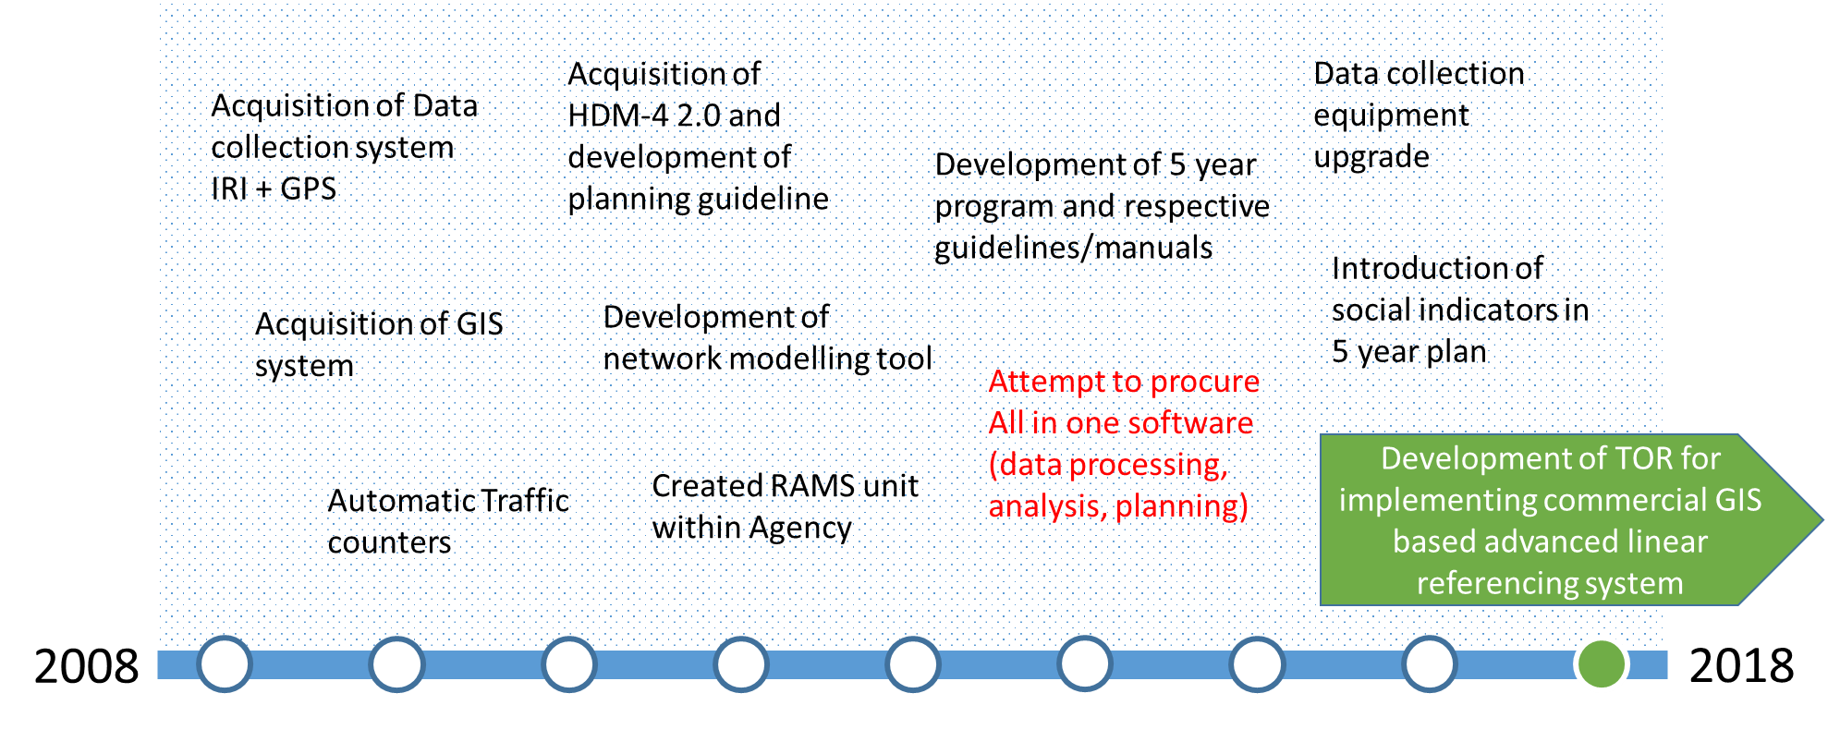
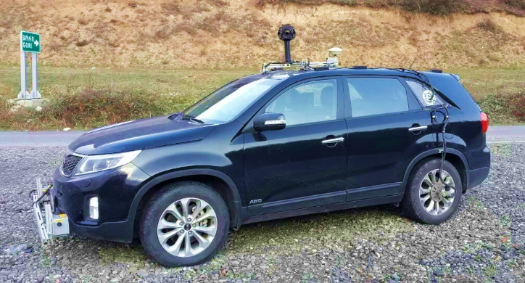
Example - Georgia
Country context
  7,000 km managed by Roads Department – local roads by municipalities
  All implementation outsourced to private sector (since 1999)
RAMS development started in 2008
  Annual pavement survey data collected directly by RAMS Unit (3 staff)
  International roads every year and secondary roads every 2 years
  Traffic data collected by maintenance contractors (24 zones)
  Purchasing additional equipment – automated laser crack measurement system
  Currently expanding data collection – to be outsourced
360 Degree camera, GPS, Geometry unit
IRI Laser Profilometers
Distance Measuring instrument

Slide 19
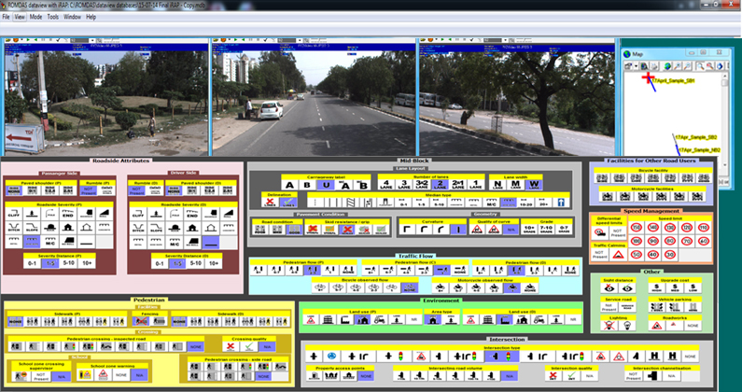
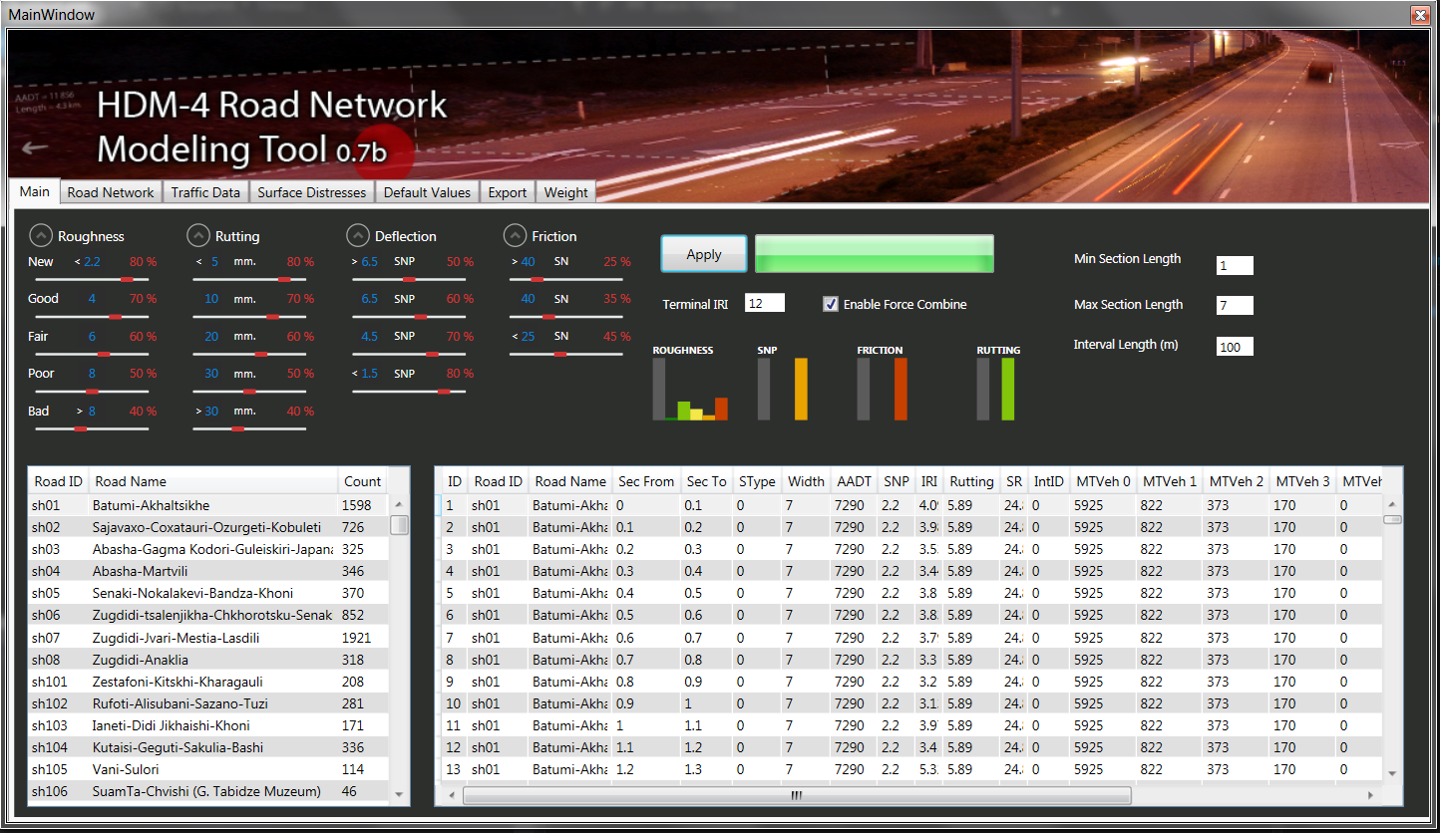
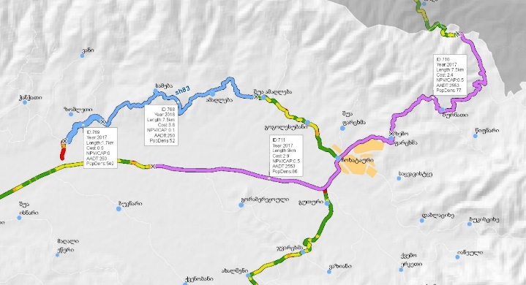
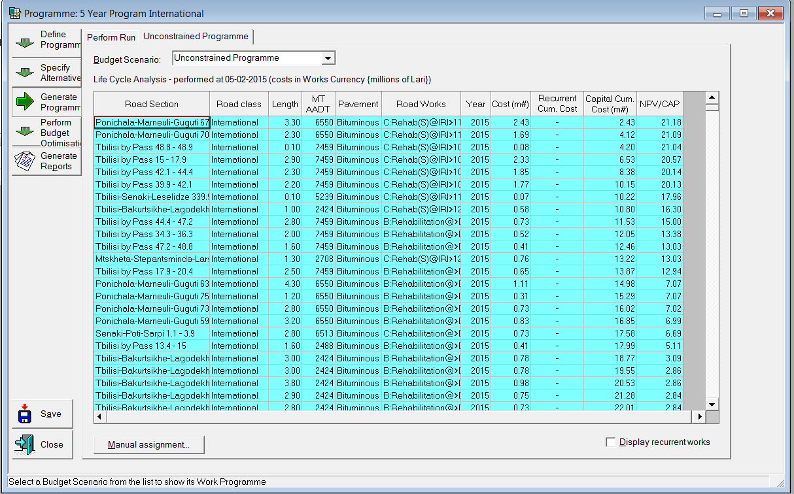
Example - Georgia
ArcGIS database for RAMS data
  Managed by RAMS Unit under Roads Department
  Integration of iRAP functionality
  Database currently being expanded to ESRI Enterprise Web to improve functionality
HDM4 program analysis each year by RAMS Unit
  Further amendments in Planning Section – 80% of annual plan in line with HDM4
  Integrates other criteria and views from regional offices
  Road sector financing from general budget
  Annual budget allocation in line with identified needs

Slide 20
Phase 2 RAMS development
Area of development | Activity | Priority
Expansion of data collection | Data collection for unpaved roads | 2-3
 | Data collection for bridges and tunnels | 2
 | Pavement strength measurements – procurement of FWD equipment | 3
Database improvement | Incorporation of data from spring and autumn surveys | 1
 | Incorporation of unpaved road data | 2
 | Incorporation of Bridge/Tunnel Management System | 2
Improvement of planning module | Funding allocation for routine and winter maintenance | 1
 | Algorithms for prioritising treatments for unpaved roads | 2
 | Algorithms for prioritising treatments for bridges/tunnels | 2
Integration of RAMS into planning processes | Use of RAMS in annual planning and budgeting – legal framework | 1
 | Planning of capital/mid-term repair at central level using RAMS | 1
 | Funding to ROs/LMUs based on road length, condition and importance | 1
Institutionalization of RAMS operation | Establishment of dedicated RAMS Unit in RMD with skilled experts | 1
 | Annual budget allocation for road network data collection by PIC | 1
 | Upgrading of survey equipment | 2
Match funding to priority needs | Assessment of long-term funding needs | 2
 | Identification of suitable funding sources for Road Fund | 2
Strengthen works implementing capacity | Involve the private sector in road repair and maintenance | 3
 | Introduce suitable contracting modalities (SLA,PBC) | 3

