Slide 1
Validation Criteria of
China Customs’
AEO Program
September, 2023

Slide 2
OUTLINE
Overview of China's AEO Program
Validation Criteria
AEO Facilitations

Slide 3
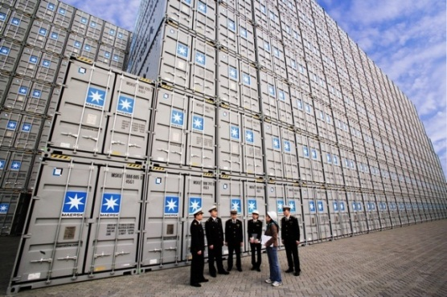
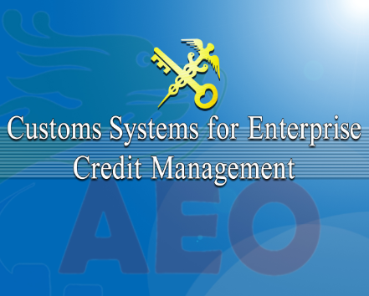
Overview of the development of China’s AEO program
April 2008
Jun 2012
Dec 2014
May 2018
Nov 2021
AEO Program
(MCME) launched.
First MRA signed
AEO program (“IMECM”) launched
AEO program (“MECM”) launched
Newest AEO program (“MCM”) launched

Slide 4
Validation Criteria and Status
Internal Control
Financial Status
Compliance
Trade Security
AEO
Facilitations
Regular Management
Strict Supervision and Control
1
2
3
Advance Certified Enterprise (ACE)
Other Enterprise
Discredit Enterprise
(DE)

Slide 5
Validation Criteria
The Measures for Credit Management of Enterprise Registered and Filed with the General Administration of Customs of the People’s Republic of China(Decree No.251, 2021, GACC)
Customs Criteria of Advanced Certified Enterprises(Bulletin No.106, 2022,GACC)
“1+1”= General Criteria+ Specific Criteria
-Processing trade and bonded import and export business
-Health and quarantine business
-Animal and plant quarantine business
Specific
Criteria
-Food import and export business
- Inspection of import and export commodities

Slide 6
Validation Criteria
-Customs brokers
-Inward and outward express business
-Logistics transport business
-Cross-border e-commerce platform business
-Comprehensive foreign trade service business
Specific
Criteria

Slide 7
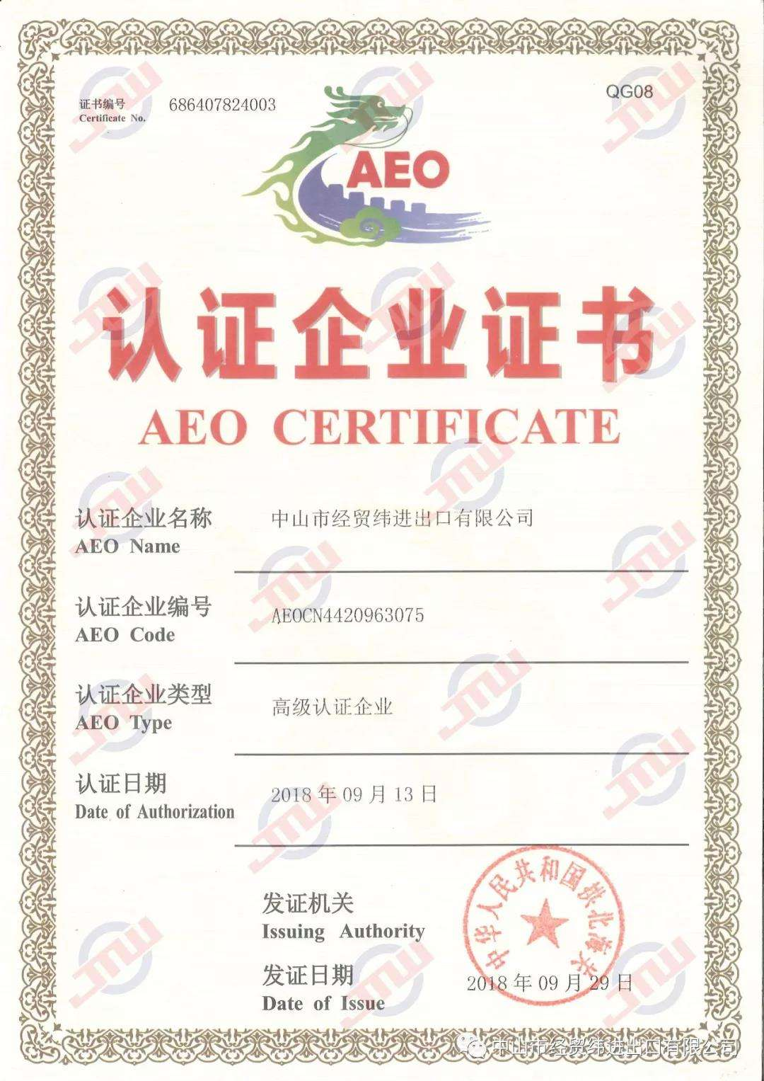
Validation Procedure
Conclusion
On-site validation
Documentary Review
Submit application to customs
Passed:Certificate for Certified Enterprise
Failed: Decision of Objection for Certification
90 Days
Additional 30 days in special circumstances

Slide 8
Internal Control
}
Communication and Cooperation Between Customs and Enterprises
Import/Export Documents
Internal
Control
IT System
Internal Audit and Improvement
Totally includes 4 items and 12 sub-items

Slide 9
Financial Status
}
Relevant proof of financial status
Financial Status
Audit report/Balance sheet
Asset-liability ratio
No circumstance where the asset-liability ratio exceeds 95% for five (5) consecutive years

Slide 10
Compliance
Compliance with Laws and Regulations
}
Record of Import and Export
Compliance
Tax Payment
Customs Management Requirements
External Credit
Totally includes 5 items and 16 sub-items

Slide 11
Trade Security
Premises Security
}
Personnel Security
Cargo and Goods Security
Trade Security
Security of Means of Transport
Security of Business Partner
Customs Operations and Trade Security Training
Totally includes 6 items and 32 sub-items

Slide 12
Conditions for passing authorization
}
1
All the items are met without “no”
2
No more than 3 “basically yes” in General Criteria
3
No more than 3 “basically yes” in Single Criteria
Passed only if all 3 requirements are met

Slide 13
Monitoring Procedure
1. AEO should be re-authorized every 5 years
2. AEO could be re-authorized by random if there’s any suspected abnormal issue with the credit situation.

Slide 14
AEO Facilitations
01
%
02
20%
Lower Inspection Rate
Lower check rate of origin
03
Priority in Declaration
04
Prior Recommendation
05
06
Reduced Post Clearance Audit
Exemption of guarantee

Slide 15
AEO Facilitations
Prior Declaration before arrival
07
08
Coordinator service
09
10
AEO MRA benefits
Joint incentive
Prior clearance in resumption
12
11
Other related measures

Slide 16
THANKS
September, 2023

