Slide 1
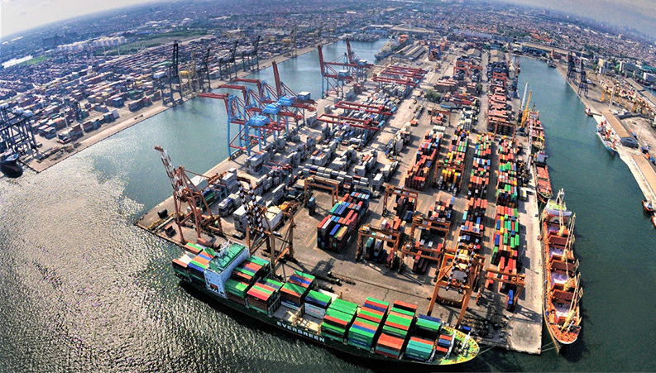
SESSION 3
INDONESIAN AEO PROGRAMME
“THE AUTHORIZATION PROCESS”
AGUS SUJENDRO
HEAD OF AEO CERTIFICATION SECTION
DIRECTORATE GENERAL OF CUSTOMS AND EXCISE (DGCE)
Tuesday, 28 September 2023

Slide 2
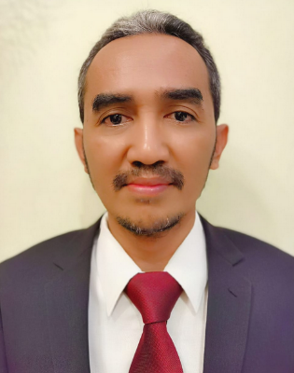
AGUS SUJENDRO
Education background:
University of Indonesia (Undergraduate)
University of Trisakti Jakarta (Master degree)
Work experiences:
Senior Auditor of Post Clearence Audit 2014 to 2020
Head of AEO Certificaton 2020 to now

Slide 3
BUSSINESS PROCESS OF AEO
Application
Development and MRA
Authorization
Monitoring and Evaluation

Slide 4
AEO AUTHORISATION PROCESS
DIRECTORATE GENERAL OF CUSTOMS AND EXCISE
MINISTRY OF FINANCE
REPUBLIC OF INDONESIA
Improvement
Application Submitted
Document
Checking
SOP/Procedure
Presentation
On-Site
Validation
Panel
Forum
Risk Mitigation
and Assessment
AEO
Certificate
Issued

Slide 5
RISK MITIGATION AND ASSESSMENT
DIRECTORATE GENERAL OF CUSTOMS
AND EXCISE
MINISTRY OF FINANCE
REPUBLIC OF INDONESIA
OBTAINING DATA FOR RISK ASSESSMENT
AEO CRITERIA
COMPLIANCE, SECURITY AND SAFETY STANDARDS
Demonstrated Compliance With Customs Requirements
Satisfactory System For Management Of Commercial Records
Financial Viability
Consultation, Co-operation And Communication
Education, Training And Awareness
Information Exchange, Access And Confidentiality
Cargo Security
Conveyance Security
Premises Security
Personnel Security
Trading Partner Security
Crisis Management And Incident Recovery
Measurement, Analysis And Improvement
INTERNAL SOURCE
EXTERNAL SOURCE
All Internal Unit of Directorate General of Customs and Excise (DGCE)
Other Government Agency (OGA)
Data/information from company
Data/information from open source
Etc
ASSESSMENT
SOP, WI FLOW
CHART
AEO GRANTED
INFORM
ATION
OBSERVATION
EVIDE
NCE
CHECKING
RISK MITIGATION

Slide 6
VALIDATION
DIRECTORATE GENERAL OF CUSTOMS AND EXCISE
MINISTRY OF FINANCE
REPUBLIC OF INDONESIA
DOCUMENT VALIDATION
Document/Administration Checking
ON-SITE VALIDATION
On-site visit to company premises
Procedure (SOP) Presentation by company
Company profile analysis and all related information

Slide 7
VALIDATION PROCESS
DIRECTORATE GENERAL OF CUSTOMS AND EXCISE
MINISTRY OF FINANCE
REPUBLIC OF INDONESIA
Purpose: to identify risks and prepare for the validation process to be effective and efficient
Understanding the company's business processes as a whole and understand its organizational structure
Self assessment Questionnaire
Organizational Structure: separation of responsibilities and authorities between sections (Accounting, finance, Inventory, IT, Internal Audit, etc.)
Company Profile
Understanding of the company’s roles in supply chain
Parties involved in the international supply chain (importers, exporters, logistics service providers (customs broker; land, sea, air, multimodal carriers; warehousing; consolidators; terminal operators; etc.) and their respective roles
Logistics process starting from the goods being made, packing, releasing the goods from the factory, transporting, etc., until the goods are imported and enter the distribution warehouse)
Internal procedures related to activities in the international supply chain
Its role in associations, Kadin, groups etc
Company Profile Analysis:
Information from internal units: requests for recommendations from internal units
Information from external unit
Information from open sources, for example the internet, audited financial statements (in the case of public companies), journals, articles, etc
Potential risks for fulfilling the conditions and requirements of AEO

Slide 8
Document Checking
DIRECTORATE GENERAL OF CUSTOMS AND EXCISE
MINISTRY OF FINANCE
REPUBLIC OF INDONESIA
Document Checking submitted by Company
Document / Administration Checking Report
Request of recommendation from other directorates and regional customs offices (about the company's track record for the last 2 years)
Presentation of business processes and Company Standard Operating Procedure (SOP) by Company to the AEO Validator

Slide 9
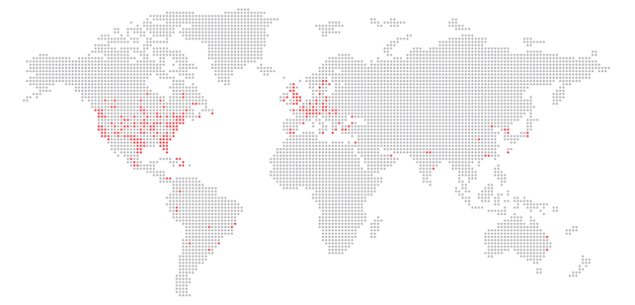
SAMPLE OF APPLICATION DOCUMENT
Application letter
Statement letter
Self assessment questionaire
Organizational structure
Standard operating procedures/SOP*
Layouts
Deed of establishment and latest amendments
Independent auditor's report for the last 2 years
Third party lists and contracts
DG Decree of customs facility (if any)
AEO certificate from other countries (if any)
Other certificates such as ISO,TAPA, Regulated Agent/Known Consignor (if any)
License of Bussiness

Slide 10
PROCEDURE (SOP) PRESENTATION BY COMPANY
DIRECTORATE GENERAL OF CUSTOMS AND EXCISE
MINISTRY OF FINANCE
REPUBLIC OF INDONESIA
Definition: Process to get comprehensive understanding about the procedures related 13 AEO condition and requirement
Conduct virtually/online between AEO validators Team and AEO Applicant (one-on-one)
Held for 3 – 5 days, depending on the business process of company
Mechanism : each PIC of the department will explain the procedure related to AEO from 1- 13 condition and requirements, if the validator provides input and recommendations (for suggestions/improvements to procedure) then deliver it to the company
The AEO Applicant then have to improve their procedure then deliver it to AEO Validator team
Next, AEO Validator Team inform about on-site validation planning

Slide 11
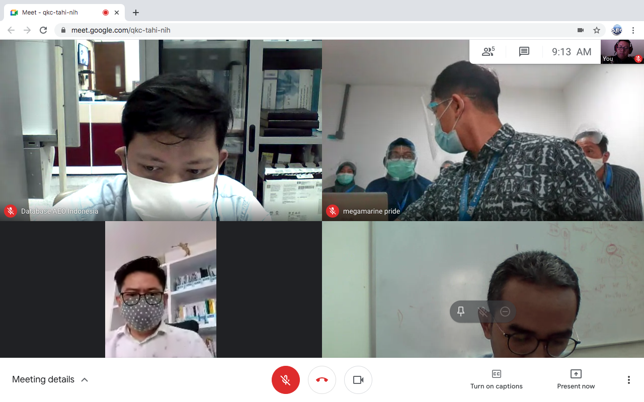
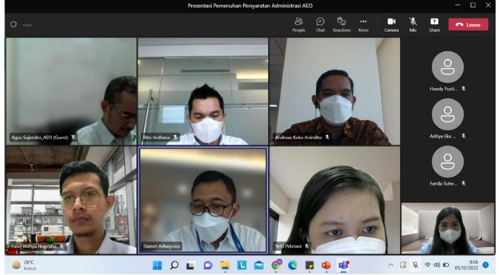
Standar Operating Procedure (SOP) Presentation and Discussion Session

Slide 12
On-Site Validation
DIRECTORATE GENERAL OF CUSTOMS AND EXCISE
MINISTRY OF FINANCE
REPUBLIC OF INDONESIA
Preparation : rundown and briefing for site validation
On-Site Validation
Arrange On-site validation report
If needed, Re- on-site Validation
Fulfillment of Recommendation by company
Delivery of Report and Recommendations

Slide 13
DIRECTORATE GENERAL OF CUSTOMS AND EXCISE
ON – SITE VALIDATION
MINISTRY OF FINANCE
REPUBLIC OF INDONESIA
On-site validation conducted to ensure that the AEO condition and requirement stated in the procedures implemented in the premises of the applicant company and also to ensure all the risks 13 AEO conditions and requirements have been mitigated.
Held for minimum 3 (three) days, depending on business process, number of premises/branches/factory and type of operator.
Result : AEO Validator Team will make Report of On-Site Validation include Input/Suggestion/Recommendations and deliver it to AEO Applicant
If the improvement has done, the AEO applicant will submit the results of improvement and request a follow-up to the AEO Team.
The AEO Team will decide whether it is necessary to conduct presentation of improvements or conduct on-site visit again.

Slide 14
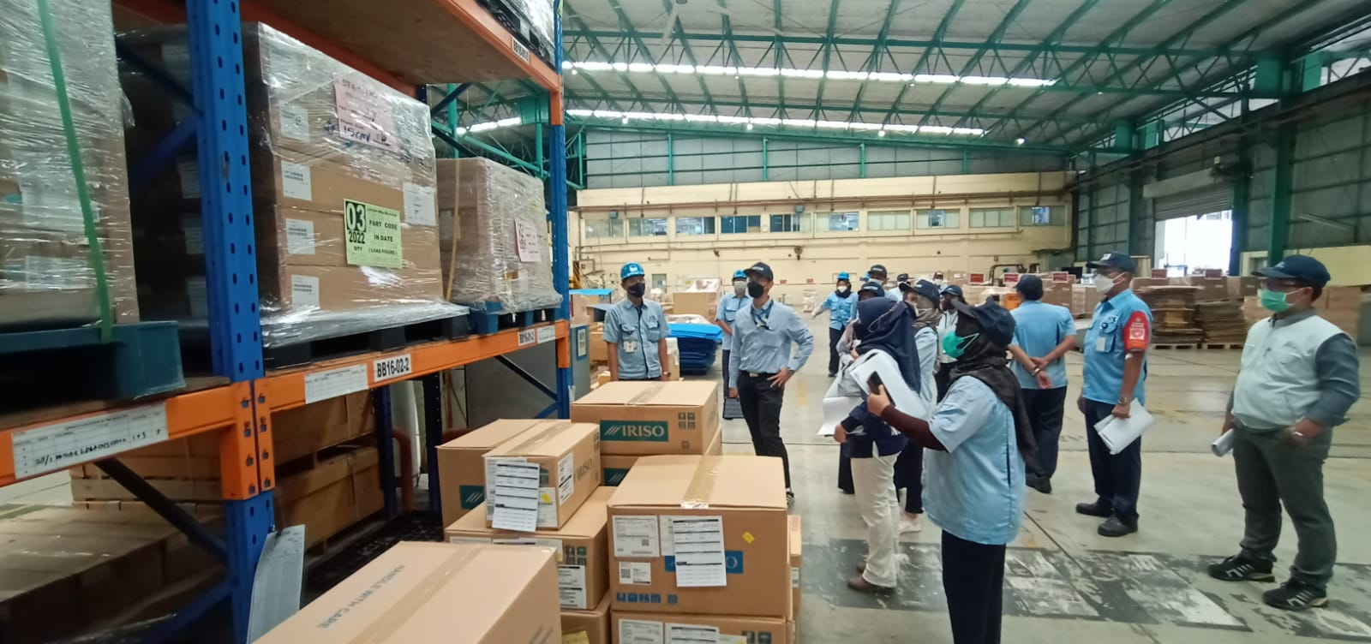
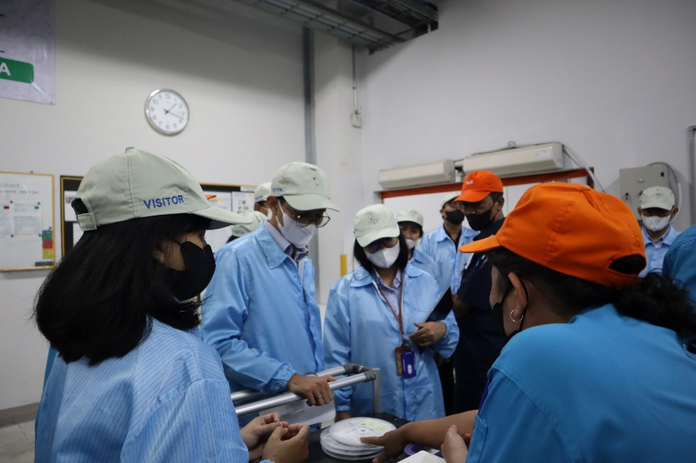
On-Site
Validation

Slide 15
Panel Forum
DIRECTORATE GENERAL OF CUSTOMS AND EXCISE
MINISTRY OF FINANCE
REPUBLIC OF INDONESIA
The panel forum is attended by Directors and Regional Office of DGCE and also involved Other Government Agency (OGA) related to the AEO applicant (permit and license) , e.g Ministry of Trade, Ministry of Industry, Ministryof Environment, Food and Drug Authority, Quarantine, etc.
The panel forum held to agree on the results of administrative research and site validation report or site re-validation and also the data and information from DGCE internal and external parties.
If the result of the panel forum is an agreement, a DGCE Decree and AEO certificate will be issued as a recognition as an Authorized Economic Operator (AEO)
If the result of the panel forum are recommendations to improve, then the recommendations will be delivered to the company.

Slide 16
Panel
Forum

Slide 17
AEO CERTIFICATE AND DG DECREE
DIRECTORATE GENERAL OF CUSTOMS AND EXCISE
MINISTRY OF FINANCE
REPUBLIC OF INDONESIA
DGCE issued DGCE Decree as AEO Recognition status and also AEO Certificate.
AEO Status valid for 5 years. Before expired date, company will be evaluated all of AEO criterion by DGCE

Slide 18
DIRECTORATE
GENERAL OF CUSTOMS AND EXCISE
MONITORING AND EVALUATION BY CUSTOMS
MINISTRY OF FINANCE
REPUBLIC OF INDONESIA
MONITORING
EVALUATION
Directorate of Customs (AEO Unit – Headquater)
Client Manager (Customs Regional Offices)
Directorate of Customs (AEO Unit – Headquater)
UNIT
Research on the results of internal audits,
Significant Change Research
Information Gathering (Internal/External)
On-site Validation
Communication, consultation and coordination with Manager AEO
Analysis of monitoring results
On-site Validation
ACTIVITIES
Suspension of AEO Recognition
Revocation of AEO Recognition
Extention of AEO Status
Suggestions / Recommendations
Evaluation
RESULT
Note:
Monitoring and Evaluation are conducted to maintain the conditions and requirements and also responsibilities as an AEO still fulfilled

Slide 19
DIRECTORATE GENERAL OF CUSTOMS
AND EXCISE
COACHING CLINIC
MINISTRY OF FINANCE
REPUBLIC OF INDONESIA
WHY
WHEN
The Company is lack of information about AEO Programme
Before submitting AEO application
After submitting AEO application (during AEO certification process)
After obtaining AEO certification
WHAT FOR
HOW
Providing assistance/support to the AEO applicant
Providing assistance to the AEO companies regarding AEO programme implementation
Explaining some points not stated in the regulation of Ministry of Finance/Director General
Breakthrough made to providing services and information to the AEO companies
One on one meeting (company - AEO Center)

Slide 20
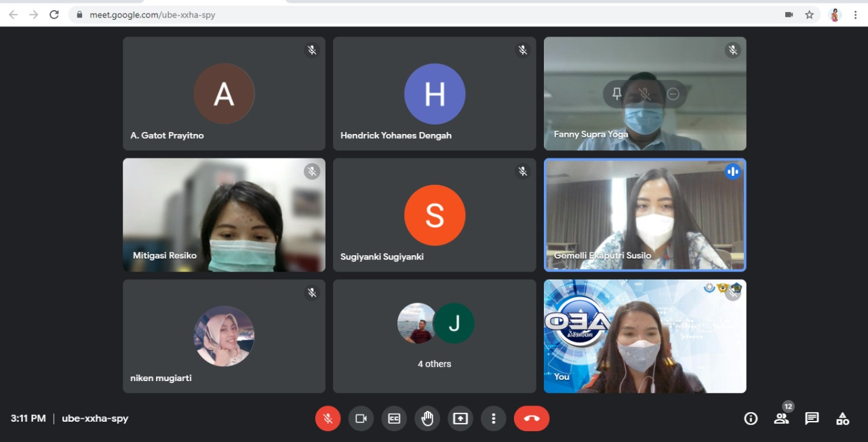
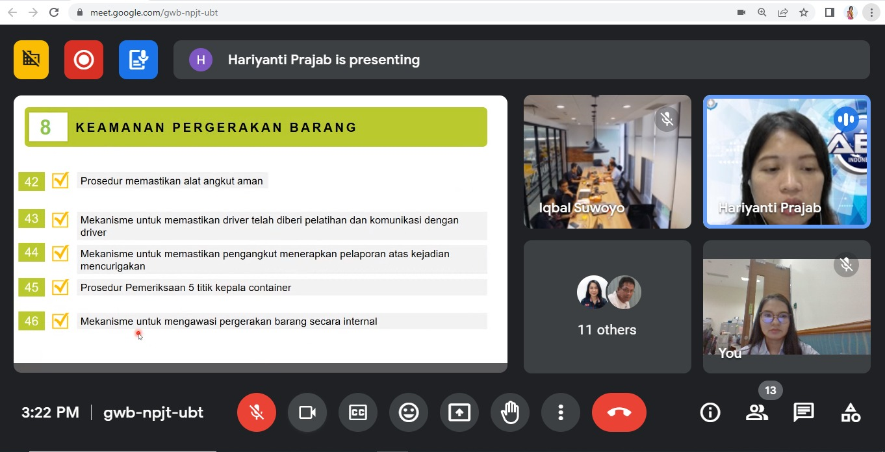
Coaching
Clinic

Slide 21
Contact Us
AEO Center, Kalimantan Building 1st Fl,
Headquater of Directorate General of Customs and Excise, Jenderal A Yani Street (By Pass) Jakarta, Indonesia
aeoindonesia@customs.go.id
+62 21-4753412

