Slide 1
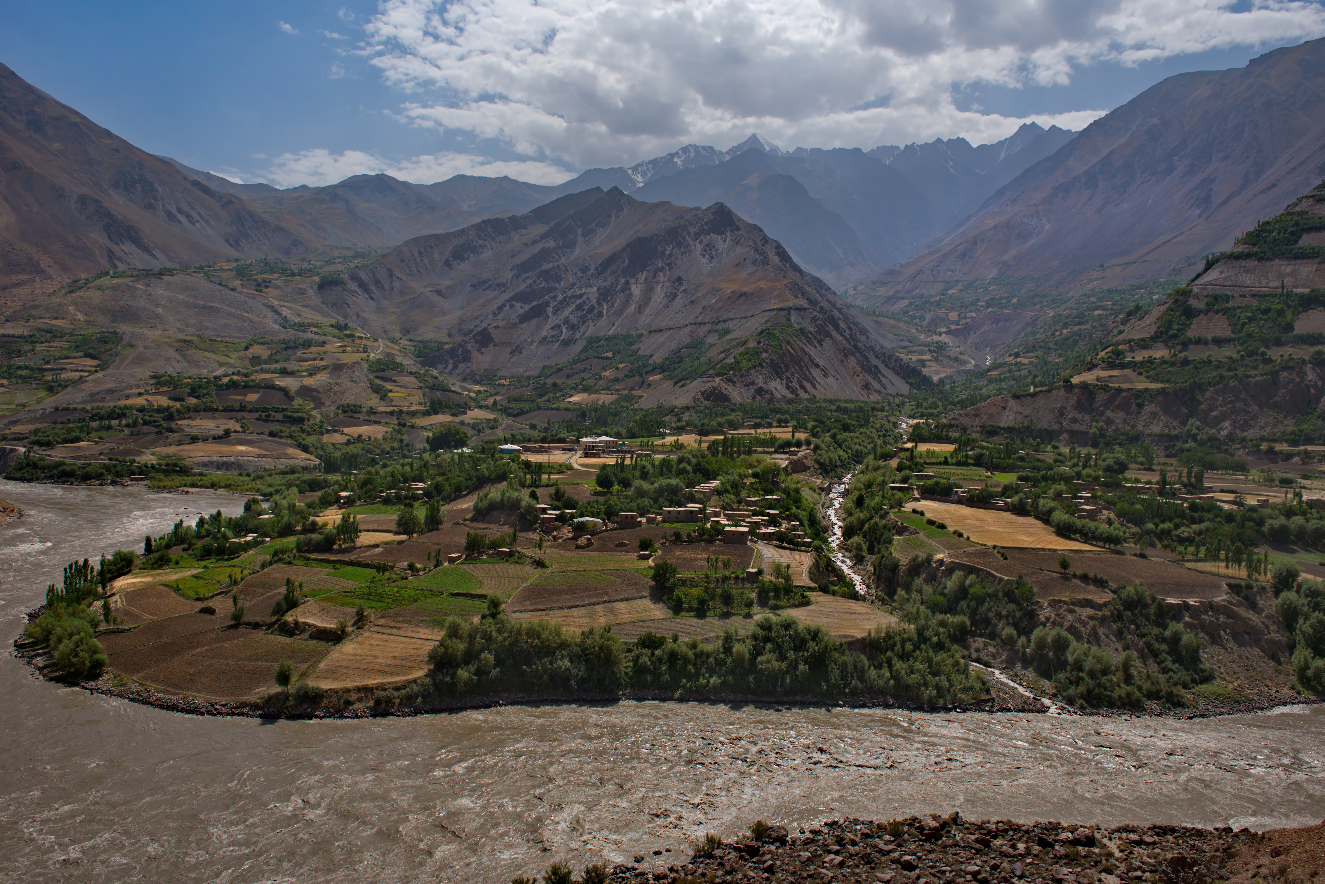
Glaciers to Farms (GCF) – Promoting a Regional Program in Central and West Asia
Objective: To enhance the resilience of communities, food systems and infrastructure in Central and West Asia countries
Impact: Increased Climate-Resilience and Adaptive Capacity of Communities, Food Systems and Social Infrastructure in Central and West Asia
Executing Entity: various at national level
ESS Category: B
Total Financing: $5B
GCF Contribution: $500M (indicative) – 2 Phases
Co-financing ($ / %): $4.5M
Implementation Period: 2025-2034 (10 years)
Countries: AFG, ARM, AZE, GEO, KAZ, KGZ, PAK, TAJ, TKM and UZB
# Beneficiaries: Indirect 148 million = total pop is 372 million of which 40% are dependent on agriculture
Tons CO₂eq: TBD (energy efficiency / improved ecosystem management)
Central Asia, Tajikistan - river Panj along the Pamir tract

Slide 2
Key Components
Successful models for upscale green business finance at the local level
Replication / Upscale through public finance instruments
Component 2: Regional Investment and Technical Assistance Facility
Climate Risk & Hydromet Data
Sectoral and Fiscal Planning
Regional Co-investment Platform
Financial Innovation & Instruments
Key Implementing Agency: Ministry of ‘Climate Change’ & Ministry of Finance
Technical Facility
Green Banking Facility (Concessional Loans)
Pillar 1: Climate Resilient Landscapes for Water Resource Management
Pillar 2: Sustainable Agriculture Value Chains and Food Security
Pillar 3: Enhancing Rural and Urban Social Infrastructure and Societies
Key Implementing Agency: Line Ministries
Component 1 Climate Resilience through Integrated Planning / Regional Cooperation
Component 3: Establishment of Green Business Financing Facility at the local level

