Slide 1
RAMS development in Kyrgyz Republic Phase 1 Completed and ongoing RAMS development activities with achievements and remaining gaps
Konsta Sirvio

Slide 2
Scope of Work
Stakeholder Management
Business Process Review and Analysis
Review and Update/Define Network Referencing System
Performance Management Framework
Data Collection and Management Manual
Road Asset Database
Road Asset Inventory
Road Asset Condition and Traffic Survey / Assessment
Asset Management Decision Support System / Planning Tool
Verification and User Acceptance Testing
Rolling Works Program
Road Asset Management Manual
Training MOTC Staff and Sustainability of RAMS

Slide 3
Main Achievements
Server, computers, radar traffic counters procured
Road condition and traffic data collected (7 000 km) with Trassa and radar counters
Road database and information system created
Web-based maintenance planning system and Geographic Information System implemented
Initial analysis and planning done
Training conducted

Slide 4
Stakeholder Management
Initial Stakeholder Management Plan was created
RAMS project has been presented to various stakeholders including the following seminars:
Stakeholder seminar 13.12.2018
JICA final seminar for BMS and disasters, 13.03.2019
KCUSTA university workshop, 18.04.2019
29.11.2019
Maintenance planning pilot training for Local Maintenance Units, 12.12.2019
20.12.2019
Local Maintenance Unit training, May-June 2021
Trainings have been given to PIC, MOTC, RO, LMU, KCUSTA
KCUSTA university has been actively involved
Road user stakeholder questionnaire has been prepared and answers obtained
Dissemination plan of the project is under preparation

Slide 5
Business Process Review and Analysis
Long-term and medium-term planning processes are currently missing
The Regional level should be strengthened with SLA between MOTC and RO
Periodic maintenance and rehabilitation planning should be done at regional + ministry level
Routine and winter maintenance planning can be done completely at the local maintenance unit level
Criteria for allocating funding to regional offices and local maintenance units should be created based on the road network length, condition and importance
Detailed routine maintenance work level supervision is not needed at the ministry level
Data collection (excluding visual spring and autumn inspections by LMU for routine maintenance planning) should be kept centralised at PIC
There should be annual budget for management of RAMS (including data collection)
Road maintenance funding should be increased
Some data collection should take place every year (to keep PIC and RAMS operational)
A RAMS unit should be strengthened with resources and right experts (road planning, bridge planning, GIS, software and systems)
RAMS software and data should be utilised as the main road network data source and planning tool

Slide 6
Business Process Review and Analysis
Road and bridge investment planning
Budget
allocation
Budget
distribution
Periodic road maintenance planning
Routine road maintenance planning
Strategy Analysis
Three-Year Programming
Annual Programming
Winter routine maintenance
Summer routine maintenance
Bridge and tunnel repair planning
Bridge and tunnel routine maintenance planning
Medium-term Planning
Short-term Planning (Annual)
Data collection and managment
Capacity building
Quality Assurance
Performance Management

Slide 7
Business Process Review and Analysis
Planning of maintenance
Request to all ROs and UADs to prepare proposal for the formation on title list
Participating in discussions
Approval
MOTC/DDH
Preparing a consolidated list on the basis of proposals
Making changes based on the results of the analysis of incoming requests
Discussions about the final proposal
The final Title List
MOTC/OOKiPR
Request proposals from DEUs
Collecting the proposals from DEUs and proposing to DDH
Participating in discussions
UAD
Preparing the proposals
Participating in discussions
DEU/RO
October - November December

Slide 8
Review and Update/Define Network Referencing System
The new ALRS is based both on roads and sections
Roads include sections with starting and ending points at Location Reference Points (junctions)
Road start and end points have been fixed as before they could start from a middle of a village without clear indication of the exact starting point

Slide 9
Performance Management Framework
An initial framework has been created, but it is being updated
A stakeholder questionnaire was done and answers received related to MOTC expectations
The preliminary results show that more active commnunication, road management and safer roads are expected from MOTC
5-Not a problem at all
1-Very big problem
Biggest experienced
safety problems

Slide 10
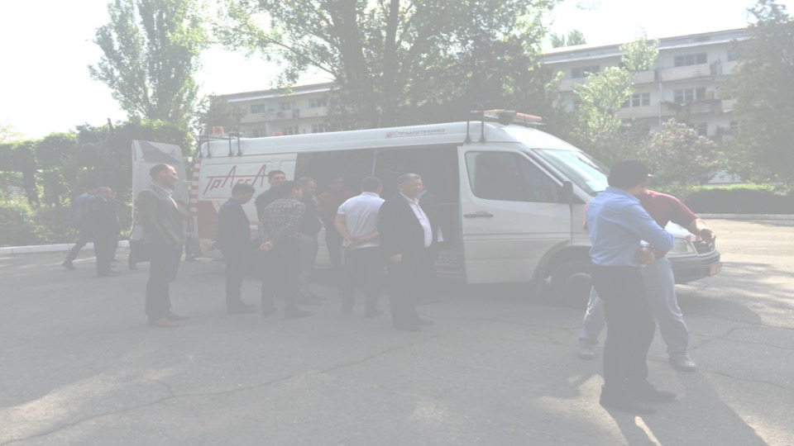
Data Collection and Management Manual
Data Collection and Management Manual has been written and an updated version 2 compiled (under translation to Russian)
The manual includes Data Collection Quality Control, Data Collection, Data Processing Procedures, Information Policy and Information Systems
The collected data includes Road Inventory, Pavement Distress Inventory, International Roughness Index, Rutting, Skid Resistance, Bearing Capacity (Falling Weight Deflectometer), Traffic, Accidents and Texture
The proposed data collection frequencies for paved roads
Survey type: Paved Roads | International Roads | National Roads | Local Roads
International Roughness Index (IRI)
TRASSA | X | X | X | 2 years
Photos and inventory
TRASSA | X | X | X | 2 years
Road Inventory | X | X | X | 6 years
Pavement Distress Inventory | X | X | X | 2 years
Traffic counting
WIM stations |  |  |  | Continuous
Radar counting | X | X | X | 3 years
Others
Friction | X | X | X | 3 years
Texture | X | X | X | 3 years
FWD | X | X | X | 3 years

Slide 11
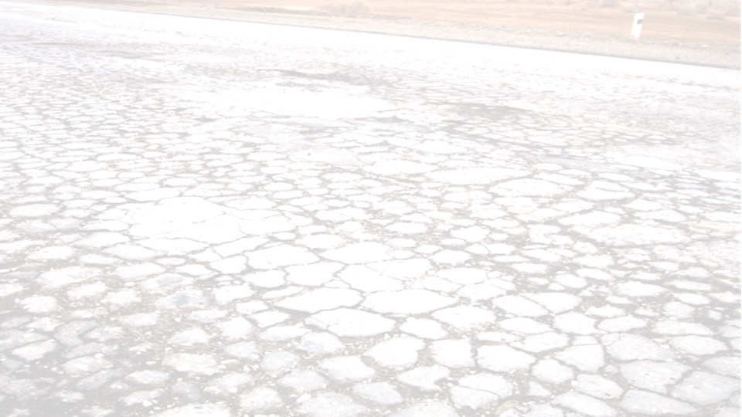
Road Asset Database
Road Asset Database has been created in Open Source platform (PostgreSQL)
The database is installed in the RAMS server
The collected data has been imported in the database
The data includes Asset Location Referencing System, road inventory, road condition, traffic, prioritisation criteria, maintenance works and costs, Bridge information from JICA project
The database is in connection with Road Information System, Maintenance Planning System and web-based Geographic Information System
The database is in use

Slide 12
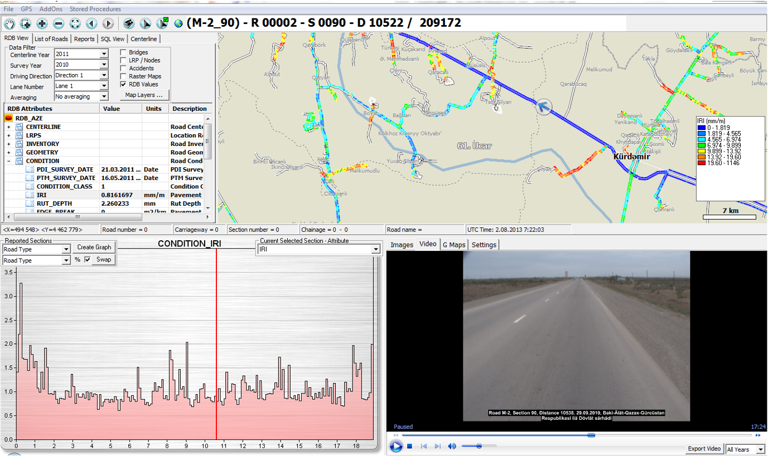
Road Asset Database

Slide 13
Field surveys
TITUL
RoadLab
Traffic
software
BMS
Survey
image files
Photos
Inventory
Devli
RAMS
import files
IRI
RUT
GPS
PDI
RI
Parameters
Traffic data
RMS
RAMS
applications
WEB GIS
HDM-4 transfer files
Road Asset Database
HDM-4
WEB-BASED PLANNING TOOL
Planning Database
Main RAMS
outputs
Graphs
Maps
Reports
Strategy plans
Network plans
Project plans
Software
File
Database

Slide 14
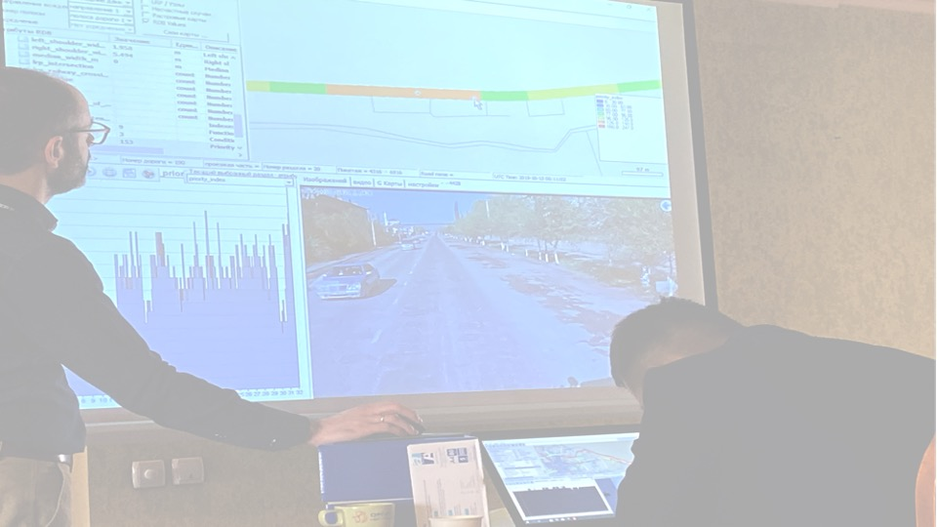
Road Asset Inventory
Approximately 7 000 kilometres of paved roads have been surveyed
Road asset inventory has been conducted on approximately 6 200 kilometres of the surveyed roads
Both Road Inventory and Pavement Distress Inventory have been conducted from photos
The following tables show the inventory items
Inventory type | Road / carriageway | Inventory item | Unit
Road inventory | Road | Number of carriageways | No.
Road inventory | Carriageway | Number of lanes | No.
Road inventory | Road | Terrain | Multiple choice
Road inventory | Road | Land use | Multiple choice
Road inventory | Carriageway | Specify LRP(=Location reference point) | Multiple choice
Road inventory | Carriageway | Surface type | Multiple choice
Road inventory | Carriageway | Width of pavement | m
Road inventory | Carriageway | Width of Left Shoulder | m
Road inventory | Carriageway | Width of Right Shoulder | m
Road inventory | Carriageway | Left Shoulder Pavement Type | Multiple choice
Road inventory | Carriageway | Right Shoulder Pavement Type | Multiple choice
Road inventory | Road | Median width | m
Pavement Distress Inventory | Carriageway | Cracking (area) | m2
Pavement Distress Inventory | Carriageway | Potholes (number) | No.
Pavement Distress Inventory | Carriageway | Repairs/Patches (area) | m2
Pavement Distress Inventory | Carriageway | Edge Break (area) | m2

Slide 15
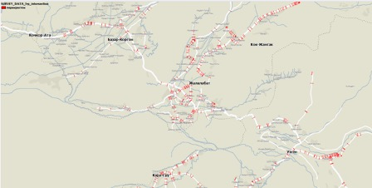
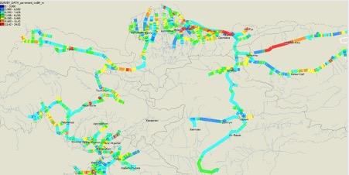
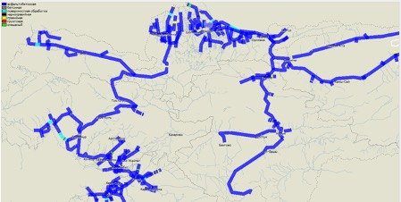
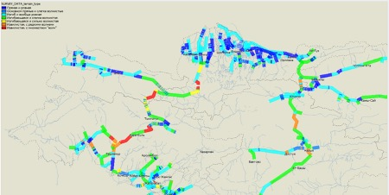
Road Asset Inventory

Slide 16
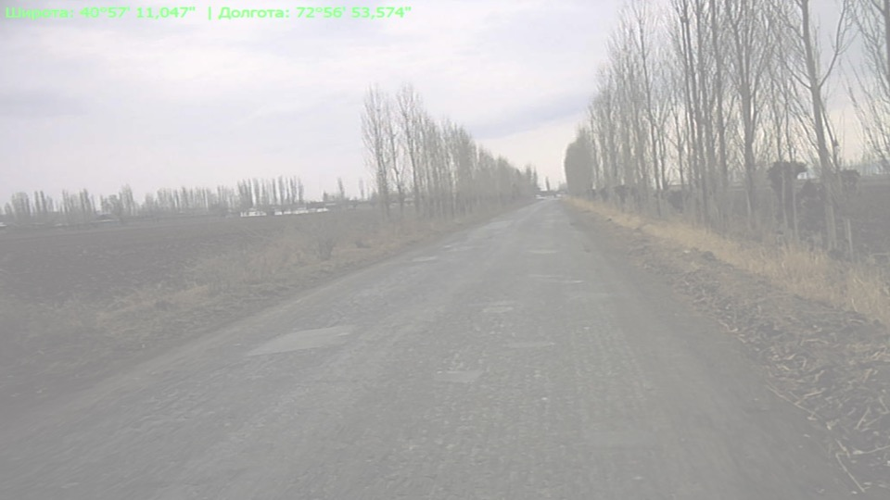
Road Asset Condition and Traffic Survey / Assessment
The equipment were calibrated prior to the surveys
Approximately 7 000 kilometres of paved roads have been surveyed
Pavement Distress Inventory has been conducted on around 6 200 kilometres of the surveyed roads
Both Road Inventory and Pavement Distress Inventory have been conducted from photos
The collected condition variables include: International Roughness Index, Rutting, Cracking, Potholes, Edge break, Patches
Photos have been collected every 10 metres (around 7 00 000 photos available)
Traffic counting has been conducted on around 230 points
All the data has been validated and time-stamped and most of the data is imported in the database visible through the web-GIS

Slide 17
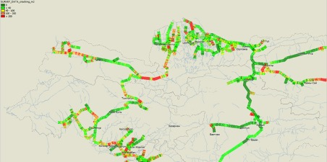
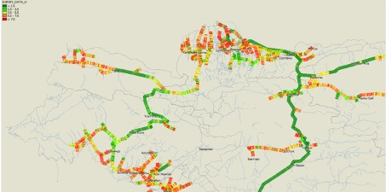
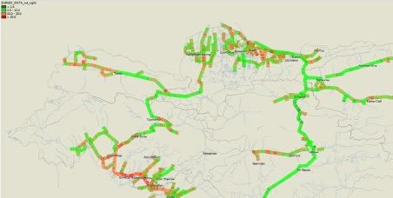
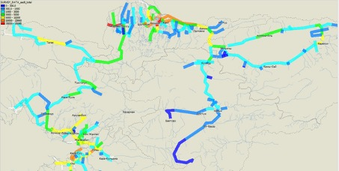
Road Asset Inventory

Slide 18
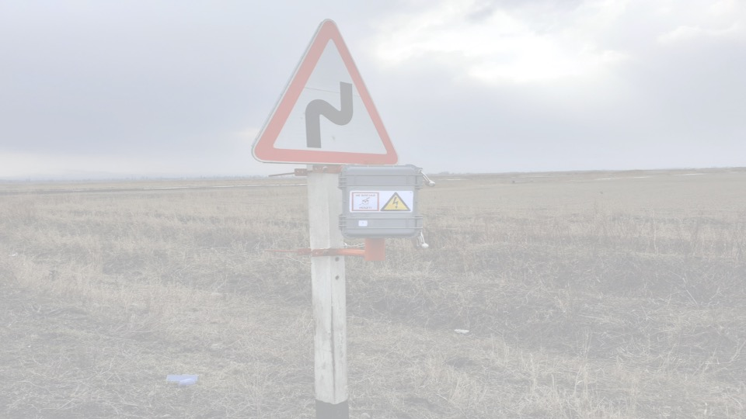
Asset Management Decision Support System / Planning Tool
The current planning process has been reviewed
Two planning systems have been introduced: HDM-4 and tailor-made web-based Maintenance Planning Tool
HDM-4 is proposed for Strategy Analysis every 3-5 years to show the optimal maintenance budget
Tailor-made maintenance planning tool allows engaging the Regional Offices and Local Maintenance Units to planning of the actual works
The maintenance planning methodology was created based on Condition Index, Functional Index and Priority Index
Average annual maintenance budget is around 100 MUSD in the next 20 years

Slide 19
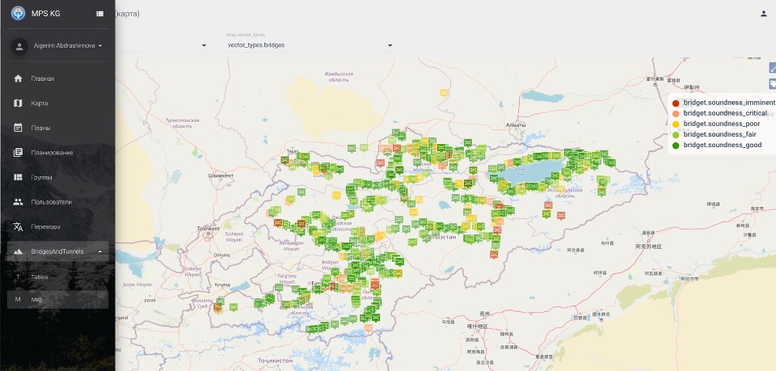
Asset Management Decision Support System / Planning Tool

Slide 20
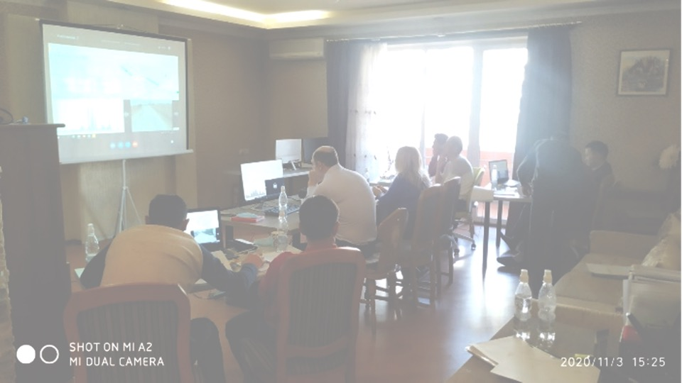
Verification and User Acceptance Testing
The User Acceptance Testing was conducted and changes have been made
UAT draft report has been prepared and being translated to Russian

Slide 21
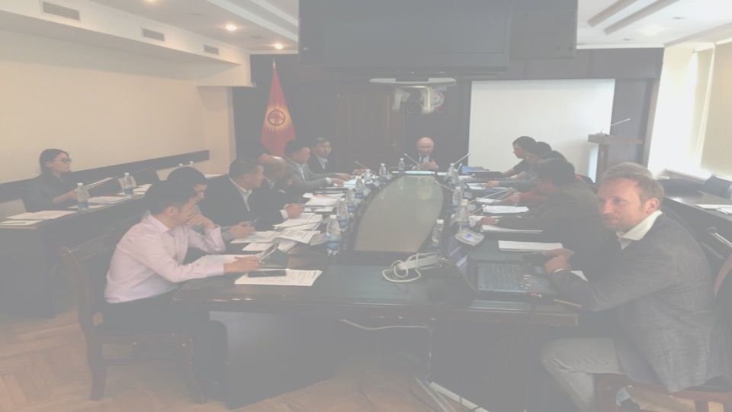
Rolling Works Program
A preliminary strategy analysis has been done
The automatically created maintenance works are available from the database
The Consultant will create a proposed Works Program with packaged works under budget scenarios in June-September, update the strategy analysis and document the process and results

Slide 22
Road Asset Management Manual
Road Asset Management Manual is under preparation
It should be the most important guiding manual for MOTC concerning Road Asset Management
The Manual will include the following:
International trends in Road Asset Management
Proposed future development steps in the Kyrgyz Republic related to RAM
Roles and responsibilities of MOTC & PIC & Regional Offices & Local Maintenance Units
Resourcing of the RAM Department in MOTC
Current status of the RAM business processes
Proposed RAM business processes
Available information and information systems for decision-making
RAM policy, strategy and objectives
Performance management framework and KPIs
Summary of the 5-years Works Program

Slide 23
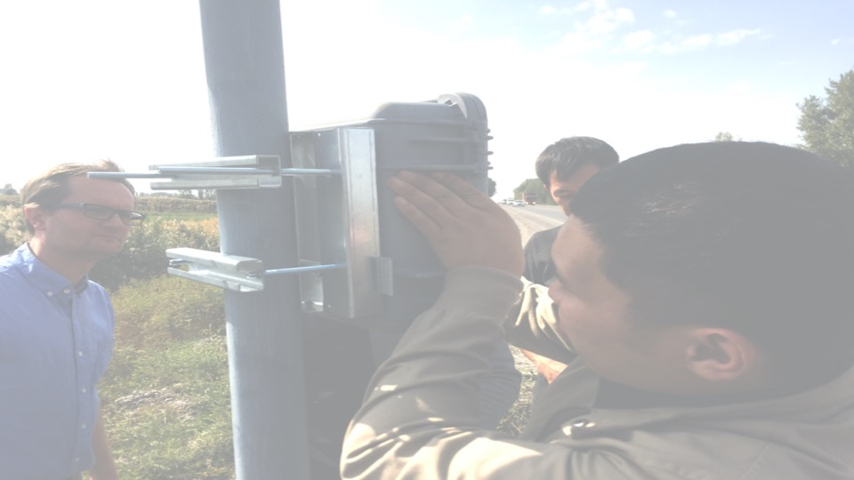
Training MOTC Staff and Sustainability of RAMS
Several workshops, seminars, class-room training, online training and hands-on (on-the-job) training have been conducted including the following:
Maintenance Planning training
HDM-4 training
UAT training
Maintenance Planning tool training
Road Information System training
Data collection training
Road and Pavement Distress Inventory training
Traffic Counting training

Slide 24
RAMS development in Kyrgyz Republic Phase 2 Identified needs during Phase 1
Konsta Sirvio

Slide 25
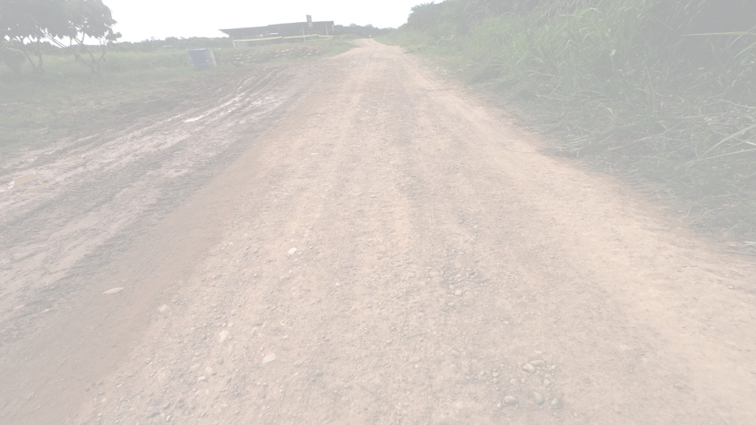
Additional data collection
Data collection for all the unpaved roads
Methodology for maintenance planning of unpaved roads
Full bridge inspections
Culvert inspections
Pavement strength surveys (Falling Weight Deflectometer)
Development of the Autumn and Spring visual inspections or overall RAMS-related data collection to support a systematic approach and that all the inspection data would be stored in the central road asset database

Slide 26
Institutional strengthening
Increased university cooperation
Increased private sector participation in the road maintenance
Merging local maintenance units
Strengthening the Regional Offices
Rules for defining the allocated funding for routine and winter maintenance
Guidelines for stakeholders’ participation in different planning processes
Rules for defining the allocated funding for Regional Offices
Strengthening of the actual maintenance of the unpaved roads
Further integration of RAMS in decision-making and planning
MOTC in cooperation with Finnroad is working on the legal framework for RAMS

Slide 27
Tools and Equipment
Reflection of the decided routine and winter maintenance planning to the web-based maintenance planning tool
Finding the proper level of details in network level planning and supervision for maintenance works
Rational number and use of proper maintenance equipment
Introduction and procurement of FWD
Introduction of full BMS instead of the mere bridge database
Upgrade of the survey equipment within PIC
Further improvement of the web-based maintenance planning tool with works completion and monitoring

