Slide 1



http://www.kazakhstan-tourist.isd.kz/page.php?page_id=116&gallery_id=109&lang=2&image=968
Public and Private Cooperation - Aviation and Tourism
Webinar 1 – January 2021
CAREC Aviation
Simon Russell
International Aviation Expert
MD Eagle Aviation Consulting Ltd
simon@eagleavia.com +64 21 657 050

Slide 2
Aviation & Tourism sectors
- major issues
Organization structure for Aviation – what are models to learn from?
National Airline – what are options can be considered?
Regional & Domestic air services – how could cities/towns be served by air?
How global travel is preparing for post-COVID aviation and tourism?
2

Slide 3
questions
How prepared are the Aviation & Tourism sectors for a fresh restart?
  Not prepared
  Somewhat prepared
  Fully prepared and ready
How supportive is the government in the Aviation and Tourism sectors?
  Little support
  Some support
  Fully supportive and active

Slide 4
Common observations in developing aviation markets
Aviation policy must be set and aligned with tourism and export needs
Country strategy unclear
High airfare prices
Poor flight frequency
Air service bilateral agreements (ASAs) not fully utilized
Tourism strategy not linked with Air Transport sector

Slide 5
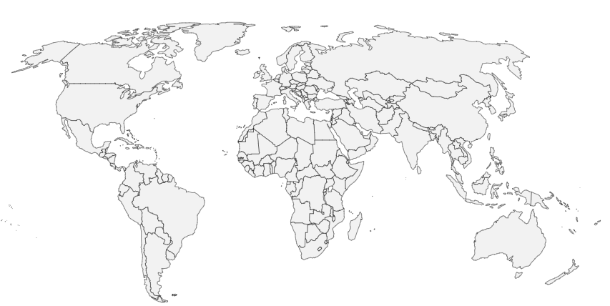
Maximizing Regional agreements
Aviation blocs for Regional collaboration
EEC
ECAA
National restrictions are still common among States
However, there are clear exceptions of liberal ownership and control regimes, mostly on a regional level
Gradual liberalisation of regional blocs allows states to apply Managed Competition to protect their own airlines as markets are opened to competition (“Open Skies”)
Integrated Air Transport markets generally represent a “community of interest”.¹
CAREC
CARICOM
YAMASSOUKORO
Examples
ASEAN
MALIAT
AN-COM
SAM
EXAMPLES OF A “COMMUNITY OF INTEREST”
ANCOM – Bolivia, Colombia, Ecuador and Peru
ASEAN – 10 member countries, ongoing liberalisation
SAM – Australia and New Zealand, Open Skies
MALIAT – Singapore, Peru, Chile, NZ, others
CARICOM – 20 Caribbean countries
ECAA - The European Common Aviation Area
EEC – Eurasian Economic Union
CAREC – Central Asia Regional Economic Cooperation
Yamoussoukro Decision -gradual liberalisation of intra-Africa air transport services
…CAREC air cooperation is an opportunity post-COVID
5
¹ Source: ICAO 2013 working paper_https://www.icao.int/Meetings/atconf6/Documents/WorkingPapers/ATConf6-wp050_en.pdf

Slide 6
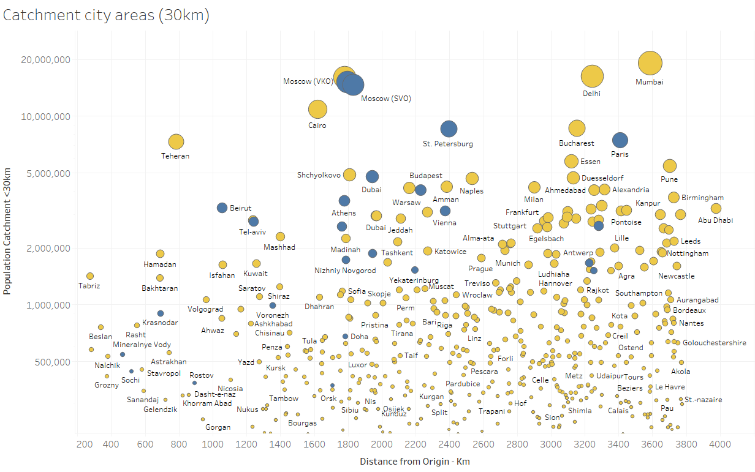
NEW CONNECTIVITY OFFERS RESTART OPPORTUNITIES
Distance from Major city airport - by Population catchment > 250,000
1,000km-3,800km
Non-stop flight
ILLUSTRATIVE ONLY
500 cities
Un-served
<1,000km
25 cities
Population catchment <30km from nearest airport
Distance from Origin airport
TURBOPROP
AIRCRAFT
NARROWBODY JET
AIRCRAFT
Smaller capacity aircraft support low passenger volumes post-COVID period - 2021-2024

Slide 7









Government strategy & policy creates the ‘climate’ for Aviation and Tourism to conduct business and grow
National Strategy, Policy, & Actions
Aviation
Tourism
PRIVATE SECTOR
PUBLIC SECTOR
PRIVATE/ PUBLIC SECTOR
International
CAA
NTO
Civil National
Aviation Tourism
Office
Market Demand
GOVERNMENT
Economy
Tourism
Commerce
Transport
Customs
Tourism
Attractions & Services
Airlines
Airports
Tourism
Providers

Slide 8




Alignment is crucial for the Aviation and Tourism sectors
Market Demand
Fragmented
Supply
Coordinated
Supply
TODAY
TOMORROW
+
X
X
+
X
+

Slide 9

PUBLIC/PRIVATE PARTNERSHIPS
Case Study examples
Post-coviD - airline industry consolidation
Government and Airline investment model - foreign airline leadership
Consortium Ownership/Operating model with Airline expertise
PrivatiZed national airline - high frequency regional turboprop OPERATION to small citieS

Slide 10
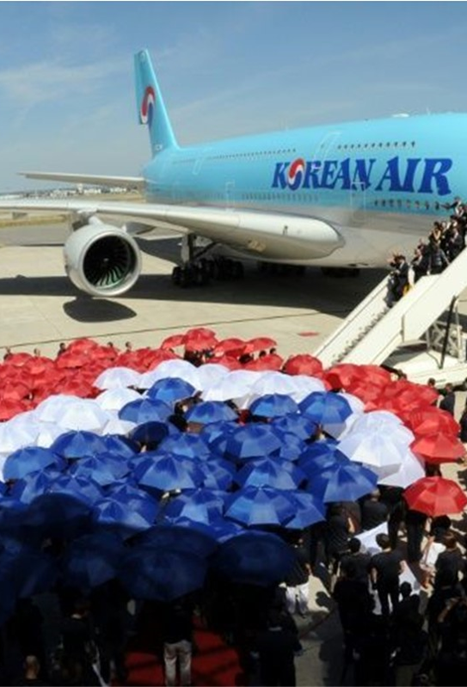
Post-covid… airline industry consolidation
CASE STUDY 1
Korean Air to take over troubled Asiana Airlines for $1.6 bn
Consolidation within the global aviation sector devastated by the coronavirus pandemic – former rivals now joining together
Stabilises the Korean aviation industry which is suffering from the Covid-19 pandemic
The deal includes Asiana's affiliates - low-cost carriers Air Seoul and Air Busan.
“…it is inevitable to restructure the domestic aviation market to enhance its competitiveness," Korean Air said
Takeout: Airline consolidation & rationalization post-COVID to maximize efficiency and retain country connectivity
Source: https://news.yahoo.com/korean-air-over-troubled-asiana-041436726.html

Slide 11
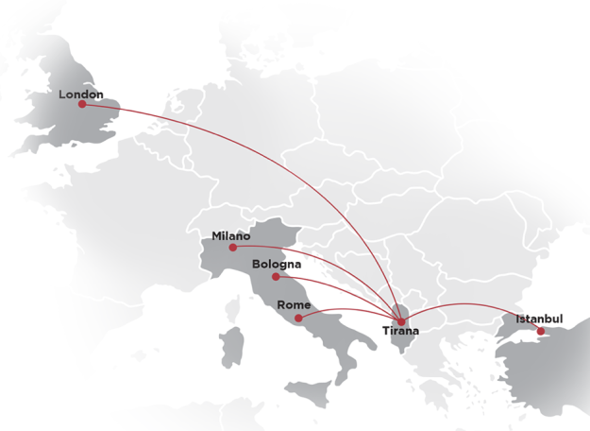

Government and Airline investment model
- foreign airline leadership
CASE STUDY 2
51% Albanian citizen ownership
  10% government investment authority
  41% Albanian national organizations
49% Foreign management (Turkish Airlines)
2 aircraft
Up to 8 destinations (COVID pause)
Established 2019
No domestic routes
Takeout: JV with efficiency of management capability and operations, and speed of startup by proven air operator
11

Slide 12
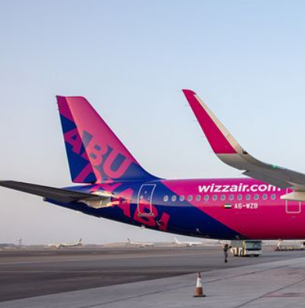
Consortium Ownership/Operating model with Airline expertise
CASE STUDY 3
wizzair Abu Dhabi
Up to 100 aircraft within 15 years
Starting in early 2021
“Attracting more visitors from a wider group of cities in India, Saudi Arabia, Europe and Africa”
Government 51% interest through Abu Dhabi Development holdings (ADQ)
National Airline of UAE status
Takeout: National investment model with proven foreign airline leadership and national airline status to add visitors
12

Slide 13

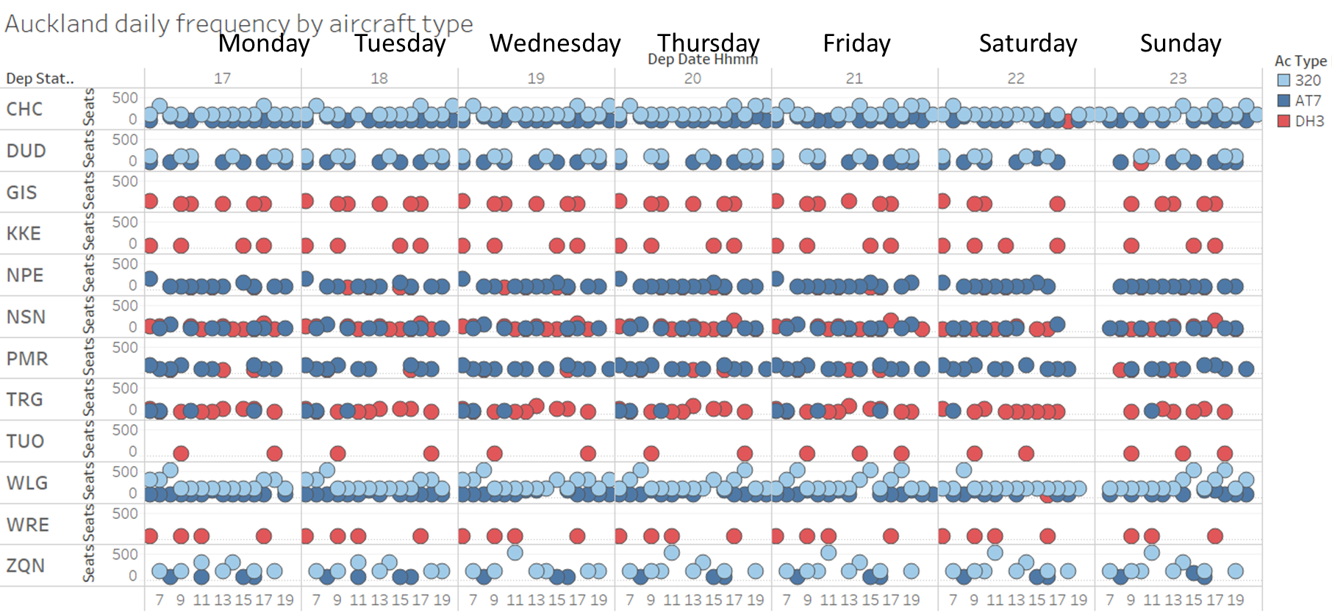
PrivatiZed national airline with high frequency regional turboprop flights to small cities
CASE STUDY 4
Picture https://samchui.com/2018/11/12/air-new-zealand-and-atr-investigating-hybrid-aircraft/
Distances flown:145km to 1045km
Population
350,000
130,000
35,500
6,500
65,000
52,900
88,500
131,500
39,300
250,000
77,000
16,000
48 ATRs & Dash-8s
50% of airline fleet
ILLUSTRATIVE
– as at February 2020
Takeout: Affordable airfares, mix of jet and turboprop, high load factor, contribute to a high profitability route network in New Zealand (population 5 million)

Slide 14

Aviation & tourism - opportunity & requirements

Slide 15
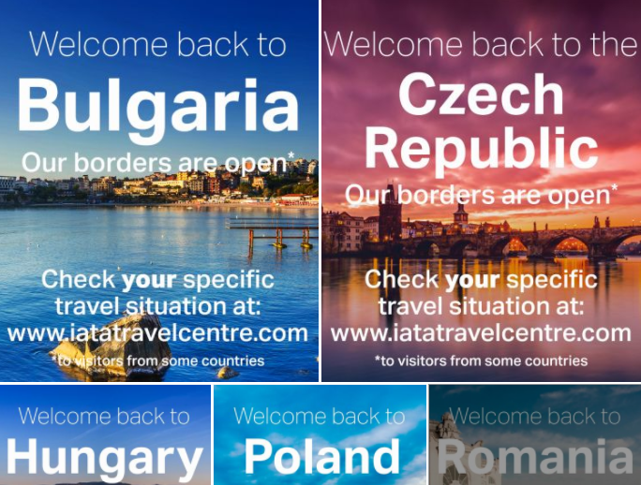

Country level promotion by public & private sectors is crucial to restart inbound visitor traffic
Destination competition is intense
Demand is highly price-sensitive
Both Connectivity and frequency are very important
New, less-familiar, markets benefit from tourism packages
Country-level promotion essential

Slide 16
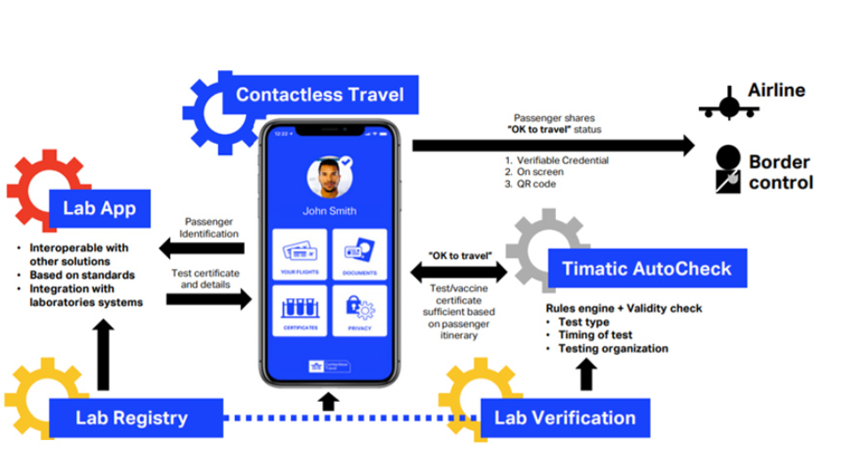

Rapidly changing process landscape requires fast, adaptable, yet robust capabilities to participate in global traveller movement
“Iata announces digital health pass plan” ¹
- biometric contactless travel pass
EXAMPLE ONLY
“…if successful, will launch in the first quarter of 2021”
ILLUSTRATIVE
¹ Source: https://www.businesstravelnewseurope.com/Air-Travel/IATA-announces-digital-health-passport-plan – 23 November 2020
https://www.biometricupdate.com/202011/iata-plans-trial-of-biometric-health-travel-pass-to-ease-border-reopenings

Slide 17




government & AVIATION stakeholders DETERMINE demand & capacity supply
GLOBAL ALIGNMENT AND OPTIMIZATION
Global
Policy
Process
Systems
Foreign government regulations/policy
GLOBAL/ PRIVATE
Traveller profiles, Air travel bookings
Airline Reservations/Departure Control systems, TIMATIC, EDIFACT
OK to Travel? YES/NO
Approved Government quotas & Passenger Demand
Border Control
Border entry approvals, Airline seats available
NATIONAL/ PUBLIC
DEMAND
Approved Countries list
SUPPLY
Health Transport Customs Immigration Police
Government Ministries
ILLUSTRATIVE

Slide 18

Way forward
Speed to prepare for the change is essential
  Aviation governing bodies advocating for easier border crossing
  Many vaccine makers launching products now
  Major airlines proposing e-Border with holder Vaccine certification
  Travel bubbles are imminent, and will rapidly change
Limited time is available to reset air transport strategy, to increase efficiency and adapt to a new norm post-COVID
Markets are shifting and country strategy & policy can enable the restoration and growth of the sectors
Clear strategy and alignment is crucial at both public and private sector level

Slide 19
Thank you!
Спасибо большое

