Slide 1



“How to Develop Air Services and Align Tourism”
Webinar – February, 10th 2021
CAREC Aviation
Simon Russell
International Aviation Expert,
MD Eagle Aviation Consulting Ltd, simon@eagleavia.com +64 21 657 050

Slide 2

Common observations in developing aviation markets
…. Aviation policy must be set and aligned with tourism and export needs
Country strategy unclear
High airfare prices
Poor flight frequency
Air service bilateral agreements (ASAs) not utilized
Tourism strategy not linked with Air Transport sector

Slide 3
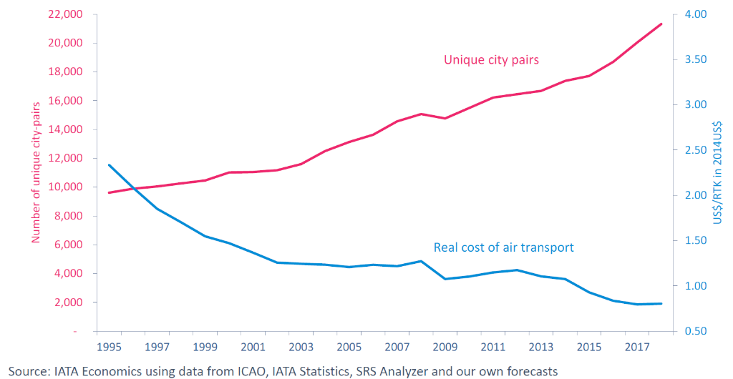
Lower airfares and increased connectivity benefit tourism
LCC strategy and profitability focus is on new un-contested routes
Real air transport costs have reduced through technology and productivity
Unique city pairs and real cost of air transport
Unique city pairs
Number of unique city pairs
Real cost of air transport
…efficient growth requires Aviation Policies for market liberalisation

Slide 4
questions
Are tourism operators prepared for national standards on COVID minimization for travelers?
  No
  Some preparation
  Yes
Is the travel industry aware of international standards & measures to restart Aviation & Tourism safely?
  No
  Some
  Yes

Slide 5












Government strategy & policy creates the ‘climate’ for Aviation and Tourism to conduct business and grow
Aviation
National Strategy, Policy, & Actions
Tourism
International
CAA
NTO
Civil National
Aviation Tourism
Office
Domestic
Border
Market Demand
GOVERNMENT
Economy
Tourism
Commerce
Transport
Customs
Tourism
Attractions & Services
Airlines
Airports
Tourism
Providers

Slide 6
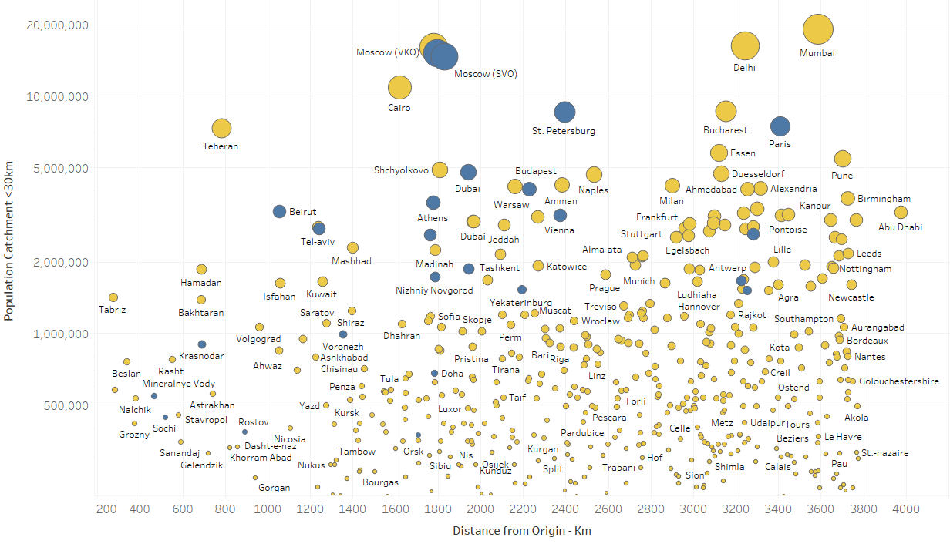
NEW CONNECTIVITY OFFERS RESTART OPPORTUNITIES
Distance from Major city airport - by Population catchment > 250,000
1,000km-3,800km
Non-stop flight
ILLUSTRATIVE ONLY
500 cities
Un-served
<1,000km
25 cities
Population catchment <30km from nearest airport
Distance from Origin airport
TURBOPROP
AIRCRAFT
NARROWBODY JET
AIRCRAFT
Smaller capacity aircraft support low passenger volumes post-COVID period - 2021-2024

Slide 7
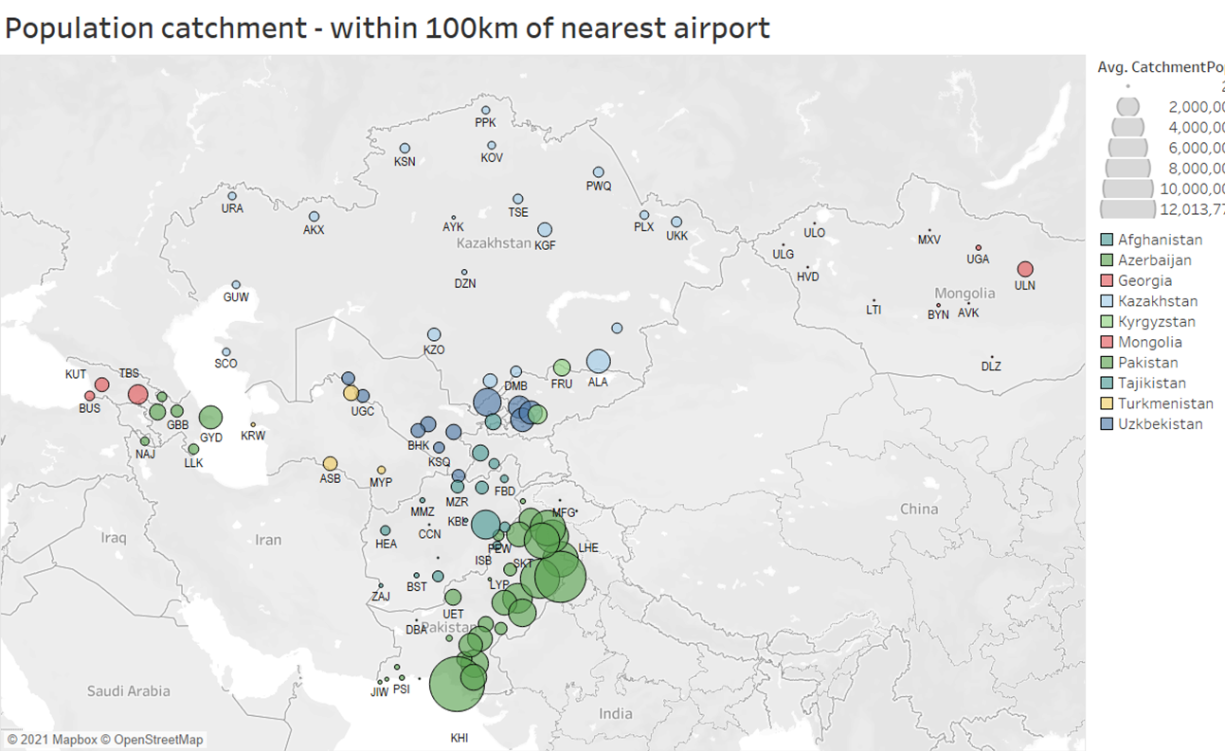
Воздушные перевозки в внутренние / региональные города могут помочь в восстановлении туризма и создании рабочих мест.
Air services to domestic/ regional cities can assist in rebuilding tourism & creating jobs
Город / Население - в пределах 100 км. От ближайшего аэропорта.
НАСЕЛЕНИЕ POPULATION
City / Population - within 100 km. From the nearest airport.

Slide 8
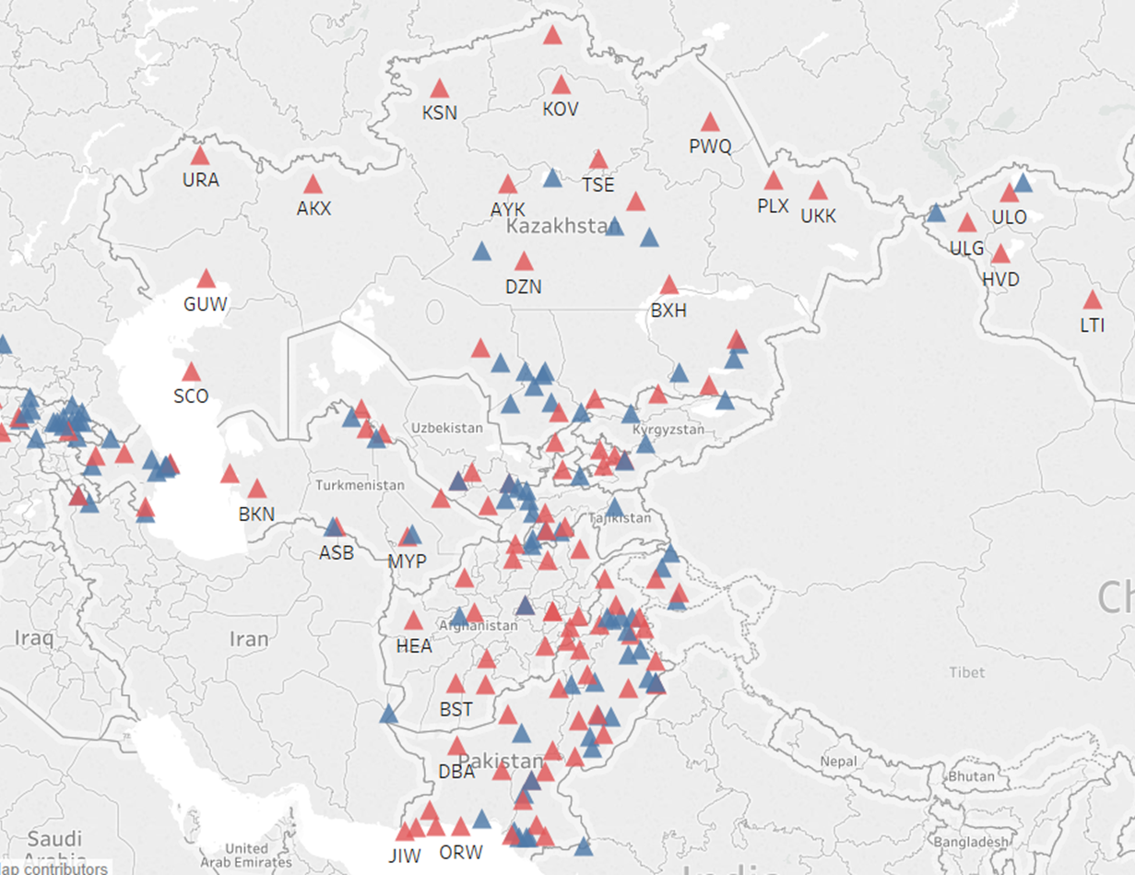
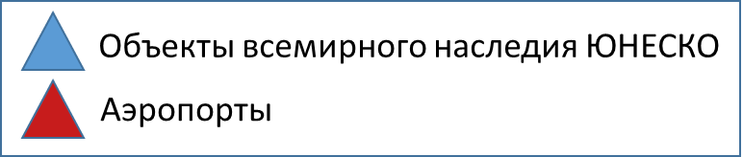
Air services open up rural areas for business travel, gender equality opportunities, poverty reduction, and ease of inbound tourism itineraries
Many attractions are close to domestic airports
Business cases needed to prioritize potential developments
ILLUSTRATIVE ONLY

Slide 9




Country-level alignment of tourism supply chain and development of packages for new inbound tourism markets?
Potential new markets?
UK Poland Saudi Arabia
70m 13m 22m
Outbound tourists 2018
Source: https://www.unwto.org/country-profile-outbound-tourism

Slide 10
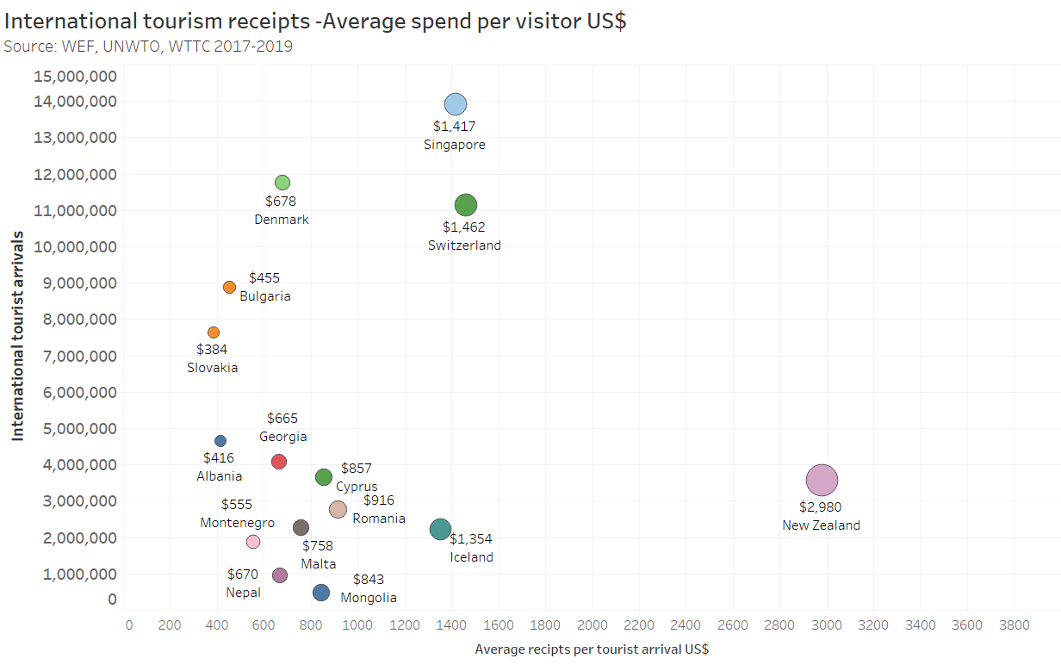
Increasing average spend per visitor is a key tourism strategy
ILLUSTRATIVE SAMPLE ONLY
Average $ receipts (spend) per visitor
US$ visitor receipts per arrival
Source: UNWTO, WTTC, WEF – 2017/2018/2019

Slide 11
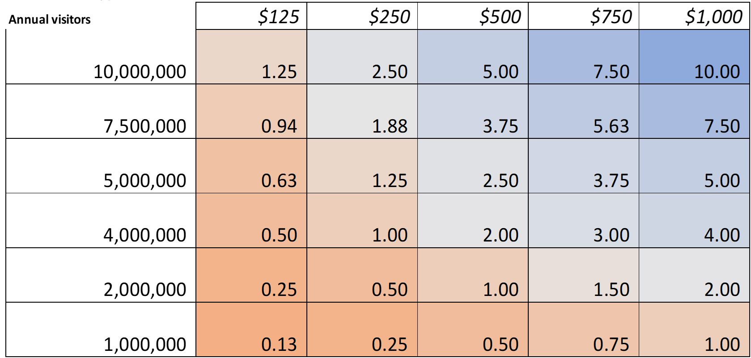
Tourism strategy to increases average spend per visitor could add +$0.5-$2.5 bn p.a.
Средние расходы посетителя за посещение в долларах
Average visitor spending per visit in US$
Ежегодные посетители
Annual visitors
Завтра
“TOMORROW”
Сегодня
TODAY
Example
Миллиарды долларов США в год US$ billions per annum

Slide 12

Tourism Development Fee Options – $5m-$25m annual potential
Analysis,/Benchmarking – 2019 sample
Tourist taxes comparison 2019
City/country | Type | Low rate | High rate | Average
Rome | Tourist tax | €3.00 | €7.00 | €5.00
Venice | Entrance ree |  | €10.00 | €10.00
Greece | Tourist tax | €0.50 | €4.00 | €2.25
Antwerp | Tourist tax |  | €2.72 | €2.72
Bruges | Tourist tax |  | €2.00 | €2.00
Bucharest | 1% of room rate | €0.50 | €1.00 | €0.75
New Zealand | Tourism infrastructure fee |  | $23.94 | $23.94
Bulgaria |  | $0.12 | $1.74 | $0.93
Croatia | Tourist tax | $1.22 | $1.53 | $1.38
Portugal | Tourist tax | €1.50 | €2.00 | €1.75
Budapest | Accommodation tax 4%
Czech Republic | Accommodation tax | €0.50 | $0.50 | €0.50
OPTIONS
Foreign Visitor tourism development fee - Potential *
Tourism development fee - potential opportunity | Volume up to | Low rate | High rate | Average rate | Annual revenue potential US$++
Low visitors | 1 million | $3.00 | $7.00 | $5.00 | $5,000,000.00
Medium visitors | 2.5 million | $3.00 | $7.00 | $5.00 | $12,500,000.00
High visitors | 5 million | $3.00 | $7.00 | $5.00 | $25,000,000.00
* Subject to restoration of tourism volumes Post-COVID-19
Sources:
https://u.ae/en/information-and-services/visiting-and-exploring-the-uae/where-to-stay-in-the-uae/taxes-in-tourist-facilities
https://www.nzherald.co.nz/nz/news/article.cfm?c_id=1&objectid=12186758
https://www.independent.ie/life/travel/travel-news/majorca-and-ibiza-double-tourist-tax-for-irish-holidaymakers-36869199.html
https://edition.cnn.com/travel/article/venice-tourist-tax-day-trippers/index.html
https://www.insider.com/countries-that-require-a-tourist-tax-2019-2#youll-also-find-a-tourist-tax-in-italy-6
https://u.ae/en/information-and-services/visiting-and-exploring-the-uae/where-to-stay-in-the-uae/taxes-in-tourist-facilities
https://www.minfin.bg/en/781
https://business.gov.nl/regulation/tourist-tax/
https://www.businessinsider.com/japan-sayonara-departure-tax-2019-1?r=AU&IR=T
12

Slide 13

Developing an Aviation & Tourism strategy and actions
Estimate Govt & Intl
Strategy Actions Cost Alignment
Conceptual overview
ILLUSTRATIVE ONLY
.
.
.
.
.
.
.
Organisation
-----
-----
-----
-----
$







Civil aviation
-----
-----
-----
-----
$
DRAFT
Aviation
& tourism strategy
connectivity
-----
-----
-----
-----
$
-----
-----
-----
-----
$
airports
airlines
-----
-----
-----
-----
$
Industry data
-----
-----
-----
-----
$
tourism
-----
-----
-----
-----
$

Slide 14
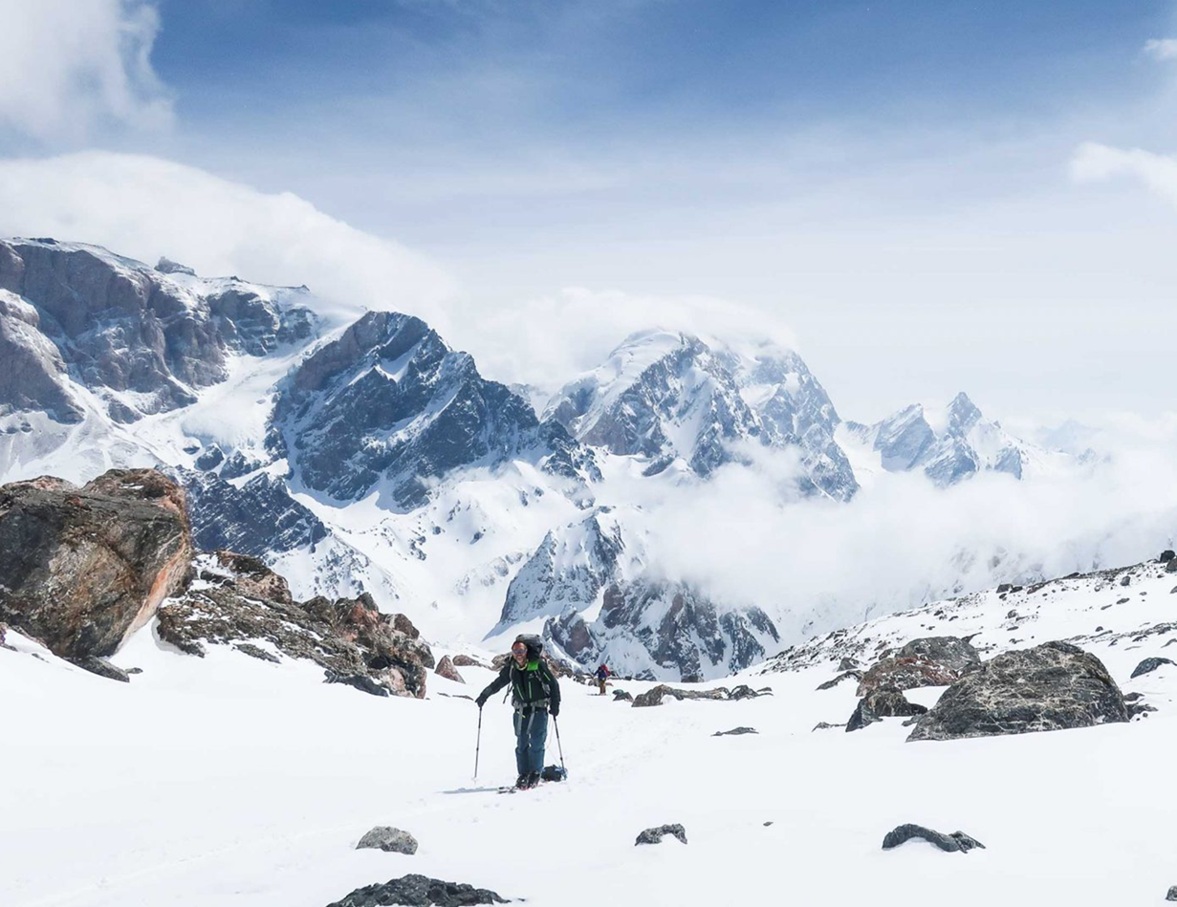
TOURISM RECOVERY ASSISTANCE
Photo: https://adventure.com/tajikistan-skiing-fann-mountains/
Катание на лыжах в Фанских горах, Таджикистан
Skiing in the Fann mountains, Tajikistan

Slide 15
TOURISM RECOVERY ASSISTANCE MODELS
PUBLIC
PRIVATE
Government ministries, departments
Airlines, airports, tourism operators
Policies and initiatives to stimulate the economic recovery of tourism sector
Commissioning of impact needs assessments
Development of country-specific plans for tourism recovery
Fee Waiver – e.g. airport landing charges
Promotional marketing campaigns to coordinate destinational offers (alignment)
Vouchers to stimulate product purchase (local and regional) e.g., “2 for 1”
Waiver of change fees, Promotional pricing– airlines, airport, tourism operators
Research sources:
https://www.unwto.org/news/unwto-releases-a-covid-19-technical-assistance-package-for-tourism-recovery

Slide 16


“$100 vouchers to support local economy”
ПРИМЕР ИЗ ПРАКТИКИ
CASE STUDY
In Australia, New South Wales (NSW) Government’s “Dine & Discover” scheme will rollout from January 2021
Provides NSW residents over the age of 18 with four $25 digital vouchers.
Vouchers can be used at participating eligible businesses and venues who are registered as COVID Safe.
Source: https://www.australia.com/en/places/sydney-and-surrounds/guide-to-sydney.html

Slide 17


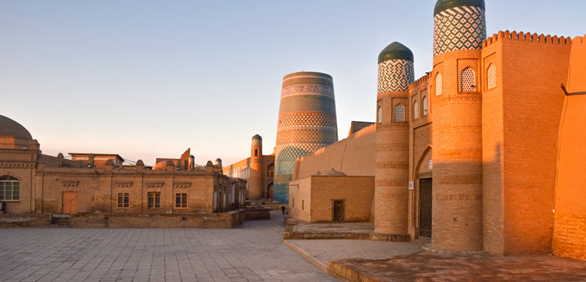
Safe travel applies within carec, as well as to & from carec
Confidence in a safe travel journey is crucial within each country
This requires private operators to work with public on policy & applicable standards, and verification of measures in place
National standards and education of travel operators is a role that Public can lead with Private to harmonise the Aviation & Tourism sectors
Raising awareness and aligning good practice is crucial for a tourism restart – both for internally and internationally
Photo: https://edition.cnn.com/travel/article/beautiful-mongolia/index.html
Photo: https://againstthecompass.com/en/tajikistan-uzbekistan-border-crossing/

Slide 18
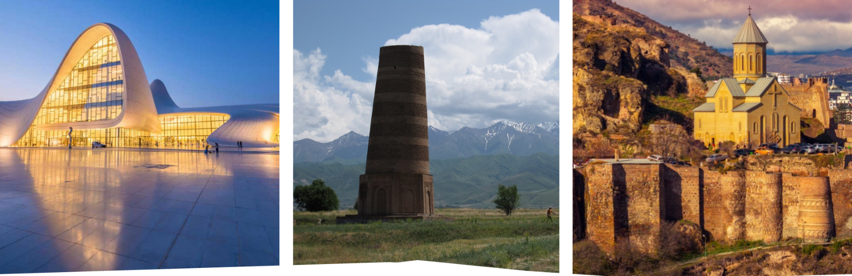
Aviation & Tourism restart opportunity
Photo: https://1.bp.blogspot.com/-rXTUENHq-C8/UHfx9TWIUKI/AAAAAAAATn0/snz-Gzyemm8/s1600/turkmenistan.jpg
Photo: https://www.allerbon.com/wp-content/uploads/2020/02/Azerbaijan-tourism.jpg
Photo: https://media.holidayme.com/images/Georgia/Georgia-635735869577982100.jpg
Ease of booking for country experience
Quality control of venues & events – national standards for Tourism experience & satisfaction
Increasing demand for nature-based products, such as regional, rural, coastal and lake areas*
Development of regional community initiatives promoting employment and skills
Connectivity for domestic aviation network
*UNWTO - https://webunwto.s3.eu-west-1.amazonaws.com/s3fs-public/2020-12/CE113_03_a_Current_trends_and_prospects_international_tourism_En.pdf

Slide 19
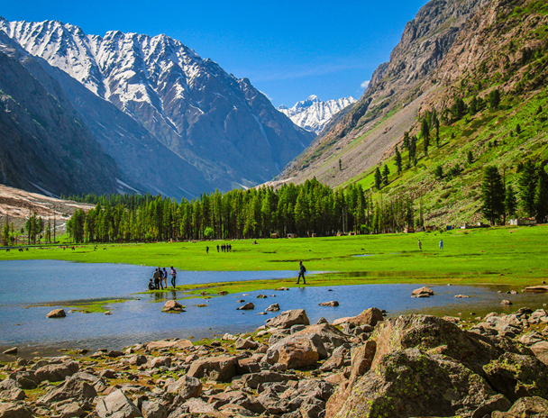


UNWTO developing an international code of practice
Minimum standards and consumer rights of tourists for post COVID -19 global travel
  Restoring tourists’ confidence - guarantee an appropriate degree of protection of international tourists in emergency situations
  Harmonizing minimum standards
  Providing greater clarity and legal certainty
Photo: https://www.tourism.gov.pk/media_gallaries.html
Alignment with global emerging trends and practices can help to position CAREC in readiness for a restart
Photo: https://aboutkazakhstan.com/blog/nature/ulytau-one-the-oldest-mountains-in-kazakhstan/
Source: https://webunwto.s3.eu-west-1.amazonaws.com/s3fs-public/2020-12/CE113_03_a_Current_trends_and_prospects_international_tourism_En.pdf

Slide 20
Спасибо за внимание!
Thank you!

