Slide 1
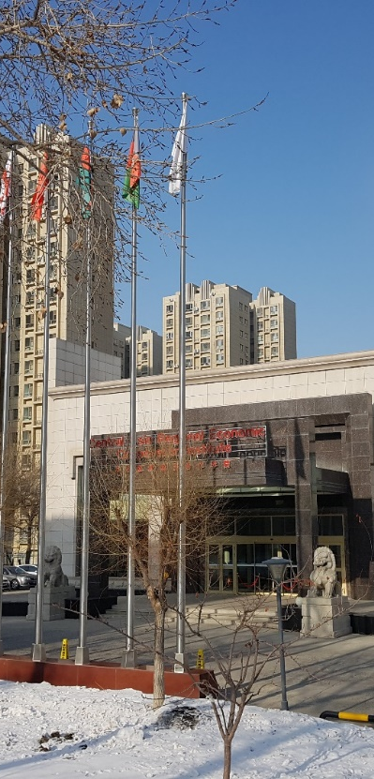


CAREC Institute Work Plan and Key Highlights
Presentation at Virtual CAREC Senior Official’s Meeting
By
Syed Shakeel Shah
Director

Slide 2
Research
Research Conference “Covid19 and Potential for Economic Recovery” . March 2021
Economic and Financial Stability Cluster
1. Financial Inclusion in the CAREC Region: Promoting Fintech to Meet Underserved Needs in Trade
2. Financial Inclusion and Fintech in CAREC: Constraints and Prospects
3. Debt and Financial Sustainability in the CAREC Region
Trade, Tourism and Economic Corridor Cluster
Framework for E-Commerce Development in CAREC – Focus on Infrastructure Development - Phase II
Developing a Framework for Mutual Recognition and Electronic Exchange of Phytosanitary Certificates in CAREC
Pakistan's trade with Central Asia- Chapter contribution in a book being published by Oxford
COVID-19 and Tourism Sector in CAREC Region: Harnessing Role of Technology in Promoting Safe Tourism Destination
Free Trade Agreement (FTA) Design for the CAREC Region
Digital CAREC: A Gap Analysis

Slide 3
Research
Infrastructure and Economic Connectivity Cluster
Infrastructure in Central Asia and Caucasia-Book Chapter in ADBI Project
Sustainable Pathway of Energy Security in CAREC Region
Agriculture and Water Cluster
Dialogue and Information Platforms for Agriculture and Water Cooperation in CAREC Region
Case Studies and Analysis of Technology Innovations and Diffusion for High-Value Crops in CAREC Region
Regional Climate Vulnerability in CAREC and Perspectives for Regional Cooperation.
Reviewing Migration and Development: Local authorities' role in Central Asia
Human Development
Reviewing Migration and Development: Local authorities' role in Central Asia
Development of Sustainable Water and Sanitation Systems in Rural Areas of CAREC Region with focus on China, Mongolia, Tajikistan, and Uzbekistan

Slide 4
Capacity Building
E-Learning Platform
Capacity Building Events
Training of Trainers program
Expert Roundtables
Increase in number of trainees
Availability of Videos of Training Events

Slide 5
Macro-Economic Analysis and CAREC Regional Integration Index (CRII) and Enhanced Outreach
Macro-Economic Analysis and CRII
CRII Updated for latest values
Quarterly Economic Monitors as regular product
Economic Briefs
Sustainable Development in Asia and the World: The Road towards Sustainable Recovery in a Fast-Changing World-Chapter contributed by CI in Boao Forum Report 2021
Outreach
13 adaptations of Knowledge products published at Development Asia Blog of ADB
Inputs into ADB Economists Forum and TRACECA 2030 concept
Coverage of events / reports in 60 media outlets in 8 countries
Russian Translation of 17 Knowledge Products

Slide 6
Institutional Development
CI’s Updated Strategy 2020
Proposal on revamping Advisory Council
Financial Sustainability and Resource Mobilization Strategy
Host City MoU and CI’s Permanent Campus
Two Governing Council Meetings Planned (July and December)
CTTN Virtual Dialogue (March 2021)
CTTF planned for October 2021

Slide 7


