Slide 1
CAREC Value ADDITION to regional investment projects Uzbekistan: Pilot project-Kashkadarya masterplan risk screening
8 July 2024

Slide 2
TA-9414: Supporting Adaptation Decision Making for Climate Resilient Investments in Uzbekistan
Summary
Deliverables
Commenced in July 2021
Key stakeholder:
Ministry of Economy and Finance
Focus on agriculture, water, and transport sectors
Aug-Sep 2021: Stakeholder consultations
14 July 2022: Workshop on Using Climate and Disaster Risk Information
1-2 December 2022: Consultation mission
11-14 April 2023: Dissemination of first-stage assessment, consultations, and capacity building workshop
23-26 October 2023: Dissemination of second-stage assessment, consultations, and capacity building
Consultations and assessment of climate, natural hazards, environmental and other socioeconomic data needs and availability - completed
Capacity building to enhance awareness on the application of climate and disaster risk information - completed
Development of country-specific tools – completed

Slide 3
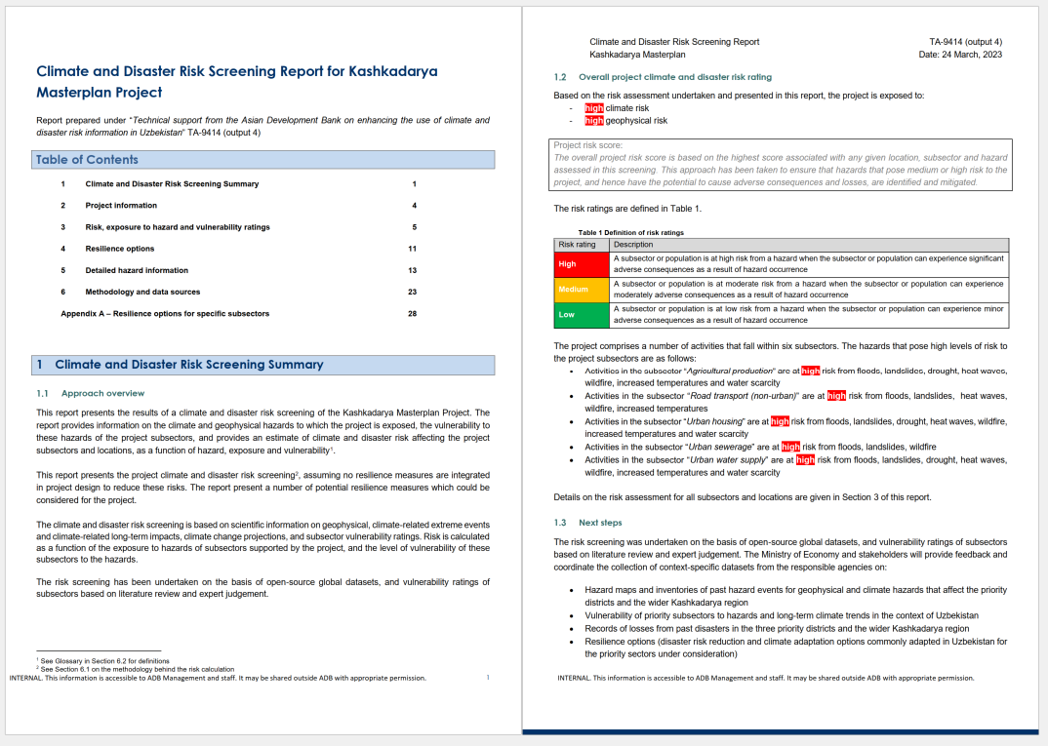
Climate and Disaster Risk Screening Summary
Risk screening for Kashkadarya Masterplan
Two-stage approach to risk screening
First-stage: using report template and data from global datasets, as in the risk screening tool being developed by ADB
Output: report issued in April 2023
Second-stage: revised screening report with supplementary or complementary local data, provided by MoE and stakeholders
Data provided in Summer 2023
Output: report issued in December 2023
Both stages supported with capacity building
Status/next steps:
Second-stage report delivered
Capacity building

Slide 4
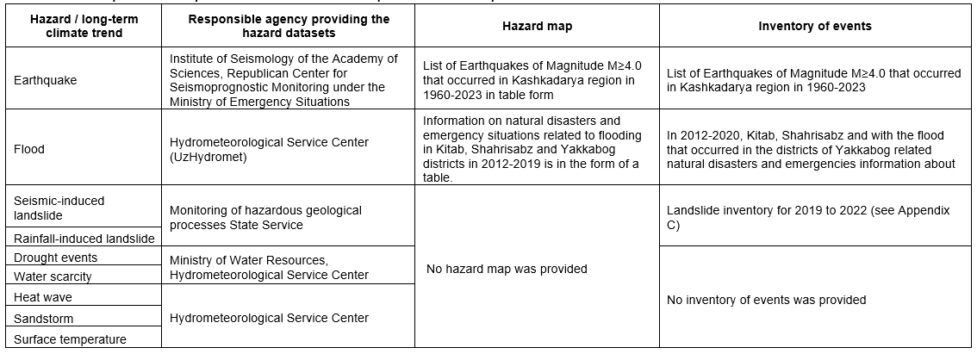
Data provided by MoE and stakeholders
Hazard maps and inventories of past hazard events for geophysical and climate hazards that affect the priority districts and Kashkadarya
A request for information was made for maps and inventories of geophysical and climate hazards that affect the priority districts and the wider Kashkadarya region. The responsible agencies useful lists of earthquake and flood events. This information was plotted in GIS and maps were produced.
The request for information did not yield any information (in the form of maps or inventories of events) for the remaining climate and geophysical hazards. These include climate hazards (drought, water scarcity, heat waves, surface temperatures) that the present risk screening has shown to pose high risks to the economy sectors under consideration.
It is not clear whether this information is not collected by the responsible agencies; whether the information is in a format that cannot be shared digitally; or whether the information exists but the responsible agency declined to share it. At the time of writing, a request for clarification had been issued to the responsible agencies on the missing hazard information.

Slide 5
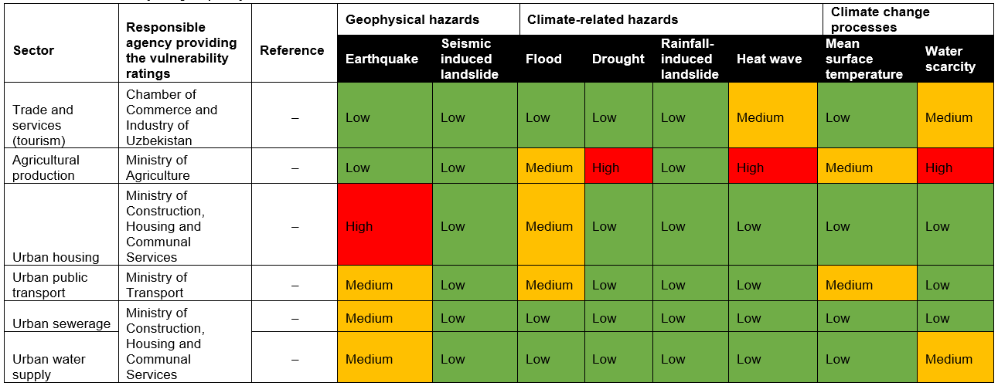
Data provided by MoE and stakeholders
Vulnerability ratings of priority subsectors
A request for information was made for the vulnerability of priority subsectors to hazards and long-term climate trends in the context of Uzbekistan. There is good agreement between the vulnerability ratings provided by the responsible agencies and the vulnerability ratings assigned in the Stage 1 risk screening report based on literature review and expert judgement. This agreement provides confidence both in the capacity of the responsible agencies to asset the vulnerability of the priority sectors to climate and geophysical hazards, and in the vulnerability ratings assigned in the Stage 1 risk screening.
There are no cases of higher vulnerability ratings been assigned by the responsible agencies, compared to the ratings assigned on the basis of literature review and expert judgement. In such cases, the vulnerability rating used in the Stage 2 assessment would have been the higher one, assigned by the responsible agency.

Slide 6
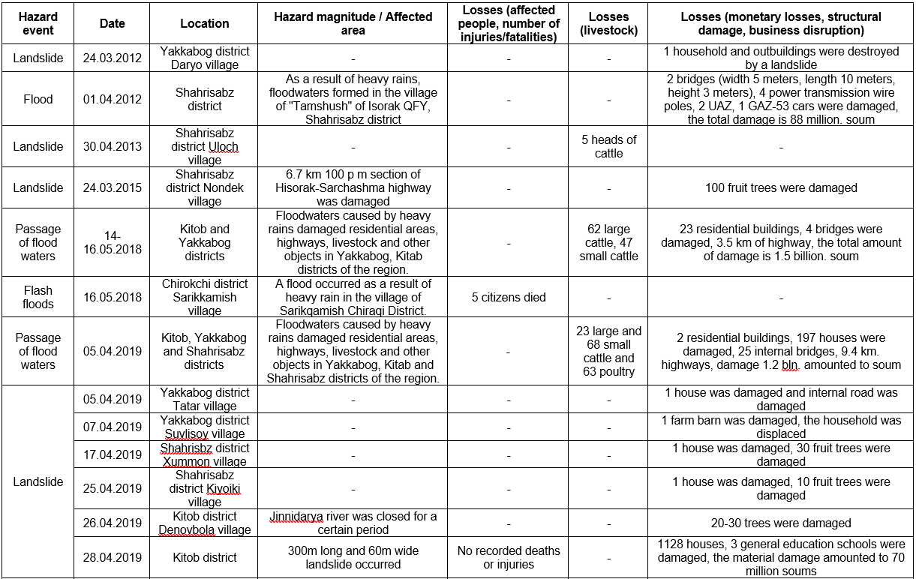
Data provided by MoE and stakeholders
Records of losses from past disasters in the three priority districts and the wider Kashkadarya region
A request for information was made for an inventory of losses from past disasters in the three priority districts and the wider Kashkadarya region.
The following comments can be made:
Recorded losses were provided from landslides, floods and strong winds that occurred between 2012 and 2020.
The data suggest that the region experiences losses from disasters with high frequency (up to several disasters in a given year). These losses confirm the high risk faced by transport infrastructure, buildings and populations from climate and geophysical hazards.
The recorded losses range from relatively minor (damage to fruit trees) to relatively severe (several dead and injured).
No records of losses from drought, heatwave, water scarcity or earthquakes were provided.

Slide 7
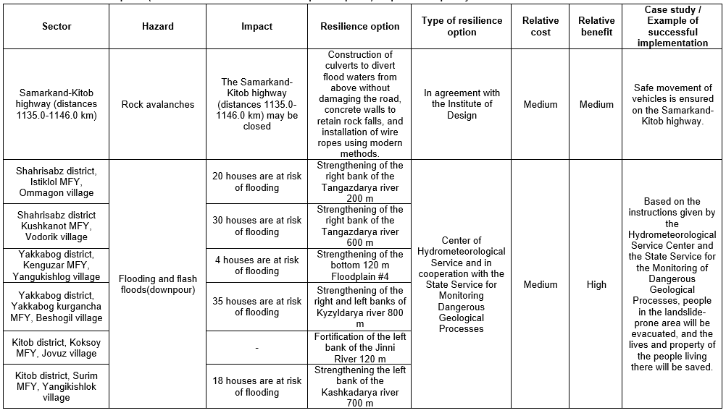
Data provided by MoE and stakeholders
Resilience options (disaster risk reduction and climate adaptation options) adopted for the priority sectors
A request for information was made for resilience options (disaster risk reduction and climate adaptation options) commonly adapted in Uzbekistan for the priority sectors under consideration
Resilience options were provided related to mitigation of landslide risk for the transport sector, and mitigation of flood risk for the housing sector.
The resilience options (diverting of flood waters away from the pavement; retaining walls to retain rock falls; strengthening of riverbanks) can mitigate risk to infrastructure and buildings from landslide and flood events.
No supporting information for the resilience options (e.g., engineering drawings, specifications, examples of completed works) was provided.

Slide 8
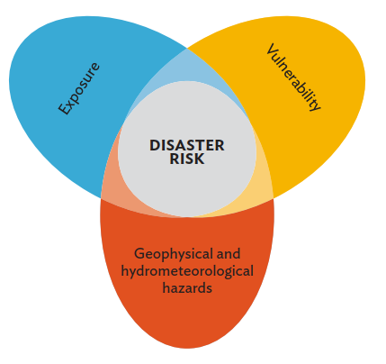
Climate and Disaster Risk Screening Summary
Approach overview / Risk assessment methodology
Risk originating from geophysical and climate hazards is defined as:
R = f(H, E, V) or R = H x E x V
Risk: potential losses triggered by natural hazards over exposed elements.
Hazard: physical phenomena that can cause impact on people and property.
Exposure: location of people, properties, activities in relation to hazards.
Vulnerability: conditions determining the degree of susceptibility to suffer impacts from an hazard.
CLIMATE AND DISASTER RISK
 |  | Hazard type |  |  | Single Risk score for the whole project reflecting max criteria | Project Risk rating and Next Steps
 |  | H1 | H2 | H3 | All hazards combined into Risk score R for each activity a and period t: R_{a,t} = f(H1, H2, H3, ..)
Project sub-sector | S1 | L | H | M |  | High risk → Light-touch or detailed CRA/DRA
 | S2 | L | M | H |  | Moderate risk → Light-touch or detailed CRA/DRA
 | S3 | H | M | L |  | Low risk → End of screening process OR light-touch CRA/DRA if recommended by expert judgment
NB: In IPCC terminology, vulnerability is referred to as sensitivity.

Slide 9
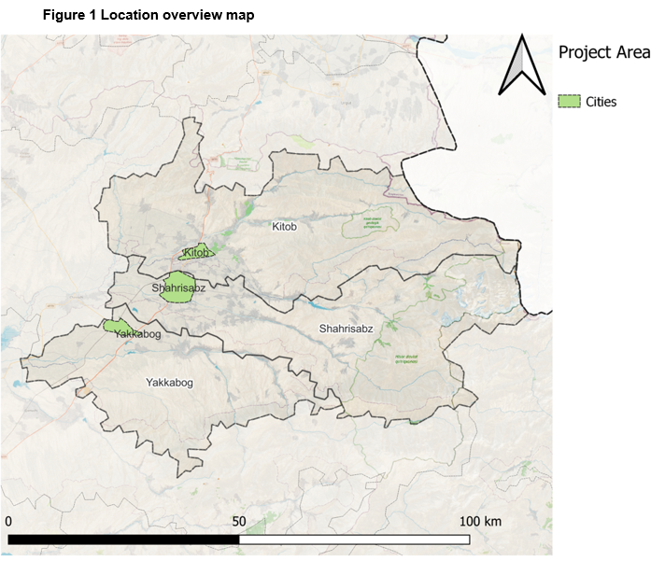
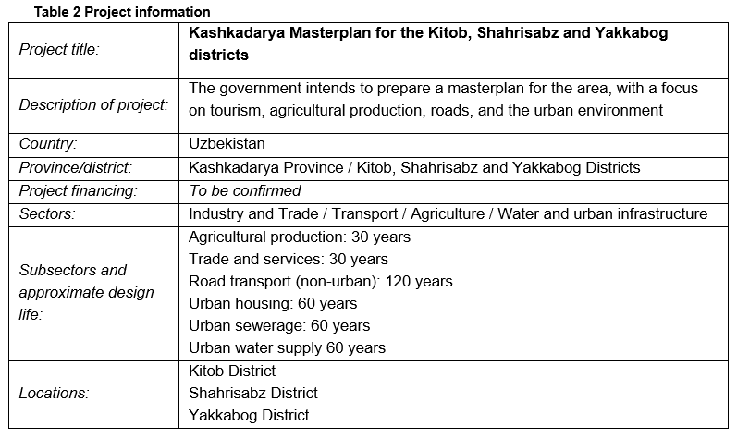
Project information

Slide 10
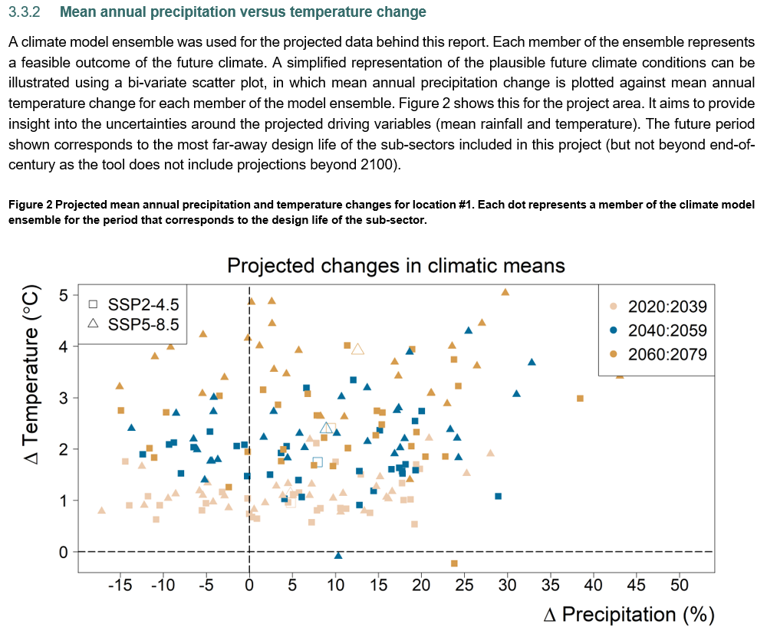
Risk, exposure to hazard and vulnerability ratings
Climate indices – Mean annual precipitation versus temperature change

Slide 11
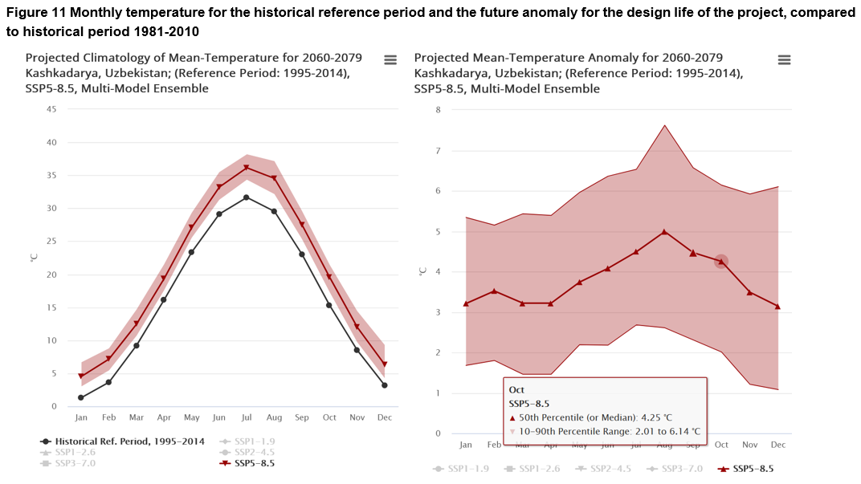
Detailed hazard information
Long-term climate change – Mean surface temperature

Slide 12
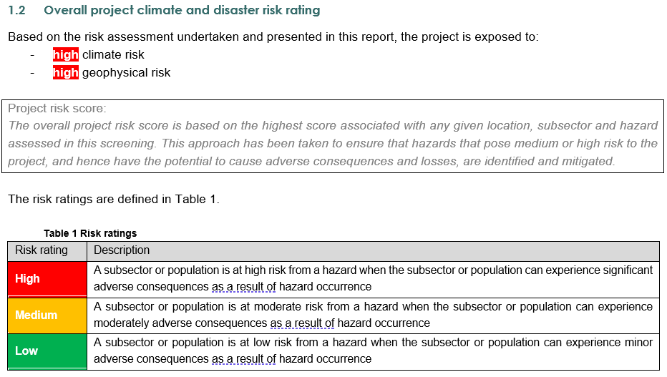
Climate and Disaster Risk Screening Summary
Overall project climate and disaster risk rating

Slide 13
Climate and Disaster Risk Screening Summary
Summary of climate and disaster risk ratings by subsector

Slide 14
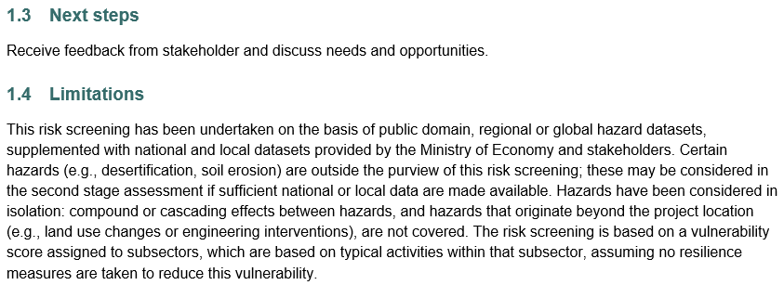
Climate and Disaster Risk Screening Summary
Second-stage risk assessment

Slide 15
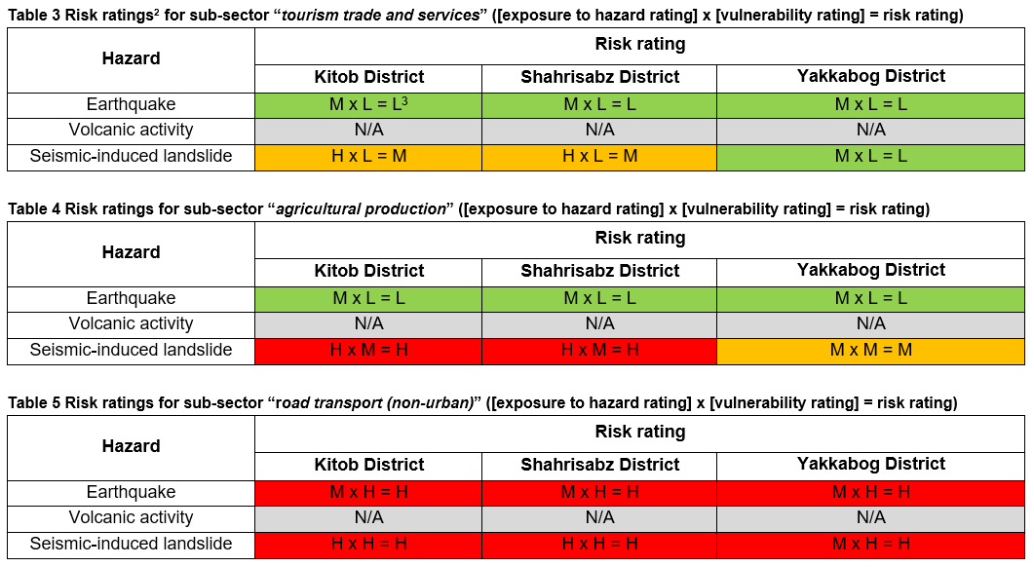
Risk, exposure to hazard and vulnerability ratings
Risk ratings from geophysical hazards

Slide 16
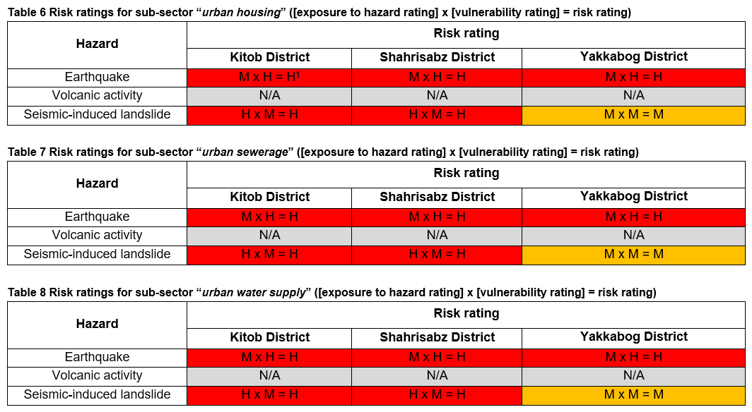
Risk, exposure to hazard and vulnerability ratings
Risk ratings from geophysical hazards

Slide 17
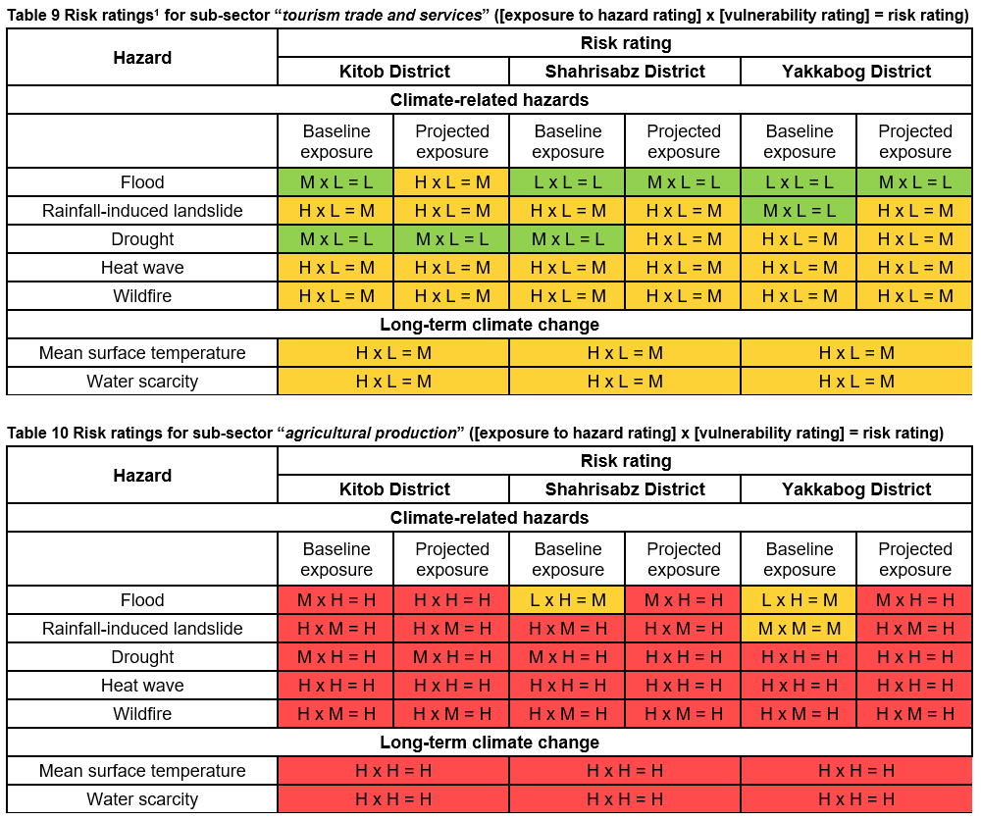
Risk, exposure to hazard and vulnerability ratings
Risk ratings from climate hazards

Slide 18
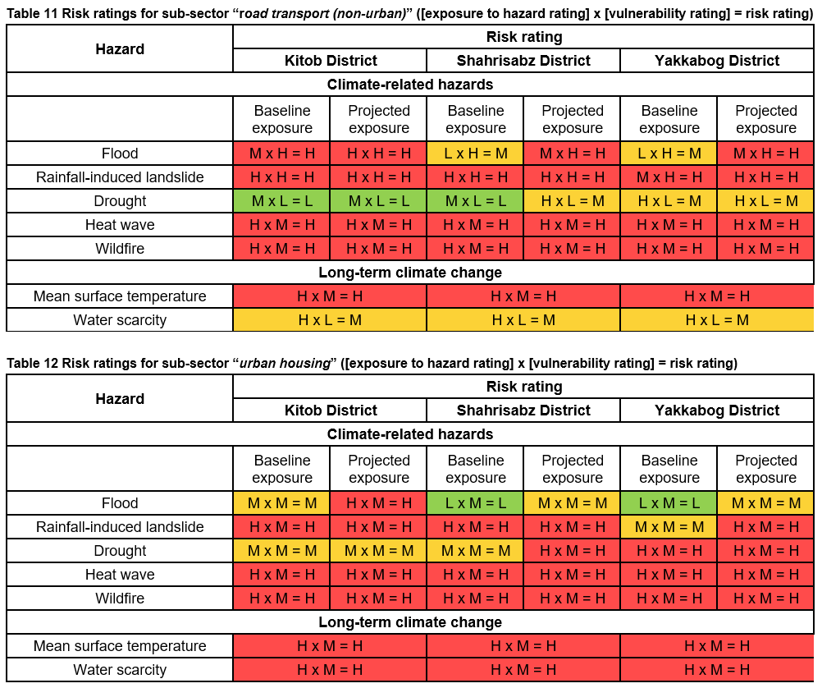
Risk, exposure to hazard and vulnerability ratings
Risk ratings from climate hazards

Slide 19
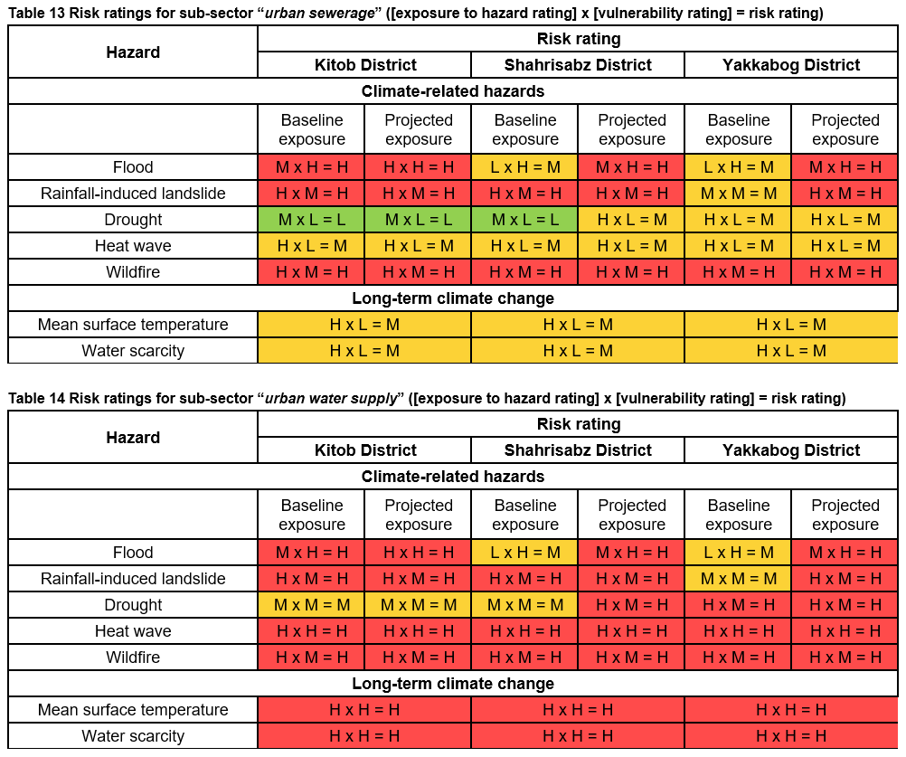
Risk, exposure to hazard and vulnerability ratings
Risk ratings from climate hazards

Slide 20
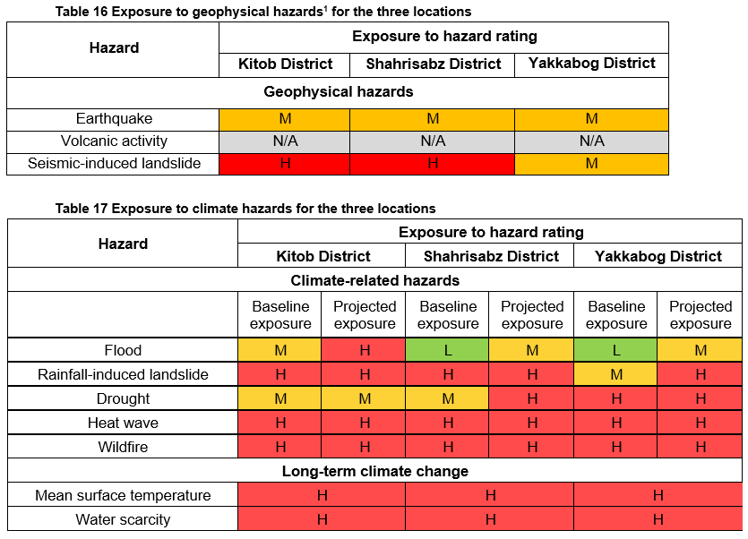
Risk, exposure to hazard and vulnerability ratings
Exposure to hazards

Slide 21
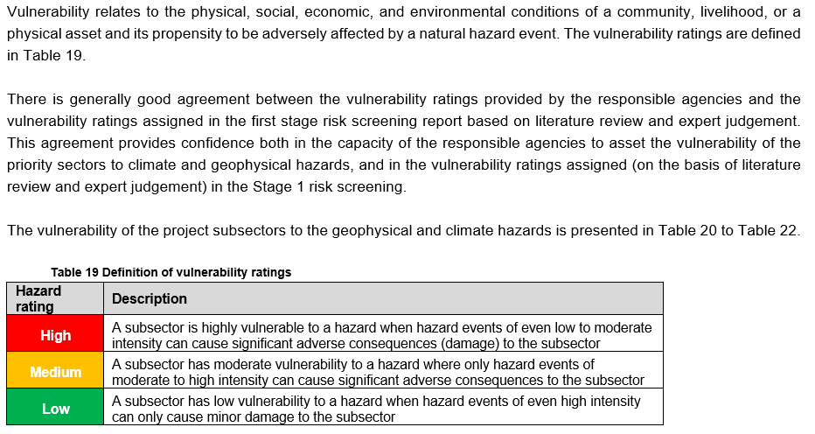
Risk, exposure to hazard and vulnerability ratings
Vulnerability ratings

Slide 22
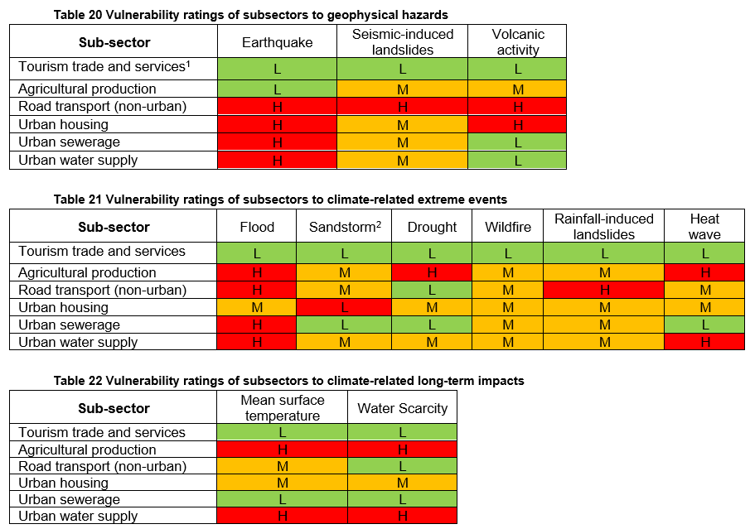
Risk, exposure to hazard and vulnerability ratings
Vulnerability ratings

Slide 23
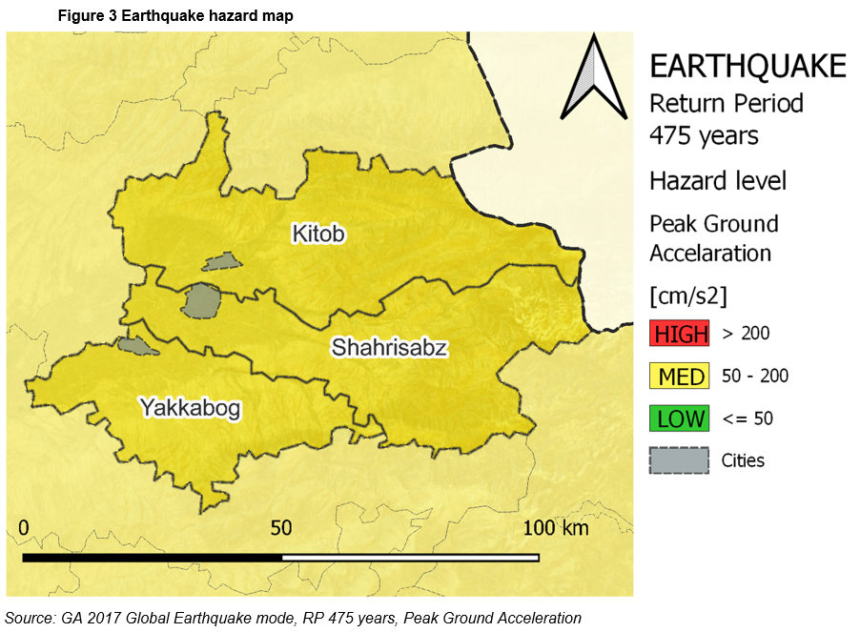
Detailed hazard information
Geophysical hazards – Earthquake

Slide 24
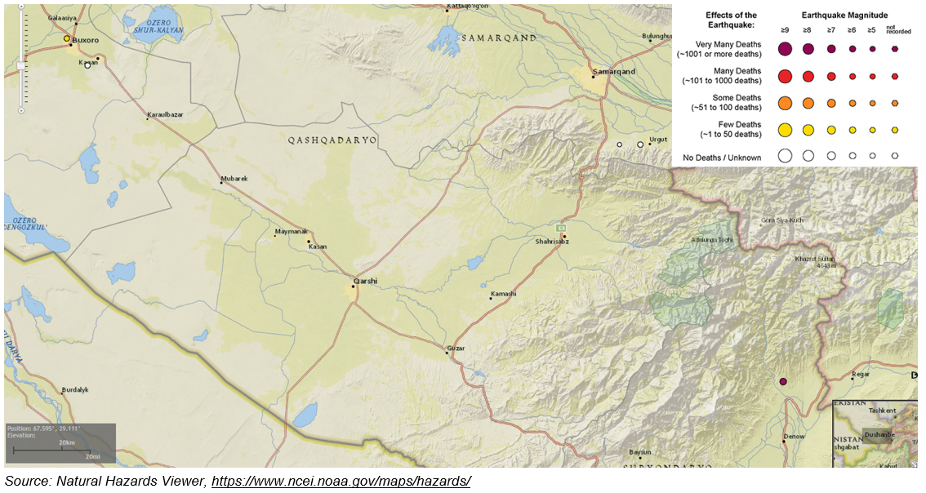
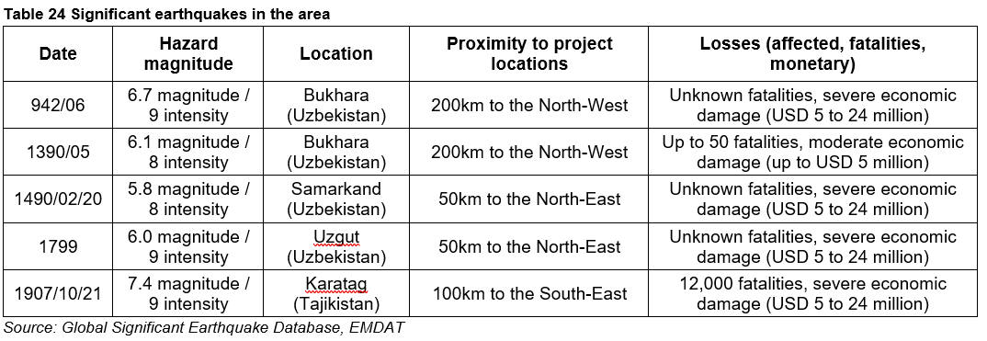
Detailed hazard information
Geophysical hazards – Earthquake

Slide 25
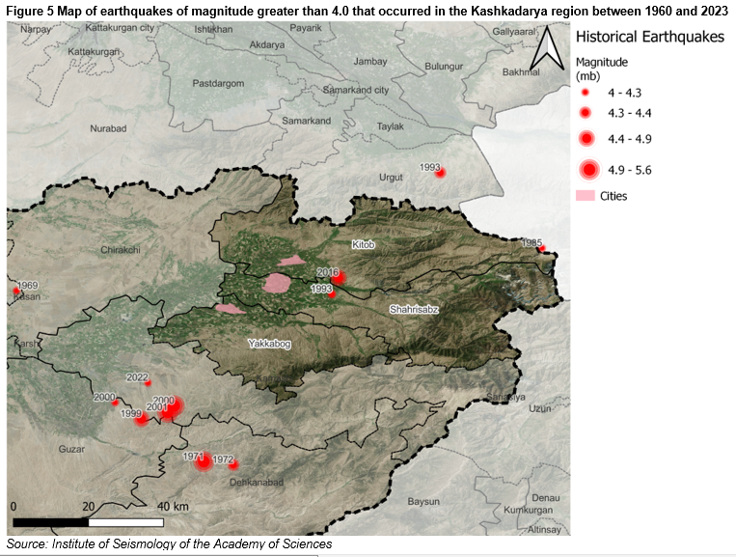
Detailed hazard information
Geophysical hazards – Earthquake
Figure 5 and Table 25 present earthquakes of magnitude greater than 4.0 that occurred in the Kashkadarya region between 1960 and 2023. This information was provided by the Institute of Seismology of the Academy of Sciences (Republican Center for Seismoprognostic Monitoring under the Ministry of Emergency Situations).

Slide 26
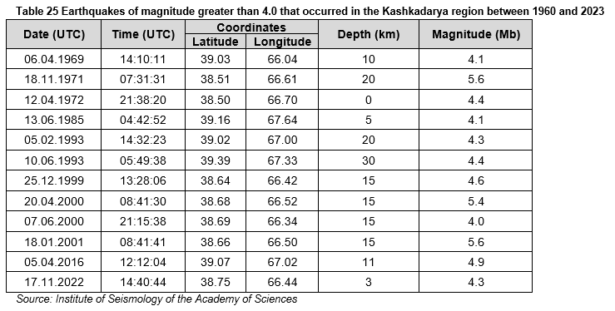
Detailed hazard information
Geophysical hazards – Earthquake

Slide 27
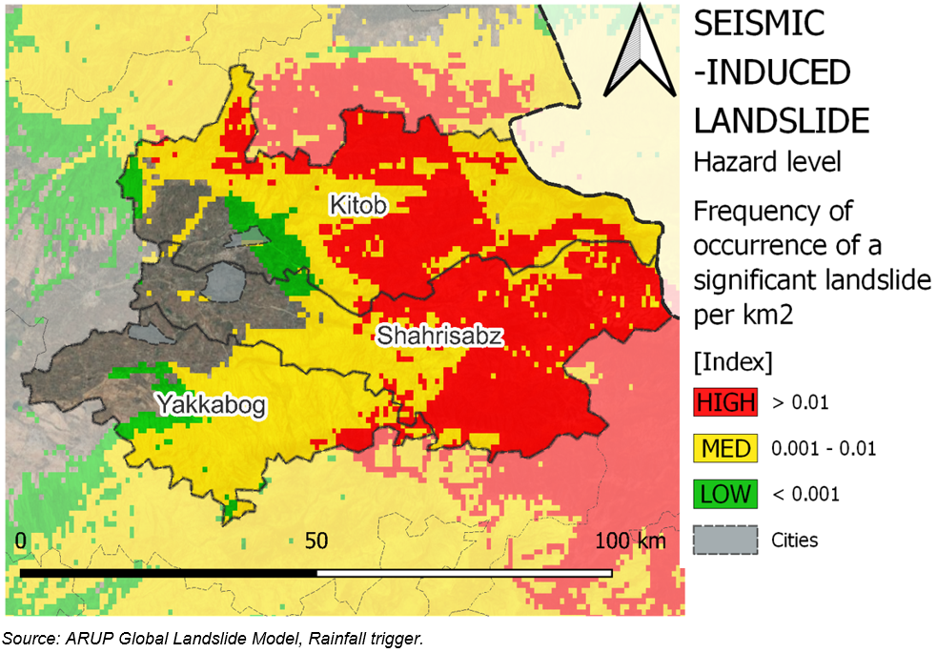
Detailed hazard information
Geophysical hazards – Seismic-induced landslides

Slide 28
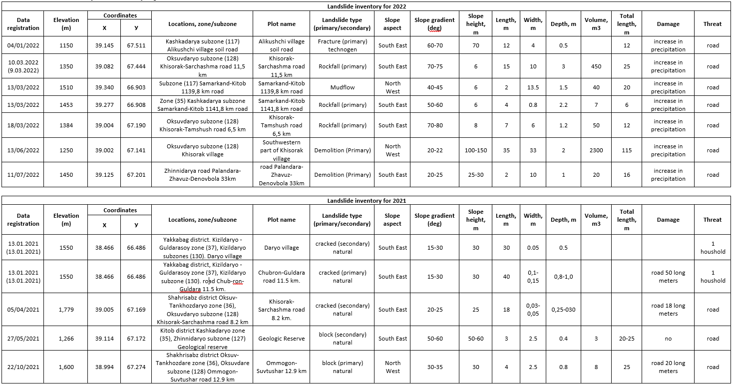
Detailed hazard information
Landsides that occurred in the Kashkadarya region between 2019 and 2022 (information provided by the Monitoring of Hazardous Geological Processes State Service)

Slide 29
Detailed hazard information
Landsides that occurred in the Kashkadarya region between 2019 and 2022 (information provided by the Monitoring of Hazardous Geological Processes State Service)
Valuable information was provided for around 100 landslide events recorded in the Kashkadarya region between 2019 and 2022. The inventory contains a large variety of events, from small rockfalls (with volumes less than 10m³) to large block slides and mudflows (with volumes of several thousand cubic meters).
The triggering factor (e.g., rainfall, seismic shaking, human activities) of the landslide events is not provided.
Certain landslide type terms used in the inventory (e.g., “crack”, “drain”) are not clear. At the time of writing, a request for clarification had been issued to the responsible agencies to edit the landslide catalogue to use internationally recognisable landslide type terms (e.g., rockfall, rotational failure, translational failure, block slide etc.).
No information is provided on the landslide susceptibility factors such as the thickness of soil overburden or the underlying geology type. That information could prove of diagnostic value in assessing locations of likely future landslide events.

Slide 30
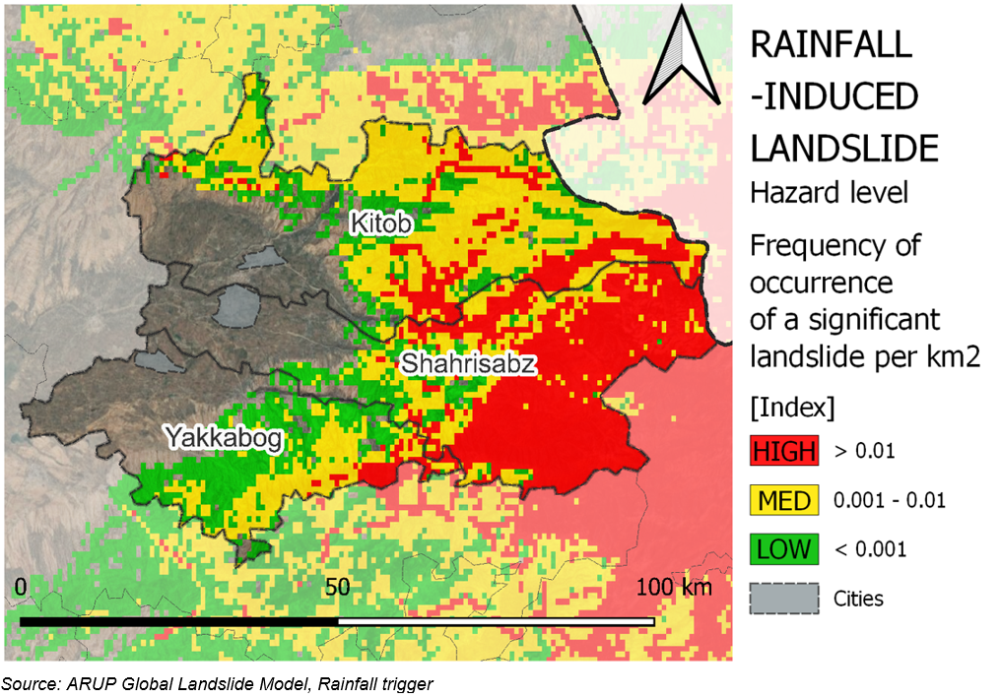
Detailed hazard information
Climate hazards – Rainfall-induced landslides

Slide 31
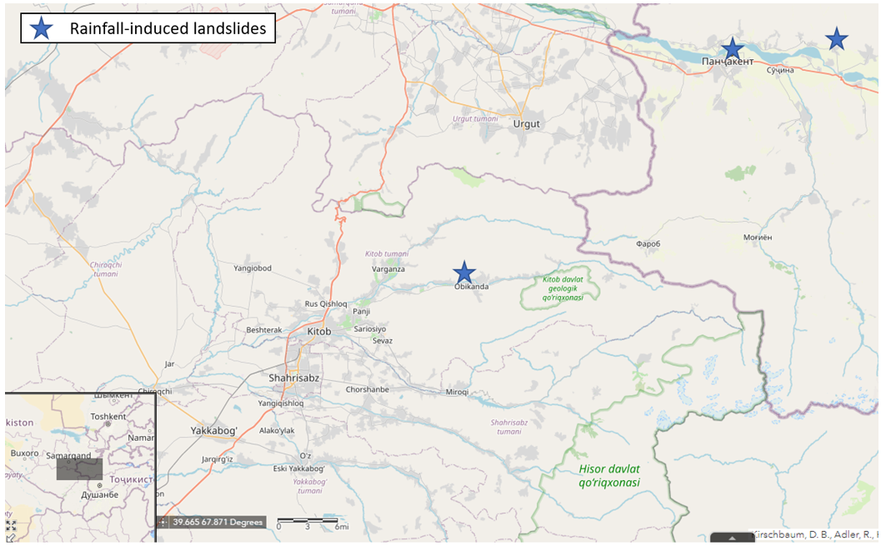
Detailed hazard information
Climate hazards – Rainfall-induced landslides

Slide 32
Landslide monitoring in the Kashkadarya region
Information provided by State Service for Monitoring of Hazardous Geological Processes, Ministry of Emergency Situations, Hydrometeorological Service Center [UzHydromet])
The following comments can be made:
The information confirms that the responsible agencies (Monitoring of Hazardous Geological Processes State Service, Ministry of Emergency Situations, Hydrometeorological Service Center [UzHydromet]) are collecting data on the occurrence of landslides and their impact on roads, canals and households in the Kitob, Shahrisabz and Yakkabog districts of the Kashkadarya region.
The impact of landslides has been mapped along affected assets, with specific sections of highways and canals been identified where landslides can block road traffic or canal navigation.
The findings of the engineering geological observations are captured in document format, which records the observed landslide occurrences; summarises the affected assets; and proposes mitigation measures (e.g., maintenance of roadside ditches, installation of warning signs)
It is not clear whether the responsible agencies:
Capture the landslide monitoring information in a digital system (spreadsheet, database), and to what extent they use GIS to store, analyse and share the information.
Are making efforts to correlate the incidence of landslides with landslide susceptibility factors (e.g., underlying geology, thickness of soil overburden, slope gradient) and triggering factors (e.g., rainfall, seismic shaking, human activities), in order to assess landslide hazard and risk.
Are comparing the effectiveness of different mitigation options (e.g., early warning systems, structural measures, non-structural measures) to reduce risk from landslides to the affected assets and communities.
At the time of writing, a request for clarification had been issued to the responsible agencies to clarify the above matters.

Slide 33
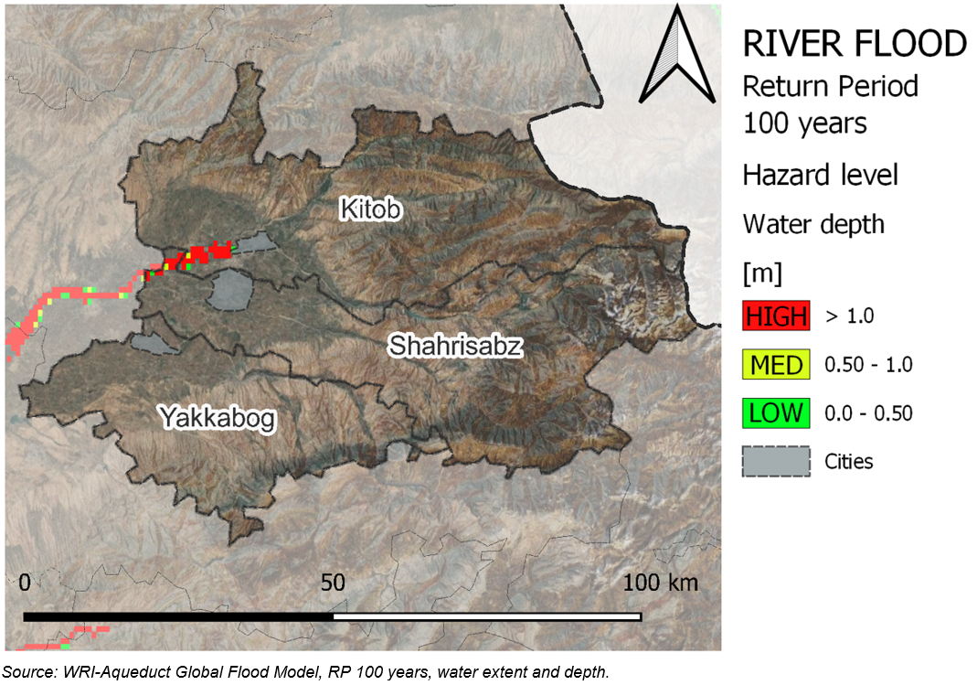
Detailed hazard information
Climate hazards – River floods

Slide 34
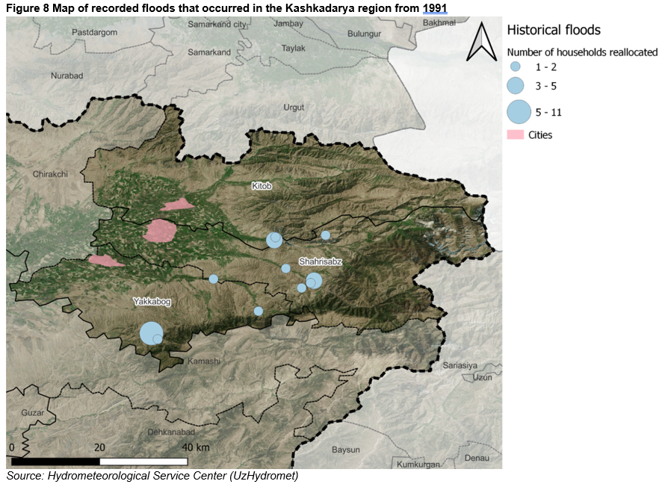
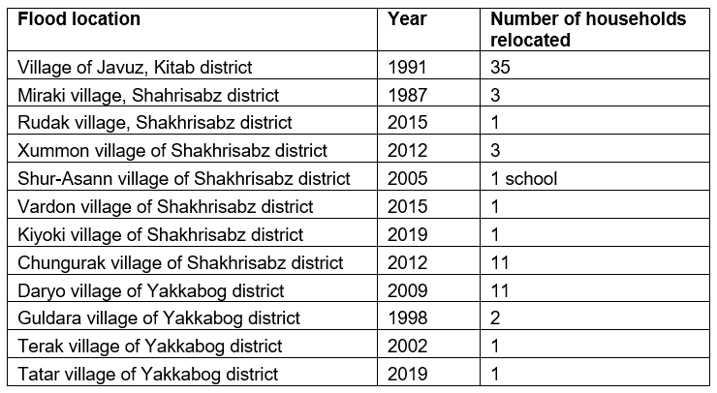
Detailed hazard information
Climate hazards – River floods
Floods that occurred in the Kashkadarya region since 1987. This information has been provided by the Hydrometeorological Service Center (UzHydromet).

Slide 35
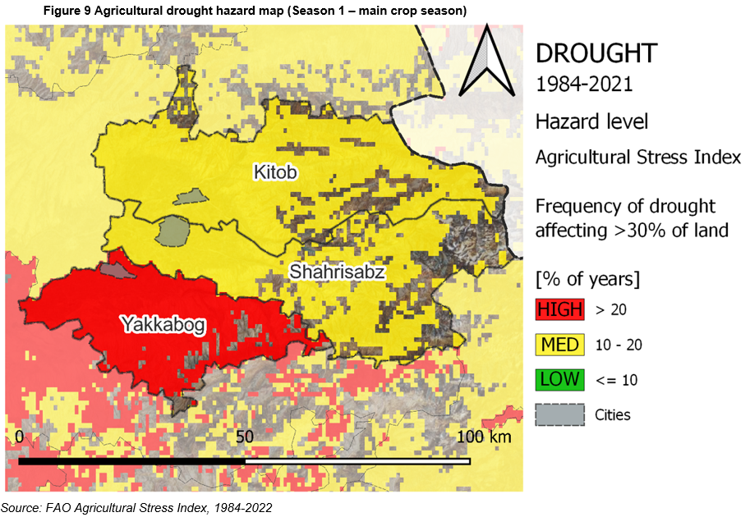
Detailed hazard information
Climate hazards – Agricultural drought

Slide 36
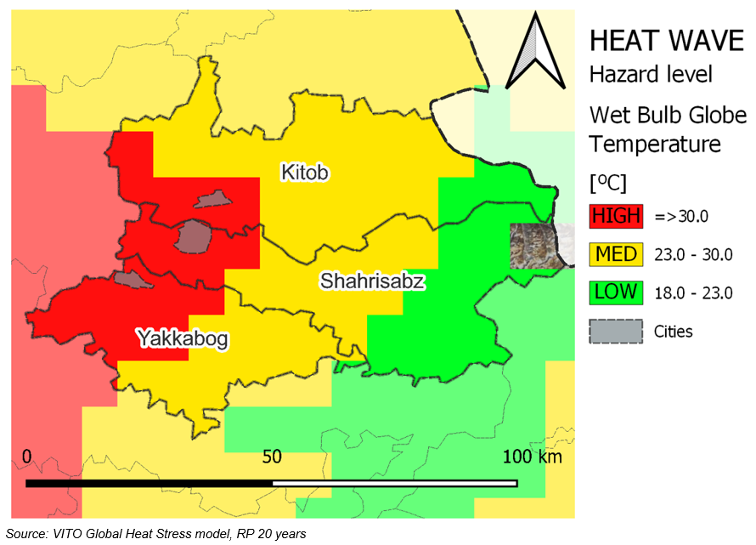
Detailed hazard information
Climate hazards – Heat wave

Slide 37
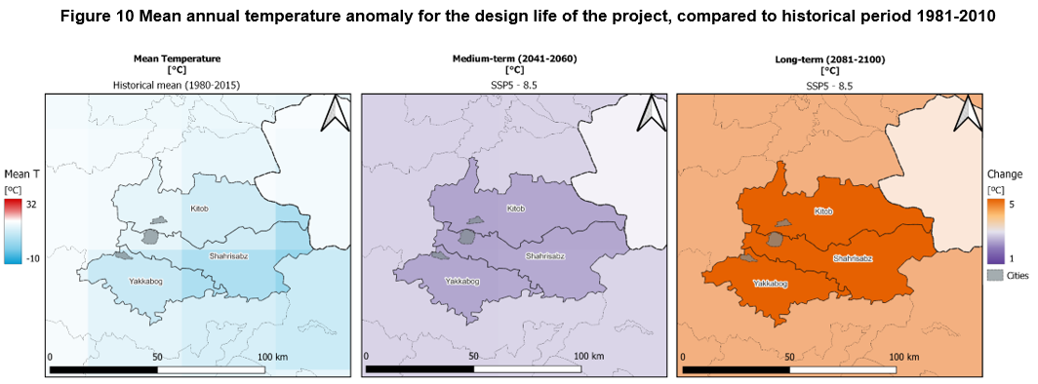
Detailed hazard information
Long-term climate change – Mean surface temperature

Slide 38
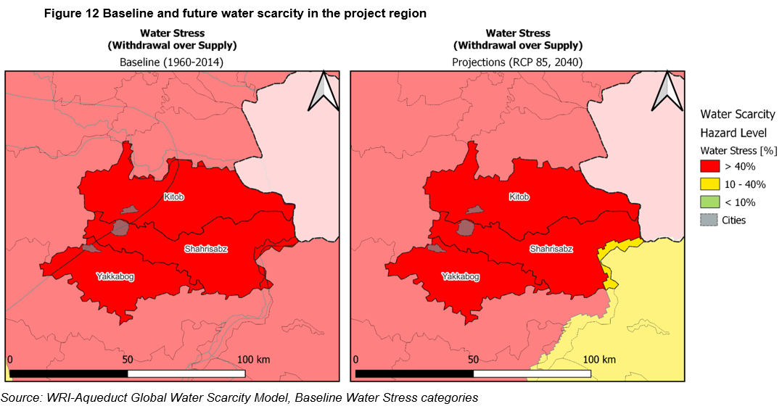
Detailed hazard information
Long-term climate change – Water scarcity

Slide 39
Resilience options
Resilience is the ability of countries, communities, businesses, and households to resist, absorb and recover from natural hazard events, without jeopardizing their sustained socioeconomic advancement and development.
Resilience options include measures, interventions and policies that target infrastructure, and those that target socio-economic aspects.
Infrastructure resilience is the ability of infrastructure systems to resist, absorb, accommodate, and recover from hazards to which they are exposed—and to mitigate the impact of such events on the users served by the systems. It includes the resilience of users under both current and changed (by development, climate change, or other factors) conditions.
Resilience solutions can include investments (engineering interventions, nature-based solutions, spatial planning frameworks), operational changes and risk transfer. Investing in infrastructure resilience before a geophysical or climate disaster occurs can reduce costly damage and losses in the event of a disaster and provide additional benefits.
Resilience options for the housing priority sector; for bridges (important elements to ensure transportation of agricultural produce as part of food security) and for flood protection structures (often protecting valuable agricultural land) are presented in this section.

Slide 40
Resilience options
Agricultural production
Resilience option | Related hazard | Resilience category
Change in woodland management (e.g., promoting afforestation and avoiding deforestation) | Landslide (impact on agricultural resources, removal of topsoil, blocking of rivers) | Institutions and governance - Policy
Insure against impact of landslides to agricultural production and profitability, to avoid farmland abandonment | Landslide (direct impacts, (e.g., loss of farmland) and indirect impacts (damage to rural transport network and business interruption) | Financing
Capacity building workshops with farmers, Develop/promote networks of farmers and farmers' organizations at regional level for exchange of information and experiences | Climate hazards (multiple) Impact: affecting soil and water productivity, and thus yield, income and livelihoods of farmers | Farmer capacity building on climate smart agriculture
Demonstrations farms, Farmer field schools/farmer discussion groups | Climate hazards (multiple) Impact: affecting soil and water productivity, and thus yield, income and livelihoods of farmers | Farmer capacity building on climate smart agriculture
Use of multi-media to disseminate information | Climate hazards (multiple) Impact: affecting soil and water productivity, and thus yield, income and livelihoods of farmers | Farmer capacity building on climate smart agriculture
Diverse system including crops (annual and perennial), livestock, forestry, and fish (aquaculture), providing production and income diversity | Climate hazards (multiple) Impact: affecting soil and water productivity, and thus yield, income and livelihoods of farmers | Integrated systems
Integration of soil and water management practices (including water harvesting and storage) | Climate hazards (multiple) Impact: affecting soil and water productivity, and thus yield, income and livelihoods of farmers | Integrated systems
Management of waste streams | Climate hazards (multiple) Impact: affecting soil and water productivity, and thus yield, income and livelihoods of farmers | Integrated systems
Sustainable household fuel supplies for cooking and heating | Climate hazards (multiple) Impact: affecting soil and water productivity, and thus yield, income and livelihoods of farmers | Integrated systems
Processing and marketing to ensure food security | Climate hazards (multiple) Impact: affecting soil and water productivity, and thus yield, income and livelihoods of farmers | Integrated systems

Slide 41
Resilience options
Road transport (non-urban)
Resilience option | Related hazard | Resilience category
Structural measures such as strengthening embankments; reducing the gradient of cut slopes and hill slopes; constructing retaining walls | Landslide (scouring of soils around road infrastructure is compounded by increased debris slides, debris flows and rock falls from landslides) | Infrastructure – Grey infrastructure
Protect against collapse of bridges, culverts, and embankments through structural measures (e.g., anchored abutments to piled foundations, strengthening foundations with concrete; reinforced earth embankment) | Landslide (increase of loads on road components through increased debris, potentially causing their collapse) | Infrastructure – Grey infrastructure
Incorporating climate change considerations (data, projections, uncertainty) into transport systems' planning, design, management, operations and maintenance practices | Landslide (debris leading to road closures, risk to road users and pedestrians, business interruption) | Institutions and governance – Management and planning
Structural and geotechnical design of road components (e.g., bridges, tunnels, culverts, embankments and cuttings) to best-practice, seismic-resilient engineering standards; require higher design standards for key components (e.g., major river crossings) | Earthquakes (seismic shaking) | Institutions and governance – Policy
Initiate studies to evaluate the costs and benefits of modifying existing road components (bridges, embankments) to be more resilient; Develop insurance scheme; Contingency funds for addressing post-disaster needs | Earthquakes (seismic shaking) | Financing
Plan for emergency response in case earthquakes (e.g. alternative or evacuation routes, early warning systems, emergency services, responsive capacities) | Earthquakes (seismic shaking) | Institutions and governance – Management and planning
Reinforce at-risk bridge structures (e.g. piers, abutments, columns, foundations) to protect against scouring (e.g. rip-rap); Elevate bridge structure (deck level, piles) | Flood (flooding can accelerate scouring of road and bridge support structures (e.g. foundations, piers), negatively impacting their structural integrity) | Infrastructure – Grey infrastructure
Protect against collapse (e.g. anchored abutments to piled foundations, strengthening foundations with concrete); Strengthen granular bases and subgrade soils (using artificial or natural cements); Strengthening embankments (e.g., with geogrids) | Flooding (saturation of pavements, subgrade materials, and embankments, which can cause road embankment instability, and can negatively affect the structural integrity of roads, bridges and tunnels) | Infrastructure – Grey infrastructure

Slide 42
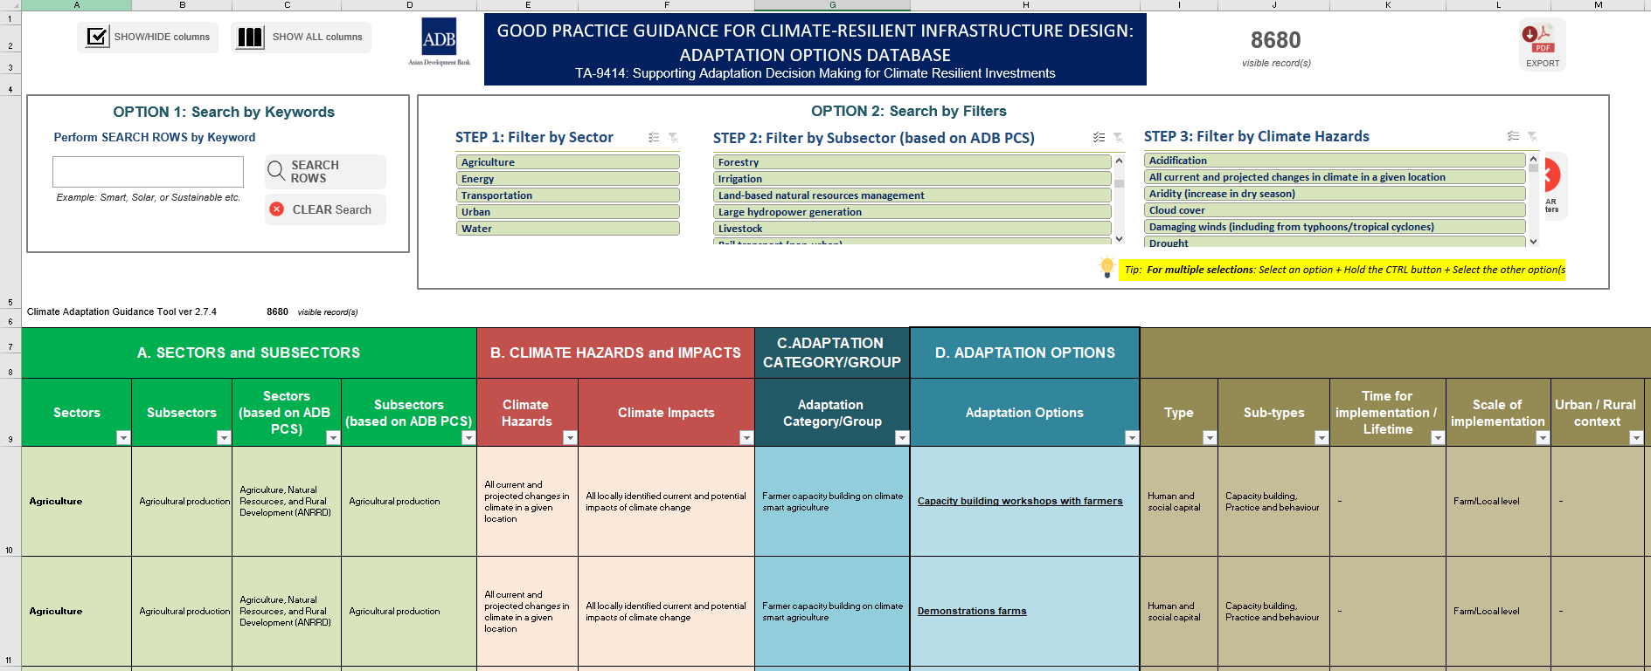
ADB’s Good Practice Guidance for Climate-resilient Infrastructure Design: Adaptation Options Database
A database of resilience options against geophysical hazards is currently in development
Notes:
This step of the analysis produces information on the status of geophysical and climate risk (hustorical reference: baseline) and projection of changes for different time horizons (according to project lifetime).
Baseline reference period is widely diverse among different models.

Slide 43
Kashkadarya masterplan – first-stage risk assessment
THANK YOU
April 2023

