Slide 1
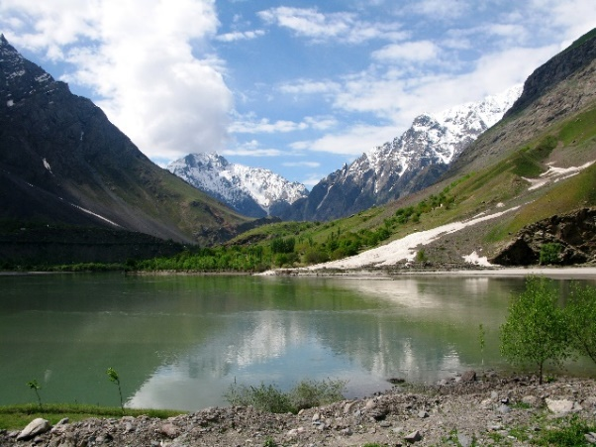
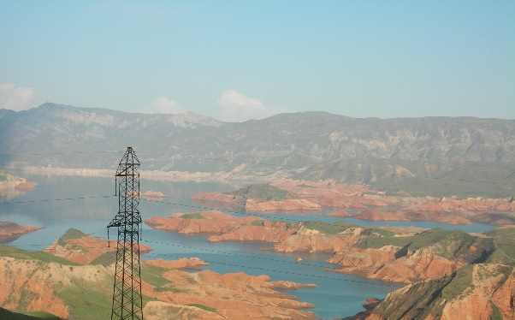
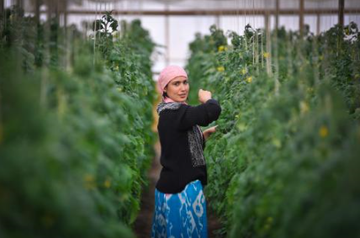
Developing the CAREC Water Pillar
“CAREC 2030 ..honest broker role, to promote discussion and dialogue on water issues to chart the way forward.” CAREC Strategy 2030
Initial focus on 5 Central Asian republics – later expansion to all CAREC members.
Water cross cutting – consistent with developments in energy, agriculture, urban development, environment and tourism sectors.
Increased water productivity and efficiency - changing demands, climate change and sustainability challenges.
Build on existing initiatives - inter-governmental organizations, bilateral agreements, and regional programs.
Policy support, joint investments, knowledge generation and capacity development under long-term partnership program.
Focus on climate resilience, sustainability and joint capacity building
Notes:
Photo sources:
J Bird
Water Resources Management in Uzbekistan, OSCE 2018
V Sokolov

Slide 2
Timeline for Scoping Study for Central Asian Countries
Nov 2020-Feb 2021 | Desk study and literature review; stakeholder consultations with regional partners
March 2021 | National consultations with country focal points Drafting of 3 thematic papers – climate, economics, legal
16 Apr 2021 | First regional consultation on preliminary findings and proposal for the Water Pillar framework with country focals and other regional partners.
Late June-mid July 2021 | Review draft Scoping Study Report by national agencies, inter-governmental bodies and development partners National consultations
End-July 2021 | Submission final Scoping Study Report
Aug 2021 | Second regional consultation
Sept-Oct 2021 | Development of concept papers for selected priority activities
Nov | Scoping Study is a key deliverable at the annual CAREC Ministerial Conference

