Slide 1
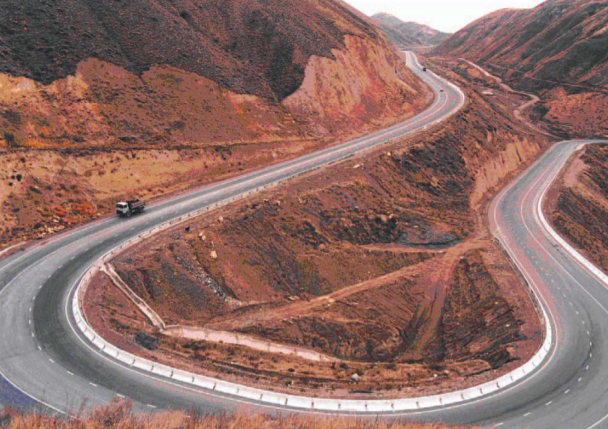
CAREC Regional Infrastructure Projects Enabling Facility (RIPEF) CAREC 2030 will continue to advance the regional infrastructure agenda, in line with the SDGs’ call for reliable and sustainable infrastructure, including regional and cross border infrastructure.
CAREC RIPEF Rationale
Addressing challenges for CAREC regional infrastructure projects: widening infrastructure financing gap, inadequate capacity, lack of investment ready projects, constrained private sector financing and undiversified financing sources, etc.
Objectives
A dedicated financing facility created to support CAREC governments in project preparation and readiness, initial design, and in application of appropriate financial solutions while promoting knowledge exchange and capacity development
Progress and Next Steps
Small-scale Technical Assistance (approved in Sept 2020) – ongoing groundwork for the CAREC RIPEF, i.e., undertake studies to help prepare the Facility and meet requirements for establishment
Transaction TA Facility (for 2021 approval) – to provide project preparation funding for regional infrastructure projects in CAREC and improving institutional capacity
Stakeholder consultation (July 2021 onwards) – governments of CAREC member countries and other stakeholders will be consulted on the draft CAREC RIPEF concept
Development partners consultation (July 2021 onwards) - multilateral and bilateral development partners will be invited to participate in the Facility by providing technical and financial support
CAREC countries may also be requested to contribute to the Facility
Deliverables for the Ministerial Conference
Technical report and CAREC RIPEF concept

