Slide 1
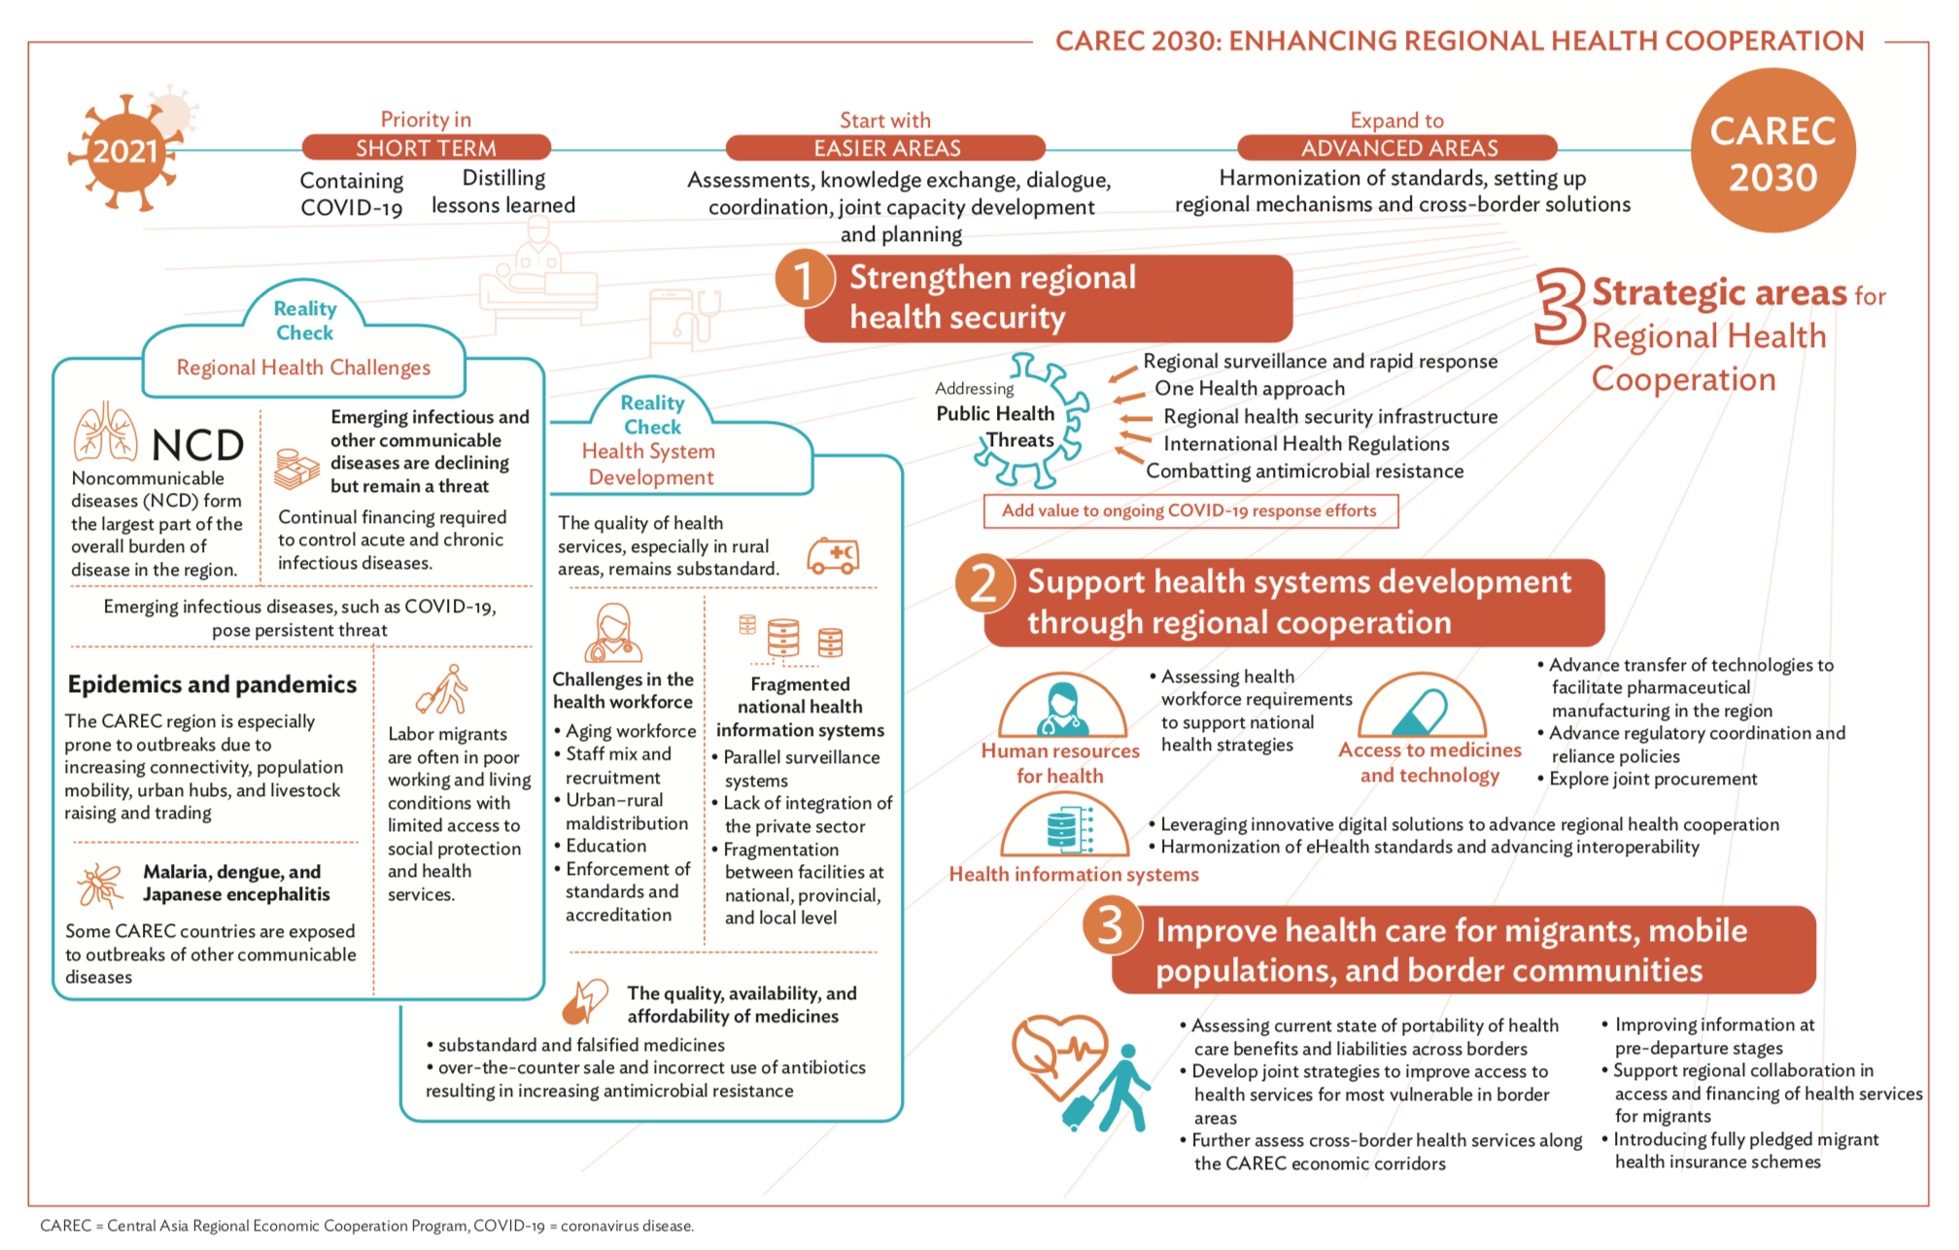
Enhancing Regional Health Cooperation – Moving towards a CAREC Health Strategy
CAREC 2030
2021
SHORT TERM
EASIER AREAS
ADVANCED AREAS
Containing COVID-19
Distilling lessons learnt
Dialogue, coordination, knowledge exchange, joint capacity development
Harmonization of standards, strengthening regional mechanisms and cross-border solutions
3
Current situation
Regional Health challenges
Non-communicable diseases (NCDs) largest part of disease burden
Continual financing required to contain infectious diseases
Poor living conditions with limited access to social protection for migrant labour
Health Systems Development
Quality of care esp. in rural areas substandard
Aging workforce, urban-rural maldistribution
Fragmented health information systems
Substandard and falsified medicines and incorrect use of antibiotics lead to AMR increase
Strategic Areas for Regional Health Cooperation
Strengthen Regional Health Security
Implementation of International Health Regulations; inter-sectoral coordination; regional surveillance; regional supply and stock of health products; health security infrastructure and capacity
Cross-cutting: Gender and Digital Health
Support Health Systems Strengthening through Regional Cooperation
Improve quality of care, health information systems and human resources for health; research; scaling up health systems innovations
Improve Health Care for Migrants, Mobile Populations and Border Communities
Mobile health services; cross-border referrals; electronic cards/records to ensure continuity of care; health services in economic corridors/addressing health risks in SEZ
Implementing Arrangements
Institutional Arrangements; Building on Existing Initiatives
Phased approach; Policy coherence and alignment with global and national level frameworks and strategies; Results Framework

Slide 2
Timeline for development of CAREC Health Strategy 2030
2021
2022
Health Strategy Steps
Mar | Apr | May | Jun | Jul | Aug | Sep | Oct | Nov | Dec
First brainstorming/ideation
Drafting of Strategy, data and information collection, assessments in-country coordination
Country consultations (working level) Country consultations with WGH (country groups) (Q3)
Further revisions
Presentation of final draft
Final adjustments and National Focal Points meeting
Final Strategy ready
CAREC Ministerial Conference to approve the CAREC Health Strategy
Finalization of Regional Investment Framework & start implementation of strategy
Timelines | Consultations/Activities | Responsibilities
February 2021 | Regional Inception Workshop Establish Working Group for Health Brainstorming on strategy: Scenario building and ideation (2-3 breakouts) Discuss recommendations of scoping study Outcome: Draft outline | Regional (all countries), DPs (main)
February to June 2021 | Drafting of CAREC Health Strategy | c/o Firm/ADB
June 2021 | Consultation #1 Consultation on draft strategy | Regional (all countries), DPs
June 2021 | SOM (tentative) | Progress reporting
August 2021 | Consultation #2 Further consultations | Country groups
August to September 2021 | Further revisions of the strategy | c/o Firm/ADB
September 2021 | Consultation #3 Last round of consultations | Regional (all countries)
September/ October 2021 | National Focal Points meeting (tentative) | Clear draft for presentation
November 2021 | Final strategy ready | c/o Firm/ADB
December 2021 | Ministerial conference
January 2022 | Publication
Notes:
Emphasize that this is a country-owned process

