Slide 1
Silk Road Air Pass: A CAREC Proposal
CAREC Aviation and Tourism Webinar,
10 February 2021
Brendan Sobie
CAREC Senior Aviation Specialist

Slide 2
Introduction
In early 2020, prior to the pandemic, ADB decided to study a possible air pass scheme to help facilitate tourism and air connectivity within CAREC
For this study, all 11 CAREC countries were included (for China, Inner Mongolia and Xinjiang)
The 30-page study/proposal was completed in August and is meant to gauge potential interest among stakeholders, including governments (aviation and tourism authorities) airlines and tourism operators
We are currently seeking feedback from stakeholders and would like to know if airlines would be interested in this concept before deciding on any next steps
While improving air connectivity is a key component of CAREC’s aviation and tourism strategies an air pass is only one potential initiative to support this objective
We are open to considering and potentially studying other suggestions

Slide 3
What is an Air Pass?
A block of several one-way flights in a certain country or region that is sold at a discount
Air Passes are typically sold to tourists planning a multi-stop itinerary and encourages combining several destinations in a single holiday
Air Passes are sometimes only sold in conjunction with international tickets from a visitor’s country of origin but this is not always necessary and can also be offered after a visitor arrives at the first stop in their holiday
Air Passes generally offer flights on several airlines – the more airlines the better as it improves the attractiveness of the pass
Air Passes are priced out on a per sector basis and incentivize more sectors by offering cheaper prices if more sectors are purchased – typically a minimum of three or four sectors is required and the maximum could be as high as 15

Slide 4
Why an Air Pass for CAREC?
An Air Pass would encourage travel within CAREC and stops in multiple countries, boosting visitor numbers and cross-CAREC travel
An Air Pass could help facilitate a recovery of aviation and tourism in the post-pandemic environment by resulting in higher traffic volumes within CAREC
Higher traffic levels would help support the launch of new routes connecting CAREC, particularly between UNESCO heritage sites. This will help improve connectivity within CAREC, which is a major impediment to tourism and air transport development in the region
Higher traffic levels would also support more frequencies on existing routes. A lack of daily services on routes connecting CAREC cities is a major impediment to tourism and economic growth
An Air Pass would facilitate partnerships between CAREC airlines

Slide 5
What would it look like?
Sample Air Pass:
4 countries
8 legs
5 airlines
1 rail operator
Almaty-Nur Sultan
Nur Sultan-Dushanbe
Dushanbe-Tashkent
Tashkent-Samarkand
Samarkand-Bukhara
Bukhara-Tashkent
Tashkent-Bishkek
Bishkek-Osh

Slide 6
What would it look like?
Ulaanbaatar-Dalanzadgad
Dalanzadgad-Ulaanbaatar
Ulaanbaatar-Nur Sultan
Nur Sultan-Bishkek
Bishkek-Dushanbe
Dushanbe-Tashkent
Tashkent-Baku
Baku-Tbilisi
Tbilisi-Almaty
Almaty-Ashgabat
Ashgabat-Urumqi
Urumqi-Islamabad
Islamabad-Kabul
Sample Air Pass:
11 countries (all CAREC)
13 legs
12 airlines

Slide 7
QUICK QUIZ
How many airlines are there in CAREC, excluding China, with scheduled international passenger services (prior to COVID-19) ?
A) 10
B) 14 C) 18
D) 24

Slide 8
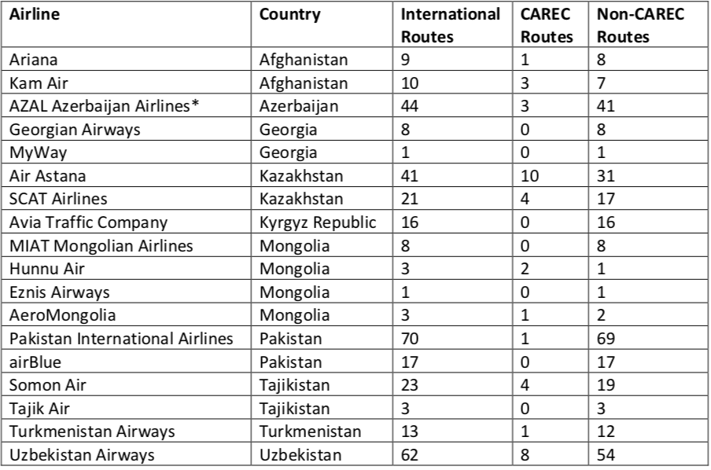
QUICK QUIZ … The Answer
CAREC airlines (excluding China) with international services
There are 18 CAREC airlines (excluding China) with international services. There about 30 Chinese airlines with scheduled international services but only two (China Southern and Air China) serve other CAREC countries
Source: Silk Road Air Pass: a CAREC proposal
Notes: Based on OAG schedules for Jan-2020 Summer-only routes are excluded CAREC routes include Xinjiang and Inner Mongolia Other parts of China considered non-CAREC AZAL routes include Buta Airways Air Astana routes include FlyArystan

Slide 9
What would it look like?
The Air Pass would include all 11 CAREC countries, including China’s Xinjiang and Inner Mongolia autonomous regions
But the Air Pass could initially be launched with a small subset of countries as a pilot program (for example Kazakhstan, Kyrgyz Republic, Tajikistan, Turkmenistan Uzbekistan)
There are about 20 airlines operating scheduled passenger flights within CAREC – 11 operate international services within CAREC and the others only offer domestic services
There are another 7 CAREC airlines that do not have any services within CAREC (no domestic services and all their international routes are to non-CAREC countries)
The Air Pass could would not initially include flights connecting CAREC with other regions but could be used to promote such flights, helping CAREC airlines improve market share
Railway operators can be considered, particularly for domestic travel

Slide 10
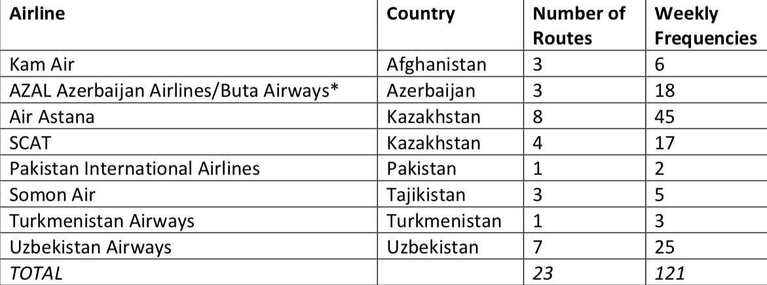
What does it include … International
23 international routes within CAREC (excluding China) from 8 airlines
Source: Silk Road Air Pass: A CAREC Proposal Notes: based on pre-COVID OAG schedules; *Buta is a division of AZAL

Slide 11
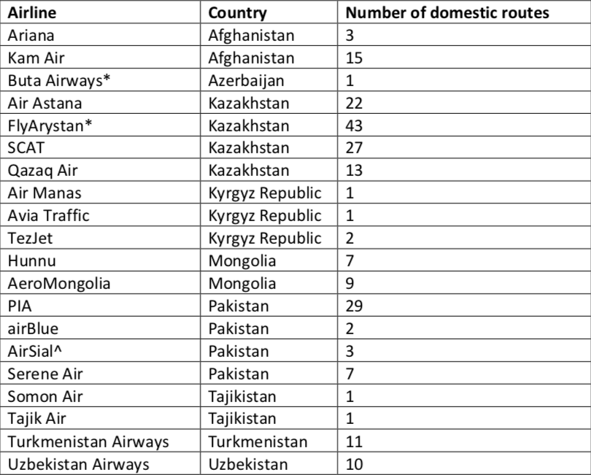
What does it include … Domestic
There are 20 airlines operating domestic services within CAREC (excluding China)
Source: Silk Road Air Pass: A CAREC Proposal
Notes: based on pre-COVID schedules from OAG
*Buta is a division of AZAL *FlyArystan is a division of Air Astana
^AirSial launched services in December 2020

Slide 12
What does it include … Xinjiang and Inner Mongolia
All CAREC countries except Mongolia have direct services with Urumqi in Xinjiang
Mongolia has direct services to three cities in Inner Mongolia
China Southern has 10 routes connecting Urumqi with other CAREC countries, operating a total of 33 weekly flights prior to COVID-19
Four other CAREC airlines (Air Astana, Ariana Afghan, Somon Air, Uzbekistan Airways) also serve Urumqi with a total of 14 weekly flights prior to COVID-19
Air China, AeroMongolia and Hunnu Air connect Mongolia with Inner Mongolia, operating a combined 10 weekly flights prior to COVID-19
Domestic services within Xinjiang and Inner Mongolia can also be considered – each region has about 20 airports. While several Chinese airlines have domestic flights within these regions Air China is the largest in Inner Mongolia and China Southern in Xinjiang

Slide 13
Why an air pass for CAREC … International
While there are 37 international routes within CAREC (including Xinjiang and Inner Mongolia), only eight were served daily prior to COVID-19 and over half these routes were served with three weekly flights or less
The Air Pass could help support more frequencies, which would make it easier for visitors to pursue multi-country itineraries
The Air Pass could also help support the launch of new international routes within CAREC, enabling visitors to combine destinations which are now difficult to combine as they involve a circuitous and expensive combination of flights
New international routes and increased frequencies on existing routes would also help facilitate intra-CAREC tourism, another segment of the market with big growth potential as discussed in the last webinar

Slide 14
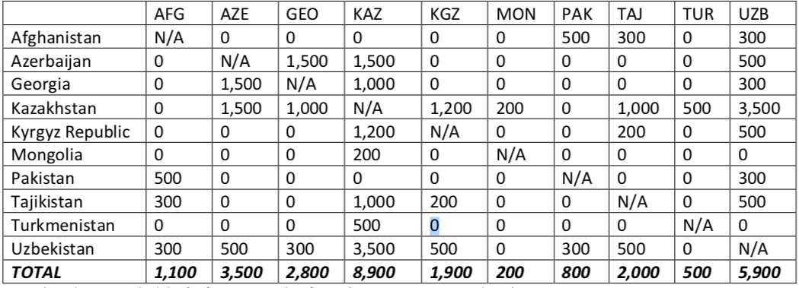
Why an air pass for CAREC … International
One-way weekly seat capacity for all CAREC country pairs (excluding China)
Source: Source: Silk Road Air Pass: A CAREC Proposal Note: based on pre-COVID schedules from OAG

Slide 15
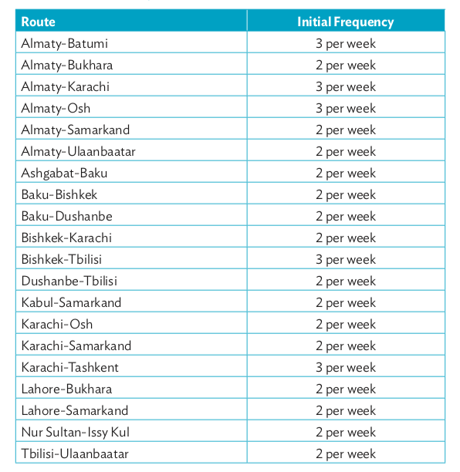
Why an air pass for CAREC … International
Examples of Unserved Routes within CAREC
“The Silk Road Air Pass is one of several potential CAREC initiatives aimed at driving a faster recovery in regional international travel within CAREC and laying the foundation for rapid growth over the next several years.”
“CAREC strives to triple the number of international flights within CAREC by 2030 and have nonstop links between all CAREC countries. The Silk Road Air Pass could help CAREC achieve this objective, part of the aviation pillar in CAREC Transport Strategy 2030, as well as similar objectives for tourism under CAREC 2030 Strategy.”
Sources: Impact of COVID-19 on CAREC Aviation and Tourism and Silk Road Air Pass: A CAREC Proposal

Slide 16
QUICK QUIZ
How many UNESCO heritage sites are there in CAREC (excluding China)?
A) 19
B) 28 C) 37
D) 46

Slide 17
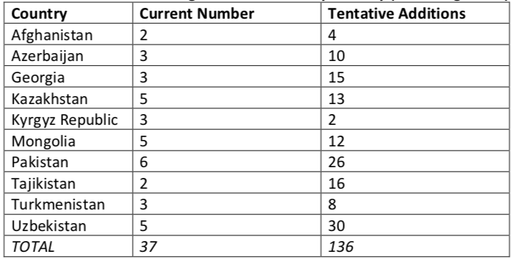
QUICK QUIZ … The Answer
Number of UNESCO heritage sites in CAREC by country (excluding China)
“Domestic air connectivity is critical for facilitating travel between UNESCO heritage and other Silk Road tourism sites within a country. Many of these sites are served with small airports that only have domestic services.”
Source: Silk Road Air Pass: a CAREC Proposal (using UNESCO data)

Slide 18
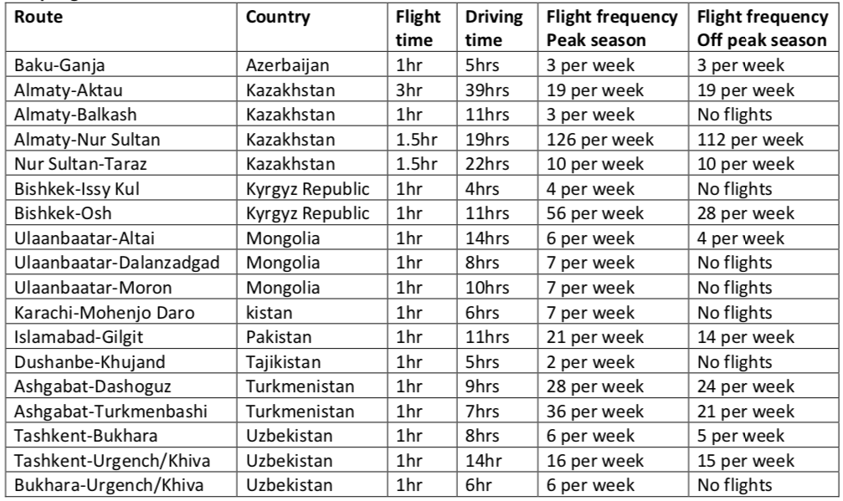
Why an air pass for CAREC … Domestic
Sampling of CAREC domestic air tourism routes
“One of the objectives of the CAREC aviation program is to improve connectivity to tourist sites – both domestic and international. For many up and coming Silk Road destinations only domestic is feasible at least for the foreseeable future due to the small size of airports and a lack of traffic to justify investment in international facilities."
Source: Silk Road Air Pass: A CAREC Proposal Note: based on pre-COVID schedules from OAG

Slide 19
Prior Air Pass Examples
Discover Airpass: covers flights within Southeast Asia on Bangkok Airways and Lao Airlines (and previously on Berjaya Air and Siem Reap Airways)
Discover South Pacific Pass: covered flights within the South Pacific on Aircalin, Air Vanuatu, Air Niugini and Solomon Airlines
ASEAN Air Pass: covered international flights within Southeast Asia by seven flag carriers
AirAsia ASEAN Pass: covered flights within Southeast Asia on all AirAsia-branded airlines
Alliance air passes: covered flights by members of oneworld, SkyTeam or Star for specific regions (Africa, Asia, Europe, Middle East, North America, Latin America or South Pacific) and domestic markets (such as Japan or Russia)
Individual airline air passes – covered or covers domestic travel when purchased in conjunction with an international ticket. Examples include Argentina, Australia, Brazil, Japan, Kazakhstan and New Zealand

Slide 20
Failures of Prior Air Passes
Air Passes have been around for over three decades and used to facilitate travel with regions
However, there are hardy any air passes which are still sold today; most were dropped long before COVID-19
Marketing has been a common issue with airlines not actively promoting the passes and consumers not aware the passes exist
Weak participation from airlines has been another issue with the participating airlines often not filing air pass fares or providing sufficient seats under the air pass fare code
Air pass fares in many cases were higher than individual sector fares, disincentivizing the purchase of air pass packages
Air passes have not been traditionally conducive to group travel due to the limited seats available

Slide 21
Potential Benefits
Drive visitor growth by facilitating travel between CAREC countries
Drive visitor growth by reducing air fares between Silk Road destinations
Increase the average number of countries visited, resulting in higher overall spend
Improve the attractiveness of CAREC as a destination compared to other regions
Help airlines improve their distribution, brand awareness and sales outside CAREC
Drive growth in passenger numbers, leading to more frequencies on existing routes
Create sufficient demand to support new nonstop routes within CAREC
Create sufficient demand to support new domestic airports near tourist destinations
Source: Silk Road Air Pass: a CAREC Proposal

Slide 22
Potential Benefits
Reduce average travel time between Silk Road tourist destinations
Enable more country pairs within CAREC to have direct air services
Facilitate partnerships between airlines, including potential codeshare arrangements
Facilitate partnerships between tourism authorities
Facilitate partnerships between airlines and railway operators
Facilitate more visa free policies
Enable CAREC airlines to better compete with foreign airlines
Help open up new source markets when combined with other regional initiatives
Hep the aviation and tourism sectors recover from the COVID-19 pandemic
Source: Silk Road Air Pass: a CAREC Proposal

Slide 23
Potential Challenges
Potential high cost of supplying the technology to support an air pass
Possible reluctance from airlines to participate in the air pass
Lack of interline agreements between airlines inhibit potential sales
Air pass seats may be limited, reducing appeal of the air pass
Air passes are typically not conducive for group travel, a big and important segment
Air passes are not conducive for short stay visitors, a very large segment
Air Pass fares could end up being higher than fares available through other channels
Railway operators may be unable to participate, reducing the appeal of the air pass
Visa constraints with some countries make it difficult to pursue multi-stop itineraries
Future low-cost airline growth could make the air pass less appealing
Limited sales of air passes could make the program difficult to sustain
Limited sales of air passes could make the initial investment hard to justify

Slide 24
Example of questions from a CAREC airline
Q: What will be the role of smaller airlines in the Silk Road air pass within CAREC countries?
A: Smaller airlines would have an important role. Most airlines in CAREC countries are small and these airlines provide critical connectivity. Many of these airlines are not well known outside CAREC and the air pass could help improve their ability to distribute and sell outside the region.
Q: Visa free policy plays an important role in Silk Road air pass as this will encourage tourists. There are still visa impediments in several countries that dissuade multi-stop itineraries.
A: CAREC continues to advocate for visa free policies as it would facilitate tourism. We hope visa impediments continue to be lifted and this will further facilitate travel within the region including multi-stop itineraries, facilitating the air pass.
Q: Who will bear the new technology solution development cost? Will it be airlines or tourism authority?
The idea would be to have the technology development costs covered as we recognize airlines would not be able to cover these costs or would likely not support this proposal if they were asked to cover these costs. How specifically the air pass will be funded will be discussed at a later stage.

Slide 25
Conclusion
While air passes have not succeeded in other regions, new technology options are now available that reduce the complexity and resolve some of the fundamental challenges
CAREC is a unique market with several smaller airlines and no low cost carries operating international routes within CAREC, making an air pass more suitable than other regions
No CAREC airlines (excluding China) are part of global alliances and there are no codeshares between airlines, increasing the appeal as it could drive a new era of partnerships
However, there are many challenges and CAREC needs your support to proceed – please read and review the proposal, including the addendum on new technology options
Please ask questions and provide feedback – during the Q&A session today, at the next webinar on 10 March and by contacting us directly
Azerbaijan Airlines

Slide 26
Thank you! Большое Спасибо!
brendan@sobieaviation.com

