Slide 1
COVID-19 Impact and Recovery Strategies
CAREC Aviation and Tourism Webinar, 27 January 2020

Slide 2
CAREC Aviation and Tourism
10 CAREC countries (excluding China)
25 CAREC airlines with scheduled services
Almost 60 million annual passengers prior to COVID-19
16 million domestic and 43 million international passengers
14 CAREC airports with at least 1 million annual passengers prior to COVID-19 (at least one in every country)
Nearly 40 million annual visitor arrivals prior to COVID-19
Around 7 million annual visitor arrivals by air
Over 6 million aviation/travel/tourism jobs prior to COVID-19
Aviation/travel/tourism generated around USD40 billion and accounted for about 5% of total GDP prior to COVID-19
Source: Impact of COVID-19 on CAREC Aviation and Tourism Note: All figures exclude China

Slide 3
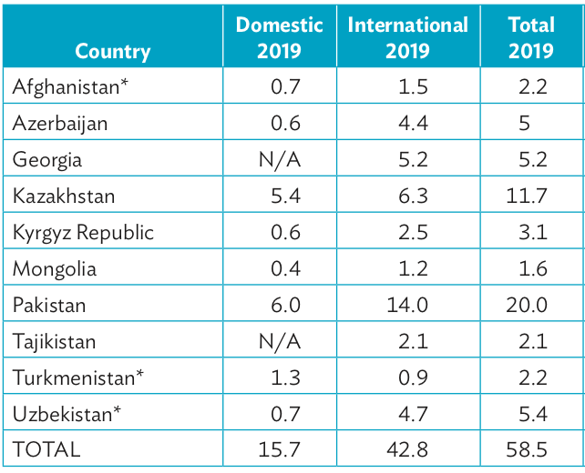
CAREC Aviation, pre-COVID
Passenger traffic (millions)
Pakistan International Airlines
Source: Impact of COVID-19 on CAREC Aviation and Tourism Notes: Georgia and Tajikistan domestic markets have less than 100,000 annual passengers Afghanistan and Turkmenistan figures estimated based on seat capacity Uzbekistan figure estimated based on seat capacity and Tashkent traffic Pakistan figure based on Pakistan fiscal year ending June; all other figures based on calendar year ending December

Slide 4
QUICK QUIZ
What is the largest airport, based on pre-COVID passenger traffic, in CAREC (excluding China)?
A) Almaty
B) Baku
C) Karachi
D) Tashkent

Slide 5
QUICK QUIZ
Poll ...... display responses from the audience here

Slide 6
QUICK QUIZ … The Answer
2019 passenger traffic (in millions) for leading CAREC airports
Note: Tashkent domestic/international breakdown is estimated
Source: Impact of COVID-19 on CAREC Aviation and Tourism.

Slide 7
Estimated impact of COVID-19
40 million fewer passengers in 2020 (68% reduction)
6 million fewer domestic and 34 million fewer international passengers
33 million fewer visitors in 2020 (83% reduction)
5.5 million fewer visitors by air
USD7 billion reduction in airline passenger revenue (70% reduction)
USD27 billion reduction in aviation/travel/tourism contribution to GDP (70% reduction)
USD11 billion reduction in international visitor spend (85% reduction)
Uzbekistan
Airways
Source: Impact of COVID-19 on CAREC Aviation and Tourism. Notes: All figures exclude China
Impact assessment study was published in November 2020

Slide 8
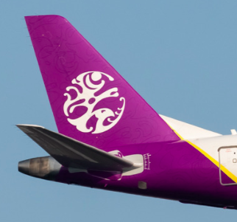
Real impact figures are starting to emerge
Georgia visitor arrivals declined by 80% - from 7.7 million in 2019 to 1.5 million in 2020 (1.1 million in the first quarter)
Georgia passenger traffic declined by 84% - from 5.2 million in 2019 to less than 850,000 in 2020 (700,000 in the first quarter)
Mongolia visitor arrivals declined by 90% - from 577,000 in 2019 to 67,000 in 2020 (36,000 in the first quarter)
Mongolia passenger traffic declined by 72% - from 1.6 million in 2019 to 450,000 in 2020 (216,000 in the first quarter)
Domestic declined by 52% from 433,000 to 286,000; international declined by 86% from 1.188 million to 162,000
Hunnu Air
(Mongolia)
Sources: Georgia National Tourism Administration, Mongolia Statistical Information Service

Slide 9
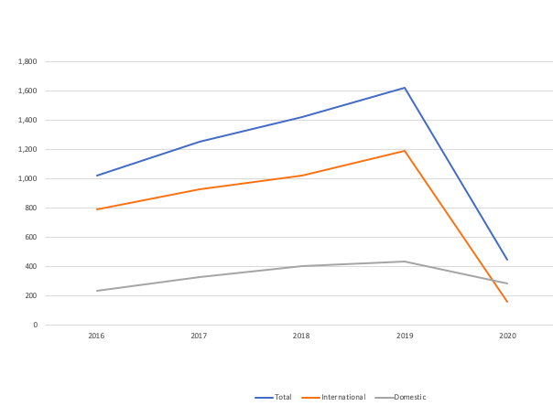
Mongolia impact
Annual passengers (thousands), 2016 to 2020
MIAT Mongolian Airlines
Source: Mongolia Statistical Information Service

Slide 10
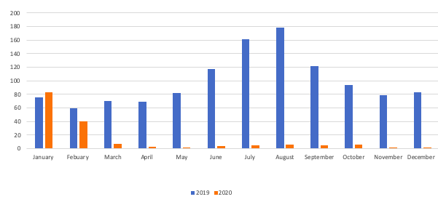
Mongolia impact
Monthly international passengers (thousands), 2020 vs 2019
Eznis Airways (Mongolia)
Source: Mongolia Statistical Information Service
CAREC is a highly seasonal market. The total loss of tourism in summer 2020 impacted aviation as only the off peak month of January was a normal month. In February China was impacted and from March all source markets were impacted. Borders may not fully reopen in time for summer 2021, which could have a devastating impact on aviation and tourism

Slide 11
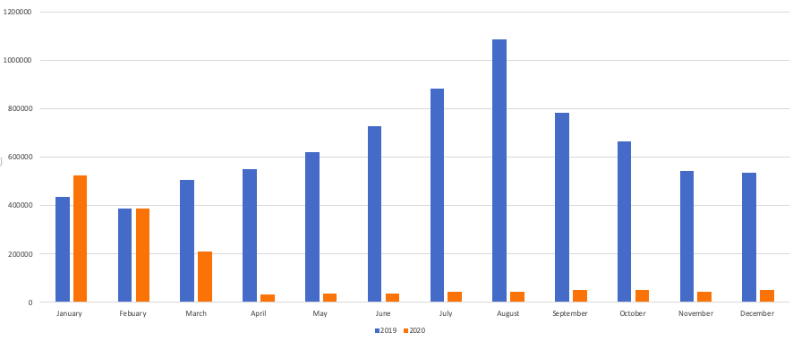
Georgia impact
Monthly visitor numbers, 2020 vs 2019
Georgian Airways
Source: Georgia National Tourism Administration
In a typical year Georgia attracts more than twice as many visitor in the peak months of July and August compared to the off peak months of January and February. Like Mongolia, Georgia now faces the bleak prospect of two consecutive summers without international tourism

Slide 12
Recovery strategies
Domestic tourism recovered in the second half of 2020 as many CAREC countries lifted lockdowns and local travel restrictions but even higher levels of domestic tourism can be achieved in 2021
CAREC countries need to rely on domestic tourism in 2021 as it will likely not be until late in the year that most source markets for international tourists reopens
However, for aviation there is limited benefit from domestic tourism outside Kazakhstan and Pakistan – which account for two-thirds of all CAREC domestic passenger traffic
Promotion of domestic tourism was the first recommendation from the CAREC COVID-19 aviation and tourism impact assessment study

Slide 13
Recovery strategies
There is an opportunity to kick-start an international recovery by opening green lanes or travel bubbles, which would help facilitate a partial recovery to tourism and the overall economy
There is limited tourism and air travel within CAREC but this crisis provides an opportunity to promote trips within the group through air travel bubbles or green lanes
A multi-lateral framework for air travel bubbles within CAREC would be ideal is it would provide a platform for flights to be resumed between several country pairs
Visa facilitation needs to be pursued in tandem, eliminating longstanding obstacles for travel between countries that are not already visa free

Slide 14
Recovery strategies
Air travel bubbles could facilitate increased capacity on existing international routes within CAREC and potentially support the launch of new routes
Any new or increased air services could be maintained after this crisis, resulting in improved connectivity within CAREC – a key goal of the CAREC aviation and tourism strategies
If CAREC citizens are able to visit other CAREC countries in 2021, interest in travelling within the region and visiting CAREC’s UNESCO heritage sites will increase over time

Slide 15
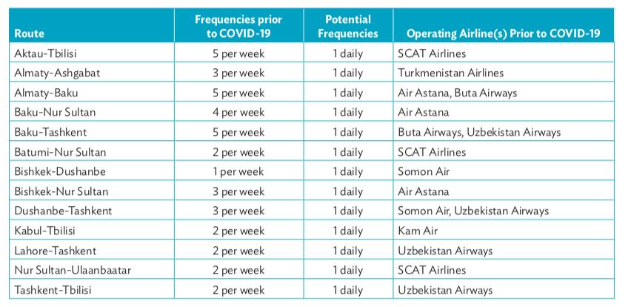
Recovery strategies
Examples of Underserved intra-CAREC Routes That Can Support More Frequencies
Turkmenistan Airlines
Source: Impact of COVID-19 on CAREC Aviation and Tourism

Slide 16
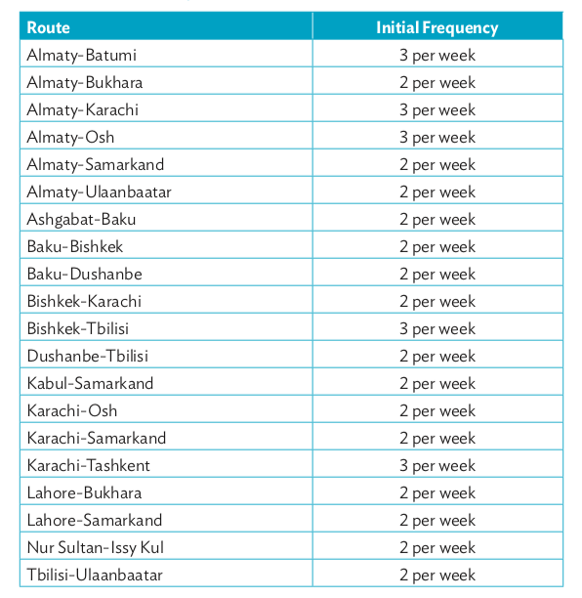
Recovery strategies
Examples of Unserved Routes Within CAREC
These are a sampling of 20 routes the study stated could be launched in 2021 by establishing green lanes or air travel bubbles and with the right policies, incentives and promotions
Air Astana is already intending to launch Almaty-Batumi
Baku-Karachi was the largest unserved city pair within CAREC prior to COVID-19; several Pakistan-CAREC routes are possible but visa facilitation is critical

Slide 17
QUICK QUIZ
Of the 45 possible country pairs in CAREC (excluding China) how many had direct air services prior to COVID-19?
A) 18
B) 23 C) 28
D) 33

Slide 18
QUICK QUIZ
Poll ...... display responses from the audience here

Slide 19
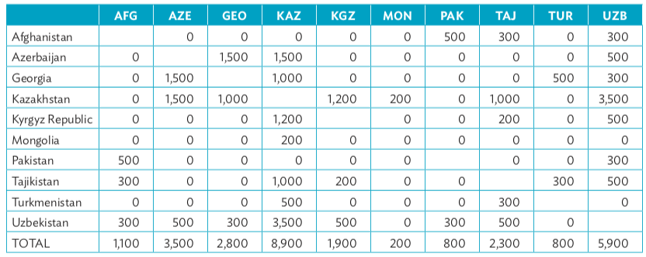
QUICK QUIZ … The Answer
Intra-CAREC one-way weekly seat capacity: prior to COVID-19
Only 18 CAREC country pairs had services prior to the pandemic
More than half the boxes have zeroes, indicating no services
Source: Impact of COVID-19 on CAREC Aviation and Tourism
Note: Based on OAG schedules for first two months of 2020

Slide 20
Recovery strategies
A
Cargo has been critical during the pandemic, generating revenues for CAREC airlines and airports when virtually all international passenger operations have halted
The crisis has highlighted an opportunity to grow cargo in CAREC, particularly trans-shipment traffic
For example, cargo traffic in Azerbaijan more than doubled in 2020 compared to 2019
Full open skies for cargo in CAREC is an achievable goal that could help facilitate growth

Slide 21
Recovery strategies
Several CAREC airlines and airports have been preparing to handle COVID-19 vaccines
The vaccines are critical to the aviation and tourism industries as they will facilitate a resumption of international air travel but the revenue benefit is relatively small
CAREC airlines and airports will play an important role in distributing COVID-19 vaccines but they represent a very small portion of overall cargo
The logistics of shipping vaccines locally once they arrive at CAREC airports is the biggest distribution challenge which ADB along with other development banks and aid organizations are helping CAREC countries meet
Vaccine transport
Silk Way Azerbaijan

Slide 22
Recovery strategies
The crisis provides an opportunity for CAREC airports to upgrade by introducing new digital technologies; many CAREC airports still rely on manual check-in and boarding procedures
CAREC airlines are also generally behind the global airline digitalization trend; investment is required to facilitate mobile check-in, bag drops and document checks
To facilitate resumption of travel CAREC countries should implement ICAO recommendations
Travel health passes, already available from IATA and the Commons Project, also need to be supported by airlines and governments to facilitate resumption of international air travel
Participation from health clinics is critical for uploading COVID-19 vaccine and test results

Slide 23
Recovery strategies
ICAO’s Council Aviation Recovery Task Force (CART) have completed two reports, in June and November, providing guidelines to facilitate a restart of international air travel
So far there has been a lack of implementation, setting back the industry’s recovery
Uniform standards or consistent travel protocols has not yet resulted due to a lack of consensus globally, including within CAREC
Adoption of CART’s 11 recommendations by CAREC countries would help facilitate a recovery
While vaccines offer an opportunity to restart international travel and recovery, new travel protocols and standards also need to be agreed
From the CART Report - Executive Summary

Slide 24
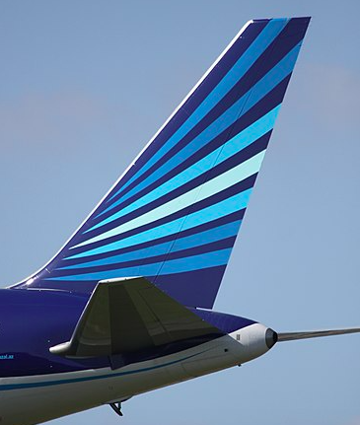
Conclusion
The road to recovery will be long and hard
It could be three to four years before international traffic fully recovers
But there are many initiatives CAREC can pursue now to help facilitate a faster recovery for the aviation and tourism sectors
Adopting common air travel protocols and standards is critical
Air travel bubbles between CAREC countries could drive a partial recovery of international traffic in 2021 and stimulate intra-CAREC tourism
Stakeholders need to work together in order for the industry to recover
Azerbaijan Airlines

Slide 25
Thank you! Большое Спасибо!
brendan@sobieaviation.com

