Slide 1
TRADE CENTRAL ASIA ACTIVITY (TCA)
PROJECT OVERVIEW
June 2023

Slide 2
OVERVIEW
Contract Award
Initial: Aug 2021 – Aug 2026
Supplemental Funding : Oct 2021 – Sept 2024
Budget
~ USD 34 Million
Purpose
Improve region-wide trade connectivity to accelerate economic growth and increase economic opportunity in Central Asia
Harmonization of customs and border procedures
Increasing public-private dialogue on trade
Improving cross-border firm-to-firm connectivity

Slide 3
Four Objectives
USAID’s Trade Central Asia activity applies a facilitative approach, incentivizing public and private sector stakeholders to implement reforms and achieve activity objectives at the regional and national levels. The assistance is provided around four objectives:
Objective 1: Customs and Border Procedures Harmonized
Objective 2: Public-Private Dialogue on Regional Trade and Investment Increased
Objective 3: Cross-Border Firm-to-Firm Connectivity Increased
Objective 4: Strengthened Resilience of Central Asian Economies Through Trade

Slide 4
Digital Trade Assessment
The aim behind the Digital Trade Assessment conducted by the TCA is to review and analyze selective transport and trade documents (CMR, Road Haulage Permit and Queuing Management System) on the subjective of (a) regulatory framework and (b) IT infrastructure for their compliance and consistence with proposed globally digital solutions.
OBJECTIVE
(i) Facilitate transformation from paper to electronic analogue of transport documents such as “CMR/Consignment Note and Permit for Road Haulage” towards streamlining movement of goods along borders.
(ii) and Improving predictability of shipments and efficiency of routing via “digitalizing organization of cargo traffic at borders” and eliminating need for physical queue.

Slide 5
Digital Trade Assessment - eCMR/Consignment Note
Number of CMRs used for transportation between Central Asian countries can be estimated to range around 200,000 CMRs. When considering transportations with third countries, this figure is likely to at least double.
CMR is free in Kazakhstan, Kyrgyz Republic and Uzbekistan (can be printed from any source)
In Tajikistan the cost for paper CMR is $5 and in Turkmenistan $200 (issued only by authorized institution)
All Central Asian countries, except Kazakhstan are signatories of eCMR Protocol
In all countries, electronic digital signatures form the basis for certifying electronic documents, except Turkmenistan.
At the same time the absence of a clear procedure for authorizing international electronic documents poses a significant barrier to the development of eCMR.
TIR-EPD has a potential to be expanded as a solution for eCMR: (i) all CA countries connected (ii) carriers and Customs connected to the system (iii) data transmitted through TIR-EPD is the same as for electronic pre-declaration

Slide 6
Digital Trade Assessment – eRoad Haulage Permit
In Kazakhstan, Tajikistan and Uzbekistan, filing an application for obtaining Permit is done without a paper document flow, electronically.
Uzbekistan has experience in applying permits in electronic format with Türkiye.
On June 2023 relevant authorities from Uzbekistan, Kazakhstan, Kyrgyz Republic, and Tajikistan have conducted the first round of multilateral negotiations on exchange of Road Haulage Permits in electronic mode, through the "Asia-Permit“ information system, yet to be developed.
# of Permits exchanged between CA countries
 | Kazakhstan | Kyrgyz Republic | Tajikistan | Turkmenistan | Uzbekistan
Kazakhstan |  | 1 995 | Permit free | 212 | 11 218
Kyrgyz Republic | 1 997 |  | Permit free | 1 244 | 4 015
Tajikistan | Permit free | Permit free |  | 1 462 | 33 363
Turkmenistan | 300 | 4 500 | 1 400 |  | 7 000
Uzbekistan | 33 000 | 10 000 | 19 500 | 3 200
Total | 134 406

Slide 7
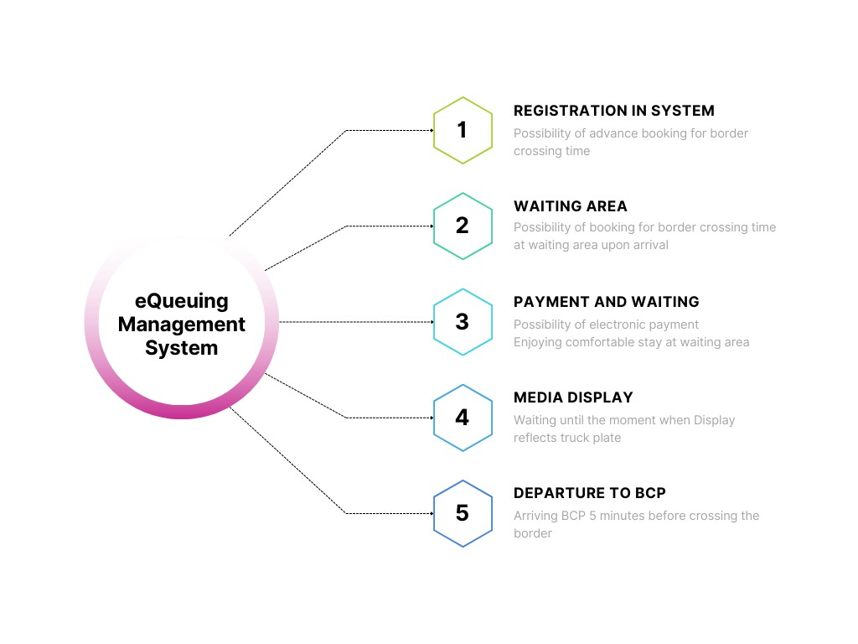
Digital Trade Assessment – eQueuing Management System
Managed by Customs
Private sector owned truck parks
Charge for service
Can be applied for both cargo and passengers
Introduced in KZ & UZ
ITC is helping Kyrgyz Republic
USAID is facilitating eQMS pilot in TJ

Slide 8
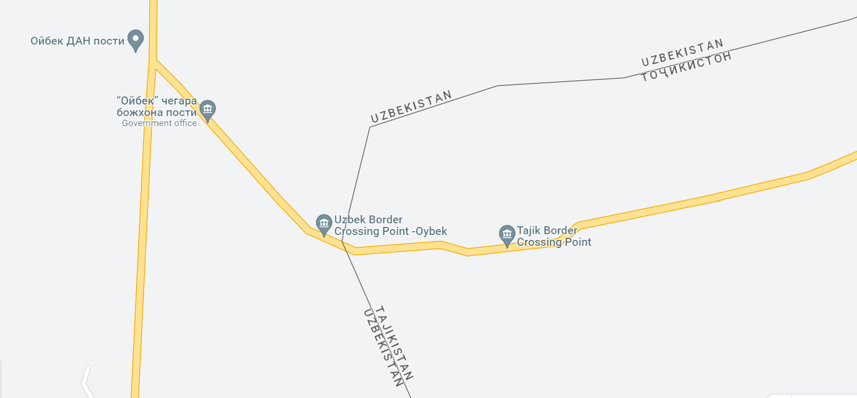
eQMS Pilot at Fotehobod BCP
Year | Entry | Depart | Total
2016 | 6 246 | 5 041 | 11 287
2017 | 9154 | 7 007 | 16 161
2018 | 19 800 | 15 932 | 35 732
2019 | 35 880 | 30 061 | 65 941
2020 | 18 782 | 18 651 | 50 620
2021 | 28 428 | 28 689 | 57 117
2022 | 50 636 | 33 507 | 84 143
Increase since 2016 in % |  |  | 745

Slide 9
Activities carried out before selecting preferable model of eQMS
Formal enquiry of Tajikistan Customs to facilitate the eQMS pilot in one of the BCPs with Uzbekistan
Coordination of efforts with ADB and ITC
Presentation of Uzbekistan eQMS experience to Tajikistan Customs
Presentation of Georgian eQMS experience to Tajikistan Customs
Presentation of ITC’s eQMS solution for Kyrgyzstan to Tajikistan Customs
Visiting Fotehobod BCP and pre-assessment of infrastructure
Uzbekistan customs interest in synchronization of eQMS systems with Tajikistan

Slide 10
Next steps
Communicating with Tajikistan Customs on the model they are interested the most
Develop specification for procurement of software/platform for selected model
Facilitate a study tour to the country where the selected model is implemented
Introduce the platform and hand it over to the Tajik Customs
Facilitate organization of coordination meetings between Tajikistan and Uzbekistan Customs to discuss potential integration of eQMS systems in Fotehobod/Oybek BCP

Slide 11
Thank You

