Slide 1
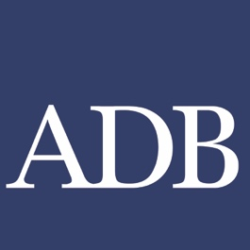
Fotekhobod – Oybek Road Joint BCP 2023
Zulfia Karimova
Principal Regional Cooperation Specialist
Central and West Asia Department
Asian Development Bank

Slide 2
Importance and Traffic Structure of the BCP
CAREC Corridor 2
Part of the Shymkent-Tashkent-Khujand Corridor
Bilateral importance: One of the largest and growing Tajik-Uzbek Road BCPs
Large and growing transit
Southbound
2022 Total Traffic: 1,063, 863 passengers, 66,716 cars, 58,113 trucks
Northbound
TAJ exports to UZB, KYG, RUS, EU: cement, minerals, textiles, dry fruit, cotton
PRC via KAZ: mainly cargoes to/from
RUS to TAJ and AFG: cargoes
EU to ATJ: used cars, fruits, etc.

Slide 3
BCP Profile
Fotekhobod | Oybek
Coordinates: 40° 32′ 46″North 69° 13′ 0″ East
Outbound Road Direction Vector: 211° SW
Road/Motorway Number: 1RB | Road/Motorway Number: 4R20
Access Road Lanes Inbound: ____________1 Outbound: _________1 | Access Road Lanes (project) Inbound: 4 – of which 2 for trucks Outbound: 4 – of which 2 for trucks
2022 Annual Average Daily Truck Traffic (AADTT) Total UZB data: 159 Customs reported total daily capacity for truck clearance: 160
Bridge: N/A lanes per direction, length: ____m, built in _______, capacity & quality: _____________________.
Altitude: 300 meters above sea level
Operations: Open 24/7 year-round for all traffic
National Codes: Oybek 27011

Slide 4
Integrated Border Management (IBM) Analysis
Reconstruction of Road BCPs should be holistic and incorporate improvements across all seven IBM components:
Institutional
Legal
Procedures / Operations - One-Stop System, future No-Stop System – ABC
Human Resources / Skills Training
Information Exchange & Communications - Single Window
Equipment – Automated Number Plate Recognition (ANPR)
Infrastructure – High-rise truck control cabins + physical site analysis

Slide 5
Topography and Site Analysis
Relatively open, flat terrain with no barriers on either side
Borderline limits expansion on one side
UZB: already has a project: 4 (current) + 4(additional) lanes, however will be forced to abandon the current facilities (please see the next slide)
TAJ: has identified available 2.37 hectares of land, with plans to widen the space and match the number of lanes and align correctly with the new axis
Renewable energy:
Excellent photovoltaic potential
Maximize the canopy and increase the current output for TAJ

Slide 6
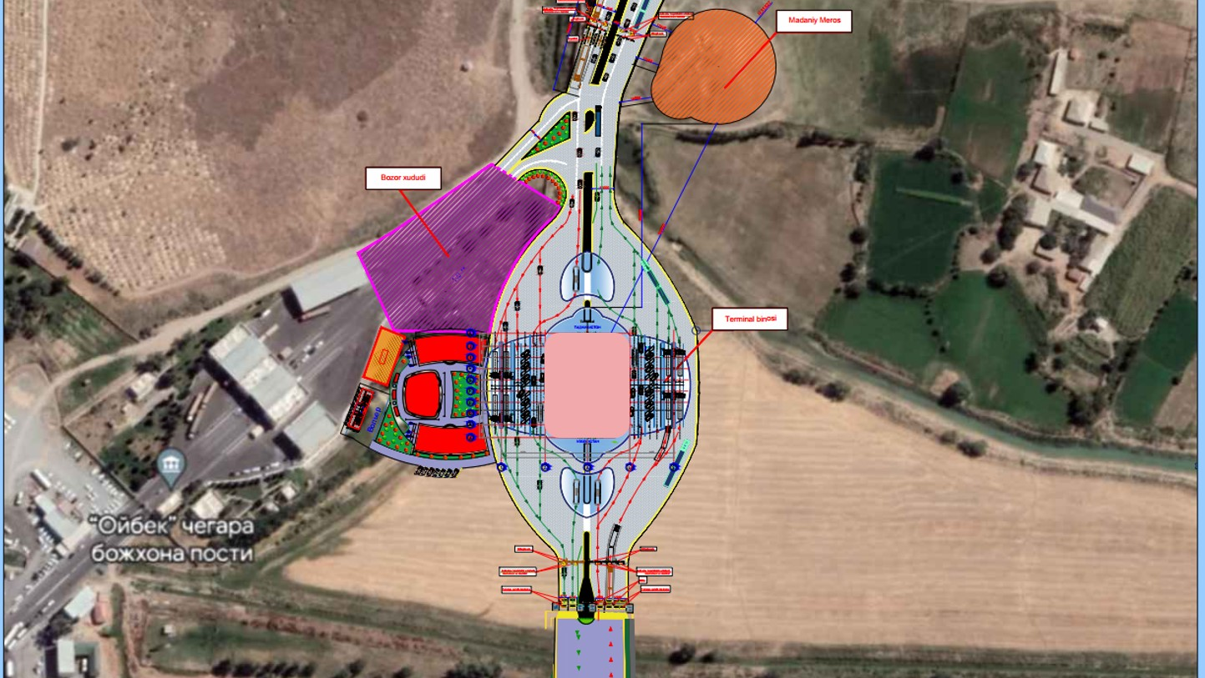
Oybek BCP Project

Slide 7
Digital / Electronic Age
The Goal
Customs Declaration and supporting documents (including documents of the driver and the truck) should be:
Available in advance in electronic form simultaneously to both UZB and TAJ Customs 2 hours before the truck arrives
Single Window accessible at BCP and real-time exchange and messages between TAJ and UZB
Abolish use of physical paper and use electronic documents:
e-TIR (TJ to join, UNECE funding available)
e-CMR
e-Phyto Certificate
Join the UNCITRAL MLETR Convention –Model Law on Electronic Trade Records

Slide 8
Issues & Solutions
IDENTIFIED ISSUES | PROPOSED SOLUTIONS
Tight space and insufficient number of lanes | Expand on both sides to match the number of lanes
All traffic crammed into one lane | Designate or organize the lanes (from the Main Administrative Building) Lanes 1 and 2 = Passenger cars/vehicles Lane 3 = TIR and empty trucks Lane 4 = Trucks Propose adding Lane 5 for dangerous goods or special-size vehicles
Too many stops | Remove redundant barriers Install One-Stop joint Control Cabin, staffed by Customs and Border Police Windows/stops for trucks be at a sufficient height (see next slide)

Slide 9
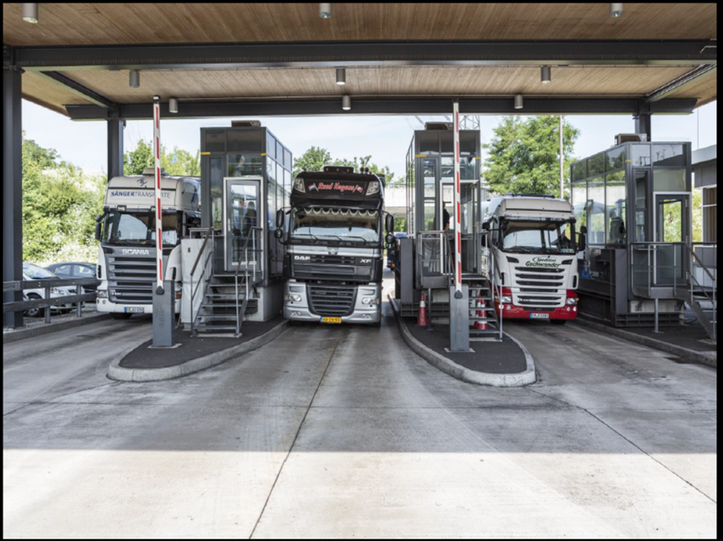
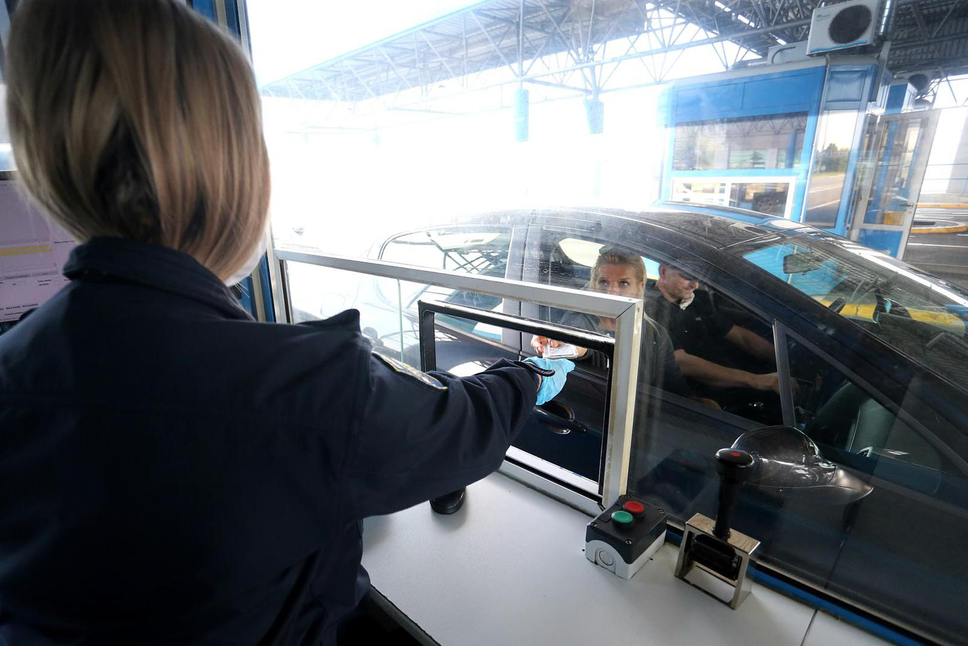
Control from Cabins
9

Slide 10
Three Action Priorities
Heat Regime in TAJ prohibits the trucks to use the roads from 8:00 – 18:00 from May to September. In UZB, this regime is in force from 10 June to 10 August.
Solutions: If the asphalt is insufficiently strong, propose to add colored coating or a special top layer to increase albedo (reflection).
Customs Convoying, especially in TAJ (TIR is exempted); fee collected.
Solutions: Apply guarantees, TIR. Implement tracking by GPS and use of e-seals.
TochVneshTrans Terminal at the BCP collects $220 per truck (for services and weighing), while the UZB terminal charges $3.
Solutions: 1) services must be offered on a competitive basis; 2) new road must be built to allow inbound trucks to bypass the terminal, and; 3) clearance and weighing should be done at inland terminals.
✓
✓
✓

Slide 11
Proposed Integrated Solution
Unify the project into one, set coordination, find common funding
Match the control lanes and introduce Joint Control Cabins on each side, connected with Earthlink cable for real-time exchange –including the passport swipe. Connect also the Centralized Risk Management systems to the cabins.
Procure two Z Portal for Trucks for Lane 4 – Exit – one on each side (total cost: $8 million), as well as the ANPR system for 10 lanes ($40k).
The next step is to set up Synchronized Joint BCP for trucks. The first requirement is full, real-time audio/video and data access between two Control Cabins working on the same direction. The second is the detailed agreed Operational Procedures. Truck is cleared by both sides in one location (at the exit).

Slide 12
STKEC Roadmap Important Quotes
Trucks from UZB going to TAJ requires an average of 3.1 hours to pass through the Oybek–Fotehobod BCP.
A proper Time Release Study (TRS) is recommended for this BCP.
To significantly reduce the cost of border crossing, STKEC countries need to modernize not only BCP infrastructure and equipment but also border crossing procedures.

Slide 13
Thank you!
Спасибо!
Ms. Zulfia Karimova
Principal Regional Cooperation Specialist, ADB

