Slide 1

Joint Road BCPs:
Silk Road JBCP (AZ-GE)
Radomir Djuric
ADB Consultant

Slide 2

Why Joint BCPs & How They Work (Or Not)
• One Stop & Joint Procedure – instead of Two
• The GOAL = efficiency
WCO SMART = Secure, Measurable,
Automated, Risk Management-based, and Technology-driven
• One-Stop could be National or Bilateral (International)
• Instead of Duplication – Integration
• Multiple, Consecutive, Complex, Duplicative Control Procedures
• To achieve it in practice, it is not enough just to put Border Agencies
in one place (=Collocated BCP), but to complete a series of measures

Slide 3

Key Measures
• Minimize and optimize the workload at Road BCPs
1. Only Customs and Border Police should be permanently working at
the Control Line (or even only one unified agency)
2. Electronic documents, filed in advance securely via the Single
Window (ideally, simultaneously to all BCPs on the itinerary)
3. Control completed at the points of origin and destination, whereas
at the intermediary BCPs a quick verification is performed
4. Use the WCO/Kyoto ConventionRisk Management principles
5. Simultaneous joint controls, based on the One-Stop system

Slide 4
Infrastructure & Equipment Changes
• One Stop mean ONE, not two, three or more stops
• For trucks, high-level truck cabins (at 1,80 meters) should be installed
• Automated Number Plate Recognition (ANPR) system + CCTV +
Automated Container Number Recognition (ACRN) - connected to ICT
systems of both Border Agencies, that automatically triggers the
respective files connected with the approaching vehicle – please see
the next slide
• Primary Control and Secondary Inspection Building
• Possible tracking system, such as GPS/GLONASS, RFID, e-seals

Slide 5
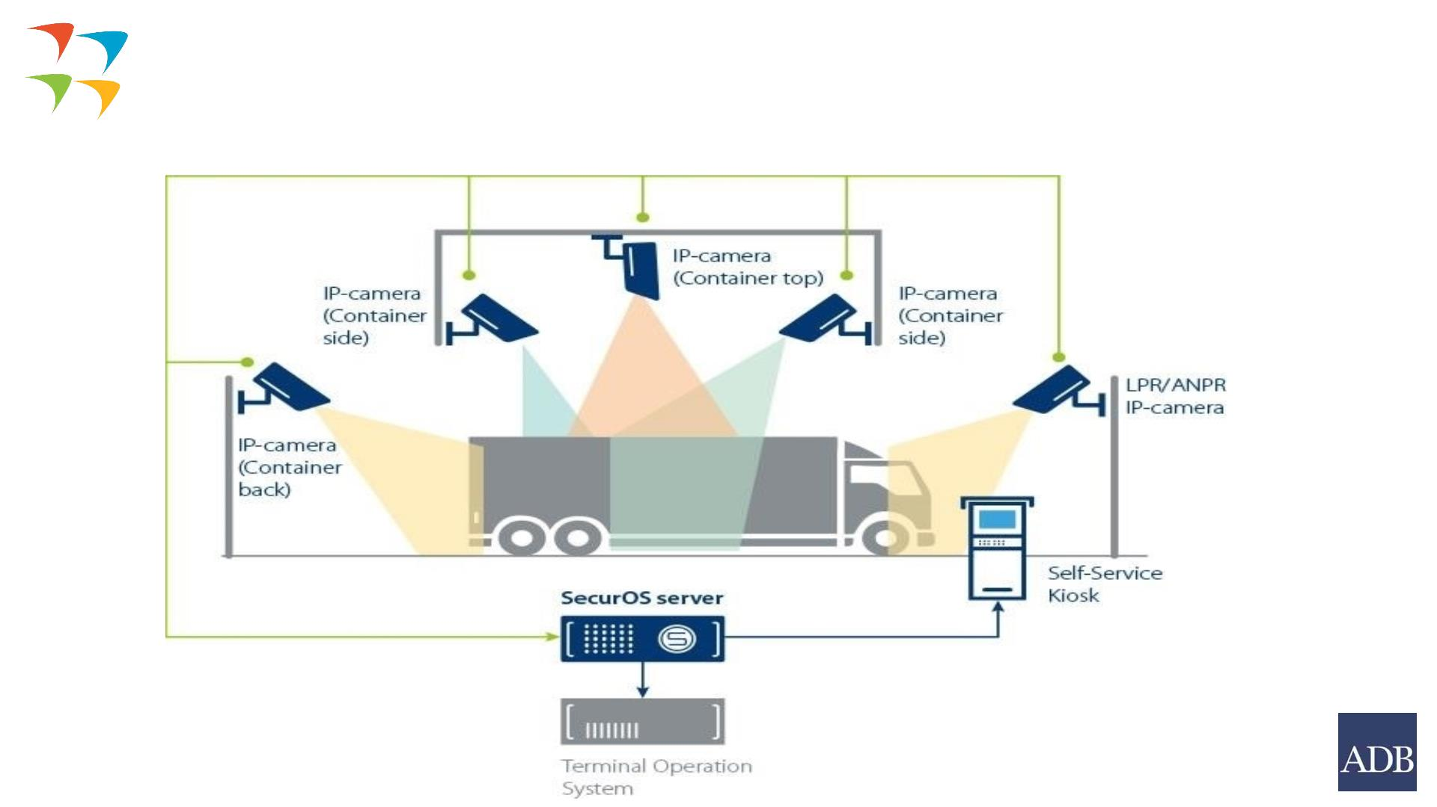
Video Control Systems
5

Slide 6
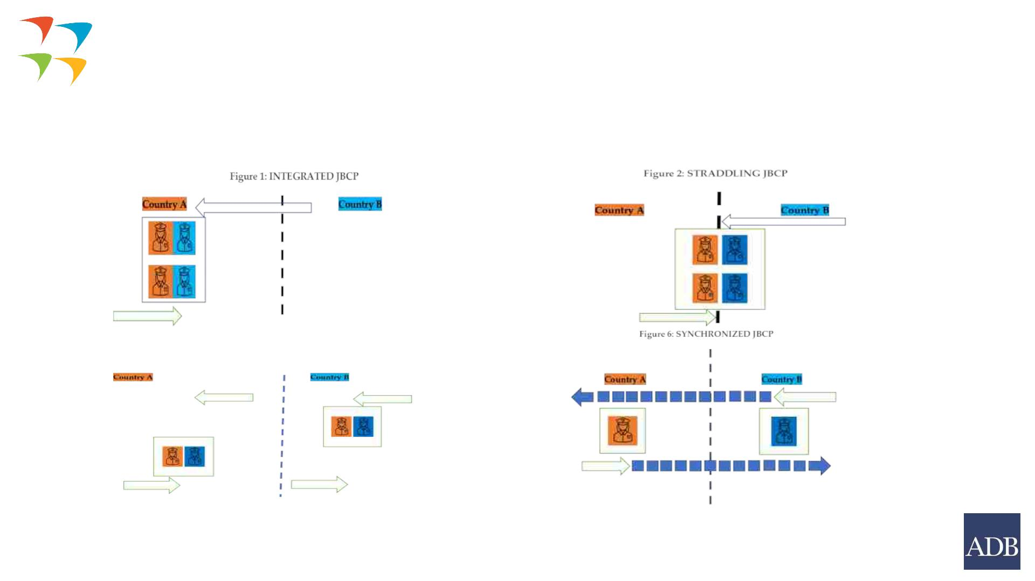
Four Types of Joint BCPs
6

Slide 7

Silk Road Joint BCP
Reasons: 1) growing international transit via the
Middle Corridor + bilateral trade (Total trucks in
2021: 264, 442, 2022: 292, 935
2) constrained space at the Red Bridge, the only
convenient Road BCP
Joint BCP (JBCP) named Abreshumis Gza- Ipek Yolu
– Silk Road. This was formalized by a Baku
Agreement of 29 September 2021. The location
was agreed and both countries published the
relevant decisions in their respective official
gazettes.
The midpoint coordinates were 41⁰ 23’ 33” North
and 45⁰ 09’ 03’’ East. Accepted by Georgia
Azerbaijan’s agreement expected.
It will operate as a JOINT BCP, firstly only for
trucks, then also cars & buses
7

Slide 8
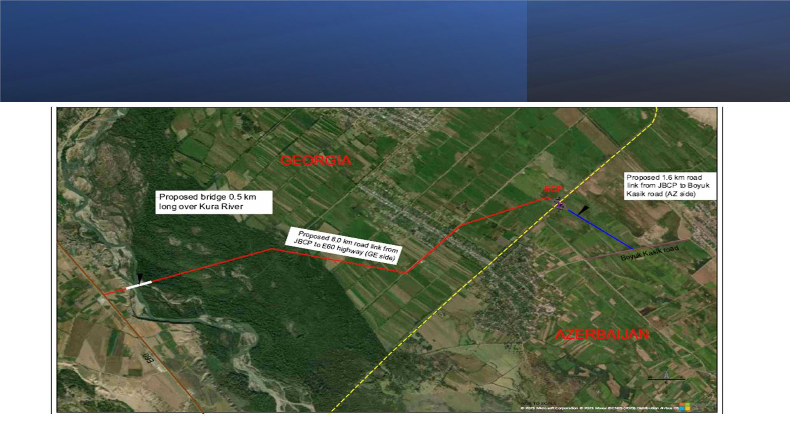
8

Slide 9

Future Operations
1. Bilateral Legal Agreement
2. Joint Operational Procedures, as Annex 1 of the Bilateral Legal
Agreement – the most important and the most complex document
3. List of Equipment
4. Design Inputs
5. Blueprints and 2D models
qClassical “Island” Configuration: Twelve control lanes planned,
six per direction
9

Slide 10
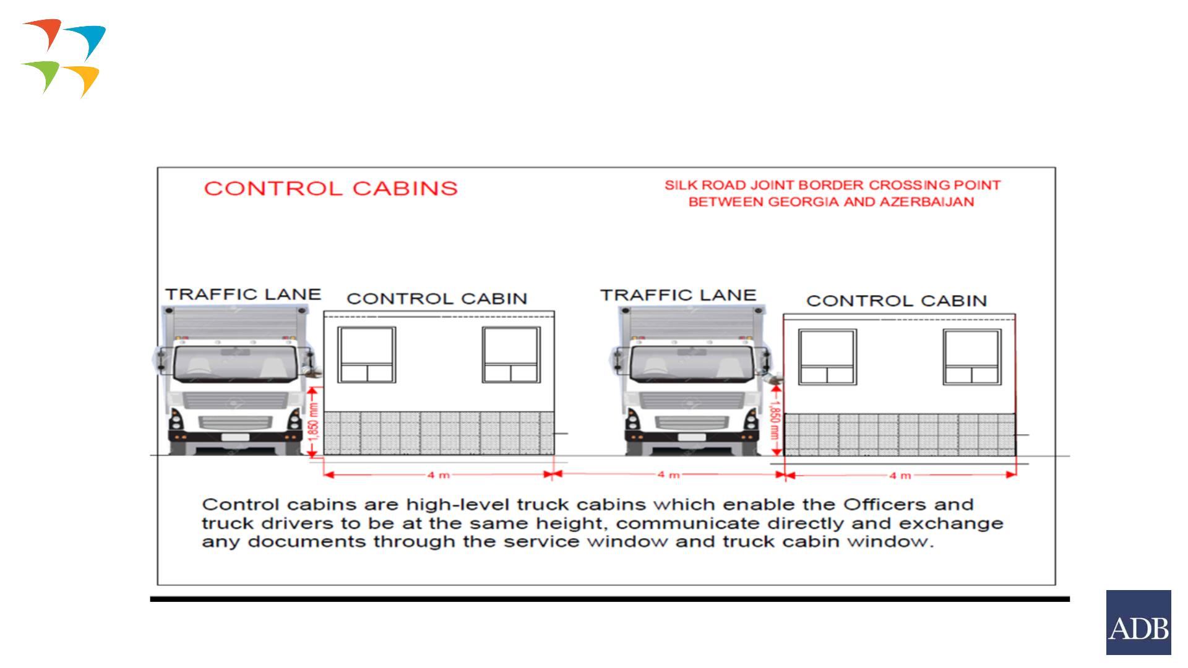
Joint Control Cabins
10

Slide 11

Renewable Energy
at BCP
Should be a standard:
qEconomic and Environmental
Benefits
qRain Harvesting
Photovoltaic, third-generation
high efficiency
Heat pump with COP of 5.0 or
higher, with A+++ label, rated
by the European Heat Pump
Association (EHPA) and use R-
290 or another environmentally
friendly refrigerant
11

Slide 12
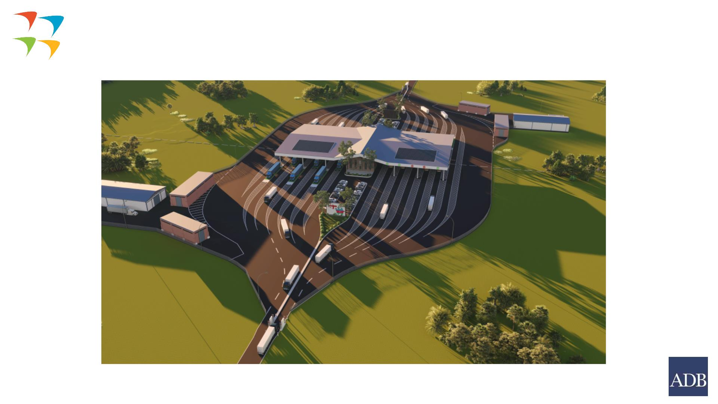
General Plan
12

Slide 13

Thank you!
Спасибо!
Mr. Radomir Djuric
ADB Consultant

