Slide 1
Prefeasibility study for establishment of International Center for Industrial Cooperation (ICIC) at Kazakhstan-Uzbekistan Border under Shymkent-Tashkent-Khujand Economic Corridor (STKEC)
Draft Final Report Discussion
September 2023

Slide 2
Agenda for Discussion
To present the outcome of prefeasibility study of ICIC
Briefly present the project context, key activities undertaken and the project status
Showcase the outcomes from the pre-feasibility study for development of an ICIC between Kazakhstan and Uzbekistan
To seek feedback and valuable inputs on the study outcomes
Way Forward and next steps to be taken by the government

Slide 3
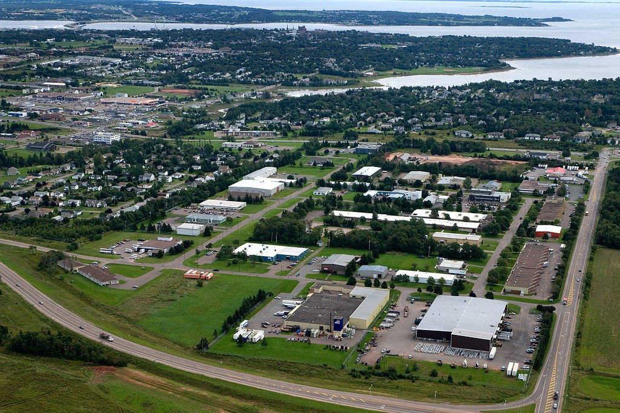
Contents
01
Project Background
02
Rationale and Context
03
Concept Plan for ICIC
04
Financial Analysis
05
External Enablers
06
Way Forward
Prefeasibility study for establishment of ICIC under STKEC

Slide 4
Project Background

Slide 5
Project Background and Progress Update
Development of ICIC…
Dec 2021
Jan-May 2023
Virtual Inception workshop in Kazakhstan and Uzbekistan (ICTEC)
Change of ICTEC to ICIC# to enhance the focus on industrial cooperation between the countries
Jan - Feb’23: Change of site for ICIC. New location finalized in the Atameken – Gulistan BCP instead of Zhibek Zholy BCP. Further, size of ICIC on each side reduced to 50 Ha.
May’23: Governments of Kazakhstan and Uzbekistan sign the roadmap for establishing ICIC
May 2022
Aug 2020
Background report preparation, as-is assessment on various development components of ICIC
Roadmap for STKEC development including the proposal for development of ICTEC*
Start
Empanelment of consultants for concept plan for ICTEC
Feb – Apr’22: Bilateral consultations undertaken with government agencies
Study team conducted as-is assessments and background review
Inception report submission
Field Visit to Kazakhstan, Uzbekistan – meetings with various government stakeholders on findings of background report
- Site visit to the potential locations
Concept Plan and Draft pre-feasibility report finalized by the study team
Regional workshops for gathering inputs from the respective state authorities
Nov 2021
*International Center for Trade and Economic Cooperation
#International Center for Industrial Cooperation
Feb 2022
Oct 2022
2023 and onwards
Prefeasibility study for establishment of ICIC under STKEC

Slide 6
Stakeholders and Key Inputs
1
Key Stakeholders
Qaztrade
Ministry of Investment and Infrastructure Development
ATAMAKEN
Ministry of Trade and Integration
Shymkent City Akimats
Ministry of Agriculture
Border Service of the National Security Committee
Tassay and Zhuldyz Industrial Zones
State Revenue Committee
Turkestan Region Akimats
Ministry of Transport
Farovon Hayot LLC Logistics centre, Tashkent
Ministry of Agriculture
State Customs Committee
Chamber of Commerce and Industry
Sanitary Epidemiological Service (SES), Ministry of Health and Agency for Plant Quarantine and Protection
Ministry of Investments and Foreign Trade
Hokimat of Tashkent Oblast
The Uzbek Agency for Standardization, Metrology and Certification
2
Key inputs
Heightened focus on bilateral trade between the two countries (target to surpass US$ 10 bn bilateral trade by 2030)
Rationale for renaming ICTEC to ICIC in order to increase focus on manufacturing cooperation
Inputs on prospects of key sectors in ICIC including food processing sector, FMCG, wearing apparels, pharmaceuticals, furniture, meat processing etc. from manufacturing perspective
Strategic inputs related to the locations to be studied for development of the ICIC
Prefeasibility study for establishment of ICIC under STKEC

Slide 7
Rationale and Context

Slide 8
Bilateral Trade and Manufacturing Growth in Kazakhstan and Uzbekistan
Bilateral Economic Relations
Break-up of traded commodities
Kazakhstan Export to Uzbekistan
Uzbekistan Export to Kazakhstan
Current trade is mostly around primary commodities:
Kaz to Uzb: Iron and steel, Aluminum, oil and wheats
Uzb to Kaz: Natural gas, fruits, motor vehicles and chemical products
US$ 1.05 bn
US$ 2.84 bn
Growth rate between 2017-2021
Manufacturing in both the countries has relatively grown faster as compared to services and agriculture, forestry & fishing
However, the manufacturing focus on high value-added products is limited
There is a large potential for both the countries to leverage their natural resources and focusing on improving the trade profile to achieve their desired goals
Kazakhstan
Uzbekistan
GDP
Agriculture, forestry, and fishing
Maufacturing
Services
Source: ITC Trade map; World Bank Database
Prefeasibility study for establishment of ICIC under STKEC

Slide 9
Non-Tariff Barriers between Kazakhstan and Uzbekistan
Non- Tariff Barriers
Multiple non-tariff barriers constrain their bilateral trade.
Kazakhstan implements EAEU technical regulations
Unharmonized trade standards
Uzbekistan adheres to its National technical regulations
Both EAEU and Uzbekistan’s National Technical standards are only partially consistent with International Standards causing significant barrier to Bi-lateral trade
High cost of border crossing for cargo shipments by road and rail due to inadequate BCP infra, cumbersome border controls
High Cost of Border Crossing
Year | 2005 | 2017 | 2018
Agriculture | 145.07 | 78.79 | 68.78
Manufacturing | 69.94 | 86.16 | 80.96
Total Trade | 89.25 | 84.63 | 76.83
Higher trade cost as % of cost of traded goods
Occasional trade Restrictions
Ad-hoc export restrictions on essential goods negatively impact bi-lateral trade flows and risks cross border supply chains
Prefeasibility study for establishment of ICIC under STKEC

Slide 10
Rationale for ICIC Development
How ICIC can help?
Strengthen Industrialization and Production
Facilitate Value Added manufacturing
Promote balanced spatial/regional development within Kazakhstan and Uzbekistan through boosting economic development
Integrated planning for the provision of utilities, SPS and other enabling infrastructure
Enhance Competitiveness and increase trade
Reduce trade and transportation cost
High industrial co-operation and provision of training centers to enhance skills and capacity building
ICIC may facilitate harmonized customs rules to expedite cross border movements
Shorten the Border Crossing Time
Manage Supply Chain Risks
Creation of storage capacity at ICIC, can mitigate the potential impact of temporary supply chain disruptions
Development of temperature- controlled logistics can reduce reliance of imported goods during off harvest seasons
Prefeasibility study for establishment of ICIC under STKEC

Slide 11
Concept Plan for ICIC

Slide 12
Framework for ICIC Concept Plan
Key elements of ICIC concept plan
1
Location
Location with sufficient land availability, having proximity to major cargo hotspots, linkage to transport infrastructure, utilities, availability of social infrastructure
2
Sectors with high future potential and aligned with comparative strengths of the two countries
Sector selection
3
Set of incentives to be extended to investors to improve the attractiveness of the center
Incentive structure
4
Institutional Structure
Suitable institutional structure for development and operations of ICIC as per the best practices and prevalent models in Central Asia
5
Component and zoning
Infrastructural components supporting the sectors to be developed within ICIC
Prefeasibility study for establishment of ICIC under STKEC

Slide 13
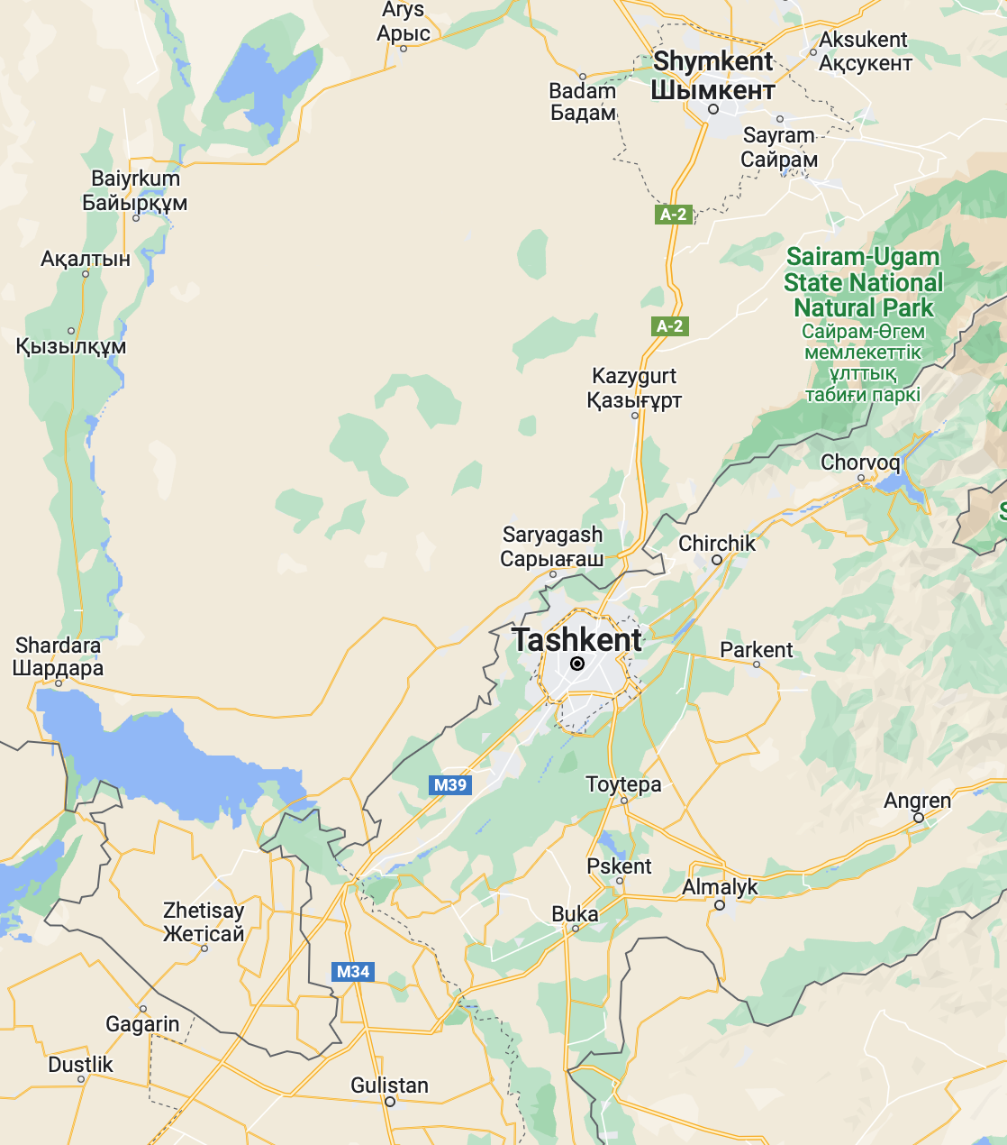
Overview of the Proposed ICIC Site near Atameken (Kazakhstan)-Gulistan (Uzbekistan) Road BCP
1: Location
2: Sector selection
4: Institutional structure
3: Incentive structure
5: Component and zoning
SHYMKENT
Parameter | Kazakhstan |  | Uzbekistan
Distance from Major Consumer Markets | ~267 Km (Shymkent City) |  | ~80 km (Tashkent City)
Rail connectivity | ~111 Km (Saryagash Railway) |  | ~80 Km (Tashkent Railway)
Air Connectivity | ~237 Km- (Shymkent Airport) |  | ~83 Km (Tashkent Airport
Nearest Highway | ~2 km |  | ~4 km
Nearest International Highway | ASIAN highway: 11 Km CAREC highway: 260 Km |  | ASIAN highway: 4 km CAREC highway : 80 Km
Availability of skilled labor | Under-developed skill ecosystem, as the identified site is significantly away from urban clusters |  | There is a good opportunity of supply of skilled workforce in the sectors of light engineering, textiles, pharmaceuticals, etc.
267 km
237 km
111 km
TASHKENT
80 km
80 km
82.8 km
28 km
Gulistan BCP
Atamaken BCP
Prefeasibility study for establishment of ICIC under STKEC

Slide 14
Shortlisted Sectors for ICIC Development
1: Location
2: Sector selection
4: Institutional structure
3: Incentive structure
5: Component and zoning
Step1: Based on the sector shortlisting framework, 7 sectors were selected for further consideration
Step 2: With further shortlisting, 4 sectors were finalized
Future Potential
Final Shortlisted Sectors
Automobile
Food Processing
Pharmaceutical
Computer, Electronic and Optical Products
Machinery and Equipment N.E.C.
Electrical Equipment
Pharmaceuticals
Basic Metals
Textile and Wearing apparel
Fast Moving Consumer Goods (FMCG)
Chemicals and Chemical Products
Food Processing
Fabricated Metal Products
Textile and Wearing Apparel
Furniture
Above were shortlisted based on
1) Trade compliance requirement: Sectors with high compliance requirement shall benefit from ICIC
2) Time Sensitivity of goods: Sectors with respectively shorter lifecycle shall benefit from ICIC
Rubber and Plastics Products
Other Non-Metallic Mineral Products
Paper and Paper Products
Leather & Related Products
Wood and of Products of wood and cork
Shortlisted Sectors
Comparative Strengths
Sectors didn’t get considered for initial development
Size of bubble represents current output of the sector in Kazakhstan and Uzbekistan

Slide 15
Fiscal and Non-Fiscal Incentives for Investors
1: Location
2: Sector selection
4: Institutional structure
3: Incentive structure
5: Component and zoning
To attract investors to ICIC, the following incentives are proposed
Customized Incentive Package
Fiscal Incentives
Incentives for Infrastructure Development
Incentives for Business Opportunities
Direct Tax benefits
Subsidized land cost and incentive on registration duties
Sector wise production linked incentives
Capital subsidies for creation of new units
Incentives for introduction of new technology
Employment generation subsidy
Rebates on utilities costs
Logistics cost reduction
Utilities and internal infrastructure
Provision of Labor housing facilities
Provision of modern warehousing and cold storage infrastructure
Inhouse Quality Certifications and documentations by provision of inhouse laboratories
Automatic clearance for access to countries under FTA with Kazakhstan and Uzbekistan
Single window clearances for setting up new units
Ability to transact in foreign currency
Joint investment desk between Kazakhstan and Uzbekistan
Prefeasibility study for establishment of ICIC under STKEC

Slide 16
Institutional Structure for ICIC
1: Location
2: Sector selection
4: Institutional structure
3: Incentive structure
5: Component and zoning
Model I: Single Entity Model
Model II: Dual Entity Model
In this model, ICIC shall be set up as a Joint Venture between Kazakhstan and Uzbekistan
Supervisory Board
Dual Development Model
Uzbekistan
Kazakhstan
The Board shall consist of Single Chairman appointed on rotational basis and Two Vice Chairman one from each country
Ministry of Economy
Minister of Economy and Trade development
Chairman
Uzbekistan
Kazakhstan
Ministry of investments and Foreign Trade
Ministry of trade and infrastructure development
Vice Chairman 1
Vice Chairman 2
Representation from key economic ministries
Advisory Body
Intergovernmental supervisory board
Ministry of Finance
State Revenue Committee Ministry of Finance
Intergovernmental Supervisory Board
Ownership
Uzbekistan / PPP
Kazakhstan / PPP
State Customs Committee
State Customs department
Operation Executives
Khokimiyat of Syrdarya region
Turkestan District Akimat
Operations
Uzbekistan / Private Entity
Kazakhstan / Private Entity
State / Region Administrative Council
Sales & Marketing
Finance
Investment Promotion
Urban Management
Legal
Administration
Akimat of Shymkent City
Pros
Cons
Pros
Cons
Harmonized laws may be achieved
ICIC to set up its own regulations
Mature Model in Central Asia
Unharmonized laws
Ease of Co-ordination
Chances of disagreement between stakeholders
Change of laws may be avoided
Co-ordination issues might occur
Preferred Model

Slide 17
Components for ICIC
1: Location
2: Sector selection
4: Institutional structure
3: Incentive structure
5: Component and zoning
Components
Need for Components
Manufacturing zone
Will allow industries to conduct value added processing and get access to shared resource base
Office Buildings
For primary administrative and managerial staff working at ICIC
Initial Phase
Will enable industries to manage inventories more efficiently, will include cold storage , cargo handling centers , distribution centers and packaging facilities
Logistics Zone
Will enable supply of essential utilities such as water, modern power storage, waste management etc
Utilities Zone
Custom Clearance zone
Provide custom clearance and facilitate goods produced in ICIC
Border Crossing point
Facilitate faster movement of goods produced within ICIC
To carry out food safety, veterinary, phytosanitary and pharmaceutical quality tests within ICIC
Laboratories
Additional Phase/s
Offer specialized training programs to businesses to upskill the workforce to meet business needs
Training center
To facilitate trade by connecting buyer-seller needs, and expanding B2B networks
Exhibition Center
Help Manufacturer to have better market access and trades to have better access to customers
Wholesale Market

Slide 18
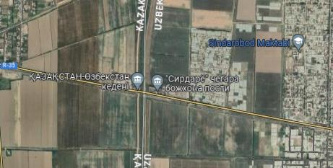
Zoning Plan under Two Proposed Institutional Models
1: Location
2: Sector selection
4: Institutional structure
3: Incentive structure
5: Component and zoning
Zoning plan under Model I: Single Entity Model
Zoning plan under Model II: Dual Entity Model
KAZAKHSTAN
UZBEKISTAN
KAZAKHSTAN
UZBEKISTAN
Proposed Area for ICIC by Kazak Government
Proposed Area by Uzbekistan Government
Proposed Area for ICIC by Kazak Government
Proposed Area by Uzbekistan Government
Manufacturing Zone
Manufacturing Zone
Manufacturing Zone
Logistics and Warehousing
Processing
Non-Processing Zone
Logistics and Warehousing
Processing
Non-Processing Zone
ICIC shall be combined into one single entity without demarcation on either side of the border
Kazakhstan and Uzbekistan governments shall be responsible for the development of their respective side of the border with separate processing and non-processing areas
Prefeasibility study for establishment of ICIC under STKEC

Slide 19
Financial Analysis

Slide 20
Financial Assessment
Total CAPEX Required
US$32.5 million
Figures are in Million US$
7 (20%)
12 (37%)
8 (26%)
3 (8%)
3 (9%)
33
Infrastructure Development
Buildings
Utilities
Pre Operating Expenses
Contingency
Scenario 1
Debt-and-equity hybrid financing
Scenario 2
Debt-and-equity hybrid financing with VGF from the Government
Equity
Debt
Equity
Debt
VGF
US$ 15.6 million
US$ 16.9 million
US$ 4 million
US$ 4.4 million
US$ 24.1 million
4
Project NPV, US$ ’000
Project IRR
N/A
ICIC will require low-cost financing and/or sizable VGF to be financially viable.
Source: Study team analysis

Slide 21
External Enablers

Slide 22
Infrastructure Investment and Trade Facilitation
1
Construct Darbaza Maktaaral Railway Link
Construction of the Darbaza - Maktaaral railway will reduce the capacity shortage in Sarygash/Keles checkpoint, especially during peak periods of seasonal freight loading
2
Modernize BCP
Considering the increasing cargo turnover from Central and South Asian countries, it is necessary to modernize the trade and logistics infrastructure at the border
Modernization of BCP entails the following:
Smart Queuing management and Parking center
Adoption of integrated border management
Smart Gate Management
Segregation of Traffic Flows
Implement a smart queuing system and parking center. . | Cargo flow can be subdivided into a green lane, over-sized vehicles, and normal vehicles. | Different lanes should be demarcated to ensure correct queuing at the entry point. | Establishment of one-stop-shop station where all relevant documents are checked
3
Rehabilitate the A-2 and A-15 roads
Prefeasibility study for establishment of ICIC under STKEC

Slide 23
Legal and Regulatory Framework
Other Soft Interventions
Treatment of Machinery
Specify terms on treatment of machinery imported from outside custom territory of ICIC
Treatment of second- hand machinery bought from outside of ICIC from either Kazakhstan and Uzbekistan
Import duties subject to above two points
Development of Logistics Services
Logistics services need improvement to meet the growing demand in both countries with investment in “Grade A” warehouses
Treatment of Machinery
Intergovernmental
Agreement
Incentives to Attract Foreign Investors
Create incentive structure to attract foreign investment and encourage participation in manufacturing within ICIC in the respective side of ICIC
Formulate sector-wise fiscal incentives and adopt ease of doing business (EoDB) measures
Coordinated Movement between Inter SEZ
Incentives to attract investors
Bonded status for such inter-center movements improve the attraction of the ICIC
ICIC can act as a conduit to value-add on raw or semi-finished goods from other SEZs, in terms of sorting, grading, packing, as well as consolidation and deconsolidation
Hiring of Foreign Labour
Hiring of Foreign Labour
Provisions to legalize the hiring of foreign labor in ICIC, including allowing swapping the labor from Kazak to Uzbek side and vice-versa
Country of Origin Rules
As ICIC is of transboundary nature, therefore it is proposed to have harmonization of laws imperative for smoother functioning
Since Kazakhstan and Uzbekistan have different laws on the rules on country or origins, it is challenging to harmonize them

Slide 24
Way Forward and Questions

Slide 25
Thank You
© 2023 PwC. All rights reserved. Not for further distribution without the permission of PwC. “PwC” refers to the network of member firms of PricewaterhouseCoopers International Limited (PwCIL), or, as the context requires, individual member firms of the PwC network. Each member firm is a separate legal entity and does not act as agent of PwCIL or any other member firm. PwCIL does not provide any services to clients. PwCIL is not responsible or liable for the acts or omissions of any of its member firms nor can it control the exercise of their professional judgment or bind them in any way. No member firm is responsible or liable for the acts or omissions of any other member firm nor can it control the exercise of another member firm’s professional judgment or bind another member firm or PwCIL in any way.

