Slide 1
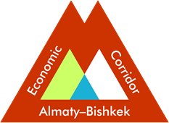
Regional Workshop on
Shymkent-Tashkent-Khujand
Economic Corridor Development
14 September 2023
https://www.almaty-bishkek.org/
Tashkent, Uzbekistan

Slide 2
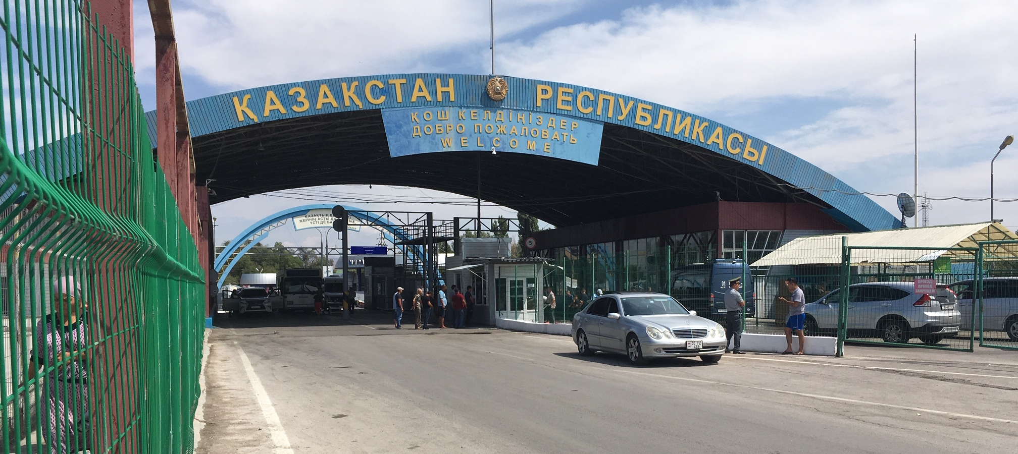
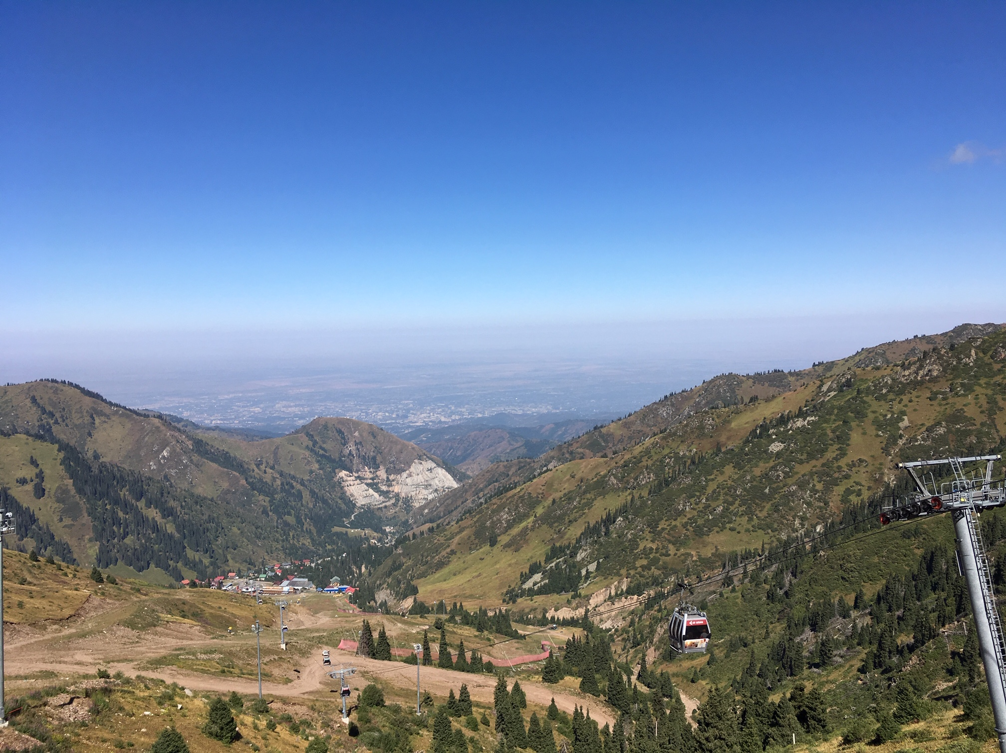
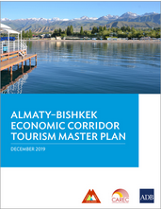
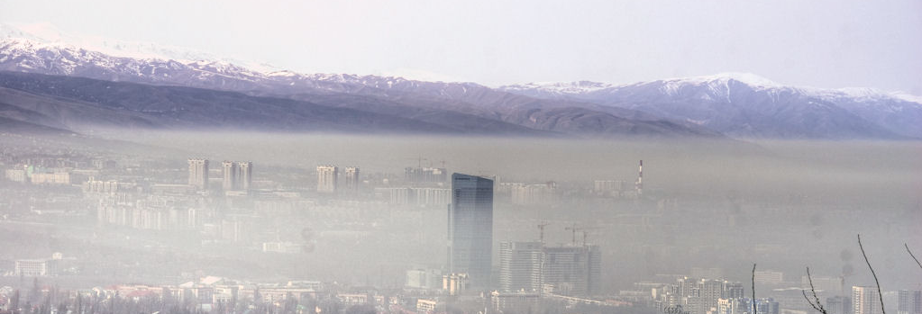
Structure
1. Overview of Almaty-Bishkek Economic Corridor
2. Regional Connectivity
Regional Tourism
Urban Air Quality Measuring
5. Regional Health
6. Regional Agribusiness
7. Lessons Learned

Slide 3
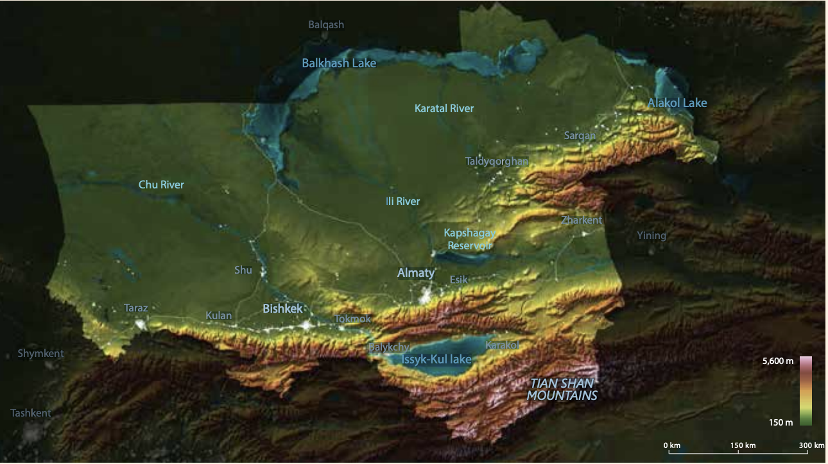
1. Introduction to the Almaty-Bishkek Economic Corridor
Vision: the two cities can achieve far more together than either alone. ABEC transforms the area into a single space where exchange of ideas, movement of goods and meeting people is fast, easy, and free of barriers.
ABEC aims to:
increase connectivity;
create one market for tourism, health, and education services; and
create modern wholesale markets to exploit export potential
Notes:
The Almaty–Bishkek Economic Corridor (ABEC) is the pilot economic corridor under the Central Asia Regional Economic Cooperation (CAREC) program. The Almaty–Bishkek Economic Corridor, which emanated from the Almaty–Bishkek Corridor Initiative, transforms the area into a single space where exchange of ideas, movement of goods and meeting people is fast, easy, and free of barriers. The motivation for ABEC is that Almaty and Bishkek can achieve far more together than either can achieve alone. The two cities are only 240 kilometers apart with relatively high economic density concentrated in services in the cities and agriculture in their hinterlands. Both Kazakhstan and the Kyrgyz Republic have acceded to the Eurasian Economic Union and World Trade Organization.
ABEC aims to shorten economic distance between the two cities. This means reducing travel times; creating one competitive market for health, education, and tourism services; and aggregate agricultural produce in wholesale markets to exploit the sector’s export potential— following the slogan: act local and think global. For example, in agriculture, the challenge is to create sufficient scale to overcome distance and trade barriers. Inadequate scale increases unit costs of transportation, certification, branding, and processing of agricultural goods. In the health sector, for example, tertiary hospitals and laboratories do not need to offer the full range of services on both sides of the border for the small domestic markets, but instead, services could be coordinated and further specialized across ABEC.
In support to the implementation of ABEC, the Asian Development Bank approved a knowledge support technical assistance for $1.75 million in 2017.

Slide 4
ABEC Evolution
2014
MoU between Mayors of Almaty and Bishkek
2015-2017
End 2017
Creation of ABEC Subcommittee by Intergovernmental Council
2018-2023
Four Joint Working Group Meetings
Seven ABEC Subcommittee Meetings

Slide 5
ABEC Institutions
Kyrgyz- Kazakh Intergovernmental Council
ABEC Subcommittee
Agriculture JWG
Tourism JWG
Connectivity JWG
Health JWG
ADB as observer and supporter

Slide 6
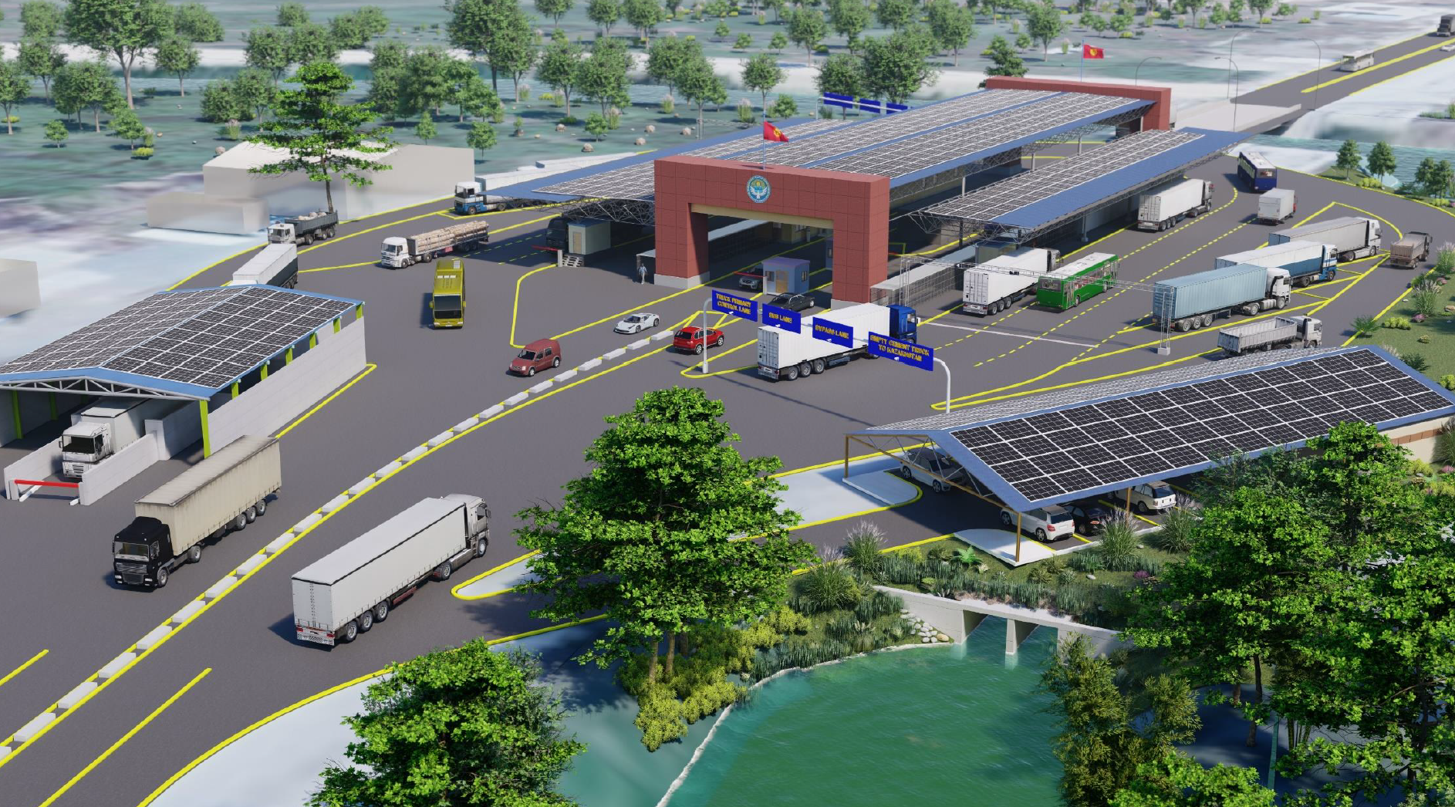
2. Regional Connectivity
Border Crossing Point Modernization
ABEC Regional Improvement of Border Services (ABEC RIBS) is planned to be approved in 2024 and proposed to include:
(i) improvement of infrastructure at BCPs Ak-Tilek, Karkyra, Kichi-Kapka;
(ii) improvement of SBS training center in Bishkek;
(iii) installation of ICT and security equipment for all BCPs
ABEC Trade and Logistics Improvement Report, including International Trade and Logistics Center Recommendations
Mobile Passport Scanners

Slide 7
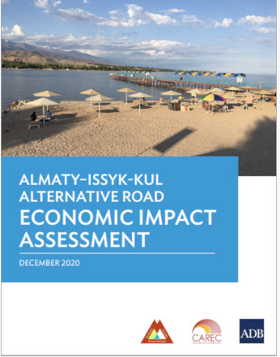
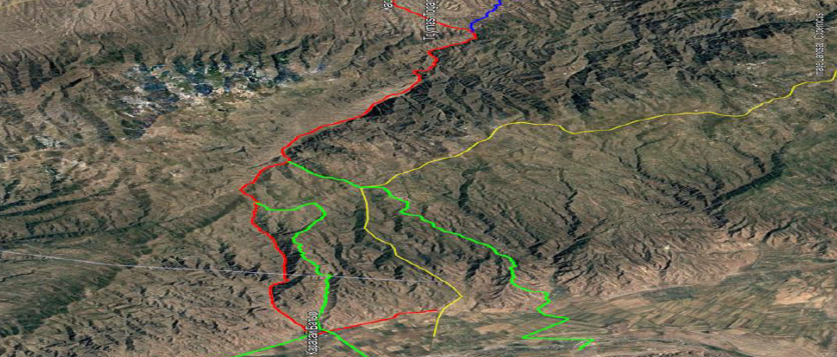
2. Regional Connectivity
Almaty-Issyk-Kul Alternative Road
ADB Almaty-Issyk-Kul Alternative Road Economic Impact Assessment
ADB support to legal and financial screening completed
ADB support for technical and financial preliminary feasibility assessment ongoing
Project Screening
Project Definition
Project Preparation
Tendering
Award of concession
Monitoring
Notes:
Almaty, a vibrant metropolis in Kazakhstan, is only 80 kilometers away from lake Issyk-Kul in the Kyrgyz Republic, renowned for its mountains and moderate summers. However, the two destinations are separated by two magnificent mountain ranges. To bypass these mountains, the existing road stretches over 460 kilometers, leading to long travel times. This economic impact assessment analyzes what impact a more direct road between the two destinations would have for tourism and economic development in both Kazakhstan and the Kyrgyz Republic. The report provides economically viable solutions that, within a supportive policy environment, would lead to strong economic development within the region.

Slide 8
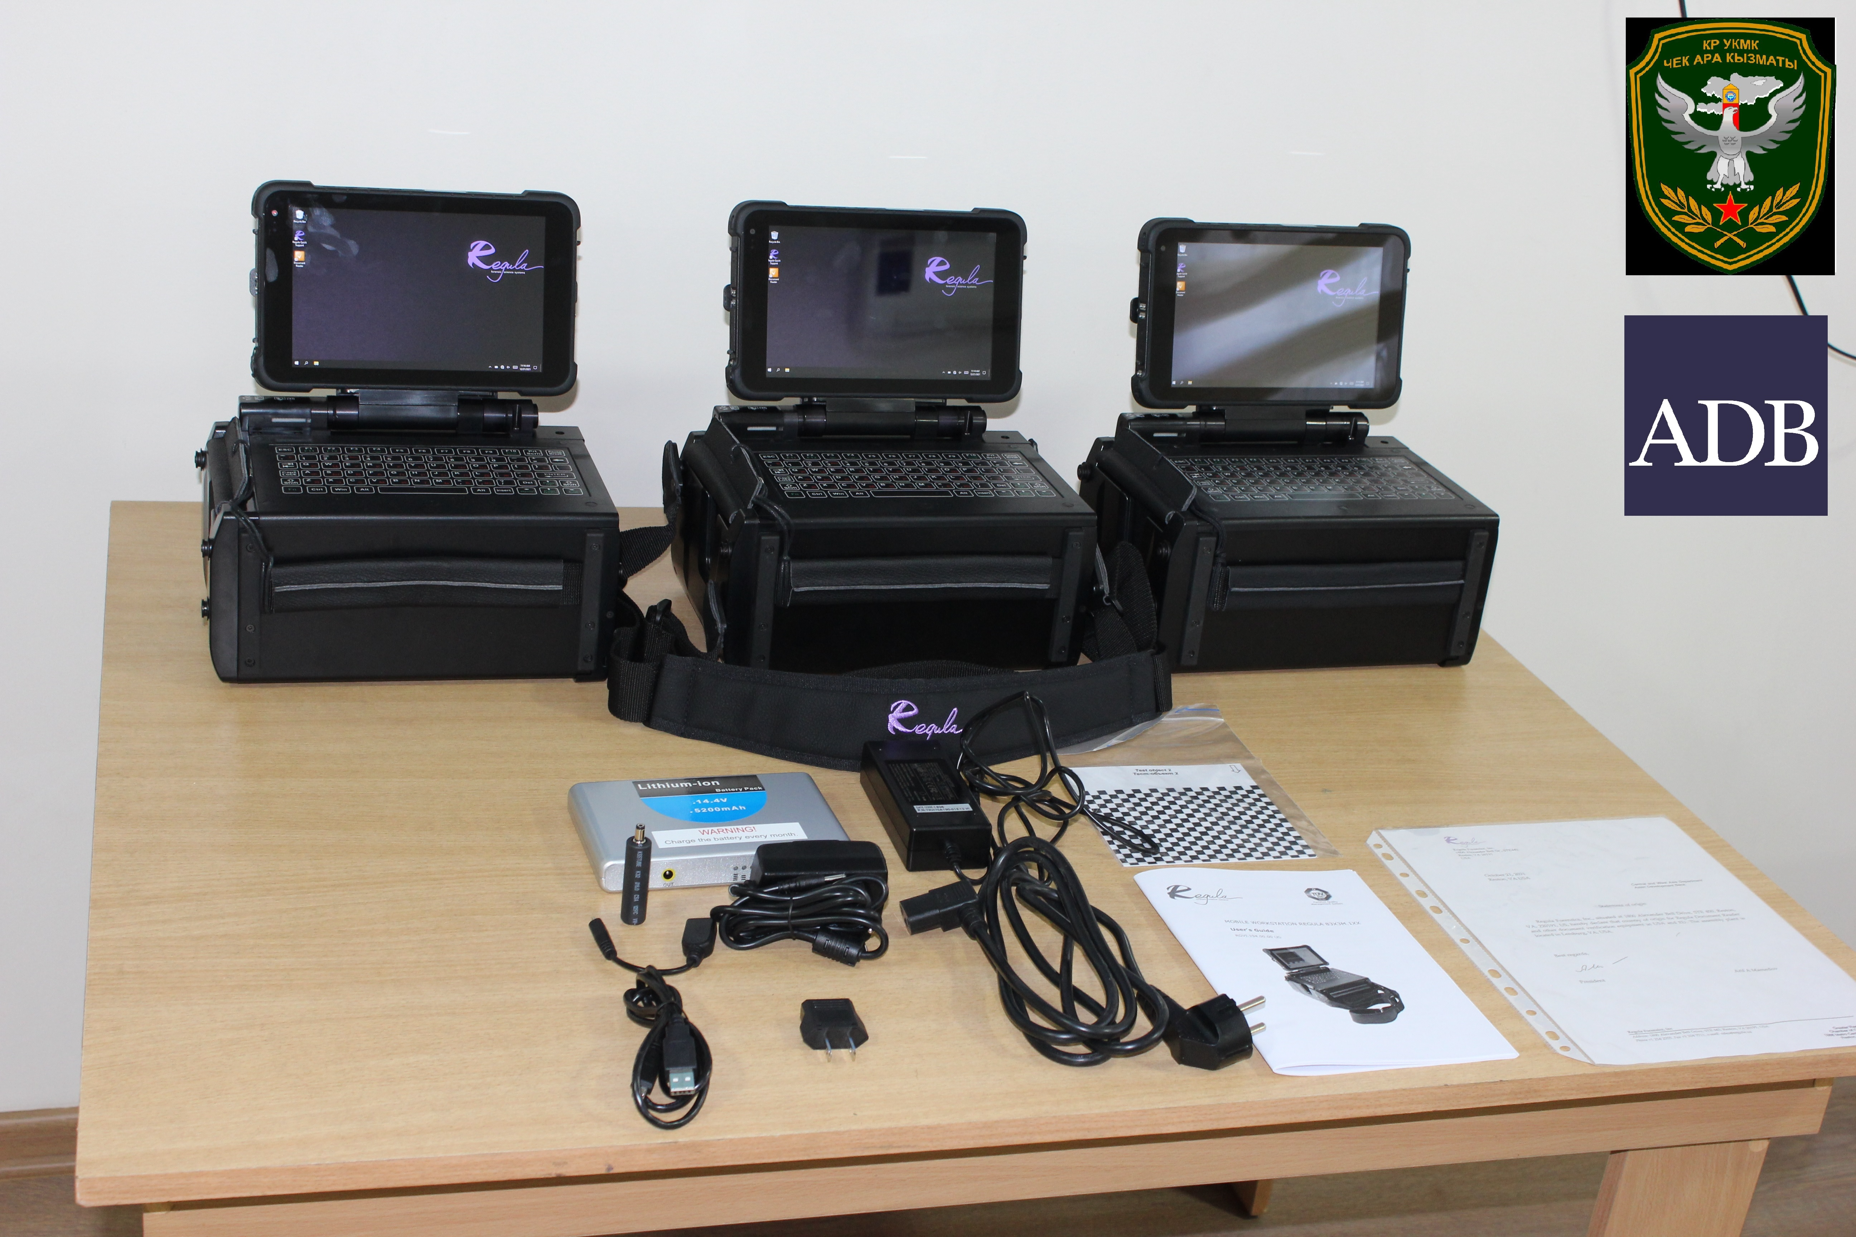
2. Regional Connectivity
Almaty-Bishkek Bus connection
A direct regular bus service was established between the two cities in September 2022, but no priority clearance of large busses, yet
ABEC demand analysis for passenger transport between the two cities
number of passengers can reach 2.5 million per year
acceptable price range for this route is KZT2000-2500 or KGS400-500
ADB Experts’ Recommendations
Separate procedure and lane for busses at checkpoints, using mobile passport scanners in busses
Test feasibility of e-busses with ADB support

Slide 9
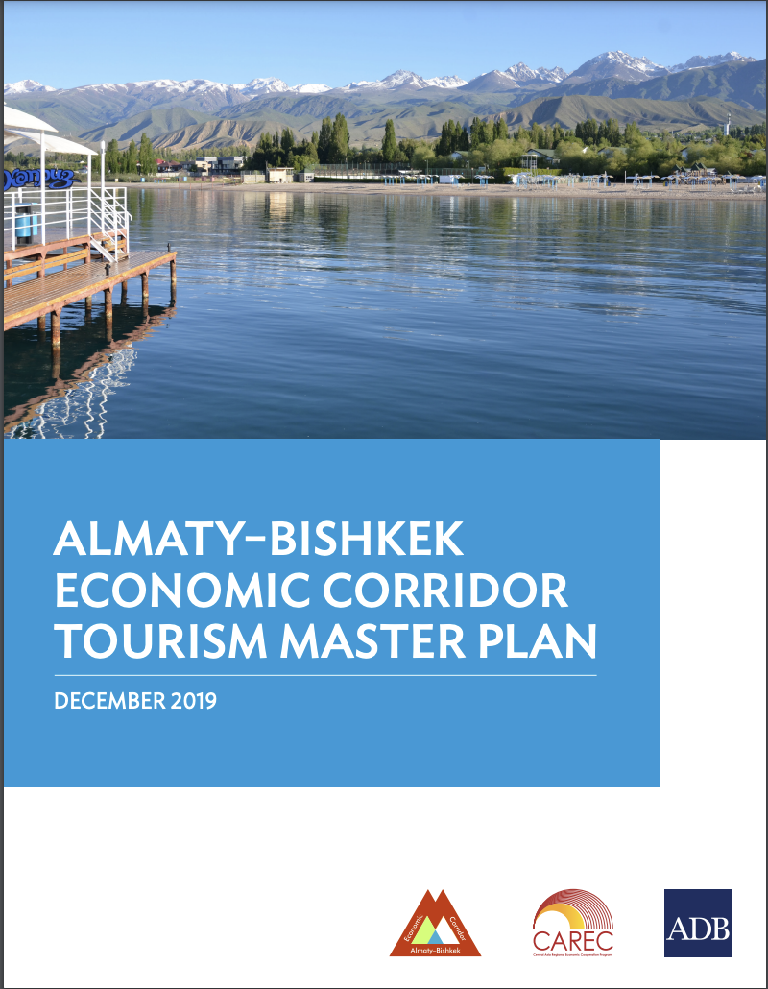
3. Regional Tourism
Almaty-Bishkek Economic Corridor Tourism Master Plan
Notes:
The Almaty–Bishkek Economic Corridor (ABEC) has an exceptional heritage and a wealth of culture and nature. This combination results in a high potential for tourism development, which is largely untapped. The mountain range between Almaty and Lake Issyk-Kul has great capacity to attract international tourists. Developing this mountain region can spur connected winter sport investments such as ski resorts in Kazakhstan and the Kyrgyz Republic. Linking winter sport facilities with summer tourism opportunities around Lake Issyk-Kul can reduce seasonality and investment risks by establishing attractive conditions for year-round tourism flows. This ABEC tourism master plan was developed to capture these benefits. This master plan aims to structure the development of an internationally competitive tourism region within ABEC. It describes the overall framework for the development and operation of the ABEC common tourism area, including (i) a vision and conceptual framework for the area, which optimizes the available resources (natural, human, technological, financial, and immaterial); (ii) ownership and organization of the common area; and (iii) development plan for land use and allocation of tourism activities as well as hard and soft infrastructure, considering social and environmental safeguards. Based on high-level demand projections and using various scenarios of project implementation, the master plan identifies the most important investment projects and estimated operating costs that will require prioritization and the necessary investments from both the public and private sectors. The master plan distinguishes between different types of investments that are reform-dependent or can be implemented within the existing frameworks, and the source of financing using public or private funds or a combination of both through public– private partnerships (PPPs). The project area map and its regional connectivity elements (Map A) depict the proposed tourism development concept for the region

Slide 10
3. Regional Tourism
Issyk-Kul Environmental Management and Sustainable Tourism Project
The $62.8 million project for the Kyrgyz Republic will:
rehabilitate climate resilient wastewater infrastructure;
develop tourism infrastructure, services, and management
One museum, one tourism information center and two unmanned information points
Bike Trails, walking path, valorization of archeological heritage site, toilet blocks
Three public parks and natural park developments
50 sanitary solid waste collection facilities, etc.,
Approval is planned in 2023.
Notes:
The mountain range between Almaty and Lake Issyk-Kul has great capacity to attract international tourists. The ABEC tourism master plan was developed to capture these benefits.

Slide 11
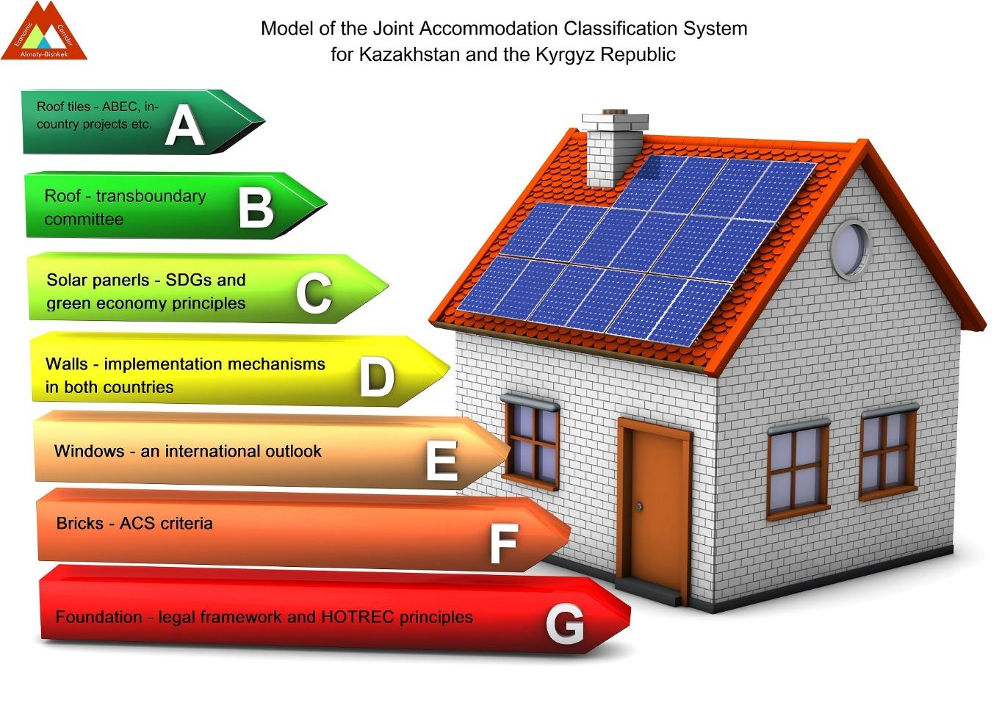
3. Regional Tourism
b) Joint Accommodation Classification System
Joint Accommodation Classification System (ACS)
ABEC team of consultants prepared a joint ACS for both countries
Goal is to raise quality standards in the hospitality sector, create standards in both countries to manage expectations of tourists, develop ABEC as a prime tourism region
Common health and safety protocols and measures
Report and recommendations have been finalized
Trainings have been held by UNWTO
Countries are recommended to set up working group to finalize and establish standards

Slide 12
3. Regional Tourism
c) Turgen Mountain Resort Development
Priority tourism destination for Kazakhstan as identified in the State Program for Tourism and ABEC Tourism Master Plan
ADB support TA was approved in April 2021 for $225,000
TA outputs were:
(i) development strategy for Turgen mountain resort
(ii) pre-feasibility study, including solutions for project financial modality prepared
(iii) Government’s capacity to develop mountain resort improved.

Slide 13
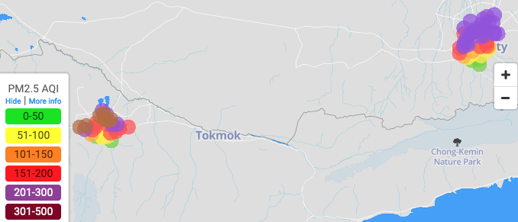
4. Urban Air Quality Measuring
https://www.almaty-bishkek.org/air-quality
50 Clarity Air Quality Sensors deployed in Bishkek in January 2021 and license extended until January 2025
50 Sensors deployed in Almaty in October 2022
Training to Kyrgyzhydromet and Kazhydromet delivered
Clean Air Action Plans for Almaty and Bishkek cities are being finalized
Almaty
Bishkek
Almaty

Slide 14
5. Regional Health
ABEC Action Plan for Reference Laboratories
First health working group met in February 2020 to develop ABEC Action Plan for Development of Reference Laboratories
Action Plan was signed by both countries on 7 December 2021 in Nur-Sultan and updated to 2022–2024
Support for the Scientific and Practical Center for Sanitary and Epidemiological Expertise and Monitoring in Almaty is ongoing
Kyrgyz Strengthening Regional Health Security Project ($30 million) was approved in September 2022 by ADB to:
Improve infrastructure and capacity of reference laboratories
Cooperate in quality assurance and standardization of reference studies

Slide 15
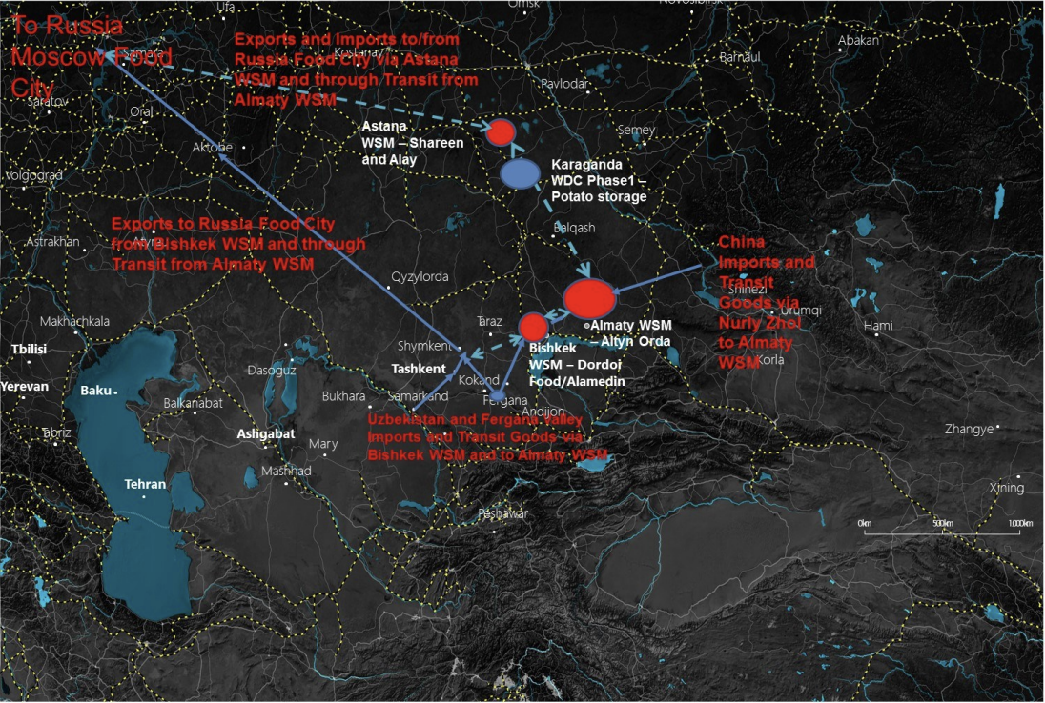
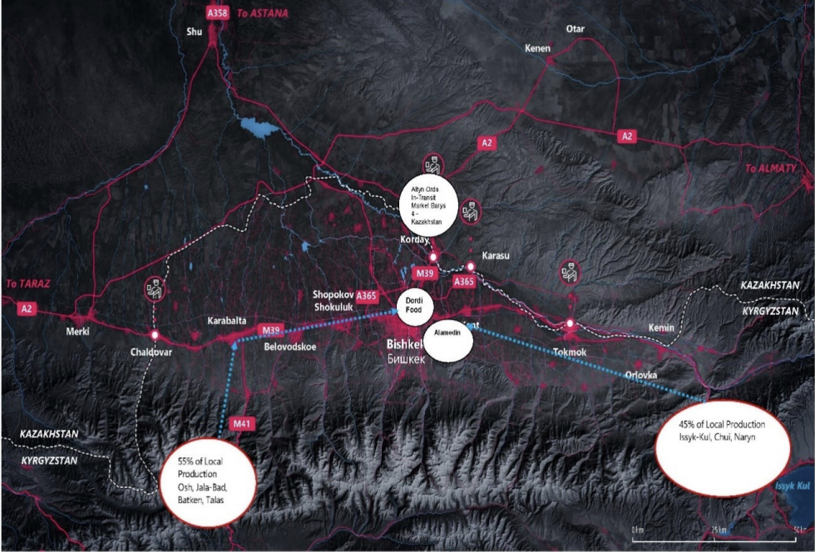
6. Regional Agribusiness
Kazakhstan National Wholesale Market Master Plans and Wholesale Distribution Center Development Strategy
Kyrgyz Republic National Wholesale Market Master Plans and Wholesale Distribution Center Development Strategy

Slide 16
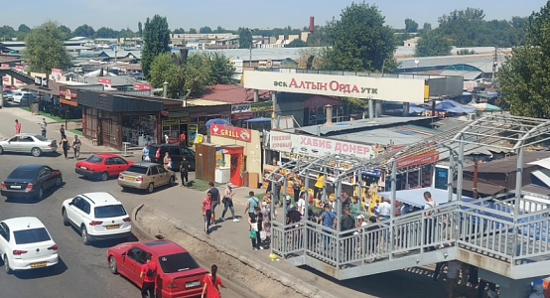
6. ABEC Wholesale Market Modernization Project
Kyrgyz Republic
Feasibility study for two Kyrgyz wholesale markets and supporting agro-logistic centers started in 2019 and finalized in end-2022
The “Climate-Resilient Agricultural Value Chain Development Sector Project (formerly Modern Agriculture Wholesale Market Development Project),” with total financing of up to $40 million is planned for approval in late 2023
Kazakhstan
ADB support possible upon request of the government or private investor

Slide 17
Lessons learned
7. Lessons Learned
Focus on projects
Institutions within established framework
Written commitments
Creation of trust among parties
Continued support

