Slide 1
Prefeasibility Study of Trade and Logistics Centre (TLC) in Sugd Region of Tajikistan under Shymkent-Tashkent-Khujand Economic Corridor (STKEC) Draft Final Report Discussion
September 2023

Slide 2
Agenda for Discussion
To present the outcomes of prefeasibility study of TLC
To seek feedback and valuable inputs on the study outcomes to finalize the report.
To discuss the way forward and next steps to be taken by the government
2

Slide 3
Contents
01
Project Background for TLC
02
Rationale and context for TLC Development
03
Concept Plan
04
Financial Analysis
05
External Enablers
06
Way Forward and Questions
Prefeasibility study for establishment of TLC under STKEC

Slide 4
01
Project Background for TLC
Prefeasibility study for establishment of TLC under STKEC
4

Slide 5
Project Background and Progress Update
Development of TLC
Dec 2021
Jan-Aug 2023
Virtual Inception workshop in Tajikistan (TLC)
Stakeholder consultations with government and private sector
Jan - Mar’23: Concept planning for TLC
Aug’23: 4th location for TLC (near Khujand airport) proposed for further consideration
May 2022
Aug 2020
Roadmap for STKEC development including the proposal for development of TLC*
Background report preparation, as-is assessment on various development components of TLC
Empanelment of consultants for concept plan for TLC
Feb – Apr’22: Bilateral consultations undertaken with government agencies
Study team conducted as-is assessments and background review
Inception report submission
Field Visit to Tajikistan – meetings with various government stakeholders on findings of background report
Sadaf Industrial Zone suggested as the 3rd potential location for TLC
Concept Plan and Draft pre-feasibility report finalized by the study team
Regional workshops for gathering inputs from the Government to finalize the study
Nov 2021
*Transport and Logistics Center
Feb 2022
Oct 2022
2023 – Present day
Prefeasibility study for establishment of TLC under STKEC

Slide 6
Stakeholder Consultations and Key Inputs
1
Key Stakeholders
Khujand logistics Centre
Taj Chamber of Commerce
Ministry of Agriculture
Private Sector participants
National Standards Agency
Ministry of statistics
Ministry of Transport
Administration Khujand city and Sugd Oblast
National Customs Authority
Ministry of health and Sanitary and Epidemiology
Ministry of Economic Development
2
Key Inputs
Khujand city is rapidly growing into a business hub with 1400 SMEs and Annual production value > US $ 120 Mn and Export Turnover $ 300 Mn
Development of Testing laboratories, Quality certification labs and other SPS Measures must be considered for TLC development
Tajikistan and Uzbekistan have signed two key trade agreements. The first was the Free Trade Agreement 1996 and a multilateral agreement involving the Commonwealth Independent States Free Trade Agreement. The Bilateral trade is robust and growing each year.​
Ministry of Transport contemplated the construction of a 22 km rail track to connect the Sugd Free Economic Zone to Spitamen station, however there are issues related to lack of funds​
Strategic inputs related to the locations to be studied for development of the TLC
Existing supply of value-added logistics services is limited in the region and leads to higher transportation cost
Prefeasibility study for establishment of TLC under STKEC

Slide 7
02
Rationale and Context for TLC Development
7

Slide 8
Trade and Logistics Context – Tajikistan and Sugd Region
US$ 10.49 bn
US$ 6.4 bn
~11 MTPA
~70% of cargo
Tajikistan GDP in 2022 with an annual growth rate of 8%
Value of trade & logistics in Tajikistan (as on 2022)
Estimated Cargo Volume in Sugd Region (2022) which is over 40% of overall cargo flows in Tajikistan
Handled via the largest BCP - Oybek-Fotehobod in the region
GDP Split by sectors of economy:
Exports Value: US$ 2.14 bn
Growth rate ~10%
Imports Value: US$ 4.26 bn
Growth rate ~3%
Cargo from manufacturing activity – 5.9 MTPA
Cargo from trade activity – 6 MTPA
Cargo in Sugd Region accounts for ~40% of the total cargo volume in Tajikistan
Growth rate - ~9%
Out of a total of 7 BCPs in Sugd region, Oybek – Fotehobod is one of the few international BCPs which account for ~75% of total trade from the northern markets
33.00%
52.00%
Agriculture
Services
Manufacturing
Source: World bank Open Data – Tajikistan GDP | ITC Trade Maps – Export and Imports volume for Tajikistan | Study team analysis on cargo volume forecasts

Slide 9
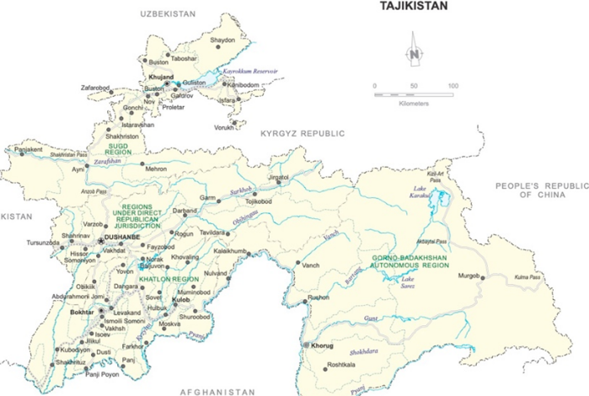
Projected Gap in Storage Capacity in Sugd Region
Current Storage Capacity in the region
The current warehousing facilities in Tajikistan are saturated and additional warehousing capacity enhancement is imperative to ensure business continuity in the region
There are six logistics centres in Tajikistan, however, there are no multimodal logistics centres
Most of them lack modern logistics facilities and equipment and provide a narrow range of logistics services. Limited options for temperature-controlled storage
Assessed storage gap
Khujand Logistics Center (2.6 Ha)
Istarafshan, Sugd province (0.67 ha)
Storage Gap: ~63 MTPA
Dushanbe city
Parking, cargo handling, storage, customs clearance, SPS controls
Existing volume surplus – 1.8 MTPA
Tursunzade city
Parking, cargo handling, storage
Murghob city, Gorno-Badakhshan Autonomous Region
Projected and current cargo volume are excluding the volumes for direct dispatch and only consider transportation via road
Legends
Khorog city, Gorno-Badakhshan Autonomous Region
Proposed TLC Location
Click to check detailed demand assessment
Major Logistics centres
9

Slide 10
Potential Economic Benefits from TLC
Diverse composition & direction of exports
Less vulnerability to external shocks
Key Economic Benefits envisaged from TLC
Increase production and exports of manufactured goods
Enhance Food Security
Stimulate overall economic growth in horticulture, manufacturing, transportation
Increase production & export of horticulture
Better availability and affordability of quality food products
Increase in employment
Reduce post harvest losses
Reduce supply chain risks for food products
Enhanced use of digital technologies in Trade and Logistics Services
Improved marketability of horticulture products
Reduce seasonal fluctuations in supply & price for food products
Increase in exports diversification
Growth in e-commerce
Development of transport services
Improvement in availability, affordability and quality of logistics and trade services
Reduced trade cost
Faster development of SMEs
Alignment with the National Priorities of Tajikistan
Improved availability, affordability and quality of logistics and trade services
Increase Employment
Prefeasibility study for establishment of TLC under STKEC
Establishment of TLC

Slide 11
03
Concept Plan
11

Slide 12
Framework for TLC concept plan
Key Elements of TLC Concept Plan
1
Components for TLC
Infrastructural components supporting the cargo profile to be developed within TLC
2
Location with sufficient land availability, having proximity to major cargo hotspots, linkage to transport infrastructure, utilities, availability of social infrastructure
Location Assessment
for TLC
3
Based on the demand projections for cargo flows, estimate the land area required for TLC
Land Area Requirement
4
Zoning Plan
Suitable zoning plan for various components within the TLC
5
Institutional Models
Suitable institutional structure for development and operations of ICIC as per the best practices and prevalent models in Central Asia
12

Slide 13
Components for TLC
Functions of Trade Centre:
Components finalized for proposed Trade Centre under TLC:
Organize trade related events/exhibitions
Exposition centres / expo centre | Convention centre/ meeting rooms etc. | Shopping centre or arcade
Commercial Complex or business centre or office space |  | Support infrastructure/ Parking zones
Knowledge desk to support traders by providing market intelligence and advisory services to traders
Bringing together public and private sector stakeholders to jointly contribute to regulatory and policy dialogues
Functions of Logistics Centre:
Components finalized for proposed Logistics Centre under TLC:
Freight aggregation & distribution
Warehouse including covered storage, open and cold storage | Packaging and distribution facility | Container depot / yard
Truck Terminal, parking facility, weighbridges | Support infrastructure/ such as administrative buildings, customs office | Truck Terminal, parking facility, weighbridges
Integrated storage and warehousing
Reducing sorting and handling losses
Promote multimodal freight transport
Provide value-added services such as customs clearance, container repositioning, labelling, packaging, etc.
13

Slide 14
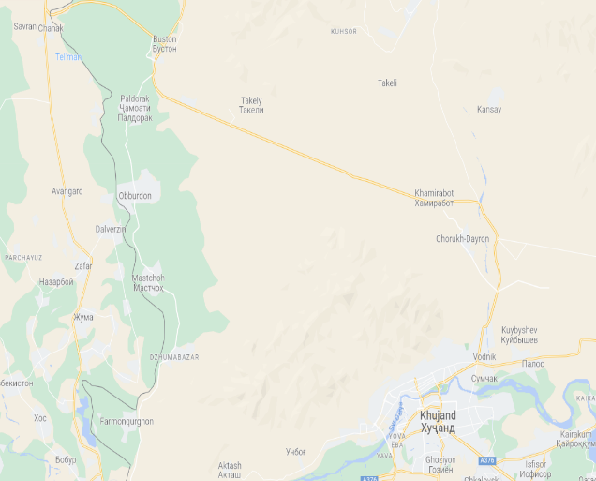
Location Assessments for TLC
1
Proposed locations for TLC
Legend
Sugd Free Economic Zone (SFEZ)
Khujand Logistics Center
(KLC)
Sadaf Industrial Zone
(SUE Sadaf)
Airport Area (Khujand city)*
Oybek-Fotehobod BCP
Identified Locations for TLC
Details of the four land options
Oybek-Fotehobod BCP
Khujand Airport
Khujand Railway Station
Special economic zone located within 10 km from Khujand city
Total Area: 310 Hectares, out of which vacant area >100 Hectares
Nearest Highway / 4-land road
Operational logistics centre within Khujand city
Total Area: 2.6 Hectares total area which is fully utilized
Non-operational industrial area near KLC
Total Area: 12.9 Hectares out of which 40,000 sq.m. of finished buildings
Non-operational industrial area near airport
Total Area: 95 Hectares vacant area available
III.
BCP Distance: 61.8 km
International Highway: 1.7 km
II.
BCP Distance: 64.0 km
International Highway: 2.1 km
I.
BCP Distance: 74.0 km
Nearest Highway: 1.9 km
International Highway: 4.5 km
II. KLC
III. SADAF
18 km
18 km
19 km
*Fourth location proposed by Sugd oblast Administration for TLC. The location to be further assessed post site visits.
I. SFEZ
22.3 km
IV. Airport*
BCP= border crossing points, KLC = Khujand Logistics Center, SIZ= Sadaf Industrial Zone, SFEZ = Sugd Free Economic Zone
Source: ABBAT Transport Carriers - Tajikistan
14

Slide 15
Shortlisted Location for TLC - SFEZ
2
Detailed Site Assessment
Parameters
Scoring for the proposed sites
Sugd Free Economic Zone
Khujand Logistics Center
SUE Sadaf
Land Features
SFEZ has existing land up to 80 Hectares
Connectivity & Related
Infrastructure
SFEZ is more likely to have railway connectivity
Internal Infrastructure &
Utilities
SFEZ & KLC have developed and operational ecosystem for industries and logistics resp.
Capital & Operating Cost
SFEZ has ready land which does not need additional acquisitions
Border Crossing Point
KLC and SUE Sadaf have closer proximity to the Oybek-Fotehobod BCP
External Environment
KLC and SUE Sadaf have better proximity to the major industries in Khujand city
Approvals & Regulatory
Authority
SFEZ has an established institutional mechanism, being a government owned land area may follow an easier approval mechanism
Shortlisted location for TLC
15

Slide 16
Land Area Estimation for Different Components within TLC
Land Area estimation has been done for 14.3 MTPA, i.e., 20-22% of the total projected volume
2
In hectare
Warehouse and Logistics facility
Value added services
Truck terminal and handling facility
Support infrastructure
Expo center (trade facilitation)
Trade and Logistics centre
16

Slide 17
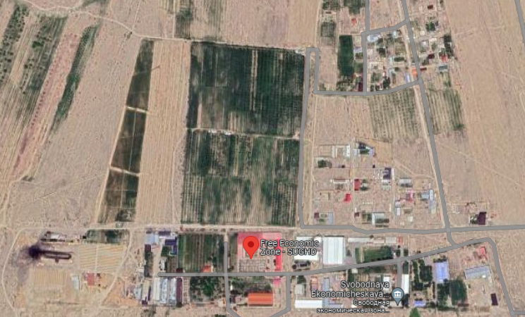
Zoning Plan for TLC
Warehouse Facility including the covered, open and cold storage space
Trucking Facility including container, depots, weighing facility, cargo handling facility
Zone 2
Zone 1
Zone 4
33 ha
32 ha
7 ha
Value Added Services including packaging, labeling, sorting and distribution center
Support Infrastructure including administration buildings, commercial offices, customs office
Zone 3
2 ha
Exposition Center & Commercial Zone
2 ha
17

Slide 18
Proposed Institutional Models for TLC (1/2)
Model – I: Government – Owned Model
Pros
Existing empowered board acts as the apex body
No modification / amendment required in the FEZ law
Less changes from the current setup under SFEZ administration
High ease of implementation and approvals as precedence of the institutional structure exists within Tajikistan
Dedicated TLC-level project development and operations function directly reporting to the management board
The TLC function shares common services of other functions such as HR, Administration, Security, etc.
The TLC function to be created as per the laws under Decree on SFEZ
Enabler: The organizational activity for SFEZ is defined as ‘industry-innovation’, the component of Trade may also need to be added to the organizational activity
All legal rights to be guided by Decree on SFEZ
Salient Features
Recommendations
The SFEZ administration: Top management body and shall be responsible for all TLC activities
A new function for the TLC can be created which directly reports to the SFEZ Administration Manager.
TLC function can be kept separate from the industrial development function within the SFEZ administration but can share the same arrangement of functioning as SFEZ
The current organizational activity for the SFEZ does not include a trade component.
As per the FEZ law, trade activity including allocation of land for processing, sorting, packaging, labeling and storage of goods is an identified activity for FEZ and can be included in the existing SFEZ
18

Slide 19
Proposed Institutional Models for TLC (2/2)
Model – II: Public-Private Partnership Model
Pros
Lenders
Creation of an SPV brings in more capability and bandwidth to develop the project, it also brings transparency in operations of the facility
Implementing Agency – SFEZ Administration
Repayment
Funding
SPV for TLC
EPC Contractors
Land as Equity
Dividends
Cons
Marketing Agencies
Project Investment
The current FEZ law does not allow ownership of asset to any third party
The SPV created may have to grant management rights to the TLC to attract private investments in TLC
Lease/ Operate components
Revenue from lease/ operations
Private Developers
Tenants/ Users of TLC
Salient Features
Responsibilities of Private Developer
SPV Formation:
SFEZ Administration shall contribute to the equity in the form of lease rights for land
Private Developer may invest for TLC infrastructure development as its equity contribution.
Both SFEZ Administration and the developer shall get dividend share as per its equity share in this SPV.
Proposed revenue model is -1) Built-up area premium model, 2) Revenue share and 3) Co-development / Dividends model.
Development of requisite TLC infrastructure
Manage Design, Construction, and financing risks of the project and share market risk with the Authority.
O&M responsibility may be outsourced to a separate contractor
19

Slide 20
04
Financial Analysis
20

Slide 21
Project Costs and Revenue heads for TLC
1
Project Costs
2
Revenue Heads for TLC
Total Project CAPEX
US$ 43.5 million
The revenue streams in TLC include:
Cargo handling (warehouses)
Volumes: Demand Assessment
Tariff: Real estate in Tajikistan
Total Project CAPEX
Site preparation
Cargo loading and unloading works
Volumes: Demand Assessment
Tariff: consultations with stakeholders of KLC
Buildings
Utilities
Pre-operating expenses
Parking with cargo
Volumes: Demand Assessment
Tariff: KLC’s parking fee for domestic and foreign cargo vehicles
Contingency
Rental area: Demand Assessment
Tariff: Monthly rental rate for commercial space based on the data of the real estate in Tajikistan
Commercial spaces rent
Tariff: Daily rental amount was based on the rate for international Expo centres
Expo centre
Project CAPEX for TLC
$ 0.55 million per hectare
Note: Land cost has been excluded from CAPEX as this is a government land where no further cost of acquisition is to be paid
21

Slide 22
Financial Assessment
Investment Scenario – I
100% Multilateral Loan
Investment Scenario – II
Hybrid of Debt & Equity
Interest Rate
6% (mark-up (2%) and risk-free rate (4%))
Interest Rate
12.3% interest
Repayment Period
10 years
Repayment Period
5 years
Scenarios
-
Scenarios
2A. 48% - Equity & 52% - Debt
2B. Viability Gap Funding: Subsidy from the government of $18.5 million
Results of Financial Analysis ($’000)
Indicators | Scenario 1 | Scenario 2A | Scenario 2B
Project NPV | 20,304 | (4,726) | 44
Project IRR | 12.5% | 12.5% | 19.4%
Project Payback period | 14 | 14 | 9
TLC will require low-cost financing and/or sizable VGF to be financially viable.
22

Slide 23
05
External enablers
23

Slide 24
Policy and Regulatory interventions
S No. | Interventions | Governing Agency | Policy/Regulations for Review
(i) Incorporation of TLC
1 | Amendment of regulations on SFEZ to expand list of its priority activities | SFEZ Administration | Regulation of SFEZ
2 | Incorporation of a customs office within the SEFZ premises which is operated by the Tajik Customs department | Tajikistan Customs Service | Customs Code of Tajikistan
3 | Amendment of laws on free economic zones and PPPs to enable the incorporation of TLC under PPP model - the FEZ and SFEZ regulations to have a provision for formation of SPV* | PPP Council | FEZ Law of Tajikistan PPP Law of Tajikistan
(ii) Operations of TLC
4 | Amendment of regulations on SFEZ to simplify the entry-exit procedures for foreigners | SFEZ Administration | Regulation of SFEZ
5 | Amendment of the relevant laws & regulations to enable Govt agencies in charge of customs, food safety, SPS and veterinary control to setup their offices and, as appropriate, laboratories and provide clearance and/or certification services at the TLC | SFEZ Administration, Tajikistan Customs Service | Regulation of SFEZ
6 | Procedure for cargo movement outbound from TLC at Tajikistan BCP | Tajikistan Border Services | Customs Code of Tajikistan
7 | Fees structure for TLC under the PPP model* | PPP Council | Regulation of SFEZ
8 | Support in developing and integration of a portal for active monitoring of cargo movement and transit to BCP | Tajikistan Customs Service | Customs Code of Tajikistan
9 | Investment promotion and customized incentives for TLC | Ministry of Economic Development and Trade | Investment Promotion Policy
*Applicable only in case of model II of institutional framework which is PPP based
24

Slide 25
Other external interventions
Enabler
Necessary/Recommended Actions
Modernization of border crossing points located in Sugd province
Adoption of Coordinated Border Management
Streamlining of border controls (including food quality, phytosanitary and veterinary controls), especially for perishable goods
Strengthening of the food safety, phytosanitary and veterinary laboratory capacity
Implementation of the e-TIR system, ATA carnet system and CAREC Advanced Transit System in collaboration with Uzbekistan, Kazakhstan and other key export/import/transit countries
Introduction of the electronic CMR consignment note, International Vehicle Weight Certificate and electronic entry permits for trucks in cooperation with key export/import/transit countries
Extension of the Green Corridor arrangement with Afghanistan, Uzbekistan and the Russian Federation to Kazakhstan and other key export/import/transit countries
Application of the Green Corridor arrangement to international shipments to/from the TLC
International trade and transport facilitation
Upgrade of the Severnaya street section of the Khujand bypass road
Construction of a railway extension (22 km) that will connect the SFEZ with the existing railway network
Development of an air cargo village at the Khujand International Airport
Development of complimentary transport & logistics infrastructure
25

Slide 26
06
Way forward and questions
26

Slide 27
Thank You
© 2023 PwC. All rights reserved. Not for further distribution without the permission of PwC. “PwC” refers to the network of member firms of PricewaterhouseCoopers International Limited (PwCIL), or, as the context requires, individual member firms of the PwC network. Each member firm is a separate legal entity and does not act as agent of PwCIL or any other member firm. PwCIL does not provide any services to clients. PwCIL is not responsible or liable for the acts or omissions of any of its member firms nor can it control the exercise of their professional judgment or bind them in any way. No member firm is responsible or liable for the acts or omissions of any other member firm nor can it control the exercise of another member firm’s professional judgment or bind another member firm or PwCIL in any way.

Slide 28
Cargo demand projections in Sugd region
1
Cargo demand in Sugd region
2
Cargo profile in Sugd region
Cargo estimation for Sugd region undertaken by assessing the cargo flows from trade and industries
Value & Volume
(2021)
Growth Rates
Projections
Agricultural activity:
Generates 3.5 MTPA cargo, Cotton, onions and grains most widely produced crop
Value
(in US$)
Volume
MTPA
Volume
2030
2048
32%
A
Imports in Sugd
9.6 MTPA
37 MTPA
Trade Cargo
1,736 mn
4.8
7.70%
Manufacturing activity:
Generates 2.5 MTPA cargo, rubber, plastic, non-metallic mineral products, processed foods
Exports from Sugd
2.8 MTPA
15.6 MTPA
23%
Exports from Sugd
655 mn
1.2
9.79%
Cargo
Flows
Agriculture activity
1,191 mn
9.79%
14 MTPA
77 MTPA
Agriculture activity
5.9
B
Trading / Import activity:
Generates 4.8 MTPA cargo, out of which 2.9 MTPA can use warehousing and storage facility while rest 40% are minerals which will be directly dispatched to the refineries / buyer
Industrial Cargo
45%
Manufacturing activity
Manufacturing activity
Extractive Industry activity
2,930 mn
10.8
17 MTPA
86 MTPA
Cargo from extractive industries not considered as these products are transported in bulk and shall not use multiple loading/unloading points
Excluding direct dispatch commodities
 | Included in Demand Estimation
 | Excluded from Demand Estimation
Final Cargo Estimate under consideration after adjusting the road-rail split 67 MTPA
Trade with partner countries of Russian Federation, Kazakhstan and Uzbekistan considered as the major markets from Sugd region
Notes: Average Growth rates calculated for 8 years period (2014-2021).
Source: ITC Trade Maps, Compendiums from Sugd Administration.
Click to go back to main slide
28

