Slide 1
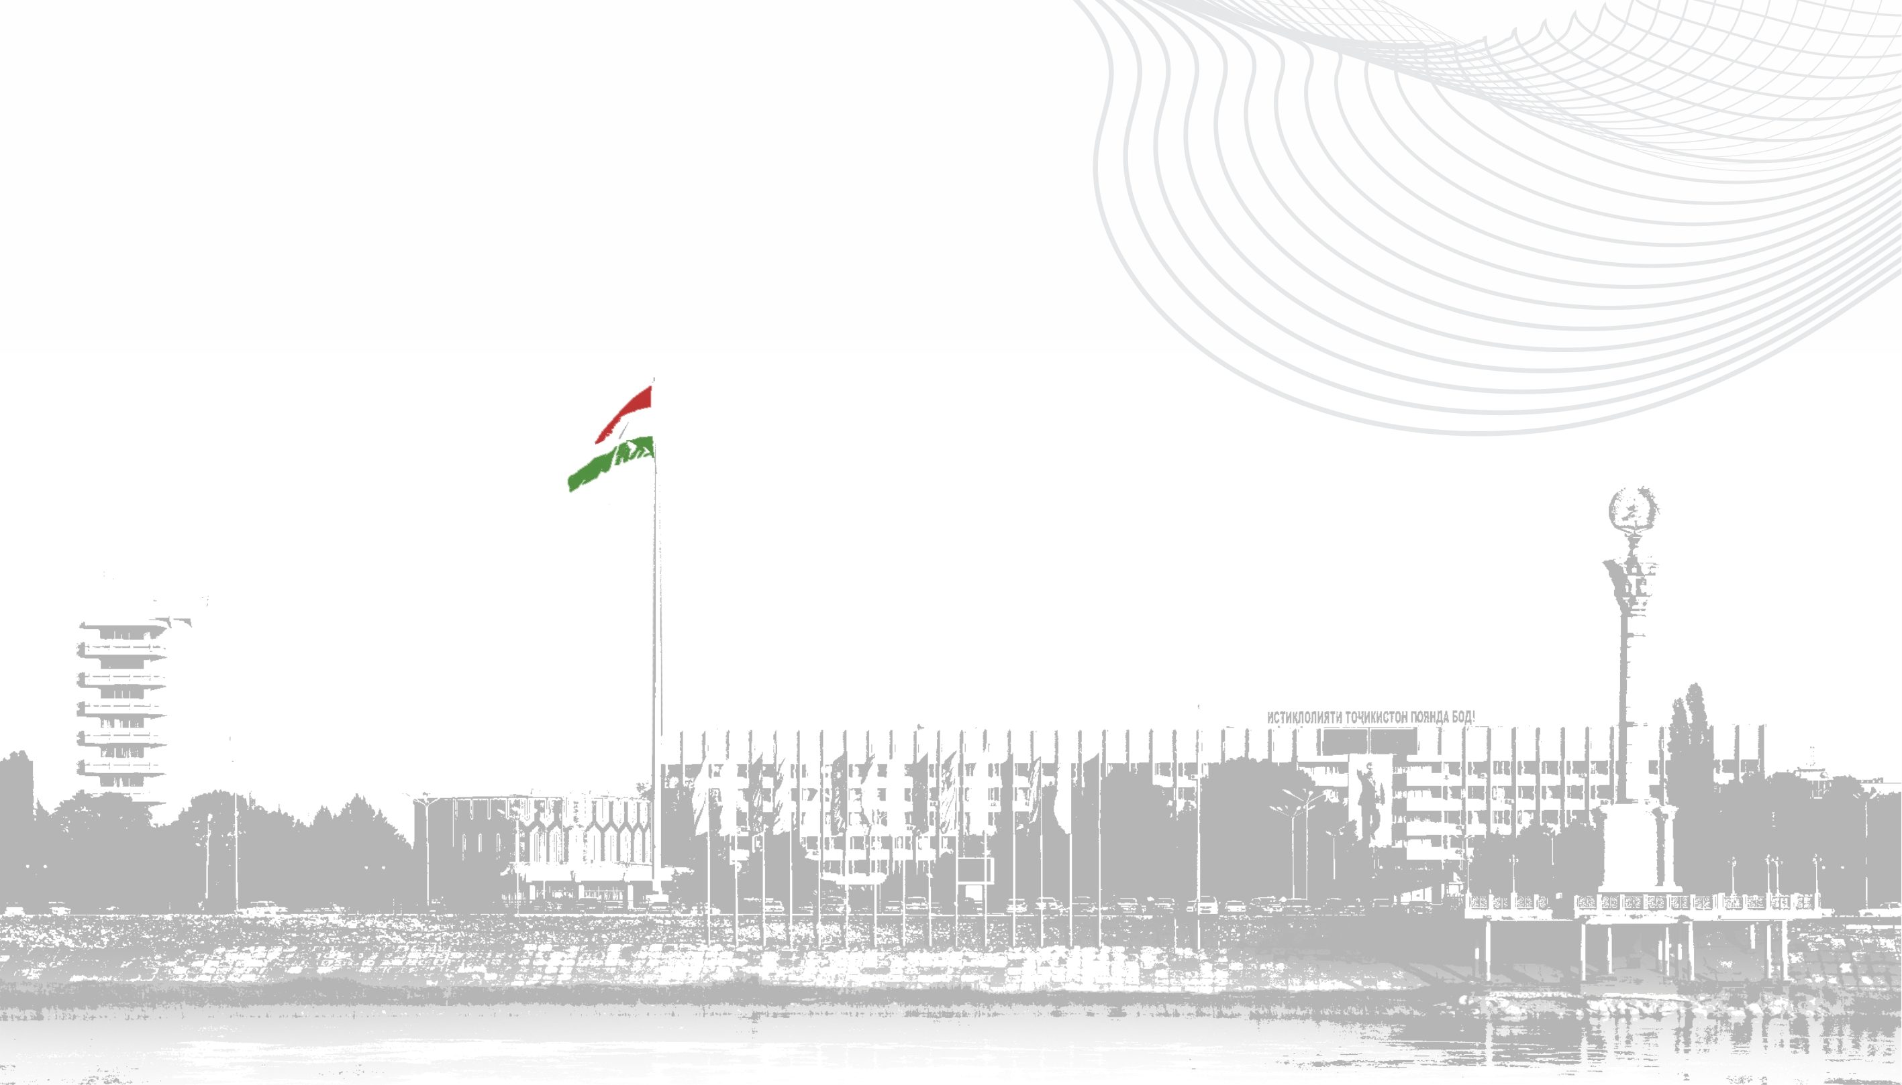


Need for Modern Logistics Center in Sughd Region

Slide 2

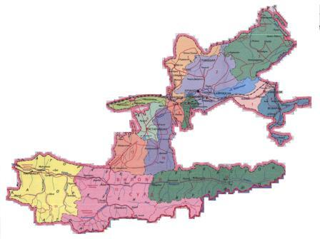


GEOGRAPHICAL LOCATION
Sughd Region borders Samarkand, Jizzak, Syrdarya, Tashkent, Namangan, Andijan and Fergana Regions of Uzbekistan, as well as Batken Region of Kyrgyzstan.
The largest river in Central Asia, the SYRDARYA, flows through Sughd Region
KHUJAND is the administrative center of Sughd Region
Due to its favorable geographical location and climatic conditions, Khujand and the Fergana Valley are the PEARL OF CENTRAL ASIA

Slide 3
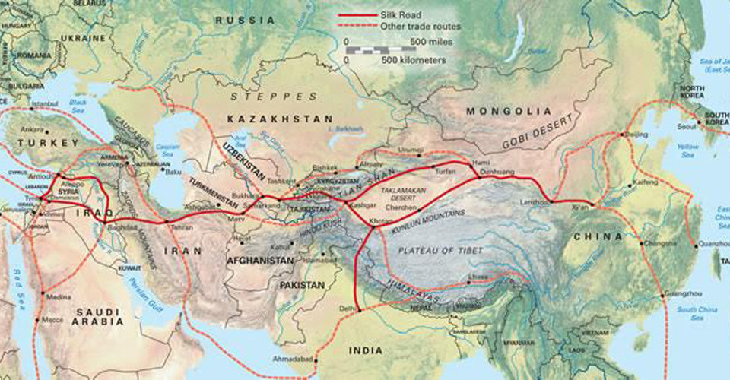
THE GREAT SILK ROAD
Located at the crossroads of the famous routes of the East, Khujand was one of the most important economic, military-strategic and cultural centers of Central Asia.
The "Great Silk Road" passed through it, linking ancient Greece, Rome, Asia Minor, Egypt with China, Persia and India

Slide 4
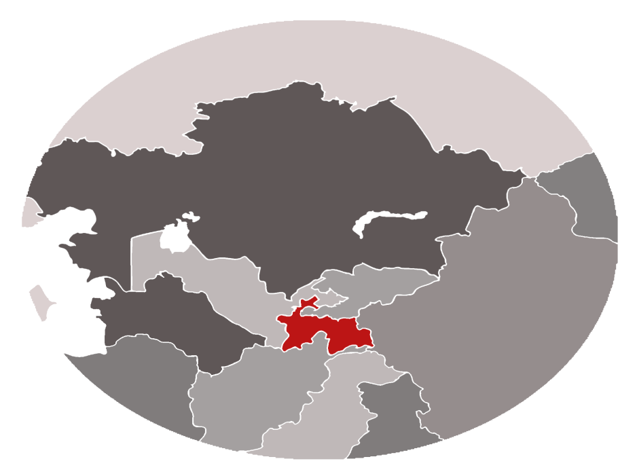

GENERAL INFORMATION ABOUT SUGHD REGION
POPULATION DENSITY
POPULATION
112,4 person/km
РОССИЯ
2,85 million
TERRITORY
КАЗАХСТАН
25400km²
УЗБЕКИСТАН
КЫРГЫЗСТАН
ТУРКМЕНИСТАН
КИТАЙ
Sughd Region
ТАДЖИКИСТАН
ИРАН
АФГАНИСТАН
ИНДИЯ
INDUSTRIAL OUTPUT
18 cities and districts
ПАКИСТАН
USD 2,4 billion

Slide 5




KEY MACROECONOMIC INDICATORS
GRP IN CURRENT PRICES
(million USD)
VOLUME OF DIRECT FOREIGN INVESTMENTS
(million USD)
3131,3
311,8
FOREIGN TRADE TURNOVER
(million USD)
INFLATION RATE
6,7%
3185,7

Slide 6
INDUSTRIAL OUTPUT
from 2018 to 2022
(million USD)
2018
2019
2020
2021
2022

Slide 7
2018
2019
2020
2021
2022
2023 (forecast)

Slide 8
Structure of industrial production of the Republic of Tajikistan
by regions for 2022

Slide 9
Processing of cotton fiber
No | Name of enterprises and regions | Design production capacity (processing of cotton fiber), tons | Actual production capacity (processing of cotton fiber), tons
1 | Javoni LLC, Khujand | 4000 | 1300
2 | Satn LLC, Khujand | 2000 | 1000
3 | Sughd-textile LLC, Khujand | 12000 | 3000
4 | Niku-Khujand LLC, Khujand | 2500 | 1800
5 | Nassoji Khujand LLC, Khujand | 3500 | 2000
6 | Spitamen Textile LLC, Spitamen | 3500 | 1200
7 | Olim-textile LLC, Mastchoh | 6000 | 6000
8 | Organic Yan LLC, Jabbor Rasulov | 7500 | 7500
Total |  | 41000 | 23800

Slide 10










FOREIGN ECONOMIC ACTIVITY
FOREIGN TRADE RELATIONS
with 60 countries around the world
WORK AND INVEST IN THE REGION'S ECONOMY FROM:
Russia
Kazakhstan
Uzbekistan
PRC
Turkey
Switzerland
France
USA
Great Britain
and others

Slide 11
FOREIGN ECONOMIC ACTIVITY

Slide 12
AGRICULTURE
Structure of gross agricultural output by producer category
Agricultural land area (thousand ha)
Total land area | 1391,1
Irrigated | 286,4
Cropland | 267,8
including:
Grains and legumes | 123,6
Technical crops | 75,2
Potatoes | 12,8
Vegetables | 13,8
Food melons | 4,5
Feed crops | 37,9
Perennial plantings | 69,7
including
Orchards | 57,3
Vineyards | 12,4
Gross agricultural output
1.5 billion USD
441,0
1090,2

Slide 13
AGRICULTURE
No. | Name | Unit of measure | 2018 | 2019 | 2020 | 2021 | 2022
1. | Gardens | ha | 70728 | 69310 | 72062 | 72971 | 78149
2. | Cropland | thous. ha. | 272,6 | 274,8 | 278,6 | 279,8 | 279,8
3. | Total agricultural production | ton | 1631012 | 1743960 | 1878230 | 1847575 | 2025469
4. | Grains | ton | 272394 | 331689 | 351374 | 328667 | 396234
5. | Potatoes | ton | 415961 | 450322 | 512069 | 530000 | 562924
6. | Vegetables | ton | 517859 | 494914 | 560393 | 572842 | 608540
7. | Gourds | ton | 113791 | 127458 | 151820 | 155374 | 148551
8. | Cotton | ton | 110294 | 126844 | 112607 | 112608 | 125206
9. | Fruit | ton | 139350 | 150985 | 139395 | 93349 | 124477
10. | Grapes | ton | 61363 | 61748 | 50572 | 54735 | 59537

Slide 14
CARGO TRANSPORTATION
No. | Name | Unit of measure | 2018 | 2019 | 2020 | 2021 | 2022
1. | Total cargo transportation volume | mln. tons | 26,9 | 28,0 | 26,6 | 29,8 | 32,1
 | including:
2. | By road | mln. tons | 23,2 | 24,4 | 22,9 | 26,4 | 28,8
3. | By rail | mln. tons | 3,7 | 3,6 | 3,6 | 3,4 | 3,3
4. | By air | mln. tons | - | - | 0,1 | - | -

Slide 15
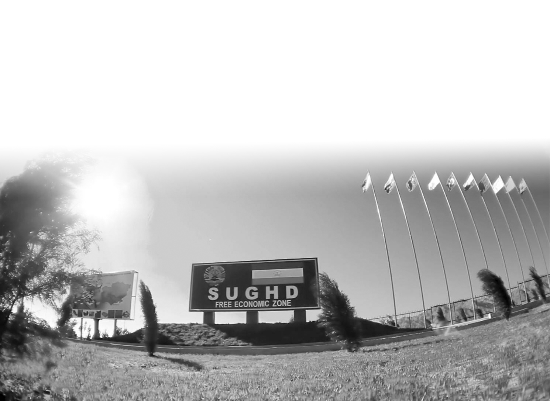

SUGHD FREE ECONOMIC ZONE

Slide 16






SUGHD FREE ECONOMIC ZONE
- industrial and innovation zone
- Established in accordance with the Resolution of the Government of the Republic of Tajikistan No. 227 of May 2, 2008
ADMINISTRATION
FINISHED BUILDINGS AND FACILITIES
2009
110 ha
VALIDITY
LAND TO BUILD
50 years
210 ha
TOTAL AREA
NUMBER OF ENTITIES *
320 ha
30

Slide 17






TAX PREFERENCES
GENERAL REGIME
FEZ REGIME
INCOME TAX
INCOME TAX
12% to 20% (from salary)
SOCIAL SECUTITY TAX
20% (of the Labor Remuneration Fund)
SOCIAL SECURITY TAX
0%
VALUE ADDED TAX
SALES TAX
NATURAL RESOURCES TAX
EXCISE TAX
VALUE ADDED TAX
SALES TAX
NATURAL RESOURCES TAX
EXCISE TAX

Slide 18



FREE CUSTOMS ZONE (IMPORT/EXPORT)
FOREIGN COUNTRIES
REPUBLIC OF TAJIKISTAN
SUGHD
FEZ
0%
CUSTOMS DUTY
VAT
0%
CUSTOMS DUTY
VAT

Slide 19
Legislative framework for investment attraction and protection
Law of the RT "On Investments"
Article 1: Basic concepts
- investments - investment of capital by an investor in the form of tangible and intangible assets on the territory of the Republic of Tajikistan for the purpose of obtaining profit;
investor - an individual or legal entity, as well as an organization without formation of a legal entity, carrying out investment activity on the territory of the Republic of Tajikistan;
Article 7: Guarantee of equity of investor's rights
The State guarantees equality of rights between foreign and domestic investors, not allowing discrimination of investors' rights due to their citizenship, nationality, language, gender, race and religion.
Article 8: Guarantee of legal protection of the investor
1. In accordance with the civil legislation of the Republic of Tajikistan, the Investor has the right to compensation for damage caused to him as a result of adoption by state bodies of acts contradicting the legislation of the Republic of Tajikistan, as well as as as a result of illegal actions (inaction) of officials of these bodies.
2. In case of introduction of amendments and additions to the legislation of the Republic of Tajikistan or adoption of new normative legal acts, worsening conditions of realization of investment activity, investors, carrying out long-term investments, within ten years from the date of coming into force of such laws have the right to choose the most favorable conditions for them.
3. Worsening of conditions of investment is considered to be the introduction of amendments and additions to the legislation of the Republic of Tajikistan, as well as the adoption of new normative legal acts of the Republic of Tajikistan, providing for:
-increase of tax burden in comparison with the tax burden on the day of the beginning of financing of the investment project;
-introduction of quantitative restrictions on the volume of investment and other additional requirements on the size of investments; -introduction of other prohibitions and restrictions;
-introduction of restrictions on the foreign investor's equity participation in the authorized (share) capitals of legal entities.

Slide 20
Legislative framework for investment attraction and protection
Law of the RT "On Investments"
Article 9: Additional guarantees and investor protection measures
1. Additional guarantees and measures of protection of investments can be provided by the legislation of the Republic of Tajikistan, along with guarantees and general measures of protection of investors.
2. Additional guarantees and measures of protection can be provided at realization of investments which total volume makes the sum equivalent to five million US dollars in national currency.
3. Additional guarantees and measures of protection of investments, provided by part 2 of the present article, shall be provided to investors within the framework of corresponding agreements and contracts on the basis of the laws of the Republic of Tajikistan "On investment agreement", "On public-private partnership", "On concessions" and "On agreements on production sharing".
Article 14. Guarantees of investor's rights at expropriation and requisition
1. The property of the investor is not subject to nationalization.
2. Expropriation of investments, including indirect expropriation on the territory of the Republic of Tajikistan or acceptance of measures equivalent to expropriation of investments is forbidden, except for expropriation in interests of the state or society, on a non-discriminatory basis, according to the order established by the legislation of the Republic of Tajikistan, with timely, adequate and effective payment of compensation.
3. Investments and other assets of investors shall not be subject to requisition except for cases of emergency situations, natural disasters, accidents, epidemics and epizootics.
4. The decision on requisition shall be made by the Government of the Republic of Tajikistan.
5. Expropriation, indirect expropriation and requisition of property of the investor shall be carried out with payment to it of cost of property.

Slide 21
Resolution of the Government of the Republic of Tajikistan from 26.10.2021, №464 "On introduction of unilateral visa-free regime in relation to some foreign countries"
For the nationals of foreign countries, to introduce a unilateral visa-free regime of entry into the Republic of Tajikistan, stay and exit from the Republic of Tajikistan within 30 days:
1. Australia
2. United Arab Emirates
3. Grand Duchy of Luxembourg
4. Brunei Darussalam
5. Kuwait
6. Qatar
7. New Zealand
8. United States of America
9. Iceland
10. Canada
11. Swiss Confederation
12. Malaysia
13. Hungary
14. Republic of Austria
15. Argentine Republic
16. Federal Republic of Germany
17. Dominican Republic
18. Republic of Indonesia
19. Italian Republic
20. Republic of Korea
21. Republic of Cuba
22. Republic of Latvia
23. Republic of Lithuania
24. Republic of Maldives
25. Republic of Poland
26. Portuguese Republic
26. Republic of Singapore
27. Republic of Turkey
28. Republic of the Philippines
29. Republic of Finland
30. Republic of France
31. Republic of Croatia
32. Czech Republic
33. Republic of Chile
34. Democratic Socialist Republic of Sri Lanka
35. Republic of Ecuador
36. Republic of Estonia
37. Hellenic Republic
38. Principality of Liechtenstein
39. Principality of Monaco
40. Kingdom of Saudi Arabia
41. Kingdom of Bahrain
42. Kingdom of Belgium
43. Kingdom of Denmark
44. Kingdom of Spain
45. Kingdom of the Netherlands
46. Kingdom of Norway
47. Kingdom of Thailand
48. Hashemite Kingdom of Jordan
49. Kingdom of Sweden
50. Jamaica
51. Japan

Slide 22
Data on Investment Inflows into the Economy of Sughd Region for 2018-2022
(in thousand USD)
No. | Sources | 2018 | 2019 | 2020 | 2021 | 2022
1. | International organizations | 2267,0 | 2305,0 | 1075,5 | 1107,8 | 1350,8
2. | Humanitarian aid | 2529,1 | 2650,0 | 1390,2 | 1741,3 | 962,2
3. | Direct investments | 171049,1 | 182350,7 | 79556,3 | 181597,5 | 134708,7
4. | Miscellaneous investments in enterprises | 84450,0 | 97524,8 | 67977,9 | 109332,6 | 62990,1
5. | Investment project implementation centers | 105689,5 | 82351,2 | 33400 | 42000,0 | 40000,0
6. | Domestic investments | 21846,1 | 31375 | 57503 | 61102,4 | 67600,9
 | Total: | 387830,1 | 398556,7 | 240903,0 | 396881,6 | 307830,1

Slide 23

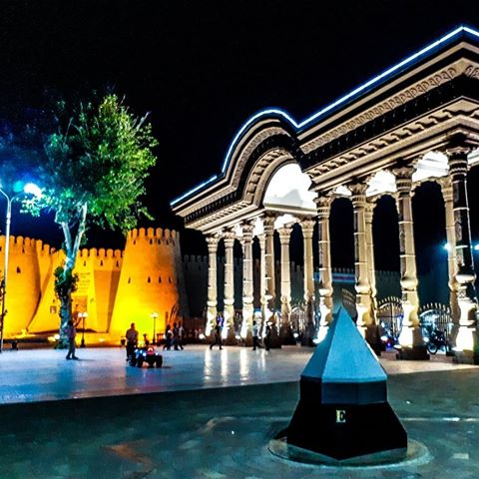
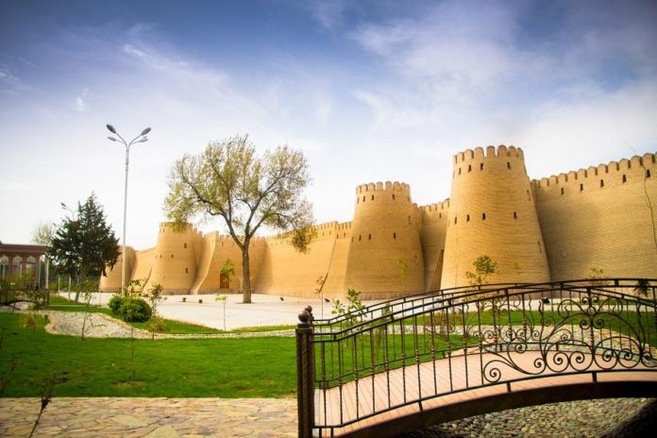
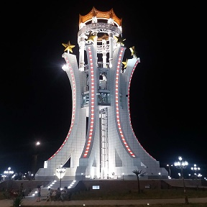
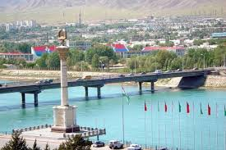

THANK YOU FOR YOUR ATTENTION!
Republic of Tajikistan, Sughd Region, Khujand city, 45, R.Nabiev Avenue,
Tel: +992342243519, +992342246560, E-mail: info@sugd.tj, sugdinvest@mail.ru

