Slide 1
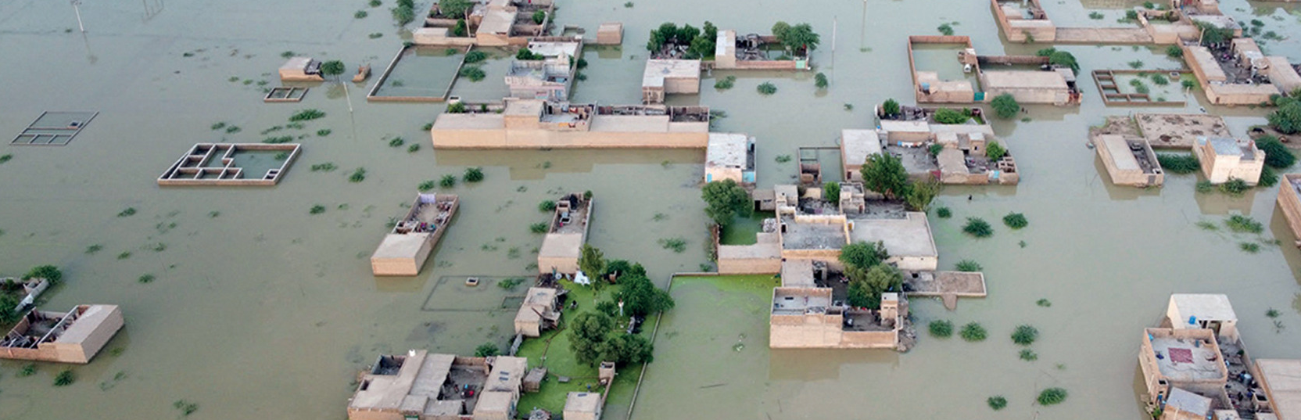

Session 7: Cross-Cutting Themes
Developing a Disaster Risk Transfer Facility in the CAREC Region
CAREC Senior Officials’ Meeting
13-14 June 2023
Tbilisi, Georgia

Slide 2




1. Overview
Project Objectives
ADB-funded Regional Technical Assistance Project ($2.75 mill) approved in 2020
    Identify and quantify flood, earthquake and infectious disease risk.
    Assess and quantify the financial disaster risk protection gap
    Provide access to modelling and capacity to assess the cost-benefit of adaptation investments
    Investigate options for regional disaster risk financing to improve financial resilience and collaboration

Slide 3
1. Overview
Project Timeline
Investigation and modelling of regional disaster risk financing solutions, including ILS instruments
Disaster risk data gathering and modelling
Draft Report on ILS opportunities and Disaster Relief Bond (DRB)
Infectious disease risk financing solutions
Protection gap assessment
CAREC SOM
Final Roadmap and DRB reports and handover of DRMI
Inception Meeting (Sep 2020)
Risk Profiles and Country Consultations
(Oct-Nov 2021)
DRMI Training (Mar-April 2022)
Engagement
Event (Nov 2022)
Proposed Engagement
Workshop – Pakistan (Jul 2023)
Conceptualization of Disaster Risk Management Interface (DRMI)
COVID-19 scenarios and compound risk analysis
Draft Roadmap on the establishment of a regional risk transfer facility

Slide 4
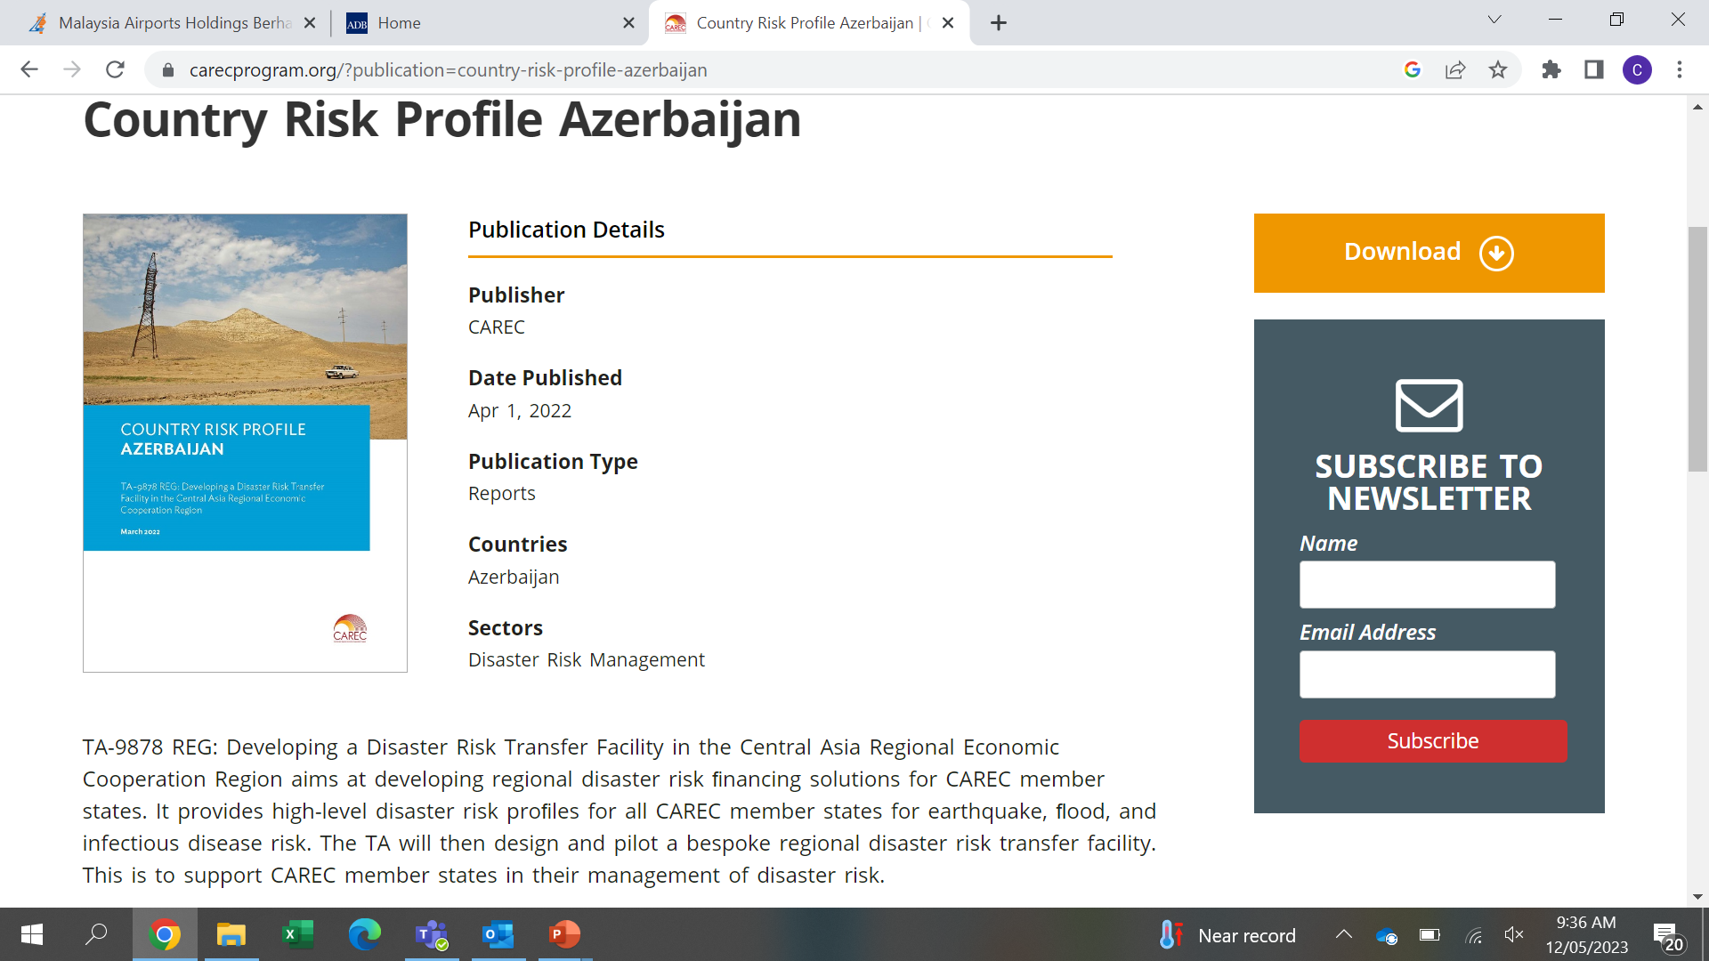
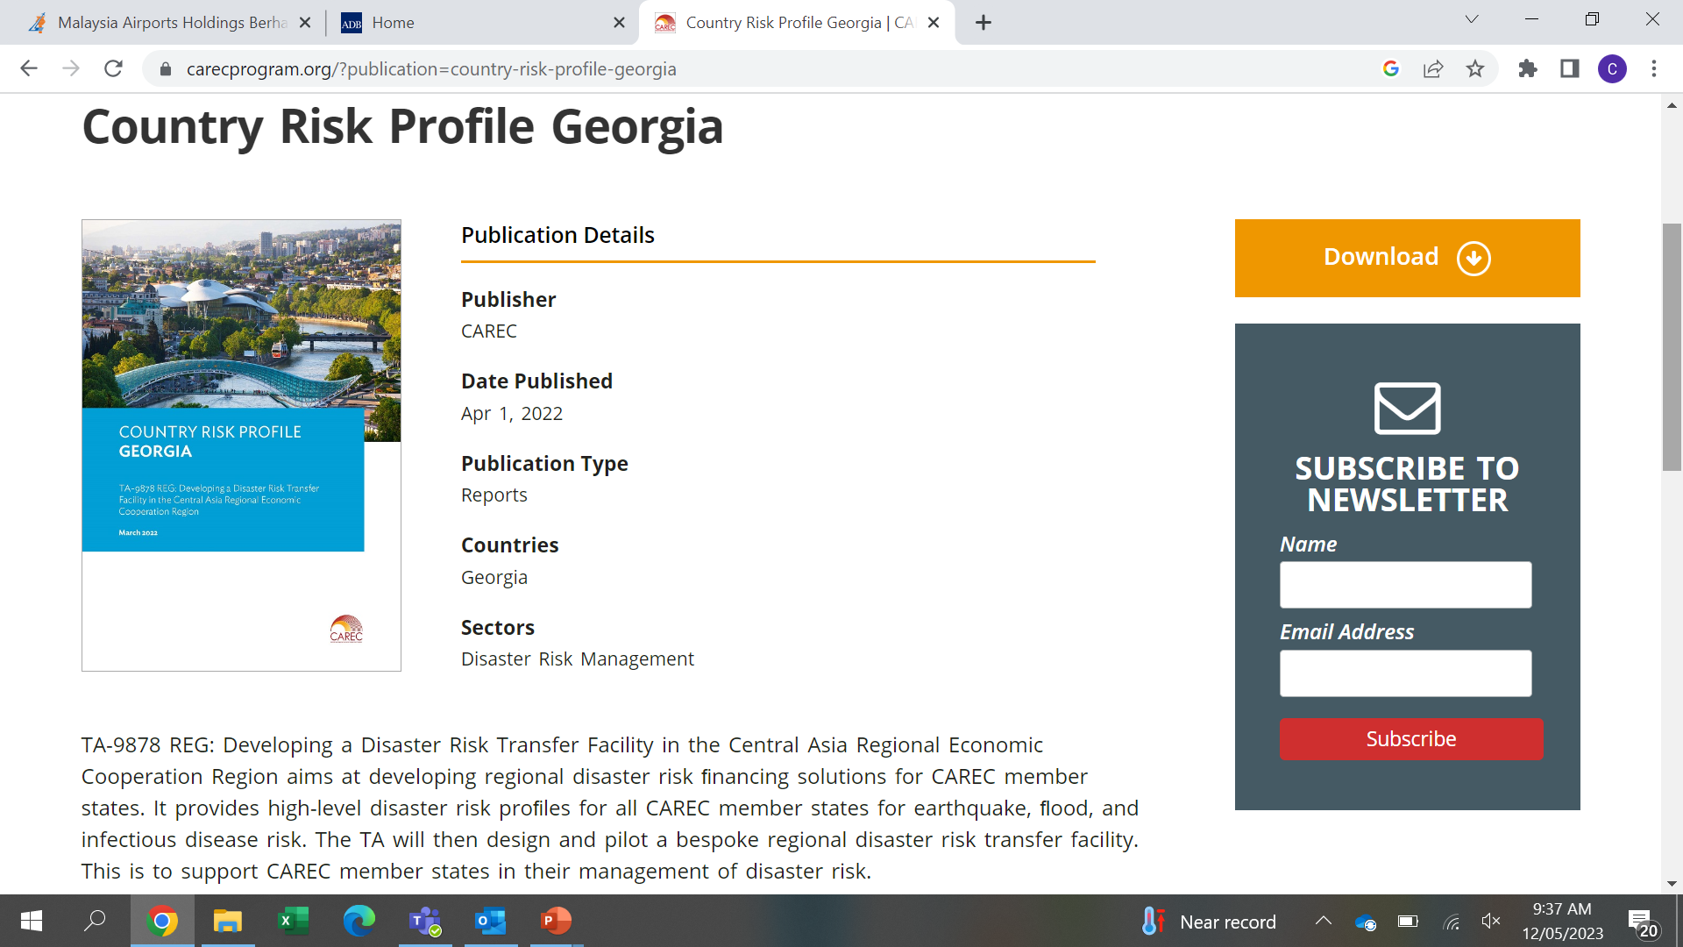
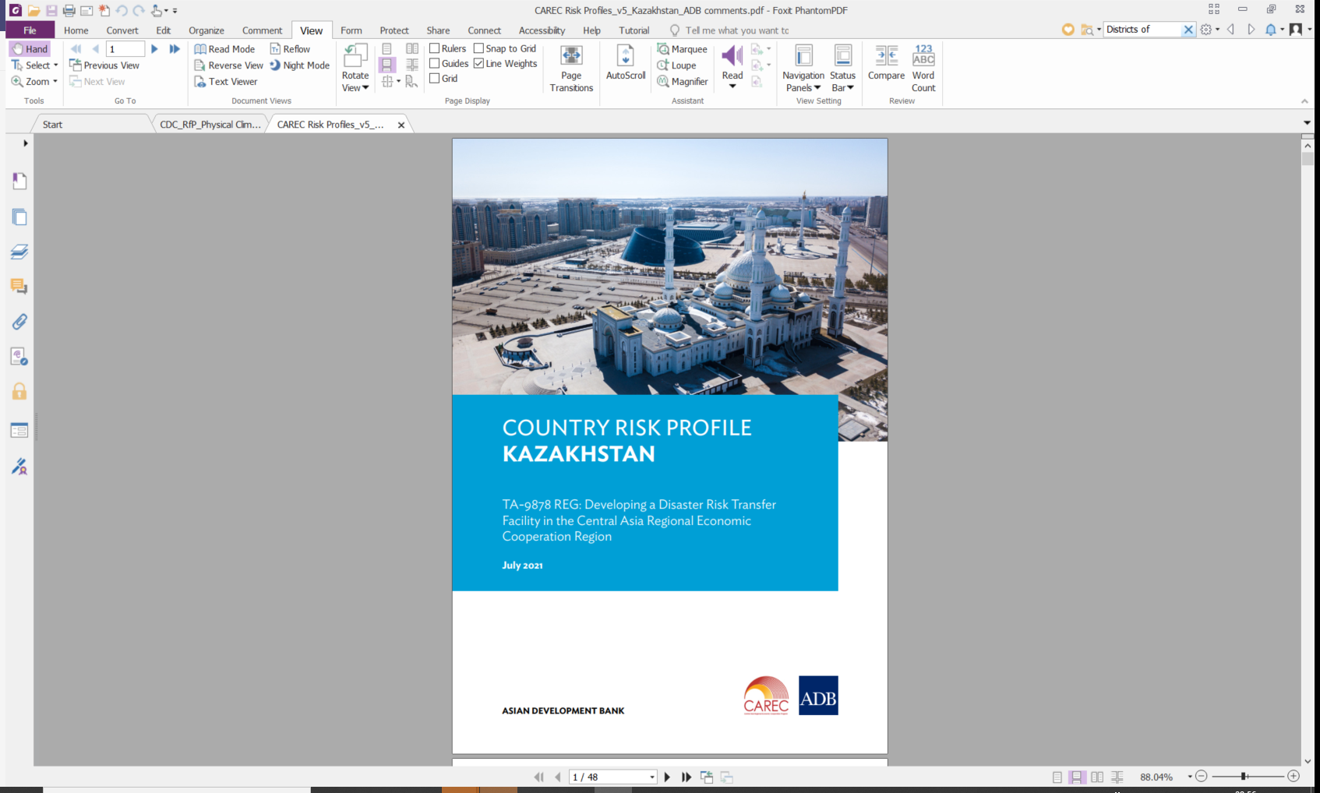
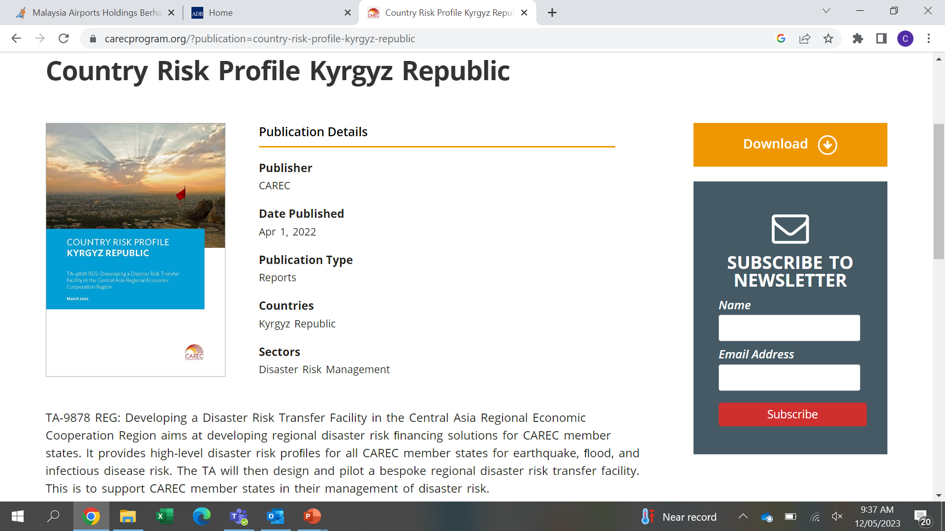
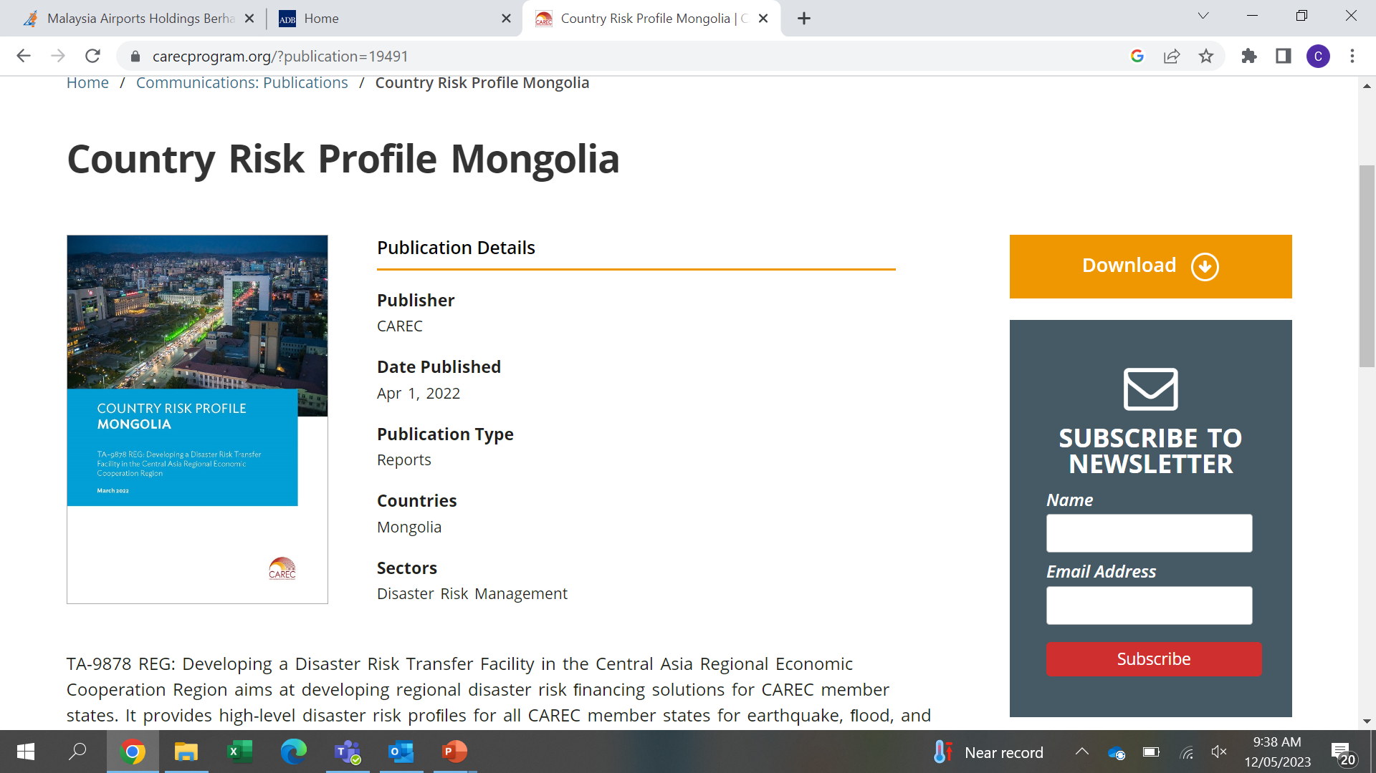
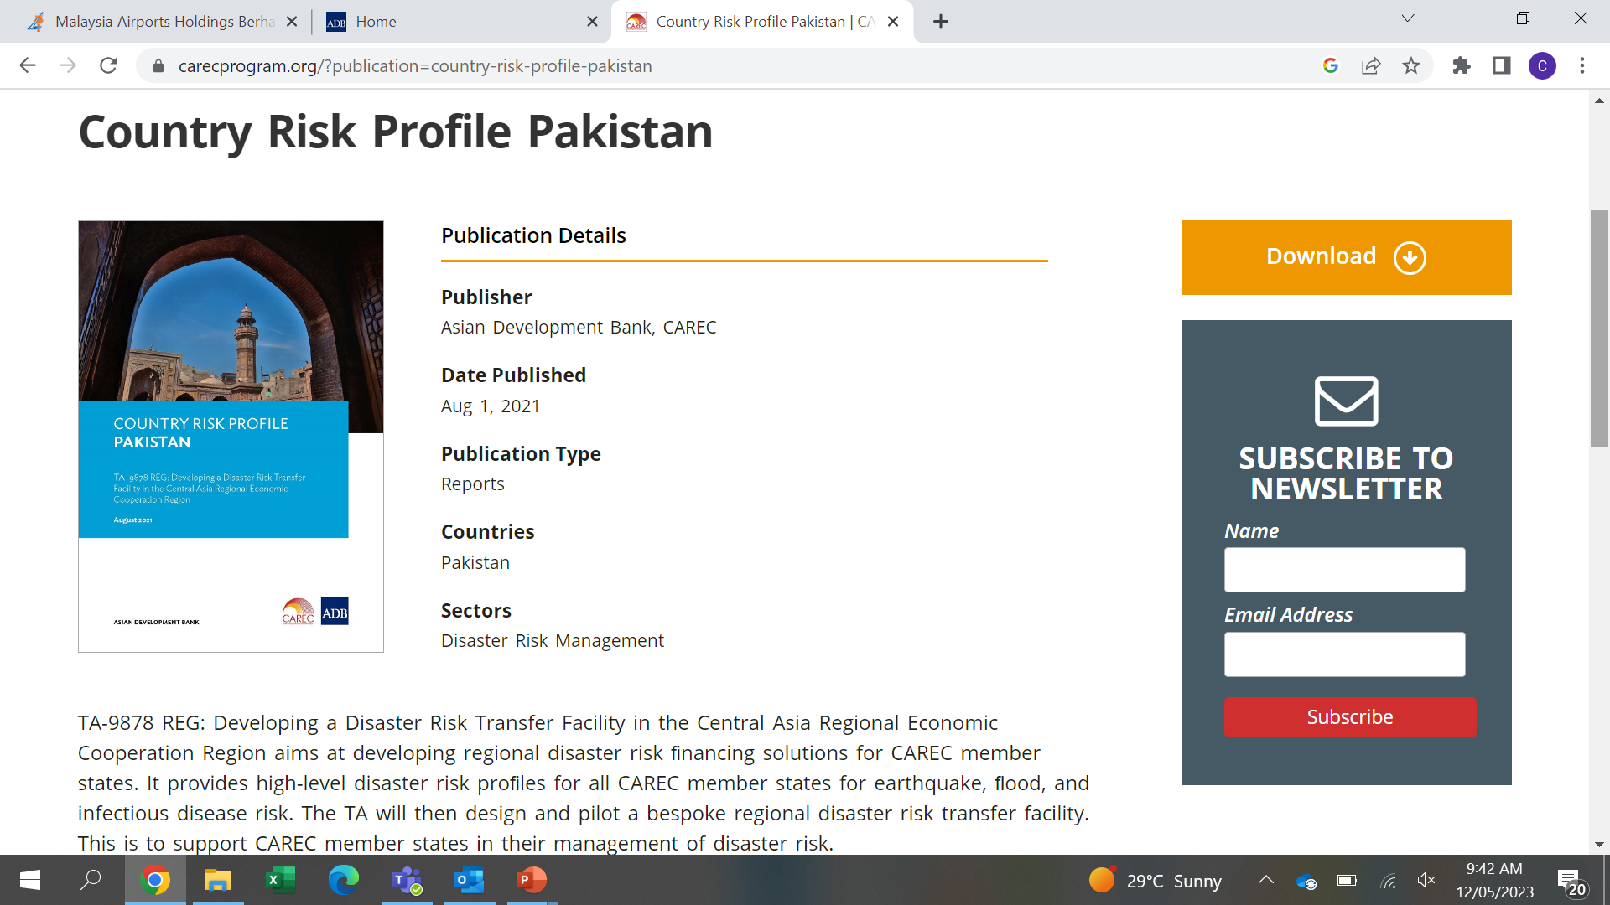
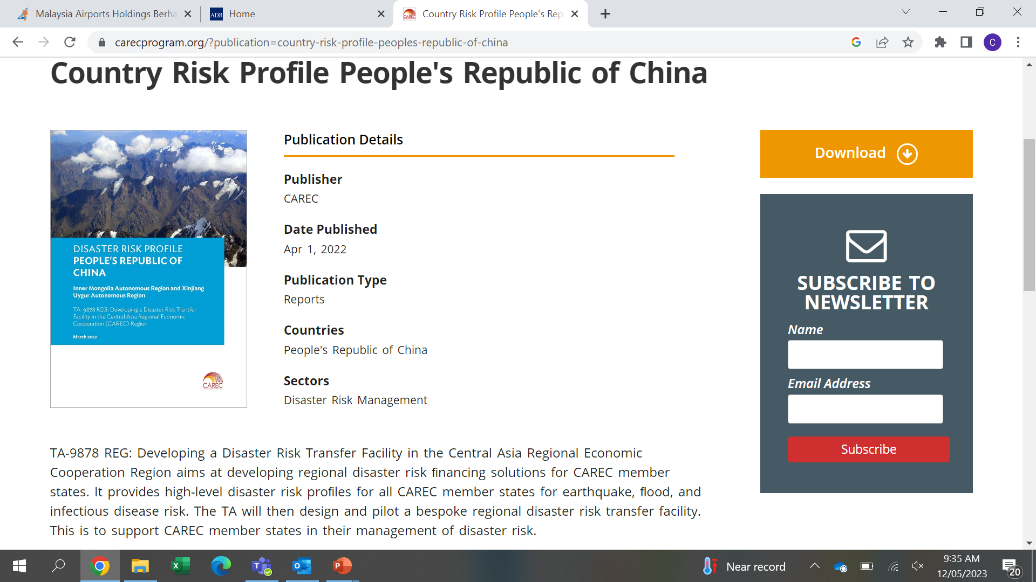
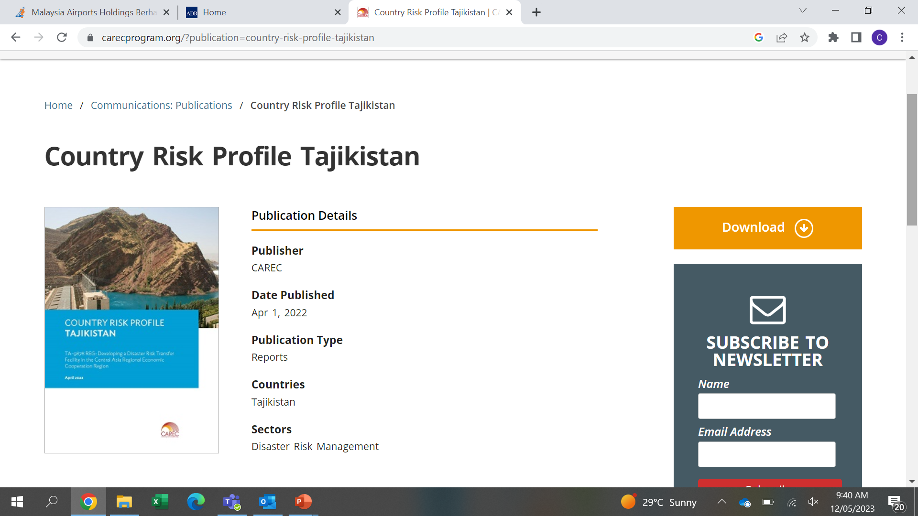
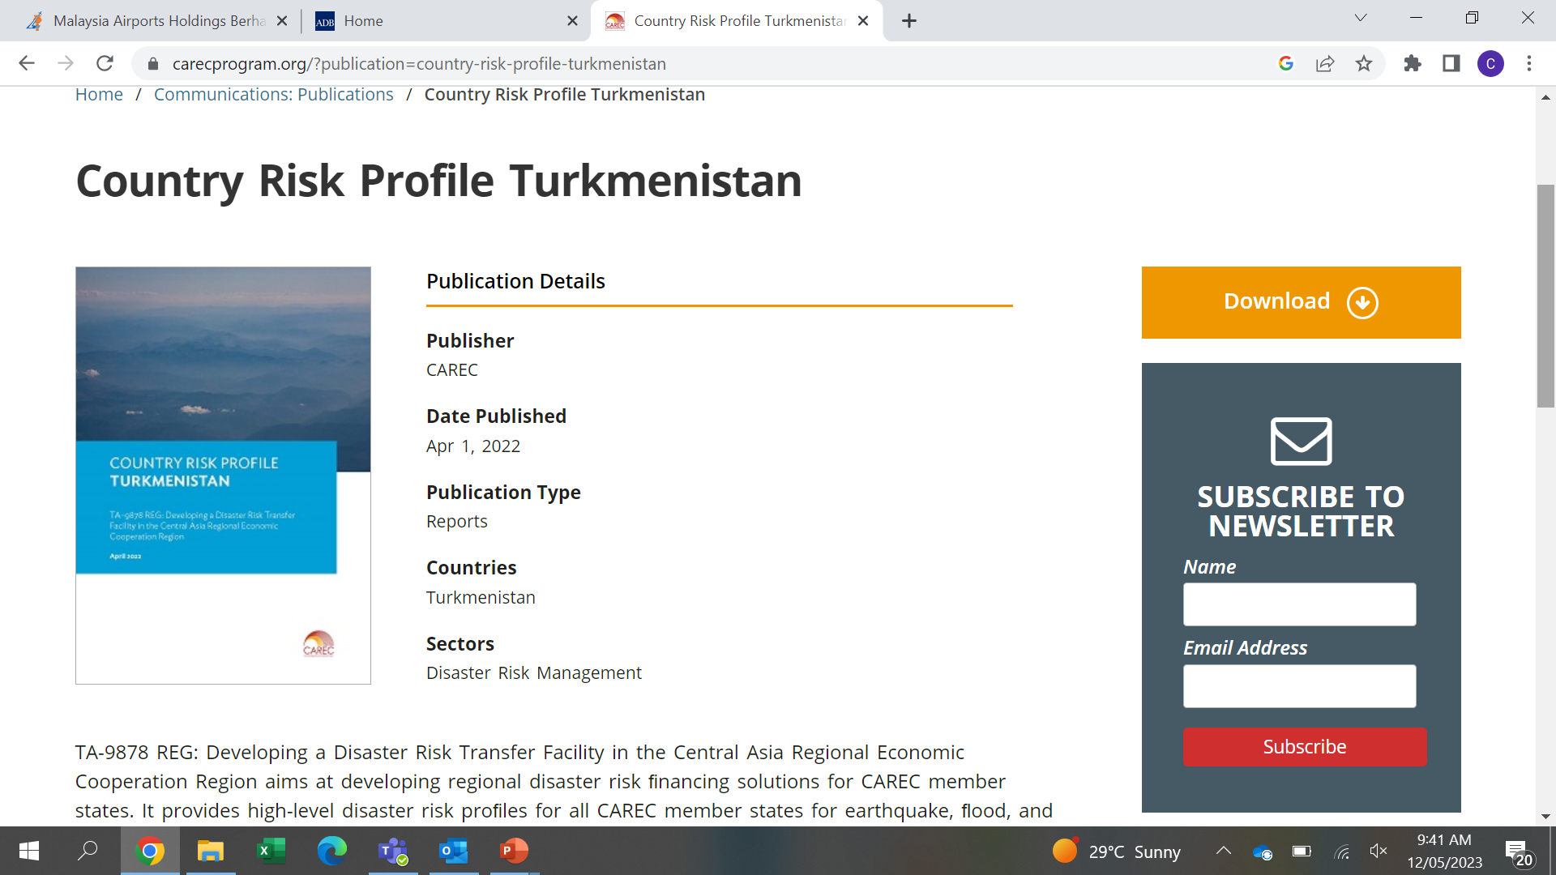
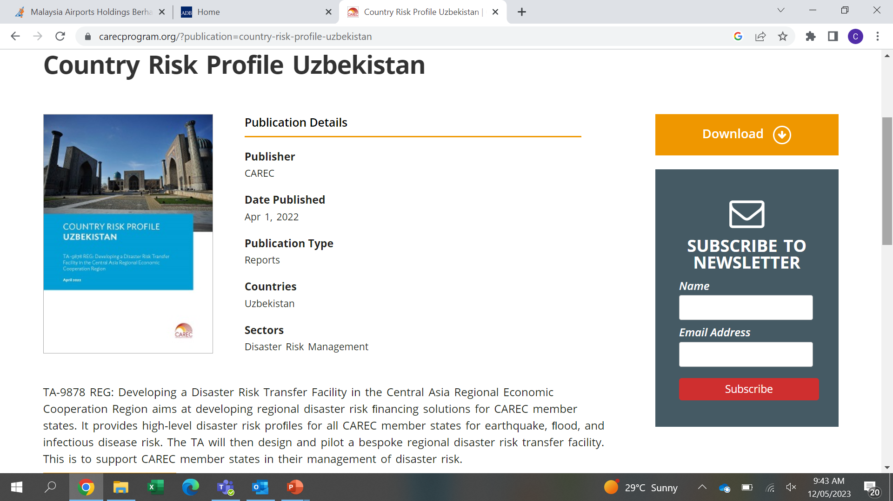
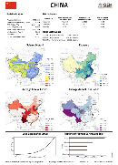
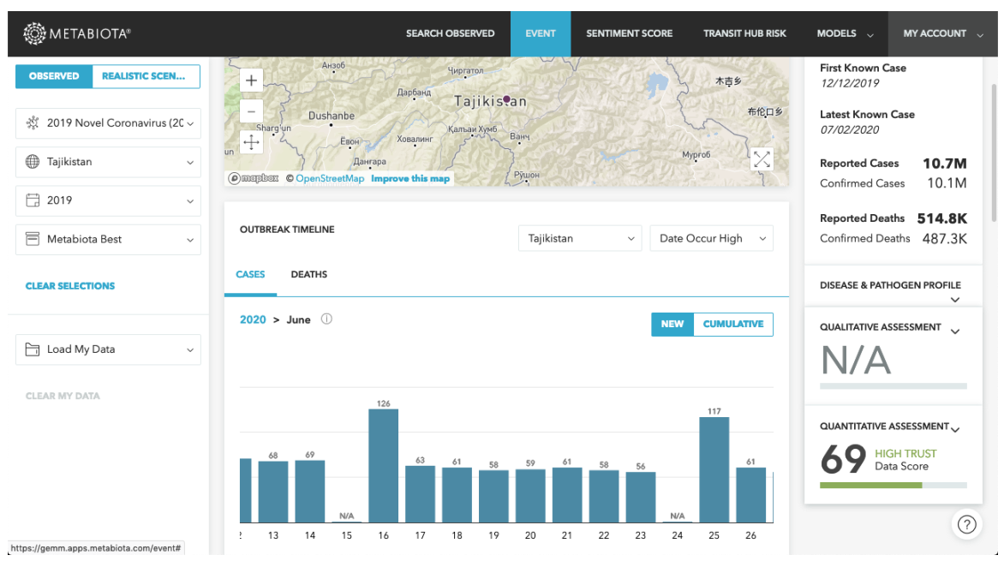
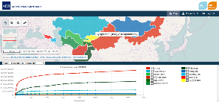

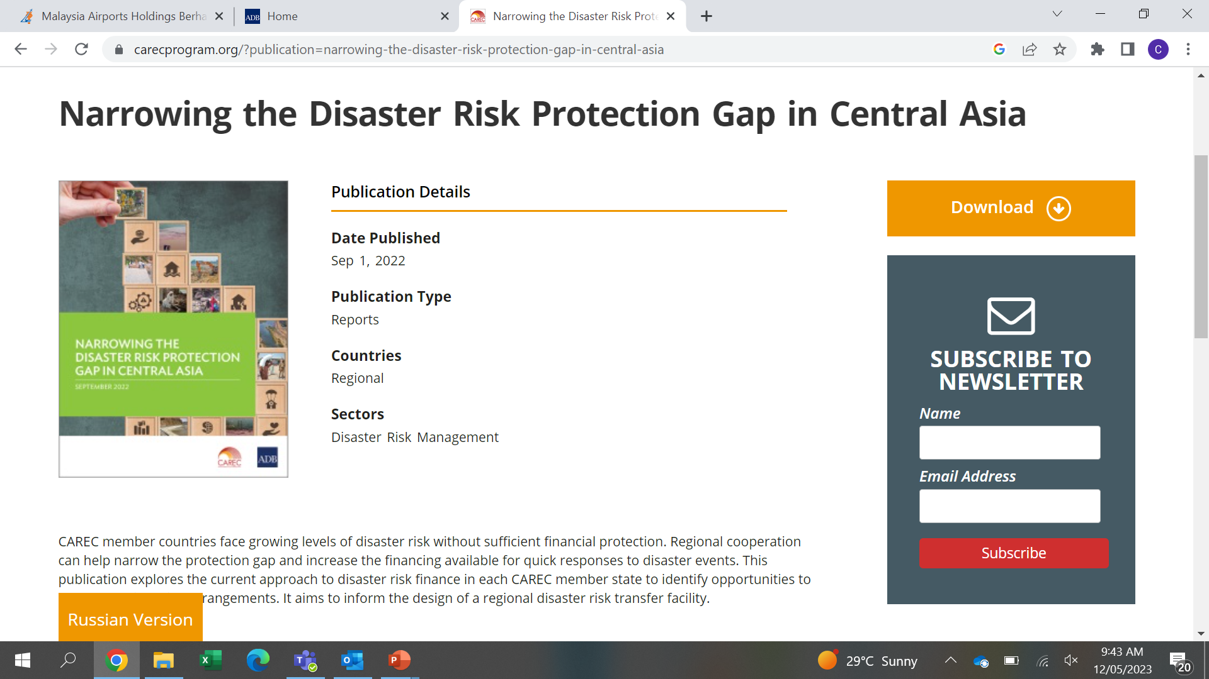
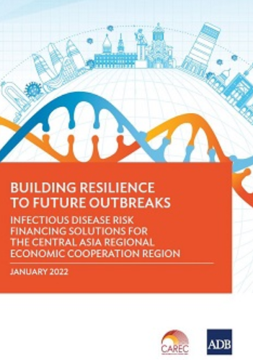
2. What has been done?
Key Milestones Achieved
Disaster Risk Profiles for each CAREC country on flood, earthquake and infectious disease risks
Protection Gap Assessment, quantifying the difference between the estimated losses from earthquake and flood risk and the existing ex-ante financing tools in CAREC countries
Infectious Disease Risk Report, identifying three potential risk financing solutions to help build CAREC countries’ financial resilience to future outbreaks
Compound Risk Analysis on potential joint impacts from disaster events and infectious disease outbreaks
Disaster Risk Modeling Interface (DRMI), allowing stakeholders to visualize the risk profiles, perform high-level cost-benefit analysis of implementing disaster risk reduction and adaptation measures; and quantify risk transfer costs for earthquake and flood parametric insurance structures
A total of 6 regional / sub-regional Capacity Building and Engagement Workshops with over 125 participants (27% women) and 20 bilateral consultations

Slide 5
3. What is next?
Planned Deliverables and Activities 2023
Roadmap for the establishment of a regional risk transfer facility for CAREC countries based on international best practices, including facility function(s), operational and financial framework, legal and regulatory requirements.
Feasibility assessment on the issuance of a Disaster Relief Bond (DRB) for CAREC countries, including financial, modeling, structural, legal and documentation requirements.
Refined DRMI, including technical manual for handover of the tool for further management and maintenance.

Slide 6
3. What is next?
CAREC Risk Facility: A Longer-Term Goal for Risk Transfer and Regional Cooperation
Fa
Lower premiums and operational expenses
Segregation of risk and no cross-subsidization
Policyholder
of parametric insurance policies
Risk Modeler
Hazard data
Country
Reinsurers/
Capital Markets
Access to reinsurance and capital markets on competitive terms
Country
Premium
CAREC
Disaster Risk Transfer
Facility
Risk Transfer Cost
Country
Claims
Trigger payouts
Fund support
Improved risk analysis and information sharing
Regional Cohesion
External Donors
Country

Slide 7


3. What is next?
Disaster Relief Bond: Bridging the Protection Gap in the Shorter to Medium-Term
Novel risk transfer product that builds on the well-established cat bond but requires that proceeds from a bond pay-out be used to implement relief, rehabilitation and recovery measures
Disaster Relief Bond
CAREC Countries
Risk Transfer Agreement
Investors
ADB funding rate + [X%]
Loss Payments
Proceeds
Immediate and effective disaster response after a damaging event, minimising long-term human and economic cost. It can be designed to address the needs of vulnerable groups
A complementary solution, part of a broader risk financing strategy and accompanied by country-specific plans outlining the use of potential pay-outs
Requires a commitment from countries to invest in risk reduction and climate change adaptation interventions
  A DRB supports the financing of projects that promote SDGs and the Paris Agreement

Slide 8
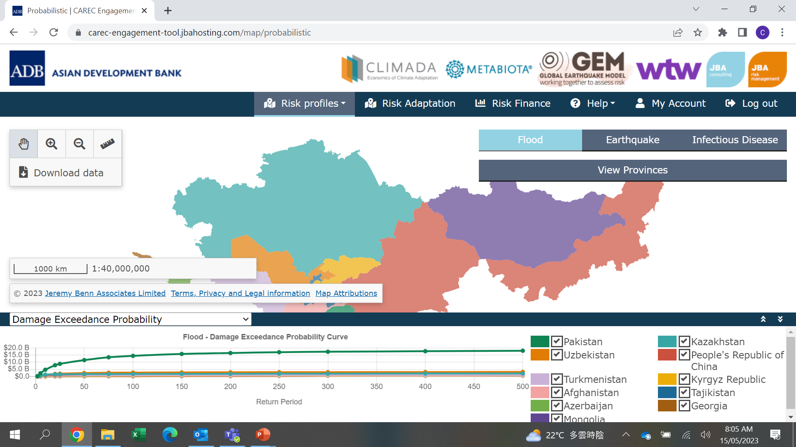
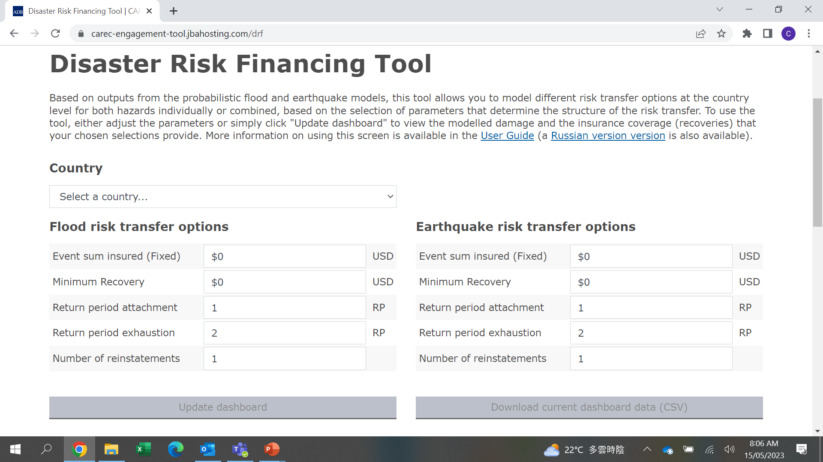
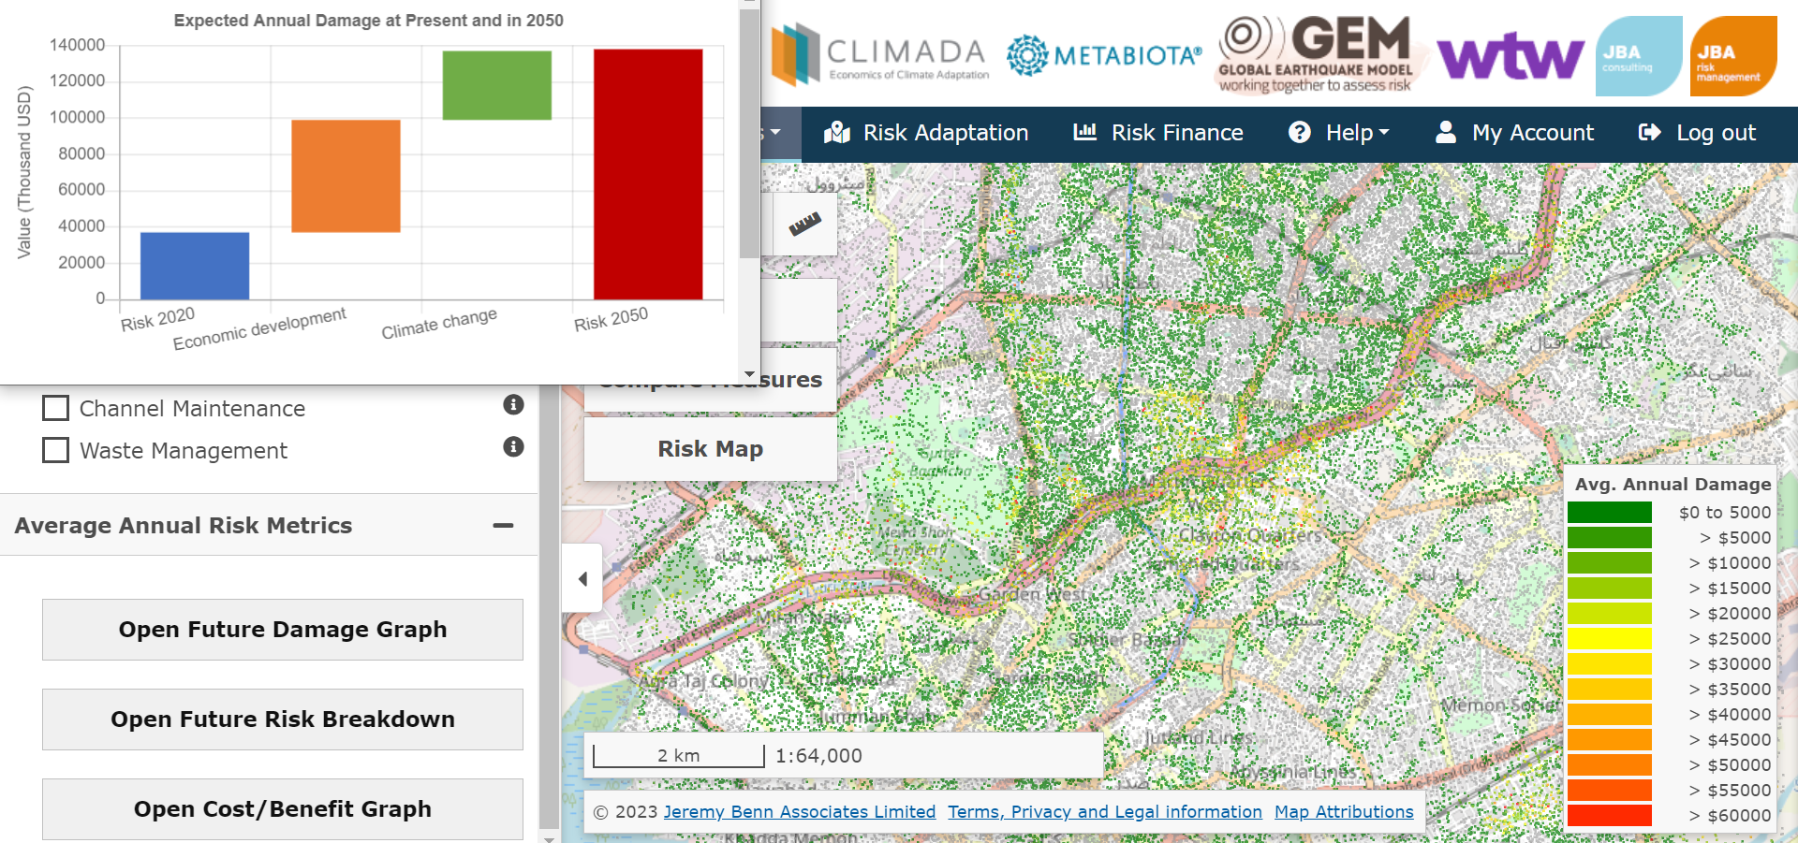
3. What is next?
Disaster Risk Management Interface
Risk Profiles
  Probabilistic: map-based view of economic losses, number of people affected and fatalities from catastrophe modelling of flood, earthquake and infectious disease
  Deterministic Scenarios: map-based view of historic earthquake and flood events, and infectious disease outbreaks
  Exposure Risk Calculator: tool to enable adjustments to the exposure component of the probabilistic risk assessments
Risk Adaptation: potential cost and benefits of implementing different risk reduction and adaptation measures, including under different climate and economic growth scenarios
Risk Finance: tool to enable testing of different key risk financing parameters

Slide 9
3. What is next?
Planned Deliverables and Activities 2023
Roadmap for the establishment of a regional risk transfer facility for CAREC countries based on international best practices, including facility function(s), operational and financial framework, legal and regulatory requirements.
Feasibility assessment on the issuance of a Disaster Relief Bond (DRB) for CAREC countries, including financial, modeling, structural, legal and documentation requirements.
Refined DRMI, including technical manual for handover of the tool for further management and maintenance.
Regional capacity building and TA completion workshop (July 2023, Pakistan)
Coordination with donors and other disaster risk management and financing initiatives in the region
Consensus on further actions for the establishment of the proposed Regional Disaster Risk Transfer Facility, to be presented at the CAREC Ministerial Conference in November 2023

