Slide 1
Crosscutting Themes:
Gender
Digitalization
CAREC Senior Officials’ Meeting
13-14 June 2023
Tbilisi, Georgia

Slide 2



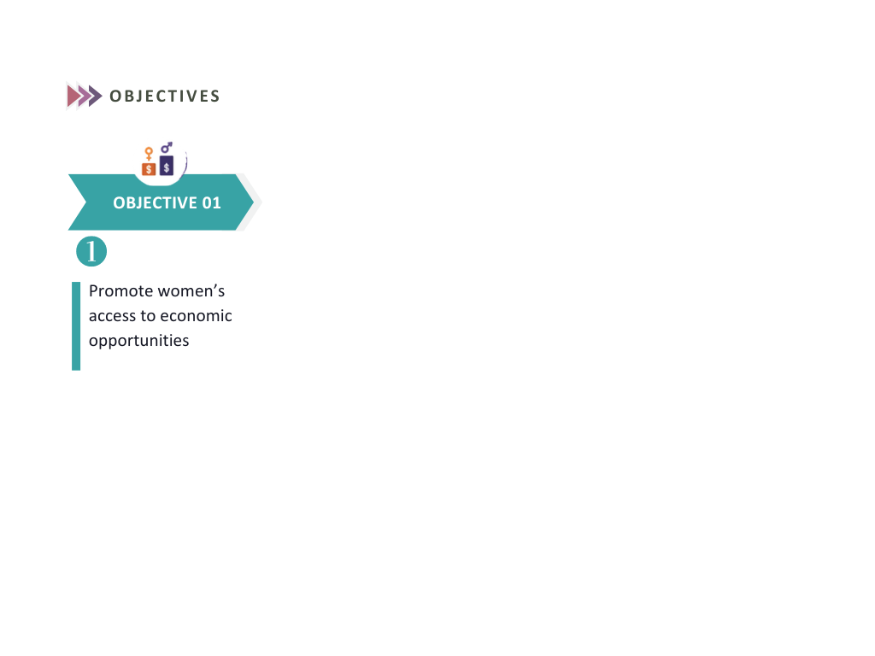
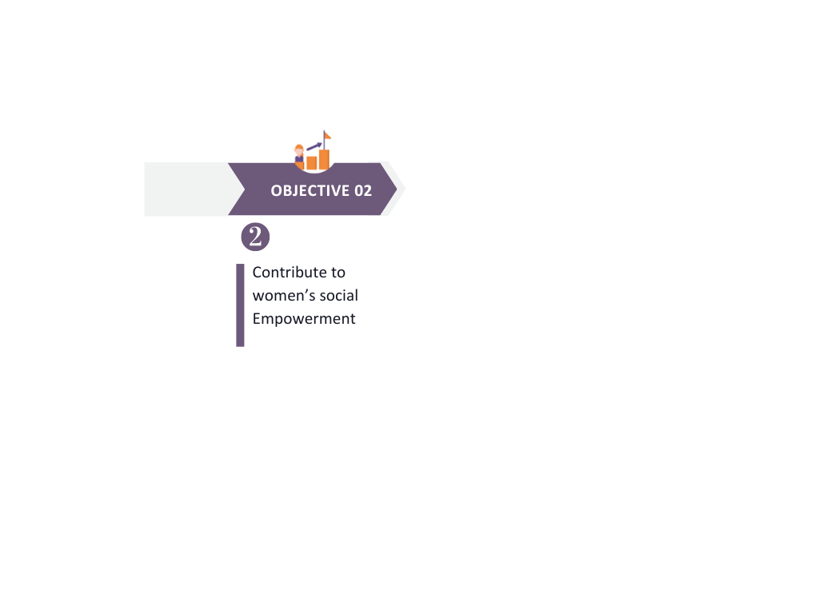
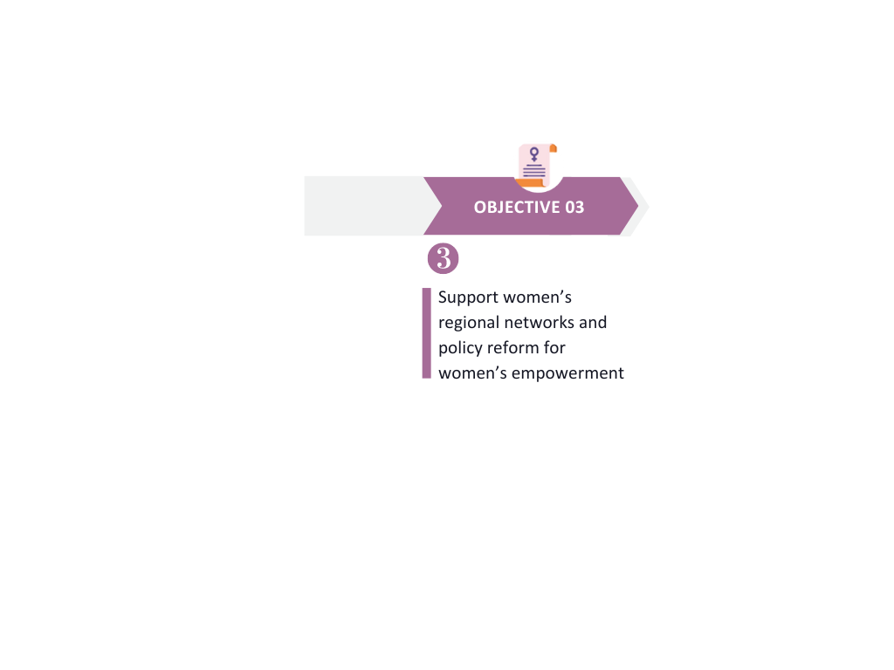
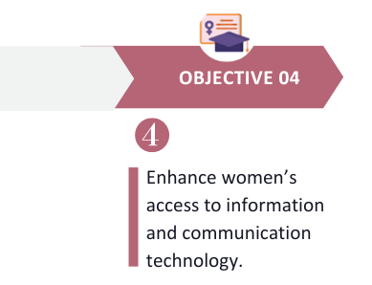

CAREC
Cross-cutting themes: Gender
Sector Committees
Regional Gender Expert Group
CAREC Gender Strategy 2030
OBJECTIVES
OBJECTIVE 01
OBJECTIVE 02
OBJECTIVE 03
OBJECTIVE 04
Promote women’s access to economic
opportunities
Contribute to
women’s social
Empowerment
Support women’s regional networks and policy reform for women’s empowerment
Enhance women’s access to information and communication technology
MILESTONES
Call for Nominations for the CAREC Women of the Year Award
The Second RGEG Meeting
The Second Women Economic Empowerment Forum
Women of the Year Award Ceremony
August
2022
June
2023
July
2023
August 2023
September 2023
October 2023
2023
2022
RGEG Inaugural Meeting held
The first CAREC Women
Economic Empowerment Forum held
Launch of the
CAREC Women in Business Online Community Platform
Launch of the
Digital - GLOW Initiative
Slide No. 2

Slide 3
CAREC
Cross-cutting themes: Gender
Sector Committees
Regional Gender Expert Group
CAREC Gender Strategy 2030
Flagship Regional Initiatives | Brief Intro | Action Plan (2023)
CAREC Women Business Forum (NETWORK) | CAREC Women Business Forum will be operated through the CAREC Women in Business Online Community Platform to strengthen the capacity of women entrepreneurs by improving their access to relevant knowledge in finance, marketing, and networking. | May - June: key actors to be identified and invited to join the online platform. June: virtual launch events to be organized. July – December: regular online community activities to be organized through the platform.
CAREC Women of the Year Award (VISIBILITY) | This award recognizes women's outstanding contributions to the region's socio-economic development, and it will provide greater visibility to women entrepreneurs and gender champions in the CAREC region. | May: event promotion and advertisement. June: the award nomination to be open to the public July: professional jury to be formed. August: nominations to be assessed by the jury. September: awardees to be announced. October: award ceremony to be held.
CAREC Digital Growth and Literacy of Women (Digital - GLOW) Initiative (DIGITAL SKILLS) | The initiative aims to empower women, particularly women entrepreneurs, in the CAREC REC region, by improving their capacity in digital business, thus increasing their economic opportunities and closing the digital gender divide. | May: Consultation with potential partners and stakeholders. June: Concept to be finalized. July - August: researchers to be engaged in needs assessment to collect baseline data September: launch event to be organized October - December: training modules to be developed
Slide No. 3

Slide 4
CAREC Digital Strategy 2030 (The 5 Pillars of the Digital Foundations)
1. Leadership, Governance, & Investment
Strengthening regional institutions for digital leadership.
2. Digital Policy, Enablers, and Safeguards (Data AI, Cybersecurity)
Harmonizing legislation and regulations across CAREC member countries and adopting regional legislation to promote digital partnerships.
Attracting investment in the digital economy.
Promoting an inclusive regional digital economy.
Leveraging digital technologies to pursue cross-cutting sustainable development goals.
Inclusion, innovation, sustainability, resilience, partnerships, and participation
Enhancing the cybersecurity of the CAREC region.
Aligning data policies across CAREC member countries.
Supporting the development of artificial intelligence (AI) in the region.
Strengthening and connecting digital infrastructure to bridge the digital divide.
Building digital resilience capacity.
3. Broadband Infrastructure, Resilience, & Digital Platforms
4. Digital Skills and Competencies
Improving education, training, and life-long learning.
Developing digital skills: basic and professional.
5. Digital Innovation, Entrepreneurship, & ICT Competitiveness
Building a CAREC regional platform economy.
Boosting digital competencies.
Nurturing the digital innovation ecosystem.
Promoting the adoption and effective use of digital technologies by small and medium-sized enterprises.
Promoting regional content.
Boosting ICT exports.
Slide No. 4
Notes:
To achieve the Strategic Objectives, the CAREC Digital Strategy 2030 will strengthen the following Five Interconnected Pillars through improved cooperation between CAREC member countries.
Implementation Approach
The approach to digitalization support in the CAREC region is overarching, gradual, demand-based, collaborative, and multifaceted. The following principles are being followed:
§Member countries to identify priorities and linkages to their national strategies and programs and facilitate coordination with all stakeholders.
§Focus and prioritize activities with regional impact and their ability to facilitate cooperation.
§Leveraging existing programs and initiatives through partnerships and collaboration with member countries, development partners, the private sector, and civil society.
§Other than soft skills and support, take proactive measures to strengthen digital infrastructure by identifying and highlighting needs and showcasing them to develop a project portfolio and mobilize necessary investments.
§Generate additional resources to support strategy implementation.
§Establish realistic milestones and results and establish a monitoring and reporting mechanism.
Put in place strong communication and outreach to increase general awareness and profile, enable advocacy, and build a constituency for reforms to reduce the digital divide and promote the digital economy.

Slide 5
Supporting Start-up Ecosystems in the CAREC
Key Initiatives
Developed the CAREC Digital Strategy Portal.
‘Virtual CAREC’ initiative to provide training, upgrade equipment, and improve connectivity.
A regional CAREC Startup Ecosystem Development Hub:
  Improves data flow and connects stakeholders
  Provides knowledge support to invigorate the ecosystem with the following initiatives:
    The CAREC Startup Map.
    The CAREC Innovation Network (CIN).
    The CAREC Innovation Decoded.
    The CAREC University Startup Competition.
Slide No. 5
Notes:
Slide 5:-
- CAREC Digital Strategy Portal (Pillar 3: Broadband Infrastructure, Resilience, and Digital Platforms):
•A CAREC Digital Strategy Portal has been developed.
•This will be transformed into the CAREC Digital Collaboration Platform to enable coordination, training, and best practice sharing as part of the CAREC Digital Strategy Implementation process.
•
- Virtual CAREC (Pillar 4: Digital Skills and Competencies of the Strategy):
•Assessed virtual connectivity setups during the pandemic
•Provided basic equipment and connectivity upgrades
•Trained selected staff to improve virtual connectivity skills
- CAREC Startup Ecosystem: (Pillar 5: Digital Innovation, Entrepreneurship, & ICT Competitiveness):
The CAREC Startup Map:
The CAREC Startup Map is a visual map of existing stakeholders contributing towards the Startup Ecosystem of the CAREC region.
It provides a Macro view of the progress of the Startup Ecosystem in the CAREC Region.
1- It helps us identify the cities with active Startup Ecosystems and identify the success factors
2- It shows the cities with not so active Startup Ecosystem and evaluate the reasons
3- Provides us a benchmark to evaluate the progress of one city’s Ecosystem vs another City
- The CAREC Innovation network:
The CAREC Innovation Network (CIN) provides an opportunity for all Entrepreneurship Support Organizations (ESOs) working in the CAREC region to Collaborate and Strengthen the services that they offer.
The CAREC secretariat will
1- Organize in-person events and invite key stakeholders (Incubators, Accelerators, and Government Institutes) to engage and seek opportunities to collaborate.
2- Organize a Regional Startup Boot Camp, where selected startups will enroll with accelerators across the region and develop their ideas with a regional perspective.
3- Create a Start-up Exchange program to increase regional collaboration among the ecosystem stakeholders
4- Provide resources to research and conduct studies to evaluate gaps and opportunities in different business areas (E-Commerce, Telecom Sector, Cross Border Payments)
5- Organize study visits to countries with robust and well-developed Startup ecosystems like Korea, Singapore, and Japan to learn from their success stories
-The CAREC Innovation Decoded:
Promote South–South learning through the CAREC Innovation Decoded initiative, focusing on the success factors of the startup ecosystem in the People’s Republic of China with CAREC member countries. A series of training and networking events will be organized.
The CAREC secretariat will:
1. Invite high-profile speakers from all innovation ecosystem stakeholders who will share their experiences, skills, and knowledge of the development of the startup ecosystem in China.
2. On-site networking events around the developed Chinese cities will be organized with seminars with prestigious entrepreneurs and partners in the Chinese startup ecosystem; exhibitions; Networking opportunities for leading innovation ecosystem partners (Gov, VC, Univ./institutes, known enterprises such as Alibaba, Tech Parks, Top tier startups, Incubators/Accelerators, etc.)
3. Developing sustainable communication and cooperation mechanism for a collaborative and interactive startup ecosystem community between Chinese and other CAREC startup ecosystem partners through the Think Tank function, resource pool building and expansion of partners.
-
- The CAREC University Competition:
The CAREC University Startup Competition is an innovation challenge for University students in the CAREC region to develop Practical, Entrepreneurial, and Soft skills by tackling real-world social and corporate problems.
The CAREC secretariat is
1- Working with universities to establish Incubation centers to promote the development of entrepreneurship among students.
2- Working with universities to create a student-exchange program to develop collaboration.
3- Organizing study trips to Universities in countries like Korea, Singapore, and Japan to learn from their success stories

Slide 6
Supporting Start-up Ecosystems in the CAREC
Future Activities
Regional Startup Ecosystem Support (Pillar 5: Digital Innovation, Entrepreneurship, & ICT Competitiveness)
Further develop CAREC Startup Ecosystem Development Hub.
Continue organizing CIN Member workshops.
Continue organizing CAREC Innovation Decoded workshops.
Organize events such as:
  Investor Summit
  Startup Roadshow
  Innovation Spaces
  Digital Nomad promotion activities
  Create a Regional Talent Poll, Regional Mentor Network, and Regional Angel Investor Network
Develop Regional Pre-Incubation Bootcamp.
Slide No. 6
Notes:
Slide 6:-
§Further develop the CAREC Startup Ecosystem Development Hub by reaching out to more players in the ecosystem space from the region.
§
§Continue organizing CIN Member workshops where subject matter experts will train the startup ecosystem organizations on selected areas and topics.
§
§Promote South–South learning through the CAREC Innovation Decoded initiative, focusing on the success factors of the startup ecosystem, starting from the People’s Republic of China and then moving to other CAREC countries. A series of training and networking events will be organized.
§Develop a Regional Pre-Incubation Bootcamp to encourage knowledge transfer and networking among incubators and accelerators in the CAREC region who have shown interest in joining this initiative.

Slide 7
Supporting Start-up Ecosystems in the CAREC
Future Activities (Cont.)
University Collaboration and Promoting Youth Engagement and Entrepreneurship (Pillar 5: Digital Innovation, Entrepreneurship, & ICT Competitiveness):
Create Affiliate Program with the universities to organize Open Innovation Challenges in the CAREC region
Create the "CAREC University Exchange Program.”
Other Initiatives:
Launch flagship CAREC Digital Literacy Program for Women.
Assess and develop a portfolio to develop digital infrastructure.
Enhance government services.
Promote dialogue on regulations pertaining to cross-border payments, data security, e-commerce, consumer privacy, and capacity building.
Enhance collaboration with the development partners in this space, such as AIIB, EBRD, ITU, UNDP, USAID, UNIDO, and World Bank..
Slide No. 7
Notes:
Slide 7:-
- University Collaboration and Promoting Youth Engagement and Entrepreneurship (Pillar 5: Digital Innovation, Entrepreneurship, & ICT Competitiveness)
§Continue organizing Open Innovation Challenges – Affiliate Program with the universities in the CAREC region and developing sustainable models to continue with depreciating support from the CAREC secretariat.
§In order to strengthen the collaboration & knowledge sharing among the Innovation centers operated by CAREC universities, we aim to create the "CAREC University Exchange Program.” Participating universities will host startups from other universities for one week, and the startups will get the unique opportunity to work with faculty and mentors from various universities in the region.
- Other Initiatives:
§Launch a flagship CAREC Digital Literacy Program for Women to address the critical digital gender divide and promote the digital economy and better service delivery access.
§Collaborate with the CAREC digital focal points to enhance the digital infrastructure and reduce the digital divide in the region. This initiative aligns with the CAREC digital strategy 2030. It aims to streamline the digitalization of Government services and promote dialogue on regulations pertaining to cross-border payments, customs & telecom services, etc.

Slide 8
Contact & Important Links
Visit our CAREC website at https://www.carecprogram.org
The CAREC Digital Strategy 2030: https://digital.carecprogram.org
The CAREC Startup Map: https://www.startupcarec.org
Feel free to Contact us at: info@carecprogram.org
Thank you!
Slide No. 8

