Slide 1
Progress made and preparatory steps for regional projects in Water Pillar
CAREC Senior Officials’ Meeting
13-14 June 2023
Tbilisi, Georgia

Slide 2
CAREC Water Pillar-towards implementation
“CAREC 2030 ..honest broker role, to promote discussion and dialogue on water issues to chart the way forward.” CAREC Strategy 2030
Initial focus on 5 Central Asian republics – later expansion to all CAREC members.
Framed Water Pillar
Vision:
‘a sustainable, climate resilient, productive and water secure region with shared benefits among States and communities.’

Slide 3
Water Pillar Framework
BLOCK 1
BLOCK 2
BLOCK 3
Climate resilient and productive water systems
Sustainable water resources and water services
Nexus solutions and cross sector learning
Longlist of proposed projects in Interim Report
1.1 Climate adaptive management in a shared tributary
1.2 Regional benefits from climate resilient irrigation
1.3 Risk management for drought and heat stress
2.1 Efficient and sustainable water services models
2.2 Salinity management strategy
2.3 Promoting safe re-use of treated wastewater
2.4 Promoting benefits from nature-based solutions
3.1 Promoting jointly managed infrastructure
3.2 Renewable energy options in water systems
3.3 Human resource capacity for climate resilience

Slide 4
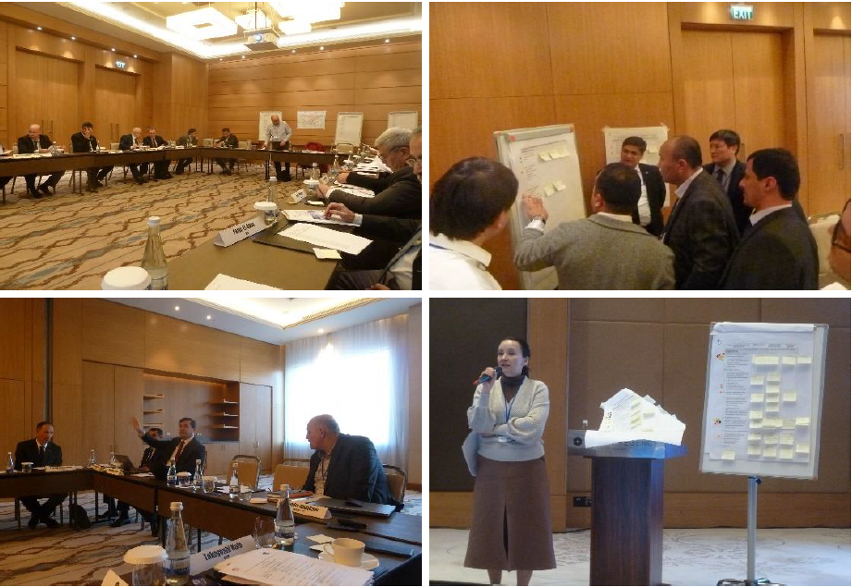
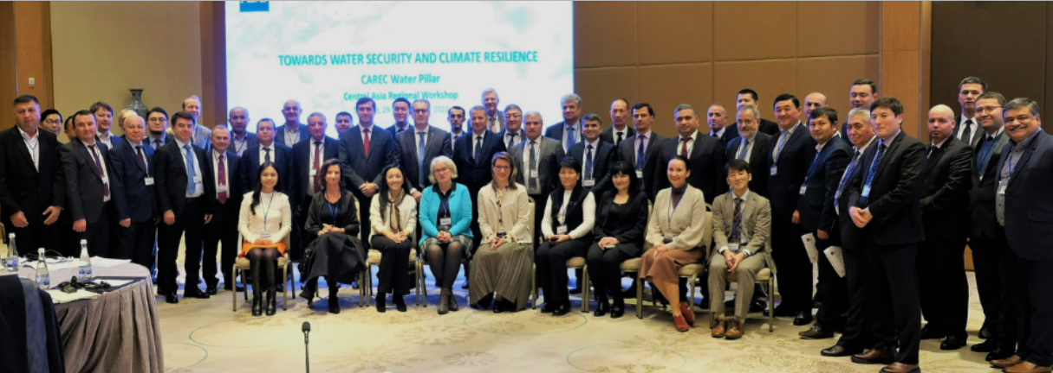
Regional Workshop: Tashkent 29-30 November 2022
involved representatives of national agencies, regional inter-governmental organizations, regional institutes and development partners
highly interactive group discussions on possible future project activities with regional benefits
consideration of institutional arrangements to guide future development of the Water Pillar – Working Group and Expert Groups
topics included:
strengthening climate adaptive management in shared
basins
climate resilient irrigation
upgrading disaster risk management systems
managing salinity in a basin context
promoting ecosystem-based approaches
strengthening human resource capacity

Slide 5
2023-24 timeline – CAREC Water Pillar
June-July 2023 | Consultations on draft technical assistance for institutional support and knowledge generation, including screening of potential Water Pillar projects Initiation of capacity building support for innovative water-energy nexus modelling on a selected tributary in Central Asia
Oct 2023 | Draft climate assessment prepared for an expanded geographic area for the Water Pillar
Nov 2023 | Establishment of Water Pillar Working Group
Dec 2023 | Regional knowledge event

