Slide 1
Senior Officials Meeting
Transport
Oleg Samukhin, ADB

Slide 2
20th CAREC TSCC Meeting
The 20th CAREC Transport Sector Coordinating Committee (TSCC) meeting was held in Tbilisi, Georgia (24-25 May 2023) along with the associated transport events: 7th Railways Working Group (RWG) and the CAREC Highways Workshop
The TSCC meeting was held in 2 days: Day 1 was to discuss the transport pillars, on Day 2 – countries and development partners shared information about their priority projects and initiatives
The meeting discussed acquisition, dissemination, and implementation of knowledge under 5 pillars of the CAREC Transport Strategy 2030
The overall transport corridor management, and specifically – improvement of the Middle Corridor (CAREC 2 Corridor) received a lot of attention in the TSCC and the RWG meetings
The cross-pillar theme of decarbonization in transport was first time introduced in the TSCC discussion. CAREC Transport will conduct the comprehensive examination of the decarbonization opportunities to develop CAREC responses in transport sector to the global warming threat

Slide 3
Key priorities for 2023-2024
Completing the ongoing knowledge products
Significantly increased knowledge dissemination activities, through national and regional training workshops, especially on Railways, RAMS and Road Safety
Launching full-scale scoping study on decarbonization of the CAREC Transport
Increase attention to the border crossing points procedures and infrastructure, carry out scoping studies and concept designs for new Border Crossing Points, including Joint Border Crossing Points
Continued analytical and investment support to improve regional transport corridors:
Middle corridor (CAREC Corridor 2)
Central Asia to East Asia (PRC, Mongolia)
North-South Corridors
Increase attention to digitalization of transport operations
Implementation of recommended actions through the IFI-financed investment projects

Slide 4
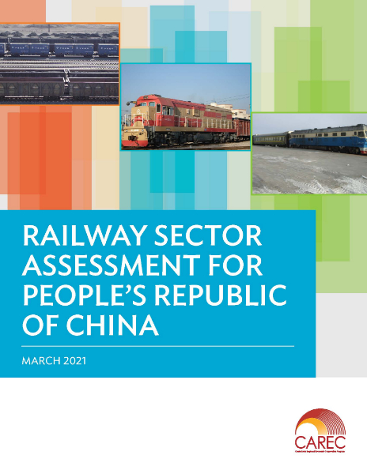
Railways
CAREC overall and 11 national railway assessments (completed)
Traffic Model – tool to support prefeasibility studies
Management support to Kyrgyz and Tajik Railways (completed)
PRC-KGZ-UZB Railway: operational and commercial assessment (ongoing)
Pre-feasibility studies:
Uzbekistan-Turkmenistan Block Train and Ferry Services
Uzbekistan Northwestern International Freight Corridor
Knowledge and capacity development (KCD) support for:
Establishing and operating a railway sales and marketing functions
Establishing accounting standards and systems for railway commercialization
Analytical study for development of rolling stock financing schemes (leasing)

Slide 5
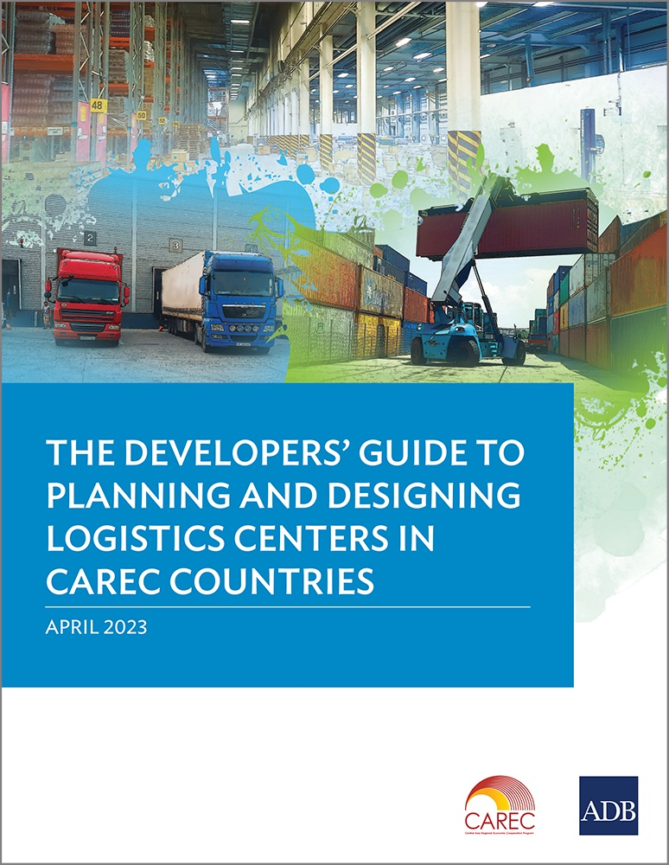
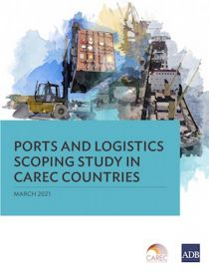
Cross-border Transport and Logistics
Recently completed, ongoing and new projects to improve border crossing points (BCP) in Pakistan, the Kyrgyz Republic, Mongolia, Tajikistan
CAREC reports and manuals: Ports and Logistics scoping study, Guide on Logistics Centers development
Concept development and design for the first joint Border Crossing Point (JBCP) between Georgia and Azerbaijan. Other countries expressed interest in the JBCP concept
CAREC Corridor Management and Monitoring, annual reports and in-depth analysis
Corridor management studies, including assessment of the Middle Corridor

Slide 6
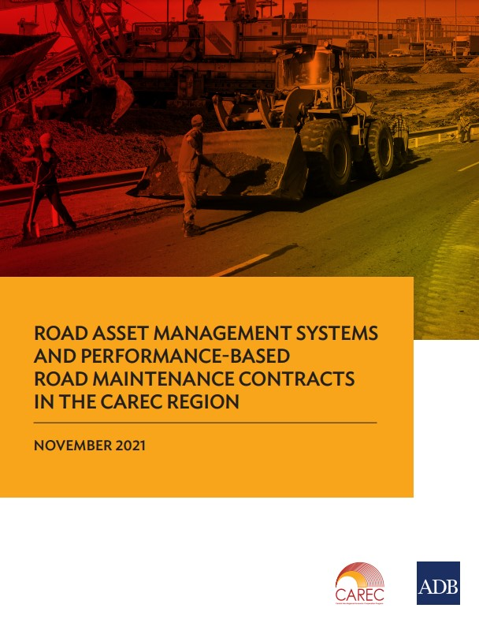
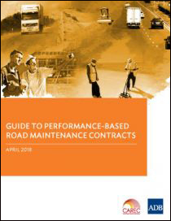
Road Asset Management Systems (RAMS)
Compendium of manuals and reports, regional and national training activities completed, ongoing and planned
Competency in RAMS significantly improved in the CAREC countries, RAMS components are integrated and successfully implemented in many IFI-financed road projects
Basic RAMS data collection and analysis is improving, but progress by country varies greatly – benchmarking and assessment of data collection practices across the countries will continue
Road maintenance remains underfunded, but objective tools for determining right allocation of public funds vs their efficient usage is yet emerging. Knowledge products for the benefit of national policy regulators (including Ministries of Economy, Finance) will be developed and disseminated
Performance-based Maintenance Contracts (PBC) gives good promise of “value-for-money” in road maintenance. Analytical work to learn from exiting PBC contracts and dissemination of best practices will continue.

Slide 7
Road Safety
Compendium of manuals and reports focusing on Road Safety Engineering (RSE) completed
Ongoing development of the RSE manuals VI (Speed Management) and VII (Black Spot management)
Regional and national training activities with support of the CAREC Institute completed, ongoing and planned
Crash data collection and reporting tools will be prioritized
Integration of best practices in road safety engineering, including safety audits and black spot investigations will be supported by the IFI-financed projects

Slide 8
Aviation
In response to the COVID-19 impact on aviation operations, CAREC program conducted the updated aviation study, which pointed at Low-Cost Carrier (LCC) aviation operations and aviation cargo as two potential growth sectors of aviation
The CAREC LCC study was completed and circulated for comments, the draft Aviation Cargo study has been completed before the TSCC meeting and soon will be circulated to the CAREC partners for review and comments
CAREC development partners supported selected CAREC countries with financing airport development projects and master planning of the aviation sector development

Slide 9
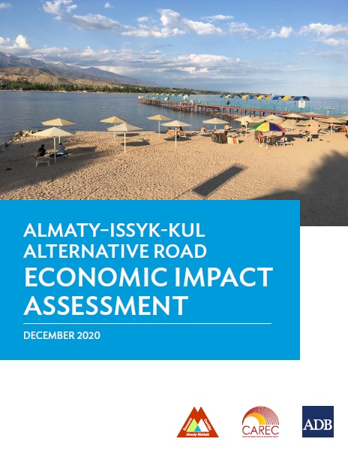
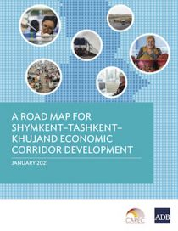
Subregional initiatives
Almaty-Bishkek Economic Corridor (ABEC) development program:
ABEC Regional Improvement of Border Services project
Almaty – Issyk-Kul alternative road
ABEC e-buses
Shymkent-Tashkent-Khujand Economic Corridor (STKEC) development program:
Feasibility studies for trade logistics facilities in Kazakhstan, Uzbekistan and Tajikistan
South Caucasus Gateways project
Regional multimodal transport assessment
Traffic modelling and mapping of various South Caucasus transportation system scenarios
Scoping new transport projects
Traffic study and process analysis for the Joint Border Crossing Point (JBCP) Silk Road between Georgia and Azerbaijan

Slide 10
Thank you!
Please visit our site
www.carecprogram.org

