Slide 1

CAREC Tourism Progress Report
Senior Officials’ Meeting
13-14 June 2023, Tbilisi, Georgia

Slide 2
TA 9776 – Sustainable Tourism Development in the CAREC Region
Approval: 2 Aug 2019
Completion: 31 Dec 2021 (original)
            31 July 2024 (revised)
Budget status (May 2023)
  Total amount: US$ 2.95 million
  Committed: US$ 1.71 million
  Uncommitted: US$ 1.24 million
Notes:
The TA aims to facilitate increased cooperation among CAREC countries to position the region as a globally attractive tourism destination, and has the following outputs.
Output 1: CAREC tourism sector strategy developed, will set out a vision and a roadmap towards 2030, in alignment with CAREC countries’ tourism priorities.
Output 2: Regional tourism investment framework for 2021–2025 prepared, will complement the CAREC tourism strategy, with specific tourism projects to be implemented.
Output 3: Institutional capacity of tourism authorities and exchange of information enhanced, will support conducting workshops and training activities to enhance the capacity of governments for tourism planning and policy making, market research and collection and analysis of tourism statistics, and will promote information-sharing between public and private tourism stakeholders in the region, including through the development of a CAREC tourism portal.
Output 4: Development and implementation of common health and safety protocols and standards in consideration of the effects of the global COVID-19 pandemic on the tourism sector in CAREC countries.
Note: Total amount includes additional financing approved on 31 October 2022 for $750,000. Remaining uncommitted amount will be used to finance ongoing and additional activities outlined in the next slides. Initial TA amount at approval was $2 million. The TA has been extended until July 2024 (final extension).

Slide 3
TA 9776 – Sustainable Tourism Development in the CAREC Region
Status of Implementation
OUTPUT | STATUS
1-2. CAREC tourism strategy 2030 & investment frame-work | CAREC Tourism Strategy 2030 endorsed To be completed: Further content development for the Web portal Definition of Geographic scope of 2 of 4 projects for concept 4 project profiles
3-4 Institutional capacity of tourism authorities | Completed per country: Requests and reception of countries’ tourism-related information for the web portal
4. Common health and safety protocols | Completed activities: (ABEC) Recommendations on new health and safety protocols Capacity-building and skills development activities
5. Enhanced service quality and min. common standards | Completed activities: Accommodation Classification System for ABEC Pilot in Pakistan to measure quality in accommodation and price benchmarking
Notes:
CAREC Strategy 2030 & Investment Framework endorsed by Ministerial Conference in December 2020
Completed activities:
Asset mapping and tourism demand analyses (per country)
Review of institutional structures for tourism development in CAREC countries and analysis of best practices in other countries
Review of Strategies and plans for tourism development (per country)
Legal and Investment frameworks analysis (per country)
Supply-demand analysis of tourism skills in CAREC countries
Marketing, promotion and branding initiatives and analysis (per country)
Stocktaking of past and ongoing initiatives in the tourism and hospitality sector from other development partners
Scope of work of the tourism expert group
Preparation of CAREC tourism strategy 2030
Technical components of the CAREC Tourism virtual portal
Tourism Infrastructure services assessment (per country and cluster)
Consultation workshops with CAREC member countries to identify priority tourism projects for hard and soft infrastructure interventions
Preparation of regional investment framework, 2021–2025 to complement the CAREC tourism strategy
Framework for selection and prioritization of regional projects
Identification of 4 projects for conceptualization
NEXT STEPS
Development of content for the Virtual Portal that allows it to have a minimum quality for launch
Keeping developing the tourist attractions’ content upon launch to keep the portal attractive to visi
Approval of the geographic scope of 2 of the 4 projects for conceptualization
Prepare four project profiles, including project description, implementation period, social and environmental impact assessment, and indicative budget and financing options.
Regional investment framework for 2021–2025 prepared
Framework endorsed together with CAREC Strategy 2030
Completed activities:
Consultation workshops with CAREC member countries to identify priority tourism projects for hard and soft infrastructure interventions
Preparation of regional investment framework, 2021–2025 to complement the CAREC tourism strategy
Framework for selection and prioritization of regional projects
Identification of 4 projects for conceptualization
NEXT STEPS
Approval of the geographic scope of 2 of the 4 projects for conceptualization
Prepare four project profiles, including project description, implementation period, social and environmental impact assessment, and indicative budget and financing options.
3. Institutional capacity of tourism authorities and exchange of information enhanced
STATUS
Completed activities:
Requests for the provision of countries’ tourism-related information for the virtual porta
NEXT STEPS
Development of content for the Virtual Portal that allows it to have a minimum quality for launch
Keeping developing the tourist attractions’ content upon launch to keep the portal attractive to visi
Approval of the geographic scope of 2 of the 4 projects for conceptualization
Prepare four project profiles, including project description, implementation period, social and environmental impact assessment, and indicative budget and financing options.
4. Common health and safety protocols and standards developed and implemented (pilot)
Completed activities:
Review of existing COVID-19 health and safety protocols and standards and provide recommendations on new protocols to be adopted at airports and in travel destinations in KAZ and KGZ under the Almaty-Bishkek Economic Corridor.
Conducted capacity-building and skills development activities for public and private tourism stakeholders in KAZ and KGZ
Implementation of the new joint Accommodation Classification System and common health and safety protocols developed by UNWTO, with a specific focus on training and the recommendations/actions contained in the final training report
4. Common health and safety protocols and standards developed and implemented (pilot)
Completed activities:
Review of existing COVID-19 health and safety protocols and standards, and provide recommendations on new protocols to be adopted at airports and in travel destinations in KAZ and KGZ under the Almaty-Bishkek Economic Corridor
Conducted capacity-building and skills development activities for public and private tourism stakeholders in KAZ and KGZ
Implementation of the new joint Accommodation Classification System and common health and safety protocols developed by UNWTO, with a specific focus on training and the recommendations / actions contained in the final training report
5. Enhanced service quality and minimum common standards adopted
Completed activities:
Development of “Accommodation Classification System for ABEC” including regulations and recommendations for its implementation and enforcement.
Translation of the Classification regulations and recommendations into the legal system of KAZ and KGZ
A pilot project in Pakistan to measure quality in accommodation and price benchmarking based on Artificial Intelligence Tool
Dissemination of the system and promotion to the consumers of KAZ and KGZ
Using the data collected for quality measurement and price benchmark to implement a quality label for accommodation in Pakistan and its promotion to the consumers.

Slide 4
TA 9776 – Sustainable Tourism Development in the CAREC Region
Status of Implementation
OUTPUT | Next Steps
1-2. CAREC tourism strategy 2030 & investment frame-work | Approvals for further content development for the Web portal Approval of the geographic scope of 2 of the 4 projects for conceptualization Prepare 4 project profiles
3-4 Institutional capacity of tourism authorities | Conduct capacity-building activities Public-private dialogue and exchange of experiences Identify options and develop a comprehensive plan for maintaining and updating the virtual portal beyond the TA implementation period Launch tourism portal
4. Common health and safety protocols | Implementation and promotion of the new joint Accommodation Classification System and common health and safety protocols developed for ABEC to the consumers of KAZ and KGZ
5. Enhanced service quality and min. common standards | Using the data collected for quality measurement and price benchmark to implement a quality label for accommodation in Pakistan and its promotion to the consumers.
Notes:
CAREC Strategy 2030 & Investment Framework endorsed by Ministerial Conference in December 2020
Completed activities:
Asset mapping and tourism demand analyses (per country)
Review of institutional structures for tourism development in CAREC countries and analysis of best practices in other countries
Review of Strategies and plans for tourism development (per country)
Legal and Investment frameworks analysis (per country)
Supply-demand analysis of tourism skills in CAREC countries
Marketing, promotion and branding initiatives and analysis (per country)
Stocktaking of past and ongoing initiatives in the tourism and hospitality sector from other development partners
Scope of work of the tourism expert group
Preparation of CAREC tourism strategy 2030
Technical components of the CAREC Tourism virtual portal
Tourism Infrastructure services assessment (per country and cluster)
Consultation workshops with CAREC member countries to identify priority tourism projects for hard and soft infrastructure interventions
Preparation of regional investment framework, 2021–2025 to complement the CAREC tourism strategy
Framework for selection and prioritization of regional projects
Identification of 4 projects for conceptualization
NEXT STEPS
Development of content for the Virtual Portal that allows it to have a minimum quality for launch
Keeping developing the tourist attractions’ content upon launch to keep the portal attractive to visi
Approval of the geographic scope of 2 of the 4 projects for conceptualization
Prepare four project profiles, including project description, implementation period, social and environmental impact assessment, and indicative budget and financing options.
Regional investment framework for 2021–2025 prepared
Framework endorsed together with CAREC Strategy 2030
Completed activities:
Consultation workshops with CAREC member countries to identify priority tourism projects for hard and soft infrastructure interventions
Preparation of regional investment framework, 2021–2025 to complement the CAREC tourism strategy
Framework for selection and prioritization of regional projects
Identification of 4 projects for conceptualization
NEXT STEPS
Approval of the geographic scope of 2 of the 4 projects for conceptualization
Prepare four project profiles, including project description, implementation period, social and environmental impact assessment, and indicative budget and financing options.
3. Institutional capacity of tourism authorities and exchange of information enhanced
STATUS
Completed activities:
Requests for the provision of countries’ tourism-related information for the virtual porta
NEXT STEPS
Development of content for the Virtual Portal that allows it to have a minimum quality for launch
Keeping developing the tourist attractions’ content upon launch to keep the portal attractive to visi
Approval of the geographic scope of 2 of the 4 projects for conceptualization
Prepare four project profiles, including project description, implementation period, social and environmental impact assessment, and indicative budget and financing options.
4. Common health and safety protocols and standards developed and implemented (pilot)
Completed activities:
Review of existing COVID-19 health and safety protocols and standards and provide recommendations on new protocols to be adopted at airports and in travel destinations in KAZ and KGZ under the Almaty-Bishkek Economic Corridor.
Conducted capacity-building and skills development activities for public and private tourism stakeholders in KAZ and KGZ
Implementation of the new joint Accommodation Classification System and common health and safety protocols developed by UNWTO, with a specific focus on training and the recommendations/actions contained in the final training report
4. Common health and safety protocols and standards developed and implemented (pilot)
Completed activities:
Review of existing COVID-19 health and safety protocols and standards, and provide recommendations on new protocols to be adopted at airports and in travel destinations in KAZ and KGZ under the Almaty-Bishkek Economic Corridor
Conducted capacity-building and skills development activities for public and private tourism stakeholders in KAZ and KGZ
Implementation of the new joint Accommodation Classification System and common health and safety protocols developed by UNWTO, with a specific focus on training and the recommendations / actions contained in the final training report
5. Enhanced service quality and minimum common standards adopted
Completed activities:
Development of “Accommodation Classification System for ABEC” including regulations and recommendations for its implementation and enforcement.
Translation of the Classification regulations and recommendations into the legal system of KAZ and KGZ
A pilot project in Pakistan to measure quality in accommodation and price benchmarking based on Artificial Intelligence Tool
Dissemination of the system and promotion to the consumers of KAZ and KGZ
Using the data collected for quality measurement and price benchmark to implement a quality label for accommodation in Pakistan and its promotion to the consumers.

Slide 5
CAREC Tourism Strategy Project Roadmap
Stage I
Strategic Analysis
Stage II
Strategy & Investment Plan
Stage III
Project Profiles
Report on Institutional Structures, strategies and plans.
Report on investment framework and legal assessment
Report on Asset Mapping
Report on Demand Analysis
Report on Marketing and Promotion
Report on Skills Gaps
CAREC Tourism Strategy and investment framework for consultation
A - Improvement of the infrastructure and services, environmentally sustainable concepts, including building units based on renewable energy sources in pilot areas and a network of public eco-toilets in remote areas.
B - Upgrading and rehabilitating historical and culturally relevant tourist attractions in integration with urban planning and development.
C - Development of a common registry of tourism assets and data collection, their content, and their management.
D - Branding, strategy, planning, budgeting, and funding sources for implementing the common brand “Visit Silk Road”, integrating additional features for the CAREC tourism portal, and developing a “CAREC tourism service quality label innovative system”.
Where?
CAREC Tourism Strategy and investment framework for approval
Report on Tourism Infrastructure , Services, and prioritization
CAREC Tourism Web portal
Main common tool
5

Slide 6
TA 9776 – Sustainable Tourism Development in the CAREC Region
Additional Activities
OUTPUT | ACTIVITY
Output 3. Content Development for the CAREC Tourism Portal | Development and improvement of the creative content of the CAREC Tourism Portal in coordination with CAREC countries. Tourist attractions (+1305) and Institutional
CAREC Tourism Sustainability and funding | Development of proposals and feasibility analyses on initiatives suitable for generating own revenues for the CAREC Tourism, ensuring its sustainability, while implementing the CAREC Tourism Strategy 2030,
Output 3. CAREC Designated Certification Course in Tourism | Development of certification courses in coordination with GIZ: self-paced online learning format complemented with onsite training (where possible) on specific topics around regional cooperation in tourism.
Output 3 and 4. Visa Facilitation Study and Travel Bubble | Visa Facilitation Study for the CAREC Region: assess current visa policy procedures and regulations and recommend areas for improvement based on global best practices and case studies with potential pilot programs (Case Study of East African Federation Tourist Visa System). Travel Bubble: (i) promote adoption of standardized safety and health protocols among CAREC DMCs to be prepared for unexpected public health risks and challenges; and (ii) share lessons from the “travel bubble” case study between Kazakhstan and the Kyrgyz Republic among other CAREC DMCs.

Slide 7

TA 9776 – Sustainable Tourism Development in the CAREC Region
4 projects for conceptualization
Project
Improve infrastructure and services, environmentally sustainable concepts, including building units based on renewable energy sources in pilot areas and a network of public eco-toilets in remote areas.

Slide 8
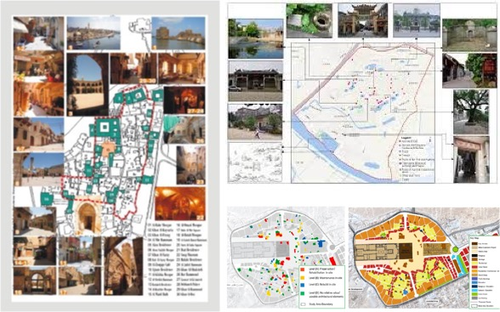
TA 9776 – Sustainable Tourism Development in the CAREC Region
4 projects for conceptualization
Project
Upgrading and rehabilitating historical and culturally relevant tourist attractions in integration with urban planning and development

Slide 9
TA 9776 – Sustainable Tourism Development in the CAREC Region
4 projects for conceptualization
Project
Development of a common registry of tourism assets and data collection, their content, and their management
B2B/ B2C
Private Sector Development
Quality label
Tourism Statistics
Attractions database
Commonly developed and shared regulations
Accommodation database
Adoption of best practices
Tour Operators database

Slide 10

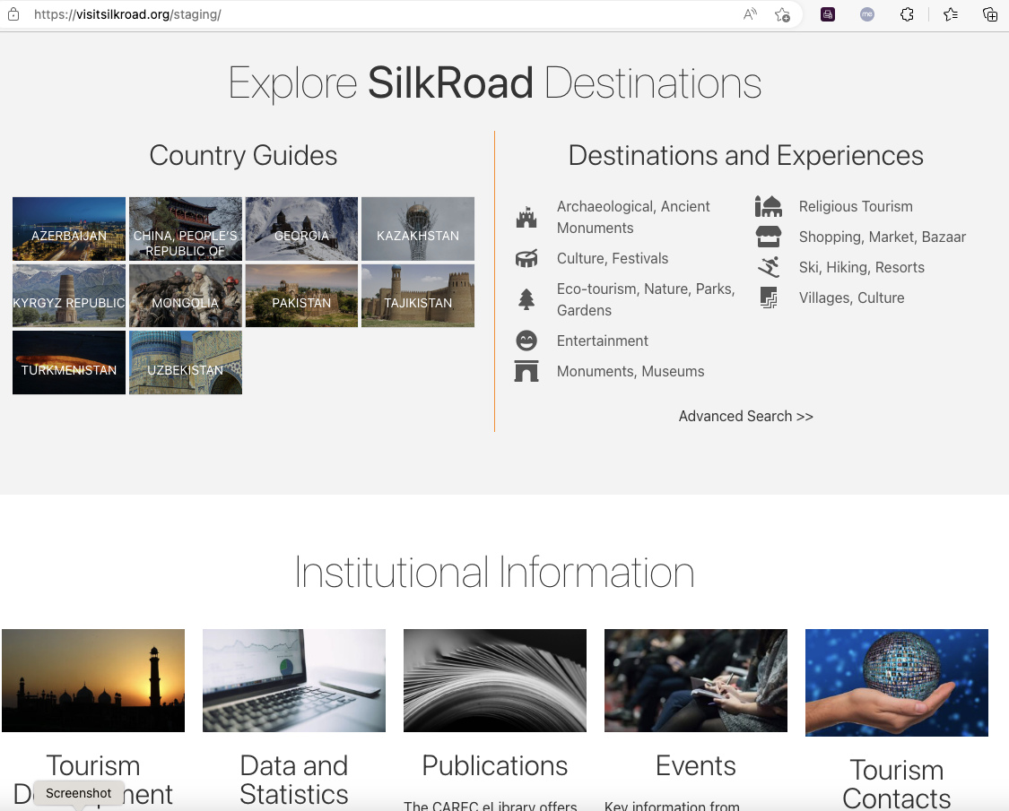
TA 9776 – Sustainable Tourism Development in the CAREC Region
4 projects for conceptualization
Project
Branding, strategy, planning, budgeting, and funding sources for implementing the common brand “Visit Silk Road”, integrating additional features for the CAREC tourism portal, and developing a “CAREC tourism service quality label innovative system

Slide 11
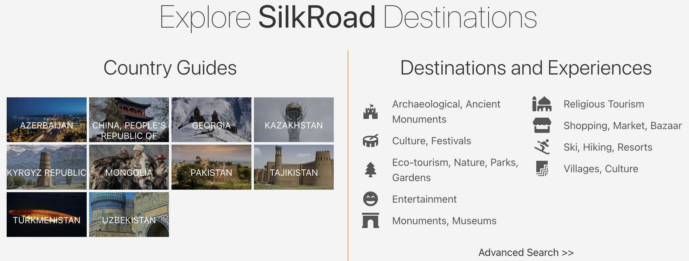
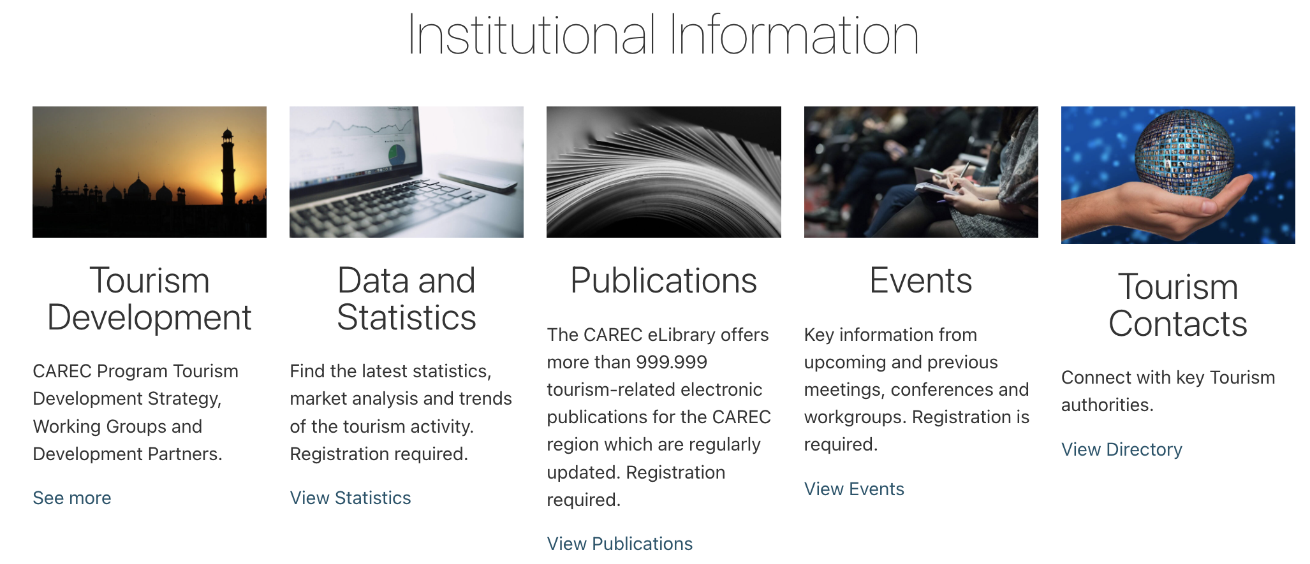
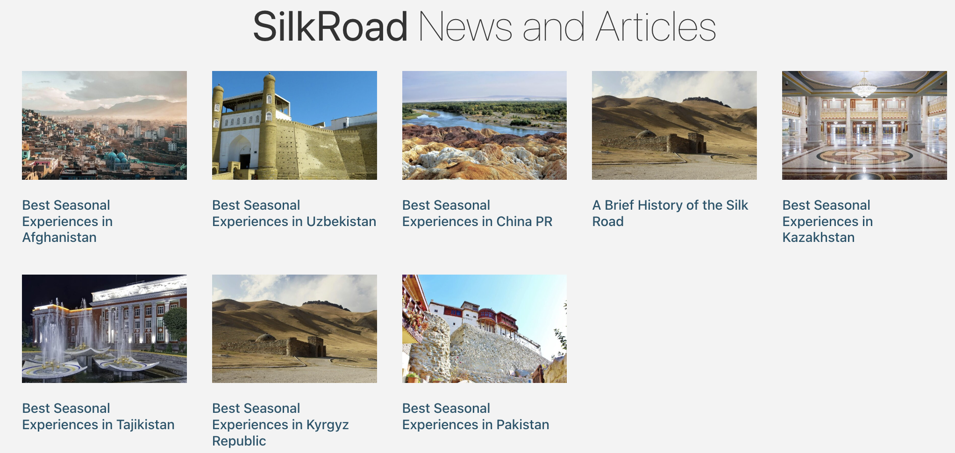

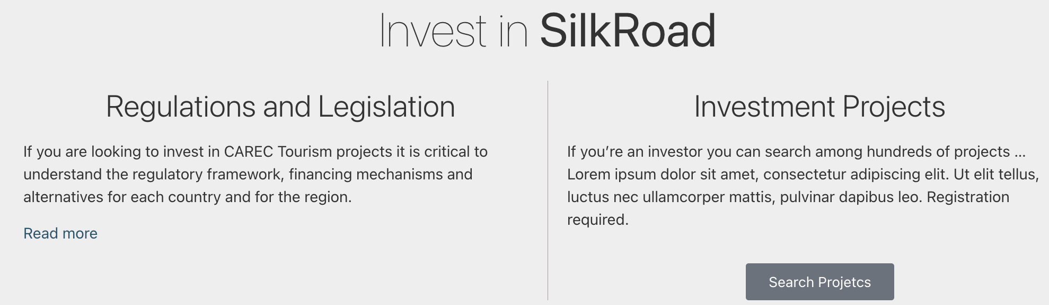
TA 9776 – Sustainable Tourism Development in the CAREC Region
Visitsilkroad virtual portal concept
Maximization of targeted traffic, further channelled to National Institutional pages and Private Sector Tourism Sites

Slide 12
Thank you

