Slide 1
CAREC Integrated Trade Agenda (CITA) 2030—
Implementation and Midterm Review
Emma Fan
Director, Public Management, Financial Sector and Regional Cooperation Division, East Asia Department
Asian Development Bank

Slide 2
Outline
1. Trade Landscape
2. Progress on the CAREC Integrated Trade Agenda 2030 and Rolling Strategic Action Plan
3. Matters for Senior Officials Meeting Guidance and Endorsement

Slide 3
CAREC Trade Performance and Outlook
Group / Year | Merchandise exports (% growth) |  |  |  |  | Merchandise imports (% growth)
 | 2019 | 2020 | 2021 | 2022 | 2023* | 2019 | 2020 | 2021 | 2022 | 2023*
Developing Asia | -2.4 | -0.7 | 30.5 | 8.2 | 8.6 | -3.6 | -6.4 | 35.7 | 10.1 | 10.4
CAREC-10 | 1.1 | -12.0 | 22.8 | 29.6 | 11.0 | 3.2 | -12.5 | 18.8 | 24.6 | 10.4
Source: ADB, Asian Development Outlook (ADO) 2023 (April 2023). 2023 forecasts are from ADO 2022.
"Trade continues to be a force for resilience in the global economy, but it will remain under pressure from external factors in 2023. This makes it even more important for governments to avoid trade fragmentation and refrain from introducing obstacles to trade.” —WTO
3
Notes:
NOTE: These are weighted averages. GDP for 2021 was used for 2022. 2023 data are forecasts made in ADO 2022.
Merchandise exports and imports of CAREC10 first shrank in 2020 owing to the pandemic, then recovered in 2021 and expanded even further in 2022.
Developing Asia exports and imports performed better than CAREC10 in 2020 and 2021, but the tables were turned in 2022 and by a large margin.

Slide 4
Trade’s Contribution to CAREC Economies
Trade in goods share in GDP improved since 2016.
Trade in services' contribution was constant, dropped slightly after 2019
Trade in goods is expanding faster than trade in services
Pre-CITA
Pre-COVID
Recovery
Notes: CAREC-10 excludes PRC; CAREC-11 includes PRC. Georgia joined CAREC in 2016. Data excludes informal trade.
Source: World Bank. World Development Indicator
4
CAREC Senior Officials’ Meeting | 13-14 June 2023, Tbilisi, Georgia
Notes:
ABOUT THE DATA: CAREC10 excludes PRC; CAREC11 includes PRC. From 10 CAREC members in 2010, they became 11 in 2016 when Georgia joined. The data excludes informal trade, which is very active in border areas. [Source of data is WDI]
CAREC10 and CAREC11 goods trade as a proportion of GDP ranged from 32% to 50% for the period 2010-2021.
The shares dropped gradually from 2010 to 2015 when a steep slump occurred due to the mutually reinforcing factors of lower commodity prices and weak demand in emerging Asian economies, in turn because of the gradual shift away from industrial production and investment. CAREC10 shares grew back and may hit previous levels if the trajectory is sustained. CAREC11 shares remained the same with a slight upward movement in 2021, indicating a recovery from the pandemic.
Trade in goods has been driven by resource-based commodities. There is growing demand for consumer goods exports, e.g. food, but trade restrictions are a challenge.
Services trade as a proportion of GDP has ranged from 7.7% - 10.5% for CAREC10, and 4.3% - 6.5% for CAREC11.
The shares have been relatively constant, in contrast to the global trend of a gradual increase, but dipped in 2020 as a result of the pandemic.
CAREC10 services trade as a proportion of total trade in goods and services has ranged from 14% - 22%, while that of CAREC11 ranged from 11% - 15%. The CAREC10 figures compare well with the world average of 22%]
Trade in services, especially logistics and tourism, was greatly affected by COVID-19 pandemic

Slide 5
Top CAREC exports continue to be: oils, petroleum gases, gold metals, copper ores and concentrates, refined copper, coal, ferro-alloys Declining share of top 5 commodities indicates diversification in major merchandise exports Top 5 exports account 55%
Diversification Indicators
Pre-CITA
Pre-COVID
Recovery
Notes: Data show CAREC-10, which excludes PRC. Top 5 refers to top 5 6-digit HS code export.
Source: UN COMTRADE; UNCTADStat
Notes:
Note that this is top 5 for CAREC10. Not individual countries.
This chart is complemented by the export diversification index (which measures the degree of concentration of goods exported, so that a perfectly diversified export portfolio will yield an index close to zero), which improved slightly from 0.78 in 2017 to 0.77 in 2021. It had first worsened to 0.796 in 2020 when the COVID-19 pandemic struck.
2017:
Oils; petroleum oils and oils obtained from bituminous minerals, crude
Petroleum gases and other gaseous hydrocarbons; in gaseous state, natural gas
Metals; gold, semi-manufactured
Copper ores and concentrates
Copper; refined, unwrought, cathodes and sections of cathodes
2021:
Oils; petroleum oils and oils obtained from bituminous minerals, crude
Petroleum gases and other gaseous hydrocarbons; in gaseous state, natural gas
Metals; gold, semi-manufactured
Copper ores and concentrates
Coal; bituminous, whether or not pulverised, but not agglomerated

Slide 6
Rising e-commerce, potential for digital trade
High percentage of Individuals using internet per population; relatively higher than global average (54%)
Online shoppers increasing in 7 CAREC
Uneven distribution, weak internet quality in some countries
Sources: UN E-Government Survey, International Telecommunications Union, and World Bank Findex.
6
Notes:
SOURCES OF DATA: ITU and WB Findex, respectively
Internet use is widespread in 7 CAREC countries, with estimates ranging from 73% to 91%. This compares very well with the global average of 54% (from UN E-Government Survey 2020). However, lack of access and expensive and poor quality of internet connection continue to be problems, even for countries with high internet penetration.
The proportion of population aged 15 and above that used the internet or mobile phone to make an online purchase has risen markedly from 2017 to 2021. The figure rose up to 5 times in some CAREC countries. According to the WB Findex, in developing countries excluding PRC, 15% reported having bought something online. At least 3 CAREC countries’ estimates exceeded this average.
Cross-border e-commerce (CBEC) is one of the fastest growing segments of global trade. UNCTAD estimated nearly 1.5 billion online consumers in 2019, and 360 million cross-border e-shoppers. Cross-border B2C sales amounted to $440 billion. https://unctad.org/press-material/global-e-commerce-jumps-267-trillion-covid-19-boosts-online-retail-sales
A January 2022 Bloomberg report estimated the CBEC market to be $532 billion in 2020 and projected it to reach $1.5 trillion by 2027, at a CAGR of 15.5% (https://www.bloomberg.com/press-releases/2022-01-19/cross-border-e-commerce-market-size-to-reach-usd-1508700-million-by-2027-at-cagr-15-5-valuates-reports)
Statista estimates CBEC (B2C) to be $785 billion in 2021 https://www.statista.com/statistics/1296796/global-cross-border-ecommerce-market-value/ It projected CBEC to account for 22% of e-commerce shipments of physical products, up from 15% in 2015.

Slide 7
Asia-Pacific Regional Cooperation and Integration Index (ARCII)
CAREC started from a low base of performance in 2006
CAREC integration improved the most across 6 groups, though still far from that of ASEAN and GMS
However, among the 8 dimensions of ARCII, trade and investment improved the least in CAREC
Notes: ASEAN= Association of Southeast Asian Nations; GMS = Greater Mekong Subregion; CAREC = Central Asia Regional Economic Integration; BIMSTEC = Bay of Bengal Initiative for Multi-Sectoral Technical and Economic Cooperation; SAARC = South Asian Association for Regional Cooperation; SASEC = South Asia Subregional Economic Cooperation.
Source: ADB. Asia-Pacific Regional Cooperation and Integration Index
https://aric.adb.org/database/arcii
Notes:
ARCII captures the extent of integration in the 8 dimensions of: (1) trade and investment, (2) money and finance, (3) regional value chain, (4) infrastructure and connectivity, (5) people and social dimensions, (6) institutional arrangements, (7) technology and digital connectivity, and (8) environmental cooperation. Higher values denote greater integration.
Indicators that comprise Trade and Investment are intraregional goods exports and imports as % of GDP, intraregional trade share, intraregional FDI inflows and outflows as % of GDP.]
CAREC posted a 19% increase in ARCII from 2006 to 2020. However, among the 8 dimensions of ARCII, trade and investment improved the least in CAREC. Nevertheless, regional value chains is strong, which is related to trade and investment.
The shock brought by COVID-19 is mainly seen in regional value chain, people and social integration, and infrastructure and connectivity, which declined across many groupings. However, all became more integrated in technology and digital connectivity.

Slide 8
CPMM Trade Facilitation Indicators
Lower delays
Reduced costs
Faster transport
2022 data show improvement in time and cost indicators for road and rail transport compared to 2021.
Significant needs for continued progress
Road Transport
$, per 500km, per 20 tons
hours
$ US
Km/h
Rail Transport
Speed without delay
$, per 500km, per 20 tons
Speed with delay
hours
$ US
Km/h
Note: BCP = border crossing point, CPMM = corridor performance measurement and monitoring, TFI = trade facilitation indicator
Source: ADB Data Library. CAREC Program Corridor Performance Measurement and Monitoring.
TFI1 Time taken to clear a BCP | TFI2 Cost incurred at BCP | TFI3 Cost incurred to travel a corridor section | TFI4 Speed to travel on CAREC corridors
8
Notes:
Using the results of the CAREC Corridor Performance Measurement and Monitoring (CPMM), the Progress in Trade Facilitation in CAREC Countries: A 10-Year CPMM Perspective identified outstanding challenges and opportunities in trade facilitation and prescribed possible actions to remove important structural barriers to enable the efficient flow of goods and unlock growth for the region. In August 2022, ADB held a conference to present preliminary findings and launch the report. Following a call for proposals in February 2022, the conference also presented selected studies that employ CPMM data and demonstrate how it can be used for policy formulation in the region and for deepening academic research in relevant areas

Slide 9
Trends in Trade
Achievements
Trade in goods as a proportion of GDP has improved since 2016,
Lower shares of the top 5 commodities in total exports indicates diversification in the export basket
CAREC integration improved the most across 6 regional groups
Rising ecommerce
2022 CPMM data show improvement in time and cost indicators for road and rail transport compared to 2021
Challenges
Trade in services as a proportion of GDP remained constant.
Top 5 commodities in total exports still above 50%
CAREC far from that of ASEAN and GMS. Trade and investment least integrated among the 8 indicators.
Uneven ecommerce adoption, weak internet quality in some countries, digital transformation required
Significant scope in reducing time and cost, and improve the speed of goods across CAREC corridors

Slide 10
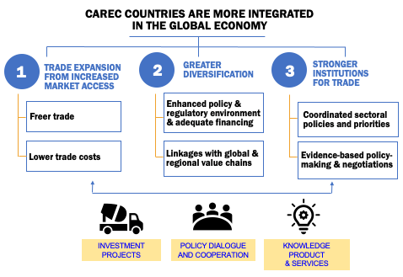
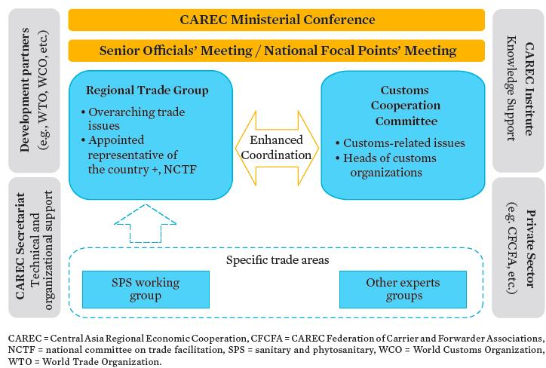
CAREC Integrated Trade Agenda (CITA) 2030
Notes:
CAREC 2030, the long term strategy, seeks to create an open and inclusive regional cooperation platforms that connects people, policies and projects for sustainable development. In support of this, CITA 2030 seeks to assist CAREC members integrate further into the global economy, enhance their growth potential and improve their living standards. It consists of 3 pillars.
CITA institutions are:
Customs Cooperation Committee (CCC) - established in 2002, the body responsible for all customs-related issues under CAREC
Regional Trade Group (RTG) – established in 2018 as the lead with full operational authority, and coordinating and consultative body for the trade sector
SPS Regional Working Group – established in 2019 as the policy-making body that implements the Common Agenda for the Modernization of SPS Measures for Trade, develops the annual SPS work program based on national plans and the CITA Rolling Strategic Action Plan and coordinates with the RTG.

Slide 11
CITA 2030 key achievements in the last 5 years: participation in international agreements
World Trade Organization Trade Facilitation Agreement
100% implementation rate of Trade Facilitation Agreement for the PRC, GEO, and KAZ; 85% average for the other four CAREC countries
WTO Accession of remaining CAREC members
UZB accelerates WTO accession talks
AZE resumes Working Party in 2023
TKM as acceding WTO member in Feb 2022, from observer status in July 2020
International Conventions Promoting Trade
UZB acceded to the International Plant Protection Convention, first CAREC to exchange e-Phyto
5 CAREC (AZE, PRC, MON, TAJ, TKM) sign UN Framework Agreement on Facilitation of Cross-Border Paperless Trade in Asia and the Pacific; 3 (AZE, MON, PRC) are parties to the UN Convention on the Use of Electronic Communications in International Contracts

Slide 12
CITA 2030 key achievements in the last 5 years:
Investment projects that facilitate trade
Regional Improvement of Border Services
KGZ and TAJ border infrastructure upgraded; PAK for completion in 2023
TAJ and PAK launched national single window (NSW), protocol for MON NSW approved
New investment for MON, with pilot smart border and one-health at the borders approach
upgrade of border facilities
National single window
pilot initiatives
mentoring, advisory, capacity building
policy & regulatory reforms
institutional coordination
Cross-border Economic Cooperation Zone
Parallel investment for MON and PRC, including capacity-building for bilateral committees
Regional Upgrade of SPS Measures for Trade
Upgrade of quarantine and inspection facilities and merger of SPS and customs inspection function In MON
Notes:
Examples of investment projects under CITA 2030
Regional improvement of border services (RIBS) projects
EARD spearheaded the conceptualization of RIBS projects under its CAREC trade facilitation TRTA. In 2013 and under One-ADB, EARD staff is co-team leader for the RIBS project in Kyrgyz Republic and Tajikistan. In 2016, the RIBS Project was approved in Mongolia, with additional financing approved in 2019. EARD continues to share the lessons learned from RIBS project with the rest of CAREC members for potential replication.
Regional Upgrade of SPS Measures for Trade
EARD through its CAREC program has supported the adoption of Common Agenda for Modernization of SPS Measures for Trade. Under this initiative, an investment project in Mongolia was approved in 2016 which aims to improve inspection and control systems that will increase agri-food trade and help diversify the economy, through building or rehabilitate laboratories and provision of new diagnostic equipment. This will decentralize testing and diagnostic capacity and support early disease detection at the borders. CAREC trade TA has a broad range of support for ongoing and potential SPS projects.

Slide 13
CITA 2030 key achievements in the last 5 years: strengthening institutions and partnerships
Regional Policy Dialogues
Development Partners Engagement
CAREC Trade Week: Enhancing Cooperation in Digital Trade (2021-2022)
CAREC Digital Trade Forum
CAREC Sanitary and Phytosanitary Measures Week (2021)
CAREC Customs Webinars
CAREC FTA Workshop Series
Long standing cooperation and partnership with WTO on accession, with WOAH, EPPO, IPPC, and WTO on SPS measures, with WCO on customs matters
TA co-financing from PRCF, EAKPF, UK-ARTCF
Joint capacity building with UNESCAP, UNCITRAL, ICC, and UNECE
Joint events with CAREC Institute, RKSI
MOU with Korea Customs Service
Joint webinar and study tours with USAID and US Department of Commerce
Regular communications, coordination and information-sharing with World Bank, ITC, GIZ, EU, and others to create synergies
Institution building
South-South knowledge-sharing
Strengthened ties and goodwill, a foundation for regional cooperation
Coordinated priorities and policies
Enhanced trade capacities
Notes: EAKPF = Rep of Korea e-Asia and Knowledge Partnership Fund; EPPO = European and Mediterranean Plant Protection Organization; EU = European Union; GIZ = Deutsche Gesellschaft fur Internationale Zusammenarbeit; ICC = International Chamber of Commerce; IPPC = International Plant Protection Convention; ITC = International Trade Centre; PRCF = PRC Poverty Reduction and Regional Cooperation Fund; RKSI = Regional Knowledge Sharing Initiative; UNCITRAL = UN Commission on International Trade Law; UNECE = UN Economic Commission for Europe; UNESCAP = UN Economic and Social Commission for Asia and Pacific; USAID = US Agency for International Development; WOAH = World Organization for Animal Health
Notes:
Institution Building
Regular, frequent, and continuous interaction among countries, like a trade transaction, strengthens ties and builds trust and goodwill, the very foundation for regional cooperation
Policy discussions enable better understanding of members' national objectives and constraints and determination of regional priorities
Seminars and workshops expose members to international standards, best practice, and lessons from global experience
Accelerating Digital Trade
CAREC countries have intensified their efforts to maximize the use of digital technologies to transform trade and promote economic opportunities. To support them, CAREC trade TA has been expanded to help establish mechanisms to accelerate digital trade. Specifically, the TA will conduct business process analysis, feasibility or scoping studies for CAREC countries to digitize trade (e.g., use of blockchain, artificial intelligence, e-certification, e-payment, or cloud platform); support discussions and provide technical assistance to a bilateral or subregional agreement or arrangement between CAREC countries that aims to promote digital trade cooperation and/or accession of CAREC members in relevant international conventions; and establish a Digital Trade forum, network or alliance between public and private stakeholders in the CAREC region.

Slide 14
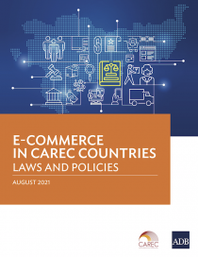
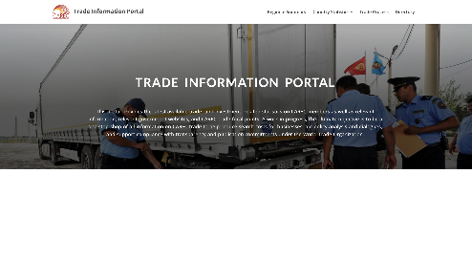
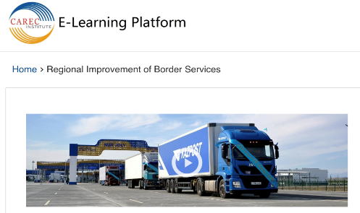
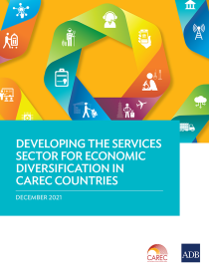
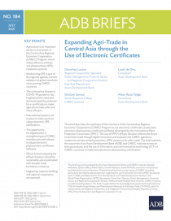
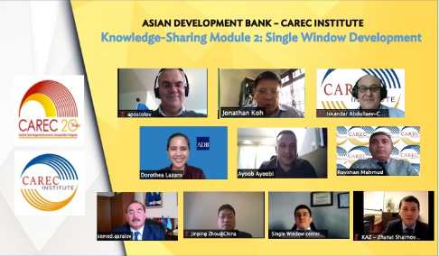
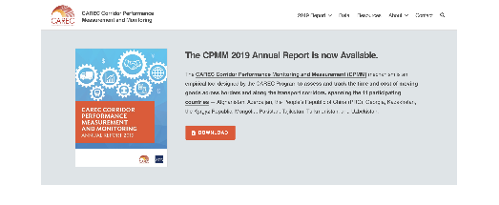
CITA 2030 key achievements in the last 5 years:
Expanding knowledge
Key Trade Publications
CAREC Trade Information Portal, CPMM database
Knowledge-Sharing Modules on CAREC Trade
https://elearning.carecinstitute.org
Notes:
KPs
Technical Study: eCommerce in the CAREC Region: Laws and Policies
Technical Study: Advancing Economic Diversification in CAREC Countries through the Development of the Services Sector
Technical Study: CAREC Corridor Performance Measurement and Monitoring 2020 Annual Report
Brief: Expanding CAREC Agri-Trade through the Use of Electronic Certificates
CAREC Trade Information Portal
The portal provides the latest available trade- and investment- related statistics on CAREC members as well as relevant information, relevant government websites, and CAREC trade focal points. A work in progress, the ultimate objective is to be a one-stop shop of all information on CAREC trade to help reduce search costs for businesses, aid policy analysis and dialogues, and support compliance with transparency and publication commitments under the World Trade Organization.
CAREC Program Corridor Performance Measurement and Monitoring Database
The CPMM database offers a time-series data (2010-2020) on trade facilitation indicators. It measures: (i) time taken to clear a border-crossing point (BCP), (ii) cost incurred at a BCP, (iii) average cost incurred to travel a given corridor, and (iv) average speed to travel along CAREC corridors. These indicators are available at the regional, country, and corridor level, by road and rail transport. At BCP-level, time spent and payments made (official and unofficial) are recorded by activity. The list of activities encompasses all anticipated checks and procedures, both at BCPs and at intermediate stops along the transit corridor. Summary statistics such as average and median are also available.
Knowledge-Sharing Modules on Trade
Two sets of modules have been developed by ADB and CAREC Institute. One on RIBS project and National Single Window establishment from country experiences and development partners perspectives. The other module is on digital sanitary and phytosanitary measures (SPS). The modules are available in both English and Russian languages in the CAREC Institute’s E-Learning Platform. As part of blended-learning approach, CAREC officials who have taken the modules at their convenient time will be invited to join a live or face-to-face workshops or seminars to be organized in 2022/2023.

Slide 15
Recent Activities (July 2022 – May 2023)
3 annual CAREC meetings supported (RTG, CCC, SPS RWG)
15 regional dialogues/webinars, 15 national trainings/ workshops
Over 900 participants from CAREC DMCs and stakeholders
Quarterly newsletter: CAREC Trade Insights and News launched in 2022
Notes:
It is noteworthy that all indicators have continued to improve post-pandemic.
Trade in fuels within CAREC as a % of GDP returned to its 2019 level.
Trade in non-fuels as a % of GDP even surpassed pre-pandemic levels. Trade in non-fuels with the rest of the world, in addition, surpassed the 2023 target.
The share of top 5 exports in total exports declined, indicating greater diversification in the export basket. The figure is also very close to the 2023 target.

Slide 16
3rd Sanitary and Phytosanitary Measures Regional Working Group Meeting (January 2023)
The SPS RWG members agreed to:
Facilitate trade and continue modernizing SPS measures
Implement reforms to align with WTO agreement, integrate global standards, and increase market access
Upgrade laboratories and inspection facilities
Leverage digital solutions (e.g., ePhyto, animal identification and traceability)
Enhance risk management and coordination among SPS agencies and Customs
Adopt a holistic approach and strengthen cross-sectoral linkages to address emerging issues
One-Health Strategy, Agriculture and Food Security Framework, Digital Strategy, Climate Change Vision
Notes:
The SPS Regional Working Group agreed to continue modernizing SPS measures to address 3 trade principles: efficiency, safe trade, and market access for agriculture products.
The working group agreed to adopt digital innovations to achieve efficiency, including in inspection and clearance of goods at borders through digital certification such as the ePhyto solutions hosted by the International Plant Protection Convention; animal identification and traceability, and food traceability systems. Uzbekistan’s Agency for Plant Protection and Quarantine (APPQ) proposed to host the CAREC regional conference on digital phytosanitary certification (scheduled in September 2023). As part of the trade digitalization initiative under the CAREC Integrated Trade Agenda (CITA) 2030, the conference will (i) promote digital phytosanitary certification; (ii) showcase Uzbekistan’s best practices and the integration of its digital phytosanitary certification into the ePhyto system; and (iii) deliberate on activities to support CAREC countries in trade digitalization.
Safe trade is important for the stability of supply chains. In this regard, the SPS work needs to focus on implementing risk-based measures and improving risk management through coordination between Customs and SPS agencies. Georgia and the PRC have demonstrated this in the region.
Increasing market access remains an important goal for CAREC to harness trade in agriculture. Establishment of pest free areas and animal disease-free zones will support countries’ negotiations to export products, especially to developed markets.
Linking SPS work with other CAREC sectors such as health, agriculture, digitalization and climate change will allow for a more holistic approach to common issues.

Slide 17
22nd Customs Cooperation Committee Meeting (9-10 June 2023)
The CCC members;
Endorsed the CCC 2023-2024 workplan
Adopted a Joint Statement promoting customs digitalization and green customs initiatives
Agreed to push forward the pilot phase of the CAREC Advanced Transit System (CATS) and Information Common Exchange (ICE)
Agreed to implement Joint Action Plan 2024-2026 between ADB and Korea Customs Service
Identified focus on priority areas of organizational development, use of technology, and providing efficient services

Slide 18
Regional Trade Group and Customs Cooperation Committee Joint Meeting (12 June 2023)
The joint RTG-CCC meeting:
Endorsed the progress of implementation of CITA 2030 and encouraged members to sustain the momentum of keeping trade open, efficient and safe and accelerate efforts to promote digital trade
Welcomed the trade-related recommendations of the ADB’s independent evaluation report on CAREC program, particularly (i) strengthening support for investment climate and trade policy reforms, (ii) modernizing border crossing points and customs processes.
Endorsed the CITA Rolling Strategic Action Plan 2023-2025 and proposals for new regional KSTA to support CITA 2030 implementation
Endorsed the Terms of Reference for CITA 2030 Midterm Review

Slide 19
CITA 2030: Midterm Review in 2024
Independent Evaluation of ADB Support for the CAREC Program, 2011-2021
Need to strengthen support for investment climate and trade policy reforms, modernize border crossing points and customs processes, develop multimodal corridor network, support climate change mitigation and adaption, and adopt better results monitoring
CITA 2030
Mandated midterm review in 2024. TOR is prepared. Inception/Consultation Paper to be submitted to RTG and NFP in Sep/Oct 2023
Objective: Ensure that CITA is responsive to emerging needs and consistent with the evolving priorities of CAREC member countries.
Accelerate digital transformation and promote sustainable, safe and inclusive trade

Slide 20
For SOM Guidance and Endorsement to 22nd Ministerial Conference
Be updated about the overall progress of CITA 2030, CAREC Trade Sector Report, and the CAREC trade sector deliverables for 2030:
CAREC Digital Trade Forum in Georgia in September/October 2023
Regional ePhyto Conference in Uzbekistan in September 2023
2. Endorse CITA 2030 Rolling Strategic Action Plan 2023–2025
3. Provide guidance and/or endorse the TOR for CITA 2030 Midterm Review

