Slide 1
CAREC 2030 Operational Cluster 1
Economic and Financial Stability
CAREC Senior Officials’ Meeting
13-14 June 2023
Tbilisi, Georgia

Slide 2
Economic and Financial Stability Cluster
Introduction & Initiatives
Objective: Increased regional macroeconomic stability, improved investment, and financial integration
Increased regional macroeconomic stability- Annual High Level Policy Dialogue on Fiscal Policy and Financial Stability
Improved investment in connection with Infrastructure and Connectivity Cluster objective - CAREC Climate and Sustainability Project Preparatory Fund (CSPPF) & TRTA Regional Infrastructure Preparation Facility
Financial integration- CAREC Capital Markets Regulators Forum

Slide 3
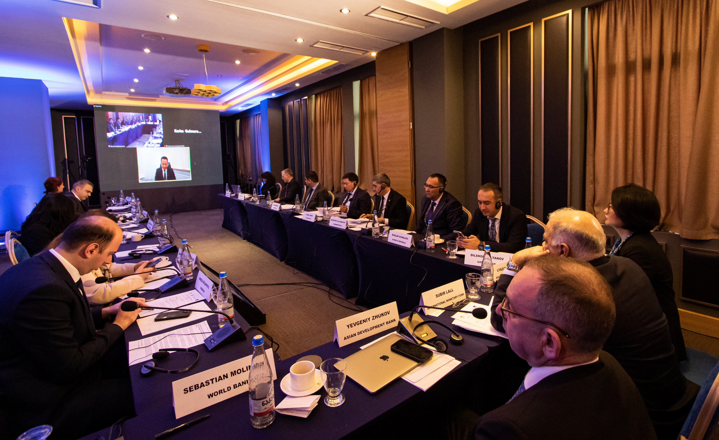
EFS Annual High Level Policy Dialogue Established as a knowledge sharing platform that convenes high-level policy dialogues on selected issues including macro-economic and financial stability, supports technical discussions and seminars, facilitating cross-learning within the region, and acts as a catalyst of knowledge.
2023 Progress, Achievements, and Next Steps
CAREC Economic and Financial Stability Cluster Forum 2023 Mobilizing Taxes for Development and Decarbonization in CAREC Region was held on 14 Feb 2023, at Tbilisi, Georgia
Attended by senior finance ministers and high-level representatives of CAREC countries, including IMF and World Bank officials
First session discussed policies and measures to raise more revenue to support national development goals and rebuild fiscal buffers of CAREC countries
- Second session discussed perspectives on carbon taxation in member countries, including non-climate reasons to use carbon taxes and issues related to its design and implementation
2023 Economic and Financial Stability Cluster High Level Policy Dialogue on Climate Change Risks to Financial Stability in CAREC Region will be held on 14 June 2023 at Tbilisi, Georgia
Jointly organized with IMF and World Bank
to examine the risks associated with climate change, particularly in relation to financial stability in the region
To explore a role of sustainable finance in mobilizing resources necessary for investments in climate mitigation, such as reducing greenhouse gas emissions, and adaptation, such as building resilience to climate change, towards green growth.

Slide 4
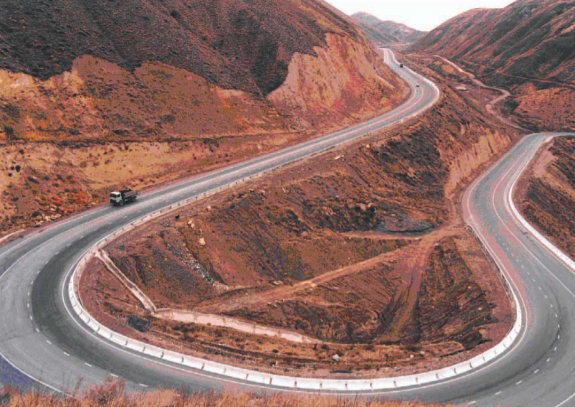
CAREC Climate & Sustainability Project Preparatory Fund (CSPPF) CAREC 2030 will continue to advance the regional infrastructure agenda, in line with the SDGs’ call for reliable and sustainable infrastructure, including regional and cross border infrastructure.
CAREC CSPPF (previously named as RIPEF) Rationale
Addressing challenges for CAREC regional infrastructure projects: widening infrastructure financing gap, inadequate capacity, falling short on climate change targets and SDG goals, lack of investment ready projects, constrained private sector financing and undiversified financing sources, etc.
Objectives
A dedicated multi-donor trust fund created to support CAREC governments in project preparation and readiness in climate change responsive and sustainable way
Progress and Next Steps
Small-scale Technical Assistance (approved in Sept 2020) – Concept report circulated for review, comments, and feedback
Transaction TA Facility (in progress) – to provide project preparation funding for regional infrastructure projects in CAREC and improving institutional capacity. Providing funding for two Projects: (i) KGZ Issyk-Kul Lake Environmental Management for Sustainable Tourism Development project, and (ii)Almaty–Bishkek Economic Corridor Regional Improvement of Border Services Project (ABEC RIBS
Stakeholder consultation (in progress) – ADB internal consultations and other fund managers consultations completed. CAREC member countries and development partners consultations are ongoing.
Donor consultation (in progress) – A few rounds of donor consultations completed and ongoing (EU, Republic of Korea, EU, etc.) with meaningful progress. Aiming to have letter of intent or MOU by Oct 2023
Deliverable for the Ministerial Conference
CSPPF Concept presented for endorsement

Slide 5
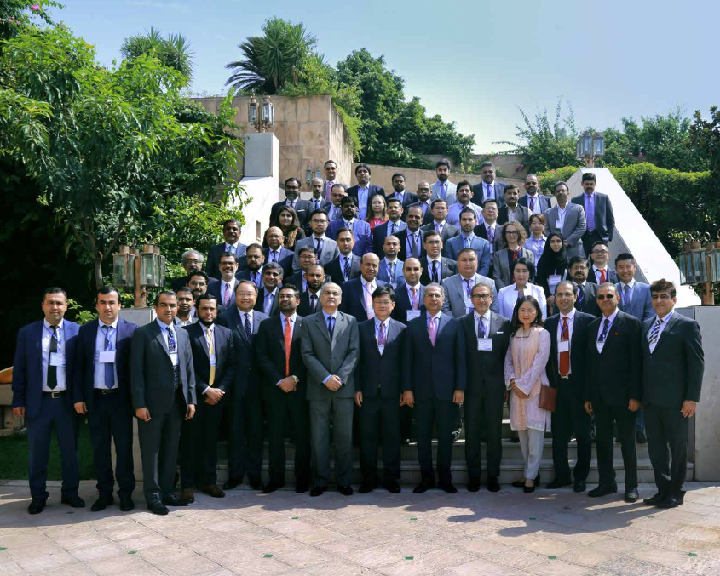
Rationale
Capital markets can play a key role in financing economic growth through facilitating trade and investment flows
The need to build strong and meaningful regional cooperation platform among our capital markets to mobilize resources within the region for a shared success
Objectives
The CMRF as regional capital markets development platform will help deepen, diversify, and help stabilize the region’s financial system. This will enable it to function more efficiently as an important source of long-term financing needs, especially for infrastructure development.
Progress and Next Steps
The first CMRF was held on 29–30 August 2019 in Islamabad, Pakistan, to discuss regional cooperation for development of their capital markets, enhancing access to finance, and supporting private sector development.
ADB TA Supporting CAREC CMRF approved in Aug ($700k) – to help the CAREC Program and its members complete the groundwork for the formal establishment of CMRF and launch its activities such as promoting knowledge exchange, building capacity, and piloting regional initiatives (e.g. the harmonization of legal and regulatory frameworks)
The second CMRF will be held in October, in Almaty, Kazakhstan, jointly hosted by the Agency of Republic of Kazakhstan on Development of Financial Markets (ARDFM) – to discuss on capital market development issues and formalizing and regularizing the CMRF, and to explore potential regional capital markets development initiatives
CAREC Capital Markets Regulators Forum (CMRF) Since its inception in 2001, CAREC Program has invested heavily in improving regional connectivity, promoting energy trade, and facilitating regional trade. In 2017, a new long-term strategy—CAREC 2030—was adopted by the 11 countries, expanding the objective of the program to strengthen economic and financial stability, including through promoting cooperation among capital markets and strengthening the investment climate in Central Asia.

Slide 6
THANK YOU FOR YOUR ATTENTION

