Slide 1
跨领域主题: 性别 数字化
CAREC 高级官员会议
2023年6月13-14日
格鲁吉亚第比利斯

Slide 2
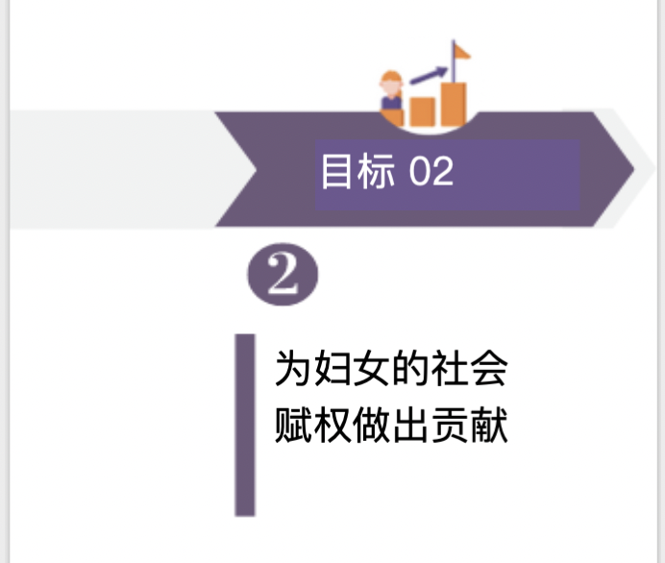
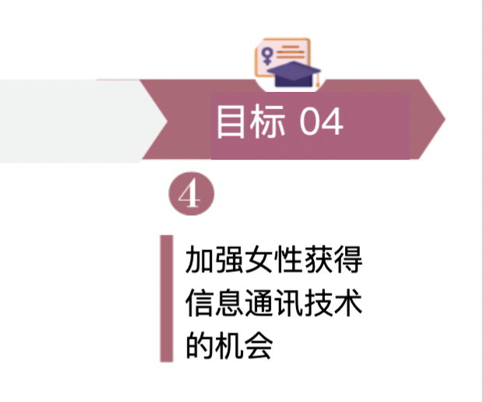
CAREC
跨领域主题：性别
部门委员会
区域性别专家组
《CAREC性别战略2030》
征集“CAREC 年度女性奖”提名
第二届 RGEG 会议
第二届“妇女经济赋权论坛”
“年度女性”颁奖典礼
2022年8月
2023年6月
2023年7月
2023 年 8 月
2023 年 9 月
2023 年 10 月
2023年
2022年
RGEG 成立大会召开
举办第一届 “CAREC 女性经 济赋权”论坛
推出
CAREC 商界女性在线社区平台
推出
数字 - GLOW 倡议
Slide No. 2

Slide 3
CAREC
跨领域主题：性别
部门委员会
区域性别专家组
《CAREC性别战略2030》
旗舰区域倡议 | 简介 | 行动计划（2023）
CAREC女性商业论坛 （网络） | “CAREC妇女商业论坛”将由“CAREC妇女商业在线社区平台”来运营，通过改善女企业家获得金融、营销和网络方面的相关知识的途径，来加强她们的能力。 | 5 月至 6 月：确定并邀请主要参与者加入在线平台。 6 月：组织线上发布活动。 7 月至 12 月：通过平台定期组织在线社区活动。
CAREC年度女性 大奖 （可见度） | 该奖项肯定了妇女对该地区社会经济发展的杰出贡献，它将为CAREC地区的女企业家和性别倡导者提供更多可见度。 | 五月：活动宣传及广告。 六月：奖项提名向公众开放 七月：专业评审团成立。 八月：评审团评估提名。 九月：宣布获奖者。 十月：举行颁奖典礼。
CAREC女性数字成长和与扫盲（数字 - GLOW）倡议 （数字技能） | 该倡议旨在增强CAREC地区妇女，特别是女企业家的能力，提高她们的数字业务能力，从而增加其经济机会，缩小数字性别鸿沟。 | 5 月：与潜在合作伙伴和利益方磋商。 六月：最终确定概念。 七月至八月：研究人员参与需求评估，以收集基线数据。 九月：组织启动仪式 10 月至 12 月：开发培训模块
Slide No. 3

Slide 4
CAREC数字战略2030(数字基础的五大支柱)
1.领导力、治理和投资
加强区域机构的数字领导力
2.数字政策、有利因素和保障措施(数据人工智能、网络安全))
协调CAREC成员国的立法和法规，并通过区域立法来促进数字伙伴关系。
吸引对数字经济的投资
促进包容性的区域数字经济
利用数字技术实现跨领域的可持续发展目标。
包容性、创新、可持续性、弹性、伙伴关系和参与
加强中亚区域经济合作区域的网络安全。
协调CAREC成员国的数据政策
支持该地区人工智能(AI)的发展。
加强和连接数字基础设施，弥合数字鸿沟。
打造数字复原能力。
3.宽带基础设施、韧性和数字平台
4.数字技能和能力
改善教育、培训和终身学习。
发展数字技能:基础和专业。
5.数字创新、企业家精神和信通竞争力
构建CAREC区域平台经济。
提升数字能力。
培育数字创新生态系统。
推动中小型企业采纳和有效使用数码技术。
促进区域内容。
促进信通技术出口。
Slide No.4
Notes:
Slide 1:-
To achieve the Strategic Objectives, the CAREC Digital Strategy 2030 will strengthen the following Five Interconnected Pillars through improved cooperation between CAREC member countries. Implementation Approach
The approach to digitalization support in the CAREC region is overarching, gradual, demand-based, collaborative, and multifaceted. The following principles are being followed:
Member countries to identify priorities and linkages to their national strategies and programs and facilitate coordination with all stakeholders.
Focus and prioritize activities with regional impact and their ability to facilitate cooperation.
Leveraging existing programs and initiatives through partnerships and collaboration with member countries, development partners, the private sector, and civil society.
Other than soft skills and support, take proactive measures to strengthen digital infrastructure by identifying and highlighting needs and showcasing them to develop a project portfolio and mobilize necessary investments.
Generate additional resources to support strategy implementation.
Establish realistic milestones and results and establish a monitoring and reporting mechanism.
Put in place strong communication and outreach to increase general awareness and profile, enable advocacy, and build a constituency for reforms to reduce the digital divide and promote the digital economy.
Slide 2:-
- CAREC Digital Strategy Portal (Pillar 3: Broadband Infrastructure, Resilience, and Digital Platforms):
A CAREC Digital Strategy Portal has been developed.
This will be transformed into the CAREC Digital Collaboration Platform to enable coordination, training, and best practice sharing as part of the CAREC Digital Strategy Implementation process.
- Virtual CAREC (Pillar 4: Digital Skills and Competencies of the Strategy):
Assessed virtual connectivity setups during the pandemic
Provided basic equipment and connectivity upgrades
Trained selected staff to improve virtual connectivity skills
- CAREC Startup Ecosystem: (Pillar 5: Digital Innovation, Entrepreneurship, & ICT Competitiveness):
The CAREC Startup Map:
The CAREC Startup Map is a visual map of existing stakeholders contributing towards the Startup Ecosystem of the CAREC region.
It provides a Macro view of the progress of the Startup Ecosystem in the CAREC Region.
1- It helps us identify the cities with active Startup Ecosystems and identify the success factors
2- It shows the cities with not so active Startup Ecosystem and evaluate the reasons
3- Provides us a benchmark to evaluate the progress of one city’s Ecosystem vs another City
- The CAREC Innovation network:
The CAREC Innovation Network (CIN) provides an opportunity for all Entrepreneurship Support Organizations (ESOs) working in the CAREC region to Collaborate and Strengthen the services that they offer.
The CAREC secretariat will
1- Organize in-person events and invite key stakeholders (Incubators, Accelerators, and Government Institutes) to engage and seek opportunities to collaborate.
2- Organize a Regional Startup Boot Camp, where selected startups will enroll with accelerators across the region and develop their ideas with a regional perspective.
3- Create a Start-up Exchange program to increase regional collaboration among the ecosystem stakeholders
4- Provide resources to research and conduct studies to evaluate gaps and opportunities in different business areas (E-Commerce, Telecom Sector, Cross Border Payments)
5- Organize study visits to countries with robust and well-developed Startup ecosystems like Korea, Singapore, and Japan to learn from their success stories
The CAREC Innovation Decoded:
Promote South–South learning through the CAREC Innovation Decoded initiative, focusing on the success factors of the startup ecosystem in the People’s Republic of China with CAREC member countries. A series of training and networking events will be organized.
The CAREC secretariat will:
1. Invite high-profile speakers from all innovation ecosystem stakeholders who will share their experiences, skills, and knowledge of the development of the startup ecosystem in China.
2. On-site networking events around the developed Chinese cities will be organized with seminars with prestigious entrepreneurs and partners in the Chinese startup ecosystem; exhibitions; Networking opportunities for leading innovation ecosystem partners (Gov, VC, Univ./institutes, known enterprises such as Alibaba, Tech Parks, Top tier startups, Incubators/Accelerators, etc.)
3. Developing sustainable communication and cooperation mechanism for a collaborative and interactive startup ecosystem community between Chinese and other CAREC startup ecosystem partners through the Think Tank function, resource pool building and expansion of partners.
- The CAREC University Competition:
The CAREC University Startup Competition is an innovation challenge for University students in the CAREC region to develop Practical, Entrepreneurial, and Soft skills by tackling real-world social and corporate problems.
The CAREC secretariat is
1- Working with universities to establish Incubation centers to promote the development of entrepreneurship among students.
2- Working with universities to create a student-exchange program to develop collaboration.
3- Organizing study trips to Universities in countries like Korea, Singapore, and Japan to learn from their success stories
Slide 3:-
Further develop the CAREC Startup Ecosystem Development Hub by reaching out to more players in the ecosystem space from the region.
Continue organizing CIN Member workshops where subject matter experts will train the startup ecosystem organizations on selected areas and topics.
Promote South–South learning through the CAREC Innovation Decoded initiative, focusing on the success factors of the startup ecosystem, starting from the People’s Republic of China and then moving to other CAREC countries. A series of training and networking events will be organized.
Develop a Regional Pre-Incubation Bootcamp to encourage knowledge transfer and networking among incubators and accelerators in the CAREC region who have shown interest in joining this initiative.
Slide 4:-
- University Collaboration and Promoting Youth Engagement and Entrepreneurship (Pillar 5: Digital Innovation, Entrepreneurship, & ICT Competitiveness)
Continue organizing Open Innovation Challenges – Affiliate Program with the universities in the CAREC region and developing sustainable models to continue with depreciating support from the CAREC secretariat.
In order to strengthen the collaboration & knowledge sharing among the Innovation centers operated by CAREC universities, we aim to create the "CAREC University Exchange Program.” Participating universities will host startups from other universities for one week, and the startups will get the unique opportunity to work with faculty and mentors from various universities in the region.
- Other Initiatives:
Launch a flagship CAREC Digital Literacy Program for Women to address the critical digital gender divide and promote the digital economy and better service delivery access.
Collaborate with the CAREC digital focal points to enhance the digital infrastructure and reduce the digital divide in the region. This initiative aligns with the CAREC digital strategy 2030. It aims to streamline the digitalization of Government services and promote dialogue on regulations pertaining to cross-border payments, customs & telecom services, etc.

Slide 5
支持CAREC中的初创生态系统
关键举措
开发了CAREC数字战略门户。
“虚拟CAREC”倡议旨在提供培训、升级设备和改善连通性
区域性CAREC创业生态系统开发中心:
改善数据流并联系利益相关方
提供知识支持，通过以下举措为生态系统注入活力:
CAREC启动图.
CAREC创新网络(CIN)。
CAREC创新解码。
CAREC大学创业竞赛。
Slide No. 5

Slide 6
支持CAREC中的初创生态系统
未来的活动
区域创业生态系统支持(支柱5:数字创新、企业家精神和信通技术竞争力)
进一步发展CAREC创业生态系统发展中心
继续组织CIN成员讲习班。
继续组织CAREC创新解码研讨会。
组织活动，例如:
投资者峰会
创业路演
创新空间
数字游牧推广活动
打造区域人才库，区域导师网络和区域天使投资者网络
发展区域性孵化前训练营。
Slide No. 6

Slide 7
支持CAREC中的初创生态系统
未来活动(续)
与大学合作和促进青年参与和创业(支柱5:数字创新、创业和信通技术竞争力):
与大学一起创建附属计划，在CAREC地区组织开放式创新挑战
创建“CAREC大学交流项目”
其他倡议：
启动CAREC女性数字扫盲旗舰项目。
评估和开发投资组合以建设数字基础设施。
提升政府服务。
促进有关跨境支付、数据安全、电子商务、消费者隐私和能力建设的监管对话。
加强与该领域发展伙伴的合作，如AIIB、欧洲复兴开发银行、国际电联、联合国开发署、美国国际开发署、工发组织和世界银行..
Slide No. 7

Slide 8
联系人和重要链接
请访问我们的CAREC网站 https://www.carecprogram.org
CAREC数字战略2030 : https://digital.carecprogram.org
CAREC启动图: https://www.startupcarec.org
请随时联系我们: info@carecprogram.org
谢谢
Slide No. 8

