Slide 1
Strengthening Regional Cooperation on Skills Development under the CAREC Program
33
Project Overview and Progress to Date
CAREC Senior Officials’ Meeting
13-14 June 2023
Tbilisi, Georgia
Guntur Sugiyarto
Principal Economist
CWRC, ADB

Slide 2
Outline
  Objectives
  Impact and Outcome
  Progress to Date

Slide 3
1. Objectives
Overall objective
To support the human development cluster of the CAREC strategy by helping CAREC member countries furthering their paths towards standardization and harmonization in two critical sectors of higher education, and technical-vocational education and training (TVET)
Four focus areas
1. Standardization and harmonization in higher education
2. Standardization and harmonization in TVET
3. Governance and regulation of recruitment systems
4. Development of labor market database and information system

Slide 4
2. Impact and Outcome
Impact
Outcome
  Human development improved through increased quality, mobility, and productivity of the labor force of the CAREC countries
  Regional cooperation and integration in the CAREC region strengthened through better utilization and allocation of human resources in line with the CAREC 2030 Strategy and Strategy 2030 Operational Plan

Slide 5
3. Progress to Date
1. Inception meeting and international expert roundtable was held in Tbilisi, Georgia in May 2022
focused on key developments, challenges, and opportunities for collaboration on skills development in the CAREC region
2. Six knowledge products are in final stage of preparation and will be circulated to CAREC member countries for review
a policy report providing a systematic assessment of the existing skills in CAREC countries, particularly the extent to which they provide relevant and utilizable skills
a policy brief providing a systematic assessment of how and how well skills development systems function in CAREC countries focusing particularly on two areas, i.e., higher education and TVET
a multi-national CGE assessment of CAREC regional skill and labor market development scenarios
a regional analysis tool for mapping regional higher education integration frameworks
a regional report on long-term trends on Central Asian Migration
a regional report on CAREC countries’ adherence to regional integration frameworks in higher education

Slide 6
3. Progress to Date
3. The TA is also working to launch two new regional initiatives over the coming months
the CAREC Regional Skill Development Initiative, which aims to develop and foster a network of policy researchers around the CAREC who can develop and analyze evidence to support national-level skill development strategies
the CAREC University Consortium Network, which will bring together and enhance collaboration among top universities within the CAREC region
4. Four additional knowledge products and tools have also been commissioned and currently in development
a regional report mapping governance and regulation of private agency-mediated recruitment systems within CAREC
a regional report on recent drivers of Central Asian migration
a mapping study of university and TVET partnerships between CAREC countries
a TVET online training module in the tourism sector

Slide 7
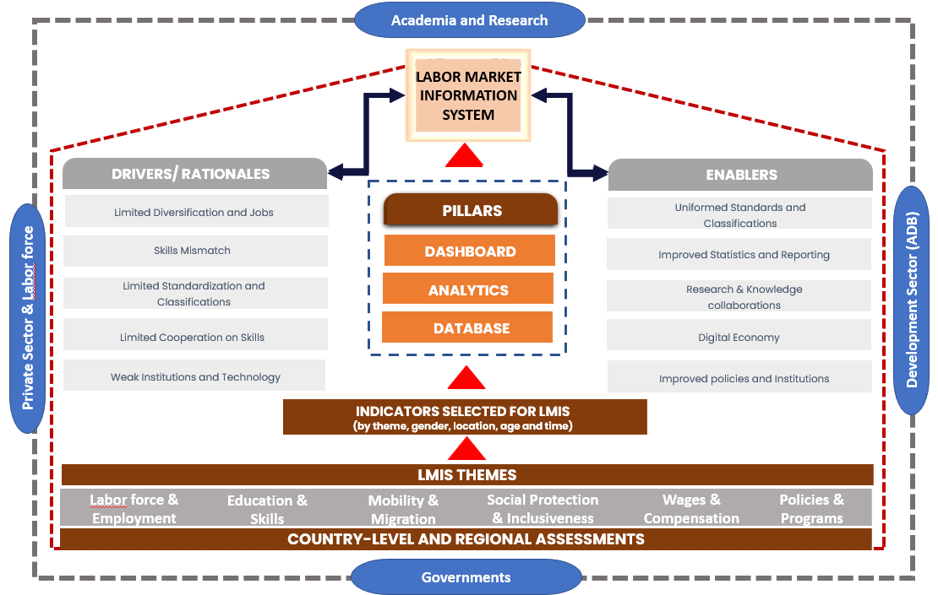
The Proposed Labor Market Information System Framework for CAREC Countries

Slide 8
THANK YOU FOR YOUR COOPERATION!
For queries please contact:
gsugiyarto@adb.org

