Slide 1
Session 3: Trade, Tourism, and Economic Corridors Economic Corridors Update
CAREC Senior Officials’ Meeting
13-14 June 2023
Tbilisi, Georgia

Slide 2
Structure
Almaty-Bishkek Economic Corridor
Shymkent-Tashkent-Khujand Economic Corridor
Economic Corridor Framework and Implementation

Slide 3
1. Almaty-Bishkek Economic Corridor
ABEC is the CAREC pilot economic corridor between Almaty and Bishkek and their surrounding regions
Key achievements during the last 12 months:
First ABEC-supported ADB Investment Project approved (KGZ: Regional Health Security)
Report on Cross-border trade facilitation and border crossing point management completed
ABEC Joint Accommodation Classification System
New ADB Support TA approved of $1.9 million in support of the ABEC Subcommittee
Deliverables for the next 12 months:
Almaty-Issyk-Kul Alternative Road PPP project concept
E-Bus pre-feasibility report
ABEC Regional Improvement of Border Services Project (KGZ)
Issyk-Kul Lake Environmental Management for Sustainable Tourism Project (KGZ)

Slide 4
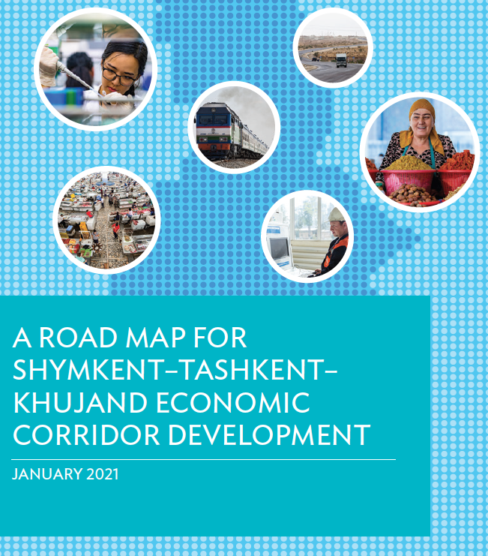
2. Shymkent-Tashkent-Khujand Economic Corridor
STKEC is the second pilot economic corridor following the spatial development approach.
Key achievements in implementing the road map for STKEC development during the last 12 months:
Prefeasibility studies on (i) International Center for Industrial Cooperation between Kazakhstan and Uzbekistan, and (ii) Trade and Logistics Center in Sugd (Tajikistan) being finalized
Knowledge Sharing on Promoting Regional Cooperation and Integration for Economic Corridor Development conducted in Georgia in May 2023
Deliverables for the next 12 months:
Complete two prefeasibility studies
Establish the STKEC Technical Working Group on Transport Connectivity and Trade Facilitation
Facilitate the Memorandum of Understanding for STEKC development among members

Slide 5
3. Economic Corridor Framework and Implementation
Economic Corridor Framework
Movement-Focused
Spatial Transformation-Focused
Transport Corridor
Logistics Corridor
Economic Corridor
Soft Infrastructure
Multi-Model Network
Hub System
Consolidation
Institutions and Regulations
Spatial Development Approach
Private Investments and Markets
Multi-Sector Approach

Slide 6
3. Economic Corridor Framework and Implementation
Conceptual Framework:
uniqueness of every ECD
dependence of ECD on diverse structural and initial factors
attributes of areas that are suitable for ECD
complexity of even modest ECD -> need for sophisticated analysis
Operational Framework:
domestic transport corridor
cross-border transport corridor
domestic spatial economic corridor
cross-border spatial economic corridor
Implementation Stages:
corridor conceptualization and proof of concept
initial stakeholder consultations and memorandum of understanding
detailed strategic and feasibility study
masterplan, project prioritization and pipeline, formalization of
institutional mechanism, and resource mobilization
individual project development, design and implementation
monitoring and evaluation
ADB Implementation Support

