Slide 1
CAREC 2030
Implementation Progress
CAREC Senior Officials’ Meeting
13-14 June 2023
Tbilisi, Georgia

Slide 2





A quick recap of the CAREC 2030 Strategy:
Driving principles
Operational Clusters
Aligning with national strategies and supporting SDGs and COP21
Expanding operational priorities selectively
Deepening policy dialogue based on CAREC’s standing and ability to deliver quality knowledge services
Integrating the role of the private sector and civil society
Building an open, inclusive CAREC platform
Economic and Financial Stability
Trade, Tourism and Economic Corridors
Infrastructure and Economic Connectivity
Agriculture and Water
Human Development
→ ICT, Gender, and Climate Change cut across all clusters
Notes:
Taken from the CAREC website: (https://www.carecprogram.org/?page_id=32)
Driving Principles of CAREC 2030
CAREC 2030 is guided by the following five driving principles:
Aligning with national strategies and supporting the new international development agenda, embodied in the sustainable development goals (SDGs) and the 21st Conference of the Parties to the United Nations Framework Convention on Climate Change (COP21);
Adopting a dual-track approach by deepening cooperation in the traditional areas of transport, energy, trade, and economic corridor development, while selectively expanding into new areas of cooperation in line with member countries’ priorities;
Deepening policy dialogue based on CAREC’s standing and ability to deliver quality knowledge services;
Integrating the role of the private sector and civil society by promoting people-to-people and business-to-business contacts across member countries; and
Building an open and inclusive platform to help strengthen cooperation and build synergies with other international and regional cooperation mechanisms active in the region, and maximize development partners’ resources and expertise to support regional cooperation.
CAREC 2030 prioritizes five operational clusters, encompassing both traditional and new areas of cooperation:
Economic and Financial Stability
Trade, Tourism, and Economic Corridors
Infrastructure and Connectivity
Agriculture and Water
Human Development
In addition, CAREC supports the integration of information and communication technology (ICT) across the spectrum of CAREC operations to promote productivity and efficiency gains in all operational clusters.

Slide 3


How CAREC 2030 Progress is measured:
CAREC 2030 Program Results Framework (PRF) endorsed by the 19th Ministerial Conference in Dec 2020
PRF reported as CAREC Program’s Development Effectiveness Review (DEfR) done every three years
CAREC Sector Progress Reports yearly
ADB Independent Evaluation Department (IED) periodic
2021
1st CAREC 2030 DEfR
(2017-2020) Completed
2017
CAREC 2030 Strategy
Endorsed
2020
CAREC 2030 PRF Endorsed
2024
2nd CAREC 2030 DEfR Planned

Slide 4
Progress of CAREC 2030 based on latest DEfR (2017-2020):
Cluster/Sector | Outcome Indicator | 2020 Progress
Cluster 1: Economic and Financial Stability | High level policy dialogue on macroeconomic issues among CAREC countries regularized, leading to greater economic stability and improved macroeconomic outcomes | Seven high-level policy dialogues with high-level participation organized between 2018-2020, sustainability of the forum needs to be ensured
Cluster 2: Trade | Increase in trade in fuels and nonfuels within CAREC and with the rest of the world as % of GDP, showing integration into the global economy | Fuel and nonfuel trade in services as % of GDP increased both within the CAREC region and the rest of the world, the challenge is accelerating progress.
Tourism | CAREC countries’ travel and tourism competitiveness index rank up | 5 of 11 CAREC countries improved ranking in Travel and Tourism Competitiveness index (WEF).
Economic Corridors | Cross-border economic corridor concepts applied by CAREC countries to strengthen economic links and drive trade and development of cross-border regions | 7 of 11 CAREC countries incorporated ECD concepts in their national development strategies, the challenge is coordination among multiple stakeholders.
Cluster 3: Energy | % of renewable energy in CAREC countries | % of renewable energy in CAREC countries increased from less to 1% to 6%
Notes:
Showed outcome indicator to compare against 2020 progress,

Slide 5
Progress of CAREC 2030 based on latest DEfR (2017-2020):
Cluster 3: Transport | Improvement in aggregate corridor performance – average speed by corridors, by speed with delay (SWD) and by speed without delay (SWOD) – for enhanced economic connectivity and sustainability of regional transport infrastructure | 24 investment and technical assistance projects approved despite the pandemic, aggregate corridor performance shows marginal improvement compared to baseline for railway transport but almost no improvements for road, governance issues and security concerns of member countries undermine efforts on improving cross-border services.
Cluster 4: Agriculture and Water | National food safety regulations in compliance with the international sanitary and phytosanitary (SPS) measures developed/ revised Number of countries with an outlined road map of national water resourced development interventions | 7 CAREC countries received technical assistance to harmonize sanitary and phytosanitary measures with international procedures and strengthened their capacity to implement these measures. The CAREC Water Pillar Scoping Study is completed.
Cluster 5: Human Development | Bilateral or multilateral agreements signed among CAREC countries and their partners on tertiary and TVET standardization and harmonization Number of CAREC countries that incorporate joint regional approaches and cross-sector activities in their health sector strategies | A scoping study on education and skills development has been completed. A regional working group on health has been established. A TA project is supporting the development of a health strategy and investment framework.

Slide 6
Evaluation of ADB Support for CAREC Program (2011-2021)
Findings
  ADB support to the CAREC Program has made significant progress in helping improve regional connectivity through support to develop transport and energy infrastructure
  ADB support to the CAREC program contributed modestly to improving economic competitiveness
  ADB support for CAREC to improve supply of regional public goods is still nascent
  ADB fulfilled the role of the CAREC Secretariat generally well. Government counterparts rated highly the importance of ADB’s role as an honest broker
Notes:
Recommendations:
Strengthen support for investment climate and trade policy reforms to promote economic diversification across the CAREC region
Increase support for modernization of BCPs and customs processes
Give a higher priority to developing a multimodal corridor network in the CAREC subregion by increasing support for the railway network and aviation
Use the CAREC platform to support climate change mitigation and adaptation in all sectors through regional cooperation
Strengthen the CAREC Program’s results monitoring system and tools

Slide 7
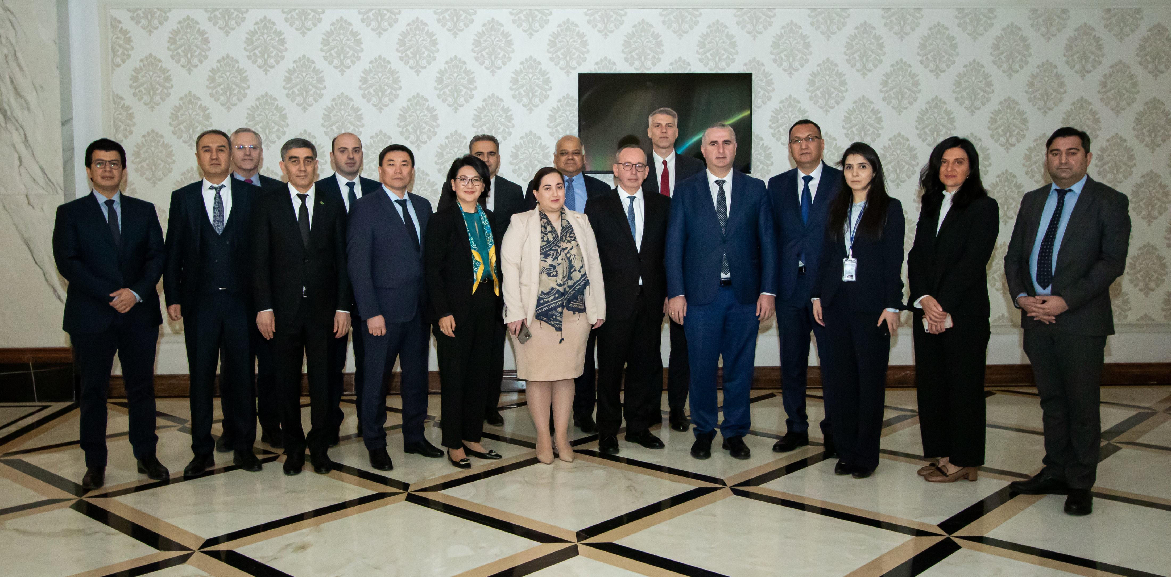


CAREC 2030 Implementation Highlights:
2. Trade, Tourism and Economic Corridors Cluster
Accelerated WTO accession talks (AZE and UZB) and TKM became acceding member in 2022
20 years of Customs Cooperation Committee establishment (October 2022)
Launch of CAREC Digital Trade Forum in 2022
Flagship report: Progress in Trade Facilitation in CAREC Countries: A 10-Year CPMM Perspective (December 2022)
Forum on Developing Sustainable SEZs and Roundtable on Supply Chain Connectivity and Resilient Border Operations (September 2022)
1. Economic and Financial Stability Cluster
2 High Level Policy Dialogues on Economic and Financial Stability organized
  Mobilizing Taxes for Development and Decarbonization in the CAREC Region, 14 Feb 2023
  Climate Change Risks to Financial Stability in the CAREC Region, 14 June 2023
CAREC Climate and Sustainability Project Preparation Fund Concept for approval
Notes:
These are the highlighted events, knowledge products published, and achievements from the period July 2022-June 2023 in all the sectors

Slide 8
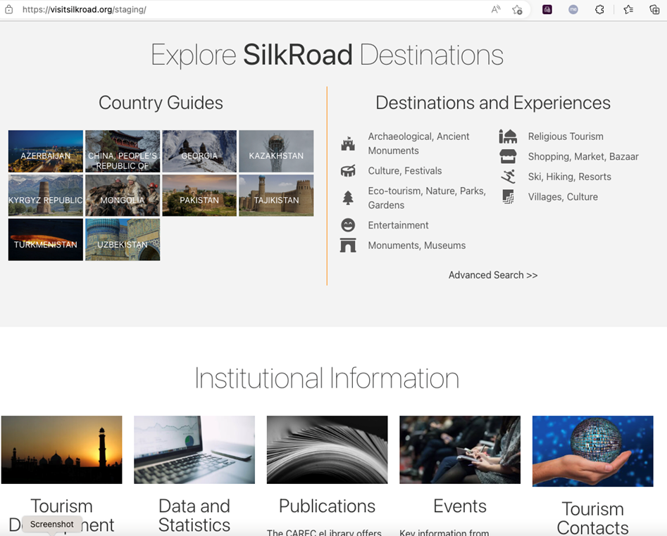
CAREC 2030 Implementation Highlights:
Trade, Tourism and Economic Corridors Cluster
For economic corridors, the Almaty-Bishkek Economic Corridor (ABEC) has one approved and two upcoming regional investment projects:
  Strengthening Regional Health Insurance Project
  ABEC Regional Improvement of Border Services Project
  Issyk-Kul Lake Environmental Management for Sustainable Tourism Project
The Shymkent-Tashkent-Khujand Economic Corridor (STKEC) finalized pre-feasibility studies on:
  International Center for Industrial Cooperation between Kazakhstan and Uzbekistan
  Trade and Logistics Center in Sugd (Tajikistan)
With plans to establish the STKEC Technical Working Group on Transport Connectivity and Trade Facilitation
Launch of the CAREC tourism portal, a tool for consolidating information on tourism attractions in the region and promoting the services of local businesses

Slide 9
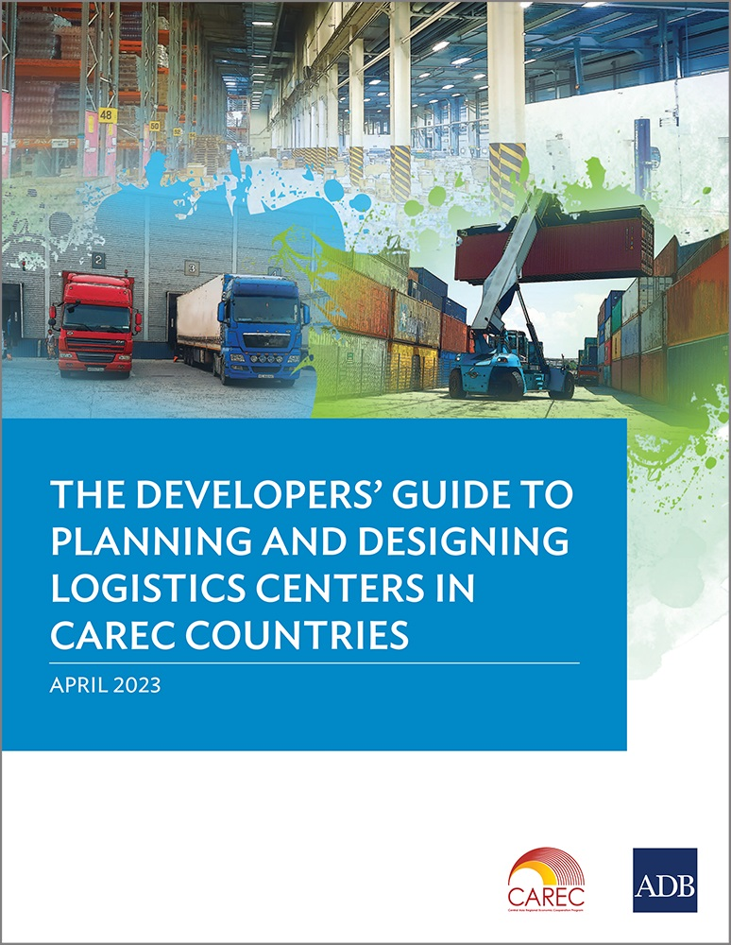




CAREC 2030 Implementation Highlights
Infrastructure and Economic Connectivity Cluster
In the transport sector, the CAREC RIBS (Regional Improvement of Border Services) Project supported the establishment of the National Single Window (NSW) of the Kyrgyz Republic, while development of the Pakistan Single Window (PSW) is ongoing, as well as 3 border crossing points (BCPs) in Mongolia
Key knowledge products launched:
  Road Safety Report Card for the CAREC Region (July 2022)
  Road Funds and Road User Charges in the CAREC Region (Dec 2022)
  The Developers’ Guide to Planning and Designing Logistics Centers in the CAREC Region (April 2023)
The energy sector published its flagship deliverable, CAREC Energy Outlook 2030, in December 2022, and completed phase 1 implementation of the CAREC Energy Strategy
33rd ESCC meeting (16 May) approved the 2023-2025 workplan and holding an Energy Investment Forum in November 2023

Slide 10
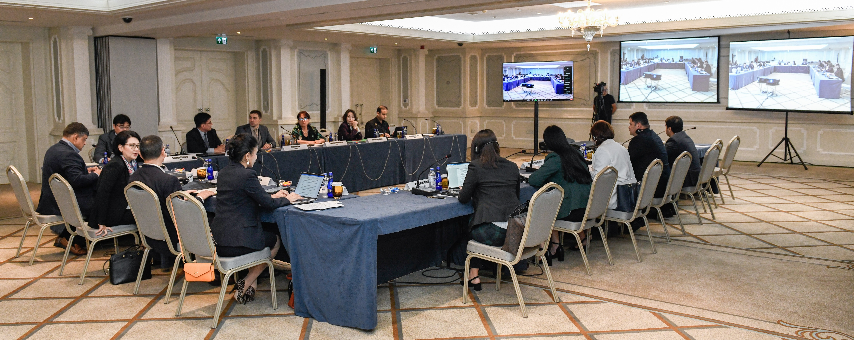


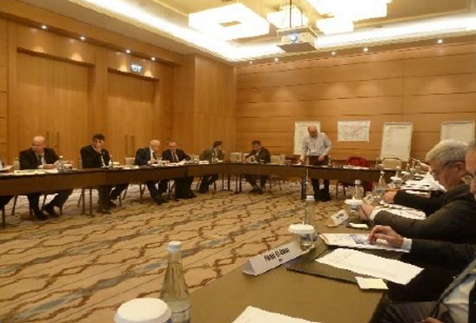
CAREC 2030 Implementation Highlights
Agriculture and Water Cluster
For water, CAREC Water Pillar Scoping Study completed
Regional Workshop on Developing the CAREC Water Pillar held in Tashkent last 29-30 November 2022, defining a shortlist of possible priority activities and plans for setting up a Water Pillar Working Group
Under agriculture, Cooperation Framework for Agricultural Development and Food Security in the CAREC Region endorsed during 22nd Ministerial Conference
Regional KSTA to support implementation of the Framework for approval Q3 this year

Slide 11
CAREC 2030 Implementation Highlights
Human Development Cluster
In the health sector, endorsement of the CAREC Regional Health Investment Framework 2022-2027 last 2 March 2023, aligned to country priorities and needs, to guide regional cooperation and supporting investment coordination across countries and development partners
For the education and skills development sector, six knowledge products are in final stage of preparation, with two upcoming regional initiatives to be launched in the following months:
  CAREC Regional Skills Development Initiative
  CAREC University Consortium Network
For gender, call for nominations for CAREC Women of the year award started this June 2023
Launch of CAREC Women in Business Online Community Platform planned for June 2023
Notes:
the CAREC Regional Skill Development Initiative, which aims to develop and foster a network of policy researchers around the CAREC who can develop and analyze evidence to support national-level skill development strategies
the CAREC University Consortium Network, which will bring together and enhance collaboration among top universities within the CAREC region

Slide 12
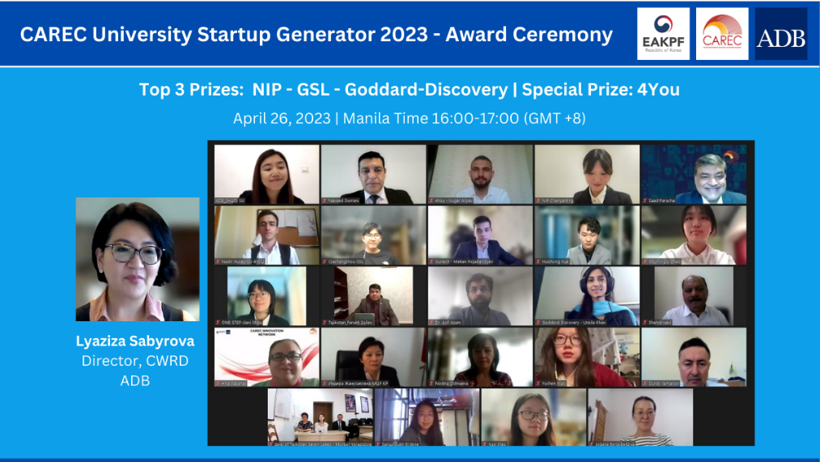
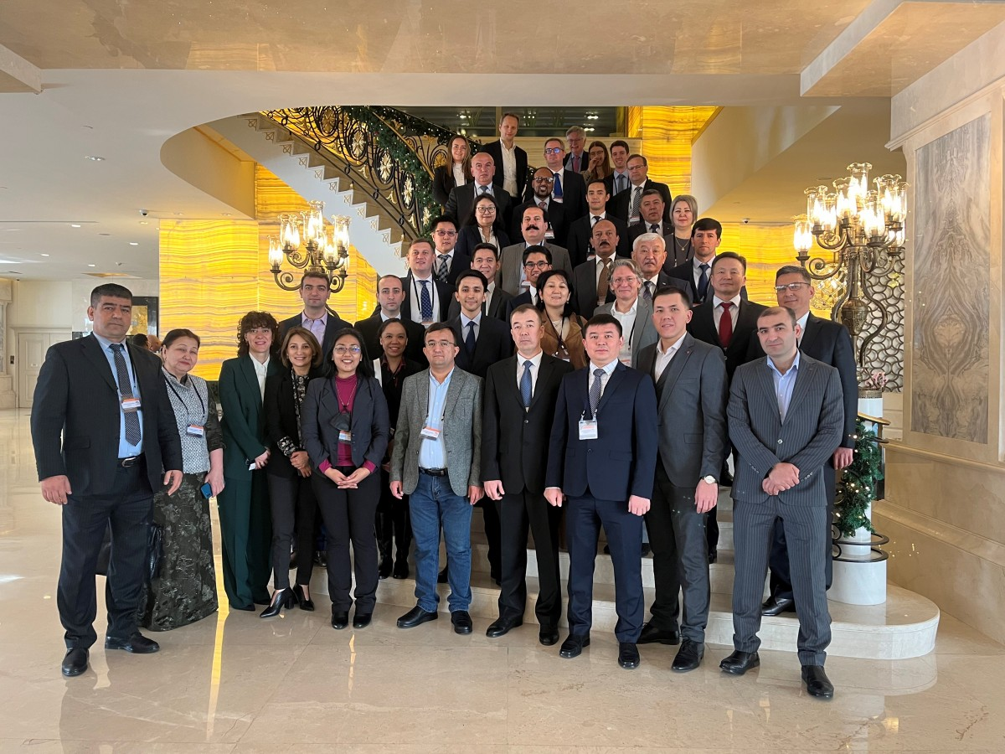
CAREC 2030 Implementation Highlights
Crosscutting Themes
For disaster risk, a Disaster Risk Engagement Meeting was held last 28-30 November in Istanbul
For the CAREC Digital Strategy 2030, a regional CAREC Startup Ecosystem Hub is in place
CAREC University Startup Generator Challenge, successfully concluded last 26 April, with 168 teams from 10 countries participating
Planned activities include:
  Roadmap for a regional risk transfer facility
  Feasibility of issuance of disaster relief bonds
  Refined disaster risk management interface (DRMI)

Slide 13
Key Challenges Facing the CAREC Program
Country engagement, low sense of program ownership [frequent rotation of government employees, view of CAREC activities as increased workload]
Geopolitical conflicts

Slide 14
Moving forward: Upcoming Activities
July/August 2023
(Islamabad, Pakistan/ TBC)
September 2023
(Tbilisi, Georgia/ TBC)
October 2023 (Tbilisi, Georgia)
(Almaty, Kazakhstan)
November 2023
(Tbilisi, Georgia)
CAREC Disaster Risk Engagement Meeting (18-19 July)
STKECD Country Consultations (TBD)
Regional Conference on Adoption of E-Phyto in CAREC countries (12-14 Sep)
CAREC Innovation Network Exchange Summit (TBD)
Tbilisi Silk Road Forum (26-27 Oct)
National Focal Points’ Meeting (Virtual, TBD)
Digital Trade Forum (TBD)
Second Capital Markets Regulators’ Forum (TBD)
Energy Investment Forum (28-29 Nov)
22nd Ministerial Conference (30 Nov)
14th Meeting of CI’s Governing Council (30 Nov, TBC)

