Slide 1
Quality Infrastructure for Export of Agricultural and Food Products
Speaker:
Eredzhepov Lenur Ametovich
International Standards Technical Expert

Slide 2
Overview
Quality Infrastructure
Components of Quality Infrastructure
Quality infrastructure in Uzbekistan, Kazakhstan and Tajikistan
Recommendations for improving the quality infrastructure

Slide 3
Quality Infrastructure
The concept of «quality infrastructure» includes access to standards and technical regulations, metrology, testing, quality assessment, certification and accreditation. Quality infrastructure should be considered as part of the country’s complete necessary infrastructure It is important for the establishment of regional markets, allowing goods to become the subject of international trade and it refers to the set of tools used to remove technical barriers to trade.
The strategic goal of quality infrastructure:
Ensurе favorable regulatory conditions in the field of technical regulation, which contribute to the development and production of competitive and high-quality products, and its promotion in regional and international markets that meet the expectations and requirements of consumers and the interests of the business environment.

Slide 4
Goals of QI
Ensuring the principles of independence and impartiality (ability to fulfill and confirm the appropriate compliance with the requirements in the field of standardization, accreditation, metrology, conformity assessment)
Access to innovation
Develop competitiveness
Access to international markets and maintaining domestic markets
Protection of the interests of manufacturers, especially small ones
Consumer protection (food safety)
Promotion of economic development
Promotion of regional integration

Slide 5
Quality Infrastructure
Advantages:
The establishment and development of a quality infrastructure is part of trade-related technical cooperation. This should enable partners to take advantage of globalization and avoid barriers.
The opportunity to obtain the greatest possible benefits for the national economy and sustainable development when applying the existing rules of international trade
Moreover, the quality infrastructure ensures fair trade and promotes socially-oriented development

Slide 6
Quality Infrastructure (QI) Components
Quality Infrastructure
Standardization
Accreditation
Metrology
Conformity assessment (testing, certification)
Management system

Slide 7
Standardization
Standardization - activity on the development, publication and application of standards, on the establishment of norms, rules and characteristics in order to ensure the safety of products, works and services
In order to recognize the work of the standardization body as a national task and to avoid confusion due to possible rivalry within the country or between ministries, the national Standardization Law may define the establishment and objectives of a single National Standards Institute for all standards to be implemented at the national level. This national standards Institute may be either a private or public legal entity, provided that the legal entity is officially recognized by the government. At the international level, the national standards Institute represents the country in international organizations such as ISO, Codex Alimentarius, or regional standardization organizations such as the Commonwealth of Independent States Interstate Council for Standardization, Metrology and Certification .

Slide 8
Standardization
Standardization
Standards
Technical regulation
Us Dst
ST RK
ST RT
Technical regulations "On safety of food products"

Slide 9
Accreditation
Accreditation is the process whereby an authoritative body formally recognizes the competence of an organization or individual to perform specific tasks.
In the structure of IQ, the department responsible for accreditation evaluates the competence of bodies that certify products, management system and personnel, testing and control laboratories.
Official recognition called “accreditation” certifies the customers and users of services the competency of the activities of these organizations.
For international recognition, a national accreditation body may be a member of the International Accreditation Forum (IAF) and the International Laboratory Accreditation Organization (ILAC). Both IAF and ILAC promote and manage the recognition of ”bilateral” or “multilateral” “agreements” or “arrangements” according to which the participating parties agree to mutually recognize the results of testing, inspection, certification or accreditation, which may be an important step towards optimizing the number of product ratings services, systems, processes and materials needed especially in international trade.

Slide 10
Metrology
Metrology is the science of measurements, methods and means of ensuring their unity and methods of achieving the required accuracy.
International quality standards (ISO 9000, ISO / IEC 17025, etc.) require traceability or uniformity of measurements.
The concept of traceability means a continuous chain of comparisons with higher accuracy instruments, starting from the instrument used in industry to the national standard.
Accurate measurements and measuring instruments are necessary to protect the health and safety of consumers and protect the environment.
Elements of metrology also play an important role in contracts, both between business partners, and in world trade in general.
Laboratory scales and other instruments must be calibrated to ensure reliable and accurate measurements.
Enterprises cannot manage the production process according to standard characteristics if control devices, such as,, pressure and temperature measuring devices, are not calibrated.
The reliability of the national system of measures is ensured by the National Institutes of Metrology (NIM) by signing the act on mutual recognition of the International Committee of Weights and Measures (CIPM MRA).
This arrangement provides an organizational and technical basis for assisting NIM in recognizing calibration standards and certificates as integral elements of world trade.

Slide 11
The main functions of the National Institute of Metrology (NIM):
develops national measuring standards and transfers the size of their units to industry and consumers in the country,
establishes and maintains a national measurement system, providing technical support to a network of secondary and tertiary laboratories,
provides traceability to the national system and through it to the international system,
participates in the modernization and transfer of technologies between the scientific community, industry and government, helping to strengthen the scientific and technical infrastructure required by industry to ensure competition in existing world markets,
supports the development of reference standards and a national system of standards,
facilitates international harmonization and comparability of measurement results,
represents the country in a regional and global metrological system,
together with the national accreditation body, organizes national intercomparisons for calibration laboratories in the country.

Slide 12
Metrology
Measurement instrumentation
Verification
Calibration

Slide 13
Conformity assessment
Conformity assessment is a set of processes and procedures that are used to demonstrate that a product or service, management thereof, organization or personnel meet established requirements.
The requirements for conformity assessment activities are given in international standards, and this helps ensure worldwide coherence as well as international acceptance of results. These requirements are usually set out in international standards developed by organizations such as ISO (International Organization for Standardization), for example:
ISO 17021 - Conformity assessment. Requirements for bodies conducting the audit and certification of management systems
ISO 17025 - General requirements for the competence of testing laboratories and calibration
ISO 17065 - Conformity assessment. Requirements for bodies responsible for certification of products, processes and services

Slide 14
Conformity assessment
Оценка соответствия
Tests
Certification of products and services
Management System Certification
Conformity assessment services are usually provided by organizations specializing in a particular industry (certification bodies, testing laboratories). These organizations can provide their services on a commercial basis, or they can work on a government mandate.

Slide 15
Tests
The product is tested for compliance with a certain set of criteria, such as quality or safety. Tests are the most common form of conformity assessment. Testing also provides the basis for other types of conformity assessment, such as product certification.
The product is checked for compliance with certain safety criteria. Tests are the most common form of conformity assessment. Product Certification.
It would be extremely expensive for every single manufacturer, consumer group or government agency in the country to set up laboratories for all required types of tests. Therefore, it is advantageous to use existing specialized laboratories and set up only those that are not yet available. These laboratories can be private or run within public institutions; what is important is that proper accreditation makes them accessible and reliable for a variety of purposes.
Quality management and technical competence criteria for testing laboratories are defined in the international standard ISO/IEC 17025, which applies the same criteria to all types of testing and calibration laboratories.

Slide 16
Certification
Certification of products proves that the production processes, content, properties, etc. of products / services meet the requirements of the standard. This type of certification is mainly required for products for which safety, health or food safety issues play an important role.
Certificates of products with appropriate symbols exist in most countries of the world. Many of them are approved only at the national level if they are issued by a state certification body that does not have internationally recognized accreditation.
Some examples of product certification relating to general safety aspects that are also of international importance:
CE: EU conformity mark
EAC: Single conformity mark for products in circulation in EAEU member countries’ markets

Slide 17
Сертификация
ISO/IEC 17065 (conformity assessment. Requirements for certification bodies for products, processes and services) and ISO/IEC 17021 (conformity assessment. Requirements for bodies conducting audit and certification of management systems) establish general requirements that must be met by a third party involved in the certification of products/services and management systems to be recognized as competent and reliable.
Examples of specific aspects of food products:
ORGANIC - Certification of organic or bio-products
GMO - (GMOs are genetically modified organisms)
Halal - (Halal - Muslim food requirements)
Kosher - (kosher-Jewish food requirements)
GLOBALGAP - international standard of good agricultural safety practices

Slide 18
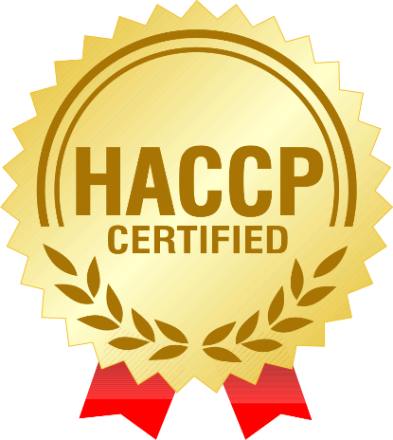
Management systems
Management systems demonstrate that the enterprise under considerations has implemented procedures for structuring and documenting business processes, taking into account the assessment of risks and opportunities. This does not automatically lead to high-quality and competitive products or services, but thanks to well-defined internal structures, independent of human factors, it helps to avoid many possible mistakes. Documentation of all processes facilitates the recognition and tracking of errors for appropriate remedial action.
Some management systems adopted around the world that can be certified by certification bodies are:
ISO 22000 - Food safety management system
ISO 9001 - Quality management system
HACCP - Risk analysis and critical control points
GMP - Good manufacturing practice
GFSI - Global food safety initiative standards, etc.…

Slide 19
Global food safety initiative
GFSI (Global Food Safety Initiative) –non-profit international organization that establishes food safety policies in Europe and the world.
The organization was established in 2000 in order to improve food safety in different countries.
web-site: https://www.mygfsi.com/

Slide 20
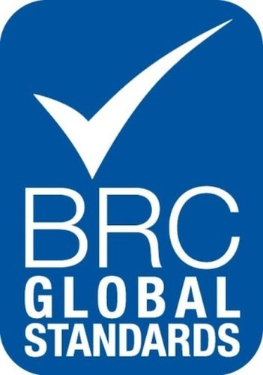
GFSI currently recognizes the following food safety management schemes:
FSSC 22000
BRC Global Standard for Food Safety
IFS Food
GLOBALG.A.P.
PrimusGFS
Safe Quality Food
CanadaGAP
Global Aquaculture Alliance Seafood Processing Standard
Global Red Meat Standard (GRMS)

Slide 21
GFSI Concept
"Certified once - recognized everywhere!"
This means that companies that join GFSI will recognize certificates of any of the standards recognized by GFSI.
An important advantage for manufacturers is that it is enough to be certified according to one of the recognized GFSI standards.

Slide 22
GFSI Approach
Suppliers
Certification under any recognized GFSI system
Recognition of the certificate by buying company
General benefits for industries
Recognized schemes
Manufacturers
Buying Companies
Raw material suppliers

Slide 23
Quality Infrastructure in Uzbekistan, Kazakhstan and Tajikistan
Components | Uzbekistan | Kazakhstan | Tajikistan
Accreditation | Accreditation сenter | National Accreditation Center | National Accreditation Body of the Republic of Tajikistan
Standardization | Uzbek Agency for Standardization, Metrology and Certification | Kazakhstan Institute on Standardization and Certification | Agency for Standardization, Metrology, Certification and Trade Inspection under the Government of the Republic of Tajikistan
Metrology |  | Committee for Technical Regulation and Metrology of the Ministry of Investment and Development of the Republic of Kazakhstan
Conformity assessment | Certification bodies and testing laboratories accredited in the prescribed manner | Certification bodies and testing laboratories accredited in the prescribed manner | Certification bodies and testing laboratories accredited in the prescribed manner
Management System | Certification bodies accredited in the established manner | Certification bodies accredited in the established manner | Certification bodies accredited in the established manner

Slide 24
Legislation in Uzbekistan, Kazakhstan and Tajikistan
Components | Uzbekistan | Kazakhstan | Tajikistan
Accreditation | Law of the Republic of Uzbekistan “On Conformity Assessment” | Law of the Republic of Kazakhstan “On Accreditation in the Field of Conformity Assessment” | Law of the Republic of Tajikistan “On Conformity Assessment”
Standardization | Law of the Republic of Uzbekistan “On Standardization” | Law of the Republic of Kazakhstan “On Standardization” | Law of the Republic of Tajikistan “On Standardization”
Metrology | Law of the Republic of Uzbekistan “On Metrology” | Law of the Republic of Kazakhstan “On ensuring the uniformity of measurements” | Law of the Republic of Tajikistan “On ensuring the uniformity of measurements”
Conformity Assessment | Law of the Republic of Uzbekistan “On Conformity Assessment” Law of the Republic of Uzbekistan “On certification of products and services” | The Law of the Republic of Kazakhstan “On Technical Regulation” | Law of the Republic of Tajikistan “On Conformity Assessment”
Management System | Law of the Republic of Uzbekistan “On certification of products and services” | The Law of the Republic of Kazakhstan “On Technical Regulation” | Law of the Republic of Tajikistan “On Conformity Assessment”
Technical Regulation | Law of the Republic of Uzbekistan "On Technical Regulation" | The Law of the Republic of Kazakhstan “On Technical Regulation” | The Law of the Republic of Tajikistan “On Technical Standardization”

Slide 25
Technical regulation
Application | Uzbekistan | Kazakhstan | Tajikistan
Food Safety Indicators | SanPiN RUz No. 0366-19 Hygienic standards for food safety | Technical regulation of the Customs Union “On the safety of food products” (TR CU - 021 - 2011) | Food Safety (TR RT 010-2016)
Labeling | General technical regulation “On the safety of food products in terms of their labeling” (UzTR.490-022: 2017) | Technical regulation of the Customs Union “Food products in terms of their labeling” (TR TS - 022 - 2011) | Food Labeling (TR RT 001-2014)
Grain | General technical regulation “On grain safety” (UzTR.99-007: 2016) | Technical regulation of the Customs Union “On grain safety” (TR CU - 015 - 2011) | Safety of meat and meat products (TR RT 011-2016)
Milk and dairy products | General technical regulation “On the safety of milk and dairy products” (UzTR.474-020: 2017) | Technical regulation of the Customs Union “On the safety of milk and dairy products” (TR TS - 033 - 2013) | Safety of milk and dairy products (TR RT 012-2016)

Slide 26
Technical regulation
Application | Uzbekistan | Kazakhstan | Tajikistan
Oil and fat products | General technical regulation “On the safety of oil and fat products” (UzTR.520-023: 2017) | Technical regulation of the Customs Union “On oil and fat products” (TR TS - 024 - 2011)
Meat and meat products | General technical regulation “On the safety of meat and meat products” (UzTR.36-030: 2018) | On the safety of meat and meat products (TR CU 034/2013)
Packaging | General technical regulation “On the safety of packaging in contact with food products” (UzTR.476-021: 2017) | Technical regulation of the Customs Union “On packaging safety” (TR TS - 005 - 2011) | Packaging Safety (TR RT 013-2016)
Juice products |  | Technical regulation of the Customs Union “On juice products from fruits and vegetables” (TR TS - 023 - 2011) | Juice products from fruits and (or) vegetables (TR RT 004-2014)

Slide 27
Safety Indicators (fruits and vegetables)
Microbiological indicators
Parameters | Uzbekistan | Kazakhstan | Tajikistan
QMAFAnM, ufc/g, not more Vegetables Fruits | 5х10⁴ 1х10⁵ | 5х10⁴ 1х10⁵ | 5х10⁴ 1х10⁵
Bgkp (coliforms), not allowed in the mass of the product, g _ Vegetables Fruits | 0,1 0,01 | 0,1 0,01 | 0,1 0,01
Pathogenic microorganisms, including salmonella, are not allowed in the mass of the product, g | 25 | 25 | 25
Mold, CFU / g, not more - Vegetables Fruits | 1000 500 | 500 | 500
Yeast CFU / g, not more Овощи Fruits | 200 500 | 500 | 500
In fresh and freshly frozen greens of the dining room, vegetables, fruits and berries, the presence of helminth eggs and intestinal pathogenic protozoa cysts is not allowed

Slide 28
Safety Indicators (fruits and vegetables)
Toxic elements
Parameters | Uzbekistan | Kazakhstan | Tajikistan
Lead Vegetables Fruits | 0,05 | 0,5 0,4 | 0,5 0,4
Arsenic | 0,2 | 0,2 | 0,2
Cadmium | 0,03 | 0,03 | 0,03
Mercury | 0,02 | 0,02 | 0,02

Slide 29
Safety Indicators (fruits and vegetables)и
Pesticides
Parameters | Uzbekistan | Kazakhstan | Tajikistan
HCCH (α, β, γ - isomers) Vegetables Fruits | 0,05 0,5 | 0,05 0,5 | 0,05 0,5
DDT and its metabolites | 0,1 | 0,1 | 0,1
According to Stockholm Convention of 2001 and the Codex Alimentarius standards, it is necessary to control all food products for organochlorine pesticides: HCCH (alpha, beta, gamma isomers), DDT and its metabolites

Slide 30
Comparative analysis (raisins)
Parameters | GOST 6882-88 | CODEX STAN 67-1981
Moisture content, % | 16%-19% | Up to 18%
Mineral impurity | Organoleptically perceptible are not allowed | Should not be present in quantities that significantly affect the taste and suitability of raisins for use.
Peduncle | 2%-8% | 50 pcs / 500 gr.
Crude or underdeveloped | 1-7 % | 6% by weight
Damaged | 2-10% | 5% by weight
Congealed into sugar crystals | - | 15% by weight
Sulfur dioxide (only for clarified raisins) | 0,01 % | 1,500 mg / kg
Mineral oil (food grade) |  | 5 g / kg
Other defects | В сушеном винограде не допускаются: ягоды загнившие; ягоды, пораженные вредителями хлебных запасов; признаки спиртового брожения и плесень, видимая невооруженным глазом. Растительные примеси (0,04-0,07%) | Практически не содержат чужеродные растительные вещества и не иметь повреждений.

Slide 31
Maximum pesticide residue set for cherry fruit in accordance with Codex Alimentarius
No. | Pesticides | (MRL | Year of adoption
1 | Abamectin | 0,07 mg/kg | 2016
2 | Acetamiprid | 1,5 mg/kg | 2012
3 | Amitraz | 0,5 mg/kg
4 | Bitertanol | 1 mg/kg | 2001
5 | Buprofezin | 2 mg/kg
6 | Captan | 25 mg/kg | 2008
7 | Carbendazim | 10 mg/kg | 2008
8 | Chlorothalonil | 3 mg/kg | 2016
9 | Cyantraniliprole | 6 mg/kg | 2014
10 | Cyhalothrin (includes lambda-cyhalothrin) | 0,3 mg/kg | 2009
11 | Diazinon | 1 mg/kg | 1997
12 | Difenoconazole | 0,2 mg/kg | 2008
13 | Dimethoate | 2 mg/kg
14 | Dithiocarbamates | 0,2 mg/kg | 2006
15 | Dodine | 3 mg/kg | 2005
16 | Ethephon | 5 mg/kg | 2016
17 | Fenarimol | 1 mg/kg | 1999
18 | Fenazaquin | 2 mg/kg | 2018
19 | Fenbuconazole | 1 mg/kg | 1999
20 | Fenbutatin Oxide | 10 mg/kg | 1997
21 | Fenhexamid | 7 mg/kg | 2006
22 | Fenpyrazamine | 3 mg/kg | 2018
No. | Pesticides | MRL | Year of adoption
23 | Fenpyroximate | 2 mg/kg | 2014
24 | Fenthion | 2 mg/kg | 1997
25 | Flonicamid | 0,9 mg/kg | 2016
26 | Fluopyram | 2 mg/kg | 2018
27 | Flupyradifurone | 2 mg/kg | 2018
28 | Flutriafol | 0,8 mg/kg | 2016
29 | Fluxapyroxad | 3 mg/kg | 2016
30 | Imidacloprid | 4 mg/kg | 2016
31 | Iprodione | 10 mg/kg | 1997
32 | Isofetamid | 4 mg/kg | 2019
33 | Malathion | 3 mg/kg | 2014
34 | Methidathion | 0,2 mg/kg
35 | Metrafenone | 2 mg/kg | 2017
36 | Myclobutanil | 3 mg/kg | 2015
37 | Propiconazole | 3 mg/kg | 2019
38 | Pyraclostrobin | 3 mg/kg | 2015
39 | Pyrimethanil | 4 mg/kg | 2008
40 | Quinoxyfen | 0,4 mg/kg | 2007
41 | Spinetoram | 0,09 mg/kg | 2018
42 | Sulfoxaflor | 1,5 mg/kg | 2015
43 | Tebuconazole | 4 mg/kg | 2012
44 | Triflumizole | 4 mg/kg | 2014

Slide 32
Recommendations for the improvement of quality infrastructure
Mutual recognition of the results of certification and tests (conformity assessments)
Obtaining international status by national accreditation bodies (IAF, ILAC)
Obtaining international accreditation by certification bodies and testing laboratories
Harmonization of local standards and technical regulations with international standards, directives and codes
Expansion of the technical area of analytical laboratories, for example, for the determination of pesticide residues
Testing based on risk assessment
Use of good agricultural practices in the cultivation of fresh agricultural products
Implementation of food safety standards based on the principles of HACCP, GMP and Codex (ISO 22000)
Implementation of commercial standards recognized by GFSI (GLOBALGAP, FSSC 22000, BRC, IFS, etc.)
Implementation of standards for certain target groups of consumers, such as HALAL, KOSHER, ORGANIC to increase the added value of food products
Implementation of food safety standards by trade companies engaged in food export, such as BRC Global Standard for Agents and Brokers, IFS Broker, etc.
Unification and regional cooperation
Creation of production cooperatives

Slide 33
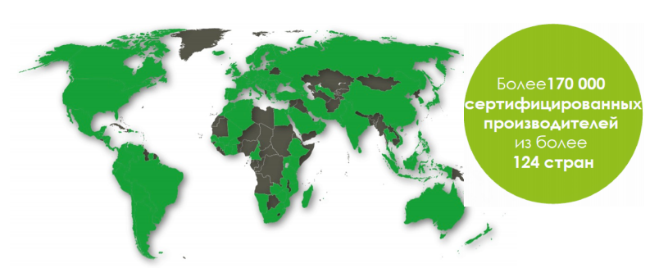
The international standard GLOBALG.A. P.
The standard ensures the safety of grown agricultural products.
Certification covers the full production cycle.
The main stages of building the GLOBALG.A.P. system.:
Preparation of the farm
Personnel training
Implementation of criteria for compliance with the requirements of the standard
More than 170000 certified producers
From more than 124 countries

Slide 34
Advantages of a company that has GLOBALG.A.P. certificate
Expansion of geography of deliveries in the international market,
Traceability of agricultural products,
Trust in farming and its products by consumers,
Improving the status of products for retailers,
Proper consideration of chemical and fertilizer applications,
Food safety guarantee,
Minimization of negative impact on the environment,
Improving the company's interaction with other manufacturers,
Harmonization of food safety management systems, health and safety of workers and environmental protection.

Slide 35
Key points in implementing GLOBALG.A.P.
Production risk analysis.
Analysis of the soil and its suitability.
Analysis of water and its suitability.
Product tracking and return procedures
Planting material quality
Occupational safety and hygiene.
Environmental protection
Application of integrated plant protection system
Proper harvesting, processing and storage of products.

Slide 36
International standard “ORGANIC”
The standard builds a production management system based on organic agriculture.
It has become especially relevant for the climate change trend, since it is agriculture that is one of the reasons for the high atmospheric emission of CO2 and soil erosion.
In a number of countries (EU, USA, India) it is supported by the state.

Slide 37
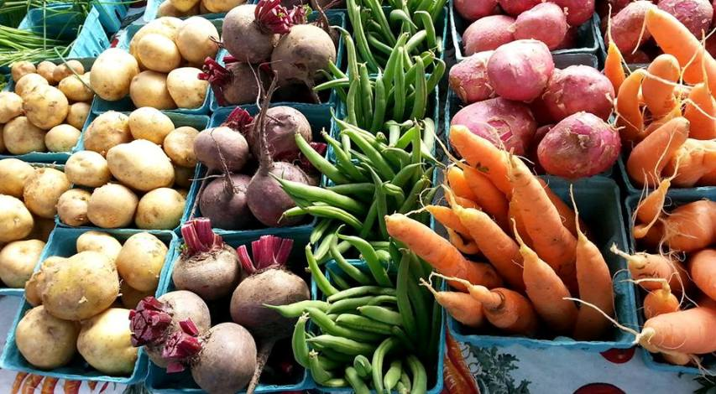
Benefits of implementing the ORGANIC standard
High price and value of grown products
The challenge is to promote ecosystem health and biodiversity
Improves soil fertility, contributing to its recovery. Reduce the risk of desertification
Reduces the risk of water pollution
Organic farms are energy efficient
Contributes to employment growth of rural population
Encourages the cooperation
Consumers prefer organic products over traditional products

Slide 38
Technical regulation “ORGANIC”
Codex Alimentarius CAC/GL 32-1999 “Guidelines for the manufacture, processing, labelling and marketing of organic food”
Council regulation (EU) of 28 June 2007 No. 834/2007 on organic production and labelling of organic products
Council regulation (EU) of 30 May 2018 No. 2018/848 (comes into force from 01.01.2021)
USDA National Organic Programme (USA)
GOST 33980-2016 Products of organic production. Rules of production, processing, marking and sale
O'z DSt 3290: 2017 Organic agricultural and food products. Rules of production, storage and transportation

Slide 39
Comparison between international standards
GLOBALG.A.P.
ORGANIC
Structuring of production processes
Product and personnel safety
Sustainable resource management
Approved list of acceptable chemicals
Optimal use of mechanization
Traceability of the final product
Principle from Field To Plate
Individual approach to land use
Biological plant protection
Support for biodiversity
Plants are not exposed to direct treatment
Minimum mechanization of cultivation
Product traceability

Slide 40
“HALAL” Certification»
The certificate of compliance with the Islamic standard HALAL is the main confirmation of compliance of production and products with the requirements of Sharia law
The "HALAL" conformity mark is a special marking that is applied to the packaging of goods of a manufacturer that has passed the “HALAL” certification and has the appropriate certificate. Only those enterprises and producers of goods and services that have successfully passed “Halal” certification have the right to use this mark. Marking is universal all over the world and is a direct confirmation of the quality of the product and its compliance with all necessary requirements and canons

Slide 41
Technical regulation "HALAL»
CAC/GL 24-1997 General guidance on the using the term “HALAL” (Recommendations of CODEX ALIMENTARIUS Commission)
MS 1500: 2009 Malaysia “HALAL FOOD” standard
OIC/SMIIC 1: 2011 Basic principles of products permitted by Islam (Organization of Islamic Conference (OIC), Standards and Metrology Institute of Islamic Countries (SMIIC ))
EU Halal - 1: 2012 Eurasian “HALAL” Standard. General requirements for the production, manufacture, processing, storage, transportation and sale of “HALAL” products
O'zdst 3286: 2018 “General guidance on “Halal” food (food products) (national standard of Uzbekistan)

Slide 42
Leading importers of Halal products in 2015 by OIC countries (in billions of US Dollars)

Slide 43
Thank you for your attention!
LLC “Global Research and Consulting”
100100, Republic of Uzbekistan, Tashkent,
Shota Rustaveli str., 45, 4th floor, Room No. 412
Tel: + 998 (71 )255-3503
+998 909985676
+998 901680244
Email: grcuz@mail.ru, grcuzb@gmail.com
Web site: https://grc.uz

