Slide 1
ADB Workshop
Tashkent, Uzbekistan
5-6 December 2019
Shymkent-Tashkent-Khujand Economic Corridor: Proposed Focus Areas and Institutional Setup
Bahodir Ganiev
ADB Consultant

Slide 2
Outline
Definition of a transnational economic corridor (TNEC)
Rationale for development of TNECs in Central Asia
Vision for the proposed Shymkent-Tashkent-Khujand economic corridor (STKEC)
Proposed focus areas for STKEC development
Current situation (existing issues)
Actions to address the issues
Proposed institutional setup for STKEC development

Slide 3
What is a TNEC?
A TNEC or a cross-border economic corridor is an integrated economic region that spans two or more countries
Typically, it includes several big cities and the areas around and between these cities
It is characterized by superior connectivity, seamless movement of goods and people across borders, and high density of economic activity with extensive cross-border trade and investment flows
It combines agglomeration (clustering of economic activity) with regional economic cooperation and integration
The concept of a TNEC is related to, but is different from, the concepts of a transport corridor

Slide 4
Why are TNECs Needed in Central Asia?
The economies of the Central Asian countries (CACs) are small and not well integrated into the global economy
Bilateral trade flows between some CACs are small
The stock of inward FDI is small in most CACs
The level of urbanization is low in the CACs
Manufacturing and services sectors are underdeveloped in the CACs
Primary commodities dominate their exports

Slide 5
Potential Benefits of TNECs
for Central Asian Countries
Development of TNECs can help the CACs
deeper integrate their economies with each other and with the global economy
attract more FDI and international tourists
develop urban agglomerations, manufacturing and the services sector
diversify the composition of exports away from primary commodities and towards manufactures and services
make a greater variety of higher quality goods and services available to consumers at lower prices

Slide 6
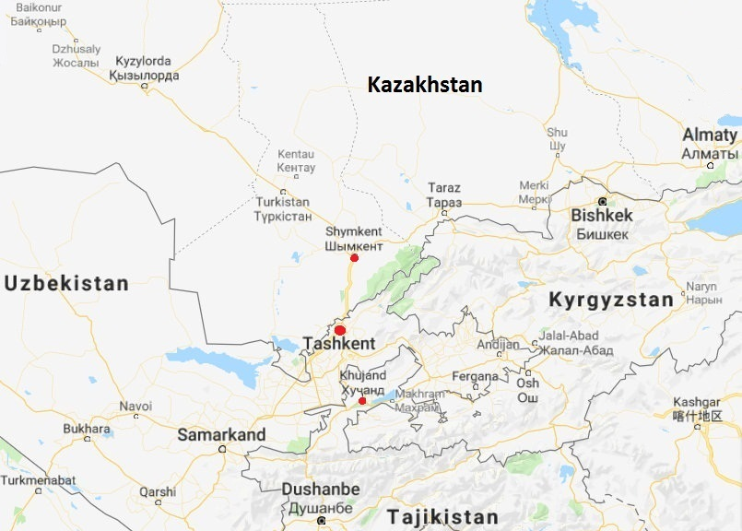
Geographic Focus of STKEC
Kazakhstan:
Shymkent city
Turkestan oblast
Uzbekistan:
Tashkent city
Tashkent oblast
Tajikistan:
Khujand city
Sughd oblast
Source: Google Maps

Slide 7
Overall Vision for STKEC
The STKEC will be an integrated, dynamic economic region characterized by:
Superior connectivity both within the region and with the rest of the world
High density of economic activity
Extensive cross-border trade and investment flows among the Kazakh, Tajik and Uzbek parts of the corridor
Extensive trade with the rest of the world
Faster technical progress
High proportion of manufactures and services in exports

Slide 8
Growth Rates of Real
Gross Regional Product (%)
City/oblast | 2014-2018 | 2019-2025 | 2026-2030
 | Actual | Targetª | Targetª
Shymkent city and Turkestan oblast | 9.8^{b} | 10.5 | 11.0
Tashkent city | 10.6 | 11.0 | 11.5
Tashkent oblast | 4.9 | 6.0 | 8.0
Sughd oblast | 6.7 | 8.0 | 10.0
ª Preliminary.
^{b} The average annual growth rate of real GRP of former South-Kazakhstan oblast in 2014-2017.
Sources: Statistics Committee of the Ministry of National Economy of the Republic of Kazakhstan, Government of the Republic of Tajikistan, State Committee of the Republic of Uzbekistan on Statistics, International Monetary Fund, and TA team.

Slide 9
Share of Selected Sectors in
Gross Regional Product (%)
City/oblast | Sector | 2018 | 2025 | 2030
 |  | Actual | Targetª | Targetª
Shymkent city | Manufacturing | 22.6 | 24 | 25
 | Services | 61.0 | 60 | 60
Turkestan oblast | Manufacturing | 9.9 | 12 | 14
 | Services | 48.5 | 50 | 50
Tashkent city | Services | 50.0 | 53 | 55
Tashkent oblast | Services | 22.3 | 25 | 28
Sughd oblast | Manufacturing | 14.1 | 16 | 18
 | Services | 40.9 | 43 | 45
ª Preliminary.
Sources: Statistics Committee of the Ministry of National Economy of the Republic of Kazakhstan, Government of the Republic of Tajikistan, State Committee of the Republic of Uzbekistan on Statistics, and TA team.

Slide 10
Proposed Focus Areas
Improvement of (road and railway) transport connectivity
Modernization of border crossing infrastructure and procedures
Development of cross-border agricultural value chains
Modernization of sanitary and phyto-sanitary (SPS) measures and enhancement of quality infrastructure for exports of agricultural and food products
Development of regional tourism
Development of special/free economic zones (SEZ/FEZs) and industrial zones/parks (IZ/IPs)

Slide 11
Road Transport Connectivity:
Current Situation
Main roads in the STKEC region, including the roads connecting Shymkent, Tashkent and Khujand cities, are in good condition
However, many secondary and tertiary roads, such the Khujand-Asht road, require rehabilitation
Operation and maintenance of roads is less than adequate
Entry quotas and fees as well as differences in road transport regulations inhibit cross-border movement of goods and people
Manual weighing stations in Kazakhstan and the “heat regime” in Tajikistan are major barriers to road shipments to/from/through these countries

Slide 12
Road Transport Connectivity:
Proposed Actions
Harmonize road transport regulations (including axle load regulations)
Abolish entry quotas and reduce entry fees
Exempt shipments of perishable goods from the “heat regime” in Tajikistan
Rehabilitate secondary roads that are important to external and/or internal transport connectivity (e.g. Khujand-Asht road)
Introduce intelligent transport systems with automated weigh-in-motion stations

Slide 13
Railway Transport Connectivity:
Current Situation
Railway transport accounts for most of international freight shipments within/to/from/through the STKEC region
Railway tariffs for transit freight shipments are much higher than those for domestic/export/import shipments
Rail transport infrastructure (including the railway networks and the rolling stock) has serious weaknesses
Rail transportation times are long and often unpredictable (for both freight and passengers)

Slide 14
Railway Transport Connectivity:
Proposed Actions
Reduce the differences between railway tariffs for transit and domestic/export/import freight shipments
Modernize the existing railway infrastructure
Consider building (i) a Turkestan-Shymkent-Tashkent high-speed railway and (ii) a railway link between the southern and the northern parts of Sughd oblast
Introduce modern information and communication technologies (such as radio frequency identification technology) in railway transport

Slide 15
Border Crossing Points:
Current Situation
There are 5 border crossing points (BCPs) between Turkestan and Tashkent oblasts and 3 BCPs between Tashkent and Sughd oblasts
Movement of goods and people through these BCPs has increased considerably over the past several years
Inadequate infrastructure and procedures at the BCPs cause substantial delays in cross-border movement of goods and people, fuel corruption, increase trade costs, and hinder tourism development
The Governments of Kazakhstan and Uzbekistan have agreed on, and are implementing, a roadmap for modernization of the BCPs between the two countries

Slide 16
Modernization of Border Crossing Points: Proposed Actions
Ensure modernization of not only infrastructure, but also procedures at the BCPs between Kazakhstan and Uzbekistan
Modernize infrastructure and procedures at the BCPs between Tashkent and Sughd oblasts
Introduce risk-based customs control at all BCPs along the STKEC
Ensure transparency and predictability of border crossing procedures (including the risk-management systems)

Slide 17
Modernization of Border Crossing Points: Proposed Actions (Continued)
When modernizing the BCPs, introduce (at least at some BCPs):
An electronic advance notification system and green/express lanes for people
e-TIR system with green lanes for trucks using this system
Integrated border management with a one-stop-shop for all or most border controls
Exchange of electronic advance notifications between customs and other border agencies of the two countries
Joint customs, phyto-sanitary and veterinary inspections

Slide 18
Agricultural Value Chains:
Current Situation
The STKEC region has considerable unrealized potential for the production and exports of agricultural products
Lack of water is a major constraint on crop production
Productivity in agriculture is low in part because of small-scale farming, poor farming practices and slow introduction of modern technologies
Agricultural value chains are underdeveloped
Post-harvest losses are substantial due to lack of storage facilities and limited processing capacity

Slide 19
Development of Agricultural Value Chains: Proposed Actions
Enhance cross-border collaboration in plant and animal breeding
Establish/develop agricultural cooperatives and clusters
Strengthen the agricultural extension systems and introduce modern agricultural technologies (such as solar-powered irrigation and precision farming)
Set up a regional network of modern agro-logistics centers
Establish/develop electronic wholesale and retail markets for agricultural goods

Slide 20
SPS Measure & Quality Infrastructure:
Current Situation
Kazakhstan, Tajikistan and Uzbekistan have all done good progress in strengthening their SPS systems in recent years
Still, the degree of harmonization of the national SPS standards and technical regulations with international standards is low
SPS measures are not always evidence-based and heavily rely on physical inspections
SPS and food quality laboratory capacity is weak in the STKEC region
Food safety/quality certification services are underdeveloped

Slide 21
SPS Measure & Quality Infrastructure:
Proposed Actions
Harmonize national SPS standards and technical regulations with international standards
Enhance cross-border collaboration of the central and local government agencies in charge of protecting plant and animal health and ensuring food safety/quality
Transition to risk-based SPS control over international trade
Develop a regional network of internationally accredited phyto-sanitary, veterinary and food safety/quality laboratories
Build local capacity for the provision of food safety/quality certification services

Slide 22
Regional Tourism: Current Situation
Shymkent and Tashkent cities as well as Turkestan, Tashkent and Sughd oblasts have numerous tourism assets
Development of tourism is one of the top priorities of the governments of Kazakhstan, Tajikistan and Uzbekistan
The number of international visitor arrivals has increased considerably in all three countries over the past several years
Nonetheless, the potential of the STKEC region for tourism, including intra-regional and inter-regional tourism, is far from being fully realized

Slide 23
Development of Regional Tourism:
Proposed Actions
Introduce multi-country tourist visas
Strengthen capacity of central and local government agencies in charge of tourism development
Enhance cross-border collaboration of government agencies and the business communities in tourism development
Develop regional tourism products and improve availability of information about tourism assets of the STKEC region
Improve transport connectivity of major tourism sites in the STKEC region

Slide 24
SEZ/FEZs and IZ/IPs: Current Situation
There are 8 SEZ/FEZs and dozens of IZ/IPs in the STKEC region
The firms operating in the SEZ/FEZs and IZ/IPs benefit from relatively good infrastructure
The companies in the SEZ/FEZs also enjoy tax privileges
The establishment the SEZ/FEZs has helped attract FDI, create jobs, and boost exports
However, the economic impacts of the SEZ/FEZs have thus far been relatively small

Slide 25
Development of SEZ/FEZs and IPs:
Proposed Actions
In developing SEZ/FEZs and IZ/IPs, rely more on improving the institutional framework and infrastructure, and less on providing tax privileges
Establish/develop agro-industrial complexes and food industry zones with modern agro-logistics centers and food safety/quality labs
Develop and implement actions plans aimed at integrating the SEZ/FEZs and IZ/IPs into regional and global value chains
Introduce regular monitoring and evaluation of the performance of the SEZ/FEZs and IZ/IPs

Slide 26
Proposed Institutional Setup
Bilateral Intergovernmental Commissions
CAREC Ministerial
Meetings
STKEC
Steering Committee
CAREC National Focal Points and Senior Officials Meetings
STKEC Focus Area
Working Groups
CAREC Sector Committees
and Working Groups
STKEC Secretariat
CAREC Secretariat
Support and reporting
Coordination

Slide 27
Proposed Functions and
Membership of STKEC Bodies
STKEC Body | Functions | Membership
Steering Committee (SC) | Oversee overall progress in STKEC development Review the proposals made by the WGs | CAREC National Focal Points for KAZ, UZB and TAJ; deputy mayors of Shymkent, Tashkent and Khujand cities; and deputy governors of Turkestan, Tashkent and Sughd oblasts
Focus Area Working Groups (WGs) | Propose actions and projects aimed at developing the STKEC Help resolve issues in the implementation of the approved actions and projects | Representatives of the concerned central and local government agencies and of the business communities of the three countries
Secretariat | Monitor progress in STKEC development Prepare periodic progress reports Coordinate with the concerned central and local government agencies and with the business communities Organize meetings of the SC and WGs | Representatives of focal agencies of KAZ, UZB and TAJ supported by ADB

Slide 28
Thank You

