Slide 1

ADB Workshop
20 April 2021
Overview of the Road Map
for Shymkent-Tashkent-Khujand
Economic Corridor Development
Bahodir Ganiev
ADB Consultant

Slide 2
Outline
Key steps in the formulation of the road map for Shymkent-Tashkent-Khujand economic corridor (STKEC) development
Geographic focus of STKEC development
Thematic focus areas for STKEC development
Expected results (vision for the STKEC)
Proposed institutional setup for STKEC development

Slide 3
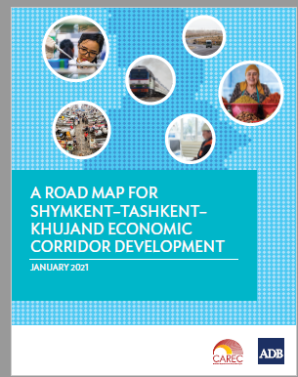
Key Steps in Formulation of Road Map for STKEC Development
Approval of the ADB technical assistance (October 2018)
Inception workshops and the first phase of filed work (May 2019)
Second phase of the field work (July-September 2019)
First regional workshop (December 2019
Second regional workshop (August 2020)

Slide 4
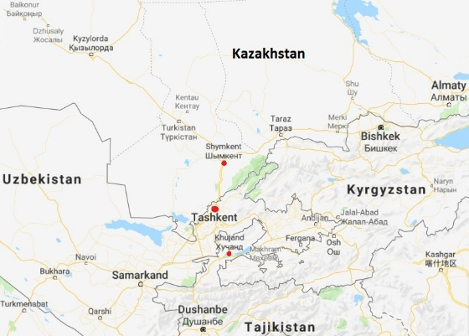
Geographic Focus of STKEC Development
Kazakhstan:
Shymkent city
Turkestan oblast
Uzbekistan:
Tashkent city
Tashkent oblast
Tajikistan:
Khujand city
Sughd oblast
Source: Google Maps

Slide 5
Opportunities for Increasing Trade
in STKEC Region
Growing markets in the STKEC region
Little trade now, but huge potential for expansion
Some scope for intra-industry trade in existing sectors
Development of new export products (higher value-added agriculture, manufacturing etc.)
Untapped potential for trade in services (e.g. tourism, education, health care)
Expansion of transit trade

Slide 6
Opportunities for Increasing Cross-Border Economic Cooperation in STKEC region
STKEC region as a ‘laboratory’ for export product development
Development of regional value chains (COVID-19 lessons)
Provision of regional public goods:
joint network of quality certification facilities
joint development of standards and certification for organic produce
joint professional education and business development programs for prospective export sectors (e.g. tourism)

Slide 7
Proposed Thematic Focus Areas
Improvement of road and railway transport connectivity
Modernization of border crossing points and border management
Development of horticulture value chains
Modernization of sanitary and phyto-sanitary measures and development of food quality certification services
Development of regional tourism
Development of special economic zones and industrial zones

Slide 8
Expected Results (Vision for STKEC)
Close economic cooperation among the Kazakh, Tajik, and Uzbek parts of the STKEC
Superior transport connectivity of the STKEC
Seamless movement of vehicles, goods, and people across borders within the STKEC
Extensive cross-border trade and investment flows within the STKEC
High levels of trade with the rest of the world
Larger shares of manufactures and services in exports

Slide 9
Proposed Institutional Setup
Bilateral Intergovernmental Commissions
CAREC Ministerial
Meetings
STKEC
Steering Committee
CAREC National Focal Points and Senior Officials Meetings
STKEC Thematic
Working Groups
CAREC Sector Committees
and Working Groups
STKEC Secretariat
CAREC Secretariat
Support and reporting
Coordination

Slide 10
Thank You

Slide 11
Implementing the Road Map for Shymkent-Tashkent-Khujand
Economic Corridor Development
20 April 202

Slide 12
Outline
Expected Outputs and Planned Activities under TA 9630
Next Steps

Slide 13
Outputs and Activities
Output 1: Prefeasibility studies to develop the STKEC
  Establishment of an International Center for Trade and Economic Cooperation (ICTEC between Kazakhstan and Uzbekistan)
  Establishment of a Trade and Logistics Center in Sugd Oblast of Tajikistan
Output 2: Institutionalization of the STKEC
  Signing of a trilateral memorandum of understanding
  Creation and operationalization of the STKEC Steering Committee, and Working Groups in the focus areas
Output 3: Knowledge sharing and capacity building on economic corridor development (ECD)
  ECD related training workshops
  Study tours in other regions and countries for learning of good ECD practices

Slide 14
Next Steps
Output 1: Prefeasibility studies to develop the STKEC
  A consulting firm to be engaged to undertake the two studies
  Strong government support desired give the complexity of the projects: large scope and data analysis for a wide range of areas
  Country and regional consultations in Q3 and Q4 2021
  Possible field studies in the countries depending on the pandemic situation
  Estimated completion of two studies in 2022
Output 2: Institutionalization of the STKEC
  Creation and operationalization of the STKEC Steering Committee and Working Groups in the focus areas
  Establishment of the STKEC Steering Committee in tandem with the signing of the trilateral MOU on STKEC development
  A first working group on cross-border transport, trade and logistics to be established upon recruitment of consulting firm on the two studies
Output 3: Knowledge sharing and capacity building on economic corridor development (ECD)
  Virtual training (cross-border transport, trade and logistics): TIR digitalization in 2021 (?)
  Study tour on cross-border economic cooperation (e.g., integrated border management) in 2022 (depending on the pandemic situation), learning of good ECD practices

Slide 15
  Any Comments and Suggestions?
  Thank you!

Slide 16

Facilitating cross-border transport for improved trade through TIR digitalisation
Tatiana Rey-Bellet
Director, TIR and Transit Services, IRU

Slide 17
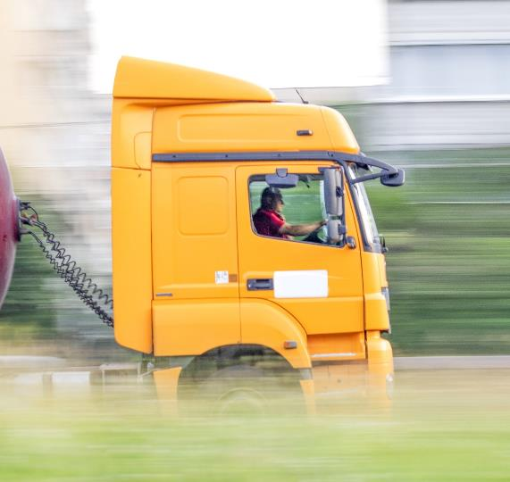
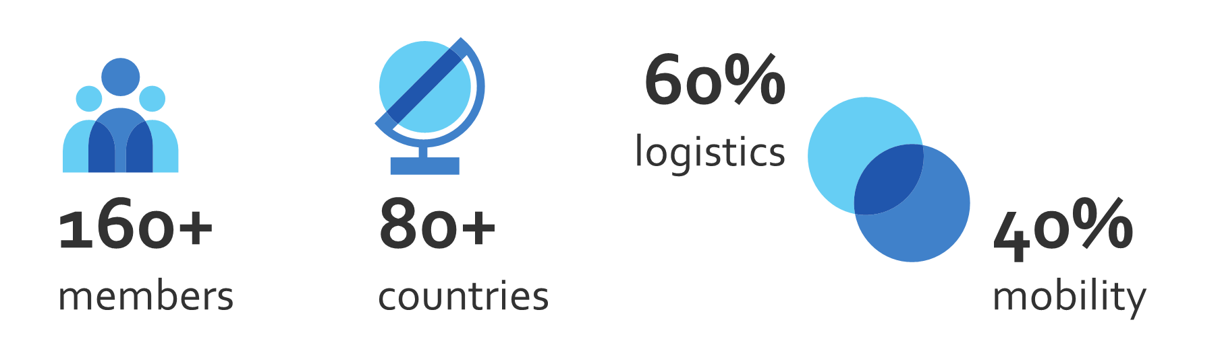
^{The world road}
^{transport organisation}
IRU is the global voice of companies providing commercial road transport, mobility and logistics services.
WE ARE THE VOICE
OF MORE THAN
3.5 MILLION
COMPANIES WORLDWIDE

Slide 18
COVID-19 IMPACTS
Macro-economic indicators
Overall, an estimated decline in GDP by -5.6% in 2020.
It will take at least 3 years to return to pre-crisis level.
Impact on road transport turnover (passenger and freight)
FY 2019 vs FY 2020
- 18%
-1 Trillion $
Looming wave
of bankruptcies
Revenue loss
Globally
Sources IHS Markit, IRU analysis 2020

Slide 19

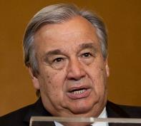
ROLE OF UN CONVENTIONS
IN FIGHTING COVID-19
First AND last response in a global emergency
“Innovative tools such as UN eTIR/eCMR systems and other tools that allow to exchange electronic information without physical contact and facilitate the flow of goods across borders should be used”
ANTÓNIO GUTERRES
UN Secretary General

Slide 20
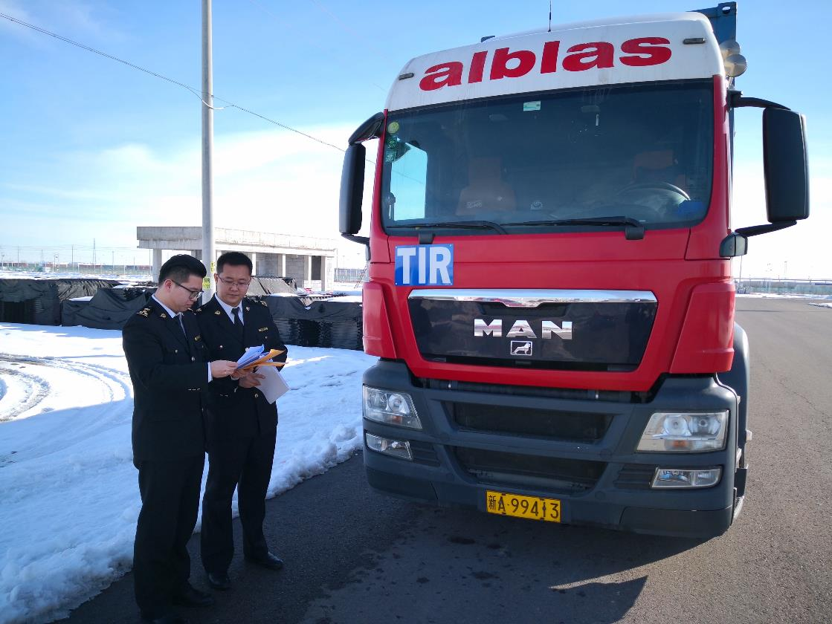
FACILITATING AND SECURING
TRADE AND TRANSPORT
MANAGED BY IRU SINCE 1949

Slide 21



DIGITALISATION OF KEY UN
TRANSIT FACILITATION TOOLS

Slide 22
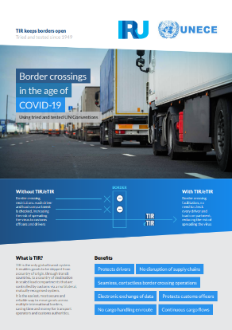
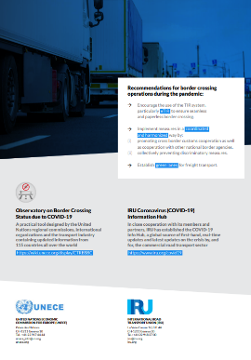
WITH eTIR
Seamless, contactless border crossing operations
Electronic exchange of data
Protects drivers
No disruption
of supply chains
Border crossing facilitated
No cargo handling en route

Slide 23
TIR Digitalisation
History
1987: B2B between IRU and Associations
IRU digitalising B2B aspects of TIR
  TIR carnets management
  Data exchange with TIR associations
1995: SafeTIR (C2B)
  Recommendation for customs to send TIR terminations data
  2006: Annex 10 of TIR Convention on SafeTIR
2002: TIR-EPD: B2C/C2B
  TIR advance information exchanges between TIR hauliers and customs
2015: UNECE and IRU endeavoring to digitalise TIR
      First eTIR transport between Turkey and Iran in 2015
  2015: UNECE-IRU eTIR pilot project between Turkey and Iran
  2019: eTIR pilot transports between Iran and Azerbaijan
  2020: Uzbekistan – Kazakhstan digitalisation projects
2021: Annex 11 - eTIR
  Adoption of Annex 11 of the TIR Convention – legal basis for eTIR
  Annex 11 entry into force in May 2021

Slide 24
Digital TIR projects
expansion
RUS
KAZ
AZE
UZB
KYR
TUR
TAJ
AFG
CHN
IRN
Operational
  1: Iran-Turkey Pilot project
  2: extension to Azerbaijan
  3: Uzbekistan-Kazakhstan
To come
  4: Uzbekistan-Tajikistan
  5: Intermodal facilitation India-Iran-Afghanistan
  5: Iran-Kazakhstan-Uzbekistan
PAK
IND

Slide 25
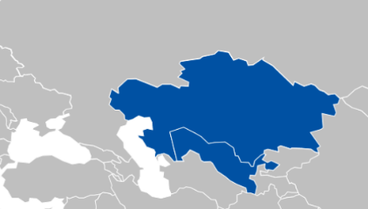
Digitalisation of Tajikistan-Uzbekinstan-Kazakhtsan corridor
Project advancement:
Uzbekistan-Kazakhstan digital TIR project lauched in November 2020
Tajikistan expressed its interest to join project in December 2020
Tajikistan implemented TIR-EPD in March 2020
Uzbekistan-Kazakhstan digital TIR project extension towards Tajikistan foreseen for 4-5 May 2021

Slide 26
Digitalisation of Tajikistan-Uzbekinstan-Kazakhtsan corridor
Status
BCP point defined for eTIR pilots:
Yallama UZB /Konisbayeva KAZ;
Oibek UZB/Fotokhobod TJK
Inland customs offices in Uzbekistan, Kazakhstan & Tajikistan defined for digital TIR project
List of TIR transport operators to participate in pilots ready
TIR hauliers‘ + Assiciations trainings
3 step approach agreed with invloved customs administrations
  TIR Carnets and message exchange monitoring (currently)
  Digital TIR pilot transports accompanied by print@home TIR forms
  Digital TIR pilot transports – fully digital
Finilisation of technical adjustments in Kazakhstan, Tajikistan and Uzbekistan is underway

Slide 27
Digitalisation of Tajikistan-Uzbekinstan-Kazakhtsan corridor
Next steps
Use Digital TIR shipments
  to ensure smooth electronic message exchange
  to prepare detailed customs procedures based on learnings from digital TIR Project
  to train customs officers and transport operators
  to implement Green Lanes for enhanced transparency & security in International transport offered by TIR system
Implement full e TIR message exchange including connectivity to eTIR International system according to Annex 11

Slide 28

«ДЕЛОВЫЕ СВЯЗИ»
Annex 11 – entry into force on 25 may 2021
C2C and C2B messages through eTIR International System (hosted by UNECE as a central database)
eTIR specifications yet to be adopted by Contracting Parties
Direct communication channel to be established between customs and UNECE and between UNECE and IRU
B2C and C2B
Already functioning and will continue to be used:
For sending TIR data to the customs of departure
For advance information to customs of itinerary
1 global system with full digital functionalities

Slide 29
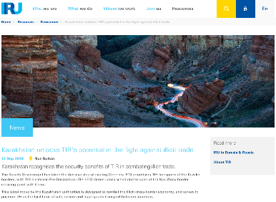
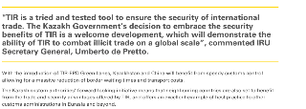
Kazakhstan unlocks TIR potential in the fight against illicit trade – TIR-EPD Green Lanes
Kazakhstan recognises the security benefits of TIR in combatting illicit trade
  The Government took a decisive step by issuing Order N°619 prioritising TIR transports with TIR Electronic Pre-Declaration (TIR-EPD)
Uzbekistan and Kazakhstan pledged for implementation of TIR Green Lanes at Yallama(UZB)-Konisbayeva(KAZ) BCP

Slide 30
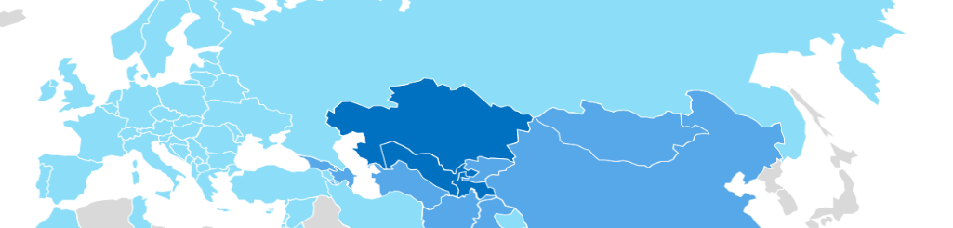

Bringing private sector actors together
for more efficient transport solutions
«Business Connections» to overcome urgent issues and help the industry:
Challenge – COVID-19
Need to keep supply chains running
Module created based on IRU existing platform for transport operators
  Selection of corresponding transport operators (TIR holders) and organisation of transport according to the needs;
  Possibility to establish contact between the TIR holders with other transport operators, the freight forwarders, exporters, shippers, warehouses, customs brokers.
Notes:
COVID-19
Following the measures taken by some countries during the pandemic – borders being closed and vehicles from foreign countries being forbidden to enter one country or another, as it was the case in Saudi Arabia, for example, the organisation of transports requires the swap of vehicles, which implies a complex organisation.
BREXIT
Following Brexit and the shortage of British transport operators, requests are being regularly received from 3rd parties to assist them to find TIR transport operators.

Slide 31
Advantages of
«Business Connections»
For TIR transport operators:
More business opportunities thanks to the visibility of TIR operators’ profile through TIR-EPD;
Possibility to partner with other TIR operators in order to overcome various restrictions, including those related to COVID-19.
For logistics operators:
Possibility to reach out to TIR operators;
Facilitated organisation of “complex” door-to-door movements, e.g. from China to Europe and intermodal transport, with all parties connected and customs declarations sent through TIR-EPD;
Facilitated organisation of transport of consolidated goods.
All trusted partners along the logistic chain are linked through the «Business Connections» module.
Notes:
For TIR transport operators:
Enlargement of business opportunities through presentation of their data (company capacities – vehicles, type of goods usually transported, itineraries, etc.) and acceptance to share it through TIR-EPD with 3rd trusted parties,
TIR to be possibly used on UK-EU, GCC, CHN-EUR routes,
Possibility to be enrolled as subcontractors
Possibility to have assistance from a dedicated partner at a fixed price, thus reducing the risk of unjustified payments.
For the logistic operators:
Facilitated access to reliable and experienced transport operators;
Facilitated organisation of “complex” road / intermodal transports door-to-door – e.g. from China to Europe – having all the actors enrolled and connected, as well as customs declarations being sent through TIR-EPD;
Facilitated procedure especially for transport of consolidated cargo – when declaring it through TIR-EPD (in the framework of e-commerce, Brexit);
Facilitated border crossing with TIR in the framework of Brexit, and facilitated organisation of such transport directly from the warehouses located in UK and awaiting goods from Europe.

Slide 32

Summary
IRU encourages the STKEC corridor countries to implement TIR Green Lanes
IRU offers its B2C/C2B and B2B capacities to better connect all actors and speed up the corridor digitalisation

Slide 33

For a world in motion
iru.org

