Slide 1

Visitsilkroad.org
Web portal
Presentation

Slide 2
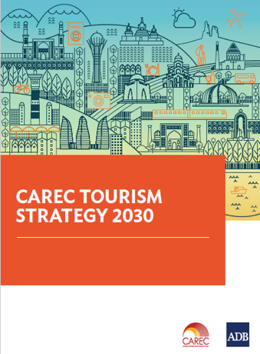
CAREC Tourism Strategy 2030
Institutions and Governance
Connectivity
and
Infrastructure
Quality
and Standards
Skills
Development
Marketing
and Branding
Market
Intelligence
Cross-cutting Themes: Health, Safety and Security, Digitalization, Gender, Environmental Sustainability, Private Sector Participation, Universal Access
Marketing strategies and initiatives to reinforce countries’ image as safe tourism destinations;
Building the common brand “Visit Silk Road” through the development of the CAREC tourism web portal

Slide 3
CAREC Tourism Web Portal: Content
The portal provides content to different audiences which creates traffic synergies and opportunities for sustaining the project.
Tourism Content
Investor Content
Countries, Regions and Assets, Clusters, Partner’s Experiences
(Where, What, How, Who)
Travel Guides and Editorial
(Aggregators, Storytelling, Traffic builders, SEO)
Investment Regulations & Legislation
(Regulatory framework, financing mechanisms and alternatives for each country and for the region)
Investment Projects (R)
(Tourism Investment projects)
synergies
Institutional Content
Education Content
Tourism Development
Tourism Data and Statistics (R)
Tourism Publications (R)
Events
Contacts
Learning Programs
(practical information, scholarships and government sponsored programs for Tourism and Hospitality education on SilkRoad countries)

Slide 4
CAREC Tourism Web Portal: Timeline
Tourism Content
Tourism content creates the baseline for significant traffic building and should be completed first.
Investment and educational content offer opportunities for generation of revenue
2 W
2 W
4 W
Country
Regions
Assets
8 W
Clusters
Institutional and investment content
3 W
3 W
A total of 13 weeks to receive information from the countries
Different entities in the Governments provide information in parallel
All countries benefit from good information provided from the other countries
Regulations & Legislation
Projects
6 W
Learning & education content
3 W
3 W
Entities
Programs
6 W
13 W

Slide 5
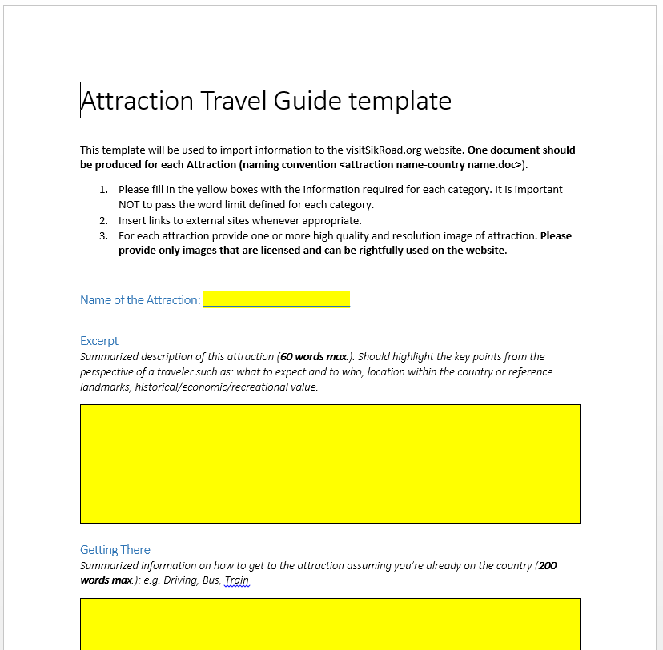
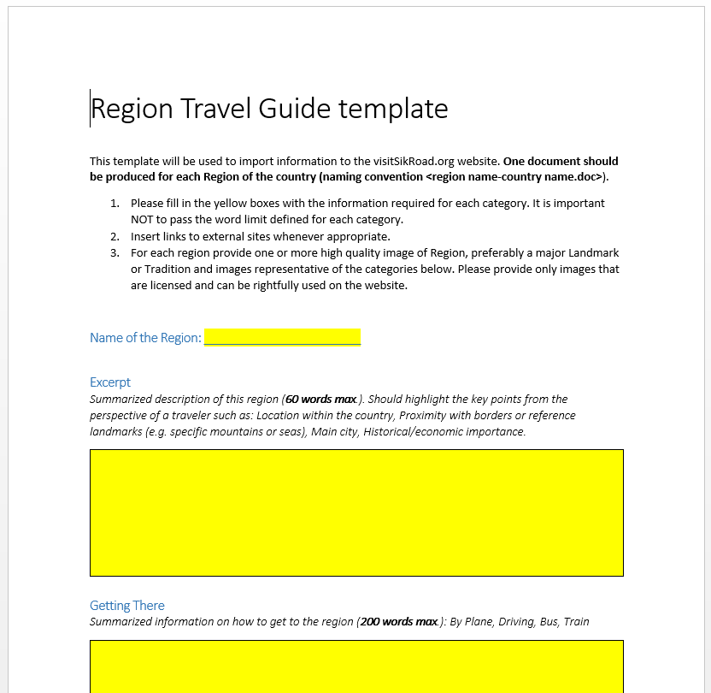
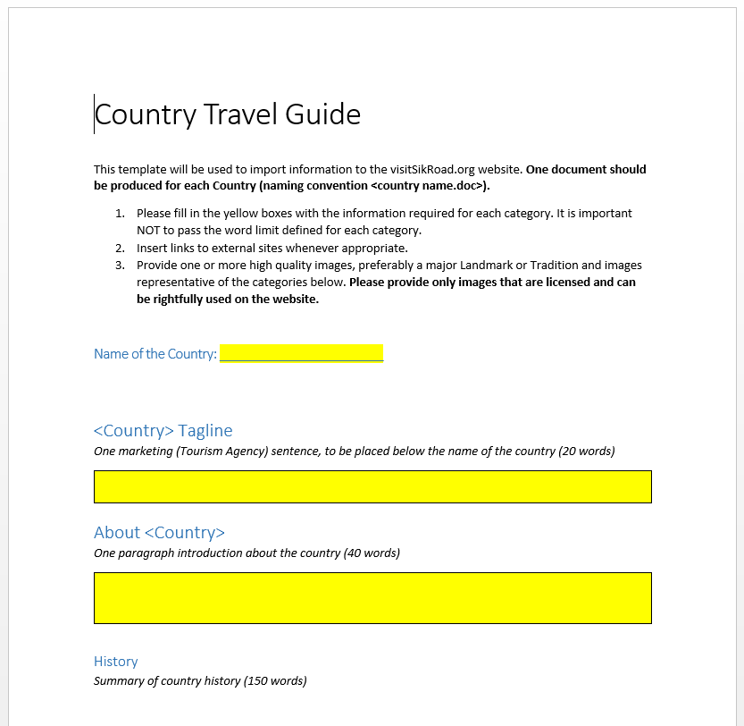
CAREC Tourism Web Portal: Next Steps
The large amount of information from different sources requires consistency and coherence. The use of templates will help creating/gathering, reviewing and importing the information on the portal.
Country key information
(Tagline, About, History, Geography and Nature, Economy, People and Culture, Important Dates, Getting There, Weather and Climate, Visa and Entry requirements, Health and Vaccines Requirements, Driving Permits, Transport in Country, Communications and Technology, Accommodation, Eating, Money Shopping and Taxes, Customs and Traditions, Safety and Security, Contacts
Region key information
(Getting There, What to See and Do, History, Culture and Festivals, Geography and Climate, Economy)
Attraction key information
(Getting There, What to Expect, History (when applicable), Facilities and Services Available)
Suggested maximum number of words per section
Images are essential to create good content

