Slide 1
Session 6: Modernization and Harmonization of Border-Crossing Infrastructure and Procedures along STKEC
Assessing ECD Potential among Kazakhstan, Uzbekistan,
and Tajikistan
05-06 December 2019: Tashkent, Uzbekistan
Rose McKenzie
Senior RCI Specialist
East Asia Department, Asian Development Bank

Slide 2
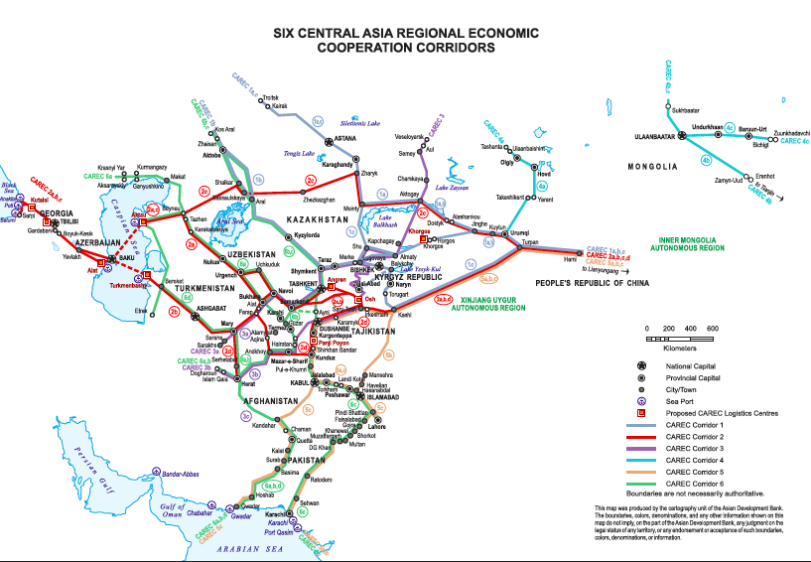
CAREC Program and CAREC 2030
An open and inclusive platform that connects people, policies, and projects for shared and sustainable development.
Mobilized more than $37 billion in investments and TA since 2001.
CARE 2030 has 5 operational clusters: economic and financial stability; trade, tourism, and economic corridors; infrastructure and economic connectivity; agriculture and water; human development.
www.carecprogram.org

Slide 3
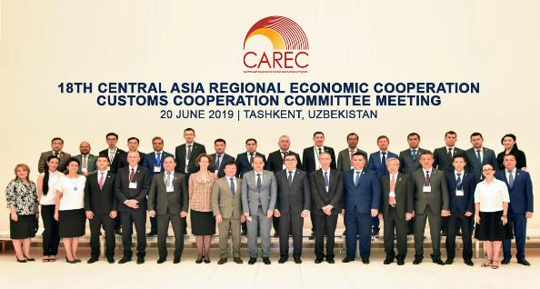
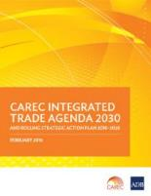
CAREC Customs Cooperation Committee
Customs Cooperation Committee (CCC)
CCC is the responsible body for all customs-related issues and priority areas of customs development, technology and services.
CCC 2002 priority areas
Simplification & harmonization of customs procedures
ICT for customs modernization
Risk management & PCA
Joint Customs Control
Regional transit development.
3

Slide 4
Coordinated border management (CBM)
A coordinated approach by border control agencies, both domestic and international, in the context of seeking greater efficiencies over managing trade and travel flows, while maintaining a balance with compliance requirements.
Integrated Border Management…
Collaborative Border Management…
Comprehensive Border Management…
Border Agency Coordination…
World Customs Organization. 2015. Coordinated
Border Management Compendium. Brussels.
A holistic approach by all cross-border regulatory agencies to coordinate their regulatory functions.
4

Slide 5
CAREC Joint Customs Control (JCC)
Definition:
The coordinated conduct of border control procedures and of their methods of application by two neighboring customs administrations.
Synchronized operations and other aspects of border control.
Objective:
To streamline customs clearance processes by
reducing the requirements and duration of controls
eliminating redundancies
strengthening customs control capabilities.
5

Slide 6
CAREC JCC in line with international best practice
UNECE International Convention on the Harmonization of Frontier Controls of Goods
1. facilities enabling joint controls or one-stop technology, 24 hours/day
WTO Trade Facilitation Agreement
1. border agency cooperation
2. customs cooperation
WCO RKC
1. correlation of business hours & competence at common BCPs
2. cooperation with neighboring customs for juxtaposed customs office
3. joint controls
JCC
6

Slide 7
Lessons from early CAREC JCC pilots
Kazakhstan and Kyrgyz Republic (Corridor 3) – 2004 and 2008
Kazakhstan and the PRC (Corridor 4) – 2007 and 2008
PRC and Mongolia (Corridor 4) – 2009 and 2011
Customs procedures expedited, release time decreased, BUT need identified for –
JCC
Political will
Enabling legislation
Infrastructure at borders
ICT
Harmonization of documents
Exchange of information
Mutual acceptance of results etc
7

Slide 8
People’s Republic of China and Mongolia
– JCC Pilot at Zamiin-Uud / Erenhot BCPs
Formalized Agreement to conduct JCC pilot in 2005.
Based on Agreement between the Government of the PRC and the Government of Mongolia on Customs Mutual Assistance and Cooperation (Sep 1993).
8

Slide 9
JCC Pilot – Institutional arrangements
Steering Group – high-level Customs officials
Annual meetings to determine the mechanisms for the successful implementation of the JCC –
identify the working objectives and research issues;
determine and resolve problems that may arise;
approve recommendations and the work plan.
Working Groups – customs field offices, expertise dependent
Prepare technical studies and recommendations assigned by Steering Committee;
Prepare work plan;
Task- or topic-specific; ad hoc and non-permanent groups.
9

Slide 10
JCC Pilot – Three phases
Harmonization of documents – importers and exporters use the same document, the UNIFIED CARGO MANIFEST (UCM), to declare goods to both PRC and MON customs
Joint border operations – customs agencies coordinate their respective operations
Mutual recognition of inspection results – goods examined by only one customs agency
1
2
3
10

Slide 11
JCC Pilot – Unified Cargo Manifest (UCM)
Standardizes essential contents of the customs declaration (Mongolia) or cargo manifest (PRC), which streamlines collection of information and ensures accuracy and consistency – paper-based.
Used for export and import of all types of goods.
Chinese and Mongolian languages.
25 data elements: basic information about the vehicle, cargo, carrier/hauler, and seals/stamps.
Data elements can be expanded – electronic UCM.
11

Slide 12
JCC Pilot – Phase 1 implementation
2005:
Bilateral discussion on PRC-MON JCC, leading to formal agreement to pilot JCC.
Bilateral high-level consultations.
2006-2009:
Steering Group and WGs created.
Determine JCC scope, TOR, and direction.
Development of Chinese and Mongolian paper-based UCM.
Development of PRC-Mongolia JCC Operation Process, including feedback mechanism.
Liaison officers appointed.
Training provided.
Paper UCM piloted at Erenhot-Zamiin-Uud BCP.
2011-2014:
Paper UCM pilot expanded to 4 additional BCP pairs.
Agreement to develop e-UCM.
12

Slide 13
JCC Pilot – Phase 1 implementation (2)
2015:
Conditions agreed for mutual exchange of manifest data.
Planning for Phase 2 initiated.
2017:
Software programs for data exchange complete in PRC & MON.
Agreement to start listing types of goods to mutually accept under Phase 2.
2018:
e-UCM piloted at Erenhot-Zamiin-Uud BCP.
Phase 2 action plan agreed and signed.
2019:
e-UCM applied to all PRC-MON BCPs.
Paper UCM eliminated April 2019.
13

Slide 14
JCC Pilot – Phase 1 early results
Increased cooperation and improved management and coordination.
Eliminated difficulties of translation.
Enhanced consistency of control measures.
Increased sharing of information and resources, and joint addressing of issues.
Improved capacity for Customs control and risk analysis.
Decrease in fraud.
Significant decrease in fraud or irregularities.
Sharing information boosted the verification of cargo authenticity.
Transparency and more reliable data for tariff collection and statistics.
Control of smuggling.
Ease of compliance.
Consistency of import-export information.
Facilitated legitimate imports and exports.
Improved traders’ understanding of “compliance and facilitation”.
14

Slide 15
JCC Pilot – Evidence-based results
Decreased dwelling times.
Erenhot BCP customs clearance time: 450 minutes for trucks (2009), decreased to 310 minutes (2013).
Gashuunsukhait BCP: 1 day and 10 hours (2012), decreased to 1 hour and 28 minutes (2013).
Average customs clearance times
Zamiin Uud-Erlian BCPs: slight drop on both sides(2013), a marked lengthening (2014), remarkable drop (2015), and additionally faster clearance from 2016 to 2018 exiting Erlian, but the opposite entering Zamiin Uud.
Reduced clearance procedures.
UCM has eliminated redundant processing of the declaration/manifest, reducing clearance procedures from 11 steps to 7 steps.
Time is saved with cargo carrier handling transaction directly with customs.
Customs-approved cargo information in the UCM now considered reliable and ensures accountability.
15

Slide 16
JCC Pilot – Key findings
High-level support ensured successful implementation.
UCM implementation improved effectiveness and efficiency of both customs agencies.
Phase 1 promoted effective cooperation.
Phased implementation is a pragmatic solution.
Monitoring and evaluation essential to ensure coverage, consistency, and quality of data.
16

Slide 17
JCC Pilot – Recommendations
Secure formal agreement for JCC initiatives.
Formal monitoring and evaluation framework to track progress, quantify benefits, and provide a quick response mechanism.
Synchronize and monitor trade volume statistics.
Secure full support of high-level decision makers for UCM automation.
Expand data elements in the electronic UCM.
Resolve infrastructural, organizational, and institutional issues.
Strengthen high-level JCC Expert Group and CCC meetings as effective coordination mechanisms.
Secure funding support and technical assistance.
17

Slide 18
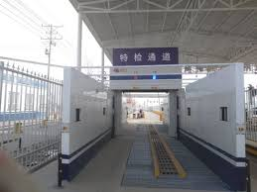
JCC Pilot – Moving into Phase 2
Mutual recognition of inspection results
Agreement in 2015 to –
Establish WG to prepare road map.
Phase 2 implementation by sub-phase: mutual recognition of weighing results, then sharing of x-ray images.
2017 –
Started listing types of goods for mutual acceptance.
Studies launched on use of smart locks for containers (Erenhot-Zamiin-Uud).
2018 –
Phase 2 Action Plan agreed and signed.
Sustained implementation of e-UCM essential before Phase 2 is launched.
18

Slide 19
Thank you!
Rose McKenzie
Senior RCI Specialist
East Asia Department, Asian Development Bank
Email: rmckenzie@adb.org

