Slide 1
tourism RING of Central Asia: Implications for Shymkent-tashkent-Khujand economic corridor
Akhberdiyeva gulmira
President of «Industry Tourism Association Of Central Asia» («ITACA»)

Slide 2
contents
Contents
Tourism trends
Historical Central Asia map
Tourism potential of central Asia
Development of private sector
Сentral Asian combined tours as a trend
Our actions in Central Asia
Our actions
Combined tours
Cross-border cooperation in Central Asia
Regional economic corridor Shymkent-Tashkent-Khujand
Proposals for government decisions
Proposals for government decisions
Regional tourism development
Proposals for ADB
Good neighboors,good partners,good perspectives.

Slide 3
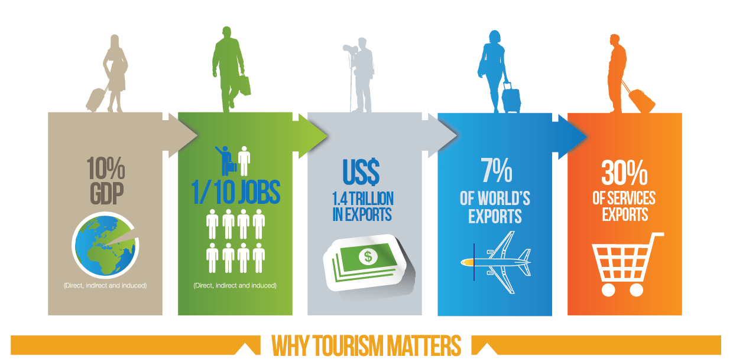
Tourism trends

Slide 4
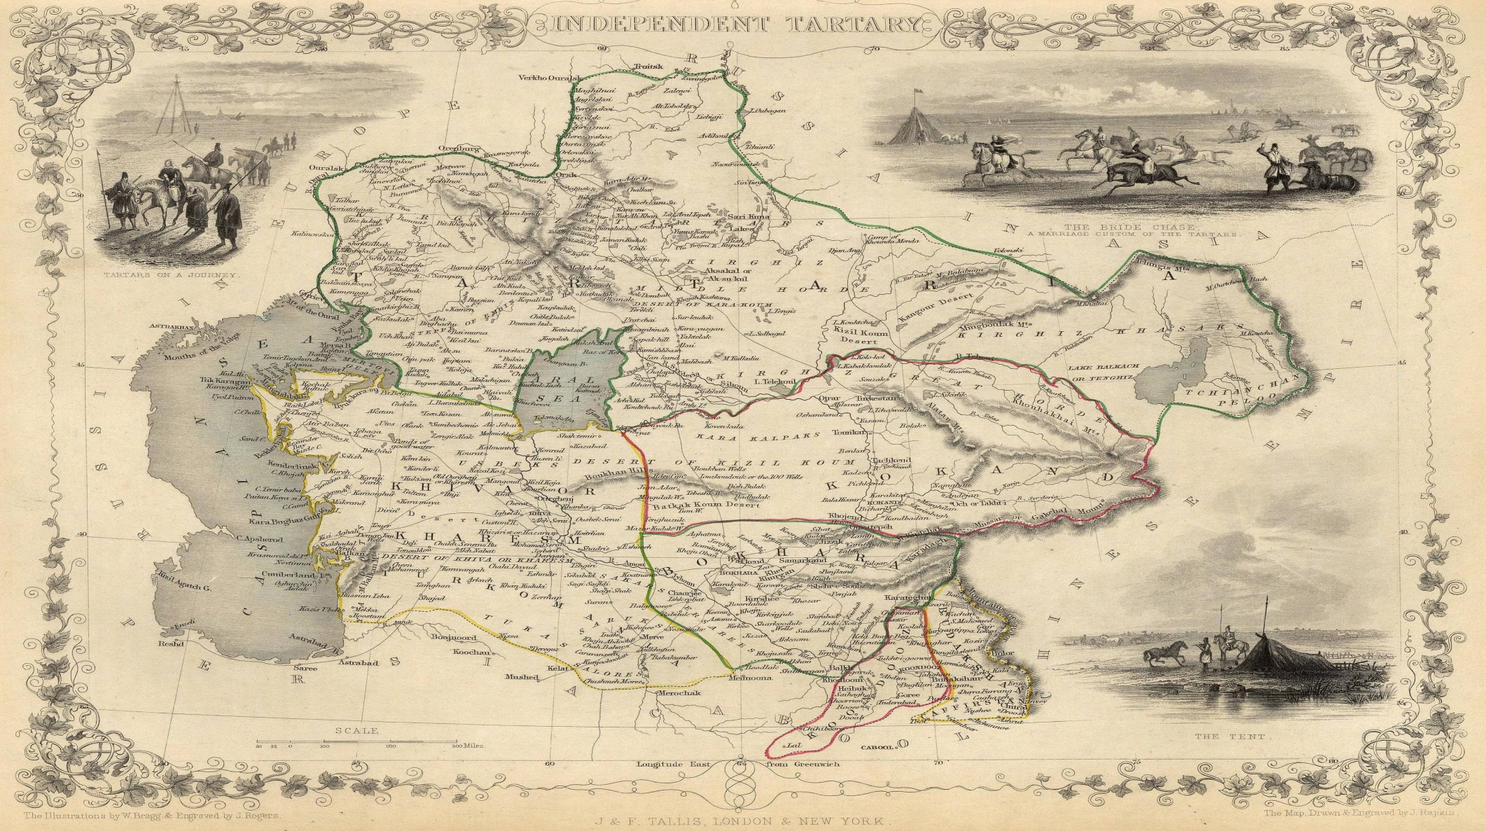
2
CENTRAL ASIA.

Slide 5
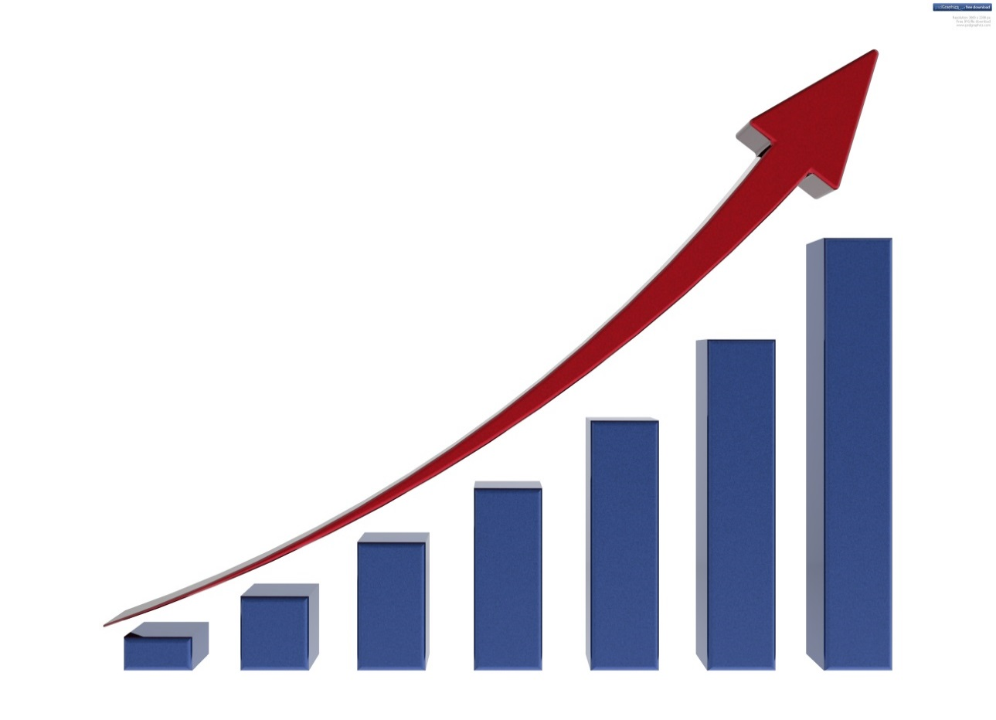
Tourism potential of central Asia
The revival of cooperation in tourism between the countries of Central Asia has a unique opportunity to assist each other in obtaining economic benefits, and to contribute to ensuring a fair and balanced economic growth of countries.

Slide 6
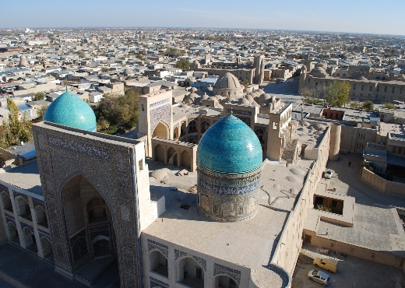
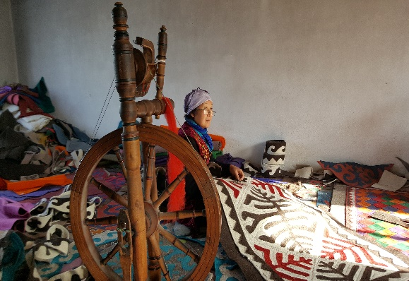
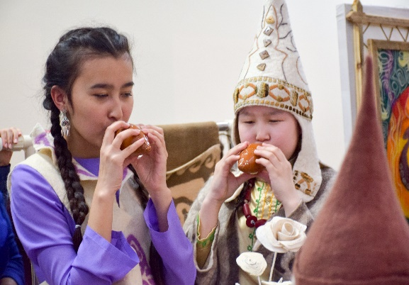
DEVELOPMENT OF PRIVATE SECTOR
CURRENT SITUATION IN CAREC
information asymmetries
weak incentives
insufficient investment conditions
poor access to finance
effective dialogue with public sector stakeholders
single strategy for the development of tourism in Central Asia
coordinated outreach activities
Common policy
plan of action in attracting foreign tourists

Slide 7
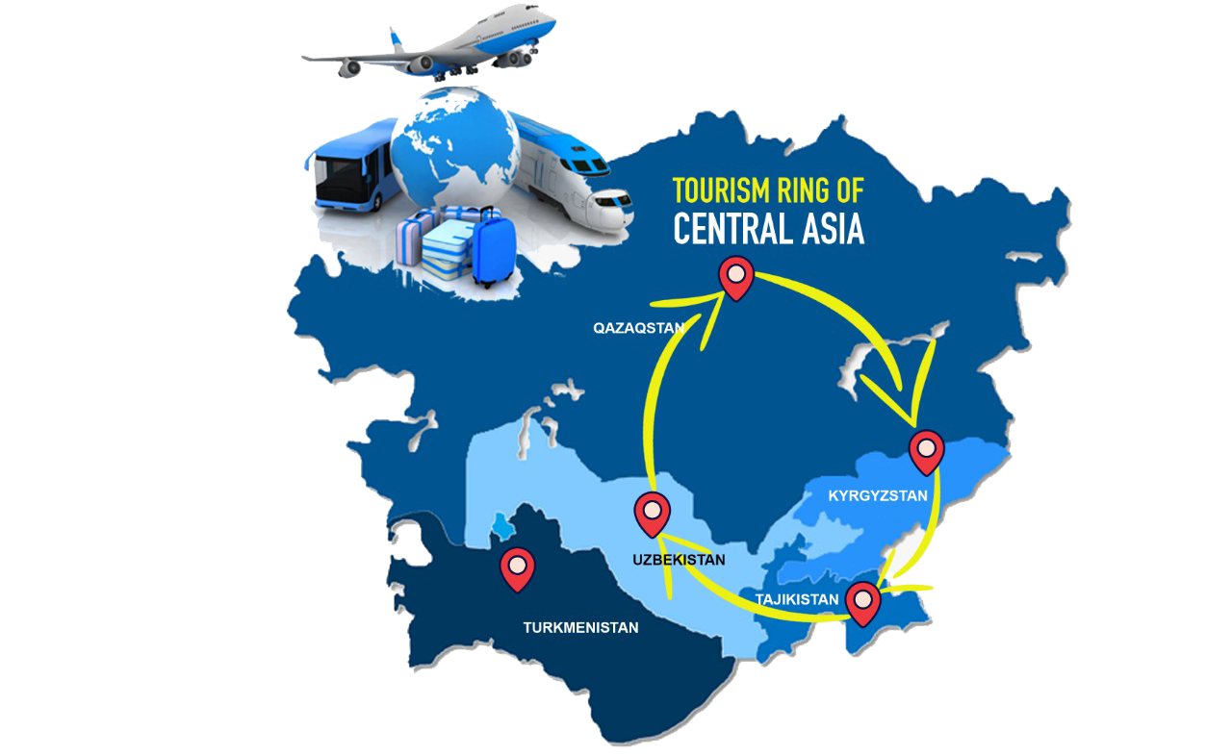
central Asian combined tours AS A TREND

Slide 8
OUR ACTIONS in central Asia
WAY OF
TAMERLANS
WAY OF
TAMERLANS
GASTRONOMY
TOURS
TOURISM RING OF
CENTRAL ASIA
PILGRIMIGE
TOURS
CENTRAL ASIAN SILK ROAD
MOUNTAIN
TOURS

Slide 9
OUR ACTIONS
Cooperation in the Tourism Development between representatives of Tourist Organizations and Associations of Central Asian Countries

Slide 10
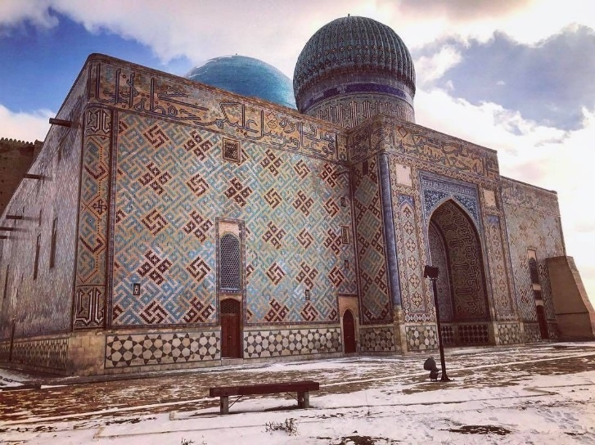
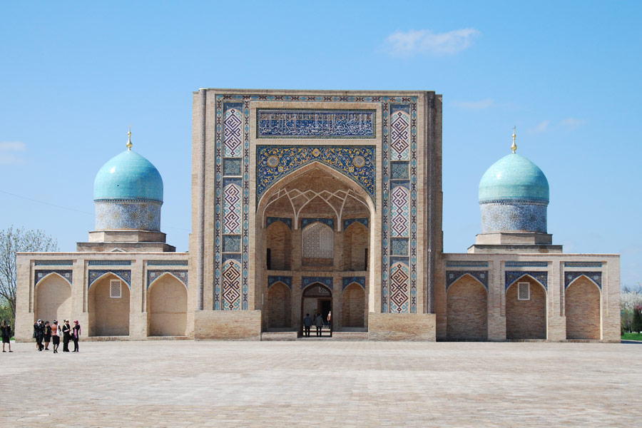
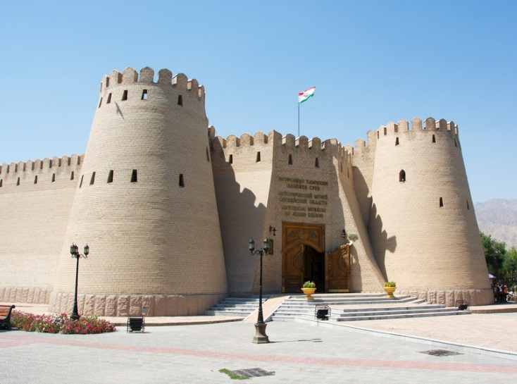
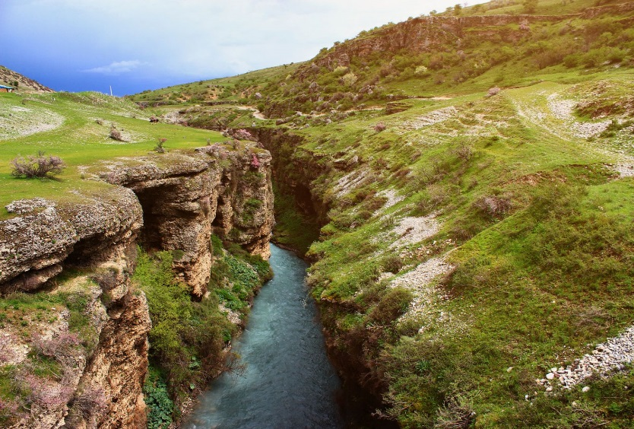
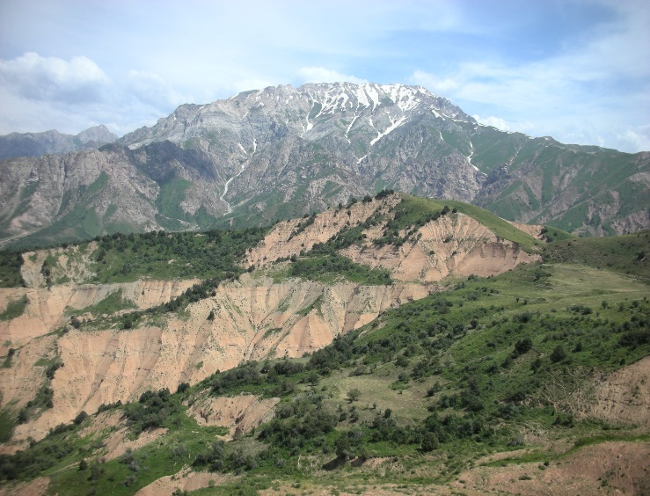
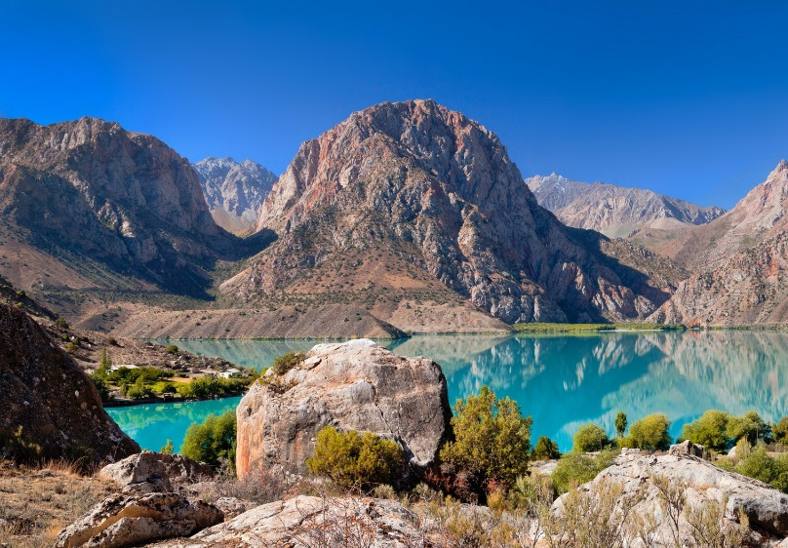
REGIONAL ECONOMIC CORRIDOR COMBINED TOURS

Slide 11
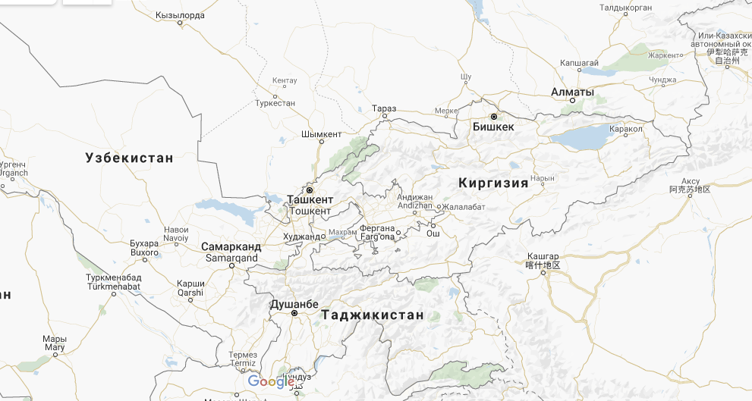
cross-border cooperation in central Asia
Distances between Shymkent, Tashkent and Khujand
Shymkent-Tashkent = 130 km
Tashkent-Khujand = 156 km
702
130
185
115
494
Population size within Regional Economic Corridor (end of 2018)
regions | total 11,1 mln.
Tashkent obl. | 2 900 000
Tashkent city | 2 500 000
Sogdian obl. | 2 700 000
Turkestan obl. | 2 000 000
Shymkent city | 1 000 000
440
431
338
707
580

Slide 12
Regional economic corridor Shymkent-Tashkent-khujand

Slide 13
proposals for government decisions
BORDER CONTROL MODERNIZATION
COMMON TOURIST VIZA
DEVELOPMENT OF TRANSPORT AND INFORMATION COMMUNICATIONS
COMMON STANDARDS FOR TOURISM SERVICES, UNIFIED SYSTEM OF PROFESSIONAL TRAINING FOR TOURIST PERSONNEL
DEVELOP A REGIONAL ECONOMIC CORRIDOR MASTER PLAN STRATEGY

Slide 14
proposals for government decisions
JOINT FORMATION OF AN INTER-REGIONAL TOURIST MARKET
EXPANSION OF MUTUAL PARTICIPATION IN ADVERTISING AND INFORMATIONAL AND SCIENTIFIC AND PRACTICAL EVENTS
CREATION OF AN INTEGRATED COMPETITIVE REGIONAL PRODUCT
CREATION OF A UNIFIED SYSTEM OF THEIR INSURANCE

Slide 16
PROPOSALs for adb
1
STRATEGY OF DEVELOPMENT OF TOURISM INDUISTRY IN REGIONAL ECONOMIC CORRIDOR
2
DEVELOPMENT OF COMMON MARKETING STRATEGY
3
ASSESMENT OF ESTIMATE TARGET MARKETS
4
ASSISTANCE IN THE TRAINING AND RETRAINING OF PROFESSIONAL PERSONNEL
5
ASSISTANCE IN DEVELOPING MECHANISMS TO ATTRACT ADDITIONAL FINANCIAL INSTRUMENTS FOR THE DEVELOPMENT OF TOURISM INFRASTRUCTURE

Slide 17
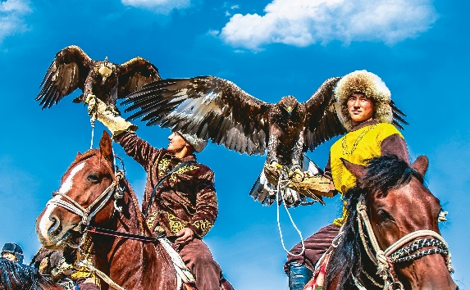
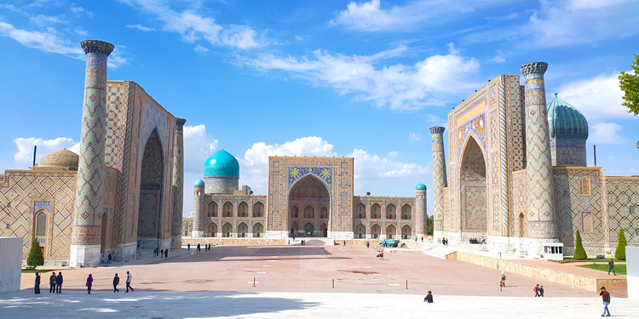
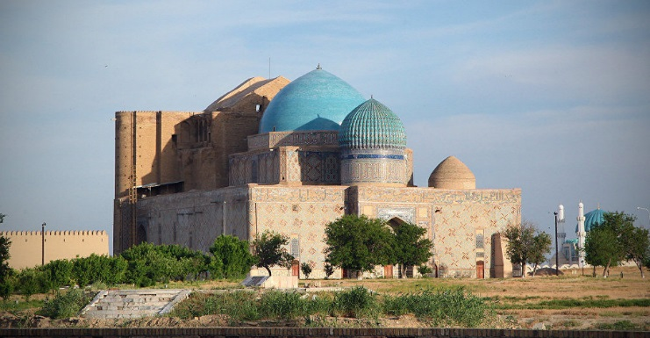
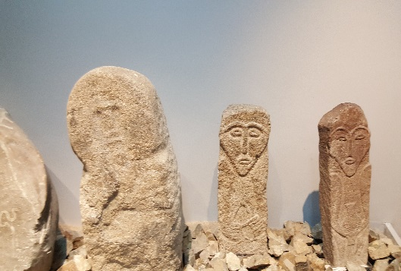
GOOD NEIGHBOORS,GOOD PARTNERS, GOOD PERSPECTIVES.
THANK YOU FOR YOUR ATTENTION!!!
www.itaca.kz

