Slide 1
Opportunities and challenges of developing regional tourism in CAREC: implications for the STKEC development
Carmen Garcia Perez
Regional Cooperation Specialist, CWRD, ADB
Regional Workshop, 6 December 2019

Slide 2
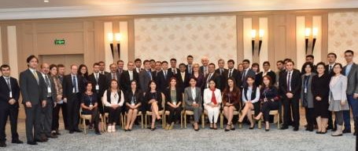
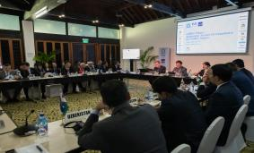
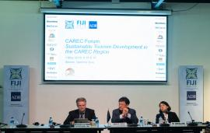
Tourism Cooperation under CAREC 2030
Cluster 2: Trade, Tourism and Economic Corridors
2018
2019

Slide 3
Tourism Scoping Study: Key Challenges
Inadequate infrastructure and facilities in tourist routes
Insufficient air connectivity
01
02
Complex visa regimes and border crossing procedures
Shortage of skilled workers and language barriers
03
04
Lack of reliable tourism data and statistics
05
Limited awareness of tourism experiences in CAREC countries
06
Challenging security conditions
07
08
Lack of public-private dialogue

Slide 4
Tourism Scoping Study: Recommendations
01
Accessibility and travel facilitation
02
Infrastructure and services
Next steps
Establishment of CAREC Tourism Expert Group
Development of a tourism strategy towards 2030
Development of sub-regional partnerships
Visa and entry procedures
Air and land connectivity
Common standards for tourist facilities
Infrastructure in cross-border routes
03
Tourism education and skills
04
Marketing and promotion
Common curricula and qualifications
University partnerships
CAREC Tourism Virtual Portal
Silk Road marketing umbrella

Slide 5
Regional Tourism Technical Assistance
CAREC Tourism Strategy 2030
Regional Tourism Investment Framework (2021–2025)
Project conceptualization (4 projects)
CAREC Tourism Virtual Portal

Slide 6
Timeline 2020-2021: Key Milestones
May-June 2020
Dec 2019
National consultations
Long list of projects and draft strategy formulation
CAREC Tourism Virtual Portal (beta version)
Presentation at CAREC Senior Officials’ Meeting
Regional inception workshop
Nov 2020 – May 2021
Aug-Oct 2020
Development of project profiles
Strategy implementation
Nov 2020
Consultations and site inspections
Shortlist of projects for investment framework
Final draft tourism strategy 2030
CAREC Tourism Virtual Portal
19th Ministerial Conference Endorsement of Tourism Strategy and Investment Framework

Slide 7
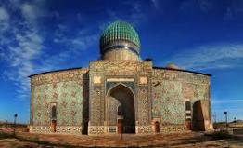
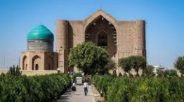
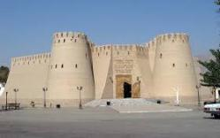
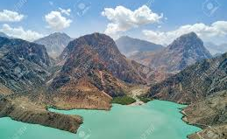
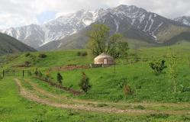
Tourism Potential of the SKTEC
1. Promoting intraregional tourism among the three regions
2. Attracting international market segments through joint tourism development

Slide 8
1. Intraregional Tourism Flows (2018)
Kazakhstan
Uzbekistan
Tajikistan
Total: 8.7 mill.
Total: 5.4 mill.
Total: 1.02 mill.

Slide 9
2. Attracting international market segments
Top 12 Inbound Tourism Markets
Kazakhstan
Uzbekistan
Tajikistan
1 | Uzbekistan | Kazakhstan | Russian Federation
2 | Russian Federation | Tajikistan | Uzbekistan
3 | Kyrgyz Republic | Kyrgyz Republic | Kyrgyz Republic
4 | Tajikistan | Russian Federation | Kazakhstan
5 | Turkey | Turkmenistan | Belarus
6 | Germany | Afghanistan | Armenia
7 | Azerbaijan | Turkey | PRC
8 | Belarus | PRC | Moldova
9 | Ukraine | Korea | Turkmenistan
10 | PRC | India | Ukraine
11 | Turkmenistan | Germany | Turkey
12 | Korea | Japan | Azerbaijan

Slide 10
2. Attracting international market segments
Appeal
The success of any destination is a function of a combination of factors:
Brand and image perception among consumers
Accessibility
1
Air and land connections, and visa regulations and border arrangements
2
3
5
Personal Safety
4
Medical facilities and security
Tourism Products
Range and quality of things to see and do related to the interests of the market segments
Standards and Service
Quality of tourist facilities and service delivery of tourism personnel to internationally expected standards

Slide 11
Visa Regimes in STKEC
 | Travelling to
 | Kazakhstan | Uzbekistan | Tajikistan
Russian Federation | F | F | F
Kyrgyz Republic | F | F | F
Turkmenistan | E | C | A*/E
Belarus | F | F | F
Azerbaijan | F | F | F
Ukraine | F | F | F
Turkey | F | F | A*/E
PRC | C | B | A*/E
Korea | F | F | C
Germany | F | F | A*/E
A = visa on arrival; E = e-visa; C = visa required prior to travel; F = visa-free
*Only at Dushanbe airport

Slide 12
Air Connectivity in STKEC
Alternative Airports
Tashkent: 121 km
Dushanbe: 200 km
Alternative Airports
Tashkent: 124 km
Taraz: 159 km

Slide 13
Air Connectivity in STKEC

Slide 14
Land Connectivity in STKEC
From Tashkent to Shymkent:
Possible to buy online
Not daily
+ 5 hours
Every day / several times per day
4 hours
Not possible to buy ticket or check schedule online
From Tashkent to Khujand:
No direct train (only Tashkent-Gulistan)
Only one bus / day
+ 4 hours
Not possible to buy ticket or check schedule online

Slide 15
Turkestan Region
Core products:
Culture and architecture
Religious tourism
Nature and adventure (trekking, bicycle riding, etc.)
City break (shopping)

Slide 16
Tashkent
Core products:
Nature and adventure (skiing, trekking, bicycle riding, etc.)
Culture
City break
Business / MICE

Slide 17
Sughd Region
Core products:
Culture
Nature and adventure (trekking, bicycle riding, etc.)
City break (shopping)

Slide 18
2. Attracting international market segments
Why working together?
Culture & religion
Business / MICE
Common target markets
Tourism products
Neighboring countries
North-East Asia
Turkey
Western Europe
Complementary tourism assets distributed across the three countries
Nature & adventure
City tourism
Improved experiences
More tourists, more days, all year round
Higher daily spending
Lower costs and increased feasibility of projects
Greater optimization of resources
Mutual benefits for the three countries
Diversified products can improve the reach of key markets and motivations for visiting, and help address seasonality

Slide 19
Are there any other challenges and opportunities for the development of tourism in STKEC region?
How can the three regions / countries work together to develop a joint tourism product in an integrated manner? What are potential regional projects and activities?
Any other issues and questions
Thank you for your attention

