Slide 1
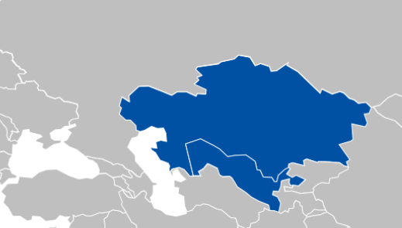
Faciliation of TIR digitalization in the STKEC countries
Recommendations
  Welcome successful implemenattion of digital TIR pilot projects in STKEC corridor and encourage STKEC‘s countries to continue supporting their customs administrations and the private sector in using and expanding TIR digital solutions in this corridor and the region;
  Welcome establishment of TIR Green Lanes at the BCP Yallama-Konysbayev between Kazakhstan and Uzbekistan and encourage all corridor countries to follow suit and establish such fast lanes at their BCPs including at Fotehobod-Oybek between Tajikistan and Uzbekistan;
  In case of limited infrastructure, implement Green Windows at first stage and seek for infrastructural adaptations for building Green Lanes at next stage;
  Increase quality/speed interconnection of all regional customs offices in Tajikistan for the purposes of digital TIR;
  Make adjustment of ASTANA-1 customs system in Kazakhstan to allow digital TIR departure from Kazakhstan;
  Welcome the extension of TIR digital pilot to Kyrgyzstan in the forthcoming days and invite all STKEC countries to work closely with each other, IRU and development partners to successfully conclude this project;
  Work on connecting national customs systems to the eTIR international system in line with the eTIR specifications (Annex 11 of the TIR Convention);
  Thanks GIZ and other development partners for their close cooperation with IRU and corridor countries on implementation of the pilot projects and encourage them to continue their support on the expansion of such projects in the region.

