Slide 1
ADB-IRU joint workshop on TIR Digitalization
Vakhtang Zarandia – Senior Adviser TIR & Transit, IRU
7.09. 2021

Slide 2
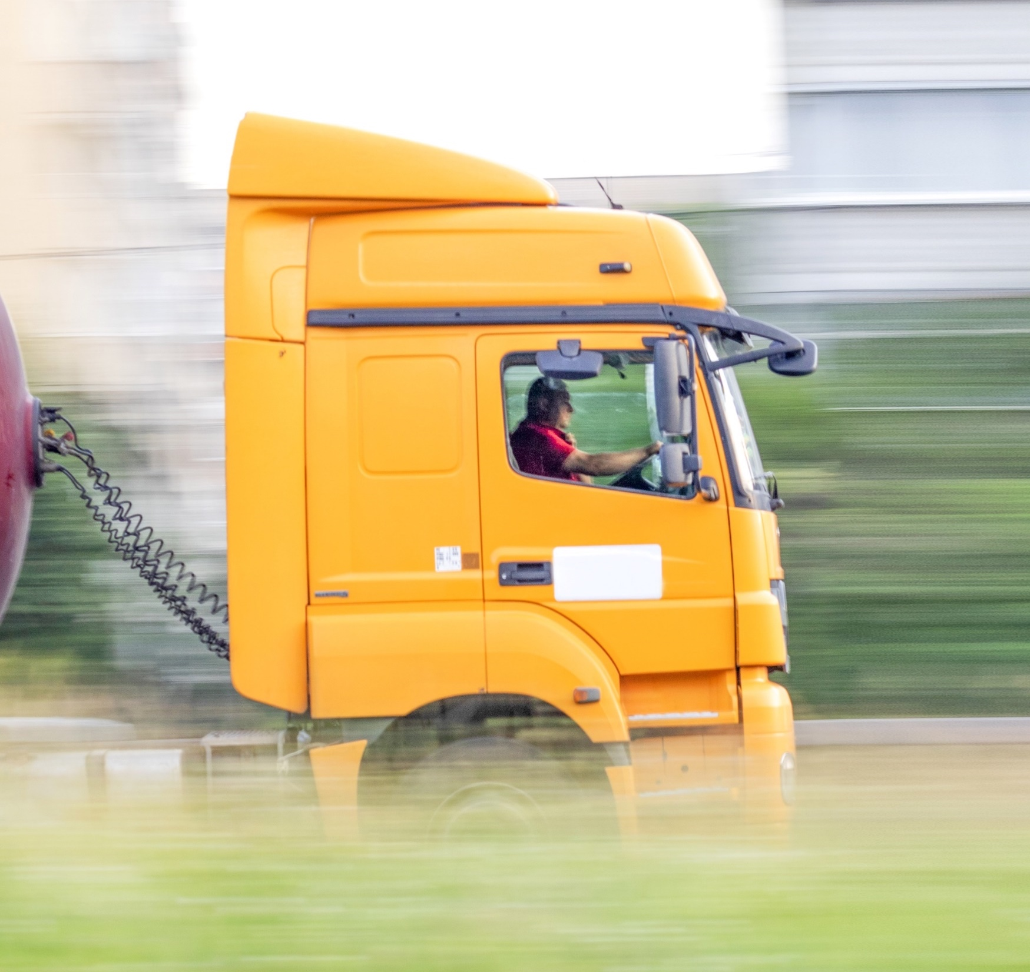
^{The world road} ^{transport organisation}
IRU is the global voice of companies providing commercial road transport, mobility and logistics services.
WE ARE THE VOICE
OF MORE THAN
3.5 MILLION
COMPANIES WORLDWIDE

Slide 3
Active in over
100 countries
14 Founding IRU Members in 8 countries
`
IRU Members
TODAY

Slide 4
TIR Digitalisation
History
1987: B2B between IRU and Associations
IRU digitalising B2B aspects of TIR
TIR carnets management
Data exchange with TIR associations
1995: SafeTIR (C2B)
Recommendation for customs to send TIR terminations data
2006: Annex 10 of TIR Convention on SafeTIR
2002: TIR-EPD: B2C/C2B
TIR advance information exchanges between TIR hauliers and customs
2015: UNECE and IRU endeavoring to digitalise TIR
First eTIR transport between Turkey and Iran in 2015
2015: UNECE-IRU eTIR pilot project between Turkey and Iran
2019: eTIR pilot transports between Iran and Azerbaijan
2020: Uzbekistan – Kazakhstan digitalisation projects
2021: Annex 11 - eTIR
Adoption of Annex 11 of the TIR Convention – legal basis for eTIR
Annex 11 entry into force in May 2021

Slide 5
«ДЕЛОВЫЕ СВЯЗИ»
Annex 11 – entry into force on 25 may 2021
C2C and C2B messages through eTIR International System (hosted by UNECE as a central database)
eTIR specifications yet to be adopted by Contracting Parties
Direct communication channel to be established between customs and UNECE and between UNECE and IRU
B2C and C2B
Already functioning and will continue to be used:
For sending TIR data to the customs of departure
For advance information to customs of itinerary
1 global system with full digital functionalities

Slide 6
Projects of TIR data exchange between business and customs (B2C)
and countries, which started working on C2C data exchange in the framework of eTIR
Kazakhstan
Georgia
Kguzastanн
Azerbaijan
Uzbekistan
Armenia
Operational digital corridors
Turkey
Turkmenistan
Tajikistan
Countries with IRU TIR IT tools
Tunisia
Afghanistan
Iran
Countries, which started interconnection with eTIR International System of UNECE for C2C
Pakistan
Индия

Slide 7
Digitalisation of Tajikistan-Uzbekistan-Kazakhstan corridor
Project advancement:
Uzbekistan-Kazakhstan digital TIR project launched in November 2020
Tajikistan expressed its interest to join project in December 2020
Tajikistan implemented TIR-EPD in March 2020
Uzbekistan-Kazakhstan digital TIR project extension towards Tajikistan on 4-5 May 2021

Slide 8
Digitalisation of Tajikistan-Uzbekistan-Kazakhstan corridor
3 step approach
agreed with invloved customs administrations
TIR Carnets and message exchange monitoring (currently)
Digital TIR pilot transports accompanied by print@home TIR forms
Digital TIR pilot transports – fully digital
Uzbekistan is fully operational, last technical adjustments in Kazakhstan under way

Slide 9
Digitalisation of Tajikistan-Uzbekistan-Kazakhstan corridor
Recent developments:
3 customs administrations confirmed the broadening of eGuarantee usage by opening it to all TIR transport operators and all customs border crossing points.
Uzbekistan and Kazakhstan customs implemented TIR Green Lanes at Yallama-Konisbayeva boreder crossing points
Working with Tajikistan customs for the prioritisation of eGuarantee movements at Fotekhobod border crossing point
Uzbekistan customs shared digital TIR experience with Kyrgyz customs in June 2021
All 3 customs administations have undertaken necessary formalities to start contacts with UNECE in order to establish eTIR project connectivity as per Annex 11 of TIR Convention

Slide 10
Digitalisation of Tajikistan-Uzbekistan-Kazakhstan corridor
Next steps
Awareness
Increase awareness of digital TIR users and business community in the region to fully benefit from this transit facilitation tool ensuring transparancy for customs and business partners:
Training for customs officers and transport operators
Active engagement of IRU and its memebrs with strong support of development partners: GIZ, Turkic Council, CLDP, ADB and others
Expanding digital TIR geography
Bring Kyrgyzstan to the digital TIR geography by beginning of October 2021
Annex 11 implementation
Implement full e TIR message exchange including connectivity to eTIR International system according to Annex 11

Slide 11
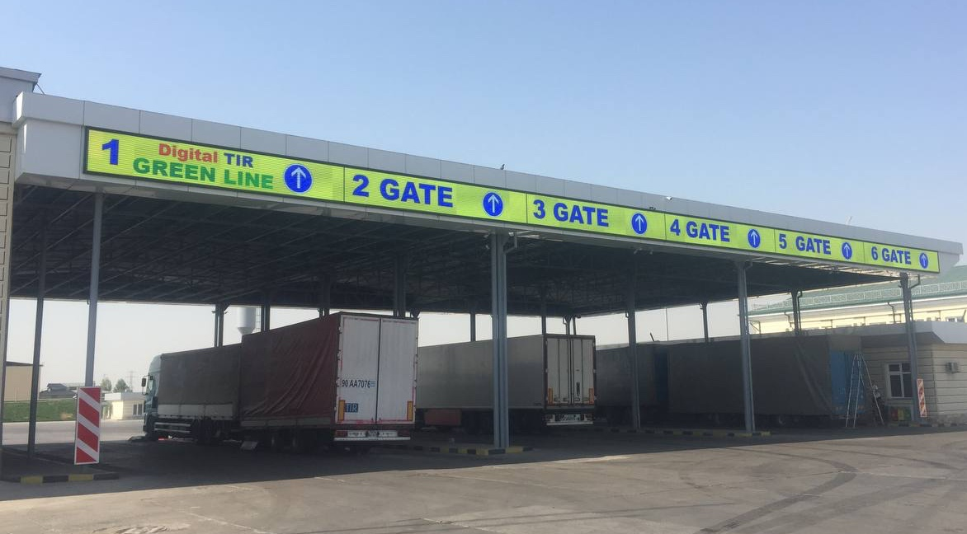
Call for action
Coordinate cross-border issues at global and regional level
Quickly move towards digitalisation of transport documents and procedures
Use best practices and global standards to solve other border crossing issues

Slide 12
For the world in motion

