Slide 1
Lessons from CAREC Corridor Performance Measurement and Monitoring for STKEC
Oleg Samukhin
Senior Transport Specialist
Central and West Asia Department
Asian Development Bank

Slide 2
CAREC Corridor Performance Measurement and Monitoring (CPMM)
Used to monitor time and cost of delays at the key CAREC border crossing points, since 2010
Data is collected by the private transport/freight forwarding associations based on inputs from the truck drivers (road) and freight forwarders (rail)
Annual reports are available on the www.carecprogram.org and www.adb.org

Slide 3
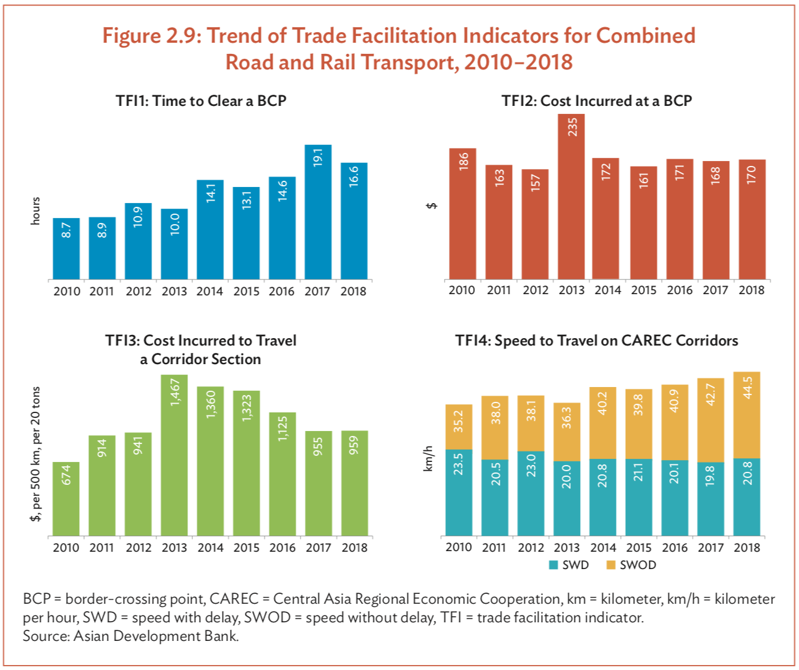
CPMM 2018

Slide 4
CPMM Results 2017-2019 (hours to cross BCPs)
Border crossing point | 2018 | 2019
Yallama (UZ), outbound | 10.2 | 10.0
Konysbaeva (KZ), inbound | 12.0 | 11.6
Konysbaeva (KZ), outbound | N/A | 4.4
Yallama (UZ), inbound | N/A | 1.3
Fotehobod (TJ), outbound | 1.4 | N/A
Oibek (UZ), inbound | 2.8 | N/A
Oibek (UZ), outbound | 5.0 | 1.3
Fotehobod (TJ), inbound | 7.0 | 1.9

Slide 5
CPMM Results 2017-2019 (cost to cross the BCP, US$)
Border crossing point | 2018 | 2019
Yallama (UZ), outbound | N/A | 54
Konysbaeva (KZ), inbound | 130 | 128
Konysbaeva (KZ), outbound | N/A | 45
Yallama (UZ), inbound | N/A | 10
Fotehobod (TJ), outbound | 27 | N/A
Oibek (UZ), inbound | 32 | N/A
Oibek (UZ), outbound | 15 | N/A
Fotehobod (TJ), inbound | 300 | 476

Slide 6
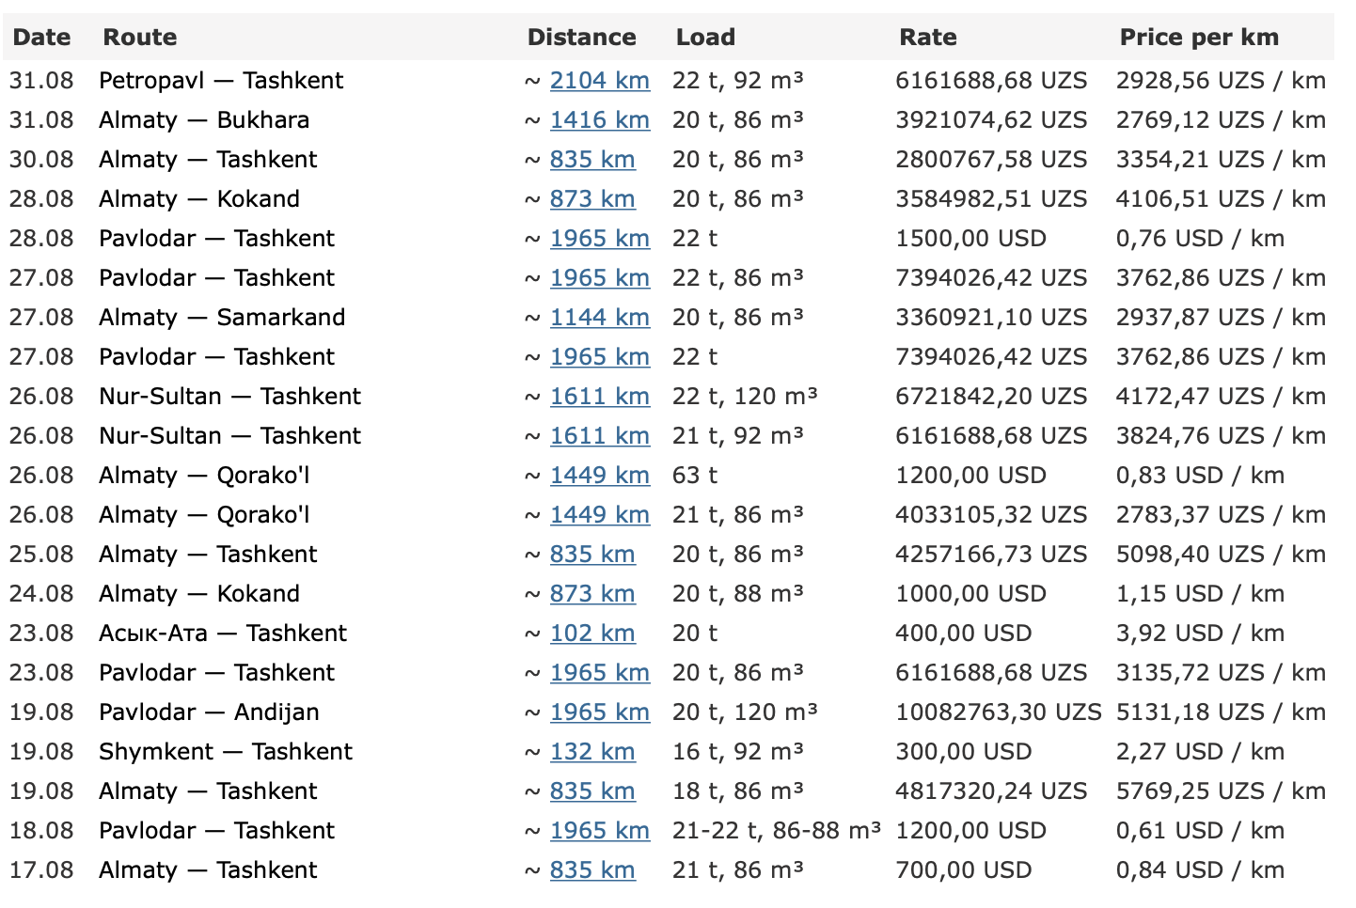

Logistics implications of high time and cost of border crossing
Even short return trips always take more than one day
Extra fees additionally increase transport cost
Cost of goods, for especially low value density agricultural goods, increases noticeably
That reduces international trade and access of lower income people to cheaper regional goods
Source: Della.uz, 31 Aug 2021

Slide 7
Actions to be considered within the scope of the STKEC Program
High level policy actions:
Set targets to reduce border crossing time and cost significantly (best performing BCPs in CPMM have border crossing time of 0.1 – 0.2 hours)
Establish continuous monitoring by the government and NGOs, with support from IFIs
Demonstrate strong political will to improving transit times and costs
Remove cargo terminals from the border areas

Slide 8
Actions to be considered within the scope of the STKEC Program
Operational improvements:
Implement risk-based border control
Use advance information for risk profiling and decisions
Implement efficient transit guarantee mechanisms. Any transit fees shall be on the equitable cost-recovery basis
Use modern technology for non-intrusive inspection of commercial and personal vehicles and cargo
Build multi-lane border crossing facilities to increase throughput
Continuously strive to simplify and accelerate control procedures

Slide 9

New project under the Almaty-Bishkek Economic Corridor (ABEC) Development program, based on these principles, is under consideration

Slide 10
Thank You

